Slide 1

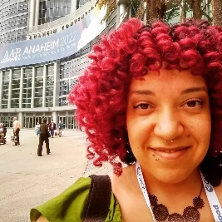
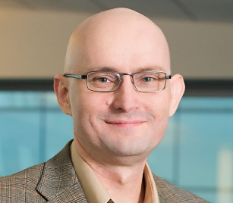
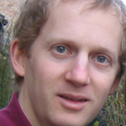
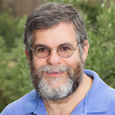
Studying Team Effectiveness via Dialogue Analysis
Kallirroi Georgila, Carla Gordon, Anton Leuski, Ron Artstein, David Traum
University of Southern California Institute for Creative Technologies
Presenter: David Traum
This work was funded by the U.S. Army

Slide 2

Definitions
Team: multiple participants persistently working together toward a common goal
  often includes more than two participants
    less studied than dyadic interaction
Team Effectiveness: to what degree is the team engaging in behaviors correlated with success?
Team Dialogue: language interaction between teammates related to team task performance
Dialogue Analysis: study of content, structure and meaning of communicative behaviors in dialogue
Image created by ChatGPT in response to prompt “create an image of a military team engaged in dialogue”

Slide 3
Research Questions
Are observable team dialogue behaviors indicative of team effectiveness?
Can relevant dialogue behaviors be automatically recognized?
Which dialogue behaviors are highly correlated with team effectiveness?

Slide 4
Presentation Outline
Datasets of team interaction (TADMUS and Squad Overmatch)
  Team interaction examples
  Team performance scores
Taxonomies of dialogue features
  Human annotations
  Automated annotations (dialogue act and team development tagging)
Correlations between team performance and dialogue features
Conclusions

Slide 5
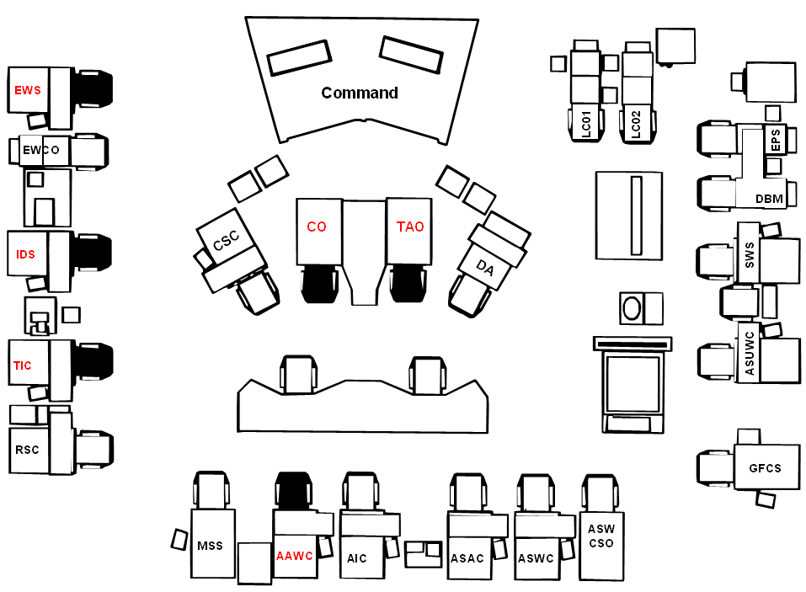
TADMUS Corpus (Tactical Decision Making Under Stress)
An air defense warfare team simulation in the Middle East
96 U.S. Navy officers enrolled in an officer training program
  16 different teams of 6
  transcribed and analyzed for team performance metrics
Purpose: Examine whether a computerized Decision Support System (DSS) increases individual and team performance

Slide 6
TADMUS: Corpus Example
Challenging Dialogue Features:
Line 1 not responded to by intended addressee
  Line 4, AAWC mistakes Line 1 addressee
  TAO corrects this in 5
  TAO repeats in Line 6
Separate conversational threads in 2-3, 7-8 (different participants and unrelated content)
# | SPEAKER | TRANSCRIPT
1 | TAO | OD THIS IS TAC CONDUCT LEVEL 1 QUERY TRACK 7013
2 | IDS | EW/IDS DO YOU HAVE A RACKET BEARING 282
3 | EW | STANDBY
4 | AAWC | TAC/AIR SAY AGAIN TRACK NUMBER FOR LEVEL 1 QUERY
5 | TAO | AIR THAT WAS DIRECTED TOWARD THE OD.
6 | TAO | OD THIS IS TAC CONDUCT LEVEL 1 QUERY TRACK 7013
7 | RAINBOW | GW THIS IS RAINBOW WE DO NOT HAVE CONTROL OF THE CAP CAP ARE UNDER CONTROL OF THE PANTHER 4 THEY ARE SAUDI CAP, OVER.
8 | GW | GW ROGER OUT
9 | BRIDGE | TAC THIS IS BRIDGE NEGATIVE REPORT OF LEVEL 1 QUERY TO 7013
10 | TAO | TAC AYE

Slide 7
TADMUS: Team Performance Scores
SMEs evaluated multiple aspects of team performance:
Seeking sources
Passing information
Situation update
Proper phraseology
Completeness of reports
Brevity
Clarity
Error correction
Providing/requesting backup/assistance
Providing guidance
Stating priorities

Slide 8
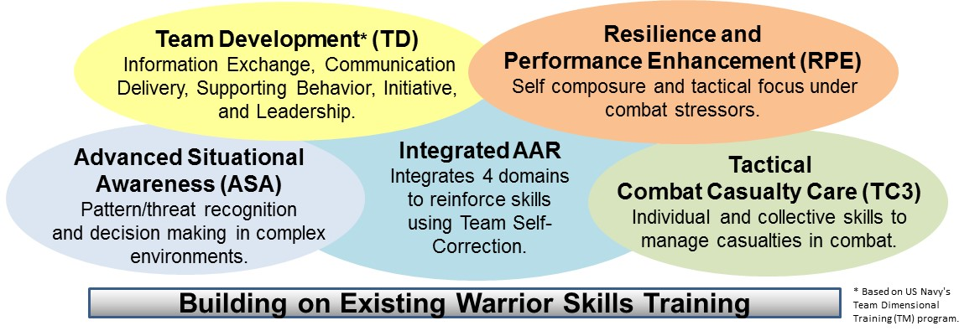
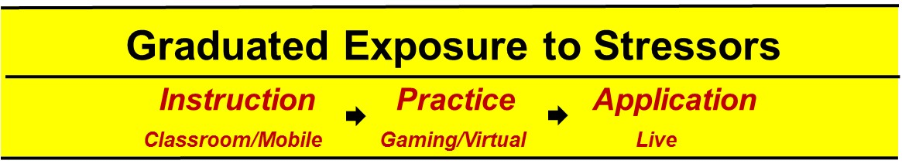
Squad Overmatch Corpus
Purpose: Test a training method consisting of extensive classroom instruction and realistic virtual simulations
  How does this training affect team performance in 5 areas?
  Our focus: SME scores for TD & ASA
Scenarios included dialogue and kinetic elements:
  combat casualties
  IED explosions
  sniper fire
7 squads (3 experimental, 4 control)
  10 members per squad, each with mic
  140 recordings, ~115 hours of raw audio
  2 live scenarios each

Slide 9
Squad Overmatch: Multi-floor Dialogue Example
Five different floors are present across 6 speakers in the short ~22 second example below:
FLOOR | SPEAKER | TRANSCRIPT
A_B_RADIO | A | we have one litter and one ambulatory xxx chest wound
A_O1 | A | hey keep talking to him tell him he's alright
O1-O2 | O1 | you're going to be ok
A_B_RADIO | B | no K I A?
SQL-O3 | SQL | where they going
A_B_RADIO | A | no K I A
SQL-O3 | O3 | got to go home soon
A_O2 | A | hey brother you're going to be just fine ok
SQL-O3 | SQL | where's home
A_B_RADIO | B | good copy
A_O2 | A | yeah
A_O2 | A | can still shoot right you can still shoot good to go alright
A_O2 | O2 | yeah I just need assisted if I'm moving
Five Floors
A-team leader – B-team leader by radio: transfer information about casualties
A-Team leader – O1, instruct on caregiving for O2
O1-O2 – caregiving
SQL-O3 – unrelated topic
A-Team leader – O2 – assessing O2 combat readiness

Slide 10
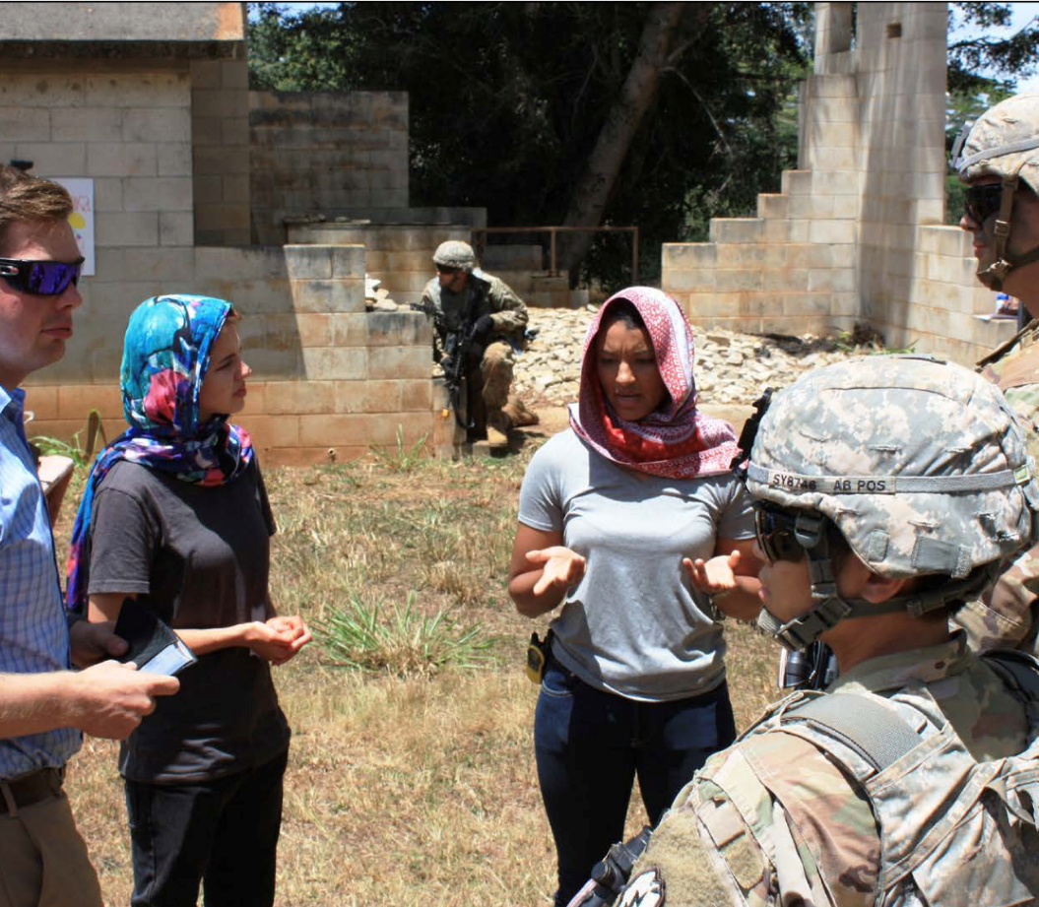
Aspects of Team Dialogue
  Complex structures for mission-related dialogue
    Multiple transactions
    Overlapping speech, interleaved threads
    Can also involve interaction with non-teammates
  Multi-dimensional participant structure
    Hierarchy
      squad leader, team leader, team member
      CO, Tactical Action Officer (TAO), …
    Role-differentiation
      Identification Supervisor (IDS)
      Electronic Warfare Supervisor (EWS)
      Tactical Information Coordinator (TIC)
      …
Team interaction from Squad overmatch, https://www.moore.army.mil/infantry/magazine/issues/2017/OCT-DEC/PDF/12)News1-Casey_txt.pdf

Slide 11
Presentation Outline
Datasets of team interaction (TADMUS and Squad Overmatch)
  Team interaction examples
  Team performance scores
Taxonomies of dialogue features
  Human annotations
  Automated annotations (dialogue act and team development tagging)
Correlations between team performance and dialogue features
Conclusions

Slide 12
Types of Annotations Performed by Corpus
Dialogue Information Type | Annotations | Squad Overmatch | TADMUS
Dialogue Participation | Speaker | ✓ | provided
Content & Meaning | Transcriptions | ✓ | provided
 | Dialogue Act | ✓ | ✓
Dialogue Structure | Transactions | ✓ | ✓
Team Assessment | Team Development (TD) | ✓
 | Advanced Situation Awareness (ASA) | ✓
NOTE: TD and ASA annotations are different from TD and ASA team performance scores

Slide 13
TADMUS: Annotation Overview
Dialogue acts: indicate the main purpose of each utterance
  3 categories of dialogue acts, each with multiple act-types:
    Information-related (e.g., inform, request-info)
    Action-related (e.g., commit-action, command)
    Other (e.g., affirmative, negative)
Transactions: represent sub-dialogues that together are part of attempting to achieve the same task purpose

Slide 14
TADMUS: Annotation Example
TRANSACTION | SPEAKER | TRANSCRIPT | DIALOGUE ACT
36 | TAO | DO IT WHEN YOU ARE READY. | command
37 | AAWC | TIC/AWC GO AHEAD AND DESIGNATE CONTACT 7003 HOSTILE ASSUMED ENEMY, ASSUMED HOSTILE. | command
37 | TIC | TIC AYE. | ack
39 | PROBLEM CONTROL | TAO/PROBLEM CONTROL TRACKS OF INTEREST? | request-info
39 | TAO | TRACKS OF INTEREST 7036, IRANIAN F-4 THREAT LEVEL 7, 7033 IRANIAN F-1 THREAT LEVEL 7, 7034, 7035 F-1 THREAT 7, 7023 PUMA HELO THREAT LEVEL 7, THAT 7033 IS COMP2. | provide-info
36 | IDS | UNIDENTIFIED AIRCRAFT BEARING 203 RANGE 42NM FROM BUSHEHR TRACKING COURSE 305 SPEED 365KNTS. YOU ARE APPROACHING A UNITED STATES WARSHIP OPERATING IN INTERNATIONAL WATERS. REQUEST YOU IDENTIFY YOURSELF AND STATE YOUR INTENTIONS OVER. | warning
39 | TAO | PROBLEM CONTROL/TAO THAT LAST CONTACT REPORT IS 7003, 7033 COMP2. | provide-info

Slide 15
Squad Overmatch: Annotation Overview
Transactions: same as TADMUS
Dialogue acts: same as TADMUS
Team Development (TD): identifies exchange of information related to the chain of command direction
  Provide new information (Direction)
  Pass information (Direction)
  Command (Direction)
  Request (Direction)
Advanced Situational Awareness (ASA): inform or describe actual or potential threat, identified through different senses
Note the distinction between TD and ASA tags, and TD and ASA scores

Slide 16
Squad Overmatch: Annotation Example
TRANS | SPEAKER | TRANSCRIPT | DIALOGUE ACT | TD | ASA
1 | SQL | be advised we have S P time now | inform | provide-info-up
1 | RADIO | good copy three one S P time now | ack-repeat
2 | A_TMLDR | three one three one alpha <unintelligible> | inform
2 | SQL | roger just waiting for three one bravo to be set | ack, inform | provide-info-down
3 | A_TMLDR | three one three one alpha | hail
3 | SQL | three one send it | ack
3 | A_TMLDR | roger I got Father Romanov in the market | inform | provide-info-up | inform-potential-threat
3 | SQL | roger that keep eyes on still waiting for three one bravo over | ack, command, inform | command-middle
4 | B_TMLDR | <name> that way go | command | command-bottom

Slide 17
Automated Annotations of DA and TD Tags
Method: Train algorithms to identify tags using dialogue transcripts
4 algorithms
  CRF (Conditional Random Fields)
  MaxEnt (Maximum Entropy)
  Transfer Learning
    static (fixed word embedding)
    dynamic (word embedding tuned to the training data)
Data used:
  Data sparsity resulted in poor performance for automated (ASA) tagging
  † Very skewed distribution, * added a no-value class (57% of samples)
 | # of utterances | # of classes
TADMUS, DA | 5055 | 20
SOvM, DA | 3606 | 18
SOvM, TD† | 3635 | 16*

Slide 18
Dialogue Act Classification – Training Data Amount (Tadmus)

Slide 19
Automated Annotation Results
(10-fold cross validation)

Slide 20
Presentation Outline
Datasets of team interaction (TADMUS and Squad Overmatch)
  Team interaction examples
  Team performance scores
Taxonomies of dialogue features
  Human annotations
  Automated annotations (dialogue act and team development tagging)
Correlations between team performance and dialogue features
Conclusions

Slide 21
TADMUS
Extracted Dialogue Features
Number of transactions
Number of speakers
Average number of turns per speaker
Number of turns
Number of words
Average number of words per turn
Number of occurrences of each dialogue act
  e.g., num-request-info, num-request-confirm, num-ack, etc.
Team Performance Scores
Seeking sources
Passing information
Situation update
Proper phraseology
Completeness of reports
Brevity
Clarity
Error correction
Providing/requesting backup/assistance
Providing guidance
Stating priorities

Slide 22
TADMUS: Correlations between
Performance Scores and Dialogue Features
Score | Feature (Pearson’s r)
Seeking sources | num-inform (manual -0.58*, auto -0.53*), num-ack-repeat (manual -0.56*)
Passing info | avg-num-words-per-turn (0.66**), num-request-permission (manual 0.53*), num-grant-permission (manual 0.60*), num-other (auto 0.53*)
Situation updates | num-speakers (0.64**), avg-num-words-per-turn (0.52*)
Complete reports | num-speakers (0.66**), num-suggest (manual 0.55*)
Brevity | num-request-confirm (manual 0.54*)
Clarity | num-speakers (0.55*)
Error correction | num-request-response (manual -0.71**)
Providing guidance | num-speakers (0.54*)
Stating priorities | num-speakers (0.64**), num-command (manual 0.54*)
***: p<0.001, **: p<0.01, *: p<0.05
No significant correlations for proper phraseology and provide/request backup/assistance
For each team performance score, there are dialogue features that exhibit strong correlation with that score

Slide 23
Squad Overmatch
Extracted dialogue features
Number of speakers
Average number of turns per speaker
Number of turns
Number of words
Average number of words per turn
Number of occurrences of each DA (e.g., num-request-info, num-inform)
Number of occurrences of each TD type (e.g., num-provide-info-down, num-pass-info-down)
Number of occurrences of each ASA type (e.g., num-inform-potential-threat, num-describe-threat)
Team performance scores
Team Development (TD)
Advanced Situational Awareness (ASA)

Slide 24
Squad Overmatch: Correlations between TD and ASA Scores and Dialogue Features
Score | Feature (Pearson’s r)
TD | num-request-info (0.73*), num-request-confirm (0.93***), num-inform (0.95***), num-ack (0.83**), num-ack-repeat (0.97***), num-inform-potential-threat (0.95***), num-describe-potential-threat (0.73*), num-confirm-threat (0.82*), num-provide-info-up (0.71*), num-pass-info-up (0.85**), num-pass-info-lateral (0.96***), num-command-middle (0.82*), num-request-info-up (0.73*), num-request-info-down (0.79*)
ASA | num-request-confirm (0.95***), num-ack-repeat (0.88**), num-provide-info-down (0.75*), num-pass-info-lateral (0.77*), num-correction (-0.77*)
***: p<0.001, **: p<0.01, *: p<0.05
Requesting and providing information are strongly correlated with how teams were rated on TD and ASA
Identifying and describing threats is correlated with ratings on TD (but not ASA, probably due to data sparsity)

Slide 25
Conclusions
(RQ1) Team Dialogue behaviors are indicative of Team Performance
(RQ2) Dialogue structure information can be recognized automatically with reasonable accuracy (> 65%)
(RQ3) There are high correlations between dialogue structure information and team performance scores, though the correlations differ depending on specific aspects of team performance
Future work:
Train team performance prediction models
Development of new (automatically recognizable) features
  Incorporate information about non-linguistic context
Assessments within a dialogue (not just at the end)

