Slide 1
From Fascinations with Foundation Models to a Useful Conversational AI Application
Deliver current values while pursuing innovation
Cheong Ang, IBM
Account Technical Leader
cheong@ibm.com

Slide 2

Agenda
The risky business
Reap the benefits now AND position for the future
Conclusion

Slide 3

How’re your AI efforts?
Many AI project attempts
87 % never go into production
  The struggle to pin down the ROI
  The needs for MLOps and governance
  How to justify the costs of an investment?

Slide 4
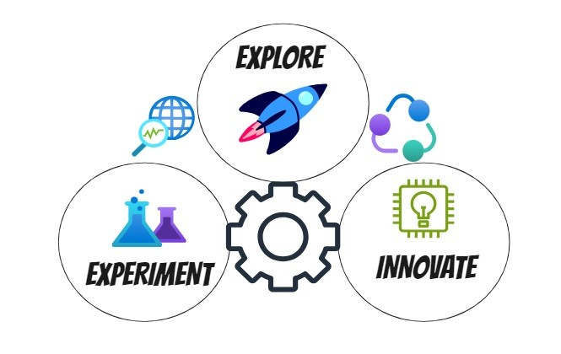

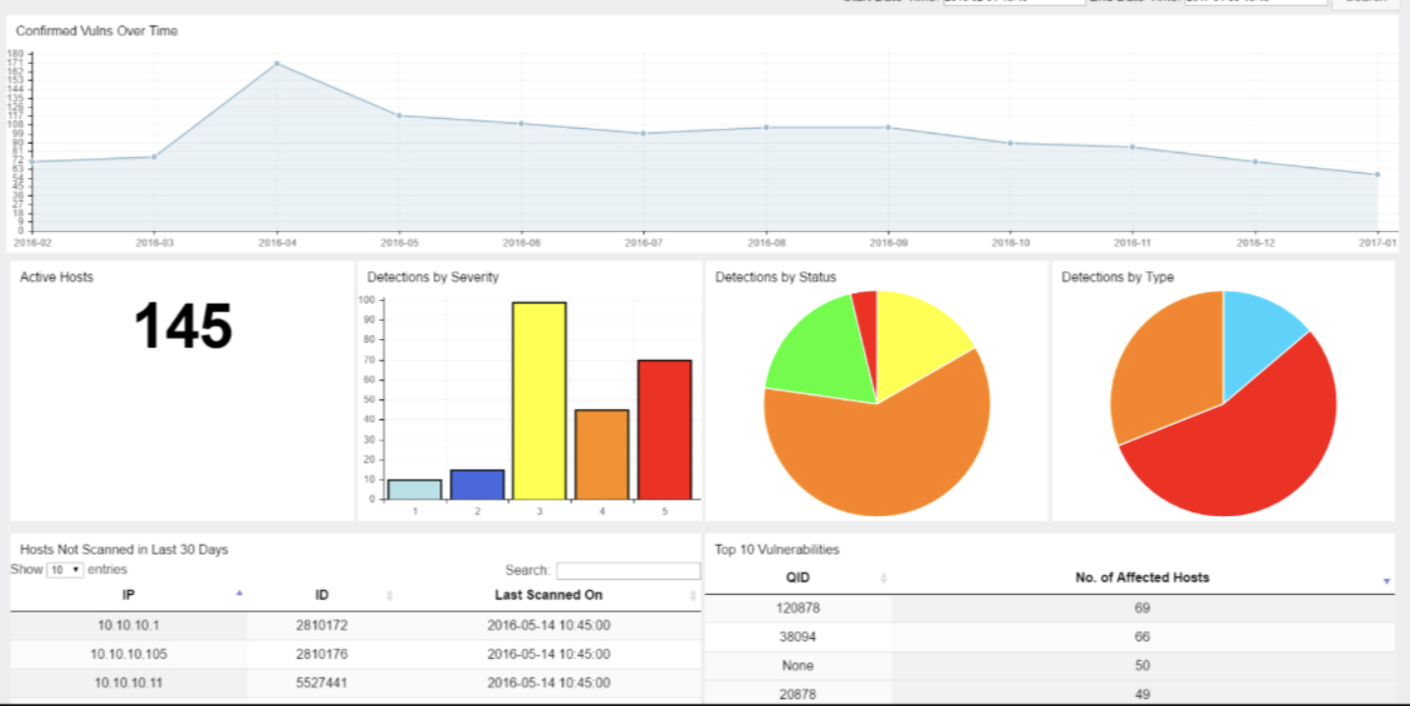
Idea: automate work now, enable innovation
Integrate into existing workflow
Enable some wins and support experimentation for leapfrog innovation
Monitor specific metrics of risks and benefits to help automate/guide course correction

Slide 5

How about this as a path forward?
Start with an area AI seems to have delivered, e.g. customer care
Leverage a proven trend – text, even voice-based interface
Use an architecture that’s flexible to
  Achieve the low-hanging fruit
  Support changing security and compliance requirements
  Scale to broader applications and larger impacts
  Importantly, enable experimentation for innovation

Slide 6
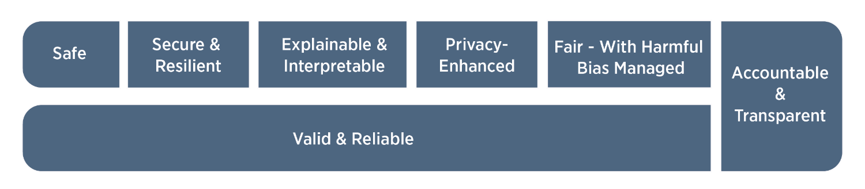
Security and compliance requirements
Characteristics of trustworthy AI systems (NIST, 2023)

Slide 7
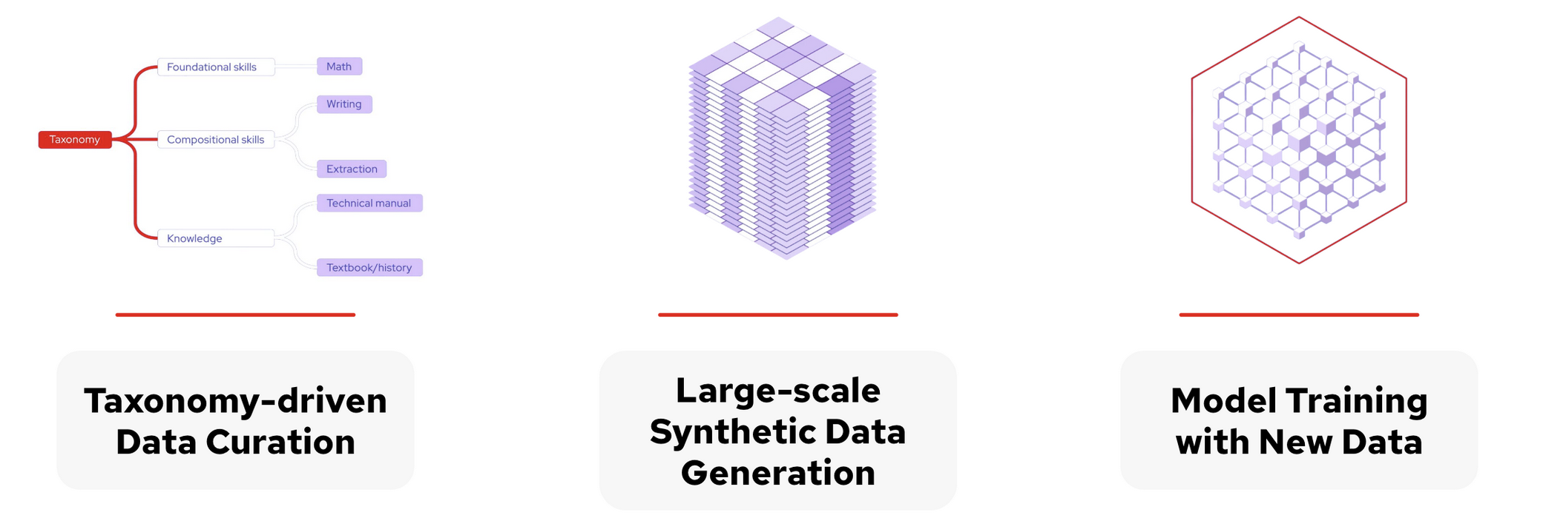
What enable AI to scale? (1/2)
Training time – removing humans as the AI-scaling bottleneck
  Unsupervised learning with prior human knowledge as foundation
  Scale by getting more from existing data, e.g. more parameters
  Beyond the Internet: behind firewall, auth wall; new types of data
  Reinforcement learning without human involvement, e.g. alpha go
  Taxonomy-based synthetic data generation with a teacher model

Slide 8

What enable AI to scale? (2/2)
Testing or run time – additional context, multi-turn context and reasoning
  Expanding portfolio of tools to furnish runtime context
  Agents well-versed on tools collaborating on goals, beyond static CoT in a prompt
  How about agents creating tools and spawning other agents? Implications?
    Evolving from an industry of hardware/software resources to skills-based resources
Joy
Fear
Sadness
Disgust
Anger

Slide 9
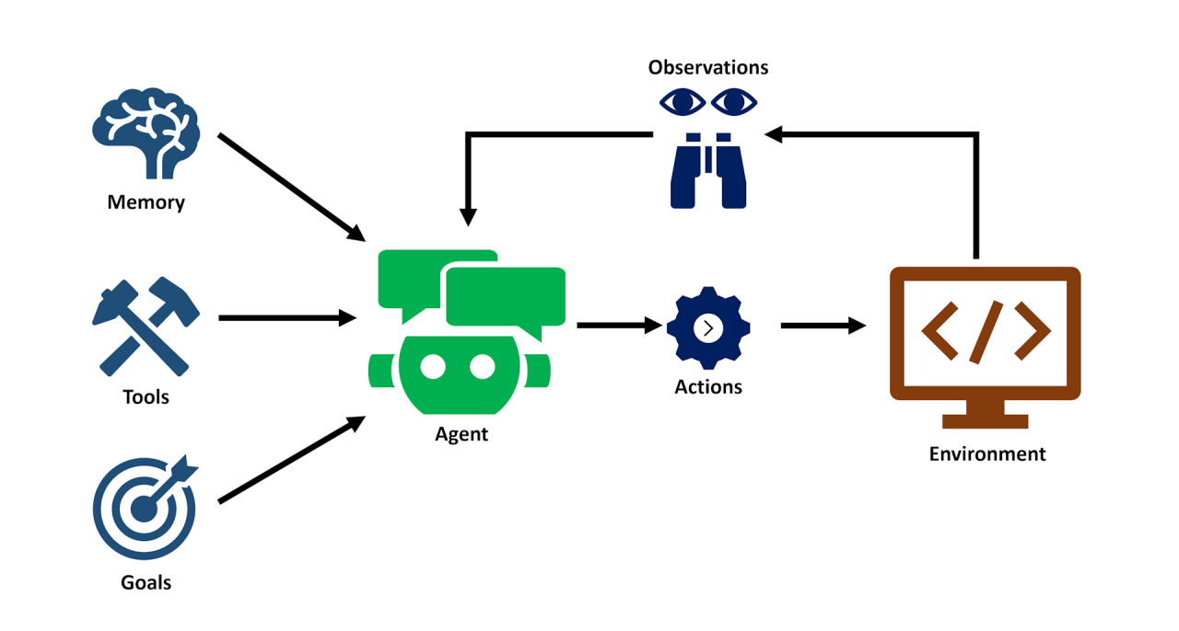
When the rubber hits the road (1/3) …
Trend: small, faster, specialized LLMs/FMs
Intelligence system v. one large LLM
Collaborate on goal(s) with reasoning, action, observation for better results
Chat, route, determine tools to call, reflect on the outputs, refine and interact with people and services

Slide 10
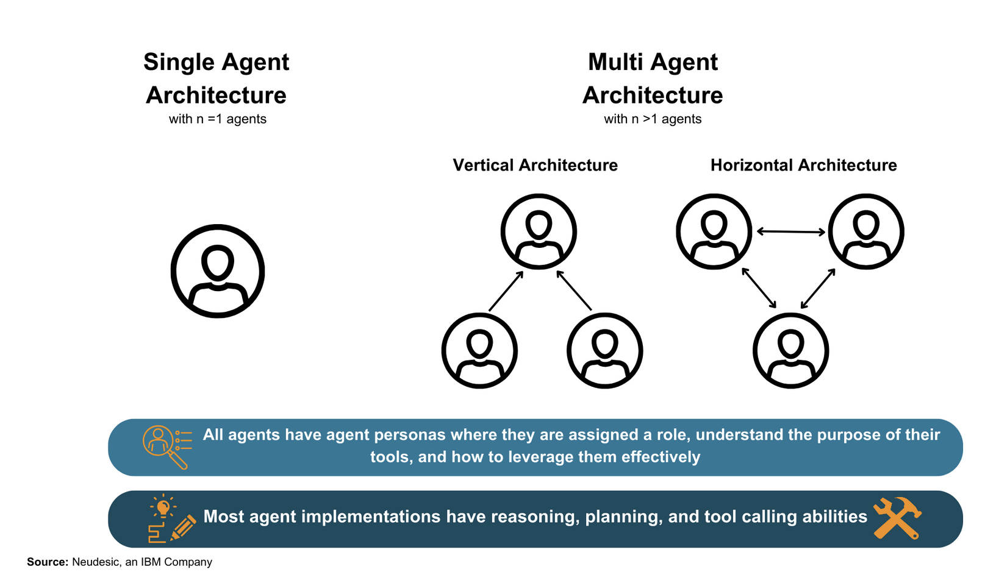
… when the rubber hits the road (1/3)
An architecture that holds LLMs together
Enhance LLMs with tools for info retrieval and invoking other systems
Enable them to interact & collaborate
Support async operations: workflow support, callback, cleaning up, etc.
Ensure data security & privacy; guardrails; governance requirements

Slide 11
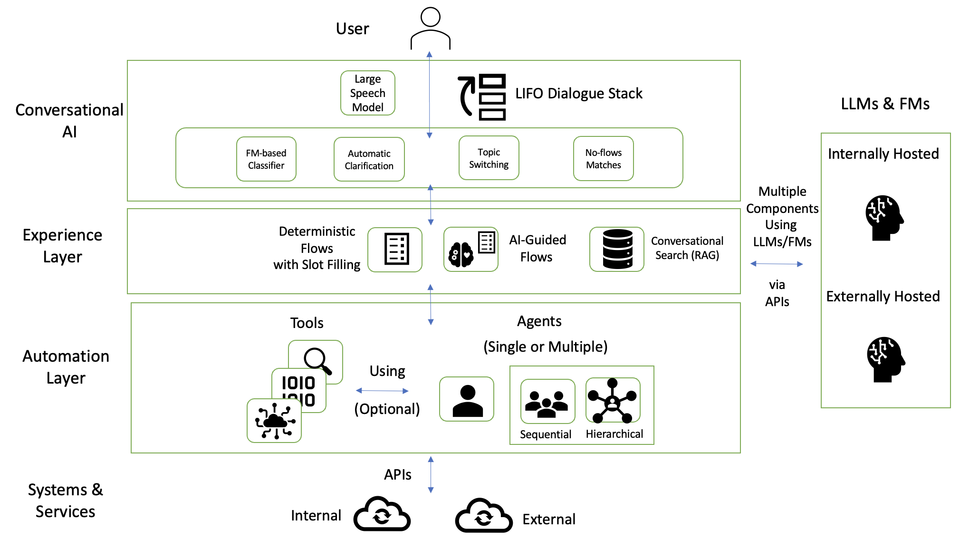
Conceptual architecture

Slide 12
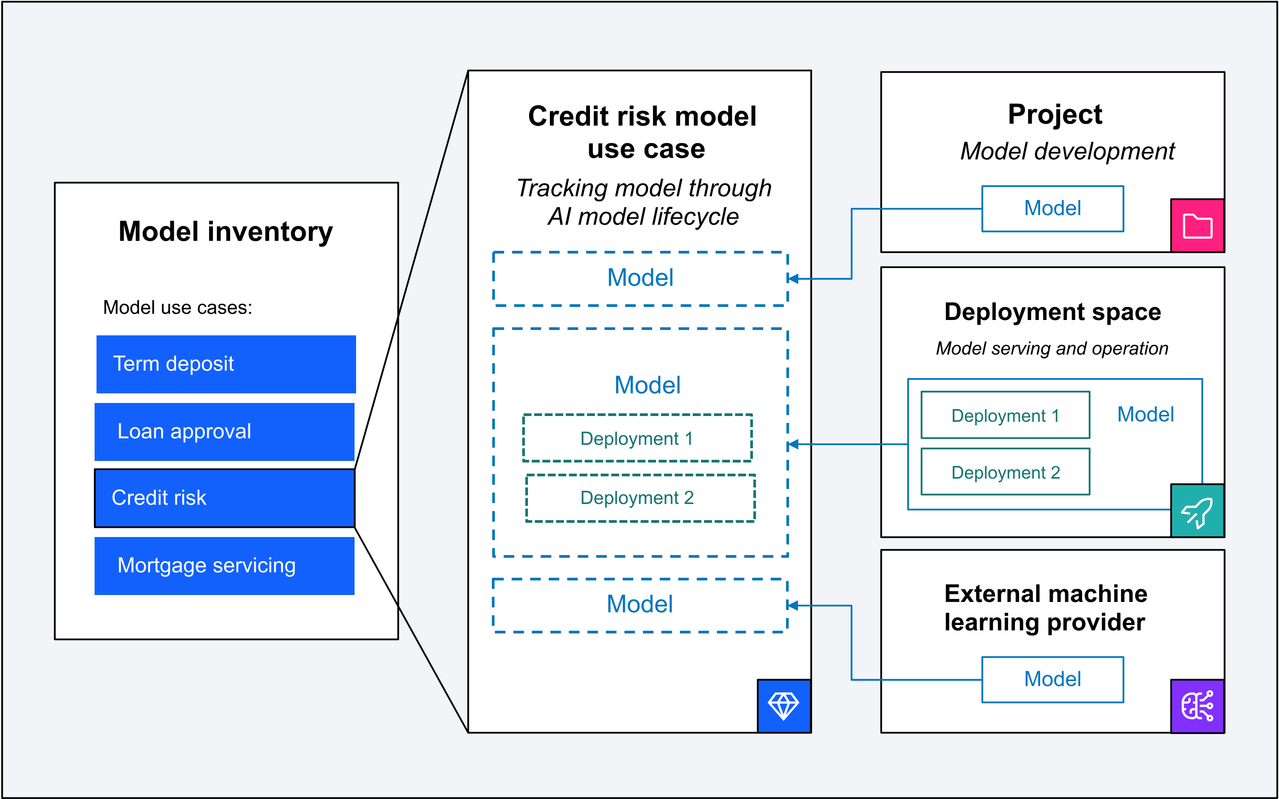
When the rubber hits the road (2/3)
Provide capabilities for
    AI governance
    Experimentation
Establish an architecture to meet governance and experimentation requirements with
    Routing
    Existing and computed metrics

Slide 13
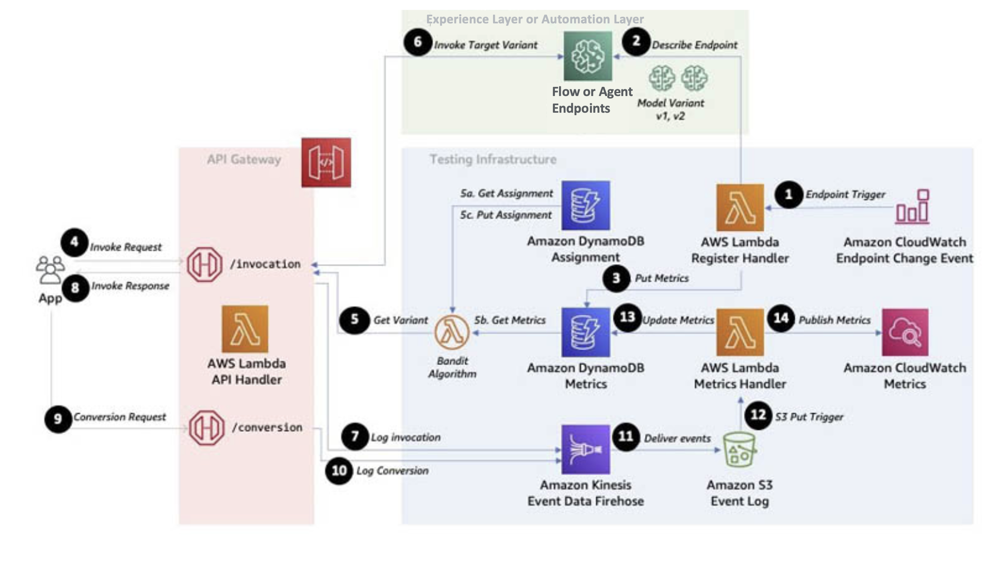
App/AI Interface, APIs, routing/AB testing
Architecture for Incorporating A/B Testing in an App in AWS Cloud (adapted) (Bright, 2021)

Slide 14
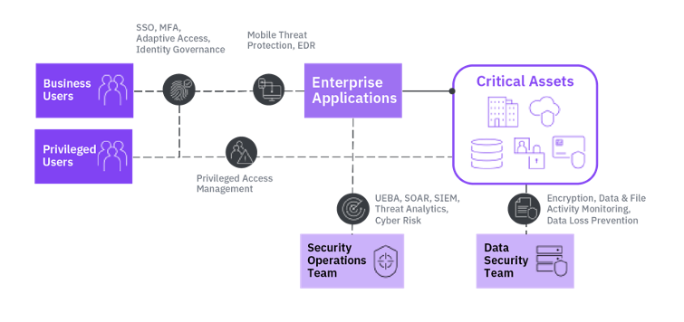
When the rubber hits the road (3/3)
Leverage current processes, frameworks, and tools for
  Zero Trust security: IAM, Security Group, VPC, etc.
  IT automation: IaC, MLOps, DevSecOps, GitHub, etc.
  AIOps: logging, observability, SRE, governance

Slide 15
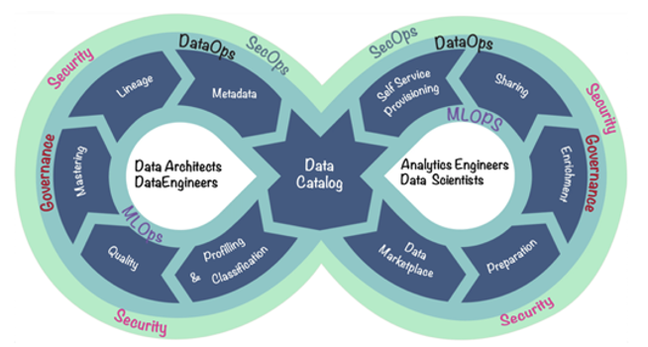
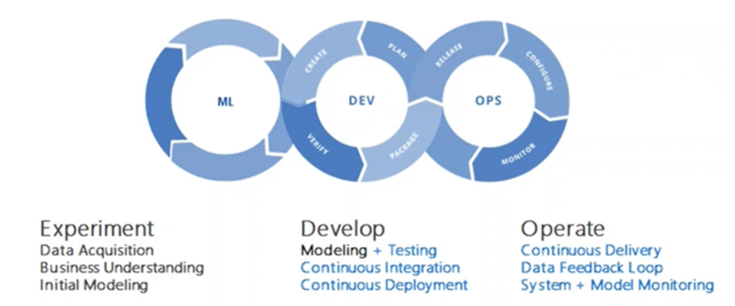
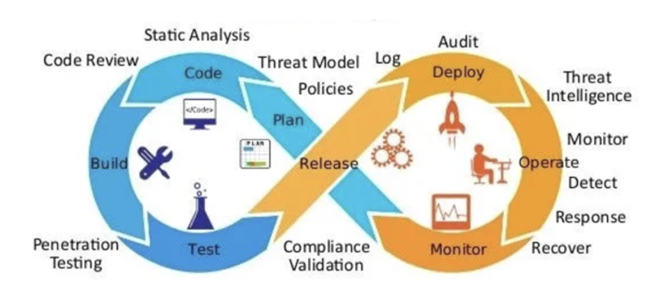
The People and Processes
An evolving relationship among people, process, and AI
  AI helping programmers
  AI creating the apps
  AI becoming the apps
Establish human in the loop in automation & governance
Feeding into one another

Slide 16
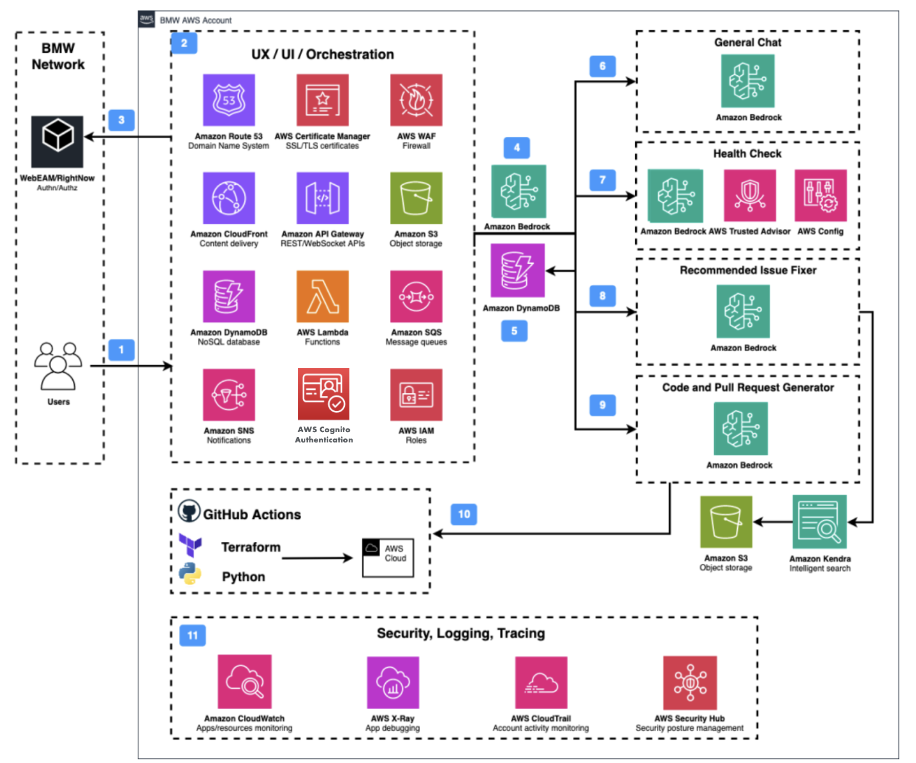
Security, processes, agents
Architecture of BMW’s Infrastructure Optimization GenAI Assistant (adapted) (Kohl et al, 2024)

Slide 17

Summary
Reap the benefits now AND position for the future
Support for experimentation-to-innovation capabilities
    The limitless unsupervised-learning possibility
    The upcoming skills-centric industry
Align with human nature – small wins leading to a big success, otherwise the project doesn’t survive to see it

Slide 18
Q&A
Cheong Ang
Account Technical Leader, IBM
cheong@ibm.com

