Slide 1


Assessing Cognitive Workload in Mixed Reality Flight Simulators for Naval Aviation
LtCol Thomas Cecil, Naval Postgraduate School
LTC Charles Rowan, Naval Postgraduate School
Mr. Perry McDowell, Naval Postgraduate School
Dr. Jon Vogl, US Army Aeromedical Research Laboratory (USAARL)
Notes:
Introductions:
LtCol Cecil, III MEF TECG Director and recent Master’s Graduate of the NPS MOVES Institute.
LTC Rowan, FA57 Army Simulation Officer and Interim Director of MOVES Institute at NPS.
Mr. Perry McDowell, Faculty Associate for Research at the MOVES Institute.
Dr. Jon Vogl, Research Psychologist at USAARL.
Today’s presentation and conference paper titled “Assessing Cognitive Workload in Mixed Reality Flight Simulators for Naval Aviation” describe the work we did in support of my thesis research at the Naval Postgraduate School.

Slide 2
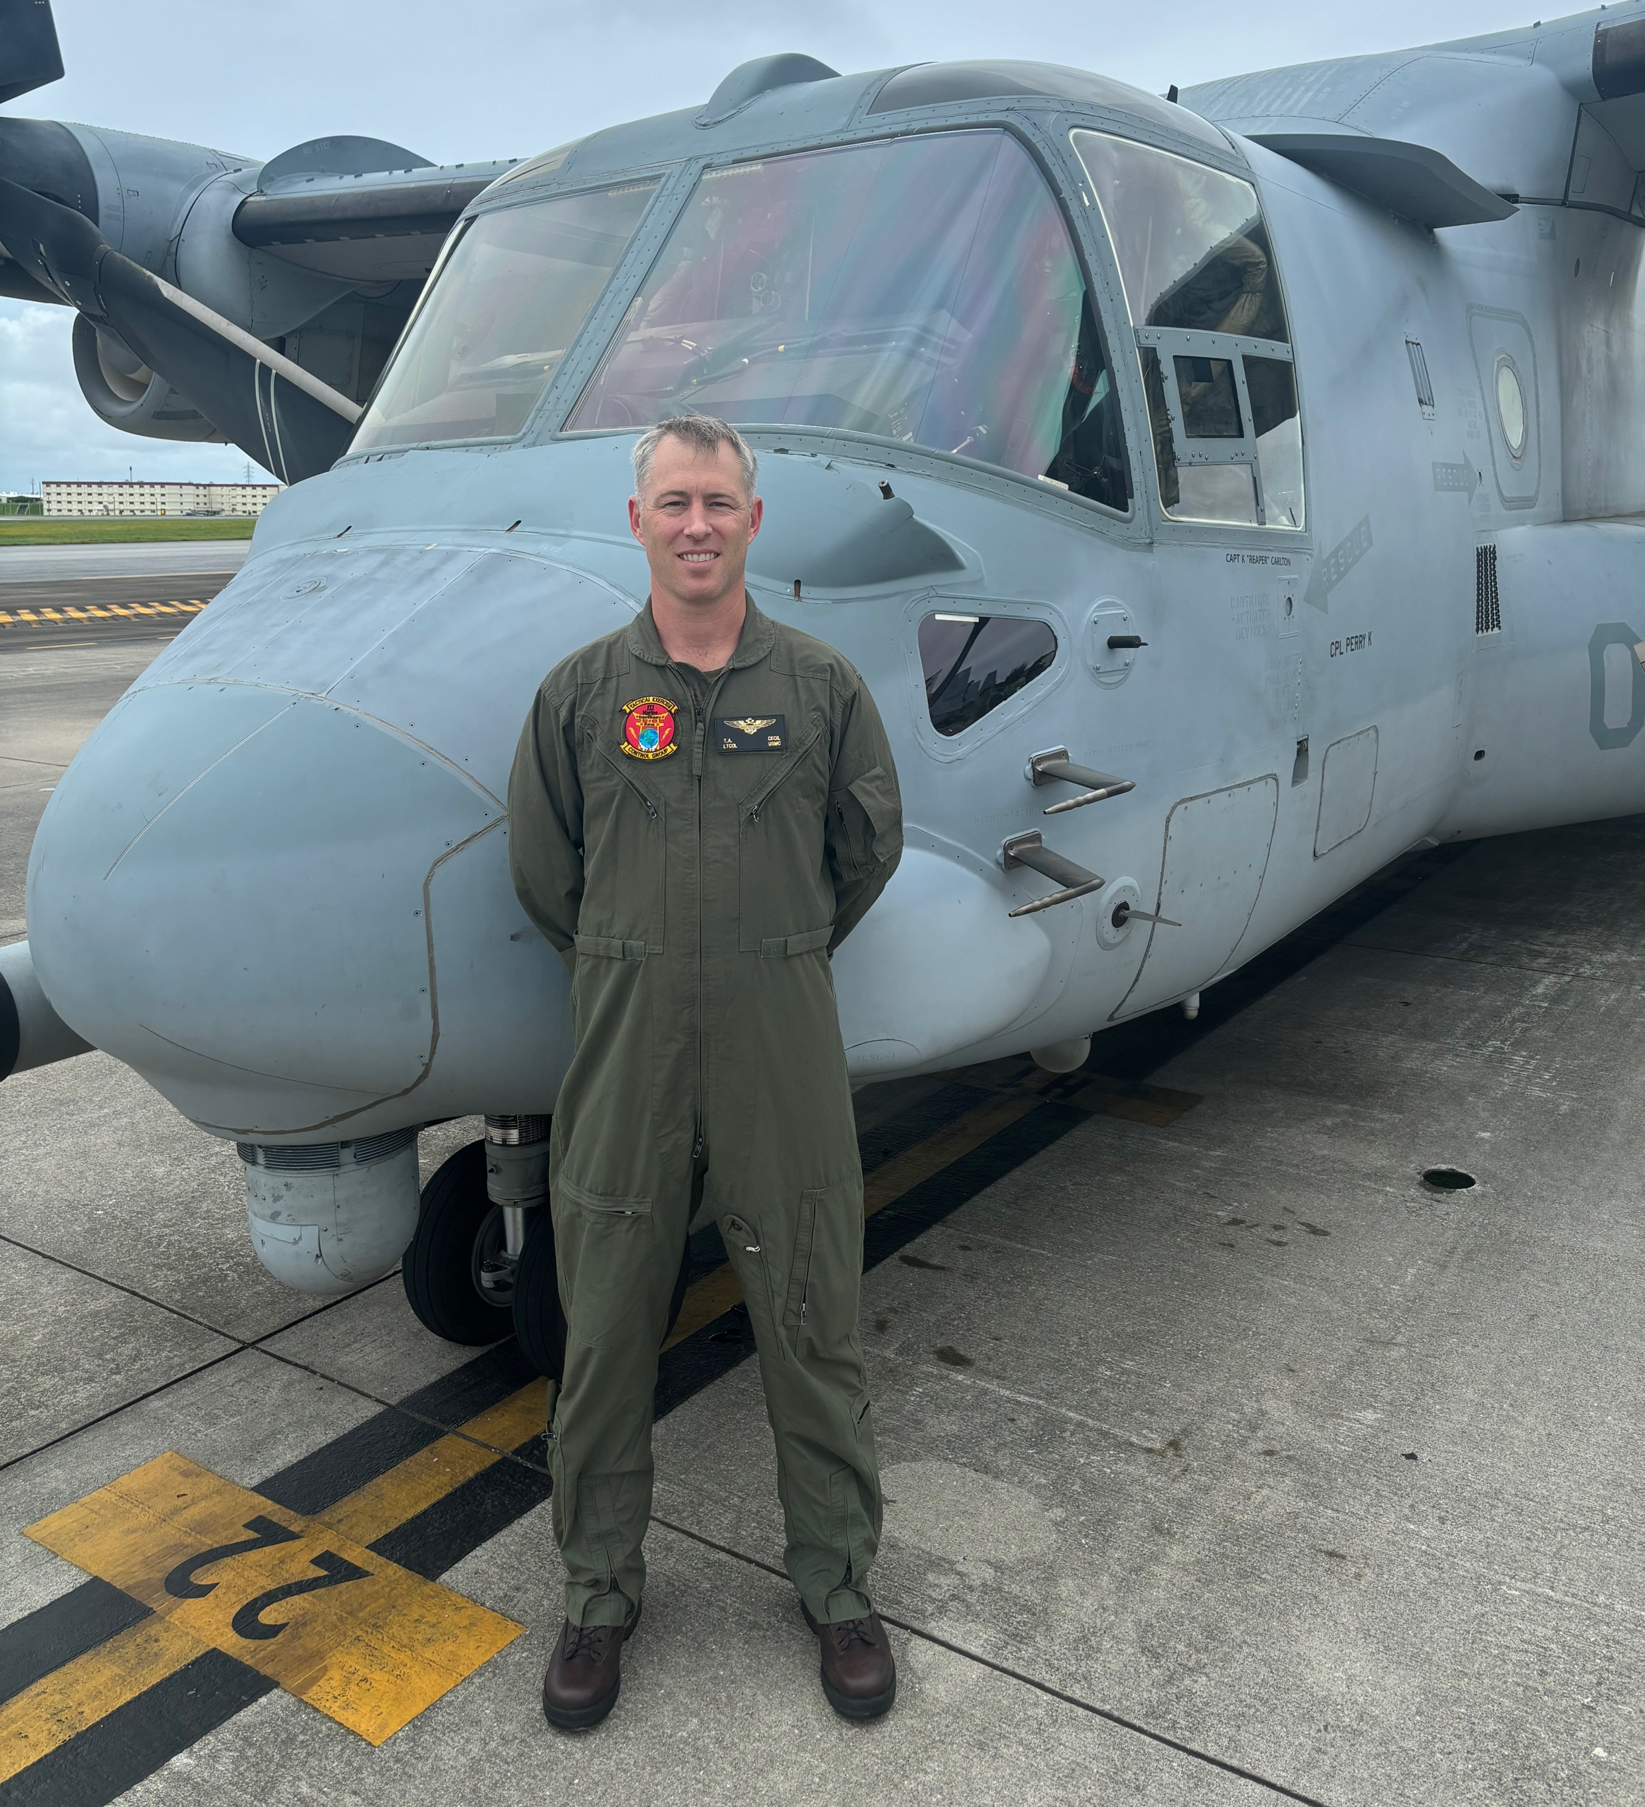
My Story
Notes:
While I’m currently filling the billet of an 8825, or Modeling and Simulation Officer, I am a Marine Corps Osprey Pilot by trade.
Prior to attending NPS, I flew the MV-22 Osprey for 10 years out of MCAS New River, North Carolina with multiple squadrons in Marine Aircraft Group 26. During this time, I accumulated over 1700 military flight hours and achieved multiple flight leadership designations including Night Systems Instructor. Over this time, I have been able to do a little bit of everything that can be done in the Osprey. And of all those things, my least favorite flight training events were Night Vision Device sorties in the Flight Simulator.

Slide 3
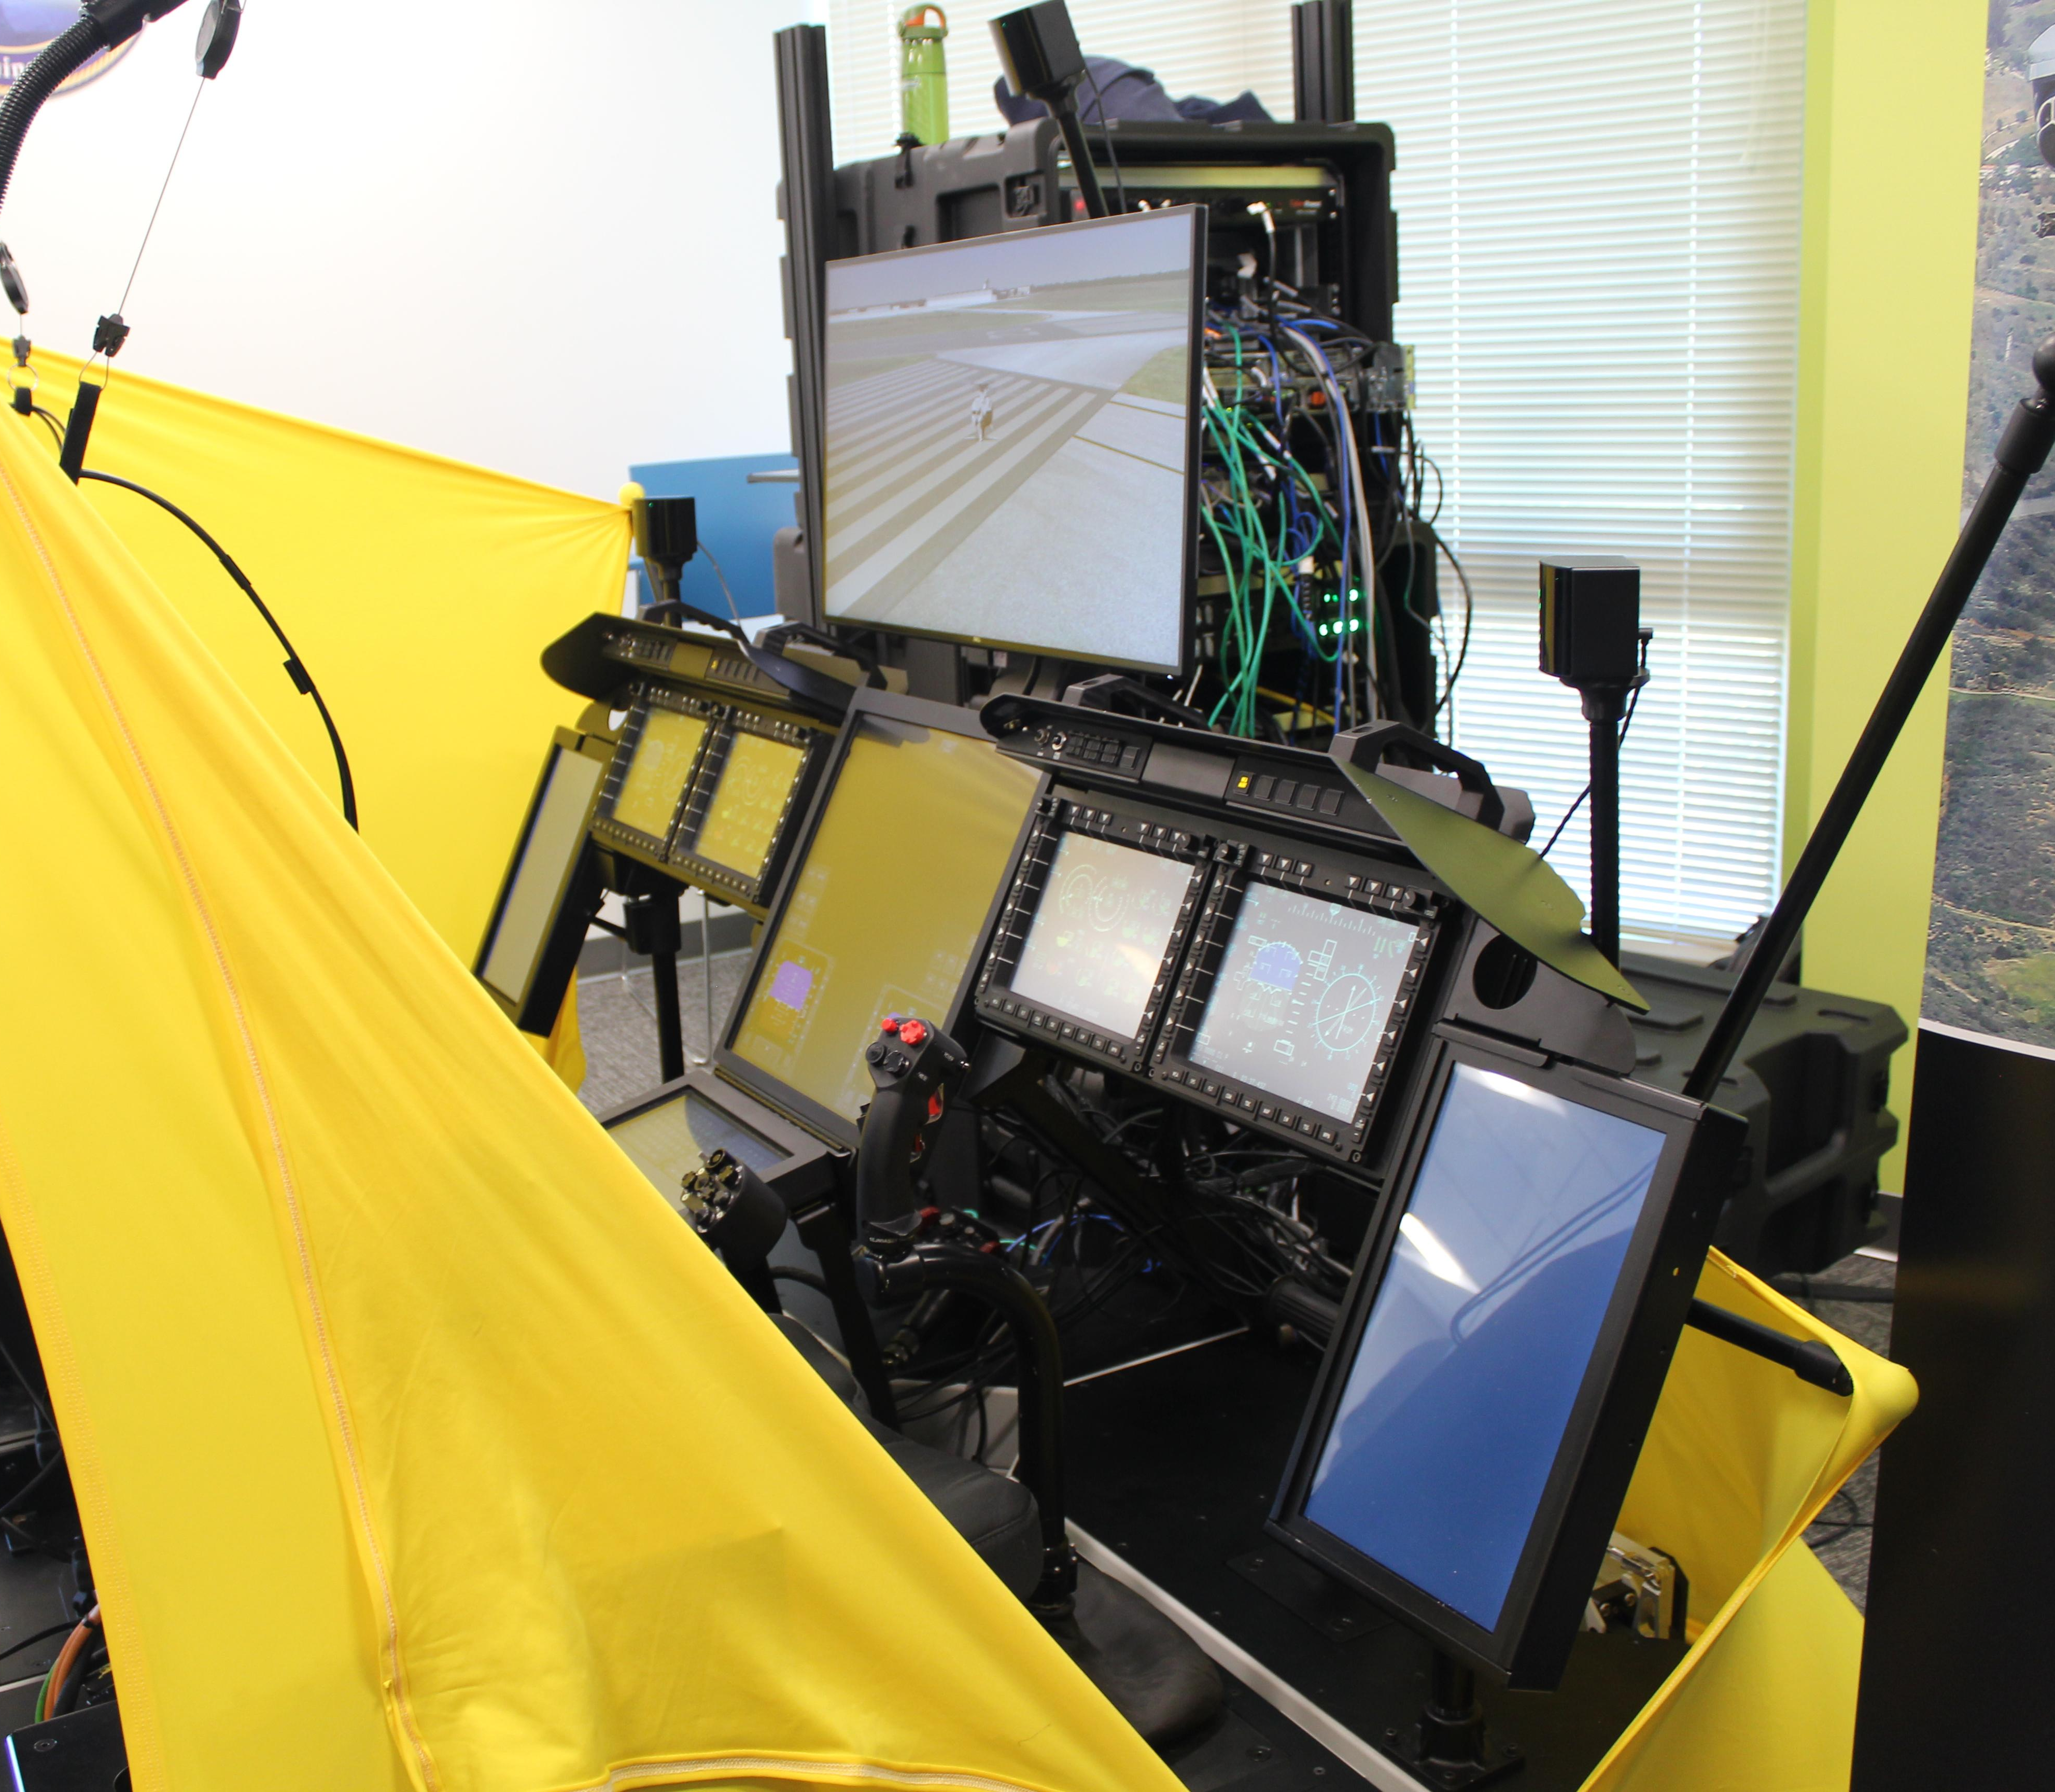
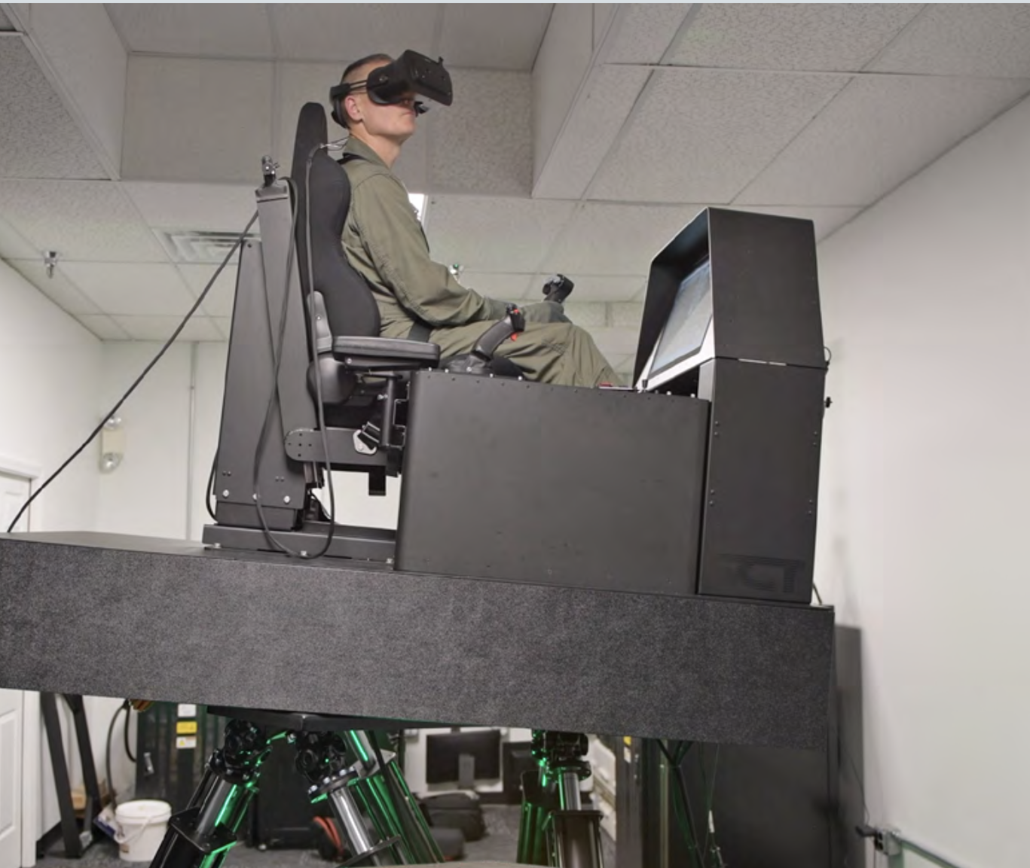
Mixed Reality (MR)
H-1 Mission Rehearsal Training (MRT). Source: U.S. Navy (2023)
Naval Air Warfare Center Aircraft Division’s (NAWCAD) CMV-22 MR simulator. Source: Perry (2023)
Notes:
Therefore, when I first saw the H-1 Mission Rehearsal Trainer on the left during a visit to MCAS Pendleton, or read about the Naval Air Warfare Center’s Mixed Reality CMV-22 simulator on the right, my initial thoughts were – that seems miserable. The thought of viewing my flight environment and cockpit for two hours through head-mounted displays just struck me as difficult and exhausting.
https://www.navair.navy.mil/news/New-H-1-Mission-Rehearsal-Trainer-improves-capability-readiness/Tue-05022023-1007

Slide 4
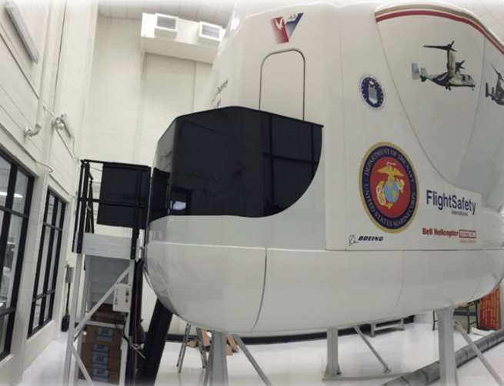
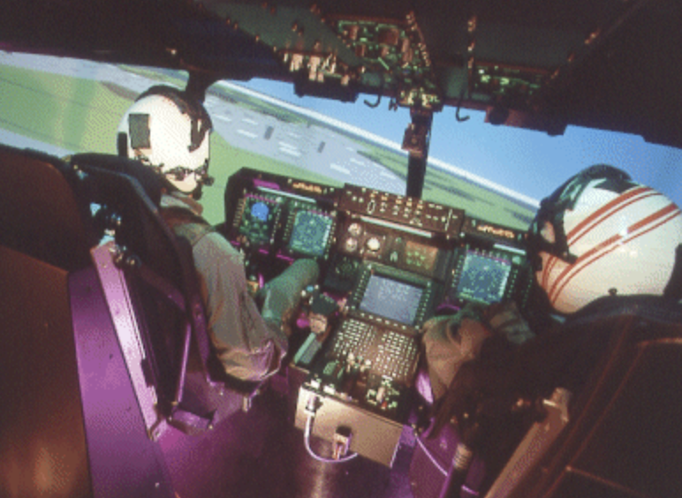
Legacy Simulator Technology
MV-22 Flight Training Device (FTD). Source: U.S. Navy (2021)
MV-22 Full-flight simulator (FFS). Source: Flight International (2000)
Notes:
On the other hand, this V-22 Flight Training Device represents what I call Legacy simulator technology. A fully functional, replica cockpit is surrounded by projection screens that present the flight environment to the pilots. Although I’m no fan of Night Vision training in this type of simulator, it’s only the projected flight environment that is viewed through the goggles; the cockpit is viewed by scanning under the NVGs so that it is seen directly by the naked eye. Once one has the hang of this type of scan pattern it becomes second nature to look under the NVGs to view and interact with the cockpit. Rather it’s the presentation of the flight environment on a screen a few feet in front of the pilot that is then viewed through the NVGs that I find fatiguing. And this is essentially the problem presented by mixed reality simulators. Both the cockpit and flight environment are viewed through the head-mounted display.
Therefore, as a Night Systems Instructor, I had sufficient simulator flight experience and a working knowledge of the human visual system to recognize that one’s ability to perceive three dimensions through a head-mounted display may affect one’s mental workload, especially as it pertains to interacting with the cockpit.
https://www.ntsa.org/-/media/sites/ntsa/events/2021/11t0/presentations/wed-16-june/16-june_1355_hicks_aviation-programs.pdf (image of the FTD)
https://www.flightglobal.com/usmc-tests-mv-22/30147.article (image of the FFS)

Slide 5
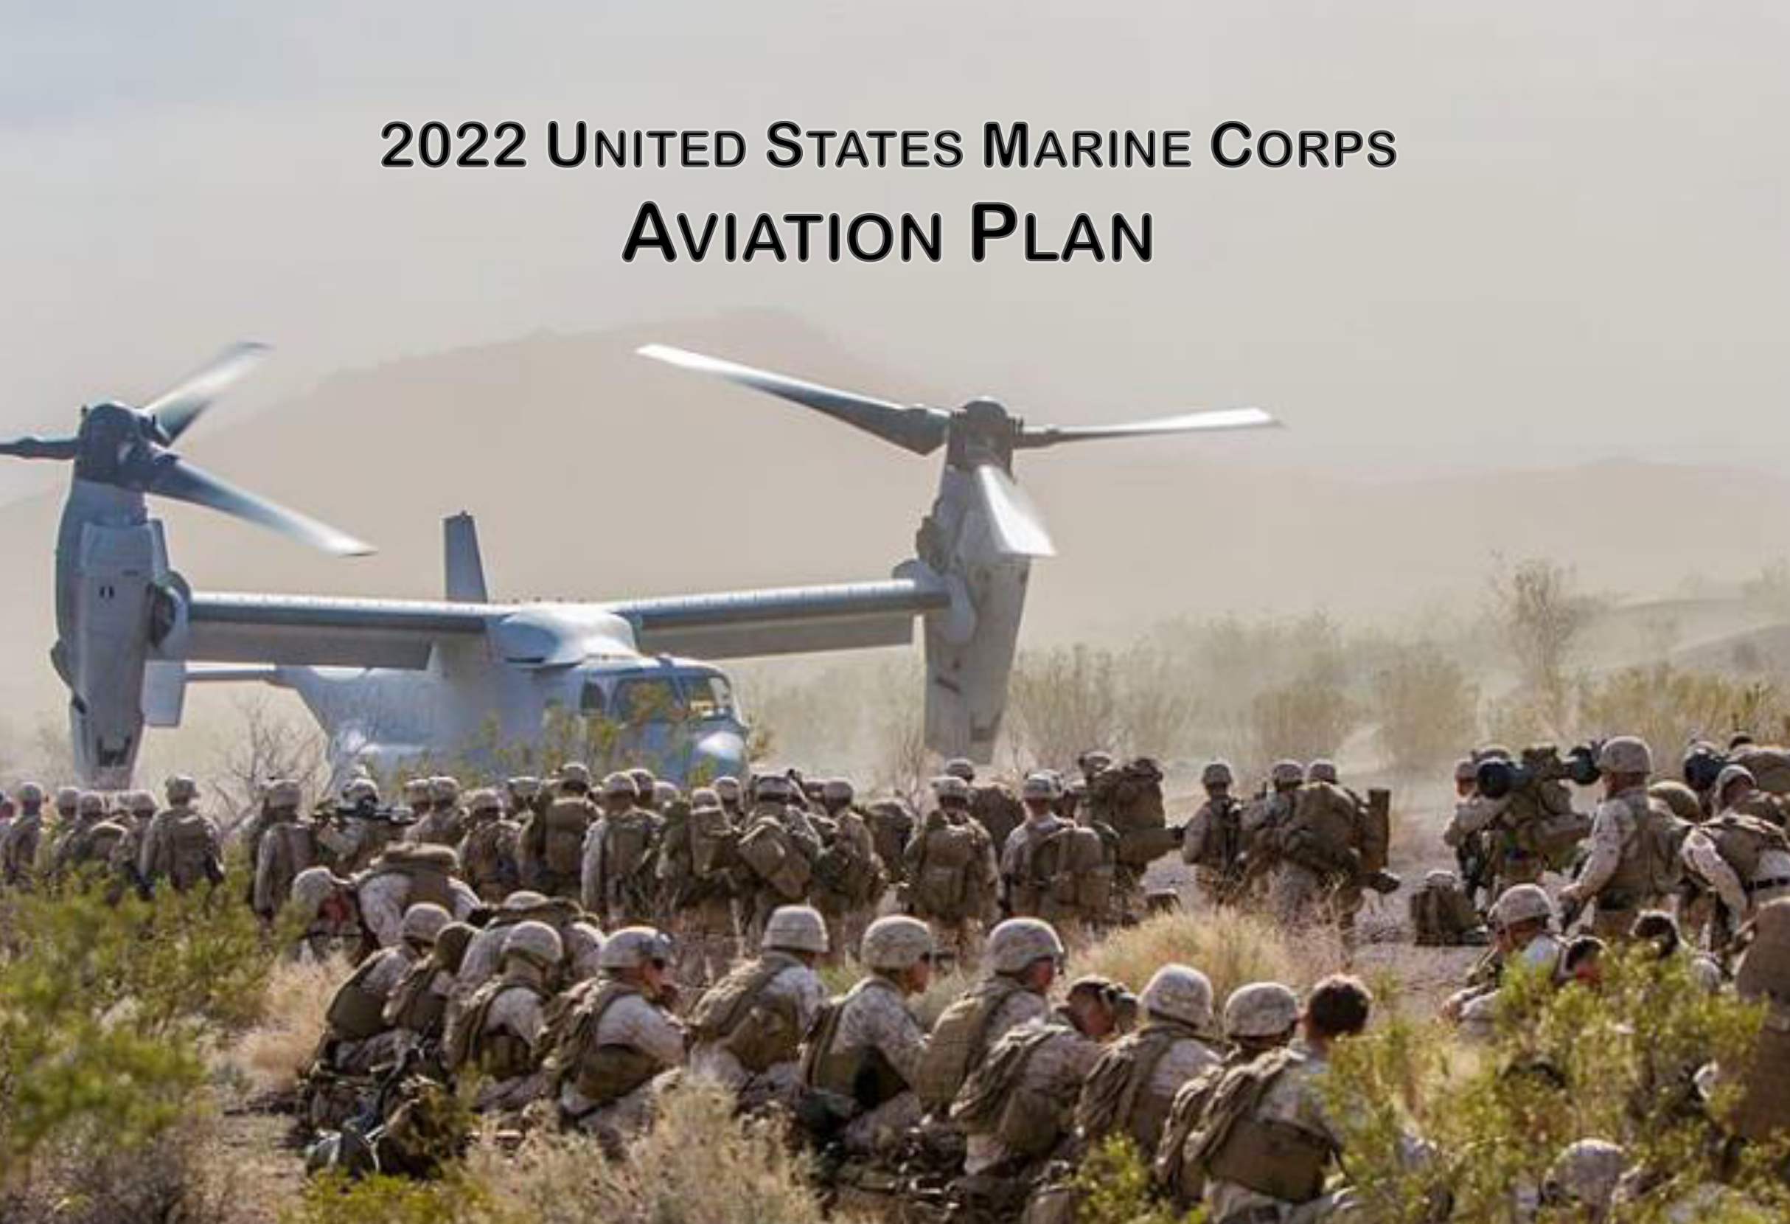
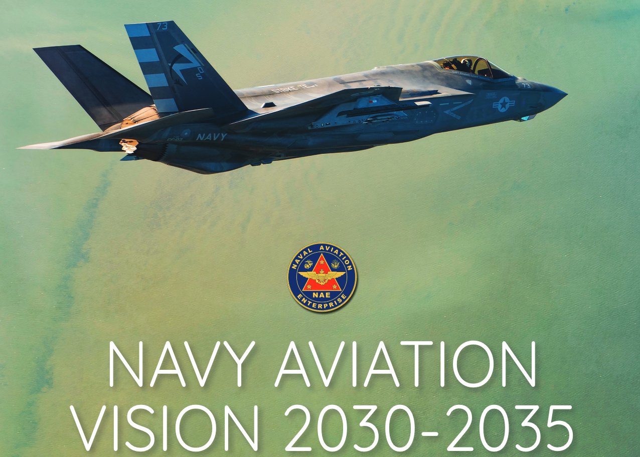
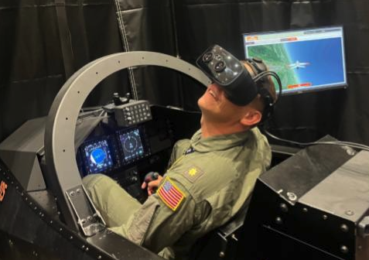
The Way Ahead
Navy Aviation Vision 2030-2035 and Marine Corps Aviation Plan 2022 call for:
Cost-effective training solutions
Deployable, distributed training solutions
Simulators that contribute to combat effectiveness
Services are implementing MR:
Naval Aviation Training Next
Projects like Avenger, Hellcat, Corsair
Naval Air Warfare Center Training Systems Division (NAWCTSD) and Aircraft Division (NAWCAD)
T-45 MR simulator. Source: U.S. Navy (2024)
Notes:
While I sensed that studying the effects of head-mounted displays on mental workload might be personally interesting, it was also important to me and the Naval Postgraduate School that the subject of study be relevant to the Navy and Marine Corps. And it is.
The Navy Aviation Vision 2030-2035 communicates the Commander of Naval Air Forces’ vision for the future of naval aviation in light of the National Defense Strategy and the CNOs guidance. Similarly, the Marine Corps Aviation Plan 2022 relays how the Deputy Commandant for Aviation intends to get after the Aviation Campaign Plan and the principles identified by the Commandant in Force Design 2030.
Both plans call for cost-training solutions that contribute to the combat effectiveness of the naval forces. Further, the services have prioritized efforts to achieve deployable and distributed training solutions that make it easier to train as a team across the country and around the globe. Although neither service calls for a wholesale departure from legacy flight simulators, mixed reality simulators are uniquely able to attain these visions due to their reduced costs, maintenance requirements, and size.

Slide 6
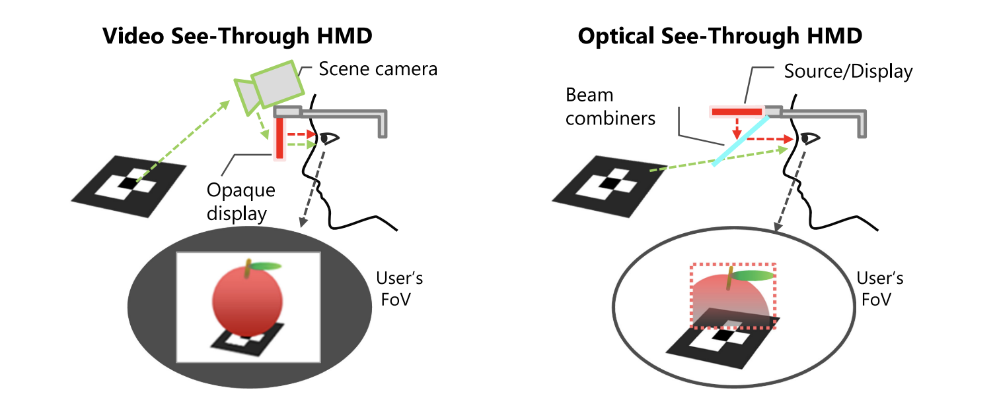
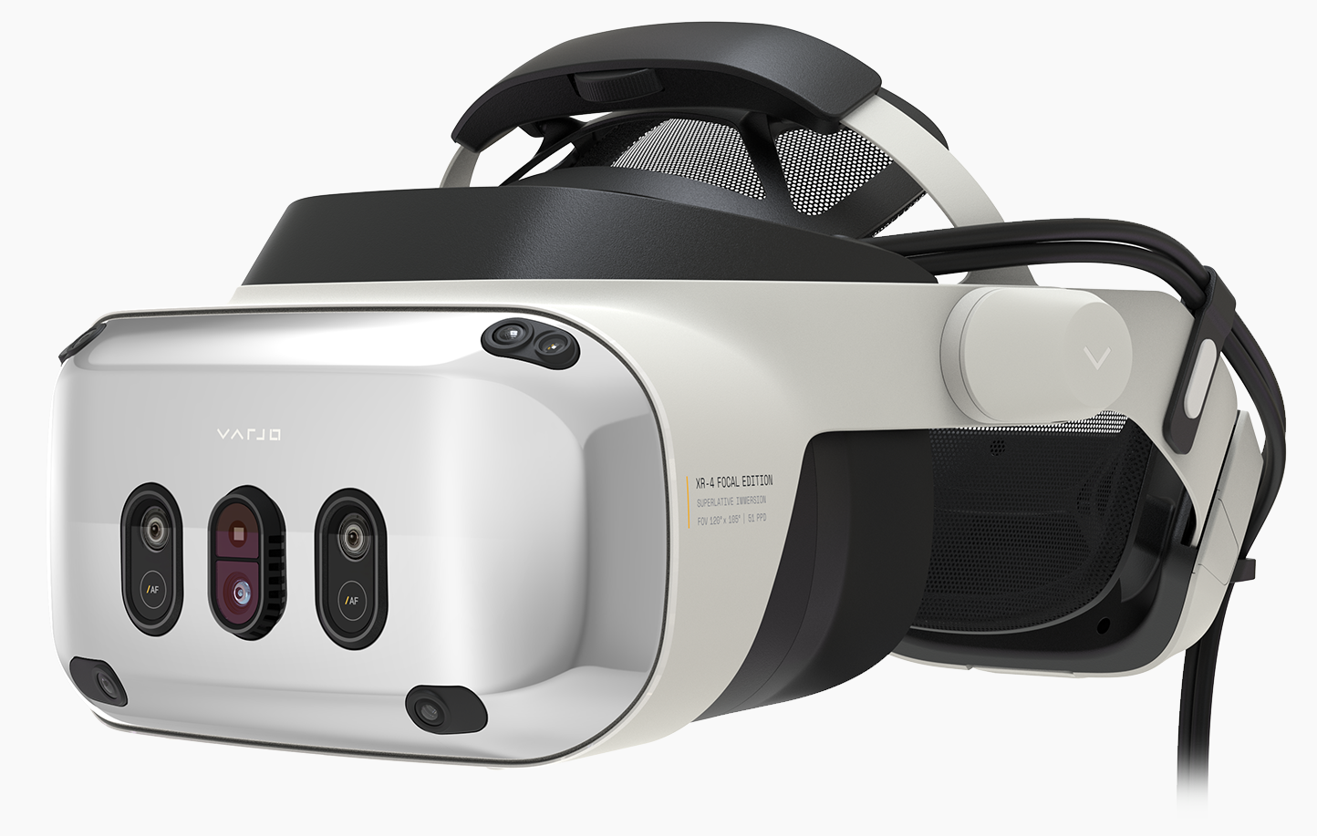
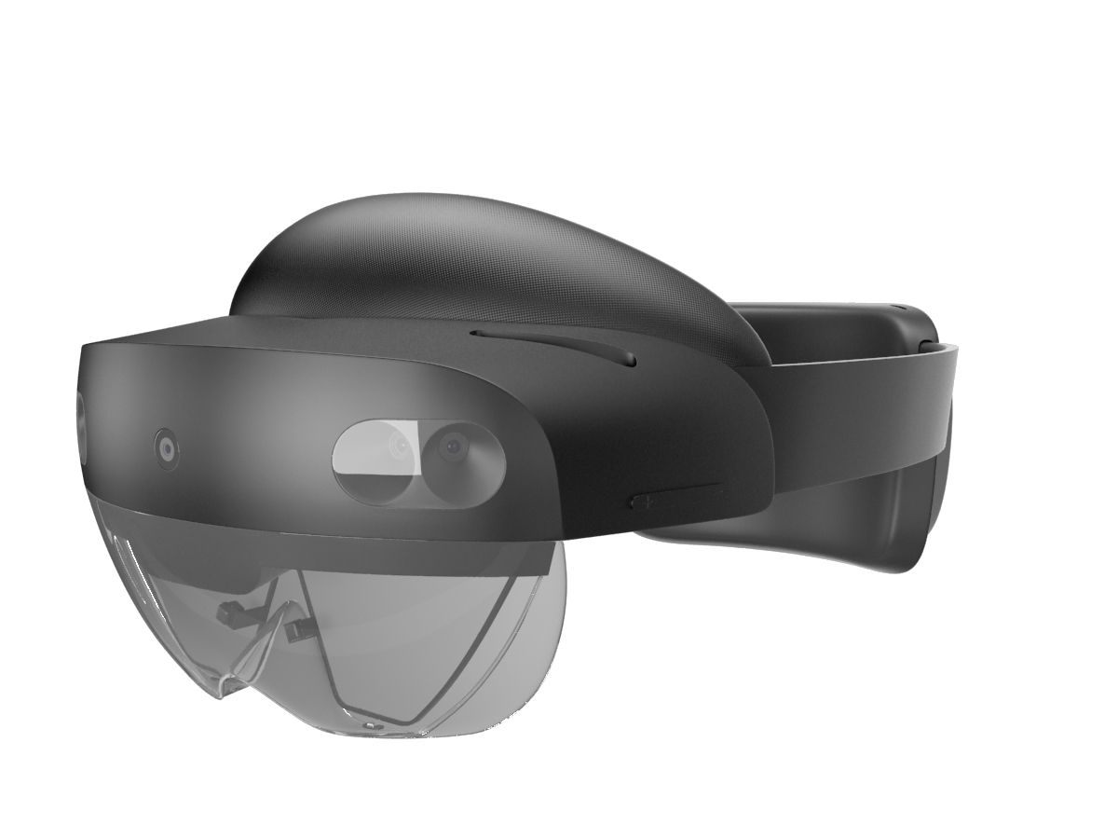
Mixed Reality Head-Mounted Displays (HMDs)
Concept of operations for video see-through (VST) and optical see-through (OST) HMDs. Source: Itoh et al. (2022)
Notes:
Video see-through HMDs are the MR head-mounted displays receiving the greatest interest from the DoN. Using this type of HMD, the user perceives the real environment via cameras on the front of the HMD. The video feed is then combined with the virtual environment via graphics shaders to provide the user with a coherent scene. Since a user does not see the real world directly, challenges of this MR technology include the user’s visual acuity and vergence-accommodation conflict, a phenomena I will discuss shortly.
Optical see-though HMDs are another MR technology that mitigates some of the challenges with VST HMDs. These HMDs allow the user to see the real environment through the headset’s lenses, as experienced wearing glasses. Occluding the real environment, the virtual environment is projected onto reflective, semi-transmissive beam combiners. While this allows the user to directly view the real environment, this feature also reduces the user’s immersion.
However, the essential difference between the two HMDs as it related to this study is the direct or indirect view of the real environment as it relates to one’s ability to perceive depth.

Slide 7
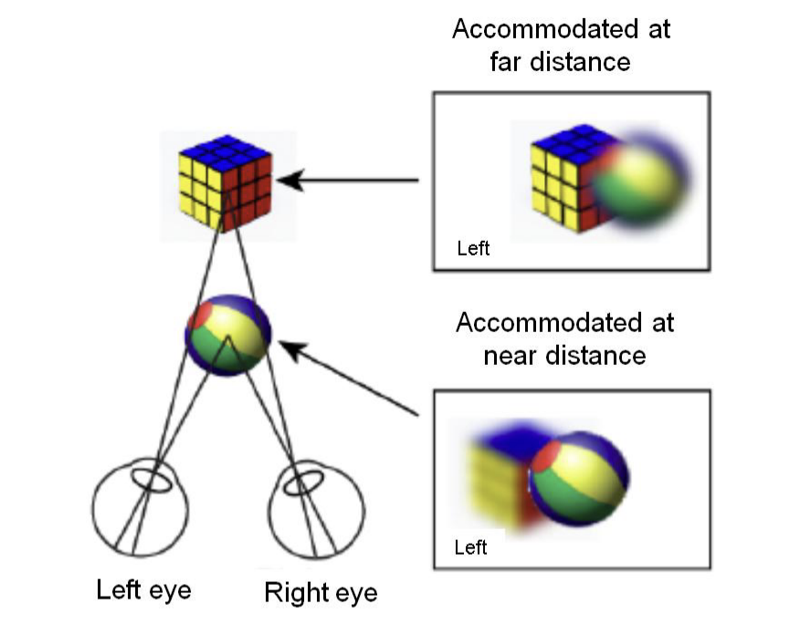
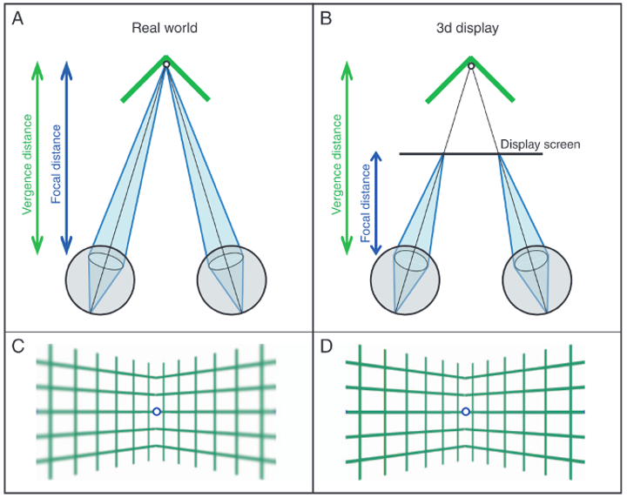
Vergence-Accommodation Conflict (VAC)
An illustration of eyes viewing the vertex of a concave hinge between two planes and the elements of VAC present in the real world and a 3D display. Source: Hoffman et al. (2008)
Vergence and accommodation illustrated. Source: Hua (2017)
Notes:
Correctly perceiving 3D space is crucial for interacting with objects or training in mixed reality. Visual depth cues are classified as visual or oculomotor. Central to our study are the oculomotor cues.
When viewing an object, vergence is the rotation of an individual eye’s axis towards an object of focus. Working in concert with vergence, accommodation is the focus action of the eye’s ciliary muscles to minimize blur for the focus depth of the object of focus.
These components of depth perception are illustrated on the left. Above you can see the image that would be seen by the left eye when accommodated for the Rubix cube at far distance. Below that is the image seen by the right eye if one were to instead focus on the ball at a near distance.
The conflict introduced by MR HMDs is illustrated by the figure to the right. For the real world in Box A, vergence and accommodation depths agree and blur effects shown below in Box C are natural. However, the 3D display illustrated in Box B depicts how a conflict is created where the eyes accommodate to the depth of the display screen but the eyes converge on the distance of the object in 3D space. Further, there is no blur gradient since the display screen provides clear imagery.
The vergence-accommodation conflict inherent to MR HMDs introduces an external factor that the user must contend with when interacting with their environment.
**Another sentence or two discussing some of the effects of VAC.

Slide 8
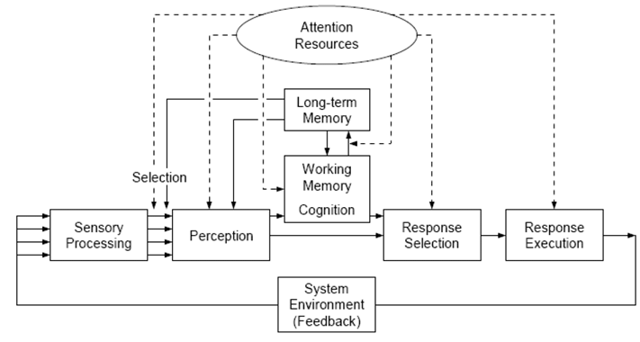
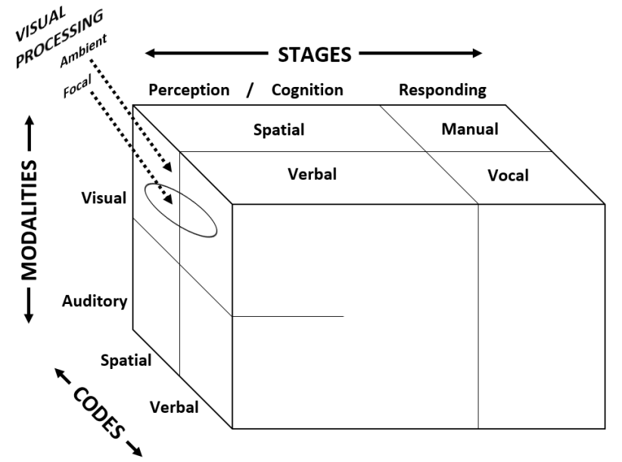
Cognitive Workload
A model of human information processing stages. Source: Wickens et al. (2013)
The Multiple Resource Model. Source: Wickens (2008)
Human cognitive system possesses finite resources.
Circumstances and factors experienced affect the task.
Internal and external factors influence one’s level of attention and effort, affecting workload.
Notes:
Although MR HMDs certainly introduce depth perception issues in the form of the vergence accommodation conflict, the effects on cognitive workload were not clear.
Longo et al.’s 2022 definition of mental workload, Wickens et al.’s Human Information Processing model, and Wicken’s Multiple Resource theory provided our foundation for understanding cognitive workload. The key elements of the definition and models that informed our approach are:
The human cognitive system possesses finite resources.
Circumstances and factors experienced affect the task.
Internal and external factors influence one’s level of attention and effort, affecting workload.
So tasks sharing commonalities across different cognitive levels compete for limited resources. For example, the visual resources needed to read system states compete with manual control responses or vocal commands resulting from a visual scan of an aircraft’s spatial information.

Slide 9
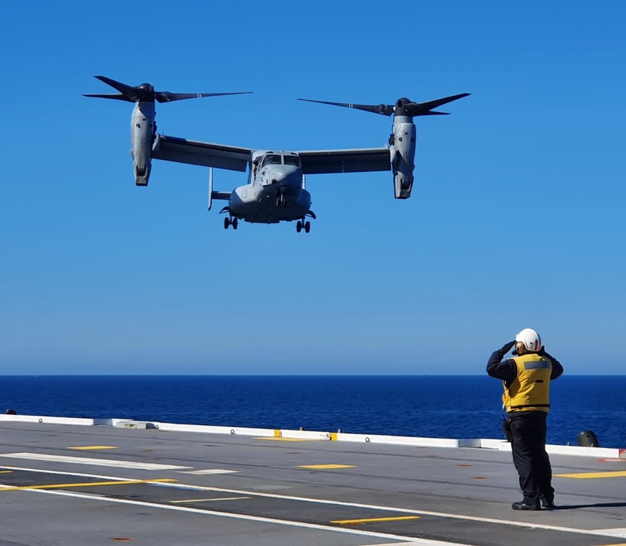
Hypothesis
Hypothesis 1:
MR HMDs will result in a significantly greater cognitive workload than legacy displays.
Hypothesis 2:
Video See-Through (VST) HMDs will result in a significantly greater cognitive workload than Optical See-Through (OST) HMDs.
Notes:
From this understanding of MR head-mounted displays, vergence-accommodation conflict, and cognitive workload, we formulated the following hypotheses:
First, MR head-mounted displays will result in a significantly greater cognitive workload than legacy displays.
Second, video see-through head-mounted displays will result in a significantly greater cognitive workload than optical see-through head-mounted displays.

Slide 10
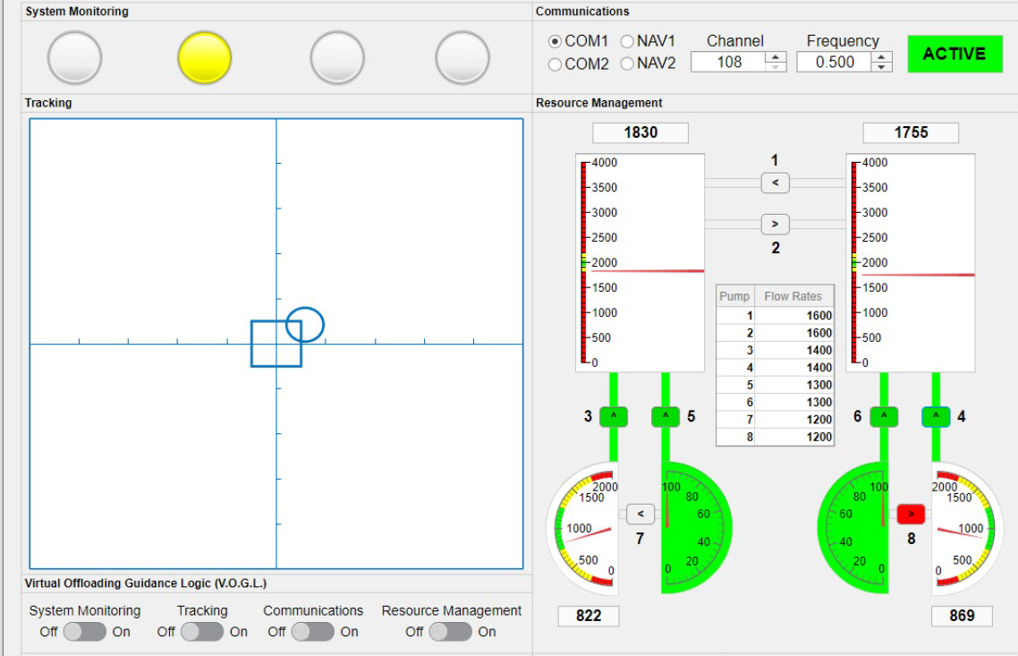
Study Design
2 x 3 repeated measures design
2 workload conditions
3 display methods
USAARL Multiple Attribute Task Battery (MATB)
Induced standardized participant workload conditions
Aviation-related subtasks:
System Monitoring
Tracking
Resource Management
Communications
Participants completed 10-minute trial for each display method.
The USAARL MATB Graphical User Interface. Source: Vogl et al. (2023)
Notes:
To investigate our hypotheses we designed a study to identify cognitive workload differences through performance, subjective assessments, and physiological measures. We used a 2 x 3 repeated measures design comparing two workload conditions and three display methods.

Slide 11
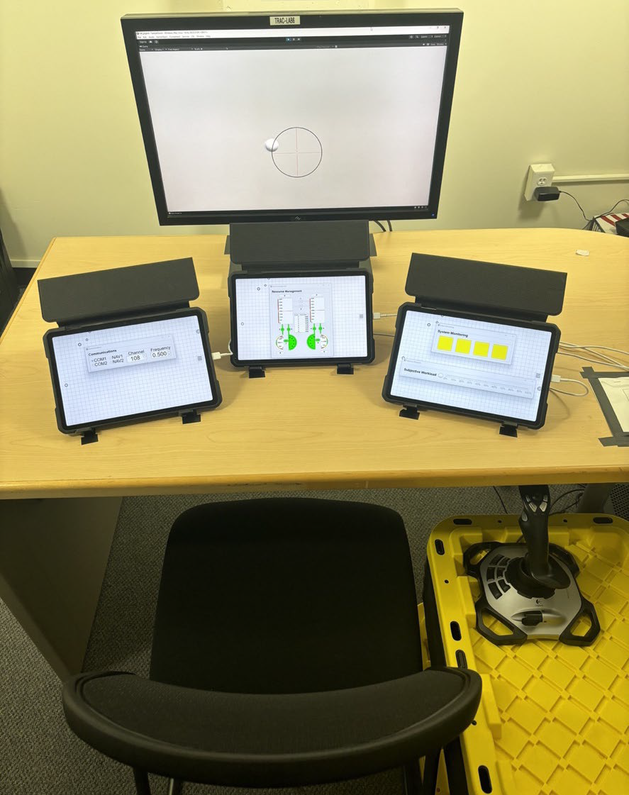
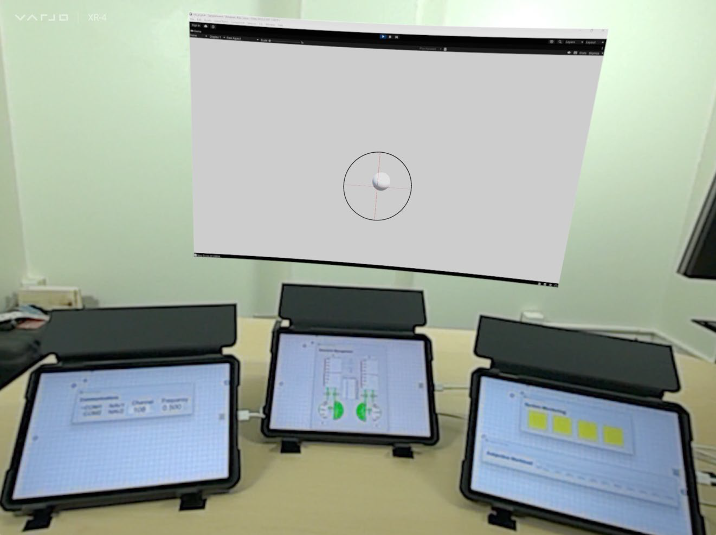
Displays (Legacy vs. MR)
Test bench configured for the legacy display trial.
Test bench as seen when wearing the VST HMDs.

Slide 12
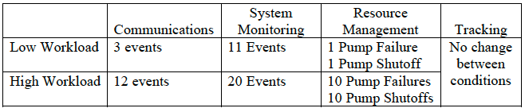
Variables
Independent
Tracking task display method: Legacy, VST, OST
Workload: Low and High
Dependent
Subjective: NASA-Task Load Index (TLX), Continuous Subjective Workload Assessment Graph (CSWAG), Simulator Sickness Questionnaire (SSQ)
Physiological: Heart Rate Variability (Root Mean Square Successive Differences)
Task Performance: Tracking, Communications, System Monitoring, Resource Management, CSWAG reaction times (CSWAGrt)
The workload condition MATB system settings. Source: McCurry et al. (2022)

Slide 13
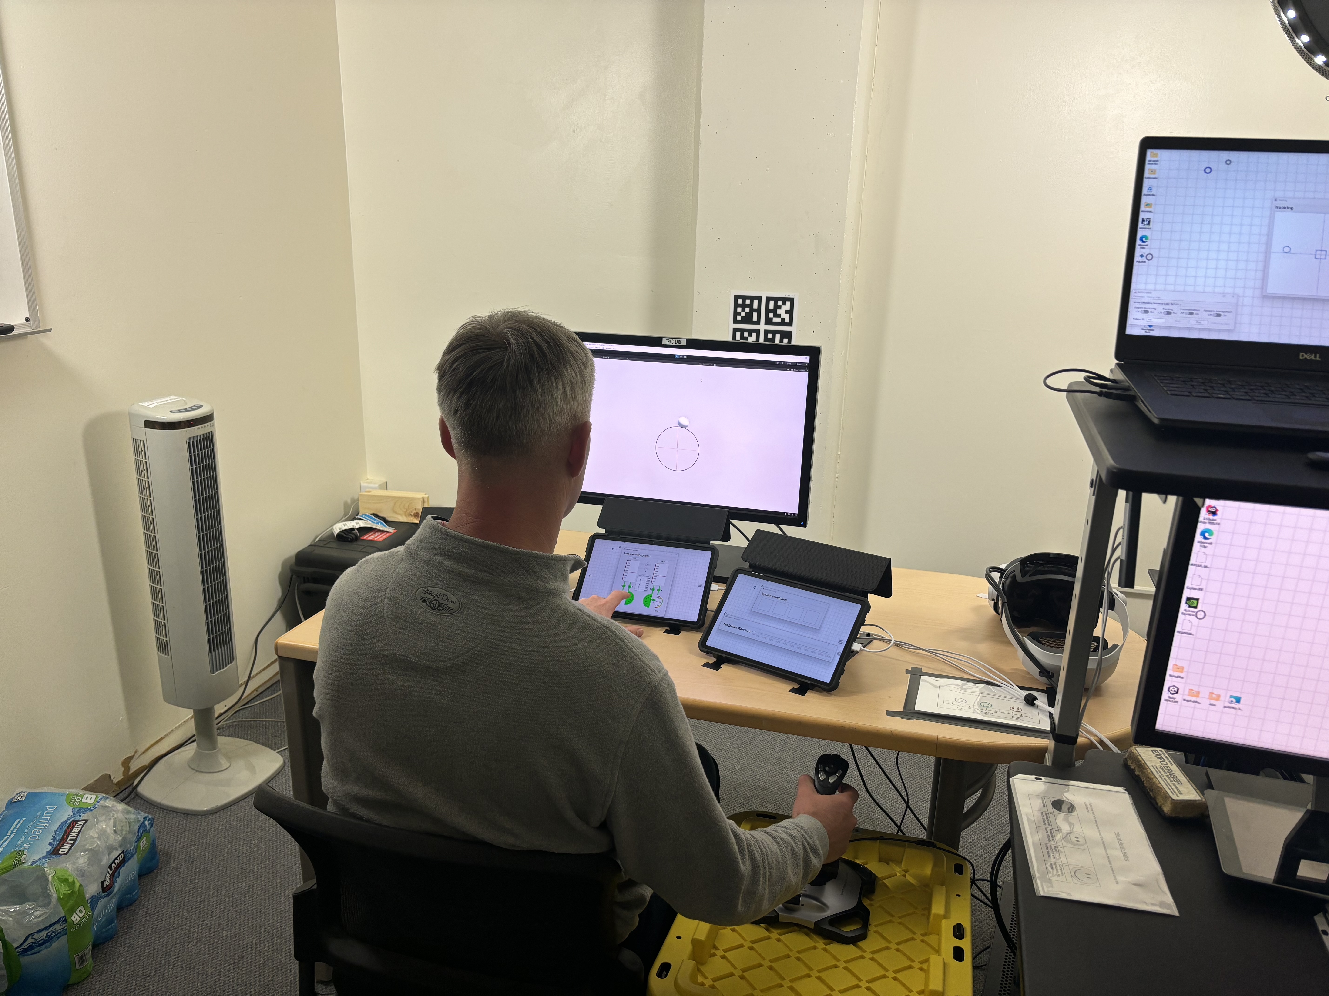
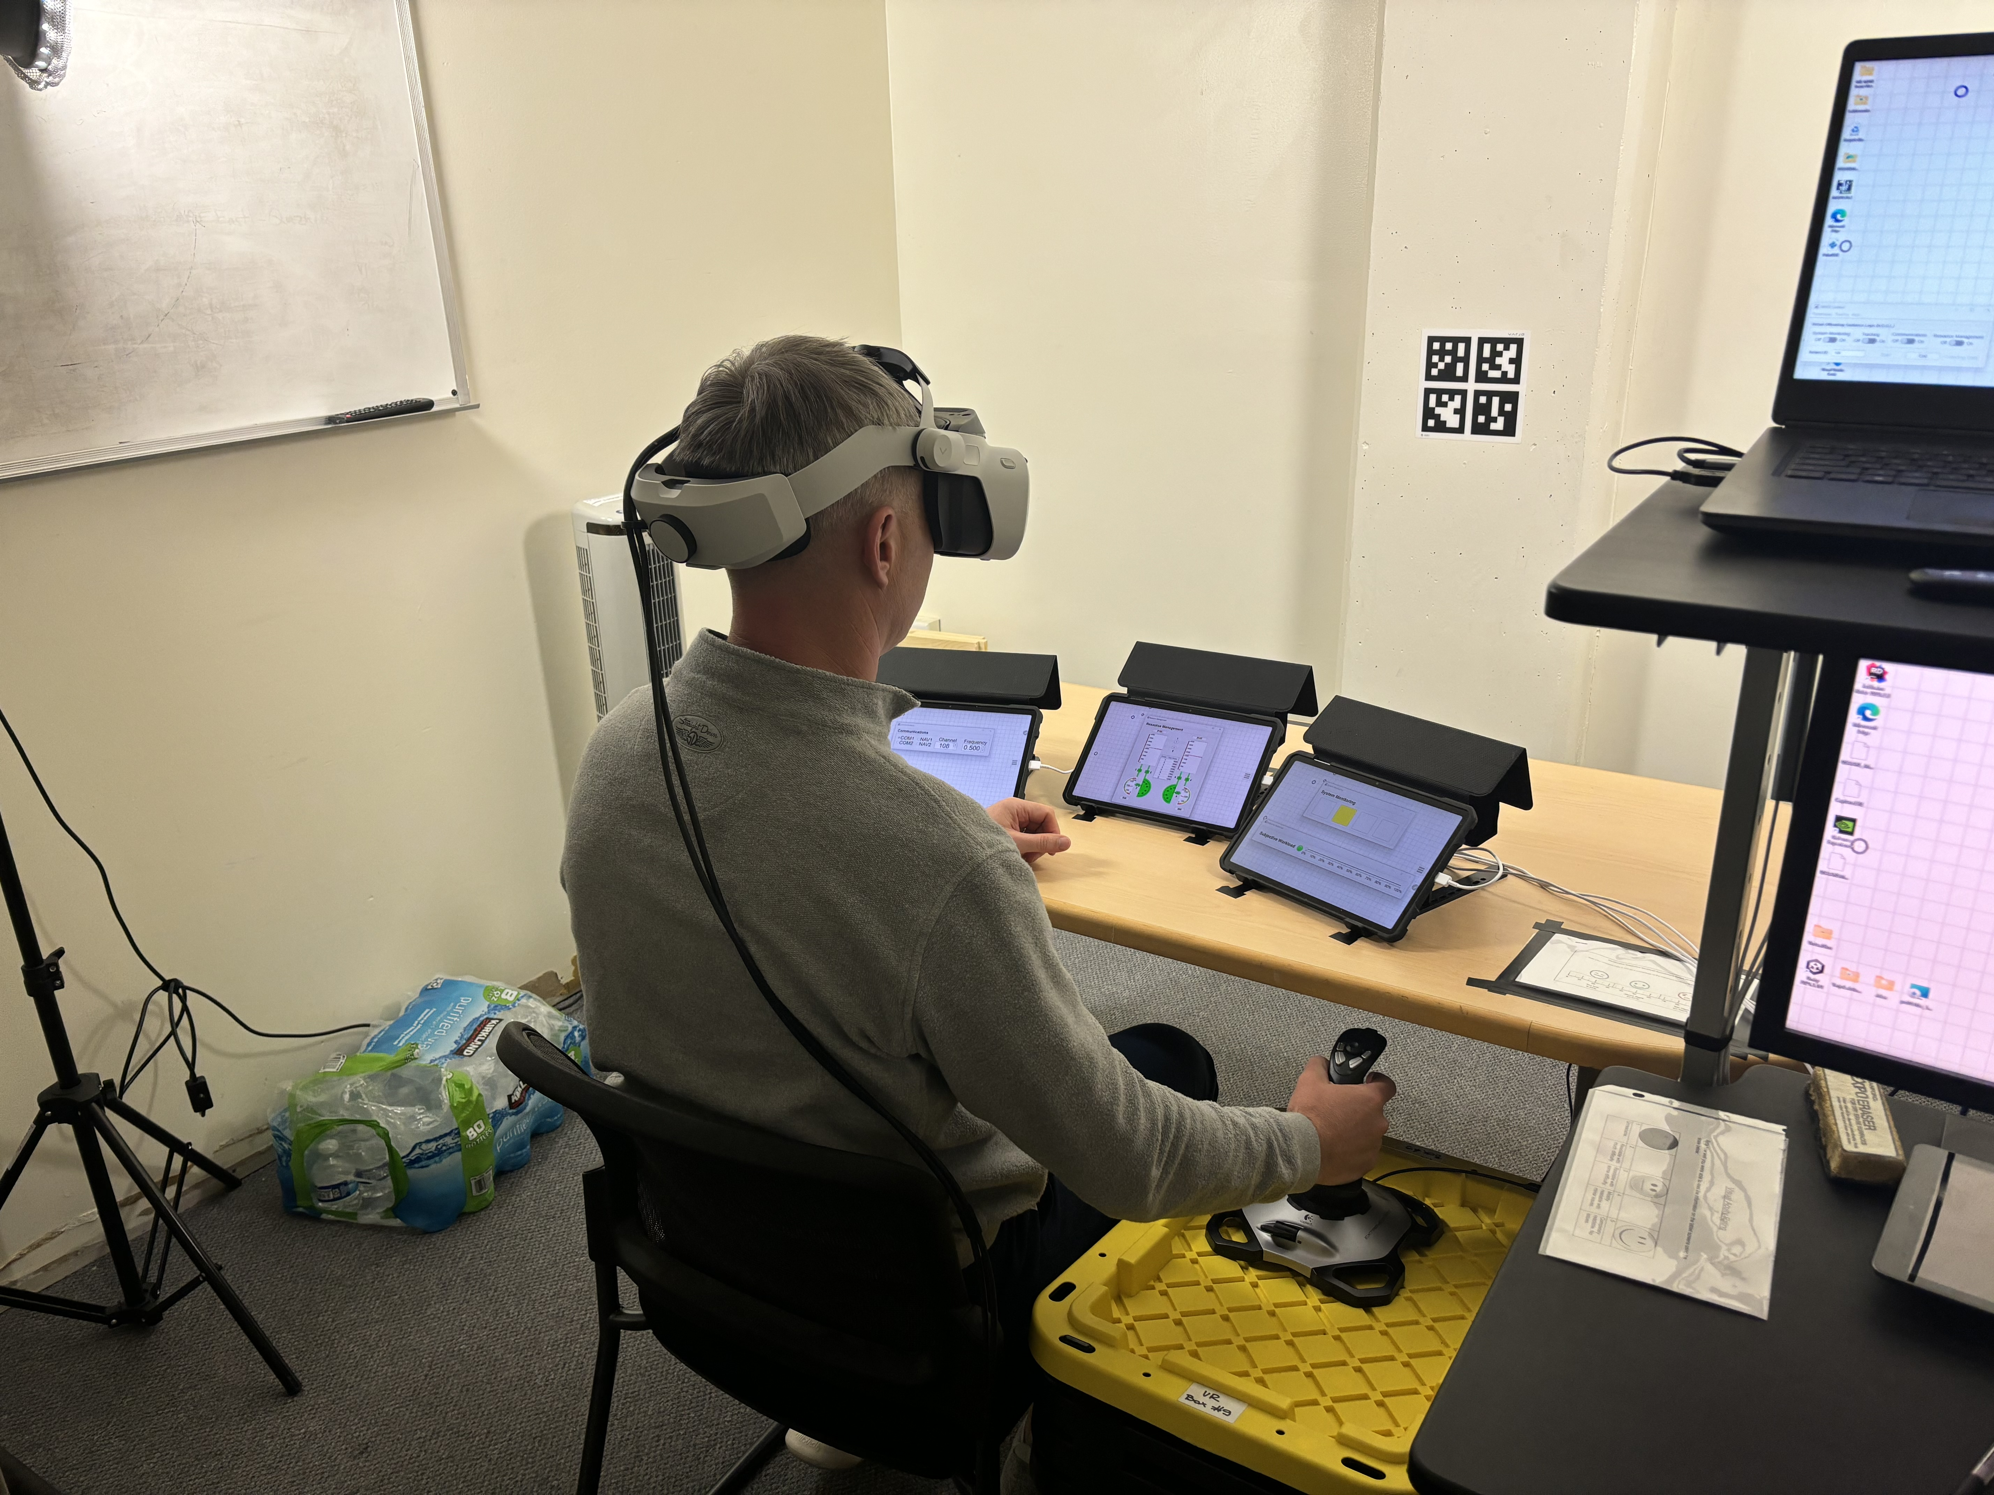
Test Bench Setup

Slide 14
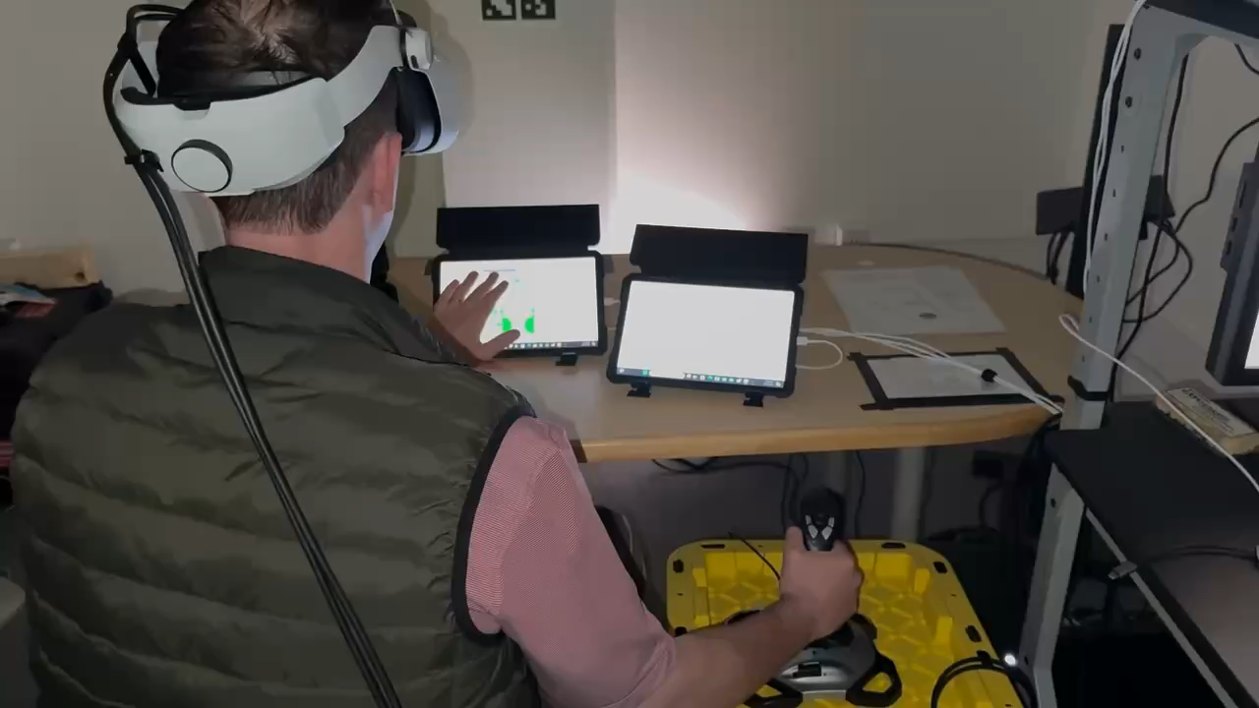
Video of Execution

Slide 15
Demographics
29 participants were required to detect moderate effects by multivariate analysis of variance (MANOVA).
30 participants completed the study (mean age = 34.5, SD = 6.47).
All students or faculty at Naval Postgraduate School
28 males (93.33%), 2 females (6.67%)
28 military (mean years service = 11.32, SD = 5.8)
Included 2 pilots (6.67%)
23 with prior VR/MR experience (76.67%)
12 with prior NASA MATB experience (40.0%)

Slide 16
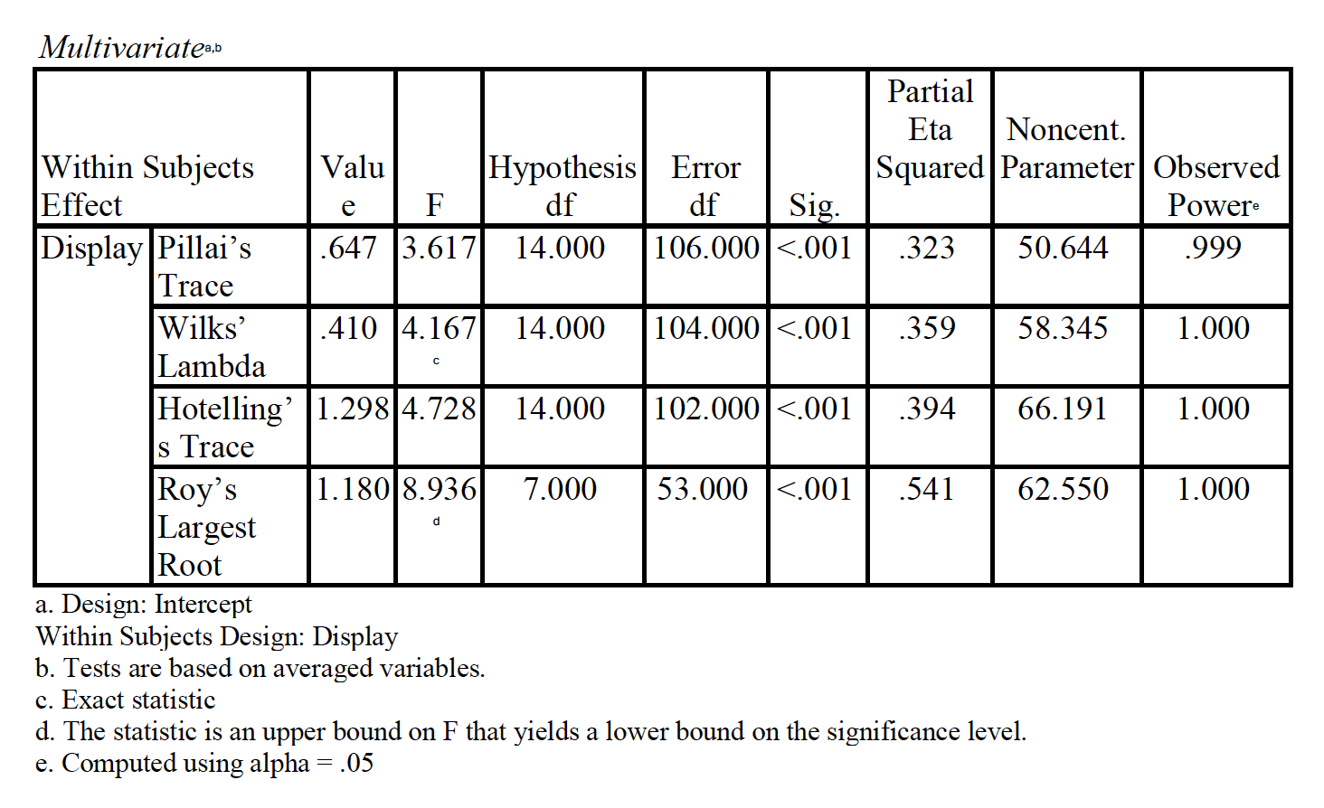
Results

Slide 17
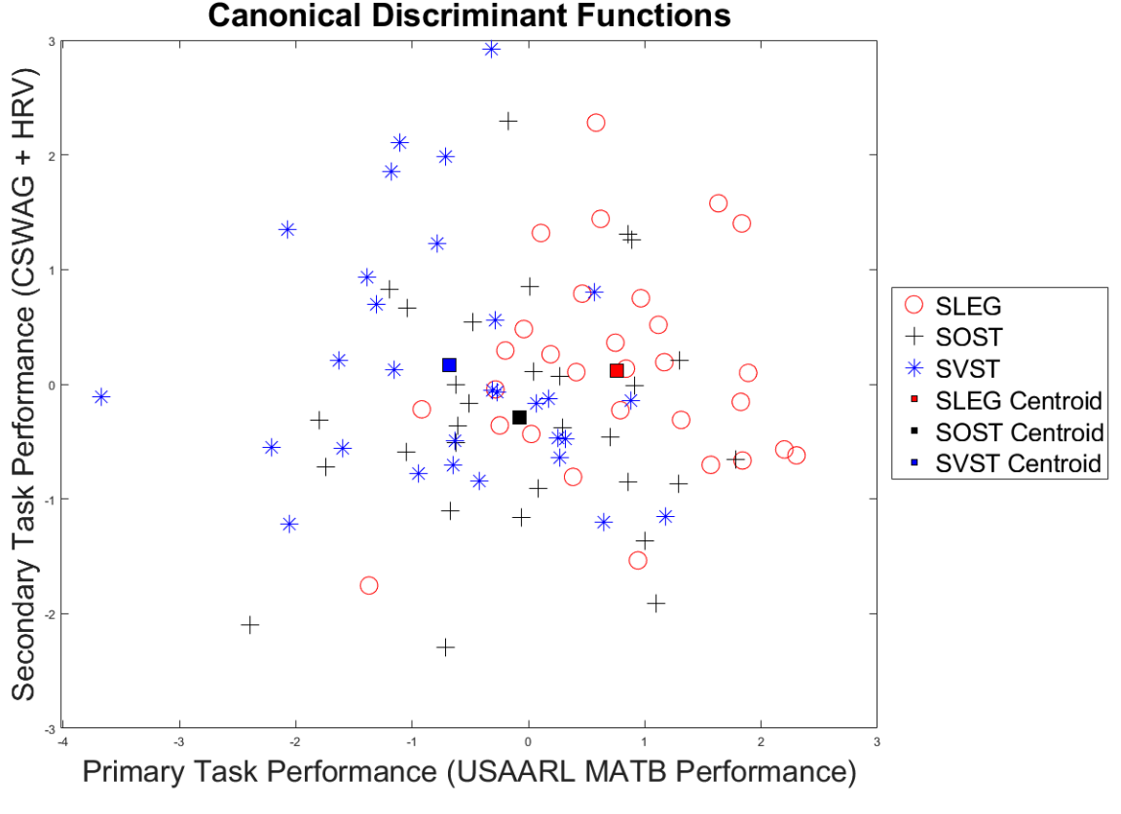
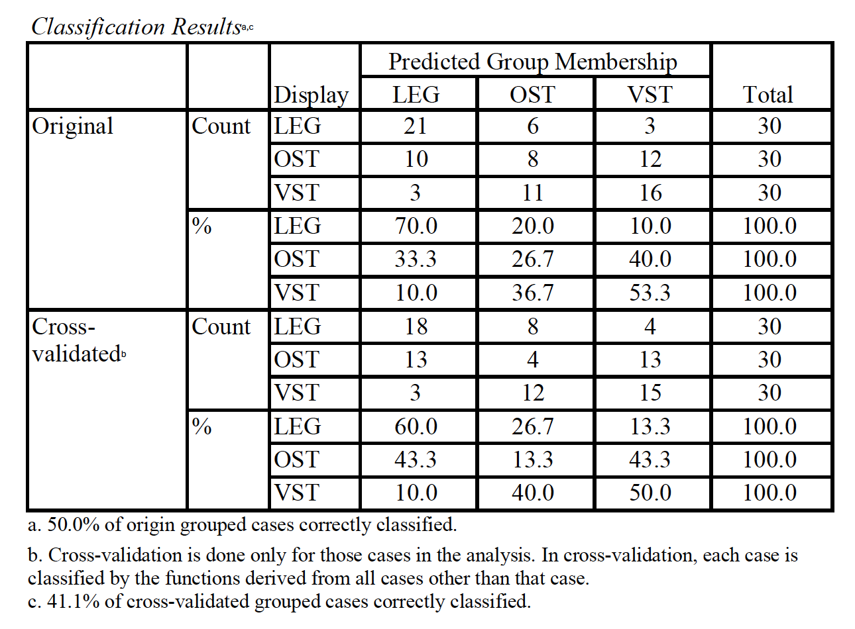
Results
Notes:
Function 1 explained 90% of the variance while function 2 explained the remaining 10% of variance.

Slide 18
ANOVAS with Significant Differences
45.0
65.0
40.0
60.0
35.0
55.0
50.0
30.0
45.0
25.0
Tracking p < .001
System Monitoring p < .001

Slide 19
ANOVAS with Significant Differences Continued
65.0
3.50
60.0
3.40
3.30
55.0
3.20
50.0
3.10
45.0
CSWAG ratings p < .001
CSWAG reaction time p = .002

Slide 20
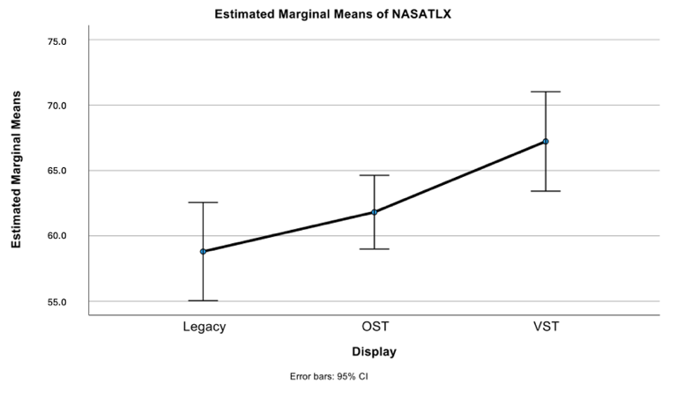
NASA TLX
T-tests between:
Legacy and OST HMD:
t(29) = -2.588, p = 0.015
Legacy and VST HMD:
t(29) = -4.25, p < 0.001
OST and VST HMD:
t(29) = -3.317, p = 0.002
NASA-TLX ANOVA p = .001

Slide 21
Implications for Naval Aviation
MR HMDs linked to higher cognitive workload
Poorer performance
Increased subjective workload ratings
Distinguish between legacy and MR simulators
Inform Aircrew
SSQ / Naval Aviation’s General Flight and Operating Instruction Manual (CNAF M-3710.7)
Study not specific to any aircraft and does not suggest MR HMDs are unsuitable for fulfilling flight training requirements.

Slide 22
Limitations
Touchscreen versus 3D instrument panel.
Studied impacts driven by interaction with cockpit but did not engage depth perception needed for 3D flight operations.
Limited study duration: 10 minutes per trial
Limited pilot participation: 2 of 30
Varjo XR-4 Fixed Focus vs. Focal Edition
Heart Rate Variability

Slide 23
Areas for Future Work
How does this translate?
Aircraft
Flight Maneuvers
Sortie duration / type
Investigate alternative physiological measures
Electroencephalogram (EEG), Electrodermal Activity (EDA), Eye-tracking
Rule out visual acuity as a confounding factor
Further investigate OST HMDs.

Slide 24
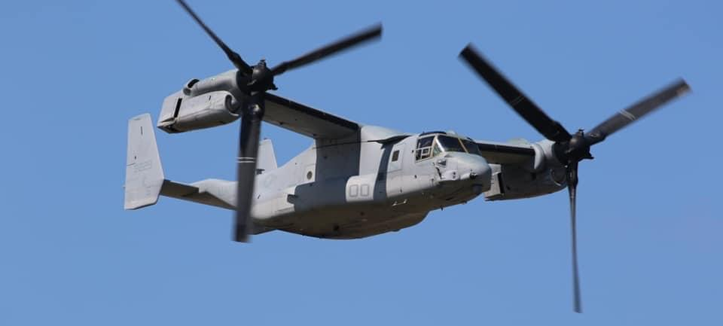
Questions
Notes:
Pending any questions, this concludes our presentation.

Slide 25
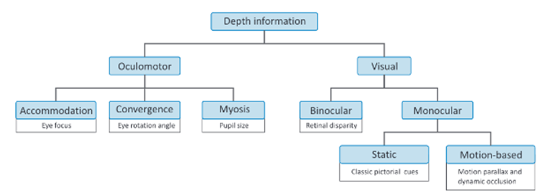
Human Depth Perception
Classification of cues contributing to human depth perception. Source: Reichelt et al. (2010)

Slide 26
OST and VST HMDs
Notes:
Add photos of HMDs used.

Slide 27
ANOVAS – No Significant Differences
30.0
60.0
25.0
55.0
50.0
20.0
45.0
15.0
40.0
10.0
35.0
Communications p = .070
Resource Management p = .016

Slide 28
ANOVAS – No Significant Differences Continued
120.0
100.0
80.0
60.0
40.0
Heart Rate RMSSD p = .831

Slide 29
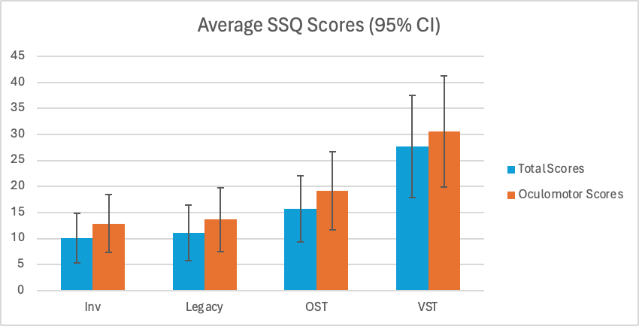
SSQ Scores
T-tests between mean total scores:
Inventory and Legacy:
t(29) = -0.713, p = 0.482
Legacy and OST HMD:
t(29) = -2.88, p = 0.007
Legacy and VST HMD:
t(29) = -4.713, p < 0.001
OST and VST HMD:
t(29) = -3.612, p = 0.001

Slide 30
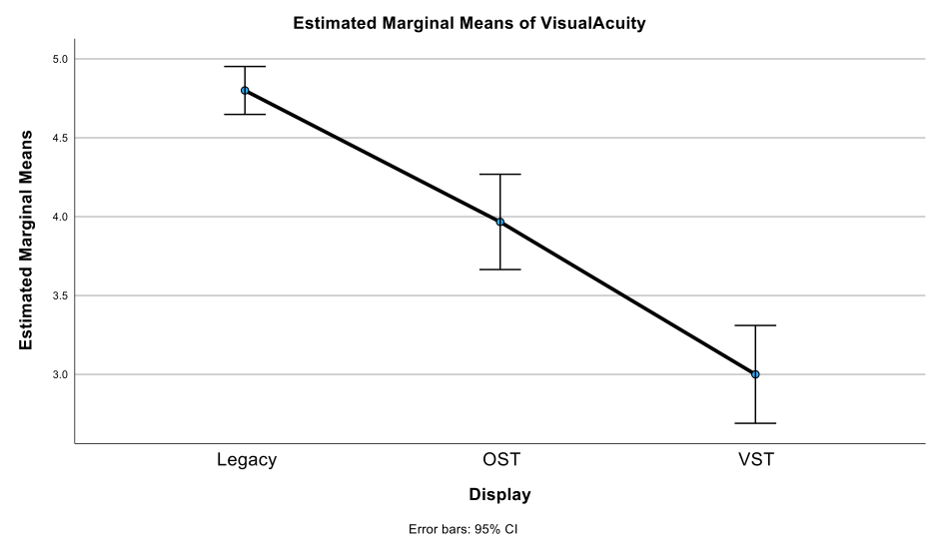
Visual Acuity
T-tests between:
Legacy and OST HMD:
t(29) = 5.767, p < 0.001
Legacy and VST HMD:
t(29) = 11.641, p < 0.001
OST and VST HMD:
t(29) = 4.690, p = 0.002

Slide 31
References
Flight Global. (2000). USMC tests MV-22. https://www.flightglobal.com/usmc-tests-mv-22/30147.article
Hoffman, D. M., Girshick, A. R., Akeley, K., & Banks, M. S. (2008). Vergence–accommodation conflicts hinder visual performance and cause visual fatigue. Journal of Vision, 8(3), 33. https://doi.org/10.1167/8.3.33
Hua, H. (2017). Enabling focus cues in head-mounted displays. Proceedings of the IEEE, 105(5), 805–824. https://doi.org/10.1109/JPROC.2017.2648796
Itoh, Y., Langlotz, T., Sutton, J., & Plopski, A. (2022). Towards indistinguishable augmented reality: A survey on optical see-through head-mounted displays. ACM Computing Surveys, 54(6), 1–36. https://doi.org/10.1145/3453157
McCurry, C. D., Thanoon, M. I., & Zein-Sabatto, M. S. (2022). Tennessee State University Multi-Attribute Task Battery (TSU-MATB). Department of Electrical and Computer Engineering, Tennessee State University.
NAVAIR. (2023). New H-1 Mission Rehearsal Trainer improves capability, readiness. https://www.navair.navy.mil/news/New-H-1-Mission-Rehearsal-Trainer-improves-capability-readiness/Tue-05022023-1007
NTSA. (2021). https://www.ntsa.org/-/media/sites/ntsa/events/2021/11t0/presentations/wed-16-june/16-june_1355_hicks_aviation-programs.pdf
Reichelt, S., Häussler, R., Fütterer, G., & Leister, N. (2010). Depth cues in human visual perception and their realization in 3D displays. Proceedings, Three-Dimensional Imaging, Visualization, and Display Technologies and Applications for Defense, Security, and Avionics IV, 7690. https://doi.org/10.1117/12.850094
Perry, R. (2023, Winter). Bringing the virtual world into reality: Manned flight simulators integrate VR/MR technology for CMV-22 platform. Naval Aviation News, 105(1), 22–29.
Vogl, J., McCurry, C., Bommer, S. (2023). USAARL MATB User Manual [Unpublished manuscript].
Wickens, C. D. (2008). Multiple resources and mental workload. Human Factors: The Journal of the Human Factors and Ergonomics Society, 50(3), 449–455. https://doi.org/10.1518/001872008X288394
Wickens, C. D., Hollands, J. G., Banbury, S., & Parasuraman, R. (2013). Engineering psychology and human performance. Routledge.

