Slide 1

Modular Analytics Framework (MAF) for Rapid AI/ML Training and Deployment
Ronald Deiotte, ISSAC LLC
Lauren Britton, ISSAC LLC
Notes:
Script:
Hello and welcome I’m Ronald Deiotte from ISSAC and along with my colleague Lauren Britton we wrote Modular Analytics Framework (MAF) for Rapid AI/ML Training and Deployment.

Slide 2
Agenda
A MAF by any other name
  What is a MAF?
  What MAFs exist?
MAFs in practice
  MAF Goals
  MAF Opportunities
A Standard “Language” for MAFs
The Experimental MAF
Conclusions
Notes:
Script:
We are going to start with defining what a MAF is and talk a bit about MAFs that exist and how they are currently used.
Then we will get into MAFs in practice to discuss some of the general capabilities of MAF and some of the specific issues with MAFs for Machine Learning and Artificial Inelegance.
This will build the case for a standard language for MAFs and the experimental use case we created and the conclusions of this effort.

Slide 3
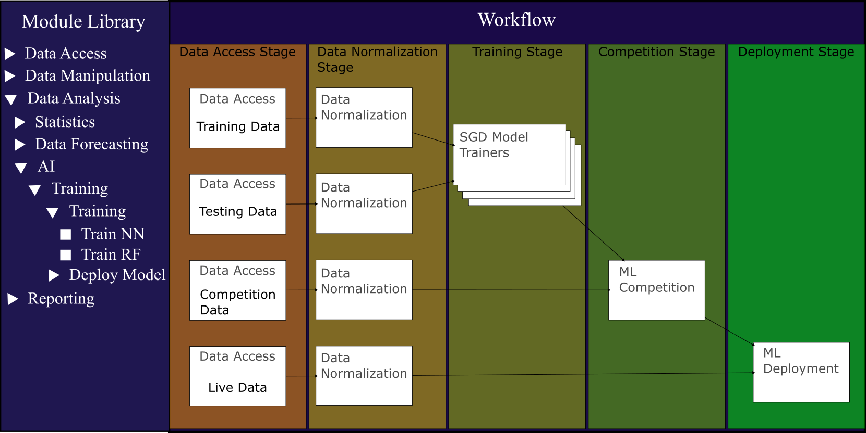
A MAF by any other name
Other Names:
Analysis Workflow
Data Pipeline
Low Code Programing
…
A Modular Analytic Framework (MAF) is a set of tools, services, and data infrastructure that allows users to rapidly develop, test, and deploy a data science workflow in a digital environment.
Notes:
Script:
A Modular Analytics Framework is a set of tools, services, and data infrastructure that allows users to rapidly develop, test, and deploy a data science workflow in a digital environment. This definition is broad and can include many thing from Data Pipelines to codeless or visual programing languages. Here we are specifically focused on the data science application of such tools
A MAF often includes, but does not require, a library of modules that can be controlled and customized using parameters and an environment for putting those modules together and connecting their inputs and outputs into a data workflow. Essentially a wiring diagram for data analysis.

Slide 4

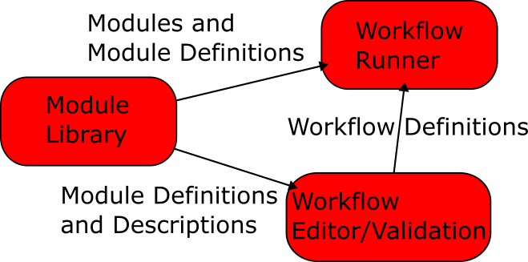


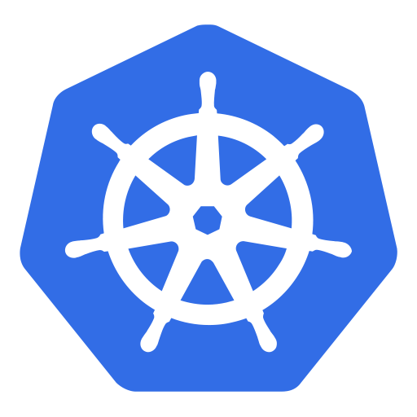
Existing Implementation
Apache Flink
Hub
+
kubernetes
Notes:
Script:
There are several products on the market that could fit our definition of a MAF; Alteryx, KNIME, Apache Flink. Even things like Docker Hub combined with docker compose or Kubernetes could be considered a MAF.
However, for a full MAF we feel that there are at least three role that need to be filled in some way.
The first is the Module Library this is a store house for all the modules that can be run in the MAF. Ideally this would contain both the Module implementations, all the metadata needed to define the module as a black box and human readable documentation so that users understand what the module will do for them.
The next is a Workflow Editor. This is where the user will identify and configure the modules, and indicate how data will flow through the modules. The Editor should also contain the logic to check if the data the is going into a module is compatible with the data input definitions for that module, validating that the workflow should in theory preform its task.
And Finally, the Workflow Runner is where the modules of a workflow are actually launched and injected with data. The Workflow Runner needs to be able to deploy modules and manage and move data between modules.
Things like Knime and Alteryx take all there parts of a the Modular Analytics Farmwork and deploy them as a single piece of software with the ability to extend to a cloud environment.
Some existing MAF like tools combine all three of this into a single software package while others provide only part of the system and expect others to fill in the gaps.

Slide 5
MAF Goals
Algorithm Optimization
Simplify Code Maintenance
Data Swapping
Analysis Swapping
Automated Analysis
Parallel Analysis
Reduce Development Cycle
Reduce Cognitive Load
AI Optimization
Model/Analysis Competition
Notes:
Script:
There are a lot of goals that a well implemented MAF may be able to satisfy. A few of these are things like:
Algorithm Optimization – most data scientist and analysist are not software engineers. They may be able to write code that will do a bit of analysis, but that code may be inefficient and slow. However, optimization is not a cheap and it is better to optimize and algorithm once and use it many times. Putting such algorithms into a module facilitates such code reuse.
Simplified Code Maintenance – The Modules in a MAF are intended to accomplish one thing and one thing only. In other words, an analysis module only needs to analyze data injected by the MAF it does not need to access several different types of databases or report its results is a well formatted presentation. So, module testing is much simpler than full code testing and the code base is smaller and easier to maintain than a typical monolithic code bases.
Modules are treated as block boxes by the MAF so as long as the inputs and outputs match data and analysis modules can be swapped out easily.
Reduce Cognitive Load – again most data scientist and analysists are not security experts, cloud experts or full stack developers. So, if some analysis pipeline needs to be run in the cloud or access data via encrypted channels or be presented in a nice way the MAF and the modules should handle those things allowing the analysis and data scientist to focus on what analysis can be done to the data and what the results of that analysis means.
I could keep going but there are a few of these that we are going to come back to in a few slides those are Parallel Analysis, Model/analysis competition, and AI Optimization.

Slide 6
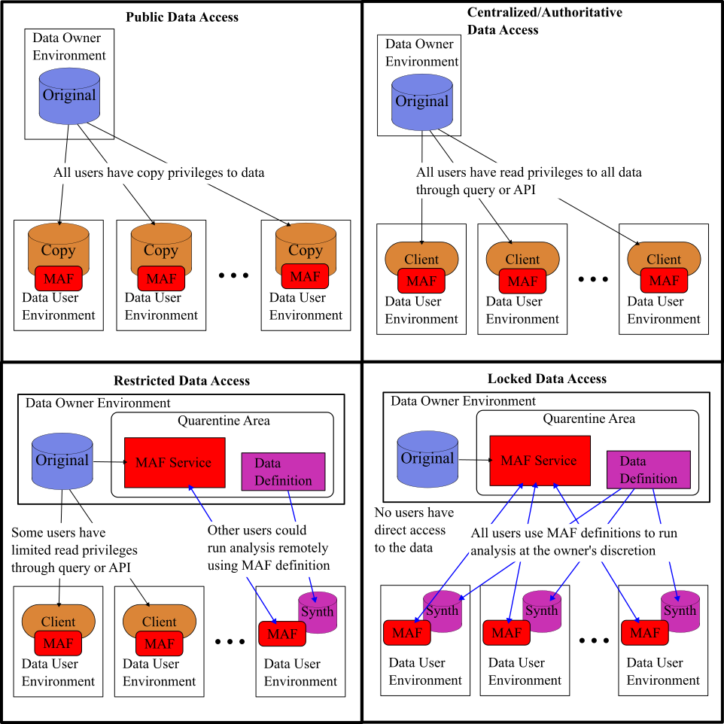
MAF + AI Opportunities
Public Data:
Freely available
Small enough to copy over a network
Centralized Data:
Need an authoritative data source
Too big to copy over a network
Restricted Data:
A need to limit who accesses the data
The parts that can be accessed via a network are not sufficient for the analysis to be done
Locked Data:
Only the data owner is allowed to directly interact with the data
Each meaningful piece of data is too big for network transfer
This is where MAF + IA can be a game changer
Notes:
Script:
One of the main opportunities for a MAF is to over come some challenges with data access. To talk about this, we have started to group different types of data access.
Public Data – is data that does not have restriction on who uses it and it is small enough to download
Centralized data – is data for which it is important for the data owner to maintain authoritative control. So, you would not want somebody downloading your database and then standing up their own instance and saying it is real thing. Or data that need constant up dating, so it is better to have a single source rather than many that need to be synced. It also might be a data set that is large, but analysis only need little parts at a time. This type of data is usually accessed via an API calls or read only queries to a database.
Restricted data – is data where the data owner wants to limit who can see the data set. There are too many reason to list for why this may be the case. The data may also be too big and an analysis may not be able to pull a big enough part of the data set though an API or query to do the analysis they want to do.
Finaly Locked Data – is data that is not allowed beyond the confines of data owners system either because there are regulator limits on this data or the data and all it’s component parts are simply to big to transfer over a network.
The Locked Data area is where MAF + AI could make a huge difference. These data sets are often huge and complicated just the type of thing that AI is intended to be used for. The data owners of this data also may not want any of their data to leak. So if we set up a workflow to train an AI model then the only thing we want out of the analysis is the AI model and we never need to see any of the data or potentially leak any of it. There is potential here to set things up in a way that a data analysis can develop a workflow that will train an AI model based on some batched data. Then take that AI model and have it start listening and analizing a data feed all without the analyst having access to the deployment system other than to submit the workflow.
A MAF could be used on any of these data types but there are particular opportunities in the Restricted, and Locked Data, these are also the two areas where AI is most likely to make an impact because these are often imagery or other large element data sets.
The way a MAF could impact these areas is if the data owner installs a MAF service on their data system. Then users could run analysis on the full data sets without having to move them and without necessarily ever seeing any of the data only the results. Further the results of any analysis run on the data owner’s system could be quarantined an only released when approved by the data owner.

Slide 7
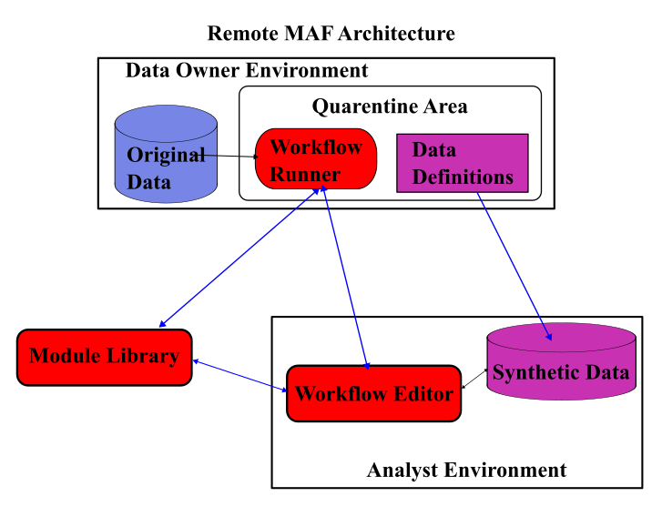
Remote MAF for AI Use-Case
With big, hard to access, data it is better to take the analysis to the data.
Notes:
Script:
Lets say we are tying to make a classifier model for, some medical condition, it could be traumatic brain injury, or brain cancer of some other brain related condition. And we know of a database of MRI images. That database would be in the Locked Data Access domain both because of HIPAA rules and because the data from each MRI scan would be on the order of gigabytes the data set cannot be transferred at all. So we would develop a data analysis pipeline using synthetic data locally then we would want to send a request to the Data owners MAF service.
But here is the problem. There is little chance that the system the data owner is using has the same implementation of a MAF as we have on our laptop. Our Laptop has limited capabilities where the data owner obviously had more capabilities, however those capabilities may be oriented more towards data storage rather than train an AI classifier. So the MAF on our laptop and the MAF on the data system need to have a standard way of defining a data type, a standard for what a module is, where to get that module, how to get data in and out of that module, how to run the module, and how to route data between modules.

Slide 8
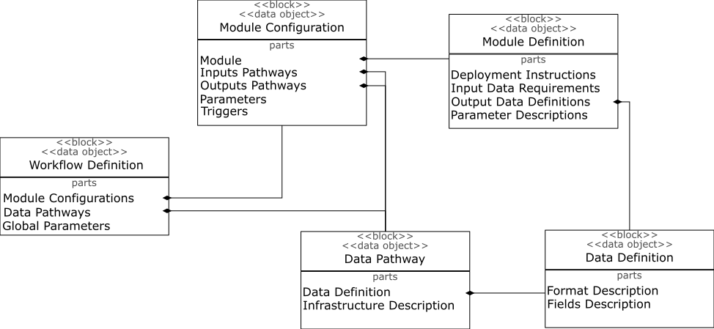
A Standard “Language” for MAFs
Notes:
Script:
With the goals of communicating between the different parts of a MAF we have started defining a standard way to describe all the parts of a MAF and all the elements used in a MAF. For instance in defining a workflow we need to define the configuration of each module, in defining the module configuration we must define the module including the data inputs and out puts as well as any parameters and the deployment instructions.
The end goal of all of this is to establish an ecosystem of MAF parts where one group might develop, maintain, and provide a module library. Another group may provide synthetic data for developing and testing workflows. A data owner may implement a workflow runner that only allows approved modules but still allows users to access previously inaccessible data sets. With a common standard for how these part communicate and define their components this type of ecosystem is possible.
As we started to define a MAF standard we realized that we needed a proof of concept to both test and prove out the MAF standard.

Slide 9
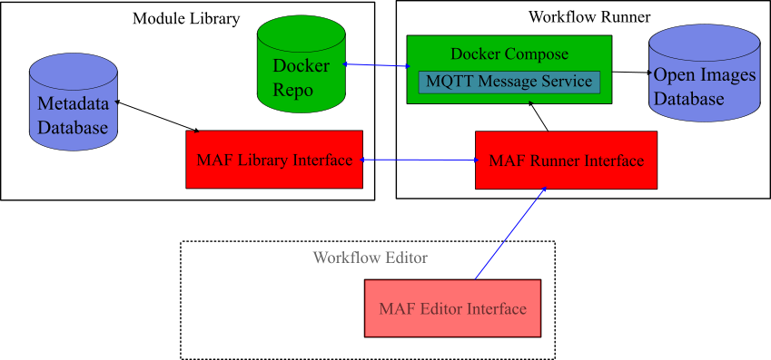
The Experimental MAF
Notes:
Script:
For this experimental MAF we developed a simple Module library and a Workflow Runner, and manually build the workflow using the parts of the standard that we wanted to test.
The Modules library consisted of an API controlling a simple database and a local docker repo. The Library was designed to except docker images, Python scripts, and bash scripts. The Python and bash scripts would be automatically wrapped into docker images to be delivered to the Workflow Runner.
The simple Workflow Runner consisted of a simple tool that would gather the needed docker images from the library, initialize an MQTT messaging service for passing data, and create and run a docker compose file for a given workflow.

Slide 10
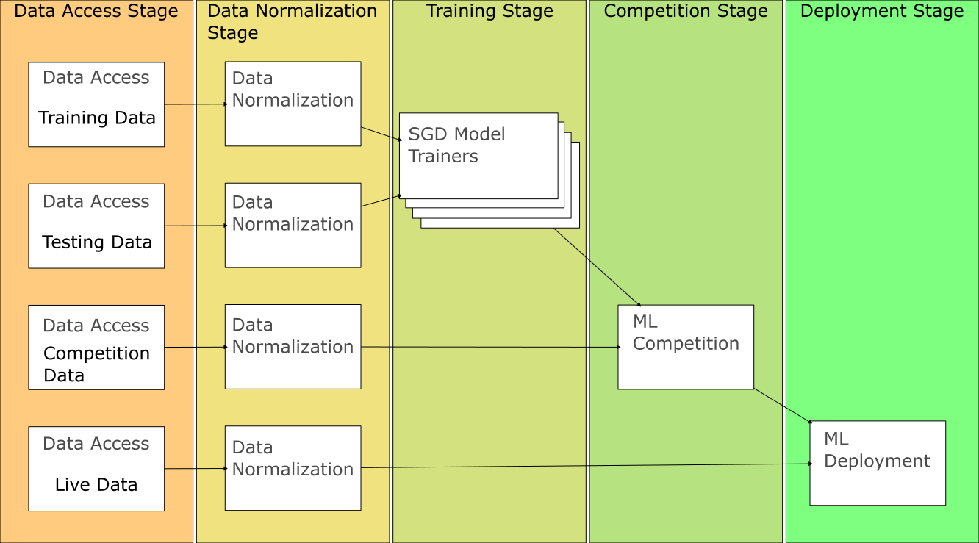
The Experimental Workflow
Notes:
Script:
In a previous effort at ISSAC we have trained an image classifier for several efforts. From those efforts we had and existing monolithic code base as well as an idea how we could improve the original code. For the original task we trained a Stochastic Gradient Descent model to be a classifier and found that our results varied depending on the initial state and the number of iterations we used. However, in moving to a MAF we could train several Stochastic Gradient Descent models in parallel with different combinations of initial states and number of iterations and decide after the training which was the best model to deploy.
For this experiment we used a set of images from Open Images using the Aircraft tag to classify the images.
For this workflow we set up four Data access modules that would access different sets images to be used for training, testing, competing, and mock streaming. These four modules were in fact the same Python script configured to pull images form different locations.
In the Data Normalization stage, we used another module four times scale the images to the same side and preform some data reduction transformations on each image. The Module used for the data normalization was also a Python script.
In the Training stage we used a docker image that would generate a Stochastic Gradient Descent model given a set of simplified images, the initial state, and the maximum number of iterations. We configured this module to use every initial state from 0-50 and maximum number of iterations from 500-5000 stepping by 500. When Run the Workflow Runner automatically deployed all 450 combinations (in batches of 10 because I was running from a laptop).
In the competition stage the 450 models created in the training stage were check to determine the best model. this was do using a single docker image module.
Finally the winning module was deployed onto a simulation of live data.
In order of accomplish this whole process we only needed to create 5 different modules and configure them in the correct way. In the end we were able to reproduce the results we had found in previous efforts using monolithic code and we were able to check out the initial capabilities of the MAF standard as we have defined it so far.

Slide 11
Conclusions
MAF already exist and are being used…
  Existing use is limited to code simplification rather than expanding data access or allowing for flexible deployment
MAF could be used to allow for analysis of data sets that are typically considered inaccessible
A standard for documenting and communicating data, module, and workflow definitions is needed to empower these other capabilities
AI and ML can be more easily and more rapidly deployed using MAFs
AI and ML may be able to be safely and securely applied to new data sets using a remote MAF
Notes:
Script:
This effort resulted in several conclusions:
The first is that MAF already exist and are being used but there are use cases and interoperability that is not currently being covered or used by existing MAF implementations.
MAF provide a technical solution for accessing data sets that are currently considered completely inaccessible by all but a few data scientist.
In order to take advantage of these use cases and the potential of interoperability a standard is needed for data, module, and workflow definitions.
Due to there flexibility and expandability a Modular Analytics Framework may be more ideal than monolithic code for the rapid deployment of Machine Learning and Artificial Intelligence.
The implementation of remote MAFs may be a safe and secure way to use ML and AI

Slide 12
Thank You
Questions and Discussion

