Slide 1

Digital Caricature: Stochastic M&S of Complex System of Systems
Ronald Deiotte, ISSAC LLC
Jarrid Carroll-Frey, ISSAC LLC
Notes:
Script
Hello and welcome I’m Ronald Deiotte from ISSAC and along with my colleague Jarrid Carroll-Frey we wrote Digital Caricature: Stochastic M&S of Complex Systems of Systems.

Slide 2
Agenda
Event Based Stochastic M&S; a brief introduction
Role of Event Base Stochastic M&S
Experimental Scenario
Physics Based Approach
Building an Event Stack
Populating Probability Distribution Function
Experimental Results
Further Research
Notes:
Script:
We are going to start of with a brief introduction to Event Based Stochastic M&S and the niche these tools fill in the large Modeling and Simulation ecosystem. Then we will get into the testbed we built to experiment with event based stochastic modeling and simulation, the results we were able to find and further efforts that we are persueing.

Slide 3
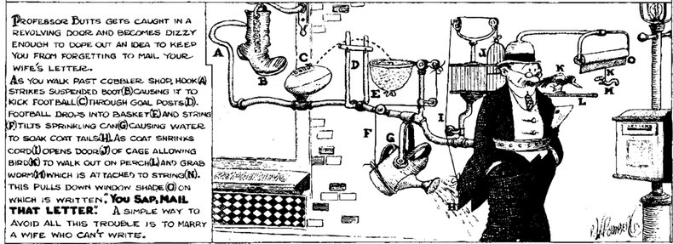
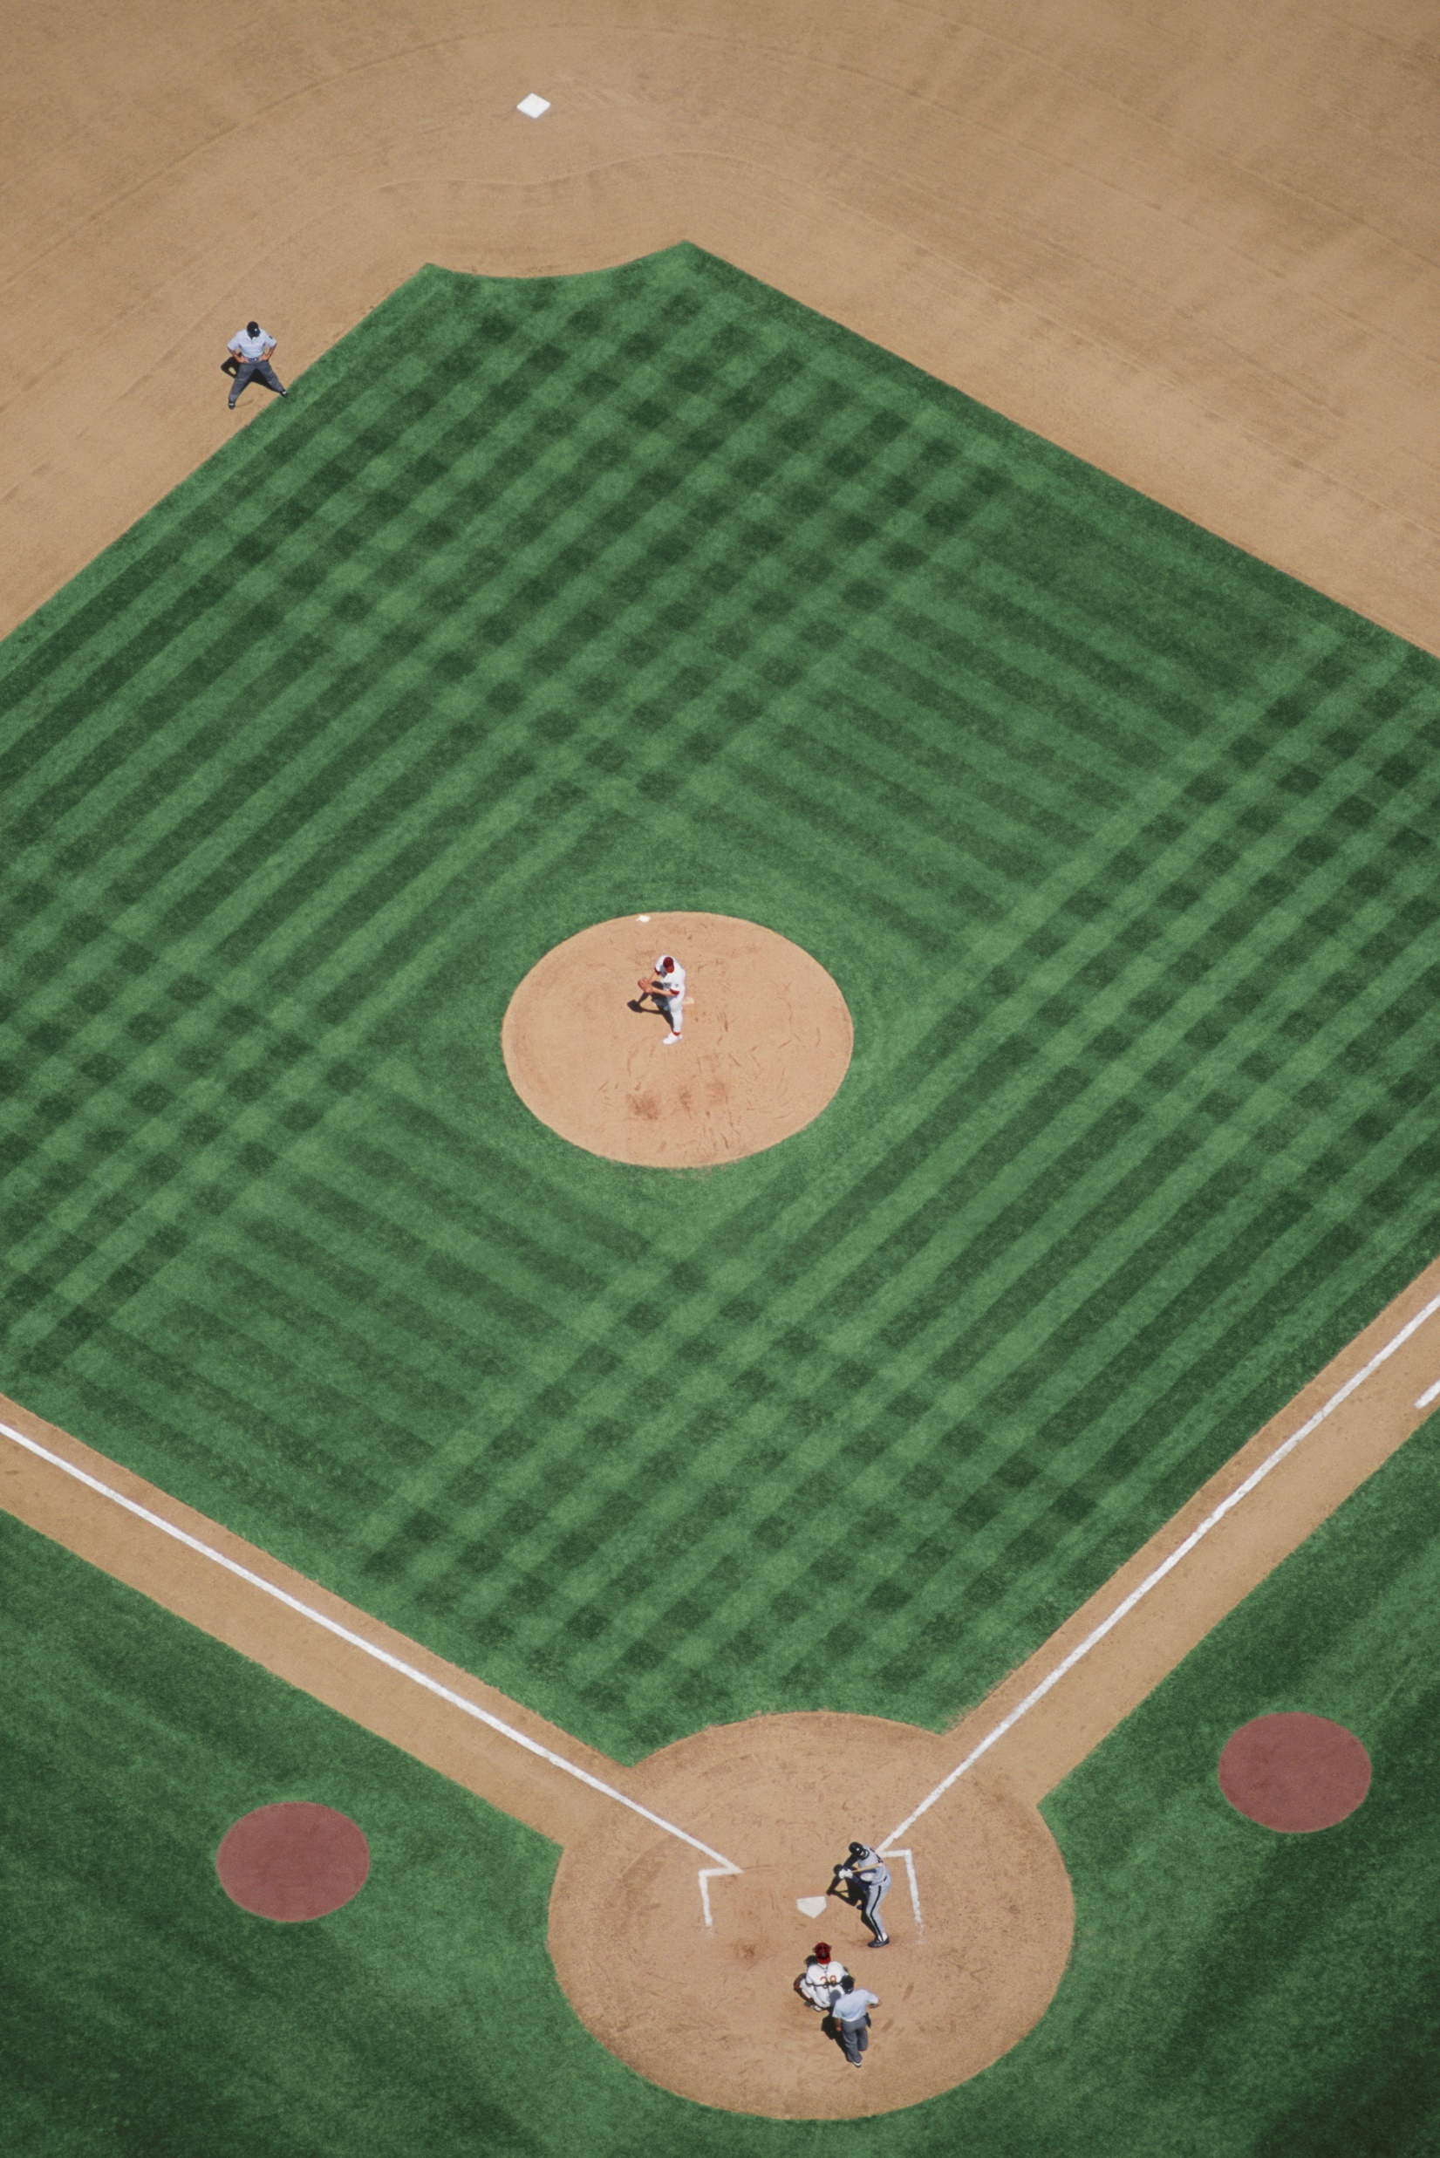
Event Based Stochastic M&S:
Simple Examples
Requires Event-Based Stochastic thinking
A complex system simplified by Event-Based modeling
Notes:
Script (~2:30)
We are going to go over a few simple examples just so we are on the same page;
The first is a Robe Goldberg device. These are always fun and interesting to watch but if you have ever built one then you quickly learn that it is best to put the most sensitive, likely to fail, mechanisms at the start and the most reliable, foolproof, mechanisms at the end. There is nothing worse than watching the whole thing work perfectly only to have the last mechanism fail and you must reset the whole thing. That way of thinking is event based stochastic modeling. You are not thinking about the mechanics of each element but about how successful each component is likely to be.
The second example is a two-system interaction. The first system propels a simple spheroid with a velocity and spin, and the second system attempts to intercept that spheroid with a carbon-based cylinder. In other words, a pitcher and a batter in baseball. From the physics point of view, we could model biomechanics of the pitcher and the aerodynamics of the ball as it travels through the air and the biomechanics of the batter (not to mention neural processes needed to react to the pitch) and the mechanics of the collision of the ball and the bat and in the end, we would know if the batter hit a home run, or a pop fly, or completely missed the ball.
Or we can say that there are two events, there is the pitcher releasing the ball, and the batter hitting the ball. There is a probability distribution for how well the batter hits the ball. If we take a random draw that conforms to that distribution function and the result is above a threshold then he hit a home run, if the draw is between some other values they hit a pop fly, etc. Now the shape of that probability distribution function is determined by the location, speed, and spin of the ball as it passes over the plate. Those values are determined by the first event, the pitcher releasing the ball, so each of those input has a probability distribution function at the pitcher release event. The pitcher release distributions are fixed as they only based on the pitcher. So, we can make our random draws from the pitcher release event and pass them to the hitter events to get a probability distribution function unique to that pitch. Then we can draw to see how successful the hit was.

Slide 4
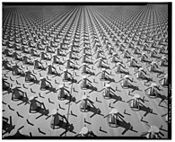
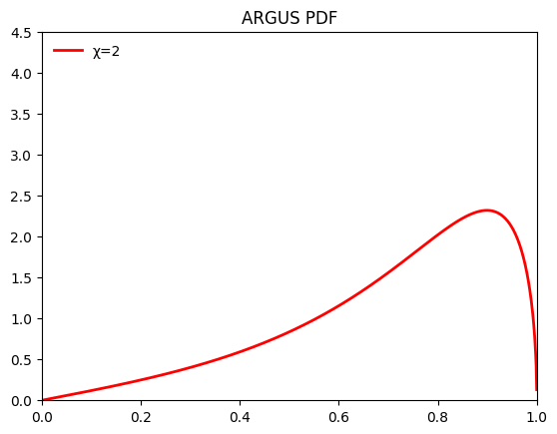


Event Based Stochastic M&S
Physics-Based and Hardware-in-the-Loop
Event Based Stochastic
$$∇∙E= \frac{ρ}{ε_{0}}$$
$$∇∙B=0$$
$$∇×E=−\frac{∂B}{∂t}$$
$$∇×B=μ_{0}\left(J+ε_{0}\frac{∂E}{∂t}\right)$$
Calculate χ to generate a probability distribution function
$$r=\sqrt{{\left(x_{s}−x\right)}^{2}+{\left(y_{s}−y\right)}^{2}}$$
$$\tan{θ}=\frac{\left(y_{s}−y\right)}{\left(x_{s}−x\right)}$$
$φ_{max}=\max_{i}\left(\tan^{−1}{\frac{\left(y_{s}−\left(y+y_{i}\right)\right)}{\left(x_{s}−\left(x+x_{i}\right)\right)}}\right)$ $φ_{min}=\min_{i}\left(\tan^{−1}{\frac{\left(y_{s}−\left(y+y_{i}\right)\right)}{\left(x_{s}−\left(x+x_{i}\right)\right)}}\right)$
$$φ=φ_{max}−φ_{min}$$
Track Creation
Track Merging
Track Forecasting
Intercept Planning
Message creations and handling
Preform a random draw from the probability distribution function
Notes:
Script (1:00)
So, a side-by-side comparison of physics modeling vs stochastic modeling
On the physics-based or a hardware-in-the-loop simulations we are dealing with a lot of higher-level math, physics, and complex algorithms, and if we are looking at a system of systems then full message sets and connectivity modeling. This all results in a large amount of data and highly complex software that often requires specialize hardware to run.
On the other hand, with Event-Based Stochastic simulation we just use Probability distribution functions to model all the events.
On the Physics side we get a digital twin which ideally will show us exactly how the real-world system will work. On the Stochastic side we get a digital caricature it may not look exactly like the real-world system, but it is recognizable, and while some things might be exaggerated or over/under emphasized it still show how the real-world system would work.

Slide 5
Role of Event Based Stochastic M&S
What it is NOT
Detailed simulation
Truth model
Verification or Validation tool
A stand-alone proof of anything
What it IS
Design tool
Sanity check on configuration changes
Aid to Physics Based or Hardware-in-the-Loop simulations
Simulation of interstitials
Failure analysis tool
Training tool
Notes:
Script: (~2:30)
I want to be clear up front about what Event Based Stochastic M&S is and is not. It is not a replacement for Detailed Physics simulations, stochastic simulation by its very nature cannot do what a physics-based simulation can do. It is not a truth model; it is randomly generated numbers we can run it enough times that is statistically significant but results from stochastics simulations should always be taken with a grain of salt. It can help with requitements Verification and Validation, but requirements should always be V&V’ed against physics models and simulations. In short Event Based Stochastic M&S should not be a stand-alone proof of anything.
However, Event Based Stochastic M&S is a very good design tool. As we have mentioned and will discuss more, the implementation of stochastics models is much simpler that implementing a physics models this mean that we can introduce Simulation much earlier in the design process allowing for better decision earlier in that process. Similarly stochastic M&S make a good sanity check for configuration changes.
In most situations the input space for a simulation would take millennia to cover to high fidelity using physics-based M&S. Stochastic M&S has much shorter run times and can be used to direct physics simulation to the areas that may present the most risk to performance.
Because it is Event Based we are better able to identify the Events that must be successful in order successfully achieve goals. Events are often representative what is happening between systems allowing for the exploration of the interstitials. This also allow for better failure analysis by directing analysists to the most sensitive parts of the system for any given failure.
Finally, the compute power needed for stochastic M&S is substantially less that that of Physics based simulations allowing full simulations to be run on a laptop rather than connecting to a server or networking several pieces of hardware together. This mean that training can be preformed more often and is more flexible.

Slide 6
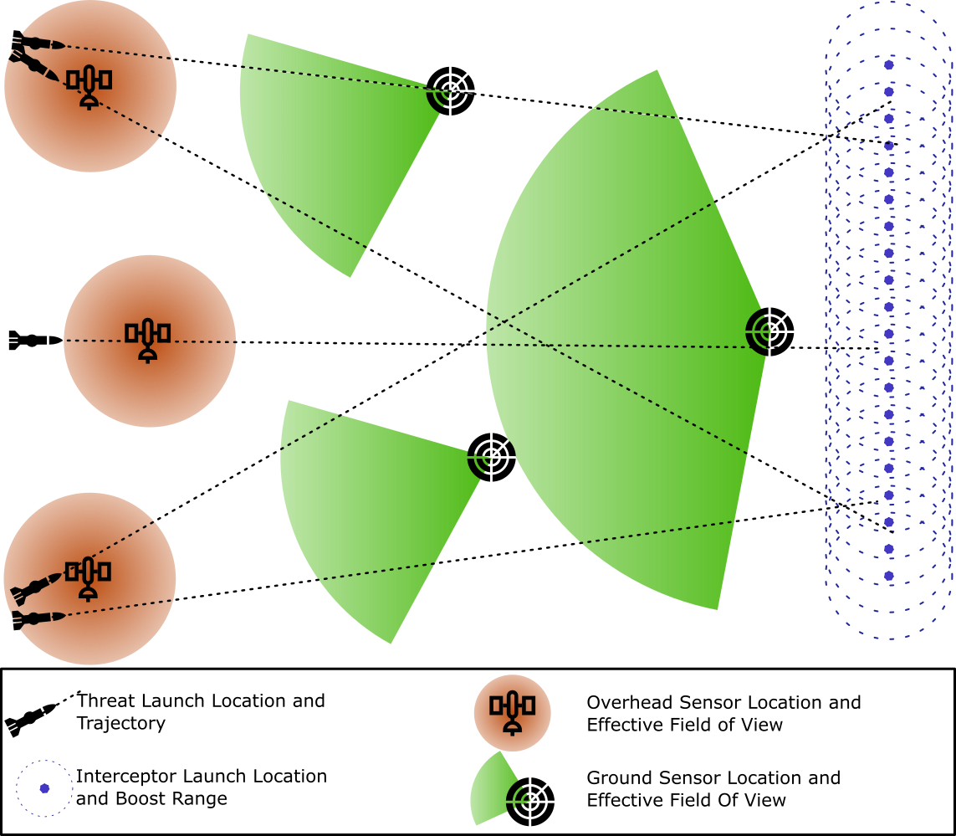
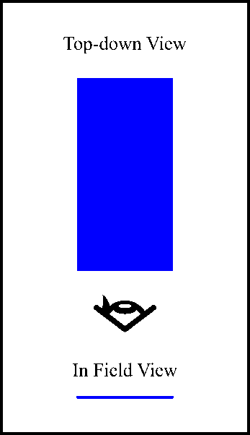
Experimental Scenario
Spinning Threats
Notes:
Script
One of the goals of this effort was to build a testbed where we can more easily work with some of the concepts and theories behind Event Based Stochastics. So, our test bed is a simple two-dimensional playing field on which we place sensors of two different types, and interceptors. We can then inject threats into this playing field to see what happens using both a physics simulation and an event-based stochastics simulation.
The threats are represented by generated files that contain the XY location, shape, and a boost value for every clock tick of the simulation. Threats accelerate form their start location until they hit a target speed then they coast until they exit the playing field. During the acceleration phase the boost value grows until the coast phase then drops to 0. The shape changes through out the threats paths this is reprehensive of spinning threat object
The overhead sensor has a circular field of view and uses the boost value to detect the threat and so can only detect threats while they are accelerating. The ground sensors have fan field of view and use the shape to calculate an angular size relative to the sensor. So, a spinning threat object will cause the angular size to change throughout the course of the detection. Interceptors accelerate a fixed distance to a know speed and then coast to attempt to intercept the threat.

Slide 7
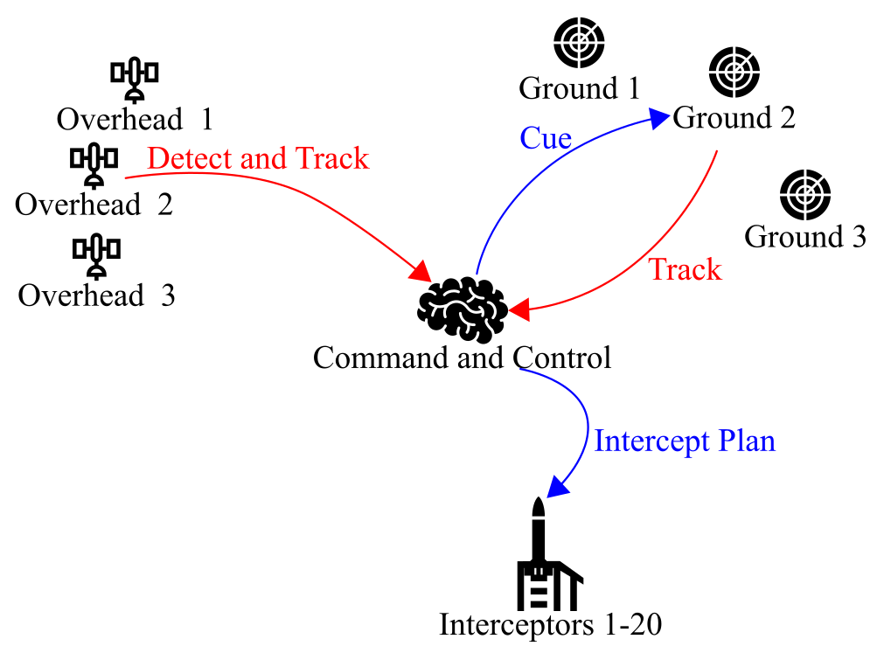
Physics Based Approach
Least Complex Tick (threat has not been tracked and is out of range of all sensors):
9 calculations
0 messages
Most Complex Tick (visible to some sensors and interceptors have been fired):
>50 calculations
>15 messages
Notes:
Script
A quick overview of the physics-based approach this was not the focus of this effort, but it is worth understanding how this works:
For the physics-based approach I’m approach we left everything unitless, so distance is measures in pixels which are some percentage of the length or height of the playing field and time is measured in ticks where one ticks is just one iteration of the simulation.
In the physics-based approach the simulations we have models for the over-head sensors, the ground sensors, the command and control, and the interceptors.
At each clock tick the simulation provided the threat information at that tick to each of the sensors with some introduced error. The sensors determine if they can “see” the threat. This is based on location and the boost value for the overhead sensors and on the location and shape information for the ground sensors. The sensor models then determine if this measurement aligns with predictions of existing tracks if it does then it add it to that track, if not it creates a new track. The sensor send all this information to the command and control. The command and control builds a prediction of the path of the threat and determines which sensors to cue and which interceptors to launch, when to launch them and where to aim them. These instructions are sent to the interceptors which then execute that plan at the appointed time. The interceptors act like moving ground sensor with a narrow field of view. If the threat is within that field of view and is within the movement range of the interceptor over the next clock tick, then the interceptor is considered to have hit the threat.
All in all, it is a standard iterative simulation.
This does mean that some ticks are more complex than others. There are no threats visible to any of the sensors and there are no tracks or operations in command and control then the simulation will need to make 9 calculations per tick.
As soon as a threat is being tracked and command and control is making predictions that jumps to more than 50 calculations and more than 15 messages per tick. And there are usually thousands of ticks per simulation
… and this is just a simple 2D testbed simulation.
When we move into the Event Based Stochastic Modeling and simulation the interaction between components are going to become the events, we are modeling. So, the interaction show here as message channels are going to become some of the events in the stochastic simulation

Slide 8
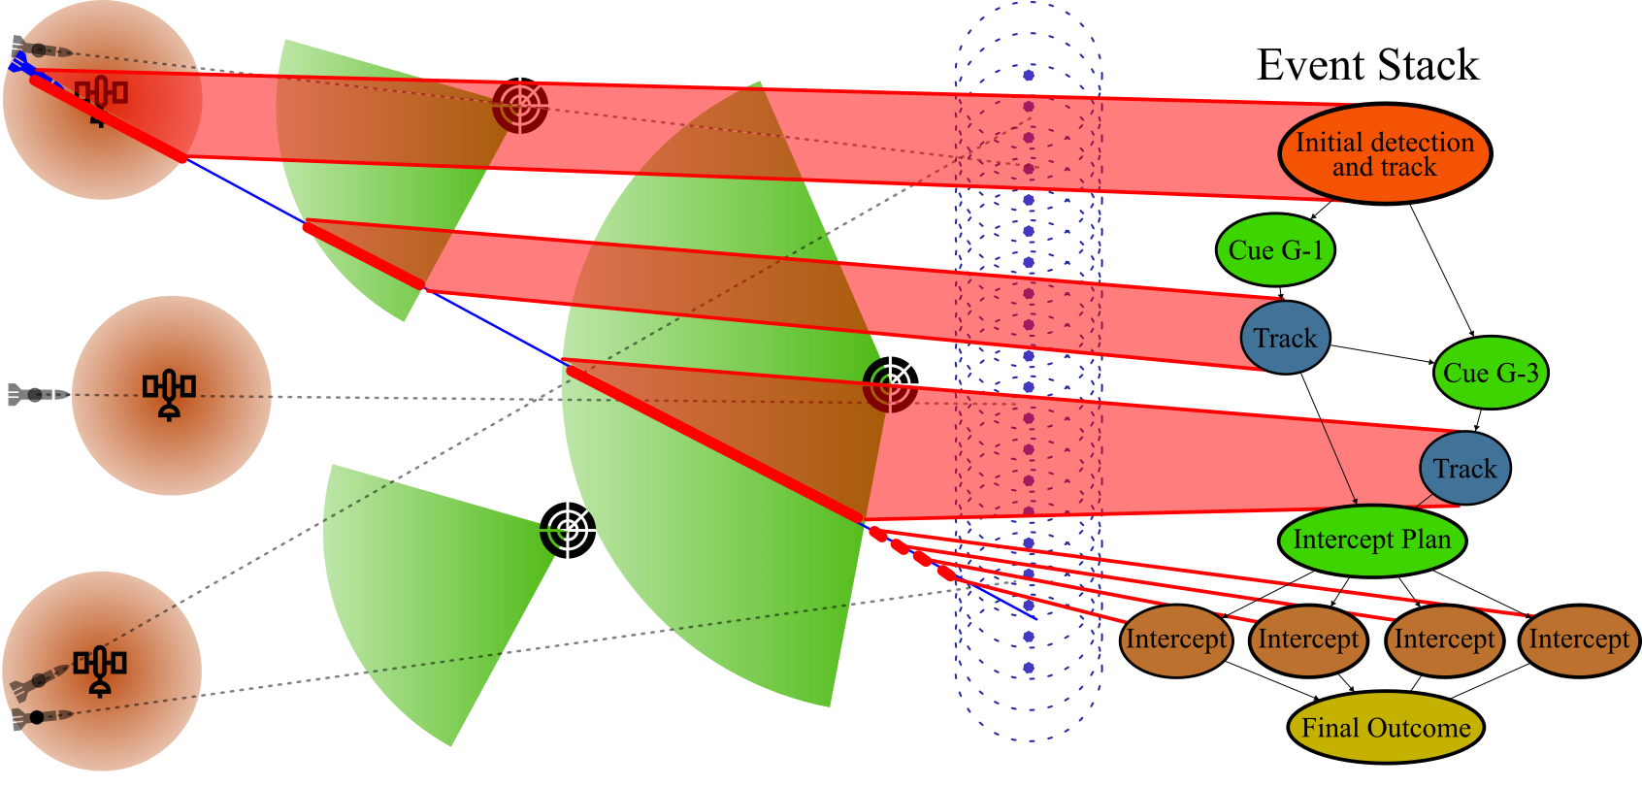
Building an Event Stack
Notes:
Script
For the Event based stochastic simulation we need to build, what we call, an event stack. An event stack describes the relationships between the different events in the simulation.
In our testbed we created an algorithm that would automatically look at several factors of the threats path through the play field to generate an event stack for each threat. This algorithm used the interaction between the threat and the sensors and the messaging we mentioned on the previous slide to build events out of the component-to-threat interactions as well as the component-to-component interactions.
So, we can see that this threat starts in the field of view of an overhead sensor causing the initial detection and track of the threat. This information is passed to the command and control which creates cues for ground sensor 1 which then track that threat and that information is combined with the initial track to create a cue for ground sensor 3 which then tracks the threat and so on. The difference here from the physics base simulation is that we are not doing this tick by tick. We are saying that the initial detection and track will have a quality, or to put it another way we are calculating how successful the overhead sensor was at initial detection and tracking. That success feeds into how successful command and control will be at cueing ground sensor 1 at the right place and so on.
It is important to note here that the Event Stack does not have to be built this way. In the past we have build event stacks by hand or we have based them off activity diagrams and other design documentation.

Slide 9
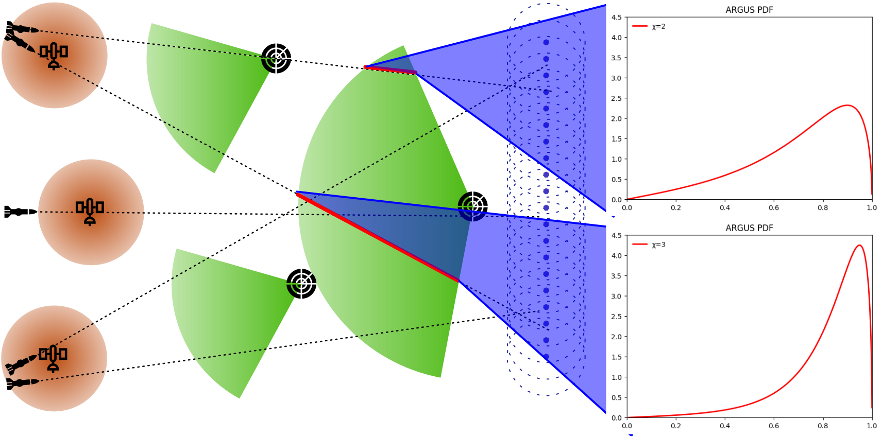
Populating Probability Distribution Function
Notes:
Script
In the algorithm that we used to make the event stack we also pull some information about threat in order to define our probability distribution functions for each event.
For this effort we used the same Probability Distribution Function for each event, specifically the ARGUS distribution. The ARGUS distribution was originally developed to describe experimental result in particle physics. We chose it because it only has one input parameter chi, and variations of that parameter define how the distribution is skewed and its peak. This simplifies the creation of the probability distribution function because it means that we one function that accounts for the physical condition rather than the several parameters that would need to be calculated for other probability distribution functions. Experimenting with other probability distribution function is a further area of research. The shape of the ARGUS distribution also is fitting for systems that are designed to be successful but at never perfect.
All chi values are dependent on the outcome of the previous events and the number of consecutive events. The chi values for sensors are also dependent on the time in view of a sensor, the average angular size, and the standard deviation of the angular size (this helps account for the spinning of the threat).
Here we can see how these might affect the probability distribution function of two interactions between two threats and the same sensor.

Slide 10
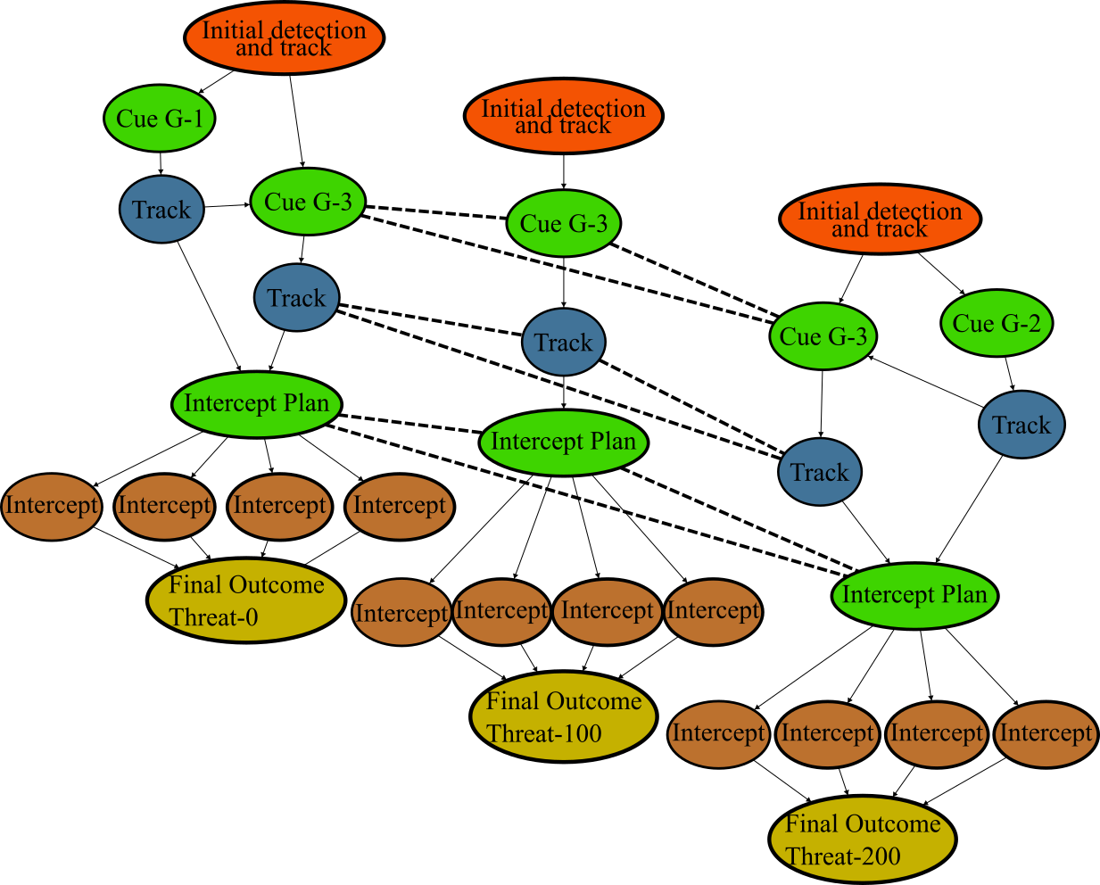
Event Stack Interactions
Least Complex Tick/Event:
1 random draw from a fixed probability distribution function
Most Complex Tick/Event:
Calculate 1 probability distribution function from input and number of concurrent events
1 random draw from calculated probability distribution function
Notes:
Script:
As mentioned the probability distribution functions are partially dependent on the number of concurrent events. This is particularly true of sensors and the command and control. This dependency allows the event stacks for multiple threats to be connected and modified by on another.
For the stochastic simulation is run by stepping through the combined events to calculate the results of each event that is needed for the next set of events. This means that rather than thousands of iterations, as in the physics based model, the stochastic simulation may only need to run a few dozen events. Further events that are not dependent on each other can be run in parallel.
With this in mind the least complex Events are typically the first events where the probability distribution function is fixed and we simply need to make a random draw from that distribution. On the other end of the spectrum are events where we need to add in the previous dependent probabilities and the concurrent operations to calculated the final probability distribution then make a random draw from that new distribution. Both of these operations are computationally simpler than the least complex tick in the physics simulation.

Slide 11
Experimental Results
 | Event Based Stochastic M&S | Physics Based M&S
Steps per run | 57 | 5499
Operations per step | 2 | >100
Unique lines of code | 500 | >2000
Average run time | 373.13μs | 224,413.54μs
Intercept rates over 1000 runs | Threat 0: 0.9433 Threat 100: 0.9388 Threat 200: 0.9419 Threat 1000: 0.9441 Threat 1001: 0.9460 | Threat 0: 0.9501 Threat 100: 0.9293 Threat 200: 0.9450 Threat 1000: 0.9492 Threat 1001: 0.9489
Notes:
Script
We used the test bed to compare these two approaches in the example problem we have been showing and these are the results
In the physics-based simulation each run of the simulation requires 5499 clock ticks. At Each of these ticks requires all the processes we discussed to be run. On the other hand each run of the stochastic simulation only needs to calculate the result of 57 events. This process only consists of the final calculation of the chi value and the random draw from the resulting Probability Distribution Function.
Further, we built both simulation engines in the same language with the same coding approaches so we can reasonably compare the unique lines of code needed to implement both simulations as a reasonable measure of complexity. For the physics based simulation there were more than 2000 lines of code, in part because we had 4 different models that needed to be implemented and these model were fairly complex (actually a good amount of code was shared between the 2 types of sensors). In contrast the stochastic simulation required about 500 lines of code, this includes the event stack builder, the simulation runner, and the ARGUS based event model.
Finally, we can look at the run time and we can see that the event based stochastic M&S runs about 3 orders of magnitude faster than the Physics-Based M&S while still getting similar results as the physics based simulation. With more experimentation we think that we could tune the probability distribution function to better reflect he physics based results.

Slide 12
Further Research
Lower levels of abstraction
Different Probability Distribution Functions
Feedback mechanisms
Branching stochastic results
Stochastic result analysis
Notes:
Script
We intentionally kept the level of abstraction high where we are only interested in interactions between components, but we could start to include internal events or event models every event that occurred in the physics simulation and still have fewer operations per run than the physics based simulation.
Different probability distribution functions may better reflect the actual probability of an event and should be used in that case.
In order to make a true digital caricature we would want a feed back mechanism between a physics based M&S or real world system. These feedback mechanism in our example would change how the chi values of the probability distribution functions are calculated. However, exactly what those changes are and how they should be implemented is an open question for the ARGUS and other distributions.
We could more effectively cover the whole result space with a stochastic simulation if we take a fixed number of draws from the first event then for each of those draws, we create the next probability distributions for the next event and do a fixed number of draws from those and so on. This would mean that a single run of the simulation would take longer but it would be equivalent to running thousands of runs at the same time
Finally there is research needed in how to best analyze the results of a stochastic simulation. In the physics based simulation this is typically done by analyzing logs of the individual components and the messages between those components. In the stochastic simulation we would have probability distribution functions for each event. How to interoperate and understand these is still an open question particularly when you have thousands of them from multiple runs.

Slide 13
Thank You
Questions and Discussion

