Slide 1
Enhancing Medical Performance Assessment using Competency Frameworks
Matthew Hackett, PhD
DEVCOM Soldier Center

Slide 2
Agenda
Military Medical Training
Competency Frameworks
Medical Competency
Competency Model
System Architecture
Prototype Development
Data Simulation
Future Work

Slide 3
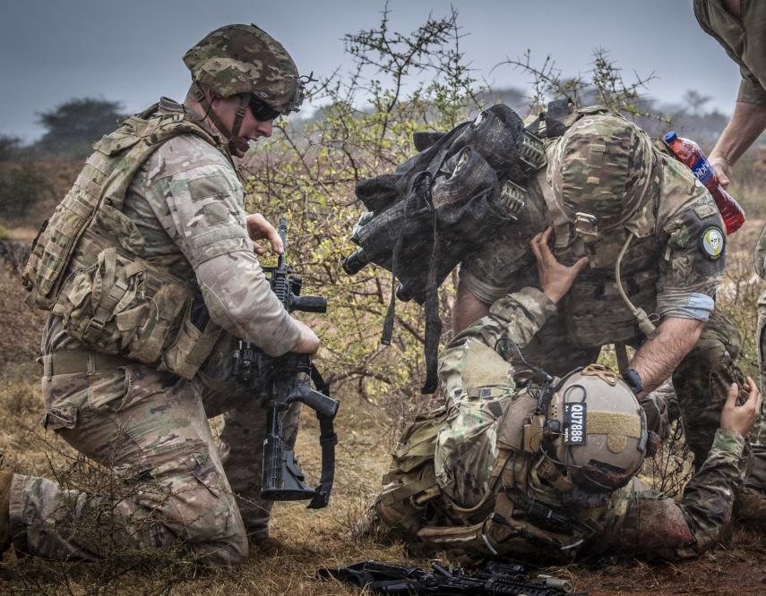
Military Medical Training
Military trains healthcare providers in nearly all healthcare roles
Combat casualty care provides treatment for a casualty at the point of injury, during transport, and at some form of healthcare facility
Combat casualty care typically split into three components
Tactical Combat Casualty Care (TCCC / TC3)
En-route Combat Casualty Care
Surgical Combat Casualty Care

Slide 4





Military Medical Training

Slide 5
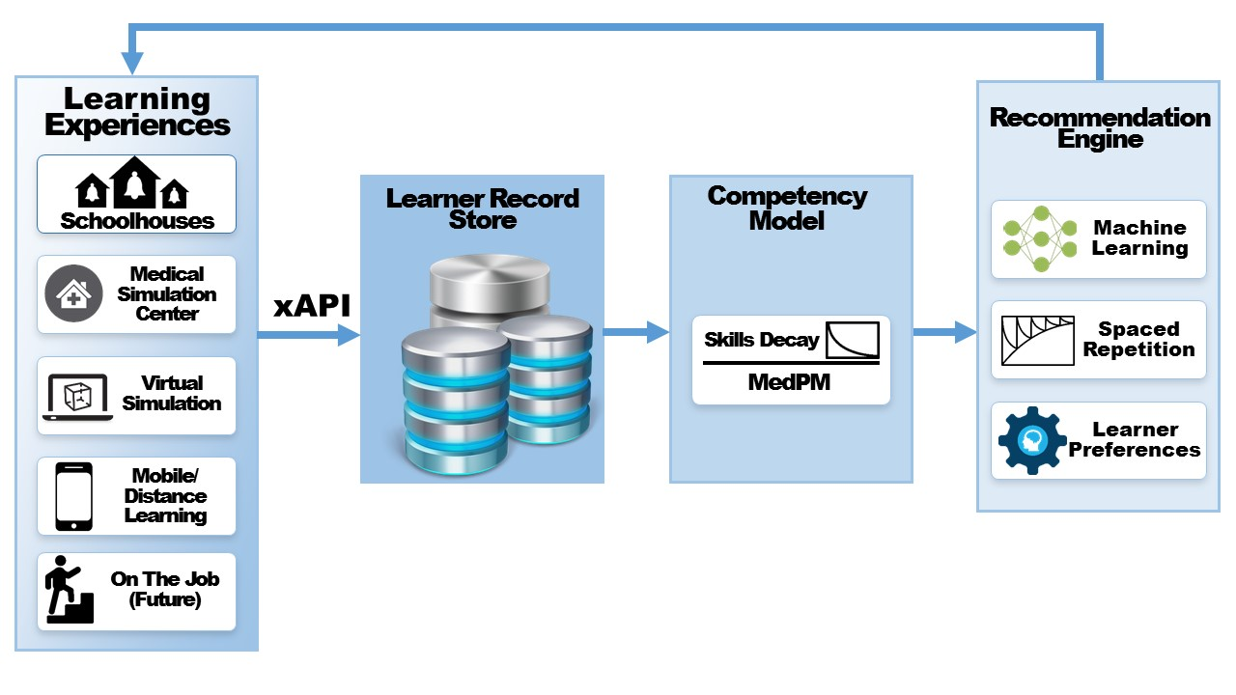
Holistic Learner Assessment

Slide 6
TEMPEST Objective

Slide 7


Competency Frameworks
Critical question - is the trainee ready to perform the tasks critical for their intended job?
Arose from educational and employment sectors
Education – a set of knowledge, motives, traits, and skills that may be a superior indicator of performance compared to test results
Evolved to include knowledge, skills, behaviors, values, and attitudes within the scope of a competency
Behavioral approach which suggest competency is a continuous and evolving concept
Employment – defines measurable performance standards which a prospective employee meets to be quailified and suitable for a position
Suggests a criterion which once met makes a trainee qualified and competent

Slide 8
Military Competency Frameworks
CBE shifts from ‘one-size fits all’ approach often taken, rigidly structured
CBE benefits include improved human capital management, career development, and more
Prior work has been undertaken
Total Learning Architecture
Sailor 2025
STEEL-R

Slide 9
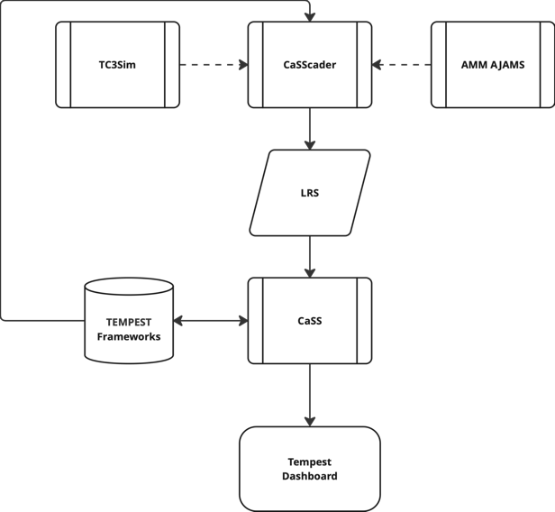
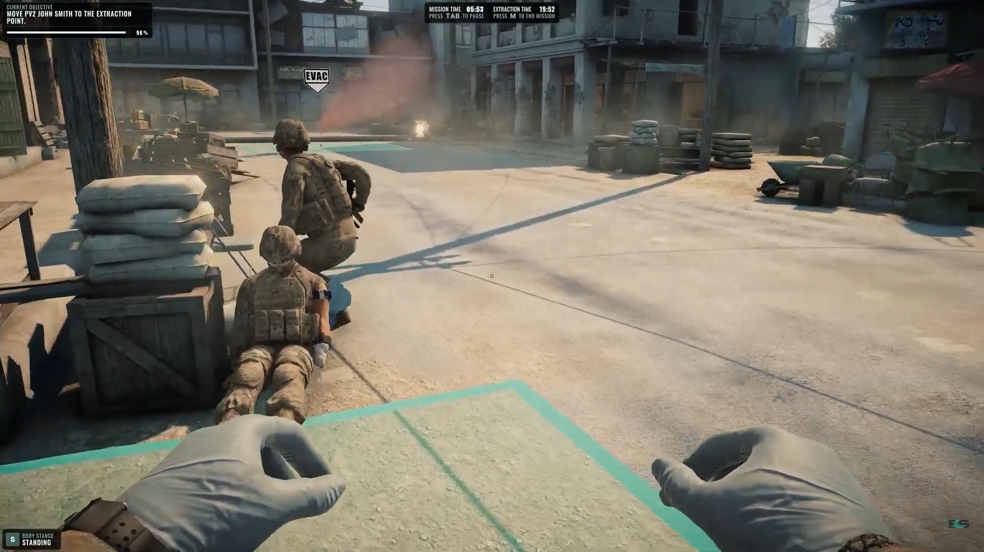
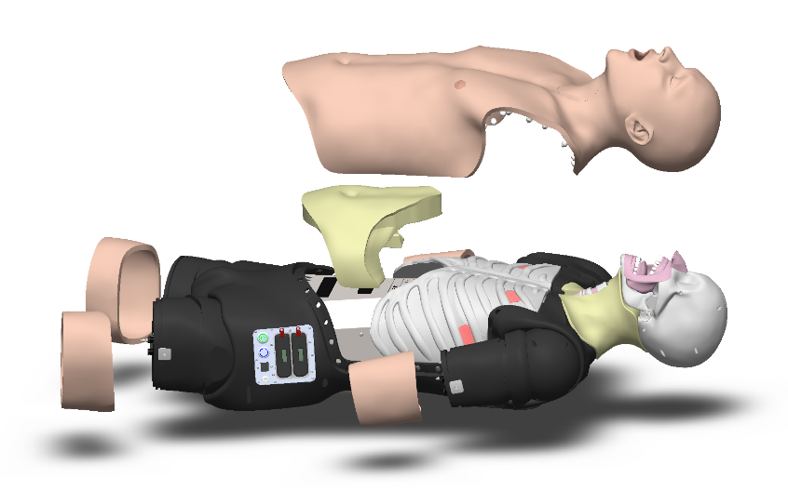
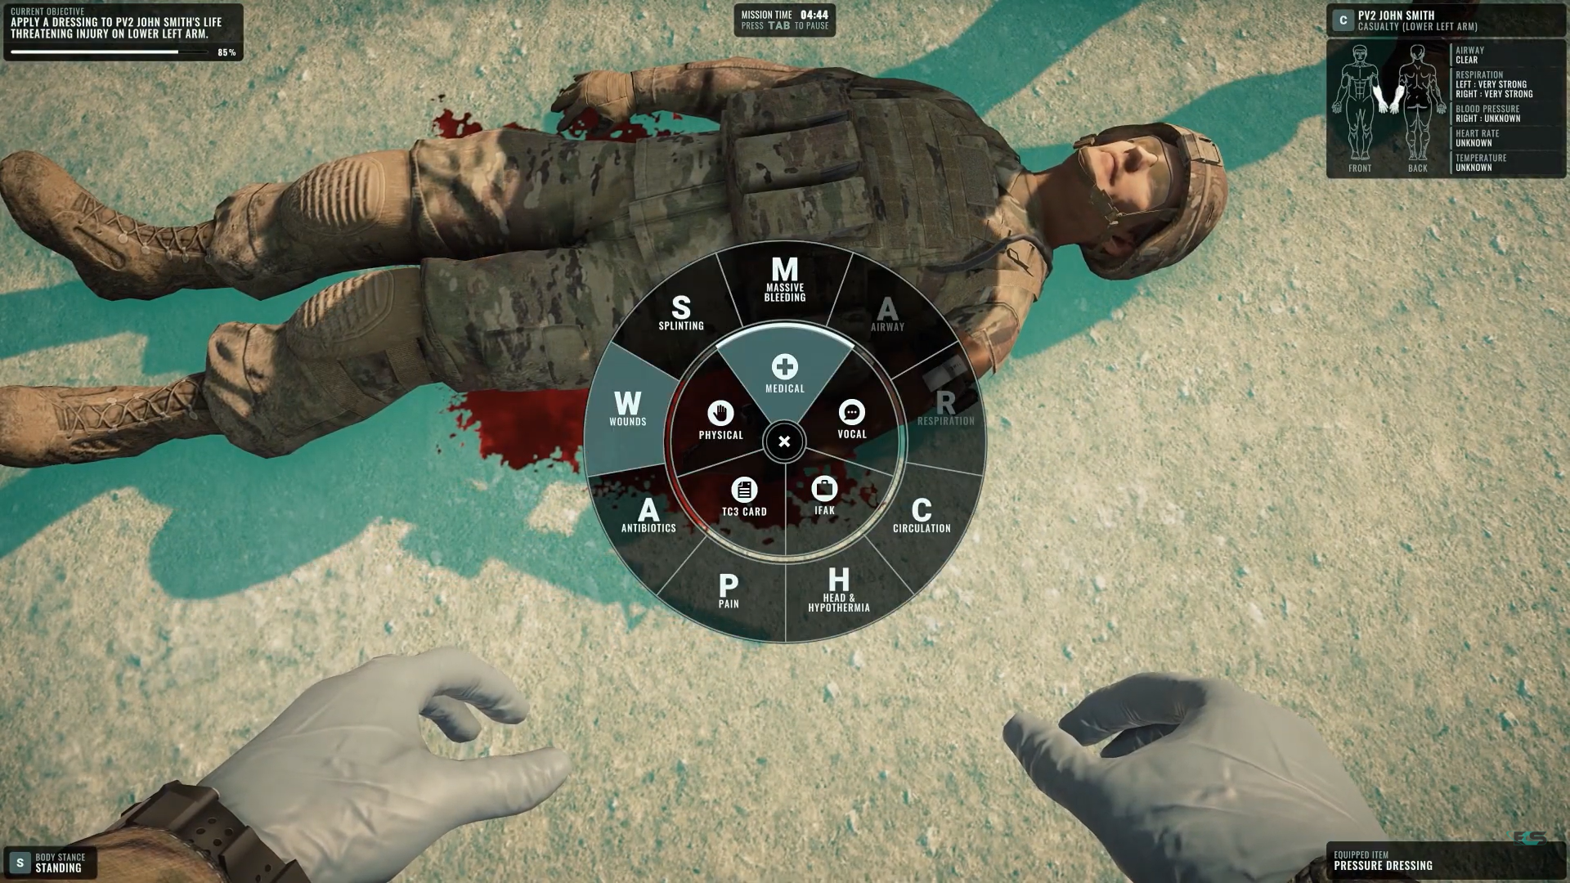
System Architecture
Medical competency framework – initial focus intubation competency

Slide 10
Competency M
Used the ABC model from STEEL-R, with a focus on individual skills

Slide 11
Data Simulation
CassCader
Creates simulated xAPI data for experiences of multiple learners and transmits this to the LRS
Assertion processor automatically recomputes a learner’s profile
Enables testing and demonstration of a standardized, scalable without requiring the instrumentation and modification of training technologies with xAPI

Slide 12
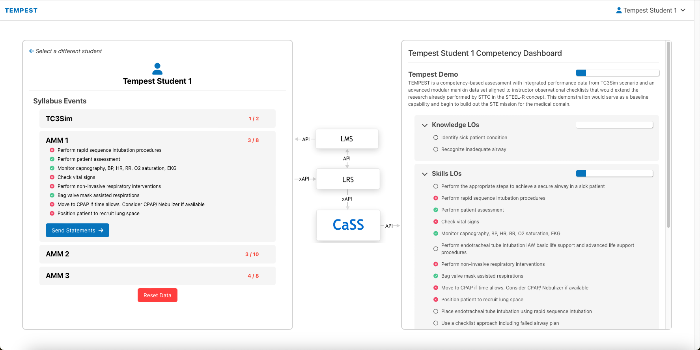
Results

Slide 13
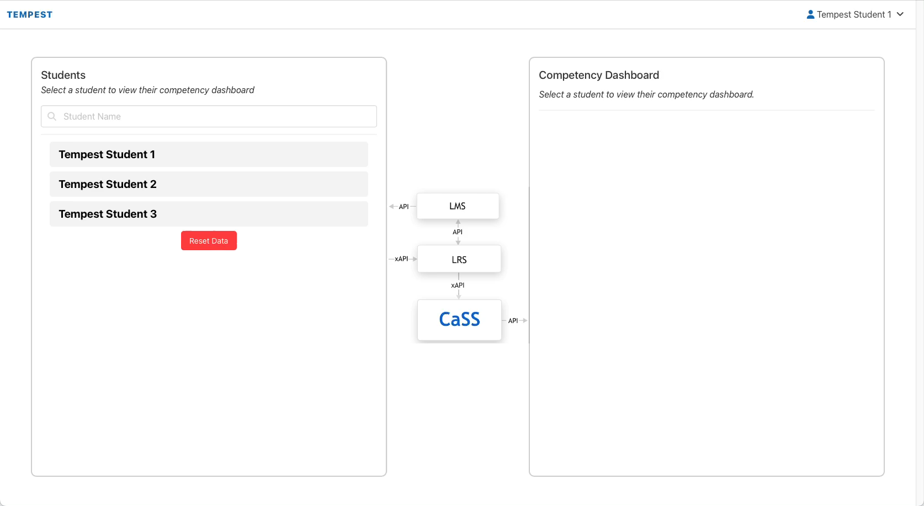
Results - Video

Slide 14
Conclusions
Successfully integrated virtual simulation (TC3Sim) with physical manikin (AJAMS) with CaSS system to create a comprehensive assessment of student proficiency
Mapped multiple training technologies and learning modalities to competencies associated with airway management
Utilized non-airway scenario (poly trauma) from TC3Sim, while still populating airway competency

Slide 15
Future Work
Integrate actual technology rather than data simulation
Create larger competency framework for full suite of TCCC and battlefield medicine procedures (Combat Medic level)
Create instructor / observer checklist
Significant assessment is still conducted using checklists and non-instrumented equipment
Investigate novel assessment techniques like computer vision, natural language processing, and more to create a comprehensive student assessment

Slide 16
Questions / Comments
Matthew Hackett, PhD
Matthew.g.Hackett.civ@army.mil

