Slide 1

Novel Techniques for Processing Building Exteriors Captured from Photogrammetry
Scott Johnson, Leidos
Scot Shiflett, Leidos
Clayton Burford, DEVCOM Sponsor

Slide 2
Introduction
Our project creates terrain databases for US Army simulators.
  Terrain from Photogrammetry vs generated from GIS data
Remeshing
Face Segmentation
Retexturing
Building Pipeline Results

Slide 3
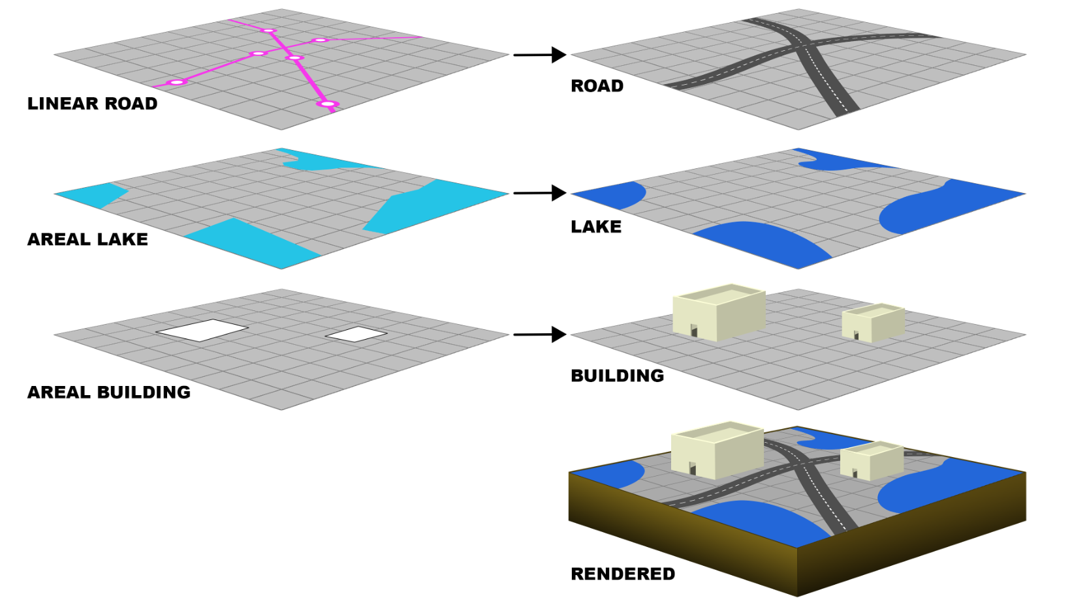
Terrain Database Generation Systems – (Not Photogrammetry)
GIS data becomes the terrain mesh
Notes:
The terrain database generation systems generate fairly clean geometry. This is the process for TerraVista and TerraTools.

Slide 4
Terrain from Photogrammetry
More recent terrain systems use photogrammetry to generate the triangles.
Then it is up to an outside processing pipeline to clean up, find, and extract the needed features : buildings, roads, etc.
This the opposite process of traditional terrain database generation.

Slide 5
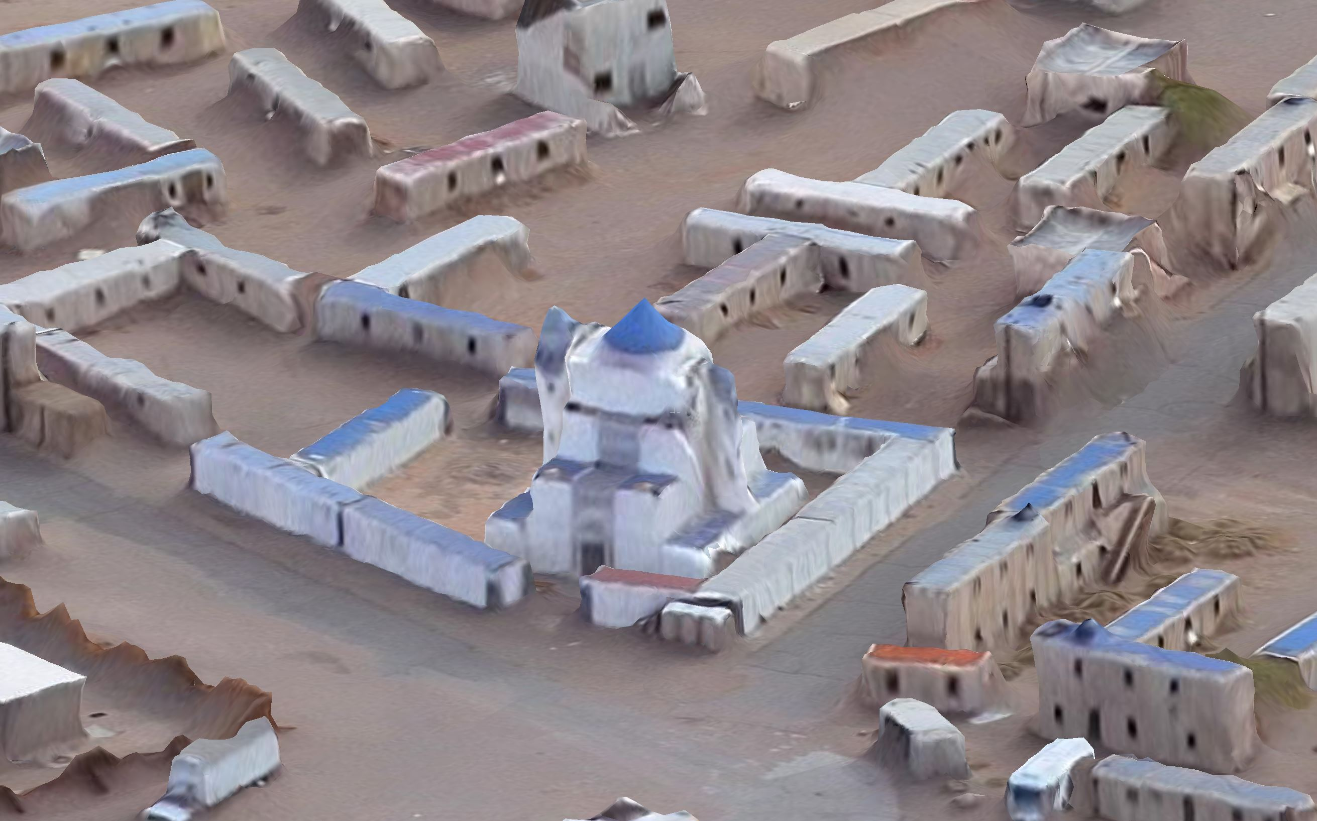
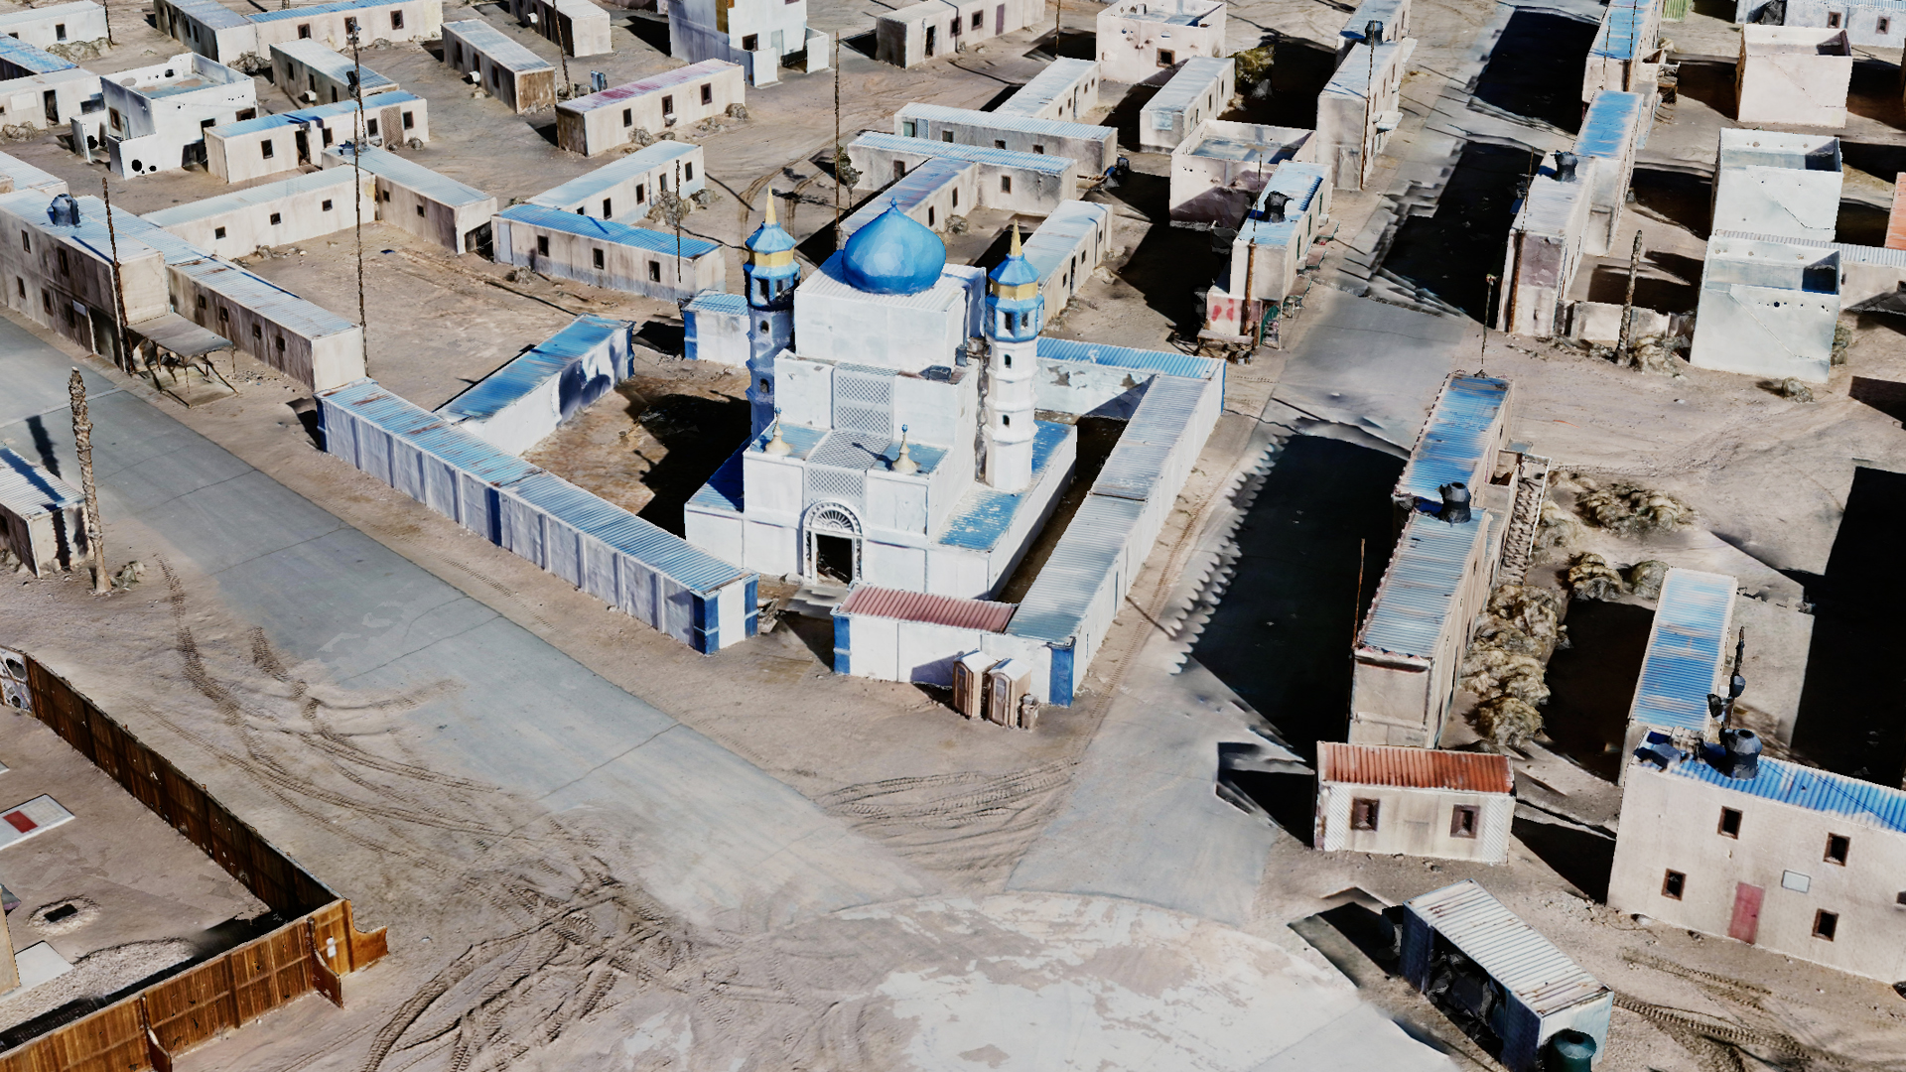
Photogrammetry Terrain – iTwin Capture
The quality varies by the detailed way that the drone is flown and how the photos are taken.

Slide 6
Building Exteriors
The extraction and processing and buildings from photogrammetry is a problem that requires some unique stages that are very different from other kinds of terrain or model generation.
This presentation is about the processing of building exteriors : Remeshing, Face Segmentation, and Retexturing.
Some results are of the whole building pipeline are shown
Remesh
Face Segment-ation
Retexture
Building
Skeleton
Mesh
Bldg
Mesh

Slide 7
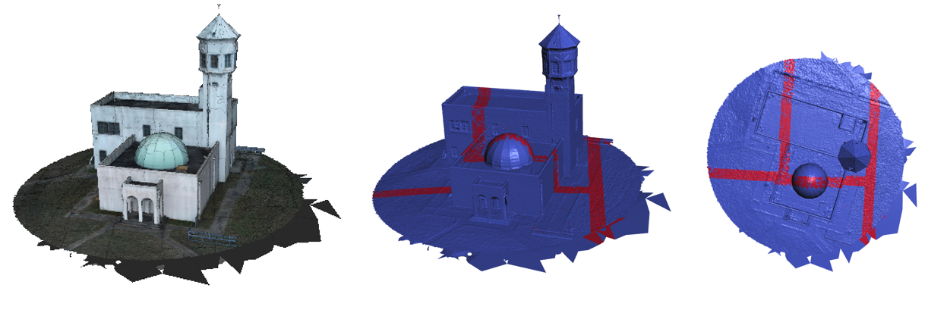
Photogrammetry Output – iTwin Capture Mesh from Fort Polk
Problem #1 Tile Boundaries - The red bands are triangles that intersect each other.
The terrain is actually several separate meshes that overlap at their edges.

Slide 8
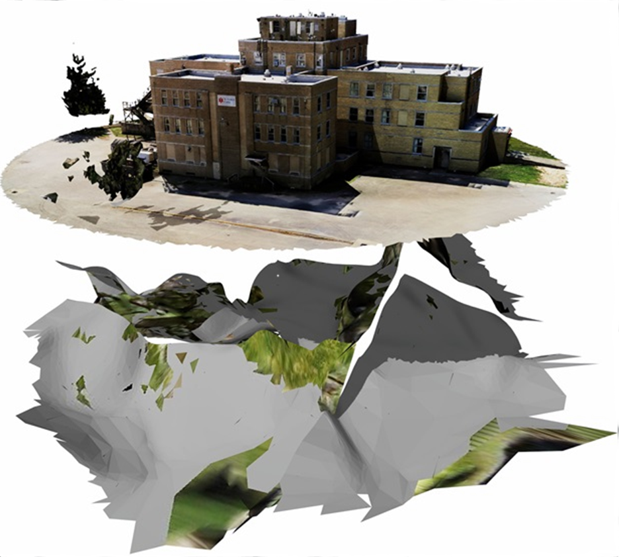
Photogrammetry Output – iTwin Capture Mesh from Muscatatuck
Problem #2 Extra Erroneous Geometry
??

Slide 9
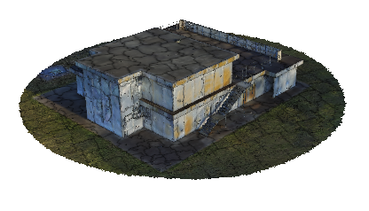
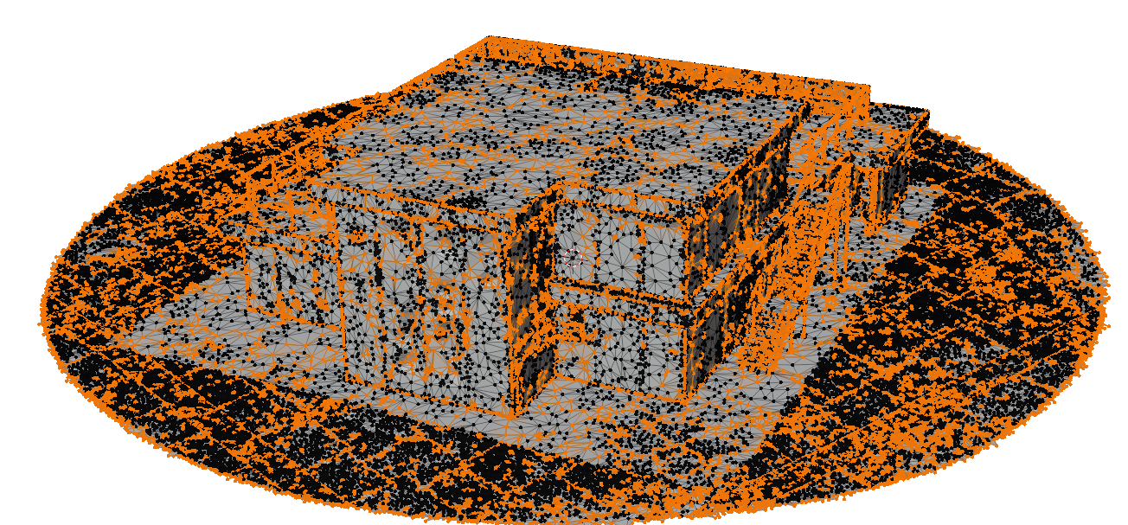
iTwin Capture Meshes – Nonmanifold Mesh
Orange vertices are nonmanifold

Slide 10

Remeshing
Throws out the existing faces and generates a new set of triangles that represent the same surface.
The famous modeling tool, Blender, has remeshing. Let’s start with that.
Remesh
Face Segment-ation
Retexture
Building
Skeleton
Mesh
Out
Mesh

Slide 11

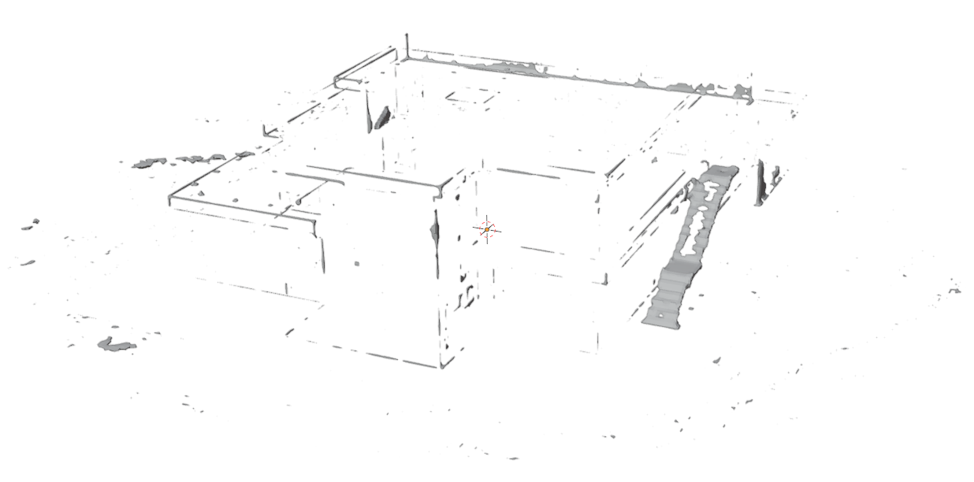
Blender Remeshing only Works on Closed Meshes
Mesh to Voxels
Voxels to Mesh
Remeshed Result
Mesh
Result (most of the building is missing)

Slide 12
Custom Remeshing
Custom
Code
Geometric Tools Lib
Mesh to Voxels
Comp Signed Distances
Voxels to Mesh
Remeshed
Mesh
Custom Remeshing works on non-closed meshes.

Slide 13
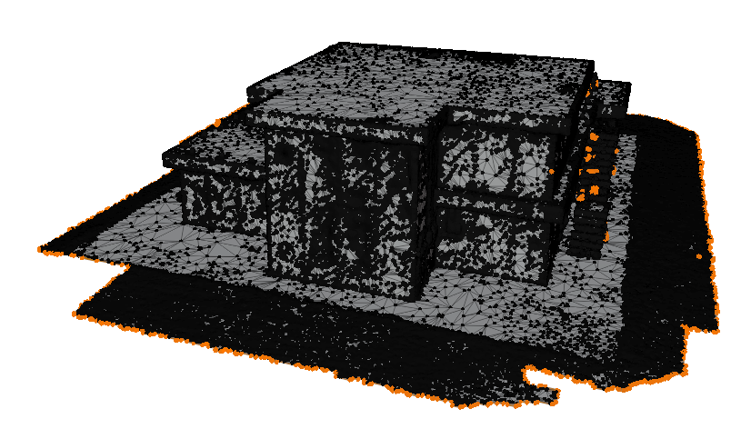
Custom Remeshing Result
Very few nonmanifold verts left
Notes:
This picture had to be decimated to show anything but a gray blob.

Slide 14
Custom Remeshing
Eliminates tile boundaries and intersecting faces
Brings the mesh very close to manifold.
  In many cases the nonmanifold vertices can be removed because they were in noisy areas.
The mesh is now connected except for the discontinuous erroneous geometry
  Remove all but the largest continuous mesh to eliminate most of the erroneous geometry

Slide 15
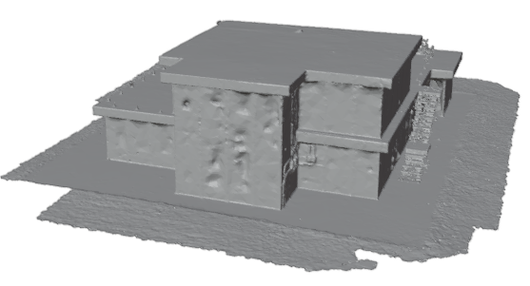
Remeshing – Results Highlighted
Blender’s Result is not usable
Our Result
We can offer our solution to the Blender Foundation so 3 million users can benefit.

Slide 16
Face Segmentation
Face segmentation groups the faces together that have meaning. The most important segmentation is determining which faces are ground faces so they can be removed.
Remesh
Face Segment-ation
Retexture
Building
Skeleton
Mesh
Out
Mesh

Slide 17
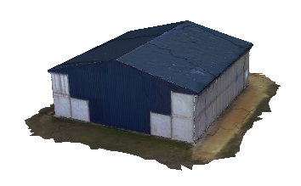
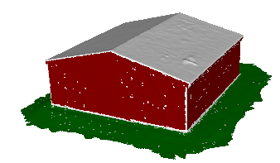
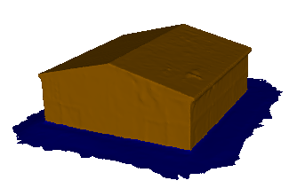
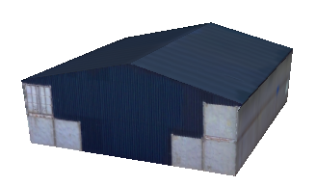
Ground Segmentation
Custom Plane Fitting
Maximum
Flow
Remove Ground Faces
Mesh

Slide 18
Face Segmentation – Before Max Flow
Source
Sink
Source
Sink
Unknown
Triangle Mesh

Slide 19
Face Segmentation – After Max Flow
Source
Sink
Source
Sink
The Seam Between Source and Sink

Slide 20
Maximum Flow Algorithm – Before and After
We use a heuristic to first judge ground versus walls. Then max flow finds the seam and fills in the white area.
Sink
Not Ground
Ground
Source

Slide 21
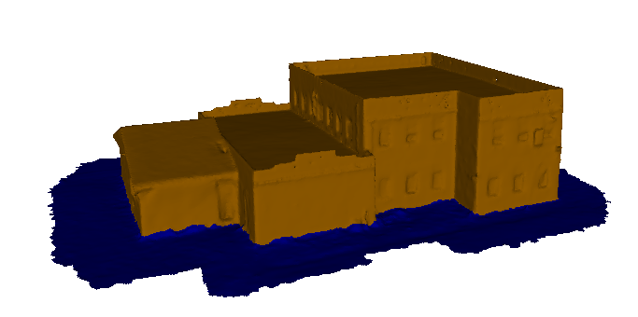
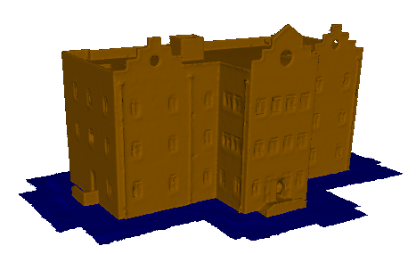
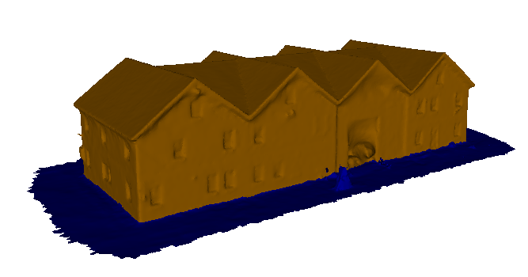
Ground Segmentation – Clean Buildings
Not Ground
Ground
Other results from cleanly captured buildings

Slide 22
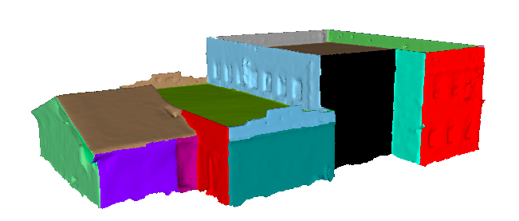
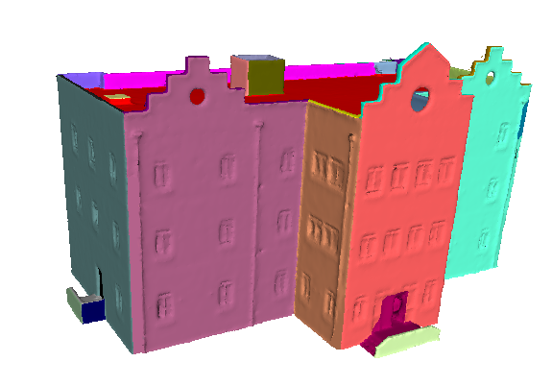
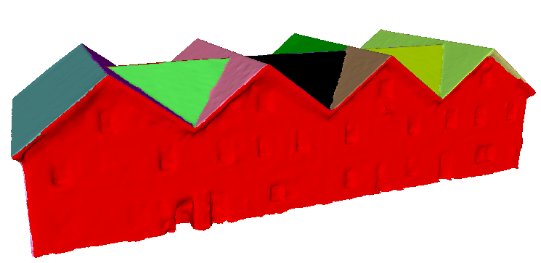
Face Segmentation
We plane fit the mesh and then repeated apply Maximum Flow to partition the building mesh.
Notes:
The references have pictures like this. I’d like to point out that their pictures are hand made without any anomalies and they tend to be very small number of polygons.

Slide 23
Retexturing
By replacing all the faces in Remeshing, we lost the texturing from the original mesh. We have to put the textures back on.
This happens at the end of the pipeline but could be considered a necessary part of Remeshing.
Remesh
Face Segment-ation
Retexture
Building
Skeleton
Mesh
Out
Mesh

Slide 24
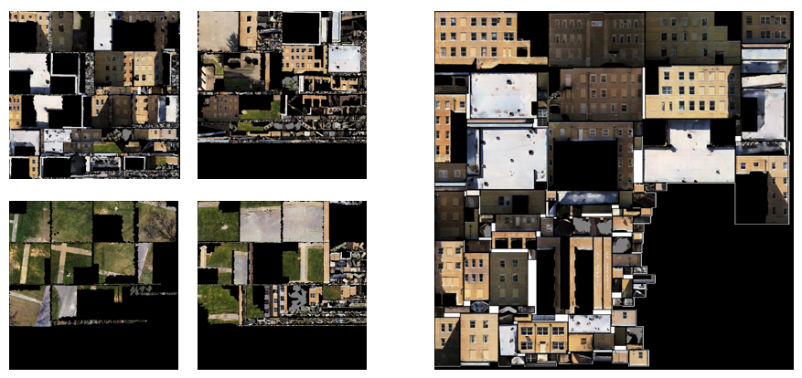
Retexturing
We lay the face partitions into UV space and then raytrace the colors back from the original mesh.
The building texture is now separated from all the terrain textures.
Face
Segments
4 sample terrain textures
1 atlassed building texture
Notes:
This process also uses Least Squares Conformal Mapping to map the non-flat portions to flat UV space.

Slide 25
Building Pipeline Results
Remesh
Face Segment-ation
Retexture
Building
Skeleton
Out
Mesh
Mesh

Slide 26
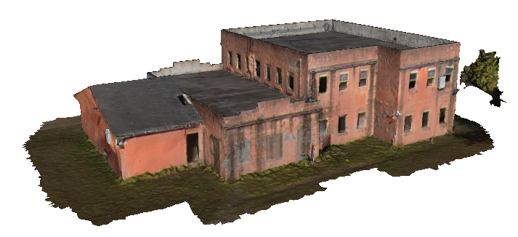
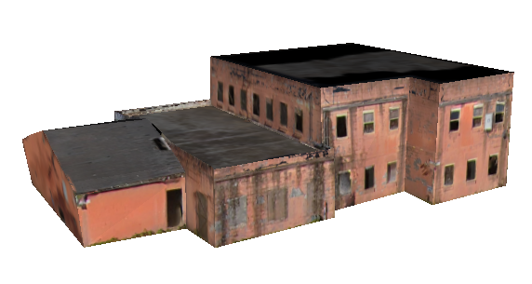
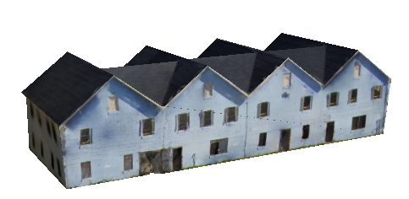
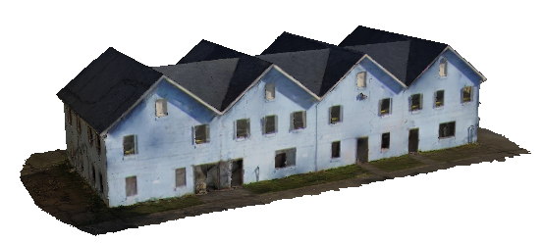
Building Pipeline Results
80,000 faces
102 faces
121,000 faces
90 faces
Well captured buildings that are isolated from each other have good results.

Slide 27
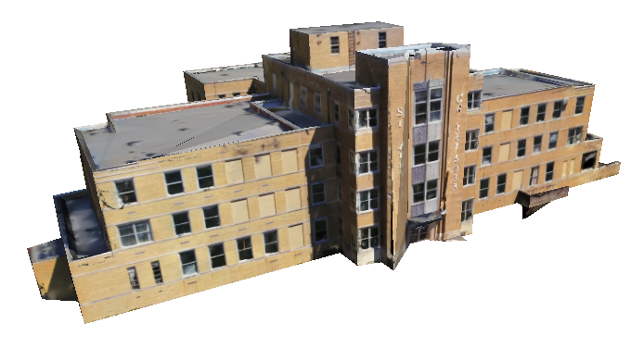
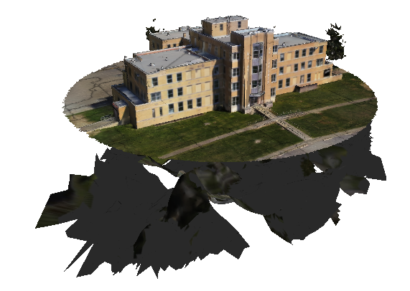
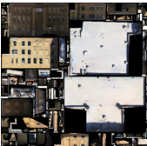
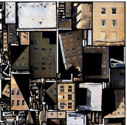
Building Pipeline Result – Muscatatuck St. Francis Hospital
865 faces
545,000 faces

Slide 28
Conclusion
Building pipelines from photogrammetry are opposite of the building pipelines from traditional database generation.
Three stages of processing combine to remove the ground and segment the faces into meaningful retextured pieces.
We showed the output of the building pipeline and that the well captured buildings are extracted, reduced and cleaned.

Slide 29
End
Question: What about noisy buildings?
Answer: AI is helping with the noisy buildings.

Slide 30
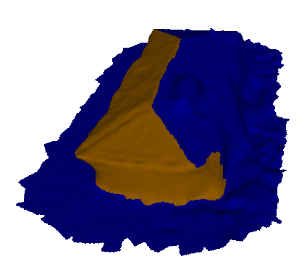
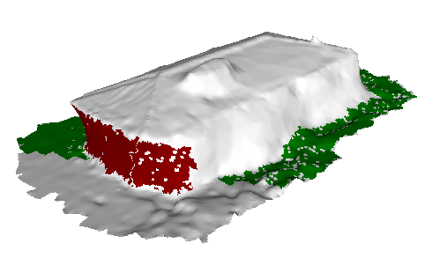
Ground Segmentation – Noisy Building
Plane fitting Before Max Flow
fails
The max flow spilled over the seam

Slide 31
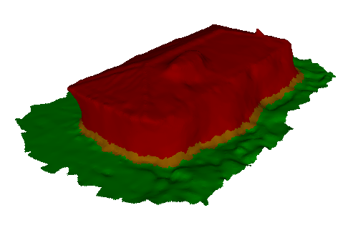
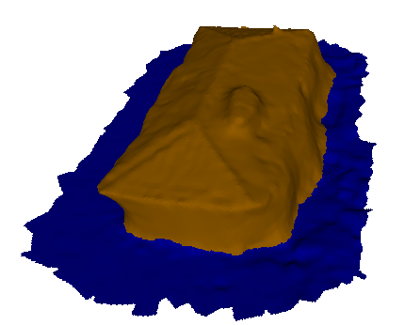
Ground Segmentation – AI helps
AI Low Resolution Segmentation
After Max Flow
Not Ground
Not Ground
Ground
AI can’t determine
Ground
Max Flow utilizes low resolution AI segmentation

