Slide 1
Achieving Accreditation Utilizing Model Description Development Indices and Model Description Reports
Mr. Jack “Jake” Borah
United States Air Force

Slide 2
Introduction
Simulation-based acquisitions strive to reduce program costs schedule and risk
This is accomplished by developing representative models and simulations of systems and subsystems
Models and simulations use referent data such as:
Subject Matter Expertise
Benchtop experiments
Test results
First-principal physics
Budget constraints and increased use of software has accelerated simulation-based acquisition

Slide 3
USAF Scientific Advisory Board Report
Identified Modeling and Simulation (M&S) as a key DoD system requirement
High fidelity M&S tools can simulate many flight scenarios necessary to provide fielding decision confidence
A rigorous M&S development process should have:
Detailed simulation validation plan
High fidelity models
Thorough Design of Experiments
However, implementation of model development and validation/verification activities left open to interpretation

Slide 4
M&S Validation and Verification (V&V) Theory
Branford McAllister developed systematic process to assess Model Maturity Levels using
Model Development Indices (MDIs)
Model Description Reports (MDRs)
Model Maturity Levels are used to provide a single, objective and universal means to assess the state and maturity of models throughout the V&V process
MDI components
Defined model maturity level criteria
Maturity assessment measures
Maturity documentation evidence

Slide 5
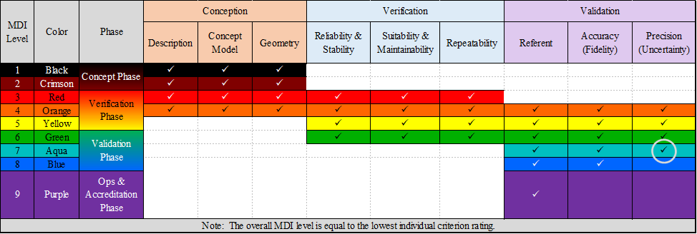
MDI Assessment Tool Graphic
Notes:
SIMULATION USERS FREQUENTLY HAVE MULTIPLE PERSPECTIVES AS WELL

Slide 6
MDR Template I
Chapter | Purpose | Sections | Subsections
Model Recognition | To produce a set of requirements that will drive Model design activities and provide criteria by with the success of the Model development will be judged. | Introduction
 |  | Intended Use
 |  | Modeling and Simulation Application
Model Definition | To produce an implementation-independent conceptual depiction of the real-world that must be represented in the Model application. | Assumptions
 |  | Limitations
 |  | Capabilities
 |  | Requirements
 |  | Risk and Impacts
 |  | Interfaces | Data Import
 |  |  | Data Fetch
 |  |  | Data Export
 |  | Referent Data Identification

Slide 7
MDR Template II
Chapter | Purpose | Sections | Subsections
Model Design | To translate the Model Definition data into a Model capable of implementing as a simulation. | Behavioral Diagrams and Algorithms
 |  | Data Structures
 |  | Model Integration Updates
Model Implementation | To monitor and document Model development activity. | Model Development
Verification | To ensure all features, functions, behaviors, and interactions defined in Model Design can be traced to requirements expressed in Model Definition and have been articulated in the simulation. | Test Plan
 |  | Test Descriptions
 |  | Test Results
Integration and Test | To verify all requirements expressed in the Model's Intended Use (Model Recognition) have been implemented testing the Model in a representative simulation domain. | Test Descriptions | Non-functional Tests
 |  |  | Close Loop Tests
 |  |  | Functional Tests
 |  | Integration and Test Results | Non-functional Tests
 |  |  | Close Loop Tests
 |  |  | Functional Tests

Slide 8
MDR Template III
Chapter | Purpose | Sections | Subsections
Validation Plans | To document validation requirements, expected data, validation tools, and processes.
Validation Results | To evaluate the resultant data, performance of the validation tools, and the processes.
Maintenance | To document Model notes, information and maintenance plans.
Appendices |  | Acronyms
 |  | Bibliography | Government Documents
 |  |  | Non-government Documents
 |  | To Be Determined/ To Be Resolved Resolution Issue Tables

Slide 9
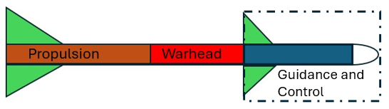



Model Conceptualization- Missile Model View
Missile
M3
M2
M1
Model Description Reports (MDRs)

Slide 10
Simulation Conceptualization- Model Maturity View
Model Description Reports (MDRs)
Conception
Verification
Validation
MDI
Color
Phase
Level
Description
Concept
Geometry
Reliability &
Suitability &
Repeatability
Referent
Accuracy
Precision
Model
Stability
Maintainability
(Fidelity)
(Uncertainty)
1
Black
Concept Phase
ü
ü
ü
2
Crimson
ü
ü
ü
3
Red
Verification
ü
ü
ü
ü
ü
ü
4
Orange
Phase
ü
ü
ü
ü
ü
ü
ü
ü
ü
5
Yellow
ü
ü
ü
ü
ü
ü
6
Green
Validation
ü
ü
ü
ü
ü
ü
7
Aqua
Phase
ü
ü
ü
8
Blue
ü
ü
Ops &
9
Purple
Accreditation
ü
Phase
Note: The overall maturity level is equal to the lowest individual criterion rating.

Slide 11
Conclusion
Simulation-based acquisition may have advantages over traditional methods
Agility in design
Cost-saving opportunities in constrained and concentrated flight-testing programs
Potentially a shorter path from concept to production
Enable development of systems that are test environment/range bounded, have limited availability, or present security concerns.
This paper presented a theoretical framework for grading the maturity of a given simulation and an illustrative example of how this framework might be applied

