Slide 1
Enabling Effective Training with Mission Partners using Resilient Multilevel Architectures
Iain Ferguson, SAIC
Jennifer Lewis, SAIC
Diana Pineda, SAIC

Slide 2
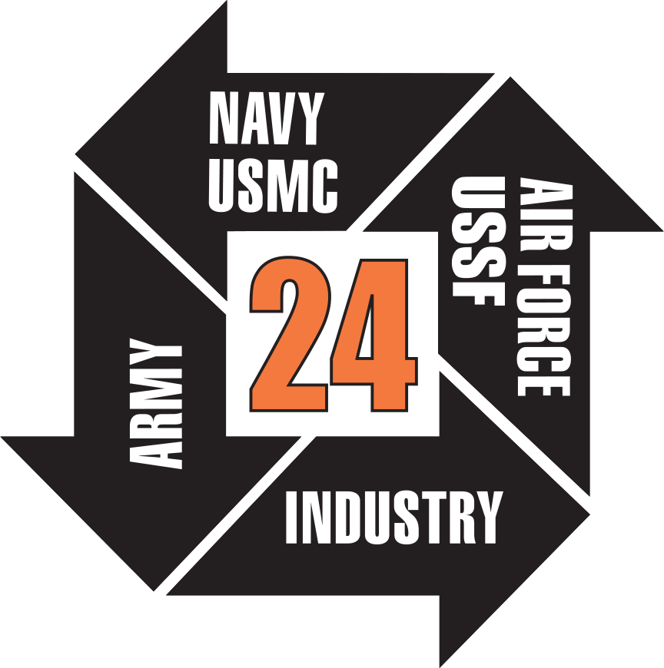

Enabling Effective Training with Mission Partners using Resilient Multilevel Architectures
I/ITSEC 2024

Slide 3
Introduction
Introduction
Multilevel Security (MLS) Concepts
MLS for Multinational Joint Task Force Training
Resilient Multilevel Architecture (RMA)
Conclusion

Slide 4
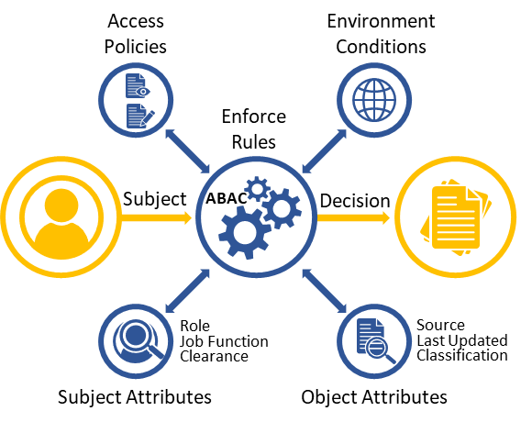
Multilevel Security (MLS) Concepts
Security Domains: Unique Security Level, including classification, releasability and dissemination controls
Security Caveats: Description of need-to-know within a security classification
MLS: The capability of an information system that is trusted to contain, and maintain separation between, resources (particularly stored data) of different security domains¹
Attribute Based Access Control (ABAC): Logical access control based on subject, attributes of the object, environment conditions, and the policies
¹CNNS Glossary, CNNSI No 4009, 2022

Slide 5
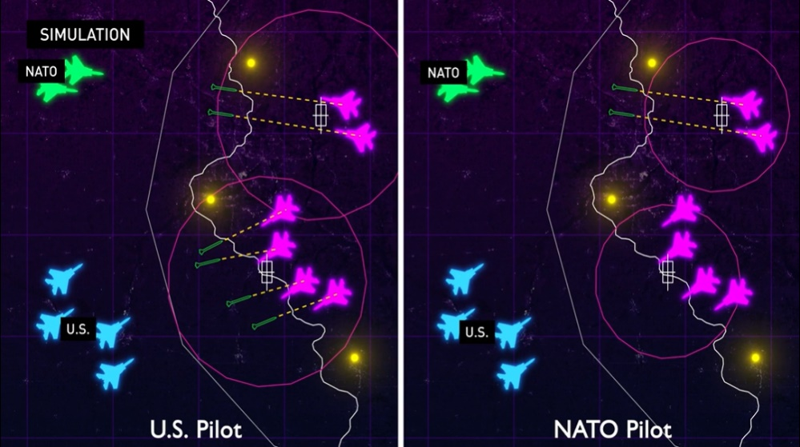
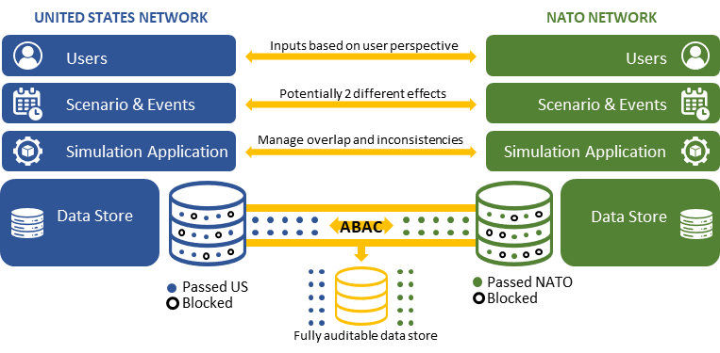
MLS for Multinational Joint Task Force Training
Simulation: Entity→ Capability → Effect
Data: Object→ Attribute→ Inference (situationally dependent)
Access Policies: Must consider all these elements using conditional logic and stateful attribute assignment
Simulation Design must consider the effects of MLS on scenario events, user decisions and application operations

Slide 6
DIS-Based Implementation Example
Entity State PDU
Entity IDs
Entity Type, Aircraft Model
Country of Origin
Other Data
Weapon PDU
Matched to Entity ID of originating Entity
Applies security attributes as needed (Block entire Weapon PDU)
Detonation PDU
Block only associated Entity ID field
Allow detonation message without associating it to a weapon (effect without attribution)
Electromagnetic Emission PDU
Maintain an Entity ID Enumeration List
Blocks all PDUs (all types) until Entity IDs can be characterized and enumerated
Triggers tailored rulesets based on classification guidance
Security attribute assignment must be applied to (and enforced on) individual fields in messages- not just data sources or even individual messages
Rulesets may require simulation states and context to contribute to security attributes

Slide 7
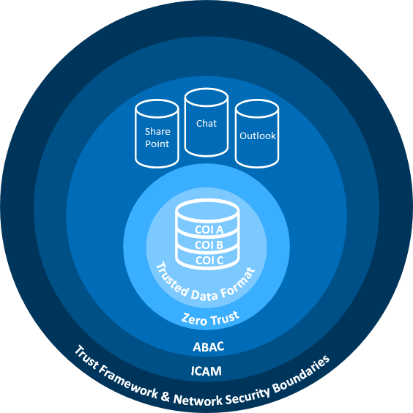
Resilient Multilevel Architecture (RMA)
There is no “One-size-fits-all” to MLS
Requires A journey or maturity model framework; evolves with enterprise IT modernization and mission needs
RMS: “A security Strategy to enable the sharing of information across traditional security boundaries through the application of Zero Trust principles, data centric frameworks and active management of the risk of sharing versus the impact to mission.”

Slide 8
Conclusion
Multilevel Security (MLS) Concepts “What it is”
MLS for Multinational Joint Task Force Training “Why its hard…and why it matters”
Resilient Multilevel Architecture (RMA) “How we can succeed…one step at a time”

