Slide 1

Enhancing a Piloting Task Simulator with Real-time Performance Feedback, Autopilot Disruption, Shock Punishment, and Adaptive Task Difficulty
Presented by Aaron Novstrup, Stottler Henke Associates, Inc.
Monica Tynan, Wellman Center for Photomedicine, Massachusetts General Hospital (MGH)
Jonathan Lin and James Heaton, PhD, MGH Voice Center
Approved for Public Release, Distribution Unlimited

Slide 2
Outline
Introduction
Background
What is the Multi-Attribute Task Battery (MATB)?
How did existing implementations fall short?
Enhancements
Automation surprise manipulations
Adaptive task demands
Instantaneous Self-Assessment of Workload (ISA)
Real-time performance feedback
Discussion
You Are Here
Notes:
Last year at this conference, I presented the results of a human study on using wearable sensors to assess cognitive workload. This year, I’m pulling back the curtains and presenting a practical case study on our development of the cognitive task used in that human study, in the hopes that practitioners who are doing similar research (related to assessing and optimizing human state and performance) or even using simulation-based training may benefit from some the techniques we employed and the experiences we had with them.

Slide 3
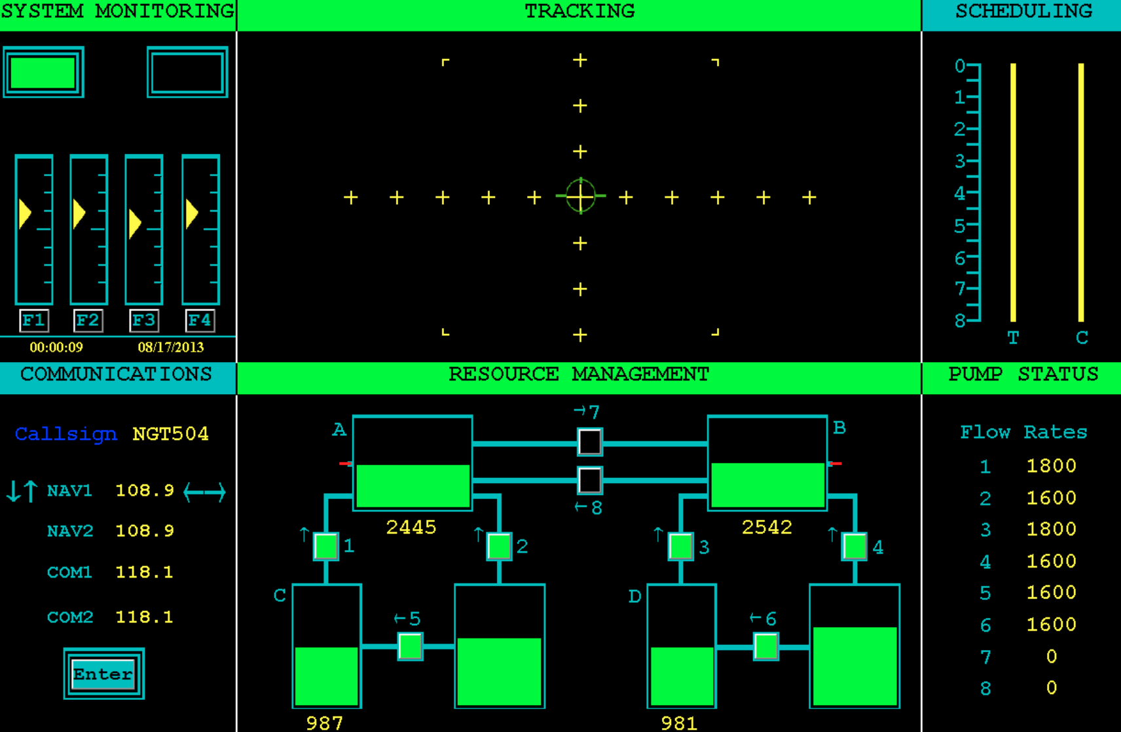
What is the Multi-Attribute Task Battery?

Slide 4
How Did Existing Implementations Fall Short?
Insufficient participant awareness of (simulated) automation system behavior
Built-in task difficulty assessments were laborious & disruptive
Lack of performance feedback, consequences
Inability to adjust task difficulty to skill/performance of participant

Slide 5
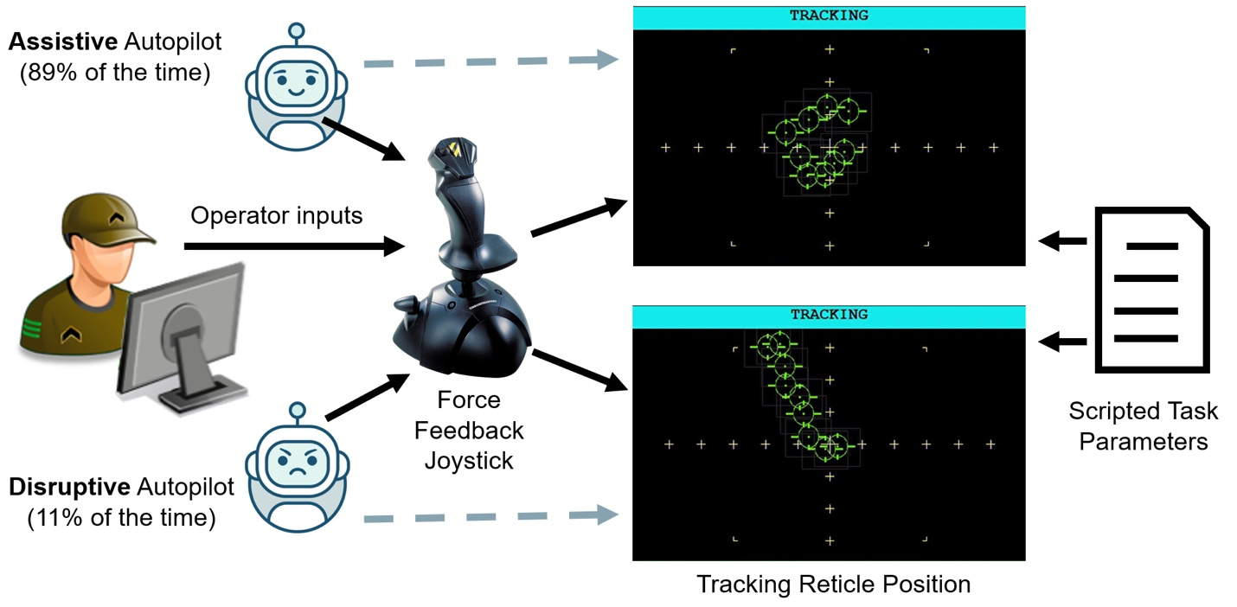
Automation Surprise Manipulation

Slide 6

Adaptive Task Demands
Block = 5 Trials
Partial difficulty resets
Full difficulty reset
T1 T2 T3 T4 T5
disruptive autopilot (2 s)
Block 1
auditory feedback
shock (100 ms)
T1 T2 T3 T4 T5
Block 2
T1 T2 T3 T4 T5
Block 3
End
Study
Task segment (35 s)
Self-Assessment (ISA;15s)
Trial (350 s = 7 x 50 s)
Performance-based advancement of segment difficulty
Easy Moderate Difficult

Slide 7
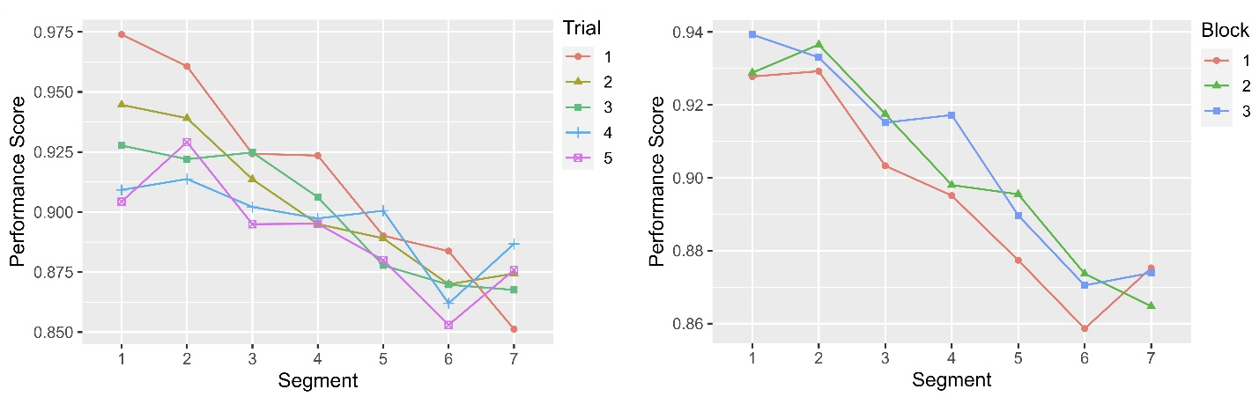
Adaptive Task Demands

Slide 8
Instantaneous Self-Assessment of Workload
Force Feedback
Joystick
ISA Unit

Slide 9
Real-Time Performance Feedback
chimes
buzzers
verbal announcements
100 ms, 30-70 V, monopolar pulses
unpleasant, not painful
BIOPAC STM200
mildly assistive force feedback

Slide 10
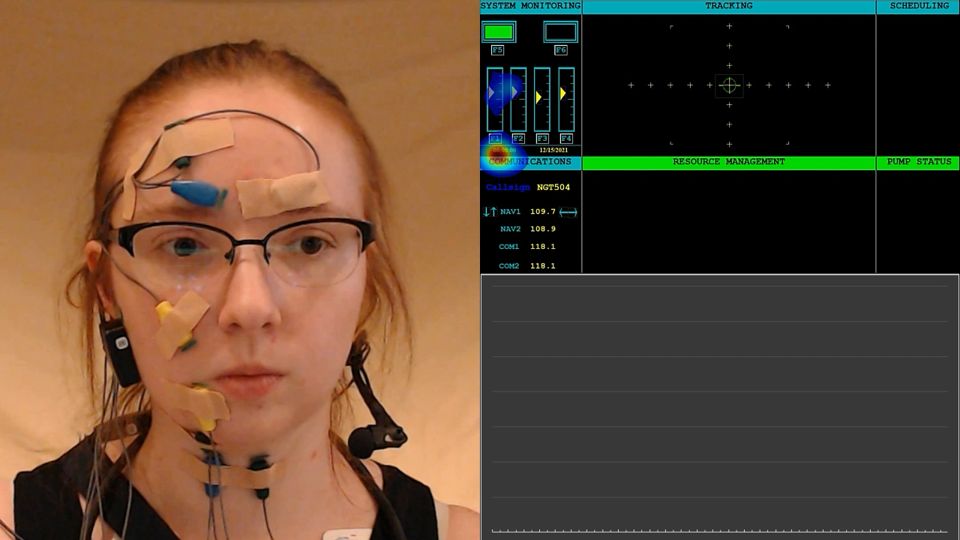

Slide 11
Discussion
Tracking task automation described here permits study of psychophysiological responses to disruptive automation behavior
Adaptive tasks demands support:
presenting a consistent range of challenges even as skills improve
efficient probing for contrasts between challenging-yet-manageable and overloading workloads
Push-button and verbal response ISA mechanisms were minimally disruptive and can be administered much more frequently than alternative subjective instruments
Real-time performance feedback appeared to increase participant engagement, understanding of task demands, and awareness of errors

