Slide 1
Digital Twins for Modeling Replacement Time for CAD/PAD
Dave Padula, Lone Star Analysis

Slide 2
Agenda
What is a CAD/PAD?
Problem Statement
Project Questions
Project Findings
Problem Details
Solution Details
Validation
Doctrine Analysis
Project Next steps
Q & A

Slide 3
What is a CAD/PAD?
Cartridge-Actuated Device / Propellant-Actuated Device (CAD/PAD) include:
  Catapults
  Rocket catapults
  Rocket motors
This project is scoped to the following devices installed on Navy Aircrew Common Ejection Seats (NACES):
  MT29 Parachute Deployment Rocket Motor (PDRM)
  WB15 Cartridge Actuated Initiator
  MT31 Under Seat Rocket Motor (USRM)
Notes:
- 2,500 Different CAD/PAD Types
- 380,000 individual components installed on aircraft
- NACES used in F/A-18 A through G and T-45

Slide 4
Problem Statement
Reliability Centered Maintenance (RCM) has proven inadequate.
Naval aviation continues to experience issues with CAD/PADs:
  Shortages
  Obsolescence
  Lot failures
  Production and shipping delays
Condition Based Maintenance (CBM) is now desired.
July 2007 in China Lake
No injuries, but significant damage to F/A-18
Notes:
70,000 Devices replaced annually (all CAD/PAD types)
RCM Ex. Replace the devices every 24 months
CBM Ex. Decide when to replace a device based on its condition and what it has been exposed to.

Slide 5
Project Questions
Can a CAD/PAD digital twin be developed that provides accurate measurements and predictions of remaining useful life for target devices?
Is the current RCM approach to removing and replacing target CAD/PADs on established service life timelines impacting safety and/or readiness?
Can CAD/PAD digital twin be achieved without adding additional sensors to the aircraft?

Slide 6
Project Findings
Digital twins generate results consistent with Naval Air Systems Command (NAVAIR) expectations.
Analysis suggesting RCM introduces a safety risk in some cases and severely under-utilizes effective life (increases cost) in others.
  One location found to make devices unsafe in as few as 12 months
  Premature removals lead to:
    Wasted procurement investment
    Negative impact to fleet mission readiness
Digital twins do not require additional aircraft sensor installations.
Notes:
Removal Doctrine is 24 months

Slide 7
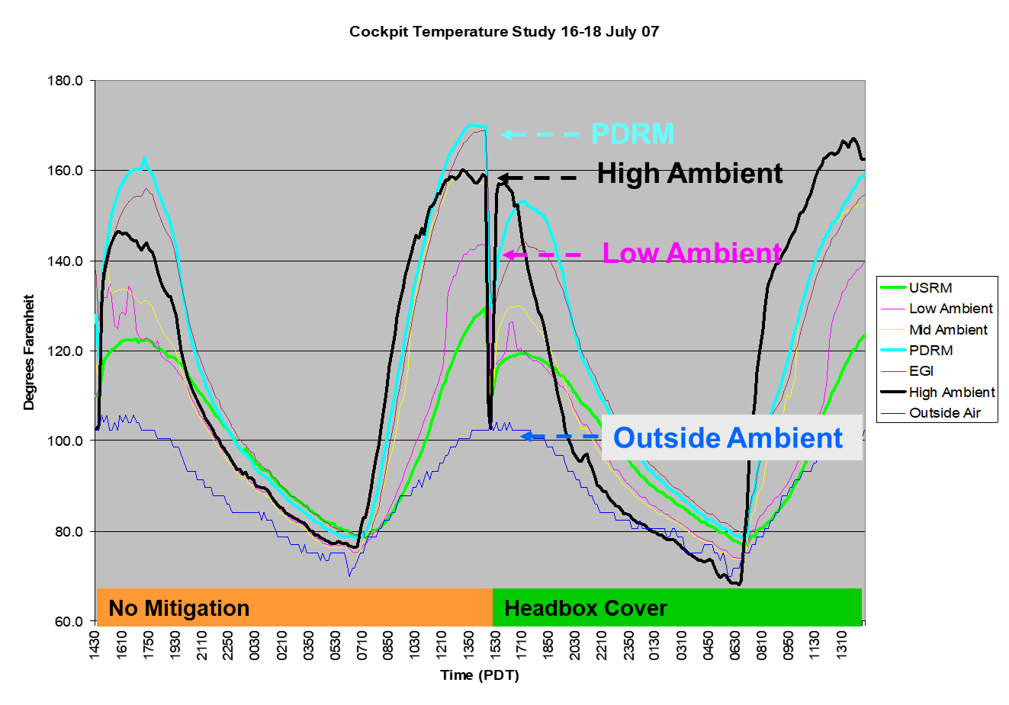
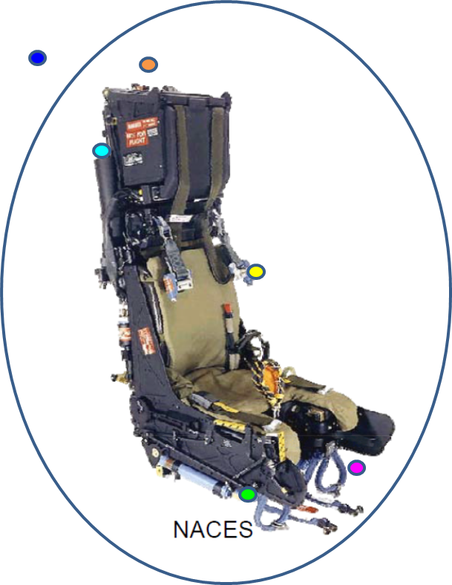
Problem Details
Effective Stabilizer Remaining dictates when device becomes unsafe and should be removed from aircraft.
Heat exposure causes degradation of the effective stabilizer.
No sensors. Solution must estimate the device temperature.
A 2007 temperature study was performed with sensors in aircraft.

Slide 8
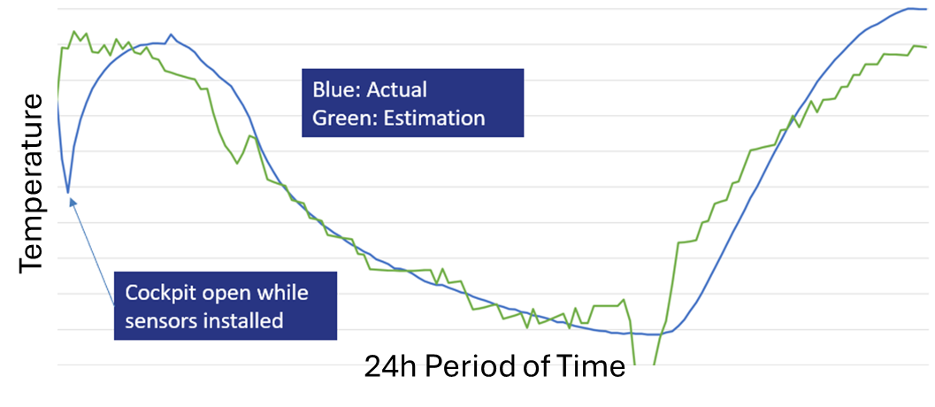
Device Temperature Estimation
A quadratic regression equation was developed to estimate the temperature of the devices.
Variables utilized in regression:
  Dry Bulb Temperature
  Solar Irradiance
    Calculated based on geographical location, time of year and time of day.
  Time Since Sunset
An adjusted R-Square of 0.843 was achieved for the PDRM device type.

Slide 9
Effective Stabilizer Degradation
Cumulative Energy Exposure
  Computed using the temperature of the device and duration of exposure.
Activation Energy
  Reaction rate of Mechanite-19.
  An Arrhenius-like equation provided by Naval Surface Warfare Center (NSWC) Indian Head Division (IHD).
Loss of Effective Stabilizer
  Cumulative energy exposure and activation energy is used to calculate loss of effective stabilizer.
Useful Remaining Life (Effective Stabilizer Remaining)
  Estimated by subtracting stabilizer loss from the starting amount.
    During production, a minimum amount is enforced but batch starting amount is not recorded and must be estimated.

Slide 10
Required Data
CAD/PAD Installation Data – At the serial number level, this device was installed into this aircraft, in this seat position, on this date.
  Data provided by NSWC IHD.
Location Data – This aircraft was at this location during these dates.
  Flight log data obtained through a US Navy database.
Dry Bulb Temperature – This location has historically seen these temperatures during these times of year.
  Data provided by Naval Oceanic and Atmospheric Administration (NOAA).
Notes:
Over the last 10 years:
At China Lake, during the month of July at 1100, the temperature ranged from 74 to 111 and is typically 100

Slide 11
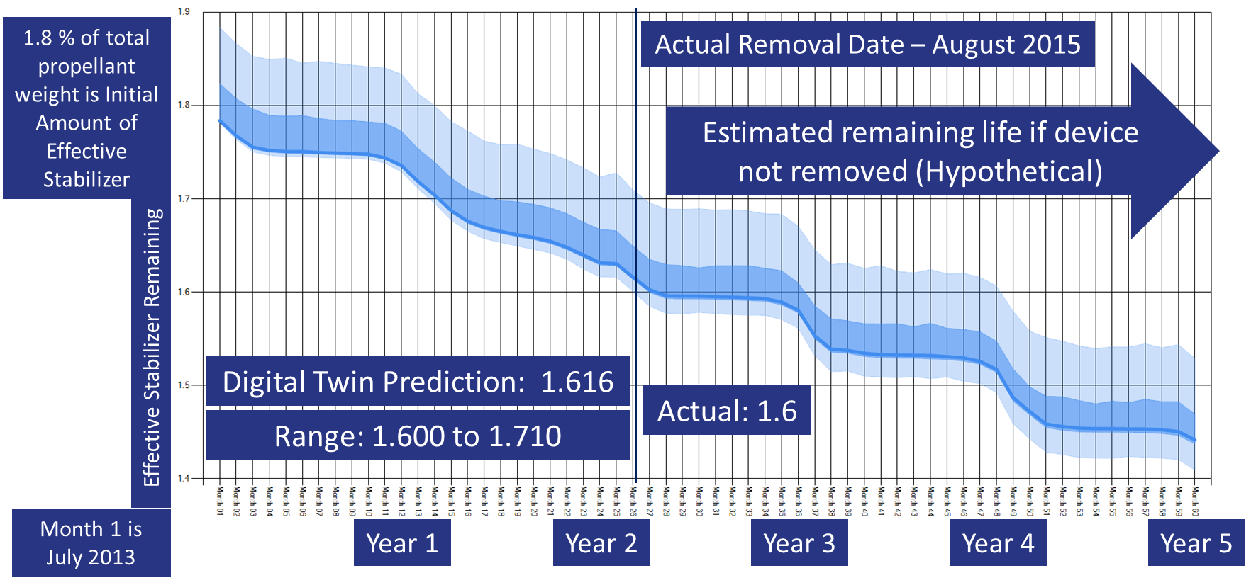
Solution Validation
Ordnance Assessment Reports (OAR)
  A sub-set of devices sent back to NSWC IHD are examined upon return and have their remaining stabilizer measured and recorded
Validation Opportunity
Notes:
- Monte Carlo Simulation
- Uncertainty Bands

Slide 12
Solution Validation
A total of four OARs were made available for validation
Last two tests likely had more starting stabilizer
Notes:
- Doctrine states effective stabilizer weight must be at least 1.8% of the total weight of compound during production.
- Some batches may start with as much as 2.2%
- Stabilizer weight is not recorded during production

Slide 13
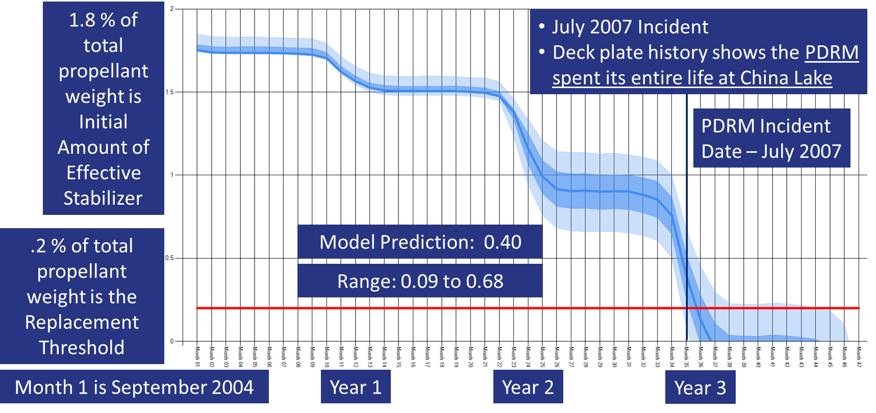
Solution Validation – 2007 Incident
A fifth validation was performed by running a scenario for the incident aircraft.
The digital twin showed device becoming unsafe in June 2007.
Incident occurred in July 2007.
Notes:
- 0.2% stabilizer weight deemed unsafe and should be removed

Slide 14
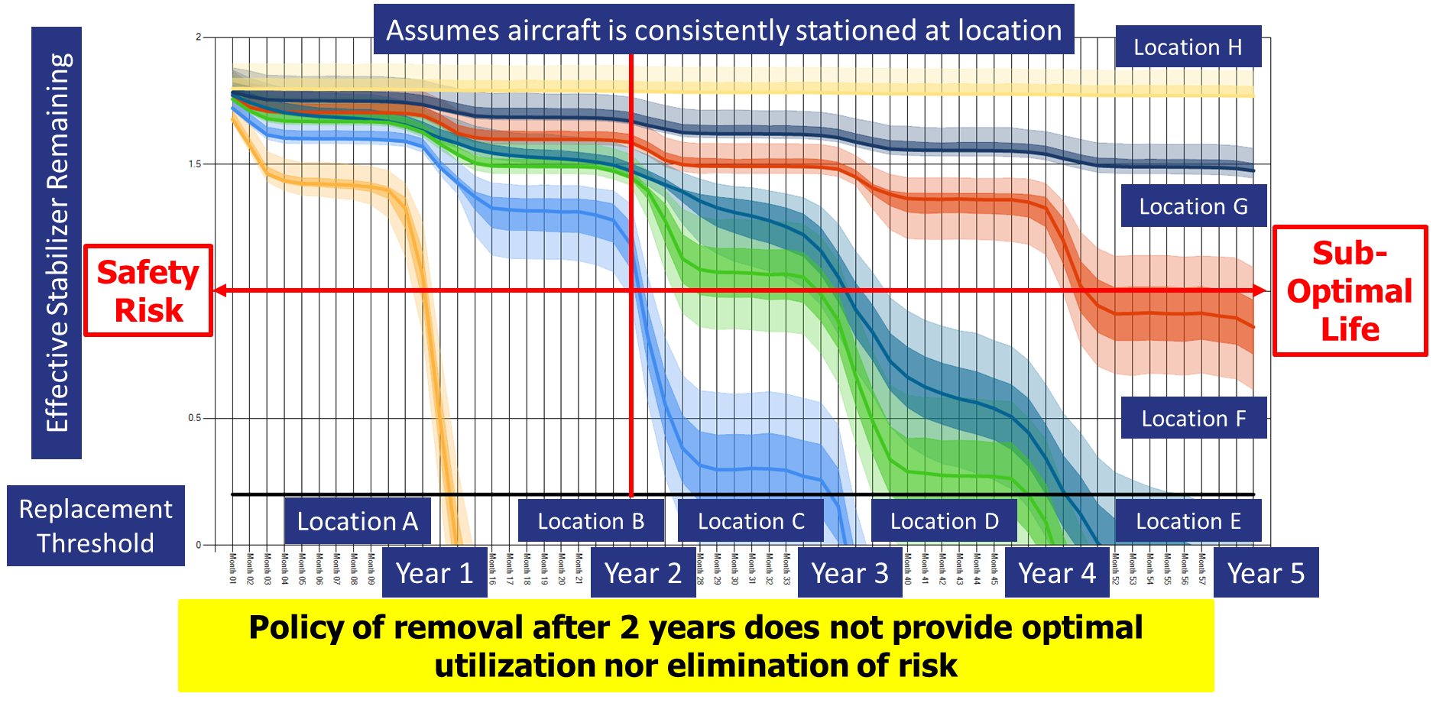
Doctrine Analysis
What happens if a device is deployed to same location for its installed life?
Results show some locations hit unsafe levels in as little as 12 months while others have useful remaining life after 5 years.
Notes:
Current RCM policy removes devices 24 months after install

Slide 15
Project Next Steps
Improve the quality of life for NSWC IHD Service Life Extension analysts.
  Automating the entry of input data.
  Automating the evaluation of individual scenarios.
Monthly Reports
  Deliver estimated effective stabilizer remaining for each in-scope device.
Further Model Validation
  NSWC IHD is collecting additional OARs.
Expand scope to include more CAD/PAD device types.

Slide 16
Questions?

