Slide 1
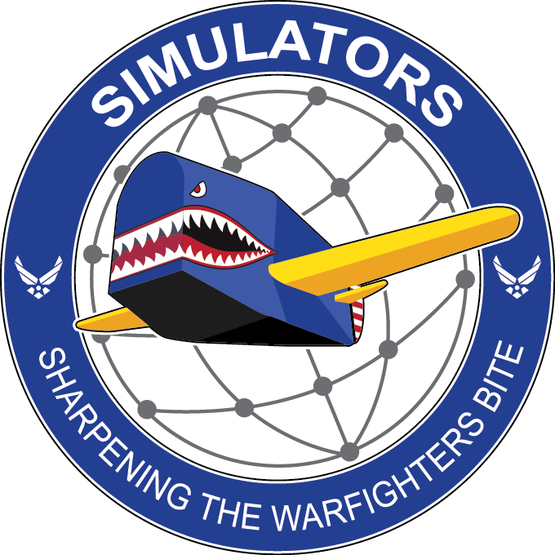
Digital Sustainment,
A Strategy For Success
George H. Ayers, AFLCMC/WNR
george.ayers@us.af.mil
Joseph A. Doak, USAF CTR, Tangram-Flex
Timothy J. Smith, USAF CTR, Tangram-Flex
Alexander D. Staton, USAF CTR, Tangram-Flex
Mohammed A. Khattab, USAF CTR, SAIC
Notes:
Good day!
I am George Ayers. I and my coauthors Joseph A. Doak, Timothy J. Smith, Alexander D. Staton, and Mohammed A. Khattab work for WNR, but used to work for WNS.
Out paper outlines how we are aligning the division’s digital strategy to AFMC's DMM goals and contribute meaningfully to the USAF's broader digital engineering strategy, ultimately enhancing warfighter readiness and operational agility in the era of great power competition.

Slide 2
Overview
Introduction
Digital First Culture
Developing Digital Strategies
Structure and Secure Data
Ensure Access to DMM Tools and Processes
Train the Digital Workforce
Modernize IT Infrastructure
Conclusion
Notes:
Standard USAF briefing format
Tell you what I’m going to tell you
Tell you
Tell you what I told you.

Slide 3
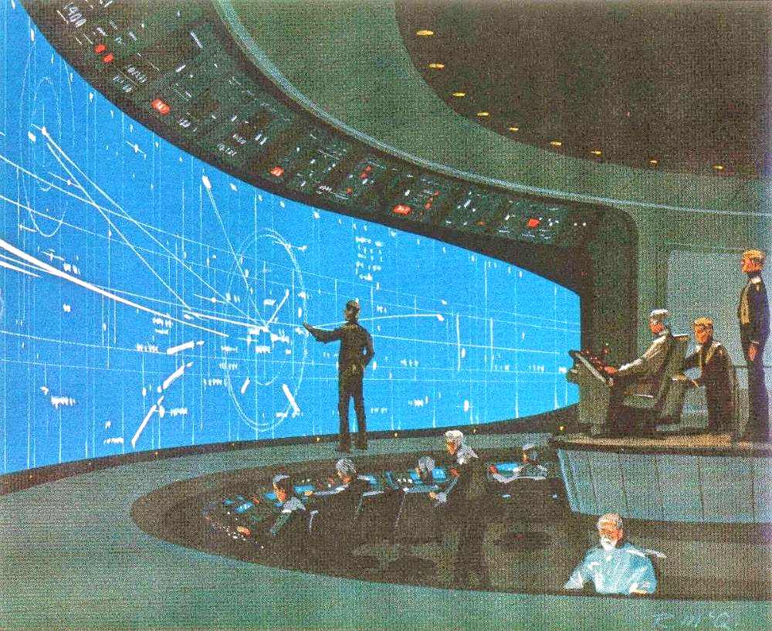
INTRODUCTION
DoD Process Improvement Efforts
Great Power Competition
Digital Materiel Management
Ralph A. McQuarrie, (c. 1978) CIC, Concept art for Battlestar Galactica [Digital Image]. https://galactica.fandom.com/wiki/Battlestar_Galactica_1978_Concept_Art?file=McQuarrie_CIC.png
Notes:
DOD Process Improvement Efforts
The drive to modernize and improve processes within the Department of Defense (DOD) predate the establishment of the Department of the Air Force.
As weapons systems grow ever more complex, the drive to efficiently manage development efforts has strived to keep pace with the scale of this complexity.
Building on accepted industrial practices, the DOD formulated a digital engineering strategy aimed at modernizing processes and improving the speed of delivery of new capabilities.
This strategy articulated five goals that leverage digital (model-based) engineering practices to improve the efficiency of communicating technical information, streamline processes, support advanced analytics, and inform decision making.
Great Power Competition
GPC in a nutshell
The recent DOD focus on Great Power Competition (GPC) is the most recent effort to adapt to current geopolitical circumstances.
As nations compete for influence, preservation of values, and economic prosperity, the USAF (and other branches) seek to deter other nations from considering using military force as a feasible strategic option.
Considering this, the USAF is reoptimizing it’s processes to better compete with the ever-accelerating pace of development and acquisition activities.
Department wide changes have recently been announced to properly confront the GPC focusing on “… developing people, generating readiness, projecting power, and developing capabilities …”
GPC Core Areas
Develop People, is focused on training personnel. This is done not only by improving training of skills for specific roles but also in how this training is developed, delivered, and assessed.
Generate Readiness, which focuses on mission readiness in addition to functional readiness – increasing the scope and scale of operational capabilities.
Project Power, emphasizes the operational and tactical aspects of the combined force by streamlining responsibilities and enhancing focus on mission.
Develop Capabilities, seeks to improve the flexibility, agility, and responsiveness of processes used to deliver new or improved capabilities to the warfighter.
DMM
Our current way of getting the job done, particularly acquisition, is not efficient enough. The white paper, Digital Materiel Management: An Accelerated Future State, describes the issues it seeks to rectify
The current capabilities development processes are no longer sufficient to stay in a long-term competitive posture.
Information does not flow between where it originates to where it is needed due to technical and cultural obstacles.
The application of digital practices in the world of defense acquisition is a likely means of shortening the time required to bring new capabilities to the field.
Leveraging the six key initiatives of the DMM effort, the Air Force can become better stewards of limited resources.
The WNS Digital Strategy
The mission of WNS is to provide the best training systems to enhance warfighter readiness.
This is primarily accomplished through acquisition and sustainment efforts, which have historically followed serialized process with limited capabilities for digital collaboration.
The reoptimization for GPC will require significant changes in how divisions like WNS operate. It amplifies the need for advanced training capabilities to ensure our forces remain agile, adaptable, and well-prepared to face any mission. WNS’s digital vision aligns with this imperative, emphasizing the importance of staying at the forefront of technology and talent development to maintain an edge in the global arena.

Slide 4
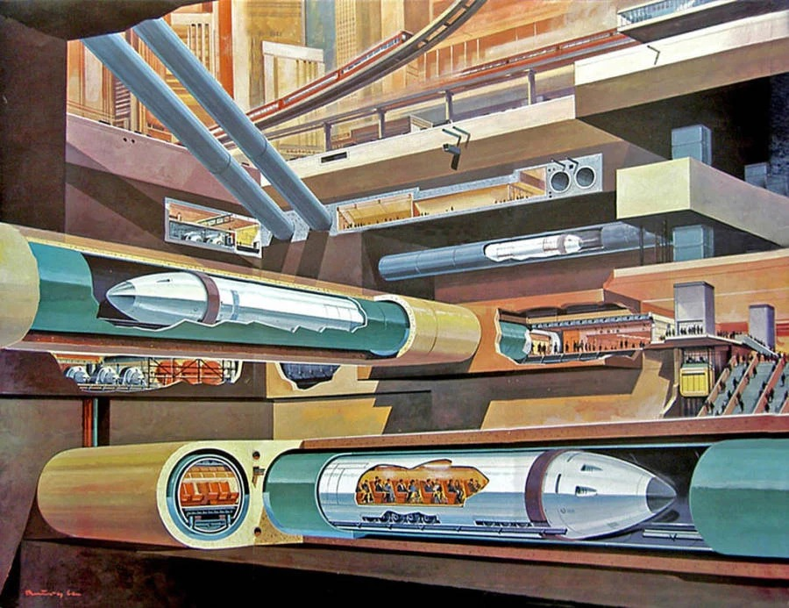
Digital First Culture
Improving efficiency, agility, and innovation
  Authoritative source of truth
  Enhanced decision making
Collaboration
  Real time transparency
  Improved quality
  Tracking changes
Klause Burgle, Tube Trains Under A City, 1969.
Notes:
The first initiative that supports a DMM capability is instilling a digital-first culture. Through this WNS would, through access to live digital artifacts, change the mode of communication with partners.
Digitization is more than just transforming analog artifacts into a digital format. It’s a fundamental shift for how we approach analyzing and solving problems.
Digital first enables the unification of tools across the enterprise, resulting in an effective digital thread.
A cohesive digital thread means an authoritative source of truth, increasing efficient, agility, and innovation
This allows for enhanced decision making
This allows for more efficient communication between government and industry – collaboration instead of review
Digital processes, in the place of manual ones, allow for real-time transparency for stakeholders, allowing for early detection of errors and an overall higher-quality final products.

Slide 5
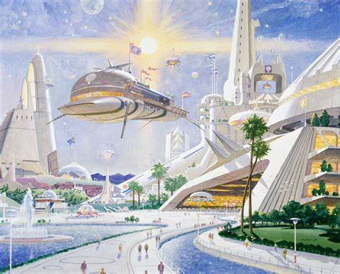
Digital First in WNS
Simulator Common Architecture, Requirements, and Standards (SCARS)
  Not born digital
Joint Simulation Environment (JSE)
  Born digital
  Efficiency through models
Robert McCall, Metropolis 2050 #3, 1984
Notes:
Two major programs within WNS (now WNR) that are focused on a digital-first mindset include the Simulator Common Architecture, Requirements, and Standards (SCARS) and the Joint Simulation Environment (JSE)
SCARS
While not “born digital”, the SCARS programs has used digital artifacts during source selection and throughout design reviews
An example of the SCARS digital initiative includes, creating system models that have allow for better requirement traceability -- These models have reduced design review times from weeks, down to just days
JSE
JSE is a program that has been majority digital since at least 2017
This joint program is currently the largest software development pathway program within the Air Force and has used models to communicate technical and administrative information.
Models of the software are used to communicate interfaces among developers across the enterprise.
SysML diagrams have been used to define key processes
Reference Architectures are being used to communicate requirements for program acquired hardware

Slide 6
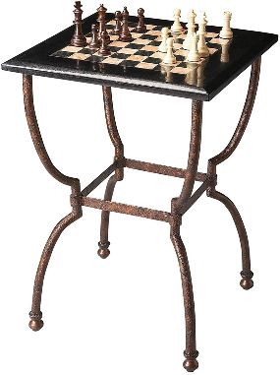
Digital Strategies
Establish a common digital vision
  Digital artifacts
  Digital processes
Overcome resistance to change
Win chess openings with this one weird trick
Notes:
The second DMM enabling initiative is developing and using digital strategies
The intent of this initiative is a vision is to use digital artifacts and processes across all functional throughout the lifecycle
Identify key artifacts that should be digital
Determine how to change processes to use digital artifacts – but don’t be limited to the old processes if new ones that accomplish the same goal are better
Overcome Resistance to change
Articulate the vision
Traditionally, many perform their work using documents and SharePoint, and may be unaware of the improvements that could be made with a digital mindset
A strategy to develop, implement, and sustain a digital first culture must be created to incentivize a new digital mindset

Slide 7
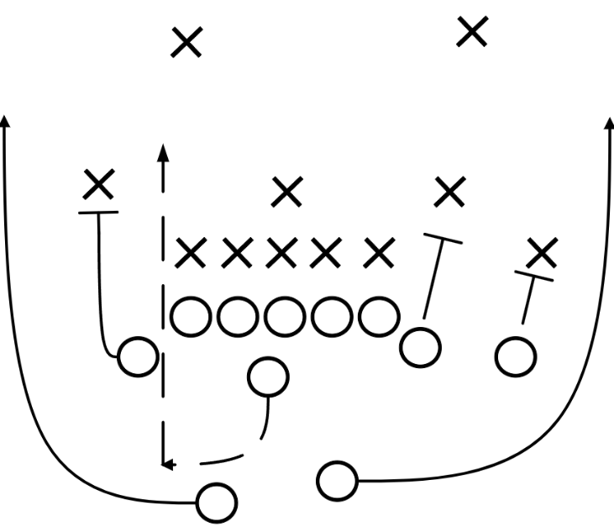
Digital Strategies in WNS
WNS (and WNR) digital strategy
  Infrastructure
  Commonality
  Organizational change management
Notes:
WNR digital strategy
WNR personnel will used digital artifacts and tools from their normal workstations to support activities to manage the enterprise
Must identify best practices in order to standardize when possible. This include common use of tools and processes
The movement towards digital is a significant change from the current standards and will require resources to formalize this organizational change
This will be familiar to those who saw the previous presentation

Slide 8

Data Structure and Security
Data Strategy
  Governance
  Architecture
  Integration and Interoperability
  Analytics
Cybersecurity
Paolo Soleri, Hexahedron Arcology, 1966
Notes:
The third DMM enabling initiative is structuring and securing data
A robust data strategy is essential for leveraging data as a strategic asset.
An effective digital strategy includes several key elements and processes
Governance
Data governance frameworks must be established to defines rules and procedures for data handling, ensuring consistency and reliability.
Governance provides consistent structure that facilitates interoperability and data exchange
Architecture
Architecture should be scalable and flexible to accommodate evolving needs of an organization
Standards
Standardized data formats facilitate interoperability
Put effort into determining what standards are appropriate
Integration and Interoperability
Involves developing frameworks and protocols for seamless data exchange
Analytics
Important to extract valuable insights from the organizations data
Cybersecurity
Cyber ensures that data is secure and protected to maintain operational continuity
Digital models play an important role in the processes leading up to an ATO
These models provide a virtual representation of the system, capturing architecture, components, and security protocols
Risk assessments are also made more efficient with the use of digital models

Slide 9

Data Structure and Security in WNS
Stakeholders
Use Cases
Data and Capabilities
Tyrell Building, Ridley Scott (dir), Blade Runner [film], 1982.
Notes:
Identify stakeholders
SCARS functionals and others
Talk to them
Develop use cases
Common tasks
Uncommon tasks
Determine data needs and usage
What needs to be captured in a model
What can be communicated by other means
What standards are appropriate
Determine needed and wanted capabilities
What must be done
What could we do, unfettered by current practices
Make plans
Prioritize with level of effort, benefit, and other factors
Increment planning
Train users
New capabilities, new processes
Write it down, but make sure to talk to people.

Slide 10

DMM Tools and Processes
Systematic Evaluation of Software
  Based on Digital guide
Ontological Diagrams
  Illustrating Interrelationships
Assessment
  Features and Utility to Division
Informed Recommendations
Security
  Multifactor
  Role-base access
  Encrypted Communication Channels
PLM Tools
Notes:
Overview
The fourth supporting initiative is to ensure access to tools and processes necessary for the DMM capability
AFMC Digital Transformation Office (DTO) provides comprehensive guidance on approved software tools available for the technology stack and integrated digital environment
The team conducted a thorough and systematic evaluation of the software listed in the Digital Guide (and other tools)
Identify tools of interest to WNS/WNR
Create a map of relationships between tools, tool categories, and users
Methodically assess each tool option for desired features and utility to the division, with the pros and cons of each option carefully listed
Use assessments to make informed choices for software tools and collaborative environments
To enhance tool accessibility, organizations must implement secure access protocols and ensure that only authorized personnel can use these tools
PLM tools are fundamental in managing the entire lifecycle of a product, from inception through design, manufacturing, and disposal

Slide 11
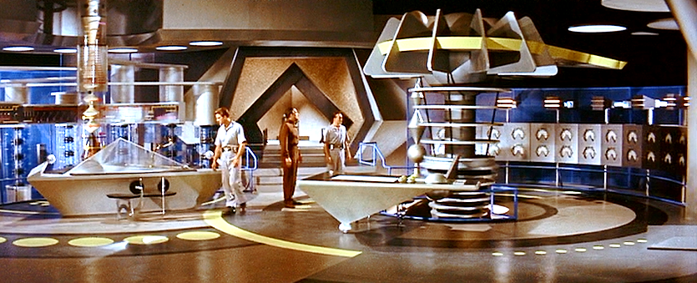
Workforce Development
Customizing Training
  Training Schedules
  Online Training
  Formats
Removing Barriers
  Support Services
  Tutoring
  Mentorship
Future Growth
Morbius’ Study, Fred M. Wilcox (dir), Forbidden Planet [film], 1956.
Notes:
The fifth DMM-supporting initiative is to train the digital workforce
When customizing training to make it appropriate to specific roles which use the tool in different ways, it is essential to tailor training programs that reflect the different sets of responsibilities and tasks that define these roles.
Ensuring that training is accessible to all who are interested involves addressing several key factors.
Training schedules should be flexible
Online training platforms
should be available in multiple formats
Removing Barriers
Support Services
Tutoring
Mentorship
Future Growth
the MBSE team is currently exploring how to support functional training plans that focus on specific digital skills relevant to each member of an Integrated Project Team (IPT).

Slide 12

IT Infrastructure
Collaborative Virtual Environment
  Capability Requirements
  Maintenance and Sustainability
  Administrators
  Infrastructure
Phuttaphat Tipsana, [Futuristic smart city infrastructure], [Digital Image], <https://shorturl.at/oTFiM>
Notes:
The sixth DMM-supporting initiative is to modernize the IT infrastructure to improve speed, connectivity, and accessibility – thereby providing a foundation for the DMM capability
Meeting necessary capability requirements is significant among the consideration for establishing a collaborative virtual environment and providing access to users.
Maintenance and sustainability efforts will likely require significant amount of labor hours for the virtual environment
Administrators of the environment need to be able to adapt and react to provide the best experience for the users.
Infrastructure is always changing – hardware and software become outdated or obsolete, requiring constant updates and review.

Slide 13
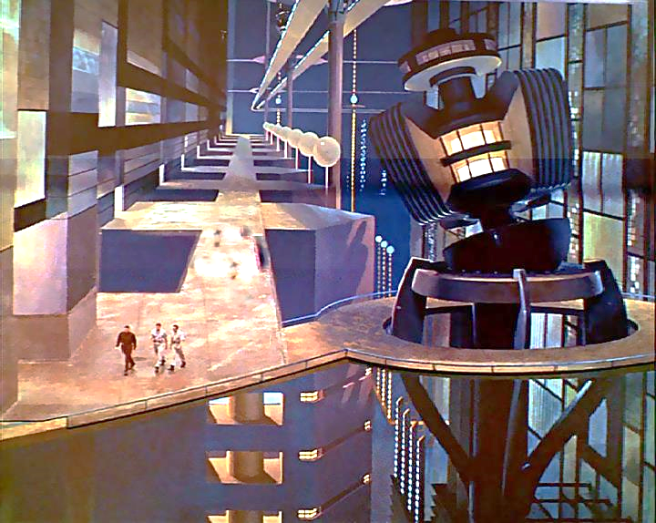
Summary
Current need is for improved efficiency in capabilities development and acquisition.
Building on previous efforts to develop digital capabilities, WNS and WNR will use DMM initiatives to address this need
The Krell Machine, Fred M. Wilcox (dir), Forbidden Planet [film], 1956.
Notes:
In this paper, we have discussed the aspects of the AFMC Digital Materiel Management capability in the context of the current period of Great Power Competition and previous efforts to use digital artifacts in defense systems acquisition. The six key initiatives that enable the DMM capability were examined from the perspective of what WNS has done in the past, and what it expects to do in the future.
Instilling a digital-first culture requires WNS to make a cultural shift to preferential use of digital artifacts and processes to facilitate more-effective communication between government and industry. Although they are in early stages, the SCARS initiative and the JSE program have served as useful examples of what can be done with this mindset. Developing digital strategies reinforces the digital-first mindset through use of the digital artifacts and tools. This helps to reduce the barriers to acceptance of a new way of working through an articulation of the vision for the future and the demonstration of the benefits of being digital. WNS is in the process of developing digital processes in addition to those used in the SCARS initiative and the JSE program.
Since data is the currency with which the future is acquired, structuring and securing the data is important. An understanding of how the data is used informs choices for standardized data structures in an overall data strategy facilitating the flow of information between source and user. WNS will build on earlier work that identified how members of IPTs could use models to inform models of information flows and develop new processes to take advantage of digital artifacts. Instituting a DMM capability requires both access to tools and the knowledge and skills necessary to use them. Since one size rarely fits all users, access and training should both be appropriate to the distinct roles within the enterprise. The established WNS role-based MBSE training approach will be expanded to additional digital tools and new digital processes.
A strong IT infrastructure is the foundation for using digital artifacts and processes. A robust, secure, collaborative environment will facilitate the flow of information and enhance the new digital processes. The current WNS digital environments are suitable for the current need and can be expanded to meet anticipated future needs. Professionally managed, these environments can concurrently accommodate government and commercial users, further advancing the DMM capability.
WNS has made significant efforts to develop digital capabilities to support enterprise-level portfolio management within the division. Expanding these efforts to support digital process in all functional areas across the lifecycle of simulators and training systems will both increase the efficiency of system sustainment and accelerate the pace of training system capability acquisition. This will result in reduced costs and faster capabilities development, enabling WNS to more-effectively “Sharpen the Warfighter’s Bite.”

Slide 14
References
Air Force Materiel Command. (2023, August 17). Digital Materiel Management: An Accelerated Future State.
Air Force Materiel Command. (2023, November 5). Technology Stack Software Tools. Retrieved from Air Force Digital Transformation: https://usaf.dps.mil/teams/afmcde/SitePages/Technology%20Stack%20Software%20Tools.aspx
Allvin, D. W. (2024). The Case For Change. Washington, D.C.: United States Air Force.
Ayers, G., Reed, C., Abraham, A., Doak, J. A., Evans, M., Jackson, C., & McCusker, B. (2020). "Model Based Systems Engineering for Simulator Sustainment". Interservice/Industry Training, Simulation, and Education Conference, Paper 20294. Orlando, FL: National Training & Simulation Association.
Henderson, K., & Salado, A. (2021, December 31). Value and Benefits of Model-Based Systems Engineering (MBSE): Evidence from the literature. Systems Engineering, 51-66. doi:https://doi.org/10.1002/sys.21566
Kendall, F. (2022, September 5). One Team, One Fight, One Year Later. Washington DC: United States Air Force.
Office of the Deputy Assistant Secretary of Defense for Systems Engineering. (2018, July 5). Digital Engineering Strategy.
Roper, W. (2020, October 7). There is no Spoon: The New Digital Acquisition Reality.

