Slide 1


Implementing MBSE Organizational Change at the USAF Simulators Division
Joseph A. Doak, USAF CTR/Tangram Flex
aaron.doak@tangramflex.com
Andrew Frost, USAF CTR/Tangram Flex
Sameep Singh, USAF CTR/PLEXSYS
George H. Ayers, USAF
Mohammed Khattab, USAF CTR SAIC
Notes:
All Presentations will be displayed using Sony VPLFH30 LCD Projector – or similar with 1920 x 1080 resolution and 16:9 aspect ratio

Slide 2
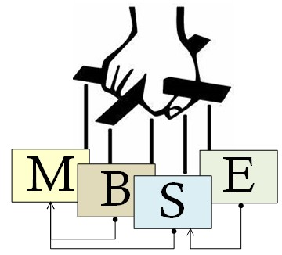
Overview
Introduction
OCM Challenges
8 steps of Kotter
Lessons Learned
Conclusion

Slide 3
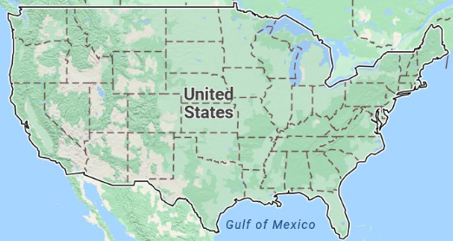

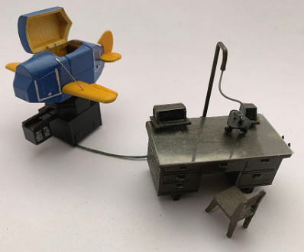

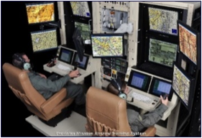
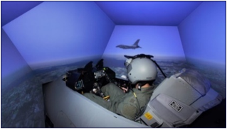
Introduction
Who is WNS…and WNR?
What do we do?
Notes:
If WNS is doing sustainment, then why do they care about MBSE
Intro about why what are we doing is unique/novel
Introduction should include the motivation… why do we think this effort is novel?
Talking Points:
WNS manages the sustainment of the AF training devices
WNR is a recent split from WNS that includes cross-platform supportive programs
Includes all sorts of training devices; from maintenance trainers and computer based trainers, to full fledged high fidelity simulators
Not developing simulators from scratch, but some development work in the form of ECPs.
Mostly interested in using MBSE to support sustainment efforts.
Image Credits:
WPAFB Sign: https://th.bing.com/th/id/R.eeaefa1c9b505ed8578053d54eef9425?rik=gLNfYpeVla4ruw&pid=ImgRaw&r=0
Map: www.maps.google.com
Blue Box Trainer: https://essmc.org.au/wp-content/uploads/2020/10/david_hutchinson_wwii_link_trainerblue_box_09_trimall.jpg
Advanced Flight Training Device and Simulator: IITSEC PPT Presentation for Reed, C. (2019). "The Foothold in the War of Cognition: The Operational Training Infrastructure Enterprise System Model". Interservice/Industry Training, Simulation, and Education Conference, Paper 19226. Orlando, FL: National Training & Simulation Association.

Slide 4
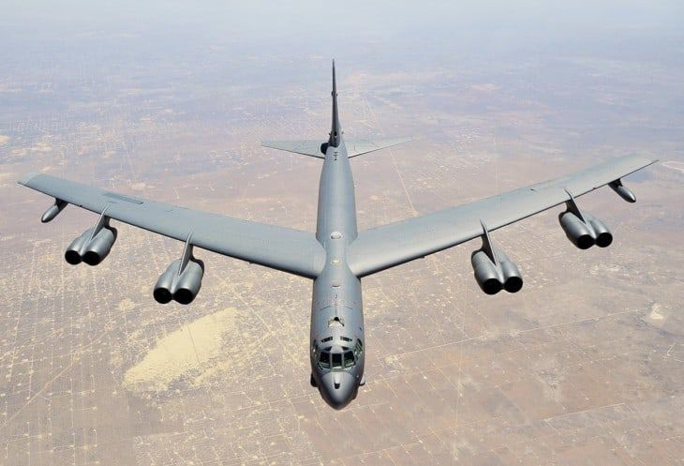
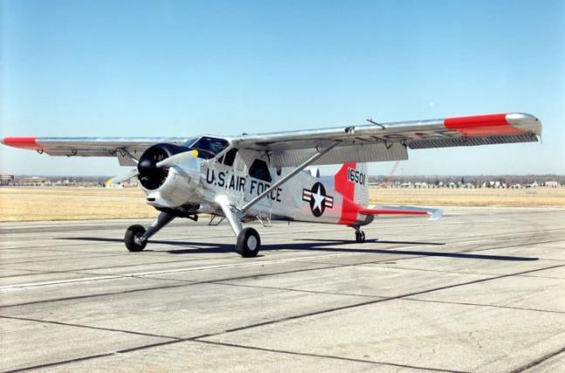
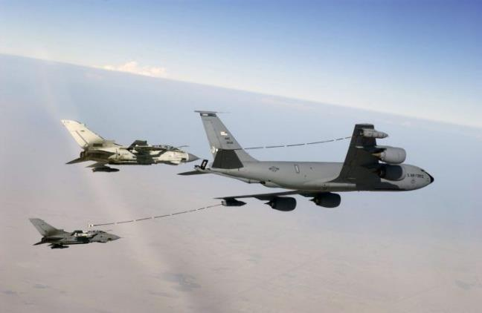
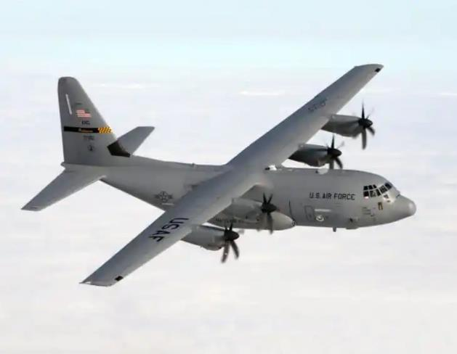
OCM Challenges
MBSE…for Sustainment?!?
  Aircraft have a long lifespan
  Limited ROI
B-52 Stratofortress
(1955)
U-6A Beaver
(1947)
C-130 Hercules
KC-135 Stratotanker
(1954)
(1956)
Notes:
Talking Points:
MBSE is generally used for system development, not sustainment?!?
Oldest aircraft still in use is….? The U-6A Beaver. More common platforms are still as old as my parents.
Aircraft have long lifespans with many revisions. MBSE is useful for sustainment, particularly for ECPs and Tech Refresh modifications.
Image Credits:
Top 12 Oldest Military Planes Still in Service - Aero Corner

Slide 5
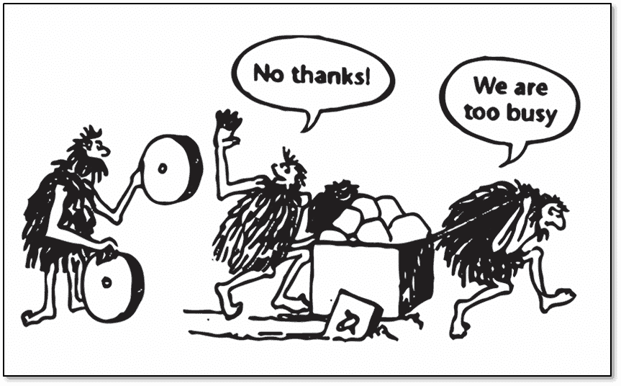
OCM Challenges
Change is hard - Common Barriers to Successful Transformation
Deloitte and Touche report of common barriers for successful transformation (Deloitte & Touche, 1998)
Notes:
Talking Points:
Deloitte and Touche identified most common barriers to change
Image Credits:
Graph: Data from Deloitte and Touche report of common barriers for successful transformation (Deloitte & Touche, 1998)
Too Busy: https://sopro.io/wp-content/uploads/2020/12/wheel-funny.png

Slide 6
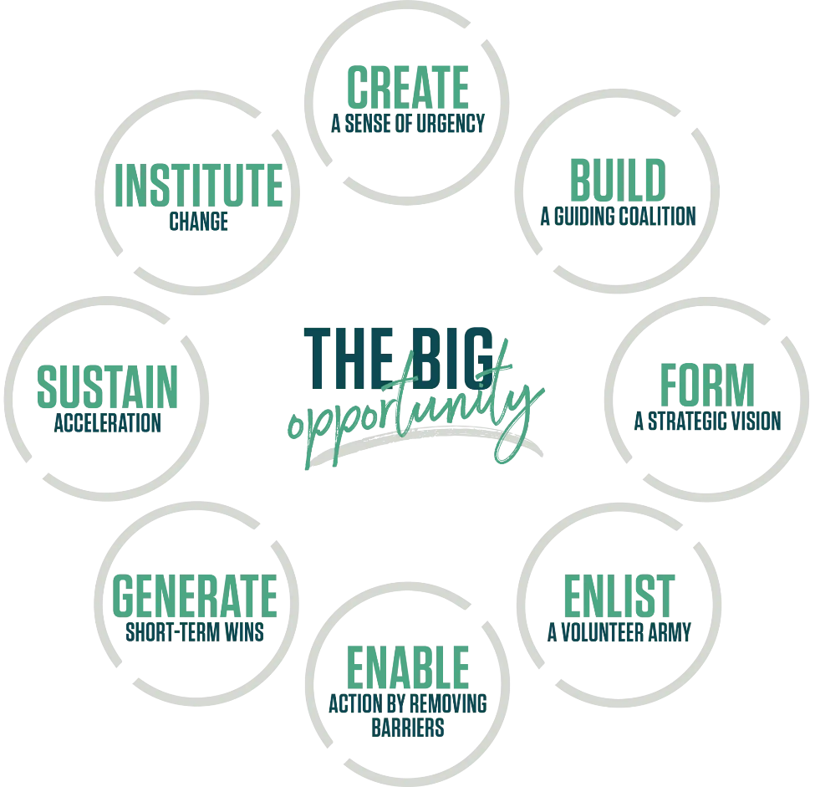
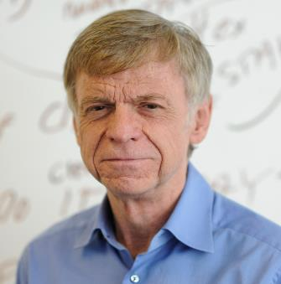

8 Steps of the Kotter Model
Dr. John Kotter
CREATE
A Sense of Urgency
BUILD
A Guiding Coalition
INSTITUTE
Change
SUSTAIN
Acceleration
FORM
A Strategic Vision
GENERATE
Short-Term Wins
ENLIST
A Volunteer Army
ENABLE
Action by Removing Barriers
Notes:
Talking Points:
A structure/framework is needed to implement OCM….Meet Dr. Kotter
8 steps to OCM, the meat and potatoes of our paper is tying WNS MBSE’s efforts to these steps.
Create a Sense of Urgency
Building a Guiding Coalition
Form Strategic Vision
Enlist a Volunteer Army
Enable Action by Removing Barriers
Generate Short-Term Wins
Sustain Acceleration
Institute Change
Image Credits:
https://www.gspeakers.com/wp-content/uploads/2018/03/nHWZ0YNZ.jpg
https://www.kotterinc.com/methodology/8-steps/

Slide 7

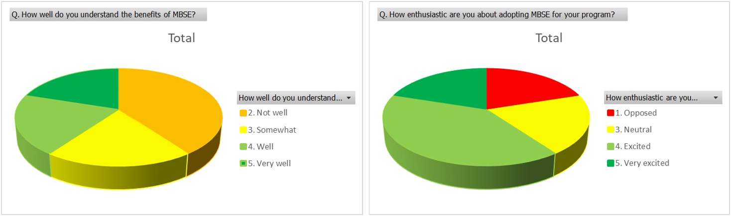
The Kotter Model at WNS (Step 1/8)
Step 1: Create a Sense of Urgency
2017 National Defense Authorization Act (NDAA)
DOD’s 2018 Digital Engineering Strategy
There is No Spoon: The New Digital Acquisition Reality
DODI 5000.88
Understanding the benefits of MBSE
Enthusiastic about adopting MBSE
Not Well
Somewhat
Well
Very Well
Opposed
Neutral
Excited
Very Excited
Notes:
Highlighting threats and opportunities
Build a compelling case
Communicate the importance of immediate action
Talking Points:
Our sense of urgency was driven by AF regulations/publications/mandates listed here
We also polled our programs that have started implementing MBSE for various Kotter OCM related topics, the first of which is shown here.
We currently have a mixed bag of users understanding the benefits of MBSE but most are excited to adopt it.
Image Credits:
There_Is_No_Spoon_(Digital_Acquisition)_7_Oct_2020.pdf (af.mil)

Slide 8


The Kotter Model at WNS (Step 2/8)
Step 2: Building a Guiding Coalition
Leadership drives change
Mixed levels of support lead to:
  Incomplete messaging
  Stinted effects of future steps
  Delays & Missed opportunities
Notes:
Talking Points:
Strong and visible support from leadership is essential to effect significant change.
WNS did have some leadership support, but not all were unified
Incomplete messaging
Stinted effects of future steps
Delays & Missed opportunities
Image Credit:
https://www.vectorstock.com/royalty-free-vector/missing-person-poster-template-vector-45392463

Slide 9

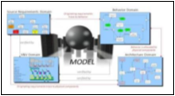
The Kotter Model at WNS (Step 3/8)
Step 3: Form Strategic Vision
WNS MBSE Strategy document
Implementing DE Step 1: MBSE
Envisioned MBSE
Current DBSE
Tools
Guidance
Training
Model Support
Processes and Plans
Notes:
clear vision that directs the change effort and developing strategies to achieve it
Ensuring that the vision is easily communicable and understandable
Talking Points:
Here’s our high level strategy for implementing MBSE

Slide 10
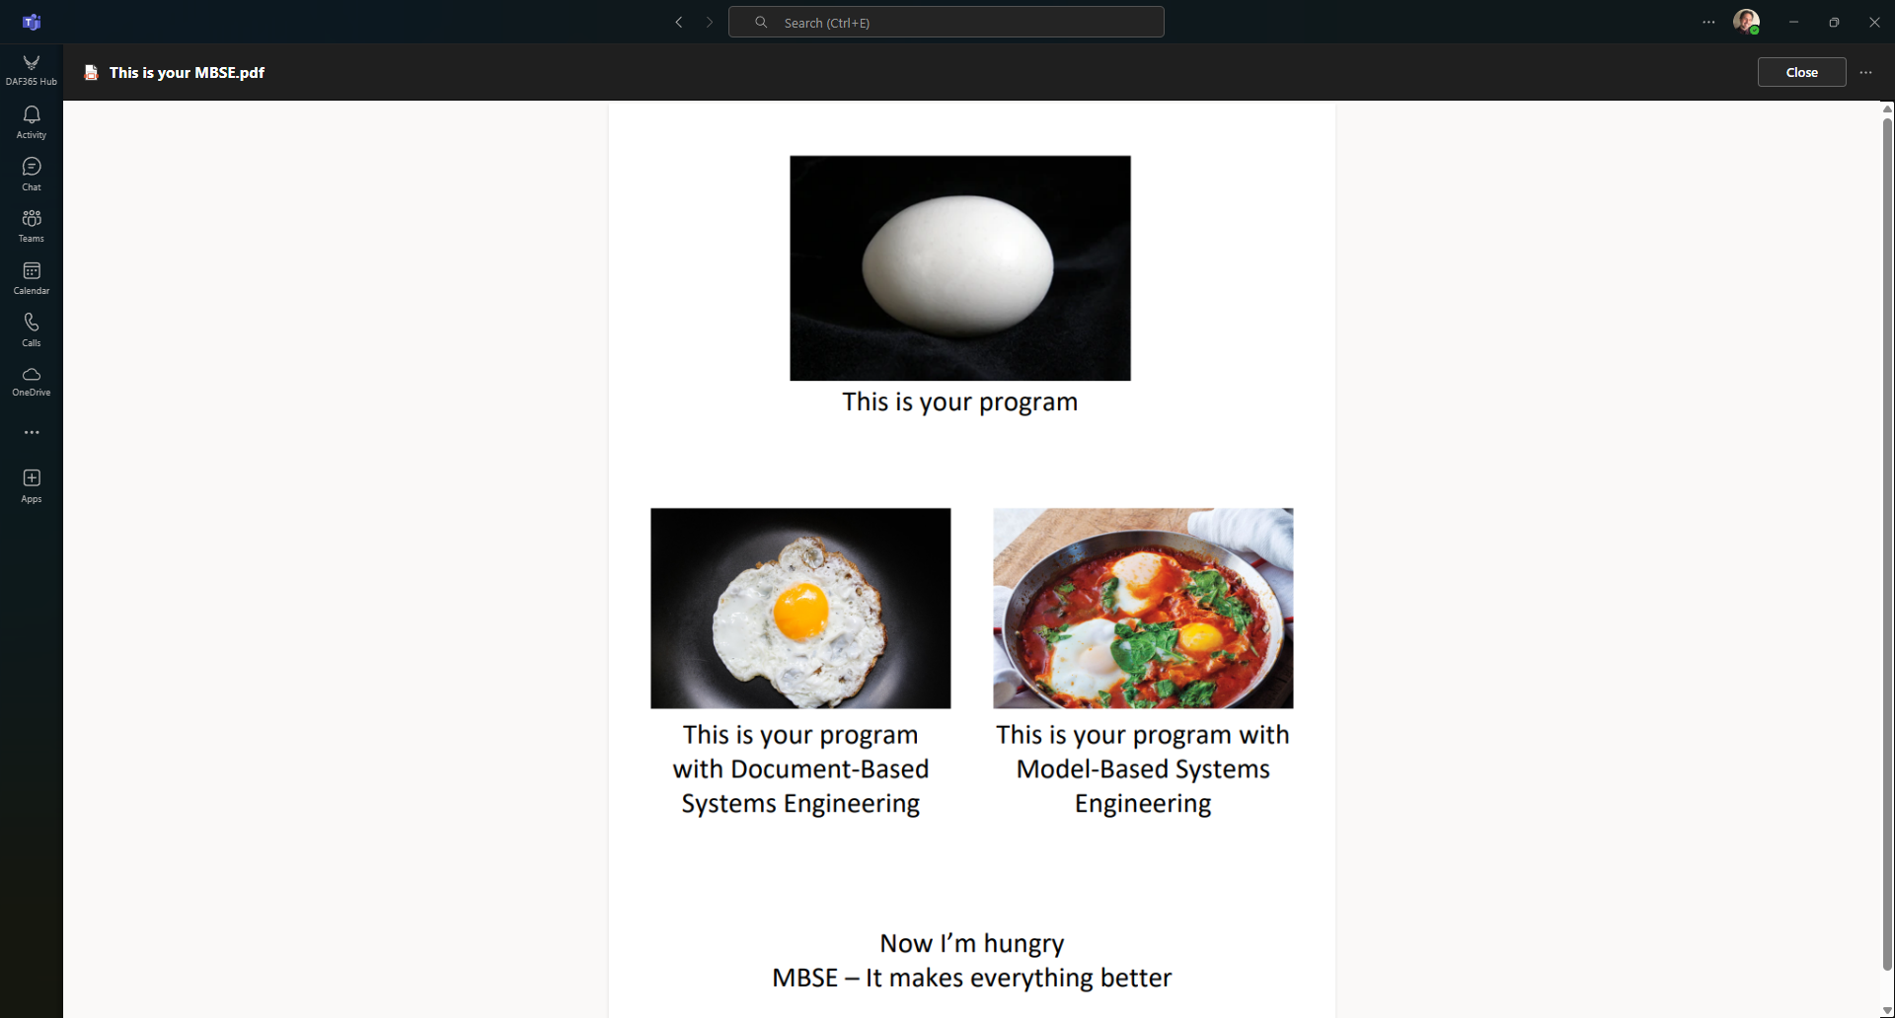
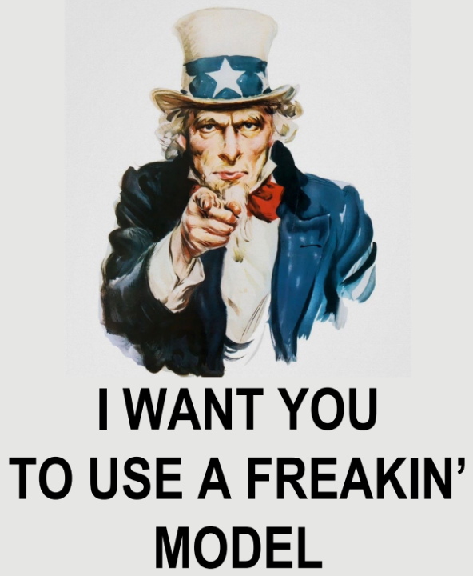
The Kotter Model at WNS (Step 4/8)
Step 4: Enlist a Volunteer Army
Enlisted Champions of Change
This is your program
This is your program with Document-Based Systems Engineering
This is your program with Model-Based Systems Engineering
Now I’m Hungry
MBSE – It makes everything better
Notes:
Broad communication of the vision and strategy
encourage and inspire employees at all levels to support and participate in the change
Storytelling and personal appeals can make the vision relatable and engaging.
Talking Points:
Guerrilla Marketing Campaign
Enlisted champions of change from different Integrated Project Teams (IPTs)
Early training
Help build excitement from the ground level
The MBSE team worked on building alliances with various groups and enlisting champions of change from different Integrated Project Teams (IPTs), including members from engineering, configuration management, and software research and development.

Slide 11
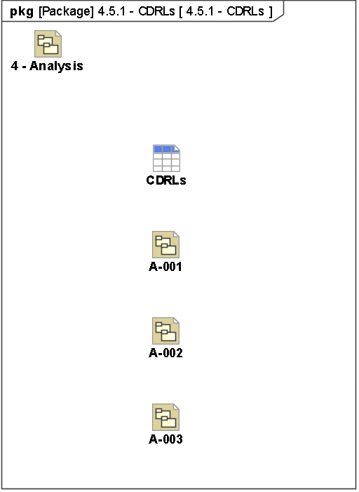
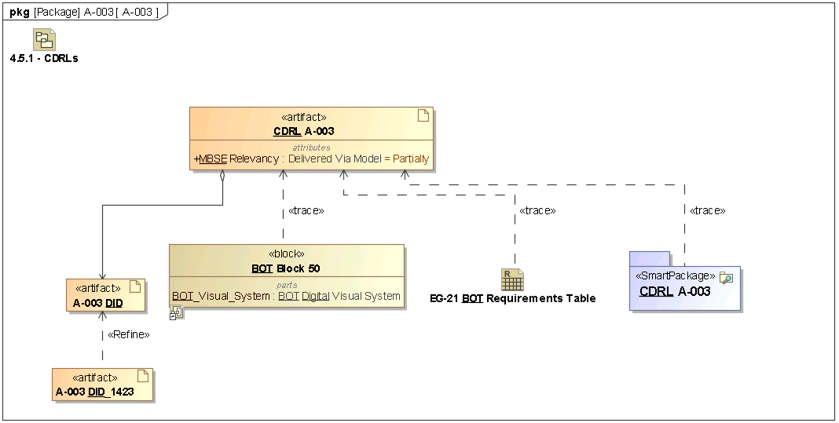
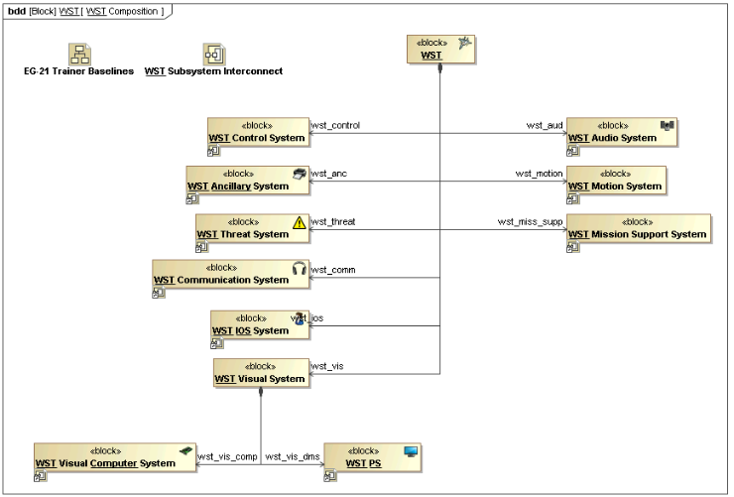
The Kotter Model at WNS (Step 4/8)
Step 4: Enlist a Volunteer Army
Communicate vision and strategy
  Crafted an example MBSE model, the EG-21
Notes:
Broad communication of the vision and strategy
encourage and inspire employees at all levels to support and participate in the change
Storytelling and personal appeals can make the vision relatable and engaging.
Talking Points:
Crafted an example MBSE model, the EG-21, to help communicate the vision/strategy and inspire support and participation
Structure to help understand the core of the model
“IPT section” to story tell how IPTs will use the model
The MBSE team worked on building alliances with various groups and enlisting champions of change from different Integrated Project Teams (IPTs), including members from engineering, configuration management, and software research and development.

Slide 12
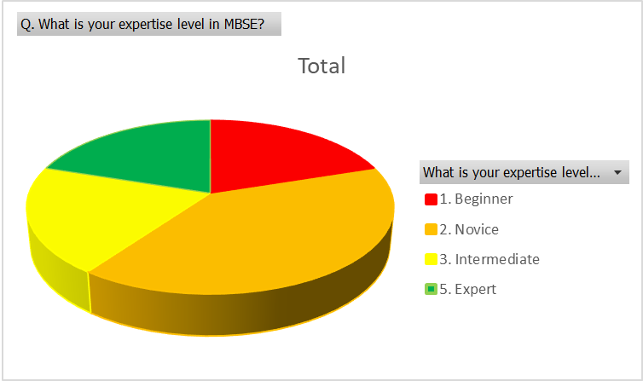
The Kotter Model at WNS (Step 5/8)
Step 5: Enable Action by Removing Barriers
Collaborative Environment
Contract Language
Training WNS MBSE Team
Multi-Tier Role Based Training
  101 – DMM in a Model-Based Environment
  201 – Introduction to MBSE and SysML
  301 – Applied MBSE using SysML
  401 – SysML Model Analysis and Evaluation
Incremental Training
MBSE Expertise levels
Beginner
Novice
Intermediate
Expert
Notes:
Talking Points:
Three main barriers: Training, access to tools, and contract language
We developed and offered several classes for teaching MBSE, now offered through AFIT to all of the AF
We also stood up our own collaborative environment using a contractor to manage it
We modified contract language to have boiler plate templates that include MBSE

Slide 13

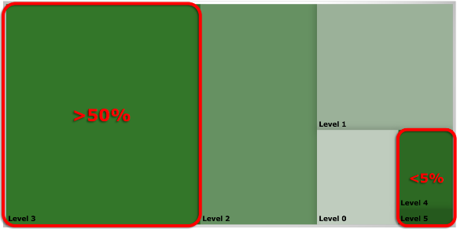





The Kotter Model at WNS (Step 5/8)
Satterthwaite, R. M. (2023). MBSE Incrementally. 2023 MBSE Cyber Experience Symposium. Allen, TX: Catia.
Incremental Training
Level 1
Level 4
Level 3
Level 2
Level 0
Level 5
Notes:
Talking Points:
Concept of Incremental training pulled from Satterthwaite, R. M. (2023). MBSE Incrementally. 2023 MBSE Cyber Experience Symposium. Allen, TX: Catia.
Incremental training modifies traditional large block training to small frequent training sessions. Keep users engaged over longer periods of time is more effective
Not everyone needs to be experts, image depicts appropriate levels of expertise across a company.
Image Credits:
Free for use stickers from Microsoft Stock Images

Slide 14
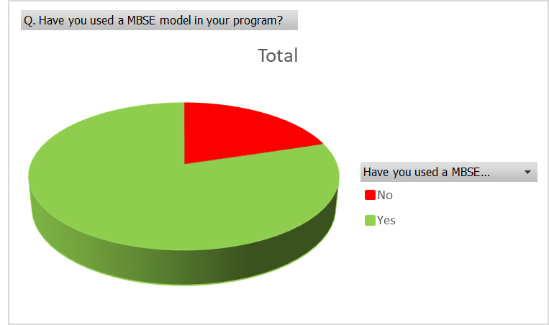
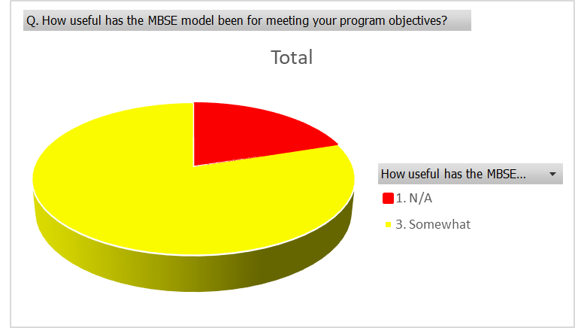
The Kotter Model at WNS (Step 6/8)
Step 6: Generate Short-Term Wins
Model usage
  12 Programs implementing MBSE
Main benefits
  Better System Understanding
  Installed Systems Management
WNS MBSE Style Guide
Have you used MBSE?
No
Yes
How useful has it been?
N/A
Somewhat
Notes:
one program reported that their MBSE model helped consolidate disparate information, identifying miscommunications and gaps in requirements. Another program noted that the model aided in understanding and managing different system configurations. Additionally, another program highlighted the model's role in improving communication between stakeholders, as it serves as a single repository of relevant data that can be easily shared.
Talking Points:
Style Guide adopted as part of the SCARS data standards and the JSE program
One is program not using MBSE bc it’s being sunset
MBSE-ifying Contract Language (PWS, SOW, 1423s, DIDs)​

Slide 15
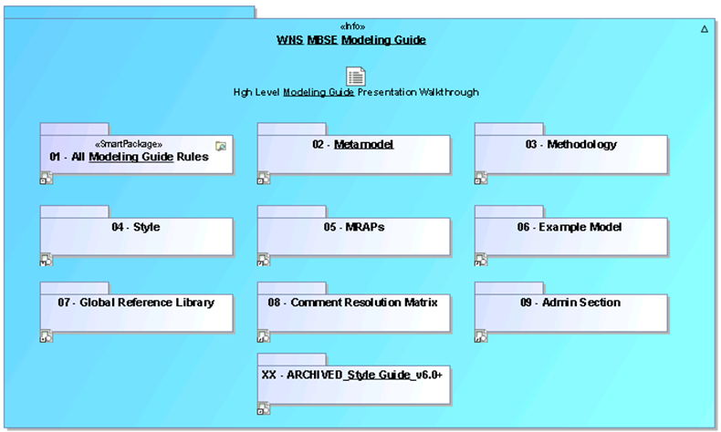
The Kotter Model at WNS (Step 7/8)
Step 7: Sustain Acceleration
Expected increase in model usage
WNS Style Guide → WNR Modeling Guide
  Metamodel
  Methodology
  Style Guidance
One model to rule them all → One model per purpose
Notes:
continuously look for improvements and opportunities, and maintain a sense of urgency to avoid complacency.
Talking Points:
Limited usage currently, but expect that to increase
Our Style Guide has evolved into a modeling guide
One Key aspect of our modeling guide methodology is our Modelverse

Slide 16
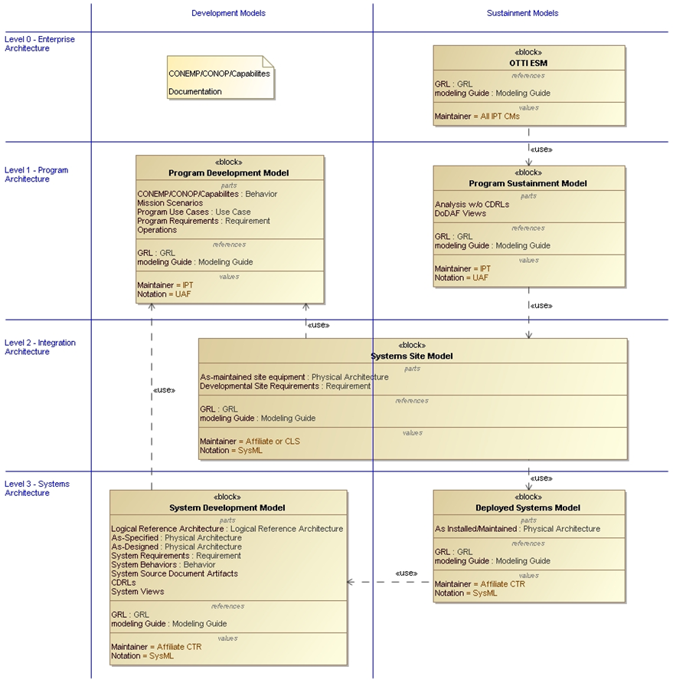
The Kotter Model at WNS (Step 7/8)
Development Models
Sustainment Models
WNS MBSE Modelverse
CONEMP / CONOP / CAPABILITIES Documents
Enterprise Systems
Enterprise Architecture
Program Development
Program Sustainment
Program Architecture
Systems Site
Integration Architecture
System Development
Deployed System
System Architecture
Notes:
Talking Points:
We created the WNS MBSE Modelverse to show the different types of models relevant to WNS and how they work together.

Slide 17
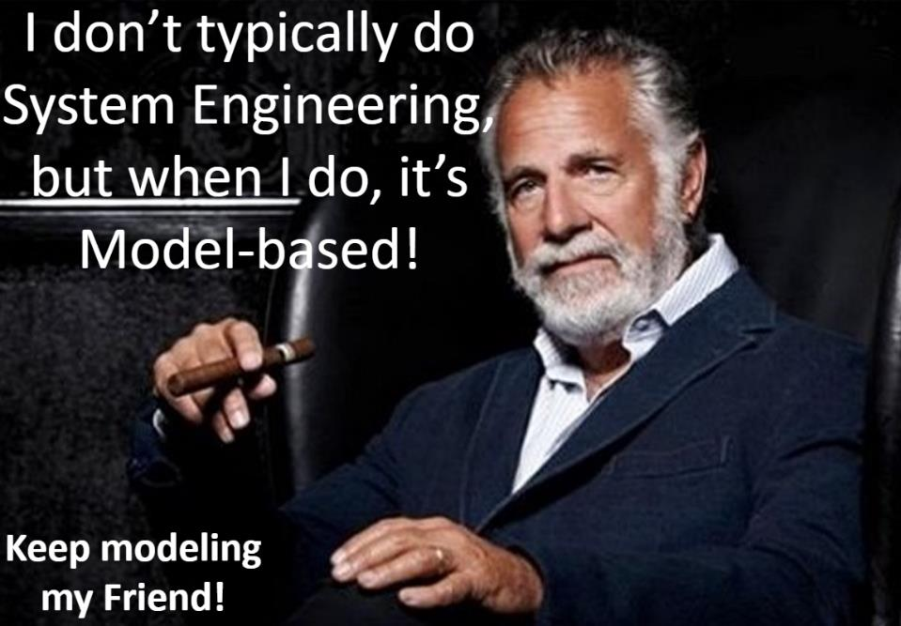
The Kotter Model at WNS (Step 8/8)
Step 8: Institute Change
OSEP mandates DE & MBSE
Short Term Goal: Improve WNS training system management
Long Term Goal: Improve enterprise management
Notes:
Anchoring new approaches in the organization’s culture is essential for lasting change. This involves ensuring that the changes are deeply rooted in the organizational culture, reinforcing them through policies, procedures, and norms, highlighting the connections between the new behaviors and the organization’s success, and promoting and developing leaders who can continue to drive the change.
Talking Points:
Still a work in progress
Short Term Goal: Manage WNS training systems using MBSE models:
ECPs
Logistics management
Audits
Affiliate CDRL deliverables
Increased traceability
Better understanding of change points
Long Term Goal: Provide a comprehensive enterprise system view
Image Credits
https://th.bing.com/th/id/R.f3fe560abbb791b83dbaeaaa5fdbad87?rik=wXfGC2oGBx3OZw&riu=http%3a%2f%2fmanjr.com%2fwp-content%2fuploads%2f2010%2f08%2fjonathan-goldsmith.jpg&ehk=IhJciWaoNVJfWZHpEddnOn8rYuIR6JnZpgFfW4RPaGQ%3d&risl=&pid=ImgRaw&r=0

Slide 18
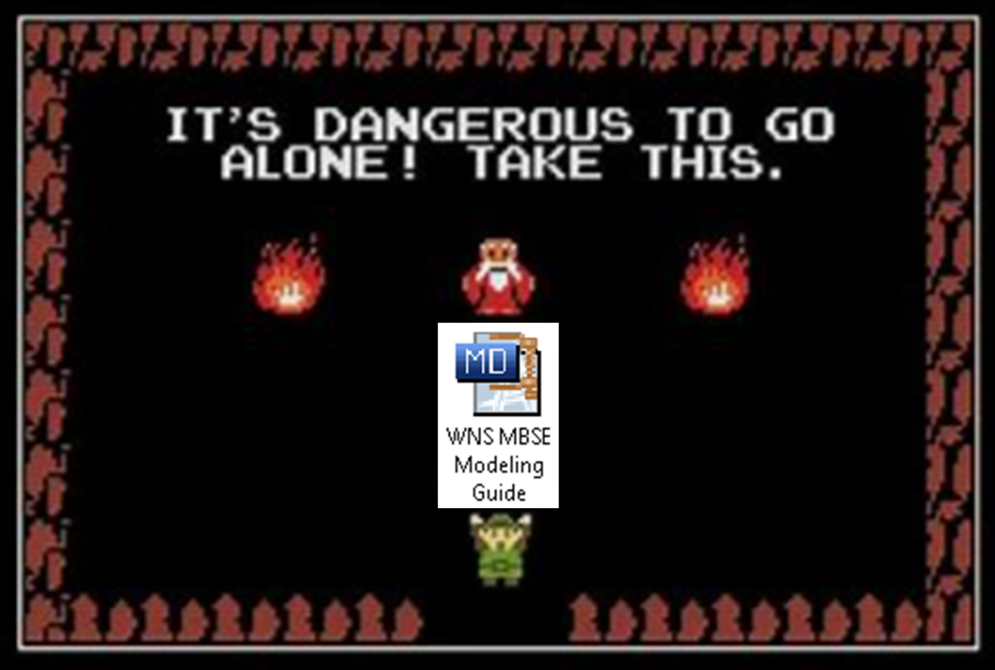
Lessons Learned
Critical Elements to aid OCM
  Leadership Support
  Example Models
  Modeling Guidance
  Frequent Training
Modeling for sustainment
  Juice > Squeeze?
  Implementing mid-contract is expensive
  Frequent Affiliate contact
Notes:
Talking Points:
A lack of support from leadership will make adoption significantly more difficult.
Single long-form training sessions, if not followed by continuous practice, will result in knowledge atrophy.
Demonstrating capabilities with example models is far more effective in building excitement and confidence than merely discussing them.
Modeling Guidance needs to be consistent throughout an organization. This guidance can be either adopted or developed, but standards should be set and disseminated.
Image Credit:
https://i.etsystatic.com/14159953/r/il/f25886/1168713642/il_fullxfull.1168713642_h6ej.jpg

Slide 19

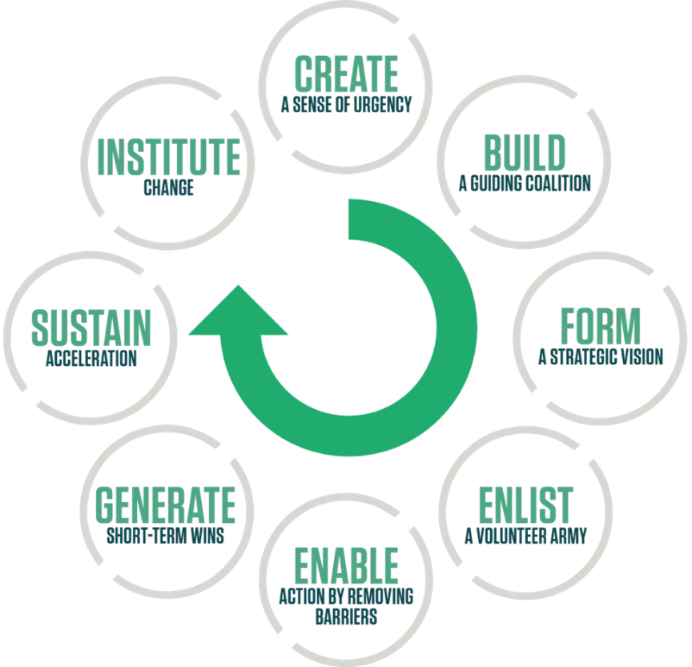



Lessons Learned & Conclusion
WNR/WNS MBSE transformation is underway
Don’t skip any of Kotter’s steps!
Notes:
Talking Points:
We’ve had a few set backs and missed opportunities, but overall we’ve done well following the Kotter model
Sense of urgency was handed to us
Could have done more to get all leadership onboard
Good job organizing our team and building an example model to inform our early adopters of our vision
Had a hiccup with skill atrophy that we’re resolving with incremental training, and somewhat naturally through receiving more models from affiliates.
Building blocks are in place, mostly a matter of time before the change is properly engrained in the culture.
Hand full of short term wins from our early programs and good guidance to help sustain our acceleration
Continuing our work + time = MBSE becoming engrained in our culture
Some additional takeaways include:
When considering implementing MBSE for sustainment, need to consider per program if it make sense.
When is the program being retiring?
Are changes expected to the architecture?
How will the model be used?

Slide 20

Questions
Notes:
Image Credits:
https://www.meme-arsenal.com/memes/74a3ee6987ccf70c56fd7fad03f463ea.jpg

Slide 21
References
Paper References
Air Force Life Cycle Management Center. (2024). AFLCMC/WNS Page. Retrieved June 2024, from https://www.aflcmc.af.mil/simulators/
Air Force Materiel Command. (2023, August 17). Digital Materiel Management: An Accelerated Future State.
Ayers, G. (2022). Dr. Strangemodel: Assessing MBSE in the US Airforce Simulator Common Architecture Requirements and Standards (SCARS) Initiative. I/ITSEC. Orlando, FL: National Training & Simulation Association.
Ayers, G., Reed, C., Abraham, A., Doak, J. A., Evans, M., Jackson, C., & McCusker, B. (2020). "Model Based Systems Engineering for Simulator Sustainment". Interservice/Industry Training, Simulation, and Education Conference, Paper 20294. Orlando, FL: National Training & Simulation Association.
Baggio, A., Digentiki, E., & Varma, R. (2019, october 7). Organizations Do Not Change, People Change! Retrieved from https://www.mckinsey.com/business-functions/organization/our-insights/the-organization-blog/organizaitons-do-not-change-people-change.
Notes:
Guides for Referencing images
https://guides.lib.purdue.edu/c.php?g=1062240&p=7723709
https://www.scribbr.com/chicago-style/image-citations/
https://www.grammarly.com/blog/cite-photo-chicago/

Slide 22
References
Paper References (Cont.)
Crane, J., Sundaram, V., Malek, J., & Brownlow, L. (2017). MBSE for Sustainment: A case study of the Air Force Launch and Test Range System (LTRS). AIAA SPACE and Astronautics Forum and Exposition. Orlando, FL: American Institute of Aeronautics and Astronautics. Retrieved from https://doi.org/10.2514/6.2017-5302
Deloitte & Touche. (1998). Deloitte & Touche 1998 CIO Survey Executive Views on the Importance and the Success of Their Change Management Effort. New York: Deloitte & Touche.
Kotter Inc. (2024). Methodology/8-steps. Retrieved June 2024, from Kotter: https://www.kotterinc.com/methodology/8-steps/
Notes:
Guides for Referencing images
https://guides.lib.purdue.edu/c.php?g=1062240&p=7723709
https://www.scribbr.com/chicago-style/image-citations/
https://www.grammarly.com/blog/cite-photo-chicago/

Slide 23
References
Presentation Image References
Slide 3
  WPAFB Sign, retrieved September 2024, from https://th.bing.com/th/id/R.eeaefa1c9b505ed8578053d54eef9425?rik=gLNfYpeVla4ruw&pid=ImgRaw&r=0
  Google map, retrieved September 2024, from www.maps.google.com
  Blue Box Trainer, retrieved September 2024, from https://essmc.org.au/wp-content/uploads/2020/10/david_hutchinson_wwii_link_trainerblue_box_09_trimall.jpg
  Advanced Flight Training Device and Simulator, retrieved September 2024, from IITSEC PPT Presentation for Reed, C. (2019). "The Foothold in the War of Cognition: The Operational Training Infrastructure Enterprise System Model". Interservice/Industry Training, Simulation, and Education Conference, Paper 19226. Orlando, FL: National Training & Simulation Association.
Slide 4
  Aerocorner.com, Top 12 Oldest Military Planes Still in Service - Aero Corner, retrieved September 2024, from https://aerocorner.com/blog/oldest-military-planes-in-service/#1-de-havilland-canada-u-6a-beaver-1947
Notes:
Guides for Referencing images
https://guides.lib.purdue.edu/c.php?g=1062240&p=7723709
https://www.scribbr.com/chicago-style/image-citations/
https://www.grammarly.com/blog/cite-photo-chicago/

Slide 24
References
Presentation Image References (Cont.)
Slide 5
  Deloitte and Touche graph, data is from Deloitte and Touche report of common barriers for successful transformation (Deloitte & Touche, 1998)
  Wheel too busy comic, retrieved September 2024, from https://sopro.io/wp-content/uploads/2020/12/wheel-funny.png
Slide 6
  Lewin’s Change Theory (Definition + Examples) - Practical Psychology, retrieved September 2024, from https://shorturl.at/WV9y6
  ADKAR Model, retrieved Septermber 2024, from, https://tse1.mm.bing.net/th/id/OIP.QCzlfnzLbW6Aszq3wpHp4AHaE8?rs=1&pid=ImgDetMain
  Kotter Inc. (2024). Methodology/8-steps. Retrieved September 2024, from https://www.kotterinc.com/methodology/8-steps/
Notes:
Guides for Referencing images
https://guides.lib.purdue.edu/c.php?g=1062240&p=7723709
https://www.scribbr.com/chicago-style/image-citations/
https://www.grammarly.com/blog/cite-photo-chicago/

Slide 25
References
Presentation Image References (Cont.)
Slide 7
  John Kotter, retrieved September 2024, from https://www.gspeakers.com/wp-content/uploads/2018/03/nHWZ0YNZ.jpg
  Kotter Inc. (2024). Methodology/8-steps. Retrieved September 2024, from Kotter: https://www.kotterinc.com/methodology/8-steps/
Slide 8
  Will Roper, There Is No Spoon: _The New Digital Acquisition Reality, Published 7 Oct 2020, Retrieved September 2024, from https://www.af.mil/Portals/1/documents/2020SAF/There_Is_No_Spoon_(Digital_Acquisition)_7_Oct_2020.pdf?ver=OUZskpiq5aw3IaxqbYcZHQ%3d%3d
Notes:
Guides for Referencing images
https://guides.lib.purdue.edu/c.php?g=1062240&p=7723709
https://www.scribbr.com/chicago-style/image-citations/
https://www.grammarly.com/blog/cite-photo-chicago/

Slide 26
References
Presentation Image References (Cont.)
Slide 14
  Free for use stickers from Microsoft Stock Images
Slide 19
  Dos Equis: The Most Interesting Man in the World, retrieved September 2024, from https://shorturl.at/FSLr2
Slide 20
  The Legend of Zelda, retrieved September 2024, from https://i.etsystatic.com/14159953/r/il/f25886/1168713642/il_fullxfull.1168713642_h6ej.jpg
Slide 21
  Kotter Inc. (2024). Methodology/8-steps. Retrieved June 2024, from Kotter: https://www.kotterinc.com/methodology/8-steps/
Slide 22
  Shrek meme, Retrieved June 2024, from https://www.meme-arsenal.com/memes/74a3ee6987ccf70c56fd7fad03f463ea.jpg
Notes:
Guides for Referencing images
https://guides.lib.purdue.edu/c.php?g=1062240&p=7723709
https://www.scribbr.com/chicago-style/image-citations/
https://www.grammarly.com/blog/cite-photo-chicago/

Slide 27
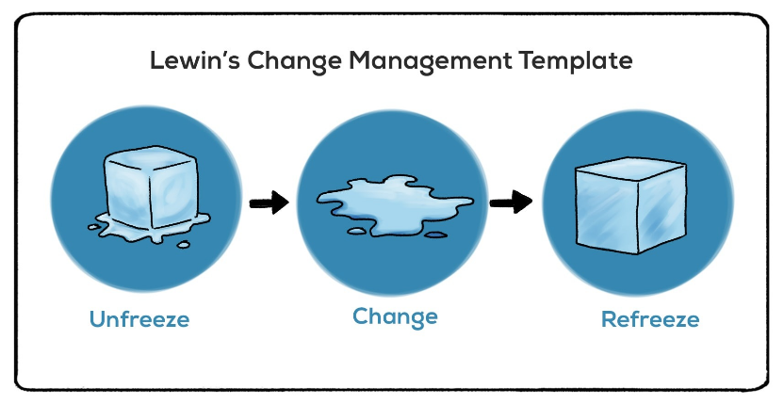

OCM Challenges
Lewin’s Change Management Template
How to change?
Unfreeze
Change
Refreeze
Awareness
Desire
Knowledge
Ability
Reinforcement
Notes:
Talking Points:
3 change models identified: Lewins, ADKAR, AND Kotter
Lewin’s is a bit basic
ADKAR is more useful at an individual level, but not what this paper is focused on
Image Credits:
Lewin’s Change Theory - https://www.google.com/url?sa=i&url=https%3A%2F%2Fwww.linkedin.com%2Fpulse%2Fwhat-evidence-sits-behind-some-our-most-popular-change-sarah-walsh&psig=AOvVaw2XPJ5IaaWQjswUNu7-fLAx&ust=1727821032709000&source=images&cd=vfe&opi=89978449&ved=0CBQQjRxqFwoTCLCV147Z64gDFQAAAAAdAAAAABAJ
ADKAR Model - https://tse1.mm.bing.net/th/id/OIP.QCzlfnzLbW6Aszq3wpHp4AHaE8?rs=1&pid=ImgDetMain

