Slide 1
Optimization to Minimize Risks Using Continuous Asymmetric Risk Analysis
Dr. Zachry Engel, Lone Star Analysis
Co-Authors: Nickalus Harrill, Nicolas Velez Camacho, Jacob Ediger, Dr. Randal Allen, Lone Star Analysis

Slide 2
Agenda
Background
  Risk Matrix
  Continuous Asymmetric Risk Analysis (CARA)
Motivation
Optimization
Demonstration
Summary
Future Work
Acknowledgements

Slide 3
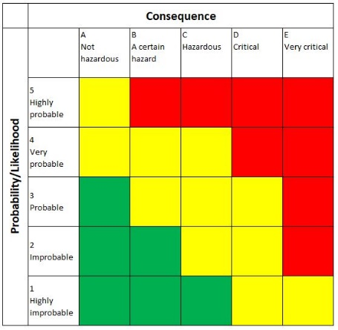
Background – Risk Matrix
The risk matrix is typically a 5×5 grid to determine the overall risk of an event based on its likelihood and consequence
The values of the likelihood and consequence are based on a 5-point Likert scale
This restricts the number of options to quantify the risk to 25 possible/discrete options

Slide 4
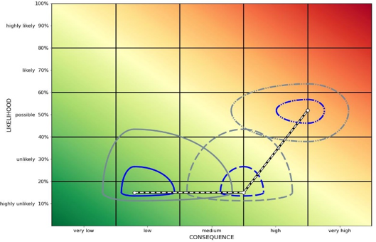
Background – Continuous Asymmetric Risk Analysis (CARA)
Continuous Gradient of Options
  CARA allows the user to select any value for the likelihood and consequence
Asymmetric Confidence Intervals
  CARA generates confidence intervals around a nominal risk value to demonstrate the severity and variability of the risk
Addition of Prevention and Mitigation Measures
  CARA allows the user to evaluate the impact of adding prevention and mitigation measures to reduce the severity of the risk
100%
Highly Likely
80%
Likely
60%
Possible
40%
Unlikely
20%
Highly Unlikely
0%
LIKELIHOOD
Very Low Low Medium High Very High
CONSEQUENCES

Slide 5
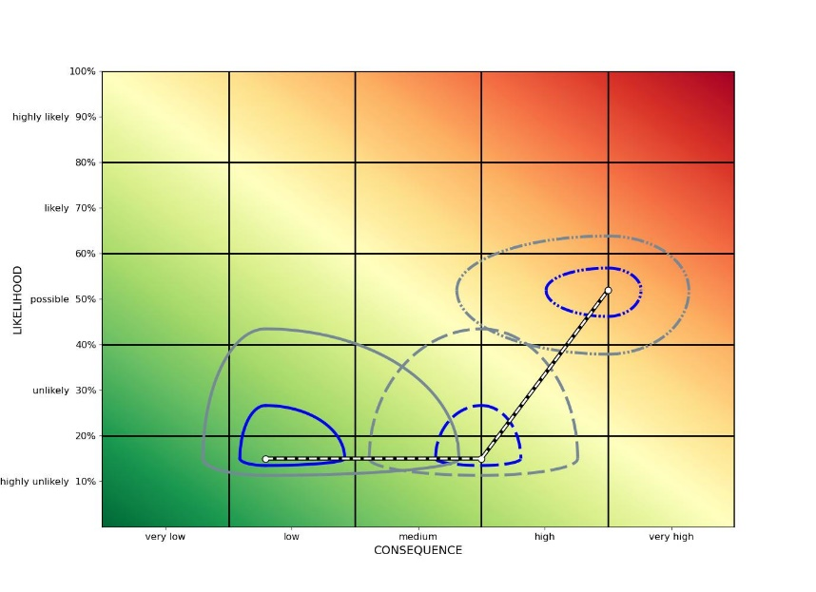
Background – Continuous Asymmetric Risk Analysis (CARA)
Initial Risk likelihood, consequence, and asymmetric confidence intervals
100%
Highly Likely
80%
Likely
60%
Possible
40%
Unlikely
20%
Highly Unlikely
0%
Risk likelihood, consequence, and asymmetric confidence intervals after a prevention measure
LIKELIHOOD
Risk Event likelihood, consequence, and asymmetric confidence intervals after prevention and mitigation measures
Very Low Low Medium High Very High
CONSEQUENCES

Slide 6
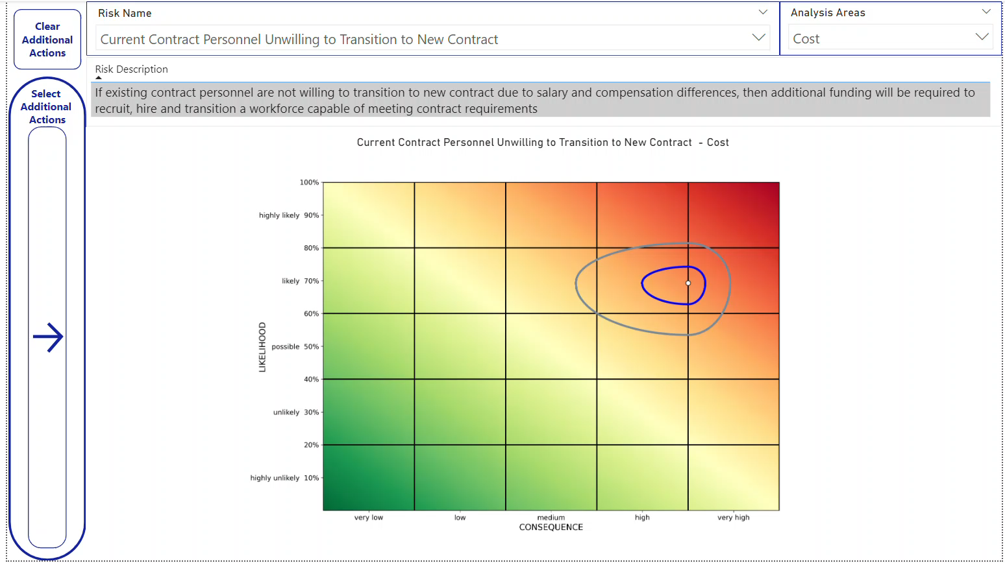
Background – Continuous Asymmetric Risk Analysis (CARA)
100%
Highly Likely
80%
Likely
60%
Possible
40%
Unlikely
20%
Highly Unlikely
0%
LIKELIHOOD
Very Low Low Medium High Very High
CONSEQUENCES

Slide 7
Motivation
By allowing the user to evaluate the impact of prevention and mitigation measures, the number of possible decisions grow exponentially
For example, if the user is considering 3 prevention and 3 mitigation measures, the number of possible combinations of decisions is (3+3)! = 6! = 720
If the user adds one more mitigation measure to the evaluation, the number of possible decisions increase to (3+4)! = 7! = 5,040
What is the best combination of prevention and mitigation measures to reduce the severity of my risk?

Slide 8

Optimization
CARA will reduce the risk using an adaptive non-convex stochastic optimization algorithm
By leveraging optimization, the user can easily find the best combination of prevention and mitigation measures to reduce the severity of the risk event
This combination of prevention and mitigation measures is found using a quantitative approach that reduces the bias inherent in a human-based decision

Slide 9
Optimization - Constraints
With unlimited recourses, the optimal way to reduce the severity of the risk would be to apply all the prevention and mitigation measures
To implement the prevention or mitigation measures, we need resources such as time, money, and manpower
Not all prevention and mitigation measures are built the same
One measure may have a huge impact on risk reduction, but may require a large amount of resources
Another may have a smaller impact, but require fewer resources
What is the best combination of prevention and mitigation measures to reduce the severity of my risk given my available resources?

Slide 10
Demonstration
To demonstrate optimization with CARA, an analysis was performed to evaluate the risk of transitioning from a direct workforce to a contracted workforce
Data was collected by Subject Matter Experts (SMEs), who were asked to answer the following questions:
Probability the event will occur
Impact of the event should it occur
Likelihood a prevention or mitigation measure will occur
Impact of a prevention or mitigation measure should it occur

Slide 11
Demonstration
The plot to the right shows the initial risk likelihood, consequence, and asymmetric confidence intervals
We now want to optimally add prevention and/or mitigation measures
100%
Highly Likely
80%
Likely
60%
Possible
40%
Unlikely
20%
Highly Unlikely
0%
LIKELIHOOD
Very Low Low Medium High Very High
CONSEQUENCES

Slide 12
Demonstration
The plot to the right shows the same initial risk, and risk reduction with a prevention measure added
CARA clearly shows a large reduction in the likelihood and consequence of the event
100%
Highly Likely
80%
Likely
60%
Possible
40%
Unlikely
20%
Highly Unlikely
0%
LIKELIHOOD
Very Low Low Medium High Very High
CONSEQUENCES

Slide 13
Demonstration
The plot to the right shows the same initial risk, then risk reduction with a prevention measure added, and finally further risk reduction with a prevention and mitigation measure added
CARA clearly shows a large reduction in the likelihood and consequence of the event
100%
Highly Likely
80%
Likely
60%
Possible
40%
Unlikely
20%
Highly Unlikely
0%
LIKELIHOOD
Very Low Low Medium High Very High
CONSEQUENCES

Slide 14
Demonstration
100%
Highly Likely
80%
Likely
60%
Possible
40%
Unlikely
20%
Highly Unlikely
0%
Which of these actions should I take?
The plot on the top shows a greater reduction in the overall risk, but it would take 5 years and $2.5 million to implement
The plot on the bottom shows a smaller reduction in the overall risk, but it can be implemented in less than 1 year at the cost of $1.32 million
LIKELIHOOD
CONSEQUENCES
Very Low Low Medium High Very High
100%
Highly Likely
80%
Likely
60%
Possible
40%
Unlikely
20%
Highly Unlikely
0%
LIKELIHOOD
CONSEQUENCES
Very Low Low Medium High Very High

Slide 15
Summary
CARA allows the user to analyze risk in a continuous, more detailed and objective way than the original (discrete) risk matrix
Although thousands of plots may be generated, by using optimization, CARA will show the optimal allocation of resources to reduce risk
This optimization is done in an objective manner that greatly reduces the bias of a decision maker when looking at the results of the plots

Slide 16
Future Work
Real-time Implementation of CARA
Allow CARA to accept data in real time and automatically generate the plots and data used in CARA
Use of Other Distributions to Generate the Asymmetric Confidence Intervals
Other distributions, such as the Metalog* distribution, may be used to create new asymmetric confidence intervals to add flexibility
*Think of a Metalog as the probability distribution analogous to a Taylor Series from calculus

Slide 17
Acknowledgements
Thanks to my co-authors: Nickalus Harrill, Nicolas Velez, Jacob Ediger, and Dr. Randy Allen for helping me develop CARA

Slide 18
Questions?

