Slide 1
Development of a Novel Architecture for Improving Cyber-Kinetic Training
J. Allen Geddes, U.S. Army Combat Capabilities Development Command Soldier Center (DEVCOM SC) SFC Paul Ray Smith Simulation & Training Technology Center (STTC)
Omar Hasan, Ph.D, Dignitas Technologies, LLC

Slide 2
Introduction
Traditional fight within air, land, sea, and space has expanded to include Cyberspace domain
Adversaries actively pursue Internet Protocol (IP)-based cyber attacks
Cyber attacks affect operational missions across all domains
Cyber Mission Force (CMF) teams direct, synchronize, and coordinate cyberspace operations in defense of U.S. national interests.
Collective cyber-kinetic training (combined cyber training with kinetic-focused training) is needed to ensure Services and Joint Forces efficiently work with CMF teams.
Live, Virtual, and Constructive (LVC) systems used for command staff training are not developed to communicate directly with cyber ranges used for CMF team training.
Cyber effects performed manually (i.e., white cards, swivel chair), hindering cyber-kinetic training by limiting realism and training effectiveness

Slide 3
Approach
In support of cyber-kinetic training, developed high-level architecture in which:
Actions within a cyber range result in communication of cyberspace effects within a connected simulation environment
Command staff can train against cyberspace threats and effects against their operational Command, Control, Communication, Computers, and Intelligence (C4I) systems.
Cyber range operators, acting as CMF, can attack or defend emulated systems or real devices that represent operational systems within the training scenario.
Cyber battle damage assessment (BDA) is performed from the results of activities within the cyber range
Damage is injected into the simulation environment as a cyberspace effect on emulated systems or real devices
System utilizes cyber range sensors to detect system and network state changes
Significantly improves cyber-kinetic training, increasing warfighter readiness for conducting MDO

Slide 4
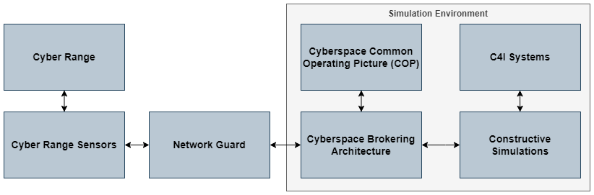
System Architecture
Developed a high-level architecture to communicate cyberspace effects between a cyber range and the simulation environment

Slide 5
System Architecture Components
Architecture Component | Description
Cyber Range | Virtual environment that contains emulated systems and networks, as well as training content used for training CMF
Cyber Range Sensors | Software applications that assess changes within cyber range systems, assess corresponding cyber battle damage, and communicate resulting cyberspace effects to simulation environment
Network Guard | Optional component which limits communication between the cyber range sensors and simulation environment based on preconfigured rulesets
Cyberspace Brokering Architecture | Provides data model and communication mechanism for communicating cyberspace-related information between connected systems
Cyberspace Common Operating Picture (COP) | Provides exercise facilitator / white cell functionality to control and monitor cyberspace effects within the training environment
Constructive Simulations | Provides models of friendly and threat actors, cyberspace devices, cyberspace operations and effects
C4I Systems | Tactical interfaces utilized by the command staff during training

Slide 6
Prototyping – Cyber Range Sensors
Prototyped the use of cyber range sensor applications with our system architecture
If the sensors detect a significant change in an emulated system in the cyber range, an alert is sent to the Cyber Effect Resolver application
Used LibreNMS as a cyber range sensor since:
It is community-supported open-source software (OSS)
It contains an existing library of alert rules and supporting macros that can be reused or extended, such as:
monitoring range VMs that were not responsive to Internet Control Message Protocol (ICMP) messages (pings)
monitoring range VMs for which a particular service was not responsive
Alerts were sent from the cyber range sensor application (LibreNMS) to our Cyber Effect Resolver application, which:
performs cyber BDA based on alert information
generates appropriate cyberspace effects within the LVC environment

Slide 7
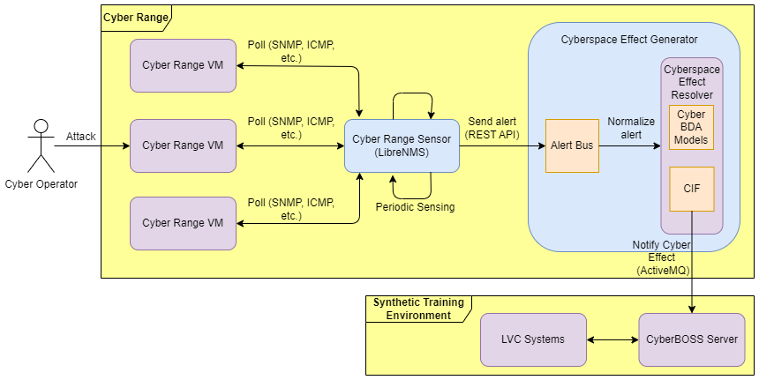
System Architecture – Cyber Range Sensors

Slide 8
Prototyping – Cyberspace Brokering Architecture
Cyberspace Battlefield Operating System Simulation (CyberBOSS) architecture was used as the cyberspace brokering architecture to communicate generated cyberspace effects to connected LVC systems
CyberBOSS Cyberspace Data Model (CDM) was used to communicate cyberspace effect information between the cyber range and LVC environment
CDM is closely related to the recently released Simulation Interoperability Standards Organization (SISO) Cyber Data Exchange Model (Cyber DEM) reference
Connected LVC systems receive the cyberspace effect information and implement the effect in a manner applicable to the receiving system.
Changes to internal constructive simulation model behaviors
Changes in stimulation of connected C4I systems due to adding/modifying/stopping communicated tactical messages

Slide 9
Experimentation
Proof-of-Concept experimentation performed at the U.S. Army Combat Support Training Exercise (CSTX) 24-02 at Ft. McCoy, WI in August 2024
Demonstrated the feasibility of our approach to communicate cyberspace effects between a cyber range and the simulation environment using a representative cyber-kinetic operations scenario
BLUFOR Cyber Protection Team (CPT) and command staff coordinate mitigation of a cyber threat against host nation Critical Infrastructure (CI) to support mission objectives
Threat performs a cyber attack within a power plant network to disable power generation by affecting Supervisory Control and Data Acquisition (SCADA) systems or Industrial Control Systems (ICS) within the power plant
CPT coordinates with command staff and conducts a Hunt/Clear/Harden/Assess operation to locate and fix the problem in the power plant network, restoring power to a nearby hospital

Slide 10
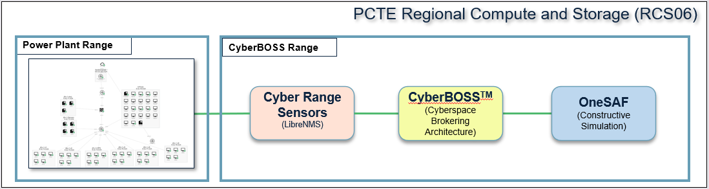
Experimentation (cont.)
Persistent Cyber Training Environment (PCTE) cyber range contained simplified representative power plant control system
One Semi-Automated Forces (OneSAF) contained constructive models of urban area lights that were affected by cyber effects generated by actions within the cyber range
Improves ability for coordinated MDO training that incudes both cyber warriors and command staff

Slide 11
Future Work
Future work to develop this architecture to support cyber-kinetic training may include:
Identification of other cyberspace effects and target systems for additional development
Development of additional scenarios that are applicable for cyber-kinetic training
Development of additional cyber range sensors and cyber BDA models
Development of cyber BDA models to support additional cyberspace effects
Data Infiltration, Data Exfiltration, Spear-Phishing attacks as an example
Use of other communication protocols (High-Level Architecture [HLA], Distributed Interactive Simulation [DIS]) to communicate the cyberspace effect information between the cyber BDA models and the cyberspace brokering architecture
Expanded integration into the Live training environment
Bi-directional effects synchronization, where kinetic events occurring in the LVC training environment could have an impact on the cyber range environment

