Slide 1


Towards a Real-Time Model of Trust in
Human-Machine Team Paradigms
Sydney Gibs, Veronica Tanner, & Eric Larson, Phd, Southern Methodist University
Sandro Scielzo, PhD, & Alvin Abraham, CAE USA

Slide 2
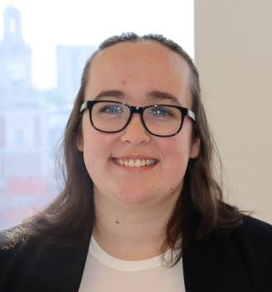
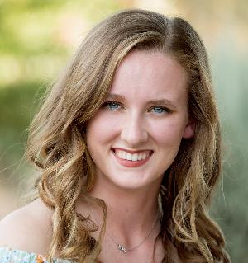
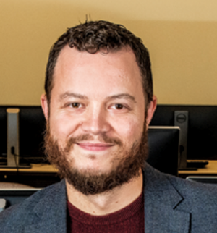
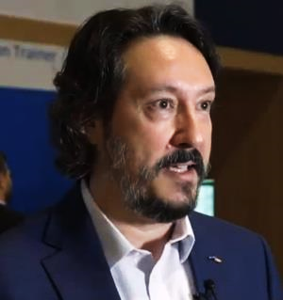
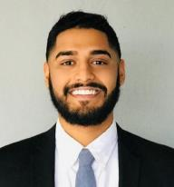
Our Team! A Collaboration Between Industry and Academia
SMU Lyle School of Engineering
Darwin Deason Institute for Cybersecurity
CAE USA
Technology & Product Development
Sydney Gibbs
MS in Computer Science
Veronica Tanner
BS in Computer Science
Dr. Eric C. Larson
Associate Professor
Dr. Sandro Scielzo
Human Systems Technical Authority
Alvin Abraham
Modeling & Simulation Engineer

Slide 3
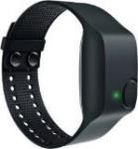
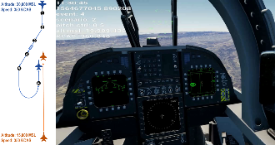
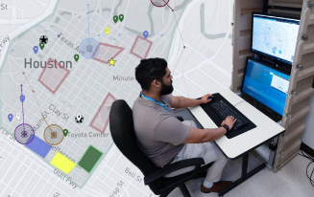
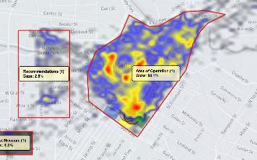
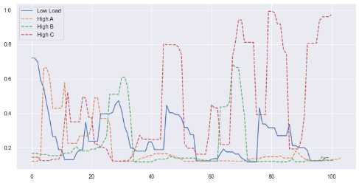
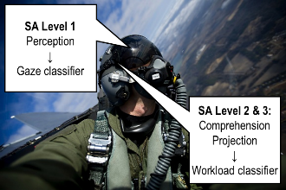
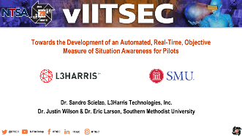
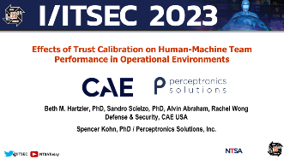
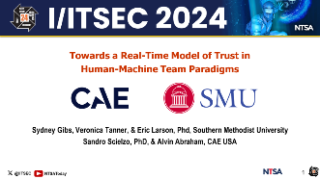
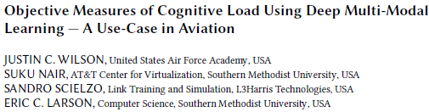
A Quick Recap…
2020
2021
2022
2023
2024
Pilot Gaze Classification
Workload Classification
Situation Awareness Model
Updated Cognitive Workload Classifier
CONS Trust Measure
Trust Modeling with Eye Tracking
Can gaze patterns predict trust?
Unobtrusive Wearables
MODSIM Proceedings
Best Overall Paper!
Best HPAE Paper!
Super cool paper!
Automated Assessment of Warfighters’ Competencies & Psychophysiological States

Slide 4
Introduction & Current Focus
From Tools to Teammates
Measuring Trust Objectively
Human-Machine Teaming (HMT)
The Problem: Current trust measures are not scalable, costly to execute, and require lengthy post-hoc analyses
Accelerated paradigm shift
HMTs supporting complex mission goals
Synthetic teammates and trust as a key construct
Our Plan:
Use Continuous Online Numerical Score (CONS) data a trust labels
Use eye tracking gaze patterns to model trust
Promoting the “Right” Level of Trust
Trust mediates HMT interactions
Need to measure trust in real time
Real time trust to drive future adaptive Human Machine Interfaces (HMI)
Gaze patterns can provide a window into a warfighter’s trust in machines

Slide 5
Gaze-based Hypotheses
Hypothesis One, Fixation Duration: higher trust will exhibit longer gaze fixations on critical interface elements.
Hypothesis Two, Gaze Distribution and Gaze Transition: higher trust will express into a more focused and centralized distribution of gaze.
Hypothesis Three, Classification and Modeling: trust levels can be reliably classified by machine learning models, using the gaze distributions.
Expanding DARPA’s concept of crosscheck ratio

Slide 6
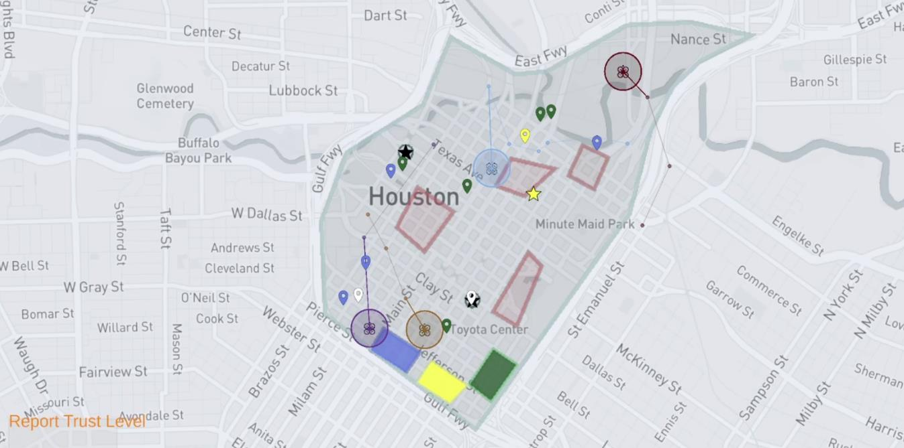
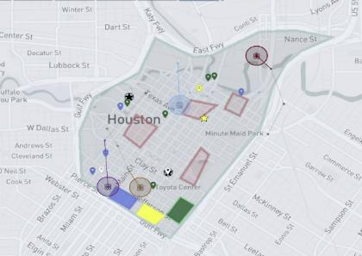
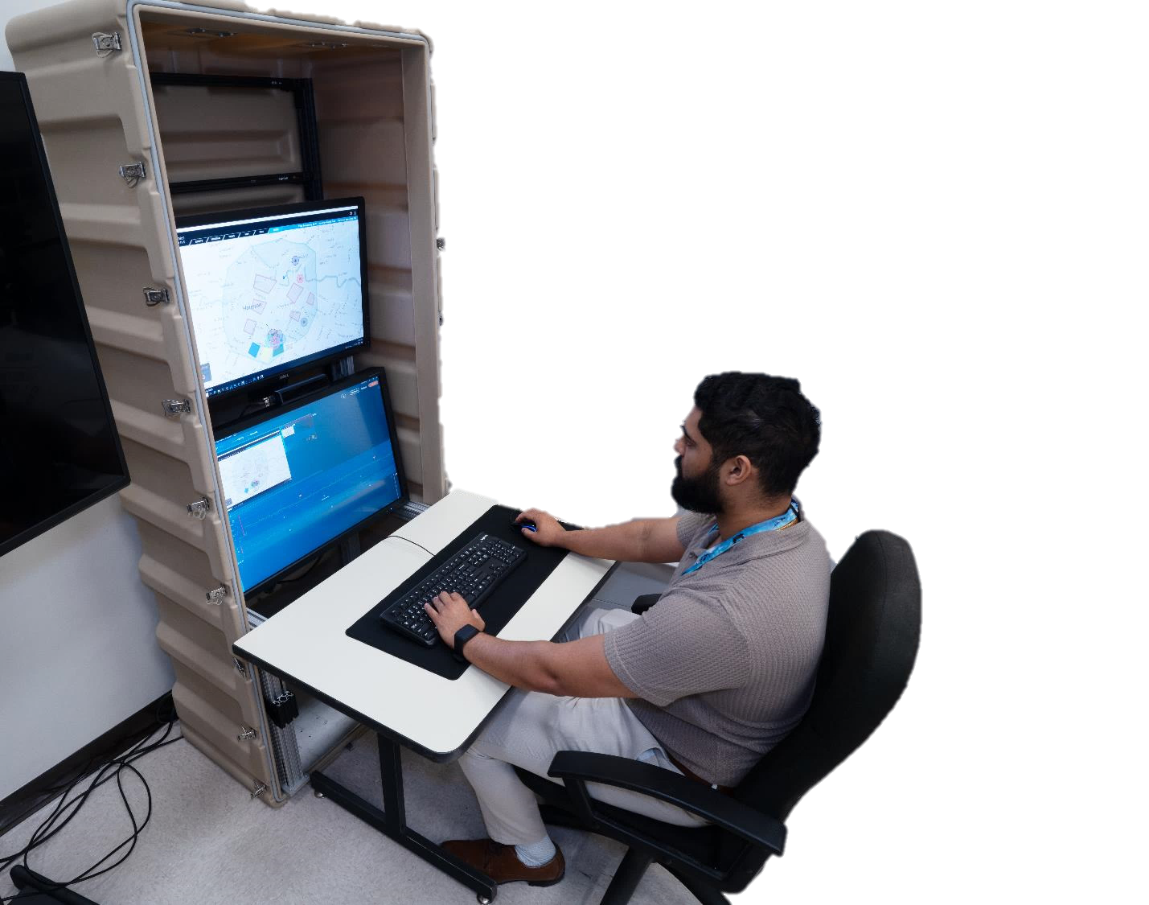
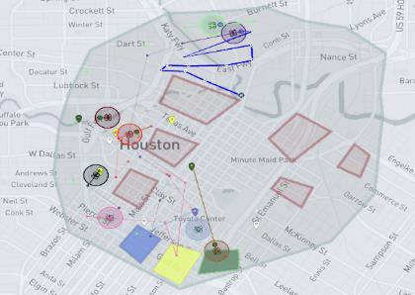
HMT Search and Rescue (SAR) Mission
HMT Testbed
SAR Mission: Locate F-4 tornado survivors and deliver supplies
C2 Interface: Point & click
Participants: 31 adults
Design: 2x2 within-subjects
Missions: 4 (1 x condition)
Low Workload
Workload
Low | High
4 drones | 8 drones
Small AO | Large AO
“AO” = Area of Operation
High Workload
Initial Recommendations
Good | Bad
Within AO | Beyond AO
Avoid NFZs | Possible NFZs
“NFZ” = No Fly Zone
4 scenarios per participant counterbalancing workload and recommendation accuracy

Slide 7
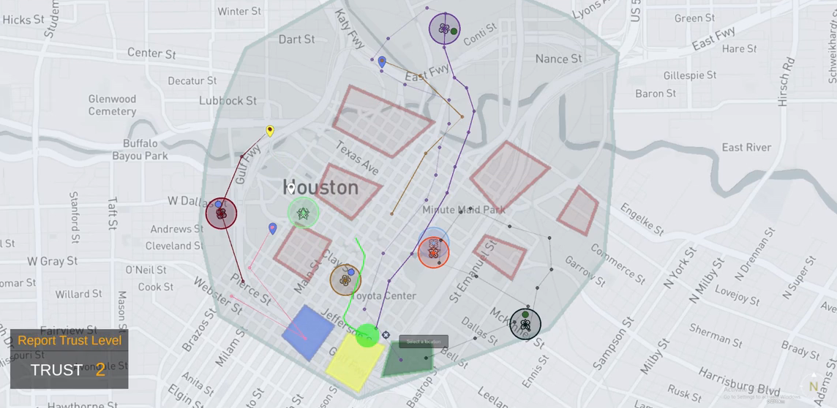
HMT Search and Rescue (SAR) Mission
HMT Testbed
SAR Mission: Locate F-4 tornado survivors and deliver supplies
SAR Mission: Locate F-4 tornado survivors and deliver supplies
C2 Interface: Point & click
Participants: 31 adults
Design: 2x2 within-subjects
Missions: 4 (1 x condition)
Workload
Low | High
4 drones | 8 drones
Small AO | Large AO
“AO” = Area of Operation
Initial Recommendations
Good | Bad
Within AO | Beyond AO
Avoid NFZs | Possible NFZs
“NFZ” = No Fly Zone
4 scenarios per participant counterbalancing workload and recommendation accuracy

Slide 8
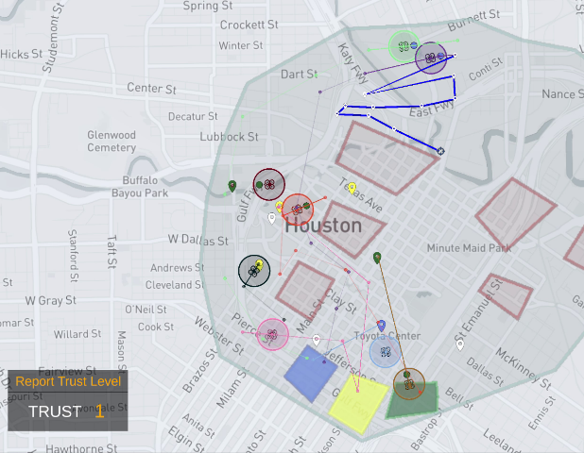
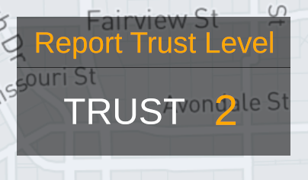
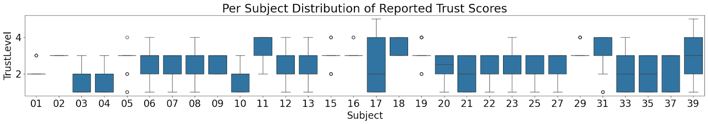
Measures & Collected Data
Trust Measure
Trust via CONS
Continuous Online Numerical Score (CONS)
Participants reported their trust throughout a mission on a 5-point scale
1 = lowest trust
5 = highest trust
Participants with near constant trust removed from analysis to mitigate bias
Prompt every 45 sec.
Keyboard entry: T, G, B

Slide 9
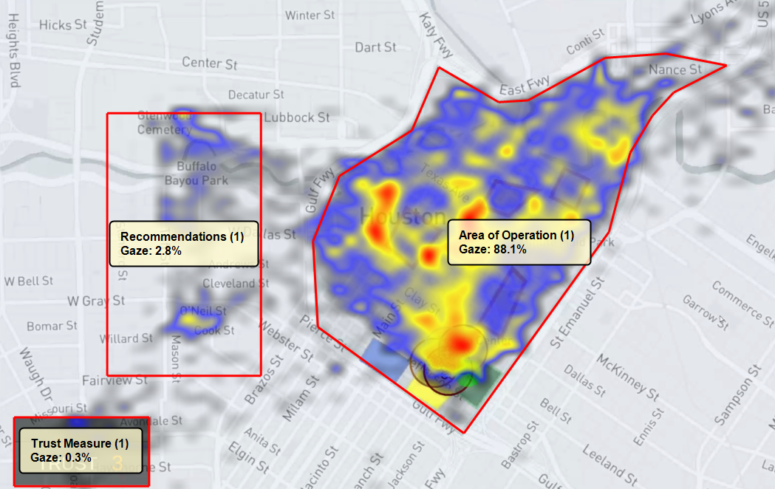
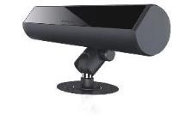
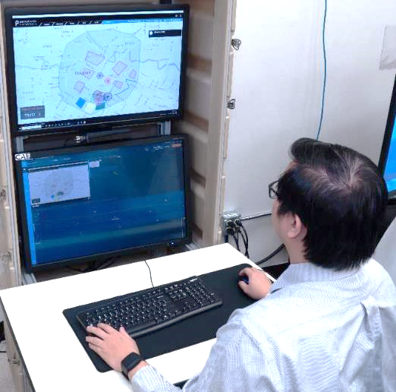
Measures & Collected Data
Eye Tracking Measures
Gaze distribution overlay for one participant with defined interface regions
FX3 Eye Tracker
Gaze convergence
Real time Index of Cognitive Activity (ICA)

Slide 10
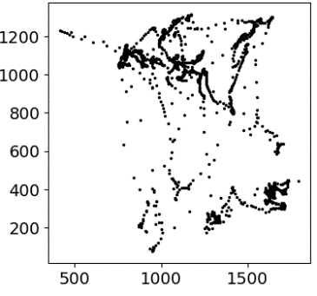
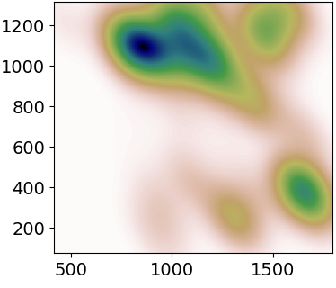
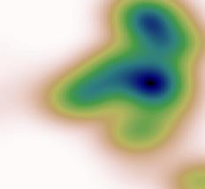
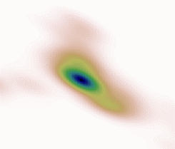
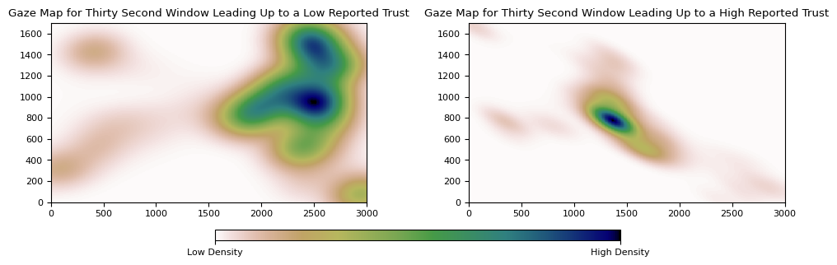
Principal Component Analysis (PCA) Group Construction
Gaze Data
Smoothing
Grouping
PCA
Components
Data extracted 30 seconds prior to each reported trust input, then aggregate
Applied kernel density estimation to reduce noise
Separate participants’ data into LOW and HIGH trust groups
PCA performed on each separate group
Visualize top 4 components
Analyses
Determine if LOW and HIGH trust groups are statistically different
Low Trust
High Trust

Slide 11
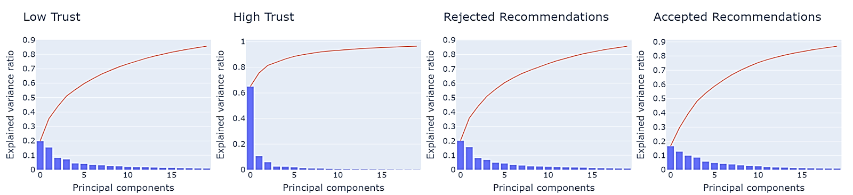

PCA Scree Plots
PCA performed to understand major gaze elements contributing to variation
Major Findings (in support of hypotheses one and two)
Less components needed to capture variability in the high-trust scenarios --- high-trust scenarios have more consistent gaze patterns
More components needed to capture variability in low-trust scenarios --- low-trust scenarios have less consistent gaze patterns

Slide 12
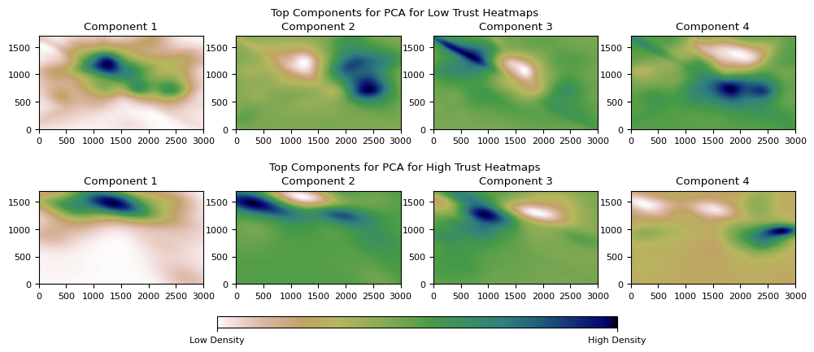
Top PCA Components for Low vs High Trust
Low Trust Gaze Heatmap PCA Components
Welch’s t-test used to determine component differences across groups
Low-trust components 1, 2, and 4 are statistically different from the same components in high-trust (p<0.001)
Component 3 cannot reject the null
High Trust Gaze Heatmap PCA Components

Slide 13
Top PCA Components for Low vs High Trust
Low Trust Gaze Heatmap PCA Components
Components for the low trust responses are more dispersed compared to high trust responses -- validates hypothesis two
Components for high trust responses are concentrated in the upper portion of the screen -- validates hypothesis one
High Trust Gaze Heatmap PCA Components

Slide 14
Trust Classification
1
Run PCA on all gaze data
2
Extract top 20 components
3
Project each gaze heatmap onto components to be used as features in model
4
Train models on features using per subject cross validation (PS-CV)
(Cross subject approach performed poorly)
5
Analyze 3 classification models
Logistic Regression
Random Forest
KNN

Slide 15

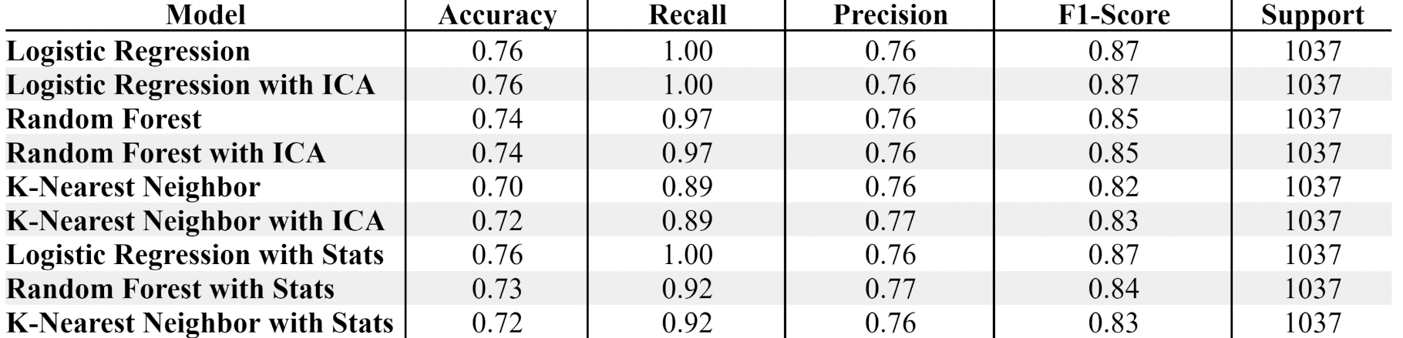
Trust Classification Results
Trust Models
Logistic Regression performed best overall
The addition of ICA features either kept the results the same, or slightly bettered them
Results use user-specific calibration.
Opportunity: Future work can investigate a more generalized model
Trust can be predicted from gaze data

Slide 16
Conclusion & Next Steps
Hypothesis 1: Fixation Duration
Hypothesis 2: Gaze Distribution & Transition
Higher trust required less components and longer gaze fixation durations
Lower trust required more components and gaze fixations had lower durations and were scattered
High trust components were concentrated in the same area
Low trust components were scattered and distributed all over the C2 interface
Next Steps
Classifiers require user-specific calibration: more work needed for generalization
Generalized trust model needs to be use-case agnostic (e.g., C2 interface, cockpit)
Real time trust model to inform adaptive interfaces
Hypothesis 3: Classification & Modeling
Good initial results: subjective trust could be predicted from gaze data, with user specific calibration

Slide 17
Thank you!

