Slide 1

Integrating Cognitive and Skills Training in a Simulated Unmanned Aerial Systems (UAS) Pilot Training Course
Bailey Miller B.A., Autonomy Research Institute
Madison Clausen M.A., Autonomy Research Institute
Eric Bird M.S., Autonomy Research Institute
Tye Payne M.A., Autonomy Research Institute
Notes:
Transition: Some of you may be curious as to what an unmanned aerial system, or UAS, actually is.

Slide 2
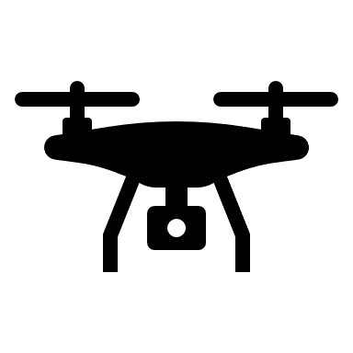



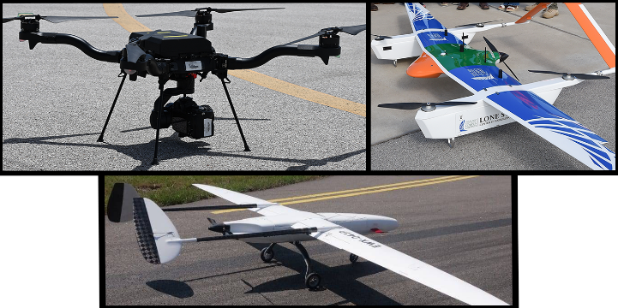
What Is UAS?
Unmanned Aerial
System (UAS)
Unmanned Aircraft
Vehicle (UAV)
Payload
Communication
Crew
Multi-Rotor
VTOL
Packages
Camera
GPS
Software
Pilots
Safety
Fixed Wing
Sensors
Air-Traffic
Control
Visual Observers
Notes:
Unmanned Aerial Systems, or UAS, are made up of four key elements.
First, the Unmanned Aircraft Vehicle (UAV), which refers to the drone itself and includes various types like fixed-wing Vertical take off and landing, and multi-rotor designs.
Next, we have the Payload—these are the tools or equipment carried by the UAV, like cameras or sensors, tailored to the mission’s needs.
Communication is another critical component, ensuring that commands, GPS data, and other essential information are sent between the UAV and the control station.
Finally, the Crew includes pilots and observers who oversee the UAS operation and ensure it’s conducted safely.
Together, these elements work together to complete tasks autonomously or with human supervision.

Slide 3
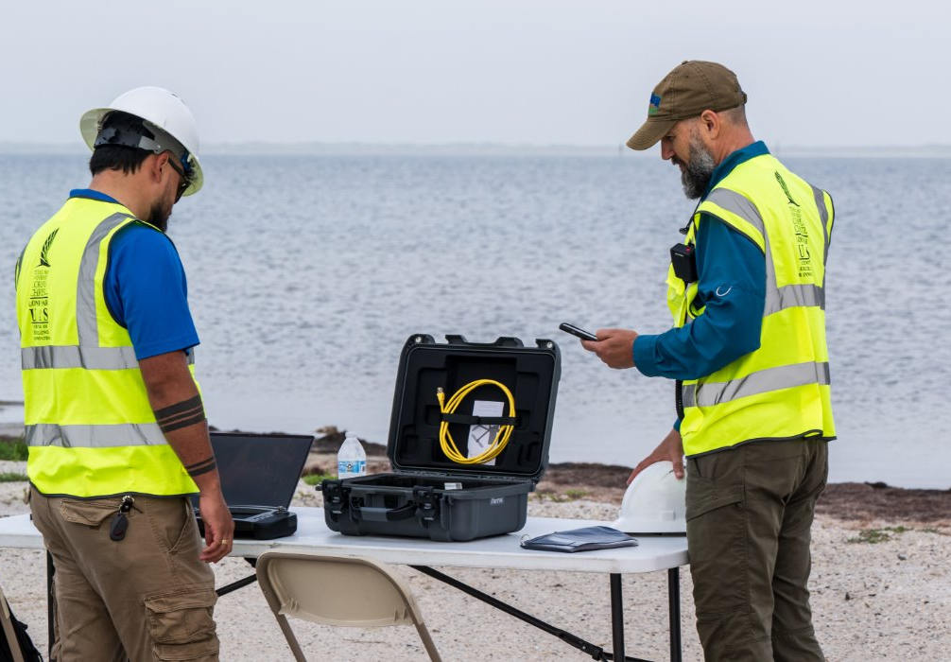
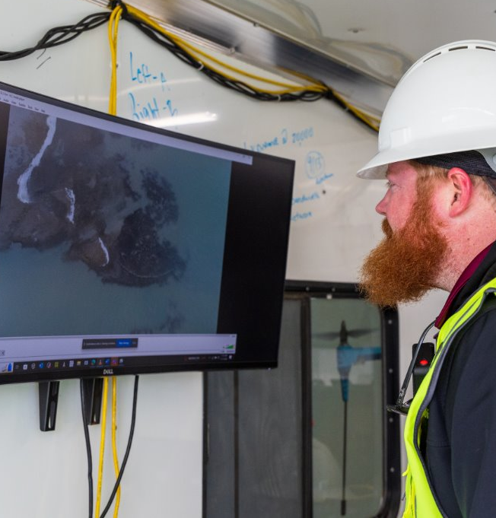
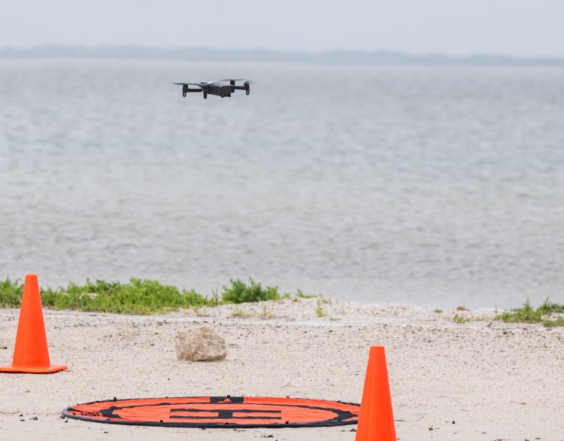
Importance of UAS
781,000 Registered Drones in the USA (FAA, 2024)
Used in Commercial, Recreation, and Military Operations
Provide Disaster Relief Aid
1/3 of All Military Aircraft
Notes:
So why is UAS research important?
As of 2024 the FAA reports that there are over 780k drones registered in the US.
These drones serve in a variety of roles from recreational and commercial to military operations and disaster relief.
In corpus UAS Pilots work with local park services to map and monitor the coastline, and aid in the rescue of cold stunned turtles.
UAS is so prevalent that 1/3 of all military aircraft are classified as UAS.
Because UAS is still an emerging field it’s important that we identify the challenges pilots may face.

Slide 4

Challenges UAS Pilots Face
Visual
Operating from a manned camera
Visual line of sight (LOS) on the aircraft
Communication
Visual Observers to Pilot
Crew Communications
Pilot and Air Traffic Control communications
Notes:
Visual challenges
Pilots must
Operate a small camera-This creates windows where pilots are slower at detecting and responding to stimuli in their environment.
In addition to this pilots must maintain
Visual Line of Sight of their aircraft at all time per FAA regulation, so that they can properly monitor any incoming objects in their airspace.
[Communication]
The job can be passed to visual observers, who keep eyes on the aircraft and report back to the pilot.
In addition to their own team’s communications, pilots must monitor air traffic control, so that they are not occupying airspace of incoming aircrafts.
Sensory- Finally, UAS pilots don’t have the luxury of physical feedback from their aircraft.
Whereas a manned pilot can feel the turbulence of the aircraft while flying, and unmanned pilots cannot and must closely monitor the weather and their aircraft for signs of danger.
Transition
The challenges that I’ve addressed so far are not an exhaustive list and each take a mental toll on a pilot while flying.
At any time one or multiple of these challenges may be affecting the pilot so It’s important that UAS pilot training addresses these concerns.

Slide 5
Training Standardization
Government offices have raised concerns over the lack of UAS training standardization
Every branch of the military trains UAS pilots differently
UAS rescue operations during hurricanes Harvey and Irma were less effective due to a lack of standardized training (Greenwood et al., 2020)
Notes:
However, Government offices such as the government accountability office and senate armed service committee have both voiced concerns over the lack of standardization in UAS pilot training.
This standardization is so lack luster that every branch of the military trains their pilots differently.
Because of this operations involving organizations and individuals tend to be less effective, as the flight skills and ability to work with a crew are drastically different between pilots, this was witnessed during hurricanes Harvey and Irma.

Slide 6
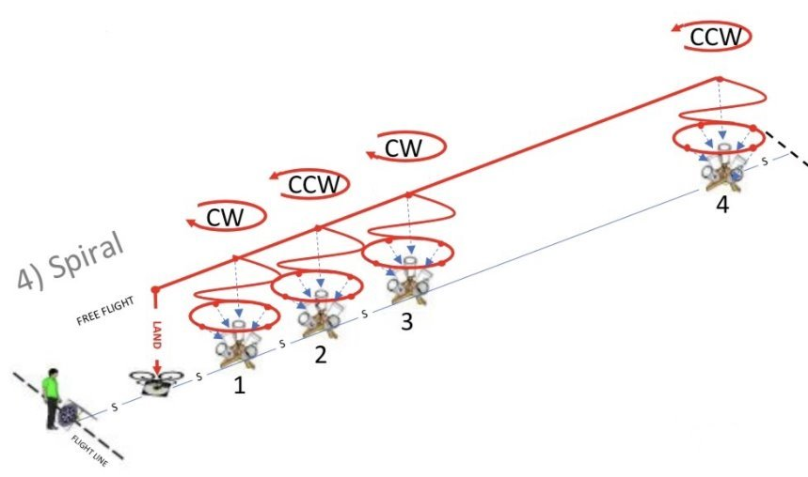
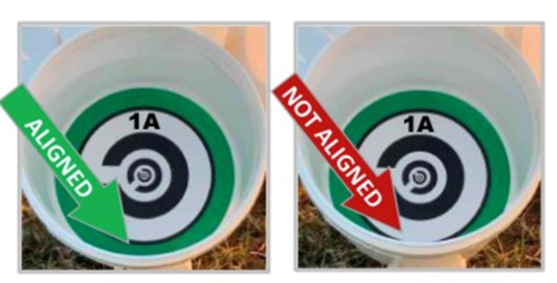
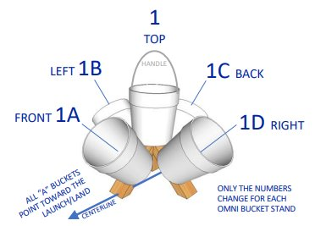
National Institute of Standards and Technology (NIST) Course for UAS Pilot Training
Notes:
The National Institute of Standards and Technology have designed their own UAS pilot training courses.
For the purposes of this study, we will only go in depth to unobstructed course #4, the spiral.
Which is considered one of the more advanced, unobstructed courses.
In this course pilots fly their aircraft around these omnidirectional bucket stands, using the drone's camera to capture pictures of aligned rings inside of each bucket, as fast as possible.
A picture is considered aligned when the colored ring is fully unbroken as pictured here, while an unaligned photo has a broken ring at any part.

Slide 7
NIST Course Advantages and Disadvantages
Advantages of the NIST Course
Low cost, easy to replicate
Tiered training system
Variety of performance measurements
Flight Time
Battery management
Consistency across trials
Disadvantages of the NIST Course
Mission logistics not addressed
Managing mental workload not addressed
Notes:
The Advantages of NIST include its low cost and easy set up, with most of the materials able to be bought at local hardware stores and course material being downloadable from the NIST website.
It’s also a tiered training system requiring more technical skill from pilots as they progress through the courses.
These courses also have a variety of measures that test things like flight time and efficiency, consistency across trials, and battery management, which are all important for UAS missions.
The disadvantage of the NIST are that it does not go far enough to address mission logistics such as communicating with crew and air traffic control, which provide serious mental workload on pilots in the field.

Slide 8
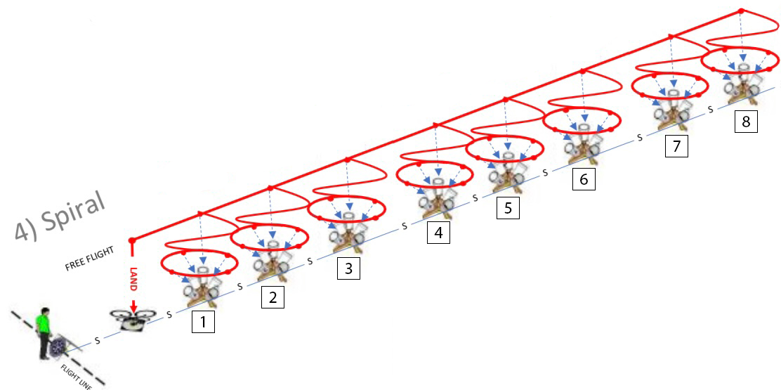
Adapted Simulated NIST UAS Course
Unobstructed NIST Course 4 was added into a mixed reality simulator
Bucket stands were increased from 4 to 8
Cognitive components added to test the effects of mental workload on flight performance
Notes:
In order to address this gap, we adapted the NIST course 4 Spiral, into our mixed reality simulator.
We increased the number of bucket stands in this course from 4 to 8 to increase the amount of observations we could make per flight.
We also included cognitive components into the course so we could test the effects of mental workload while flying

Slide 9
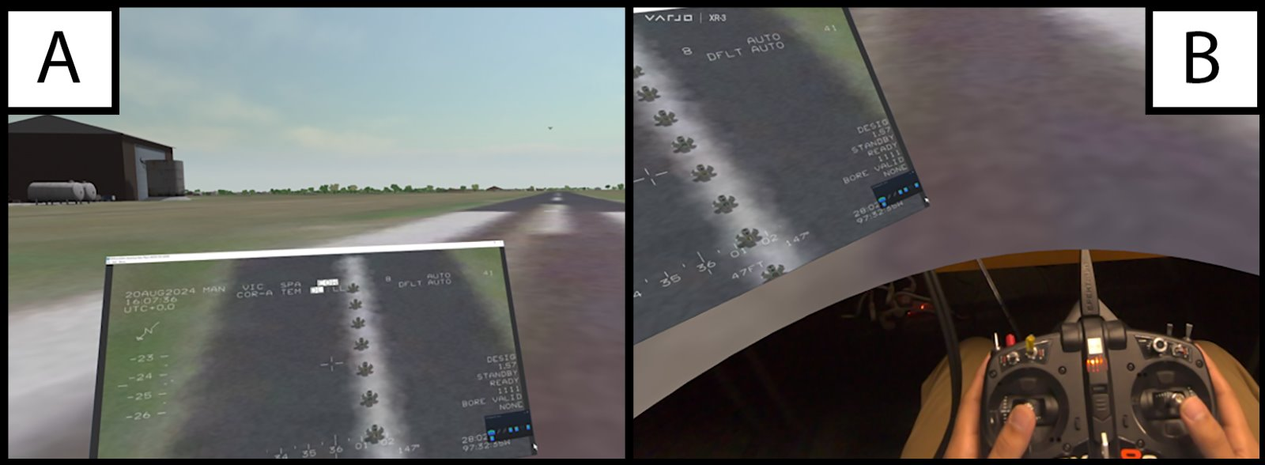
Inside the MR Simulator
Drone
Drone Camera View
Pilot’s Hands &
Controller
Notes:
Here is a quick glimpse inside our Mixed reality simulator.
In Panel A you’ll see that our Pilot is inside the headset, standing on the runway.
When they look forward, they can see their aircraft out in the distance
Directly in front of them is a small window, which shows the Drone’s camera, that displays a live feed of the course while they run through it.
Giving them the ability to capture fully aligned images while navigating the course.
In Panel B you’ll see what happens when our pilots look down in the headset.
A small window is created which shows the pilot’s their hands and controller which we believe increases the transferability of MR training to real piloting.
Compared to Virtual Reality training which construct an artificial controller and hands, MR training allows pilots to train with their own hands and their own controller that they'd use in the field.

Slide 10
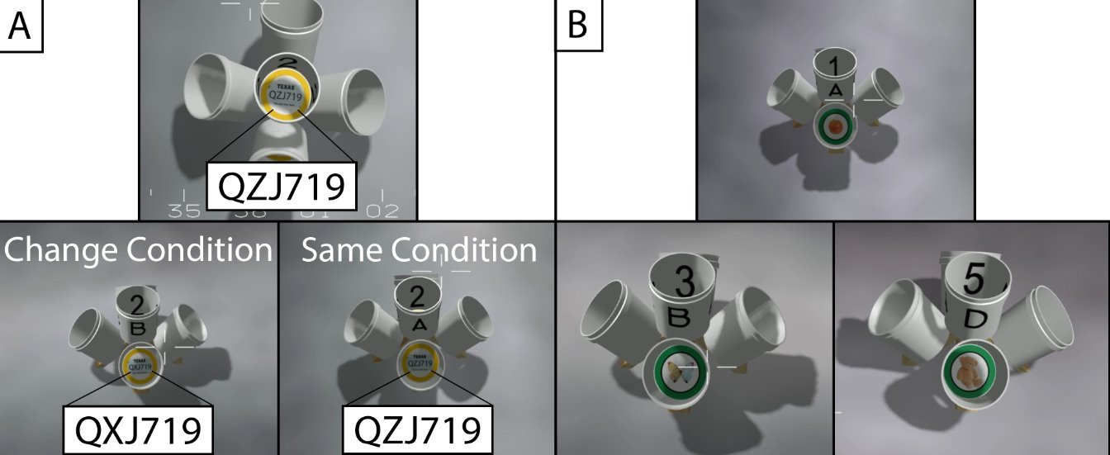
Cognitive Integrations to the NIST
Notes:
To implement cognitive workload into the course we altered the targets inside of the buckets to be either yellow rings with license plates or green rings with random objects.
Pilot’s would approach the top bucket of each stand, they would observe the plate and commit it to their working memory– A short term version of memory that allows you to take in and manipulate information to use in immediate problem solving.
They would then capture an aligned picture using the camera attached to the aircraft and move on to the next bucket in the stand, In this case, Bucket A.
Inside again they would find a plate, and capture an aligned picture, just like before, then using their working memory they would compare the plate in Bucket A to the top bucket, and tell the researcher if string was the same or if it had changed.
If something on the plate had changed, participants would need to tell the researcher what had changed.
They would then continue this process through the rest of the stand, comparing the top bucket to the rest of buckets A-D in their working memory.
Panel B
Green ringed buckets, were designed to test episodic memory– which is the ability to retrieve longer term information form memory.
For these stands, participants would capture aligned photos and try to remember which specific objects were found in each stand.
After the flight had concluded participants would be tested over the locations of objects.

Slide 11
Study 1
Participants
2 undergraduate students
No previous flight experience
1-hour session (x3)
Measures
Flight Efficiency
How fast participants flew through the course capturing properly aligned photos
Working Memory
Accuracy on the yellow ringed tasks
Episodic Memory
Accuracy on the green ringed tasks
Notes:
We recruited 2 undergraduates with no previous flight experience to fly three, one hour sessions separated by about 3 weeks.
We measured flight efficiency, how fast participants could complete the course while capturing aligned pictures.
Working memory, which was participants accuracy of the yellow ringed tasks
And Episodic memory, which was the accuracy on the green ringed tasks.

Slide 12
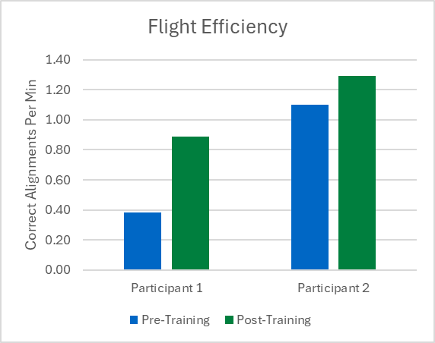
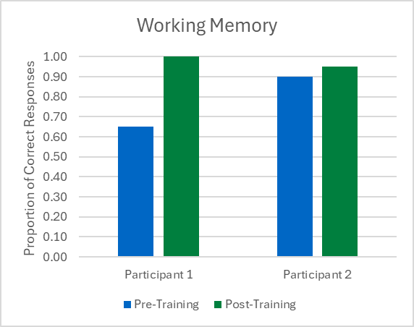
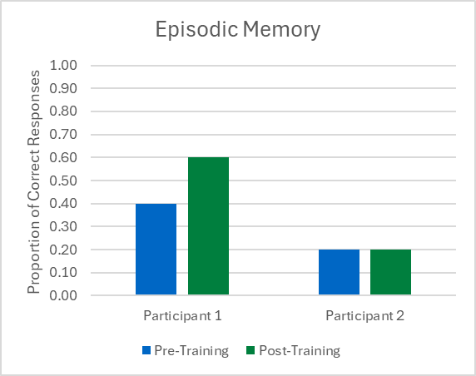
Study 1 Preliminary Results
Training appears to improve both flight and memory workload performance
Training increased efficiency for novice pilots
Training appears to increase working memory accuracy
Training didn’t appear to increase episodic memory accuracy
Notes:
The preliminary results from our first study showed that flight efficiency for novice pilots increased with training, even just 3 spaced out sessions was enough to see some improvement.
For our working memory task, we saw some improvement from one participant but hit a ceiling of 90% for both participants after the second session.
For our Episodic memory task, we saw one participant improve, while the other made no change from session 1 to session 3.
This could be due to the fact that participants were completing cognitive training tasks leading up to their flights.
Participant 1 was consistent in their completion of these tasks, while participant 2 would often fail to do them in a timely manner and complete them right before their flight session.
Strong conclusions cannot be draw as of now, since we only have 2 participants.
However, these results did point us in the direction that Training appears to improve both flight and memory workload performance

Slide 13
Alterations Between Studies
Episodic Memory Task
Removed from buckets
Implemented as a flight path
Working Memory Task
Added to all 8 bucket stands
Stimuli was altered to make the task more difficult
Session Structure
Each session now included two courses
1 Base line course without cognitive workload
1 Course with cognitive workload
Participants increased to 7
Stand # | Flight Path (Baseline) | Flight Path (Workload)
1 | Clockwise | Counter
2 | Counter | Counter
3 | Clockwise | Counter
4 | Counter | Clockwise
5 | Clockwise | Clockwise
6 | Counter | Counter
7 | Clockwise | Clockwise
8 | Counter | Clockwise
Notes:
We decided to reexamine our approach to some of our measurements.
First we opted to change the episodic memory task to something a little more familiar with our pilots, a flight path.
At the start of each course before flying, pilots would be told what direction there were to fly at each stand, they would only be told this before flying and had to remember it throughout the course.
WM
Since we removed episodic memory from our bucket stands, we added working memory to the rest of the course and altered how the stimuli looked to increase difficulty.
Session structure also changed, now participants would fly 2 courses, one Baseline with no cognitive workload added, and one with cognitive workload.
Finally we were also able to increase our participant pool to 7

Slide 14
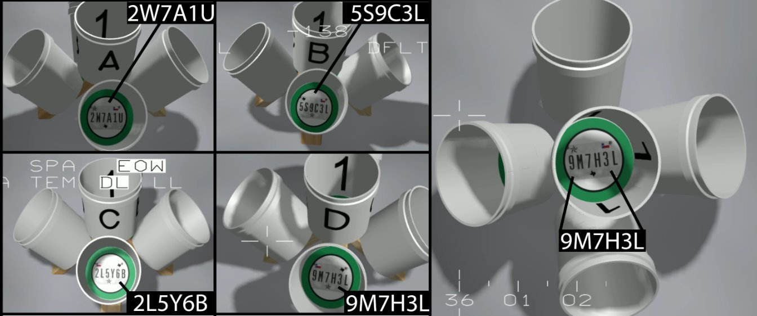
Flight Path Explained
Clockwise Path: Top – A – B – C – D
Counterclockwise Path: Top – A – D – C – B
Notes:
I quickly want to illustrate what the flight paths look like.
For our clockwise pathing, participants would fly from the top bucket to A, then to B C and D
For counterclockwise pathing participants would fly from the top bucket to A again, but then fly to D, C, B.
This is in line with how the NIST does counterclockwise pathing.

Slide 15

Altered Working Memory Stimuli
Three icons added
Icon positions randomized between bottom-center, top-left, top-right
String now combined letters and numbers
Icons
Notes:
As mentioned before we altered the working memory stimuli.
We added 3 icons which would be randomly placed in one of three positions.
Icon positions would be randomized between bottom-center, top-left, top-right
We also randomized the elements of the string, so that letters and numbers were combined, making it more realistic.

Slide 16



Responses Illustrated
String Differ, Icon’s Differ
String same, Icon’s Differ
String Differ, Icon’s Same
Notes:
Finally, with these changes participants would now have 3 possible responses at each bucket stand.
String is the same, Icon positions differ
String differs, Icon positions are the same
Both Icon positions and String are different
We removed the both similar condition as this response was typically a go-to if participants did not know.

Slide 17
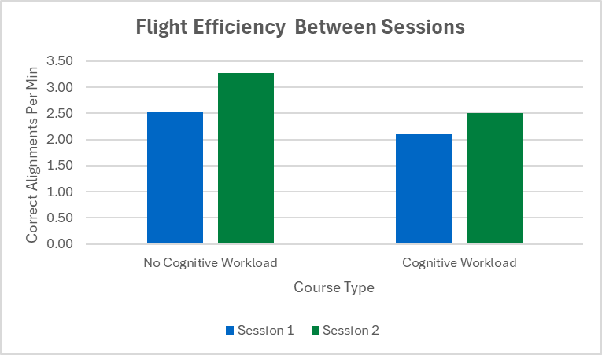
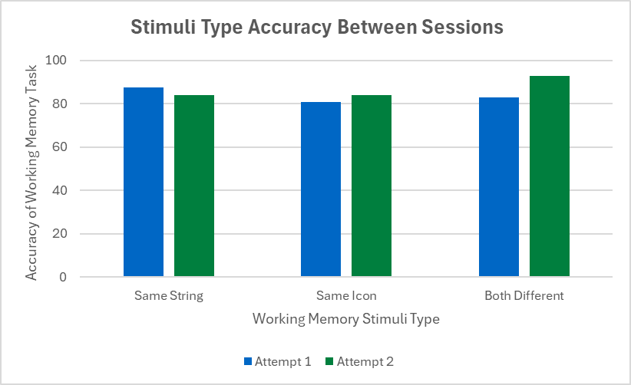
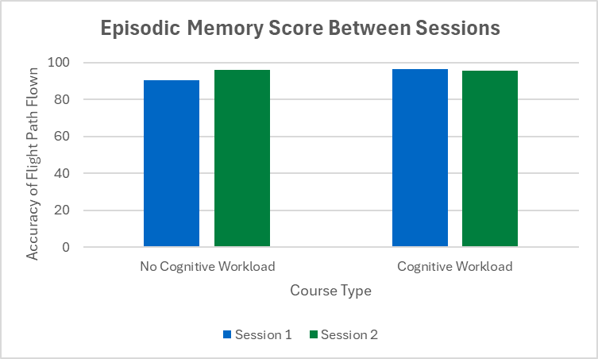
Study 2 Preliminary Results
Cognitive workload appears to lower flight efficiency,
but training seems to be able to reduce the effect of it.
Participants were more efficient in courses without cognitive workload
Participants showed no working memory improvement with practice
Participants showed no episodic memory improvement with practice
Notes:
The preliminary results from our second study showed that flight efficiency for was higher in courses without cognitive workload.
For our working memory task, we still saw a ceiling effect were no improvement was found between sessions.
Something interesting that happened was, even though pilots did not get any better or worse at the working memory task, if we look at the cognitive workload data from the flight efficiency graph, they did get faster in between session 1 and 2.
So, our pilots were able to develop strategies to move through the course faster even by their second session.
For our Episodic memory task, no change between session one and two.
And it appears we may have created another ceiling effect with this task.
Once again strong conclusions cannot be draw with such a small sample.
However, these results did point us in the direction that Cognitive workload appears to lower flight efficiency, but with training we seem to be able to reduce this effect.

Slide 18
Future Directions & Limitations
Next Steps
Increase sample size
Add alterations to other NIST UAS courses both virtually and real-world
Add cognitive practice outside of flights
Limitations
Small sample size of pilots and nonpilots
Pilots expressed mixed feelings about the MR simulator’s accuracy at replicating piloting
VR/MR simulators tend to cause motion sickness, making recruitment efforts challenging
Notes:
What we would like to do in the future is increase our sample size so we can perform statistical analysis of our data.
We would also like to add alterations to other NIST courses and apply them to the real and virtual world
In addition, we would like to investigate the effects of cognitive practice outside of flights, to see if we can further reduce the strain of cognitive workload
As mentioned previously, this study was limited in its sample size, so strong conclusions cannot be drawn from this preliminary data.
Pilots had mixed feelings about the simulator’s accuracy. Some expressed that it was very similar, while others had a more challenging time adapting to the SIM and cited that when they normally fly their controls feel different.
Finally we were limited by the fact that VR/MR simulators tend to cause motion sickness, making it difficult to get consistent participation.
Thank you all for attending this presentation over integrating skills and cognitive training in a simulated UAS pilot training course.
If you have any questions, I’d be happy to answer them now.

