Slide 1

Mapping Trust in AI: Right Tool, Right Task
Connor Baugh,
Intuitive Research and Technology Corporation (INTUITIVE®)

Slide 2
Agenda
Introduction
Dataset
Defining Model Trust
Formulating Model Trust
Variational Autoencoder (VAE)
Mapping Trust in AI
Evaluating our Trust Metric
Conclusions

Slide 3
Introduction
Primary Objectives
Objectively measure trust in an AI system across varying tasks
Provide a visualization of model trust for effective stakeholder decision-making
Make sure trust metric aligns with stakeholder risk-tolerance levels

Slide 4
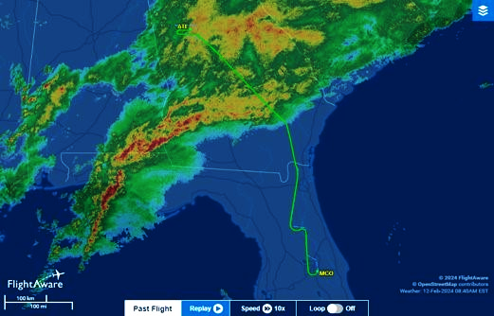
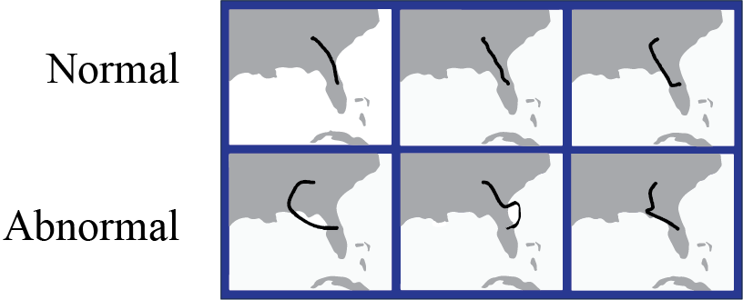
Flight Data
Commercial Airline Flight Paths
Normal – Flights tracked between ATL and MCO
Abnormal – Synthetic paths simulating flight diversions
Image from FlightAware.com

Slide 5
Defining Model Trust
No singular definition of model trust
We define trust as a function of algorithmic stability and uncertainty quantification
Algorithmic Stability – Degree to which the model focuses on the same evidence to come to the same decisions
Uncertainty Quantification – How uncertain the model is about its predictions given the input data

Slide 6
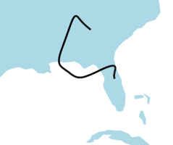
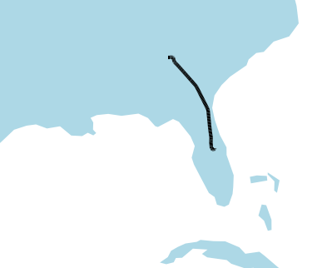

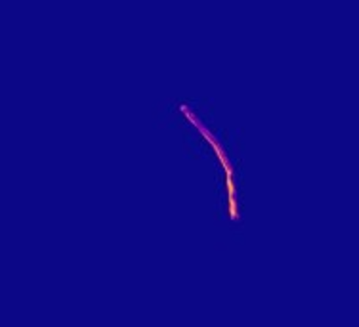
Example of Model Focus
Evidence comes in the form of heatmaps that reveal model decision process
Brighter regions indicate higher impact on decision-making
Flight trajectory angles play a critical role in flight classification

Slide 7
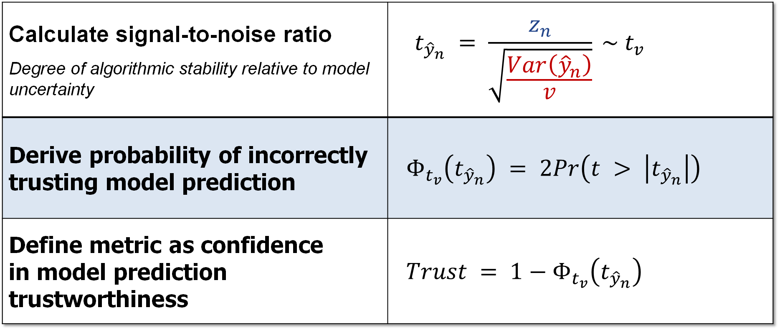
Formulating Model Trust
Calculate signal-to-noise ratio Degree of algorithmic stability relative to model uncertainty | $$\begin{aligned} t_{{\hat{y}}_{n}} = \frac{z_{n}}{\sqrt{\frac{Var\left({\hat{y}}_{n}\right)}{v}}} \sim t_{v}\end{aligned}$$
Derive probability of incorrectly trusting model prediction | $$Φ_{t_{v}}\left(t_{{\hat{y}}_{n}}\right) = 2Pr\left(t > \left|t_{{\hat{y}}_{n}}\right|\right)$$
Define metric as confidence in model prediction trustworthiness | $$Trust = 1−Φ_{t_{v}}\left(t_{{\hat{y}}_{n}}\right)$$
0.95 indicates stakeholder can be 95% confident that prediction is trustworthy

Slide 8
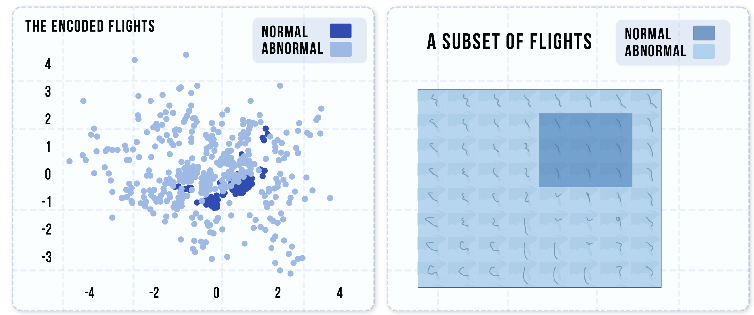
Variational Autoencoder (VAE)
What is this?
Desirable properties for mapping trust in AI
Preserves global structure
Enables identification of transitions in model behavior

Slide 9
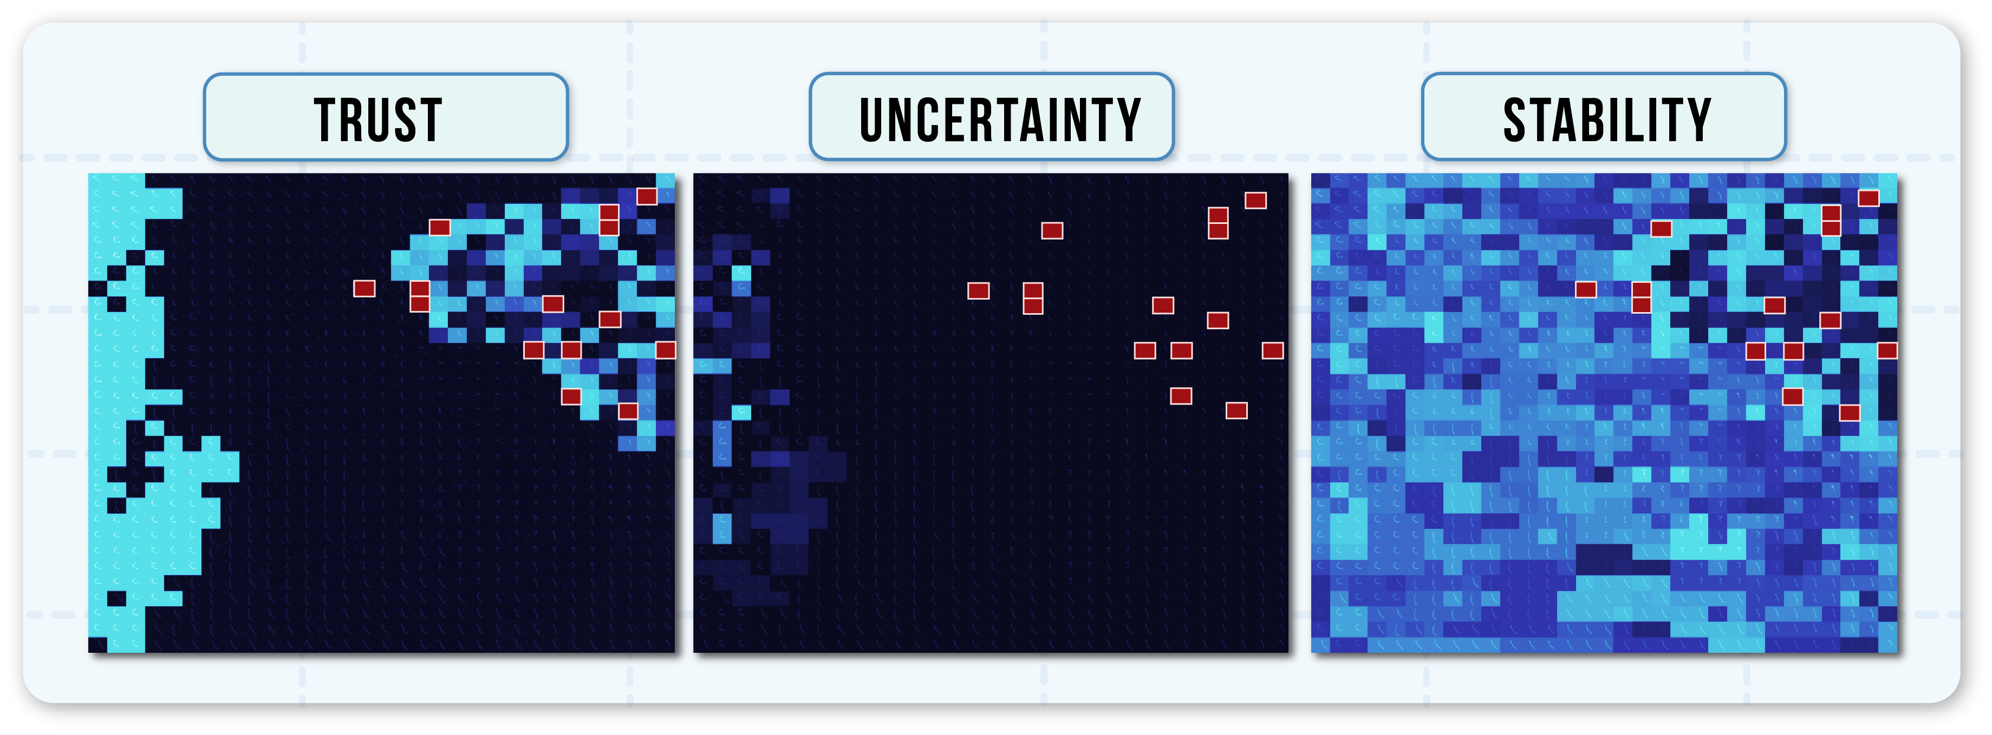
Mapping Trust in AI
GRAPH
KEY
UNTRUSTWORTHY
TRUSTWORTHY
MISCLASSIFICATION

Slide 10
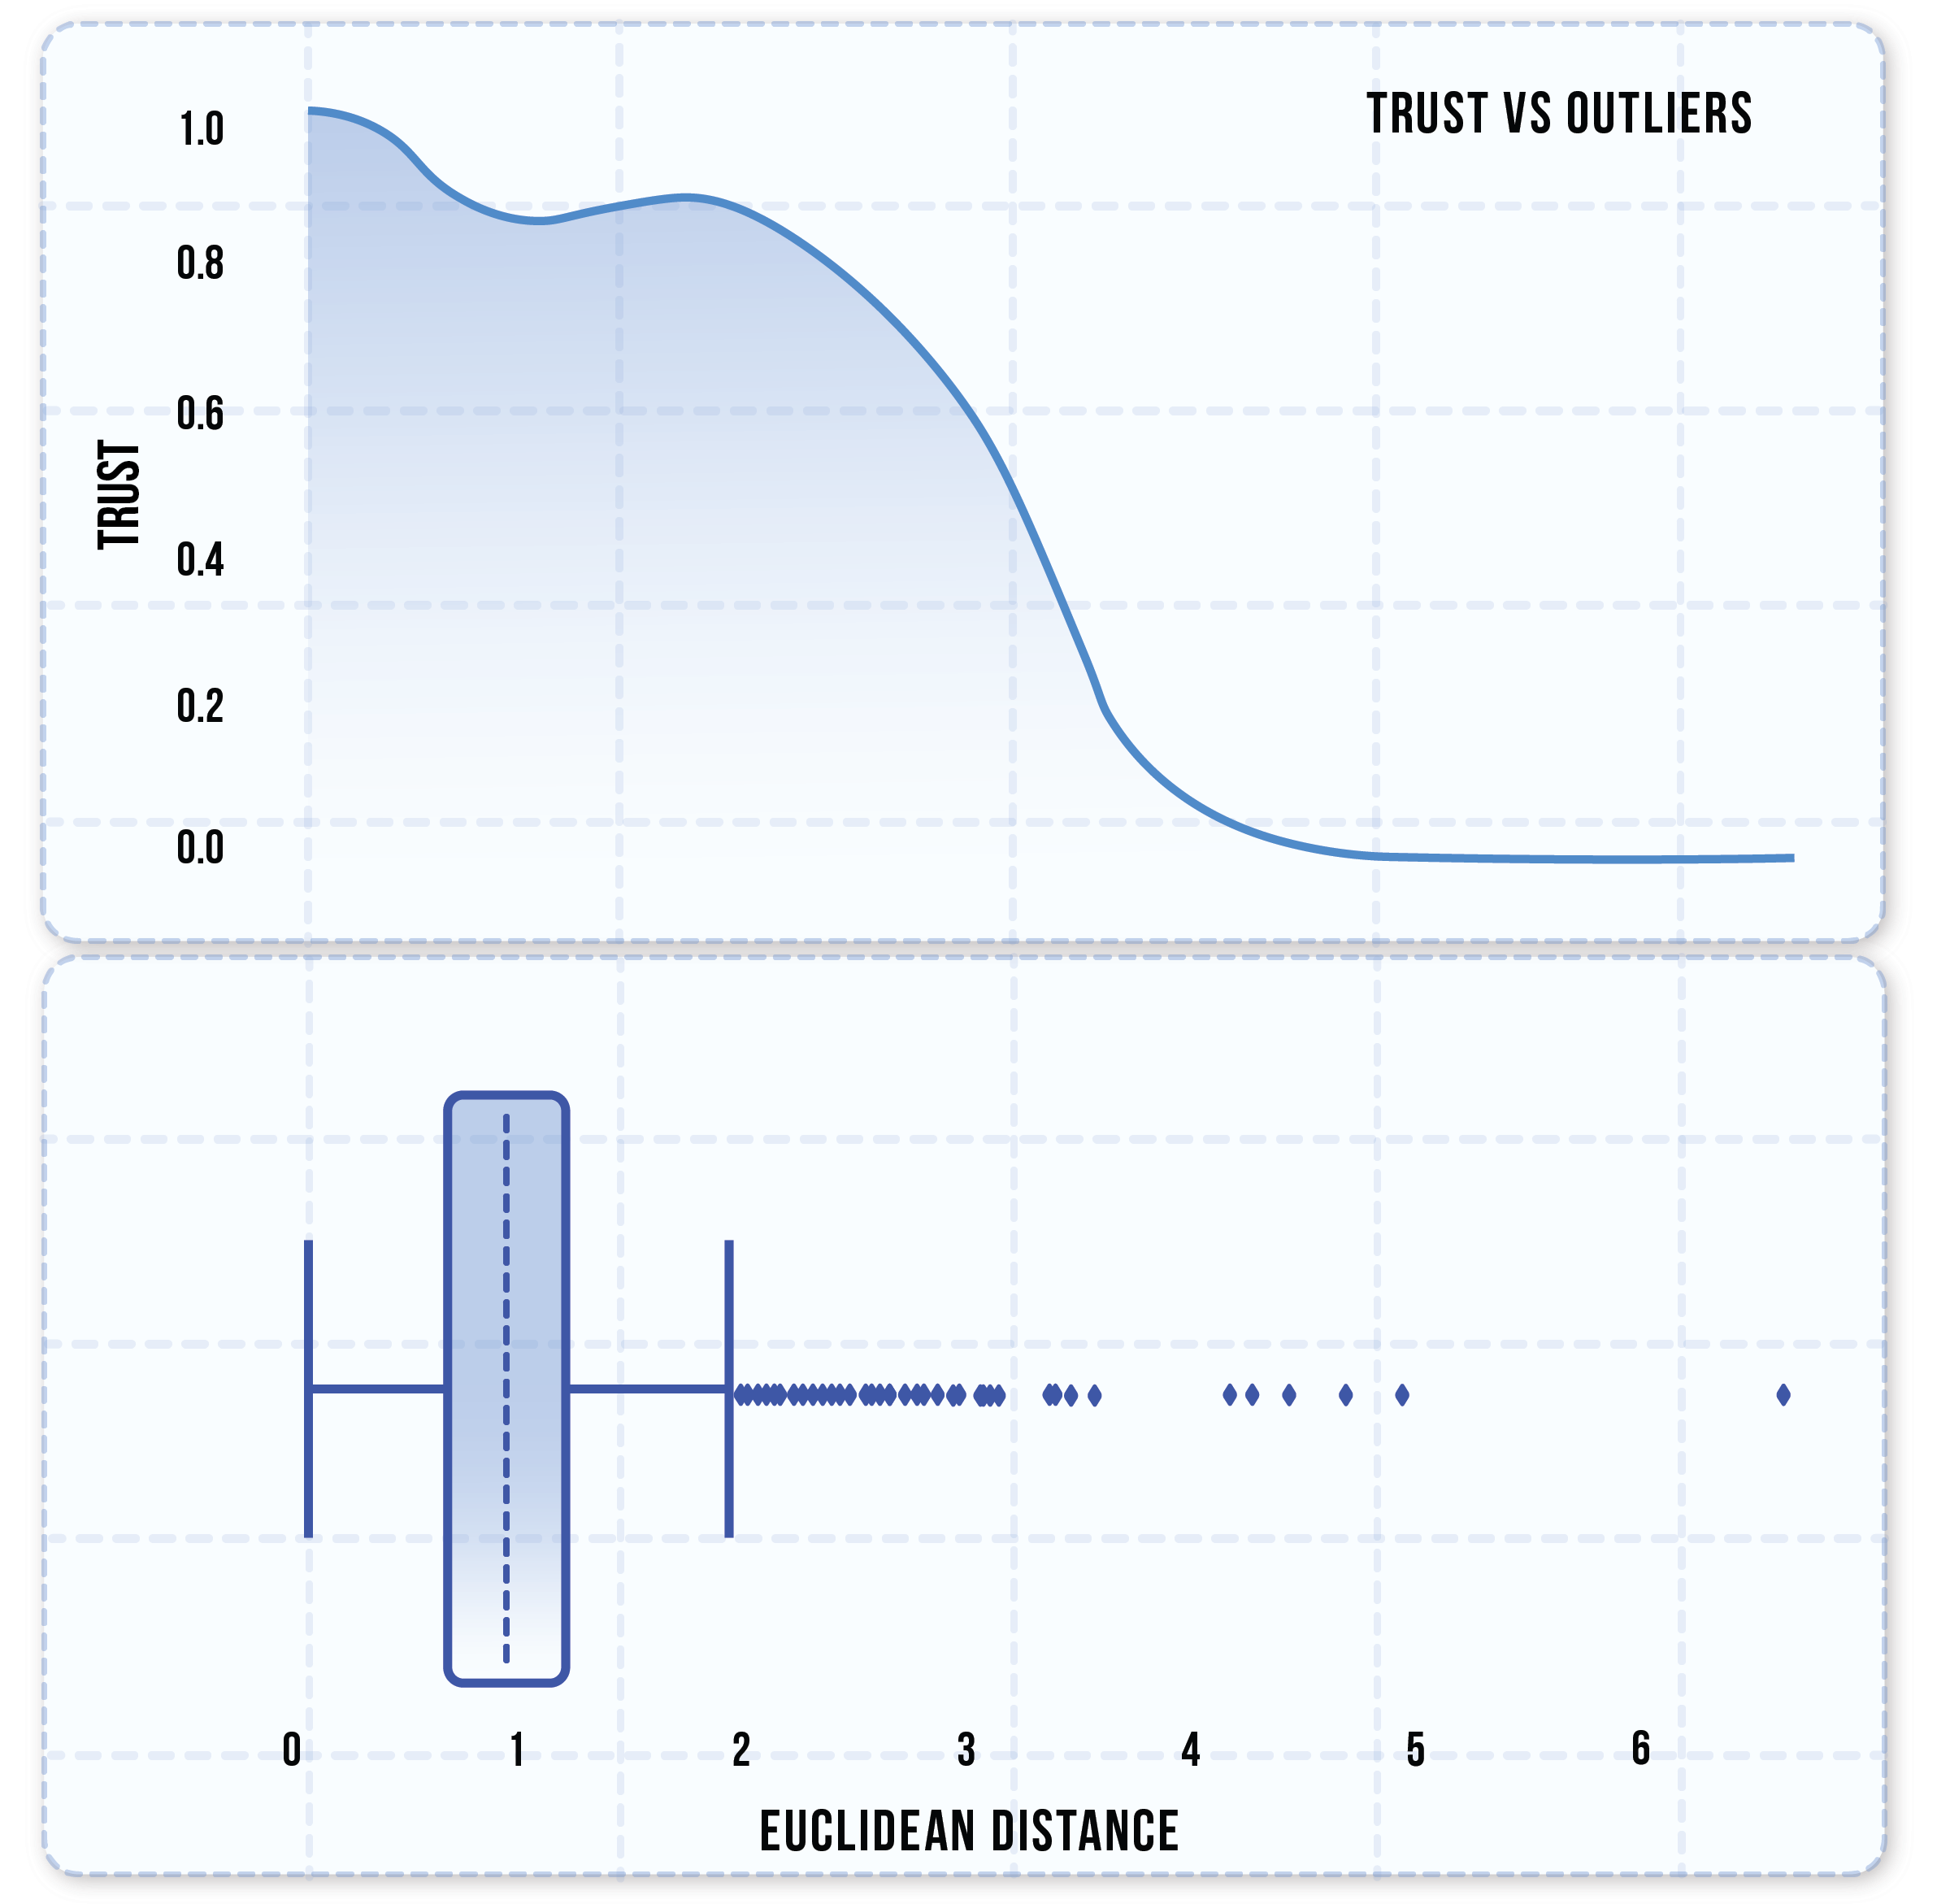
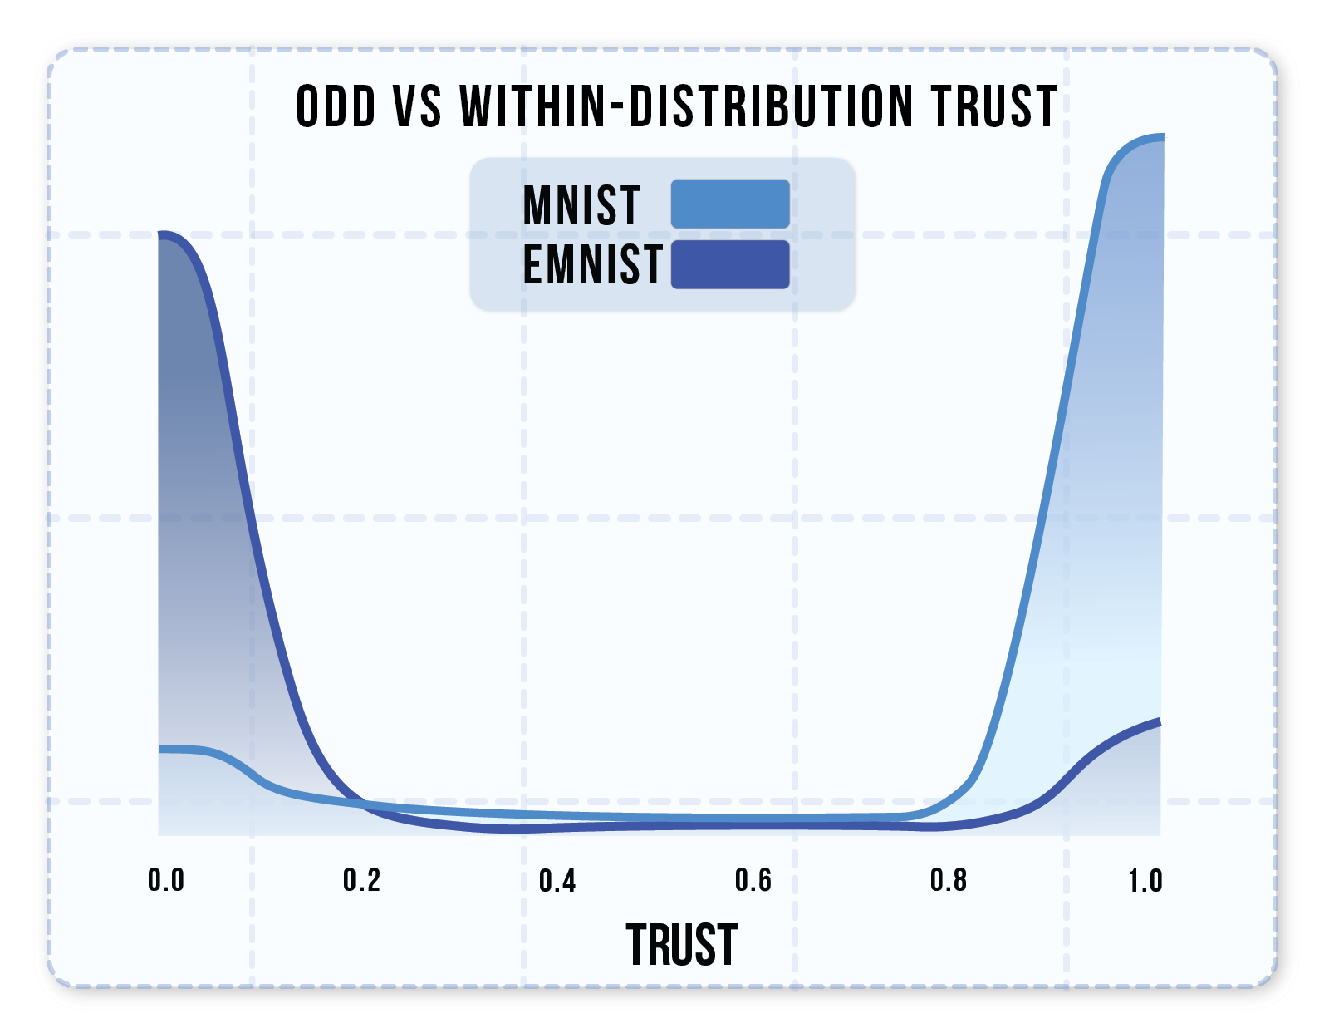
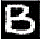
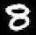



Evaluating our Trust Metric
Exhibits high trust for common samples, significantly less for outliers & edge cases
Capable of detecting out-of-distribution (OOD) data
High trust overlap due to resemblance of some letters to digits

Slide 11
Conclusions
Conclusions
Provides intuitive visualization of model trust across scenarios
Allows for comprehensive evaluation of AI system decision-making
Trustworthiness metric is objective and aligns with stakeholder risk-tolerance levels
Future Work
Refinements to improve efficiency and scalability
Explore extensions to non-visual data
Expand evaluation to real DoD aircraft operations

Slide 12
Questions?

