Slide 1


Enhancing Air Force Training: A Data Integration Framework
Eric Haney PhD, Lone Star Analysis
Samantha N. Emerson PhD, Aptima
Mark Schroeder-Strong PhD, Aptima

Slide 2
Future Direction of Training
Current State
Siloed and non-connected datasets
Slow, subjective instruction feedback loops
Conservate training paradigms
Future State
Adaptive, responsive & holistic training
Multi-modal, multi-fidelity environments
Real-time integrated training progression
Gaps to Improve Today & Inform Tomorrow
Analysis methods that work on small, noisy datasets
Framework that improves incrementally – without waiting for ideal future state
Reflects urgency to improve readiness outcomes today

Slide 3
Requirements for Improving Training Data
Gaps to Improve Today & Inform Tomorrow
Analysis methods that work on small, noisy datasets
Framework that improves incrementally – without waiting for ideal future state
Reflects urgency to improve readiness outcomes today
Data-to-Skill Mapping
Identify which data can be used to measure which skills
Data Segmentation and Extraction
Isolate events from others in continuous data streams
Available data in Air Force and broader pilot training
Grade sheet / event reports (G/TIMS, ARMS, xAPI)
Detailed simulator event data (DIS)
Data Integration and Weighting
Integrate multiple signals into a holistic picture
Predictive Validation
Identify data discrepancies early in process
Knowledge of Air Force training
Continuity of training skills through pilot career
Context to future mission sets
Updated Training Data Infrastructure
Modernize Air Force data infrastructure

Slide 4
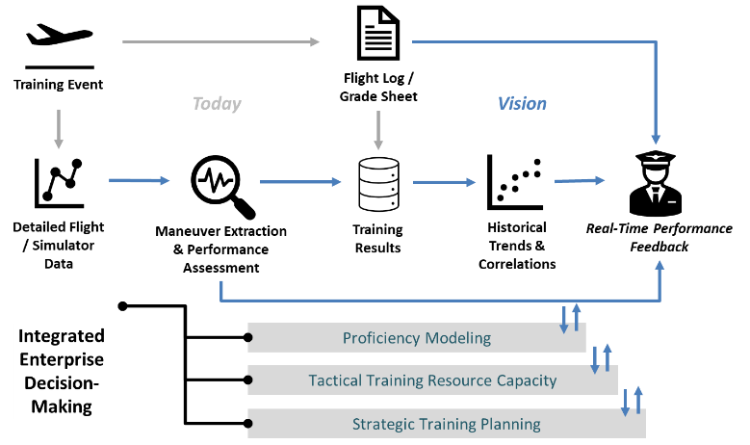
Framework Vision

Slide 5
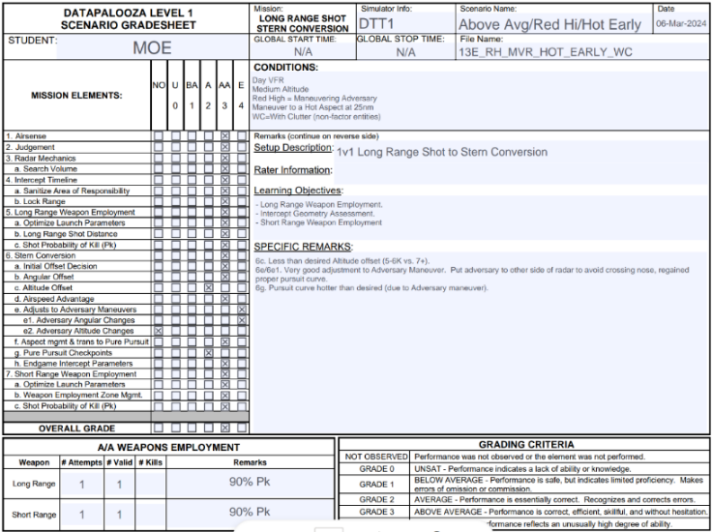
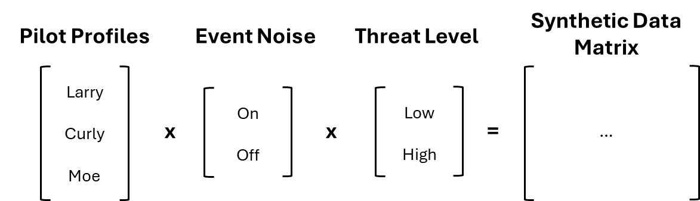
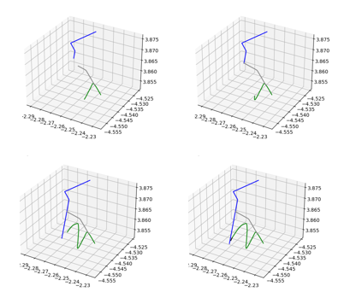
Extracting Skill Maneuvers from Event Data
Datapalooza Dataset
Simulator data generated by Air Force instructor pilot as synthetic student data – stand-in for enterprise training data that remains stovepiped
Multiple instances of same event with different noise / threat / simulated proficiency values for exercise algorithm robustness
Two artifacts provided from each event:
Grade Sheet that follows existing AF standards
Time Space Position Information (TSPI) detailed simulator data
Algorithmic methods investigated to
Decompose TSPI data into mission elements from grade sheet
Grade mission element performance

Slide 6
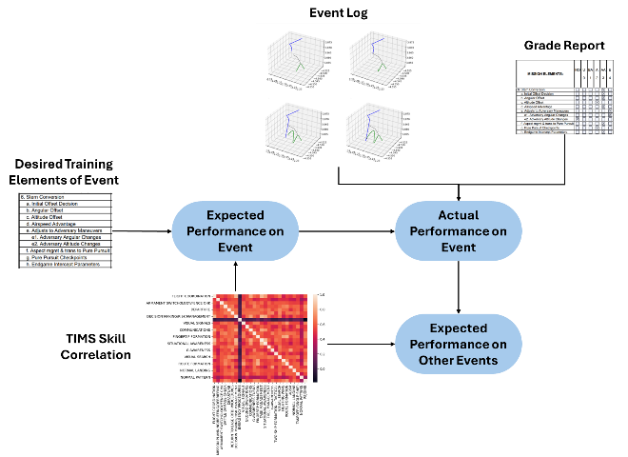
Analyzing Future Event Performance
Analysis of G/TIMS data to predict future performance based on previous events / mission elements
Lack of variability in grading values and limited time window of outcomes from G/TIMS limited the predictive value of existing Air Force data
Isolated clustering analysis was able to identify four key skills that lead overall performance
Flight Coordination
Decision-Making
Task Management
Situational Awareness

Slide 7
Lessons Learned for Improving Readiness
Digital Transformation initiatives are making impact, but silos still remain
Data security / classification of event records
Incomplete migration to shared storage systems
Even so, barriers are surmountable to improve Readiness today
Multi-modal data informs a more holistic picture of learner performance
Analytics can reduce instructors’ workload by automating mundane, repeatable tasks
Framework is in place to improve Readiness outcomes today AND inform Digital Transformation initiatives of tomorrow
Centralized Storage, Standardized Formats, Flexible Security, Designed to Evolve

Slide 8



Contacts
Eric Haney PhD Chief Technology Officer Lone Star Analysis ehaney@lone-star.com
Samantha N. Emerson PhD Scientist Aptima semerson@aptima.com
Mark Schroeder PhD Scientist Aptima mschroeder@aptima.com
This work was funded by Air Force Research Laboratory under SBIR AF222-D018 Direct-to-Phase 2
David Malek Technical Point of Contact AFRL Human Performance Wing david.malek.1@us.af.mil

