Slide 1


A biosensor solution for real-time and prognostic health monitoring
Paulien Roos, PhD, Nathan Pickle, PhD, Joshua Hogue, PhD, Philip Whitley, PhD
CFD Research Corporation, Huntsville, AL
JoEllen Sefton, PhD
Auburn University, AL
Contact: paulien.roos@cfd-research.com

Slide 2
Acknowledgements & Disclosure
This material is based upon work supported by the Army Futures Command (AFC) and Army Applications Lab (AAL) under Contract No. W911NF-22-C-0011.
Thank you to Andrea Taylor and Chad Hearing for their support of this work.
Any opinions, findings, and conclusions or recommendations expressed in this material are those of the author(s) and do not necessarily represent the official views of the US Government, the Dept. of Defense, Army Futures Command (AFC), or the Army Applications Lab (AAL).

Slide 3

Battlefield of the future
Free image from unsplash.com
Notes:
Extensive suite of sensors available that can monitor physiological status.
Challenges in interpretation and presentation of data in a meaningful way to facilitate informed decision making

Slide 4
Urgent Need
At-a-glance data interpretation
Good
Needs attention soon
Needs immediate attention

Slide 5
Objectives
To develop a comprehensive warfighter health status assessment that:
Uses an open, extensible software architecture for fusing diverse biosensor data into a comprehensive warfighter health status assessment that runs on a mobile device using the Android Tactical Assault Kit (ATAK)
Is sensor agnostic with the prototype set to automatically scan for generic skin temperature, pulse oximeter, heart rate, and inertial measurement sensors.

Slide 6
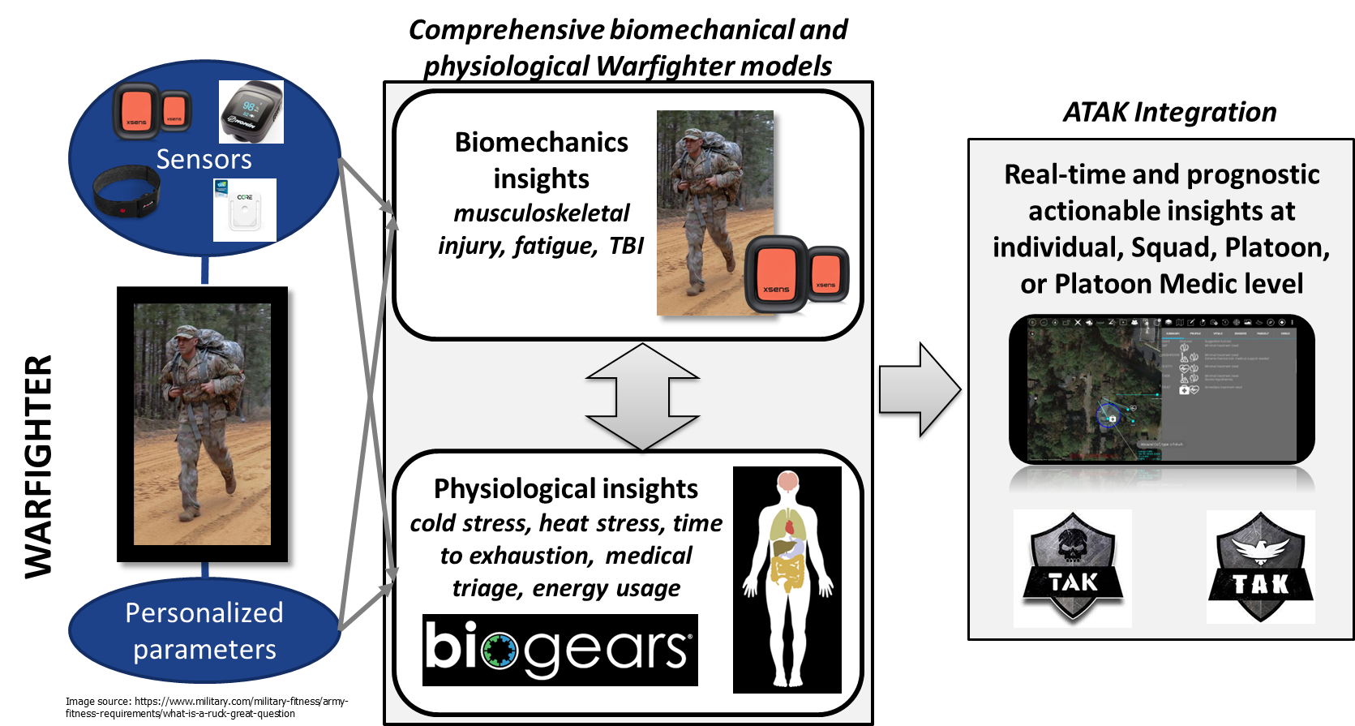
Our Solution
INTEGRATE data streams into the ATAK platform
FUSE data using novel equations for energy expenditure
VISUALIZE data intuitively for actionable insights
PREDICT future physiological status for mission planning

Slide 7
Approach
Design
User informed
Platform
Android
ATAK integration
Software
Extensible
Modular
Visualization
At-a-glance insights
Rank-based
Sensors
Sensor agnostic
Direct connect to device

Slide 8
Sensor Integration
Cross-platform, extensible sensor hub (Java)
Publisher/subscriber design
Sensors, simulations, and analyses provide publish or subscribe to data as they become available
Enables straightforward integration of new components
Tested on Windows and Android
Multiple Bluetooth sensors currently integrated
Heart rate, pulse oximeter, skin temperature, inertial measurement unit (IMU)
Easy to add additional sensors
Network connectivity not required
Demonstrated real-time integration of sensor data with BioGears simulation on Android
SENSORS
Heart rate
SIMULATION
Physiology
Pulse oximetry
Biomechanics
PUBLISHER SUBSCRIBER
IMU
Network
Thermal injury
Visualization
Musculoskeletal
injury
OUTFLOW
ANALYSIS

Slide 9
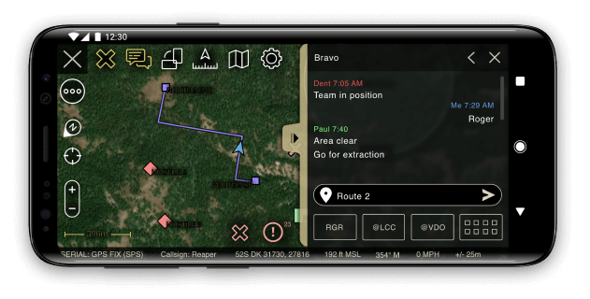
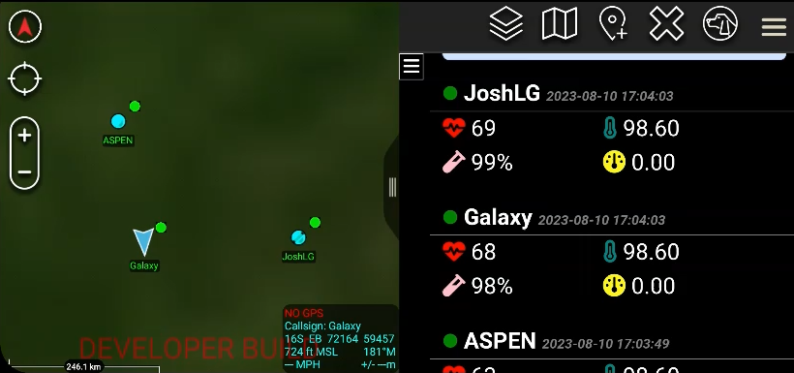
ATAK Integration
Android Team Awareness Kit
ATAK-CIV, ATAK-GOV, ATAK-MIL
Situational awareness tool
Team location
Environmental information
Communication
Mission planning
Photo/video
Extensible via plugins
Aspen
Galaxy
JoshLG
“TAK is the core of a suite of georeferenced imagery and communications tools that allow for scaled operational planning, data sharing, visualized elevation data, and target management. With TAK, your team can get oriented quickly, make better informed decisions and quickly respond to threats.”

Slide 10

Prognostics – BioGears Physiology Engine
Improved physiology predictions
Integrated body systems
Improved accuracy
Expanded prediction scenarios
Cross-compiled for Android
~3x real-time speed on Android (with ATAK app also running)
BioGears simulations regularly updated
Environmental conditions and metabolic cost
Metabolic cost – Load Carriage Decision Aid (velocity and slope from ATAK)
Algorithms turn outputs BioGears into actionable insights
Actionable insights
User specifications:
Sex
Height
Weight
Age
VO2max
Resting heart rate
Resting skin temperature
Load carried
Clothing
Metabolic Cost (W) - LCDA
Cold stress
BIOGEARS
ALGORITHMS
Heat stress
BioGears output:
Time
SpO2
Heart rate
Skin temperature
Core temperature
Breathing rate
Sweat rate
Environmental conditions – ATAK
Humidity
Temperature
Visibility (not needed?)
Wind speed (not needed)
Atmospheric pressure
Fatigue

Slide 11





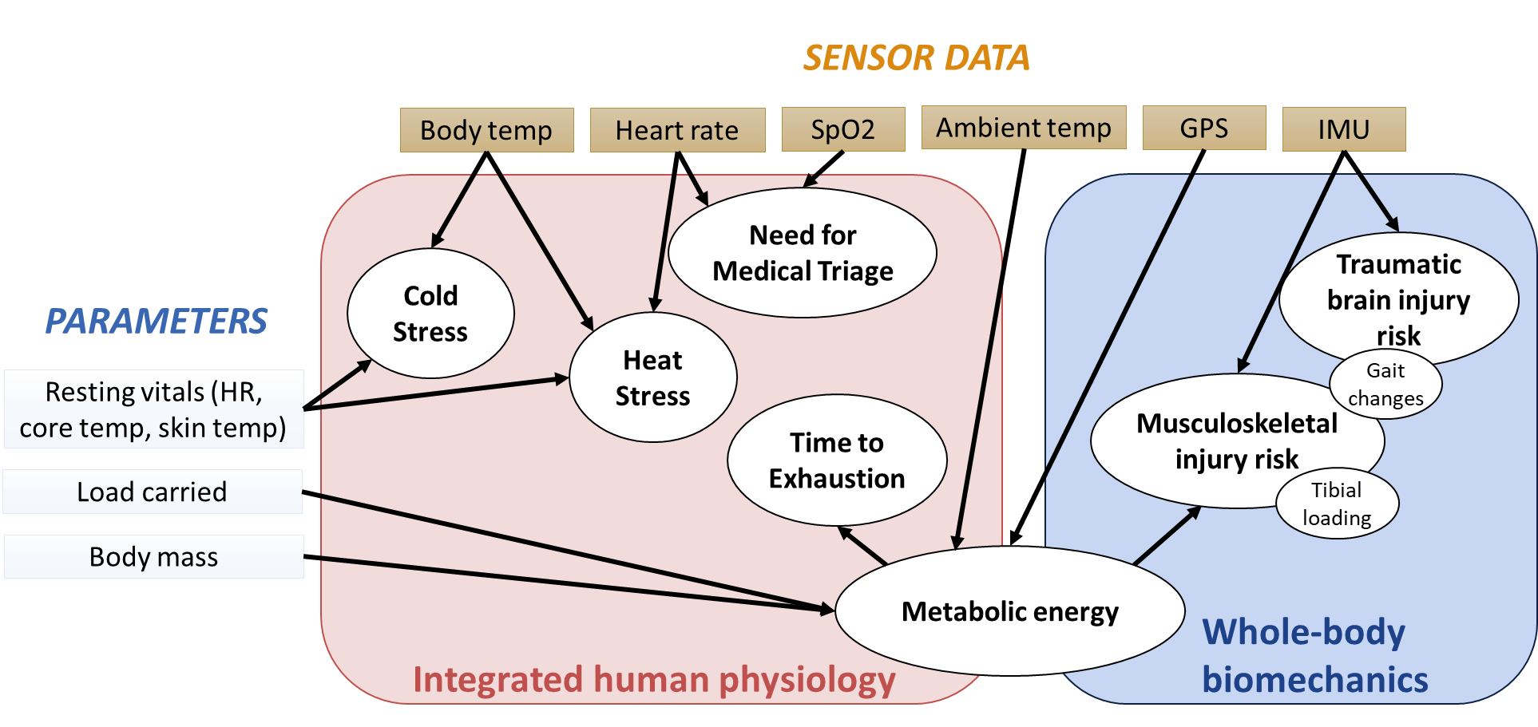
Actionable Insights
Musculoskeletal injury risk
Tibial acceleration (overuse injury)
Gait changes (acute injury)
Fatigue
Fractional Heart Rate Ratio
Gait changes
Traumatic brain injury
Gait stability (nRMS)
Medical
Cold stress (CSI)
Heat stress (PSI)
Medical triage (STAR)
Comparison to nearby warfighters to exclude terrain effects
Comparison to baseline data to identify sudden changes
Data flow and actionable insights

Slide 12
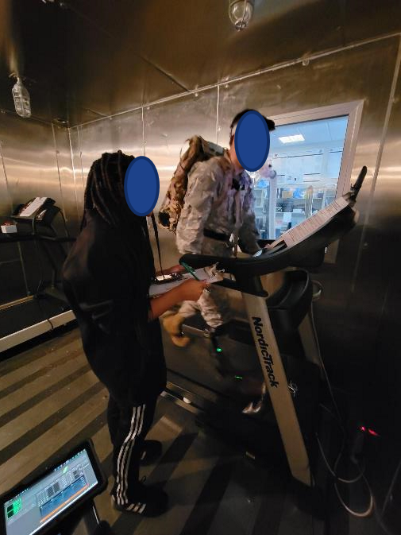
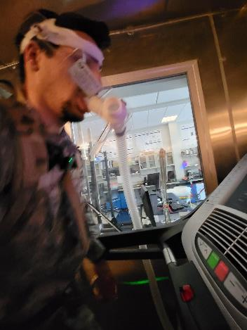
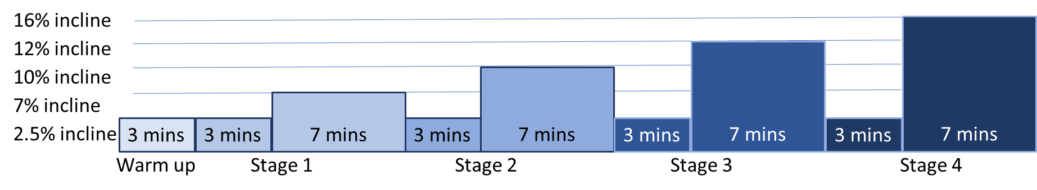
Experimental Evaluation
Experimental study at Auburn Warrior Research Center:
Challenging protocol:
Heat chamber
30% body weight backpack
Inclined march
Up to 40 mins or exhaustion
Outcomes:
Verification of BioGears for ruck marching scenario
Heart rate
Respiratory rate
Skin and estimated core temperature

Slide 13
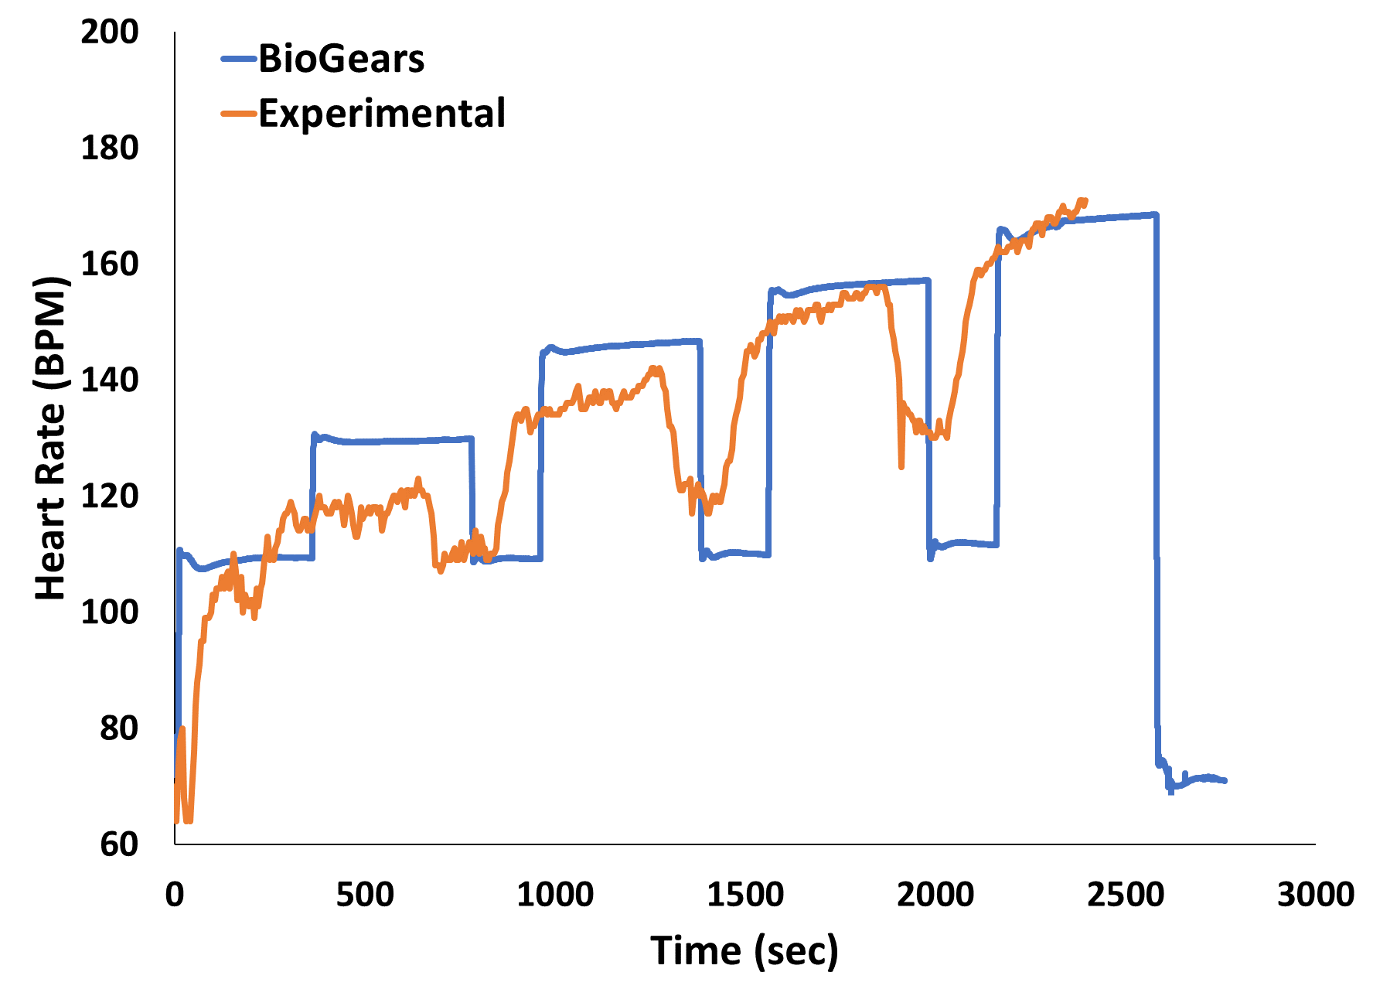
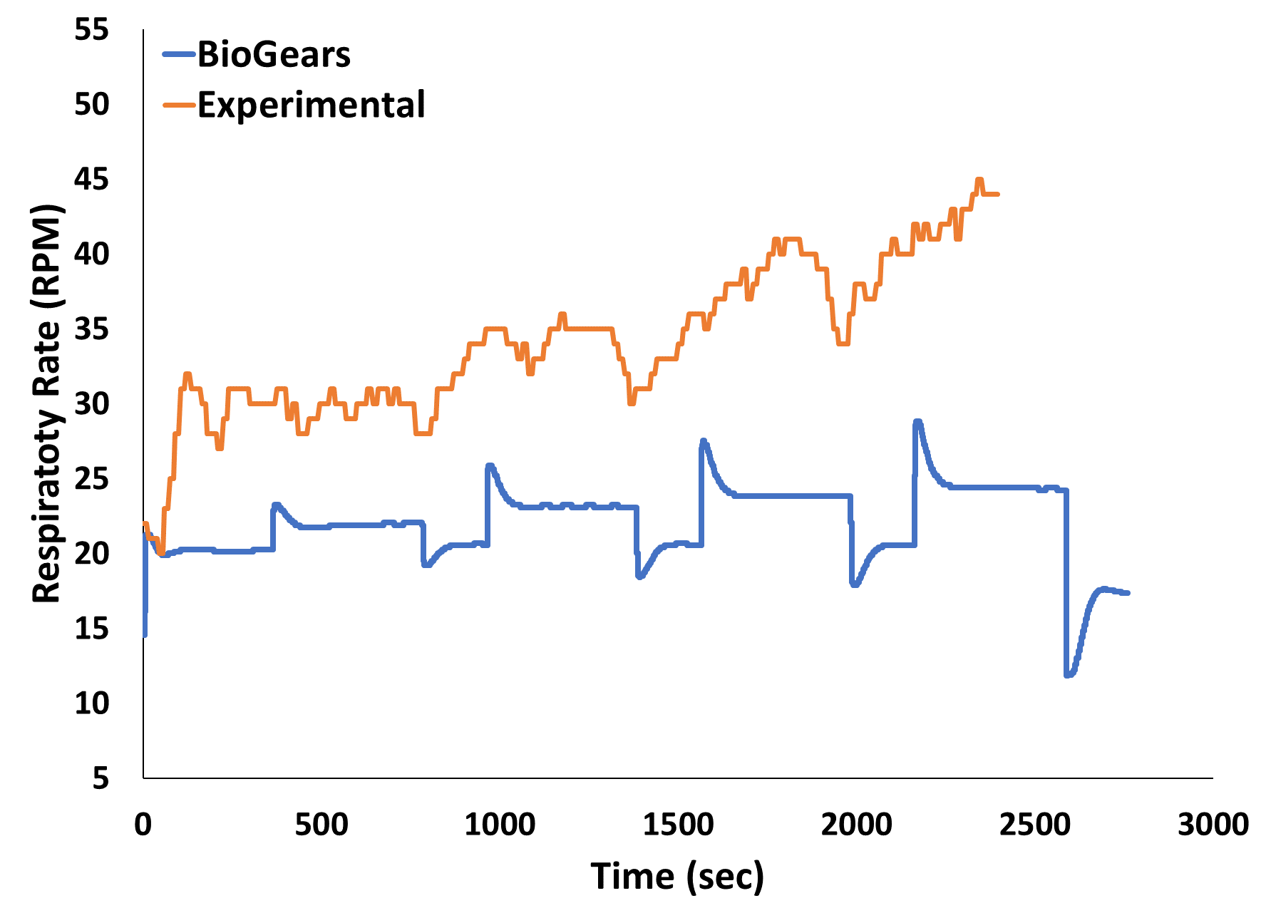
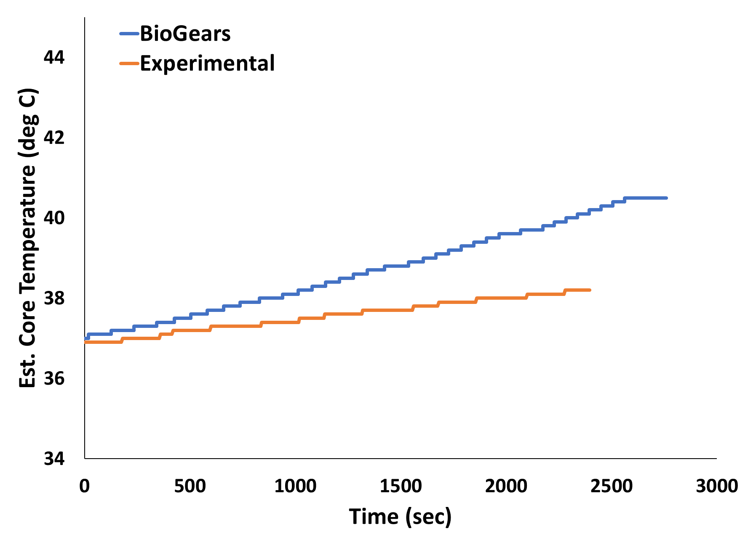
BioGears Simulations compared to Experimental Data
Subject specific models and simulations
BioGears vs Experimental data:
Heart Rate:
48% < 10% difference
67% < 20% difference
Respiratory rate:
57% > 30% difference
Possible initial conditions issues
Skin temperature:
100% < 10% difference
58% < 5% difference
Core temperature:
100% < 5% difference
Differences must be small (37-39ºC is 5.4% increase)
Percent Difference | Heart Rate (BPM) | Respiration Rate (RPM) | Skin Temperature (C) | Est Core Temperature (C)
<10% | 48% | 9% | 100% | 100%
10-20% | 19% | 14% | 0% | 0%
20-30% | 21% | 21% | 0% | 0%
>30% | 12% | 57% | 0% | 0%

Slide 14
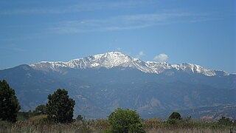
Demonstration – long duration march
Open source BioGears engine [1]
Available parameters
Fitness and anthropometry
Temperature and humidity
Clothing thermal properties
Oxygen levels
Mobile and desktop platforms
Test scenario: Pikes Peak ruck march
7,000 to 14,000 ft elevation
Elevation profile from Pikes Peak Highway
0.8 m/s with 10-minute rest every 50 minutes
Clothing 1 CLO (similar to battle dress uniform)
Added rucksack at 30% and 40% body weight
Hogs555, CC BY-SA 3.0, via Wikimedia Commons
1. Baird, A., McDaniel, M., White, S., Tatum, N., & Marin, L. (2020). BioGears: A C++ library for whole body physiology simulations. Journal of Open Source Software, 5(56), 2645. https://doi.org/10.21105/joss.02645

Slide 15
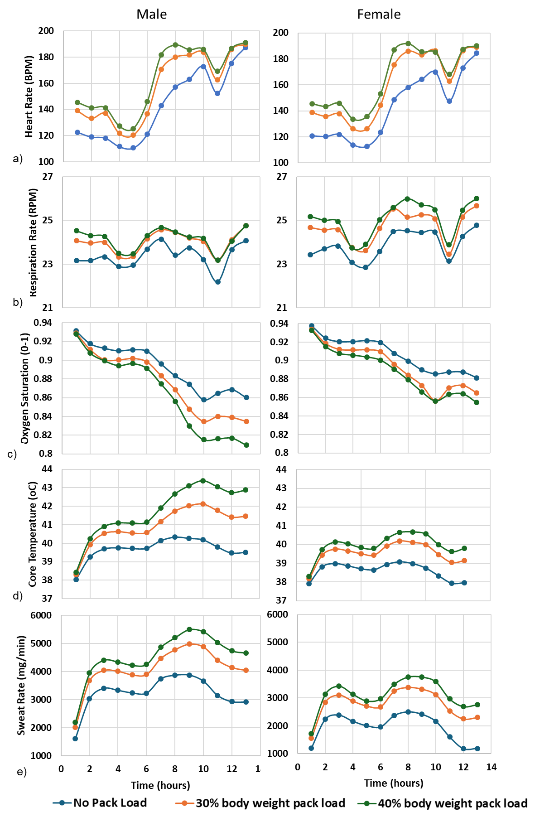
Results
Notes:
Successfully completed simulation of 12-hour ruck march
Reasonable physiological responses to exertion, temperature, oxygen
Demonstrates proof-of-concept for simulating long-duration missions
More validation is needed

Slide 16
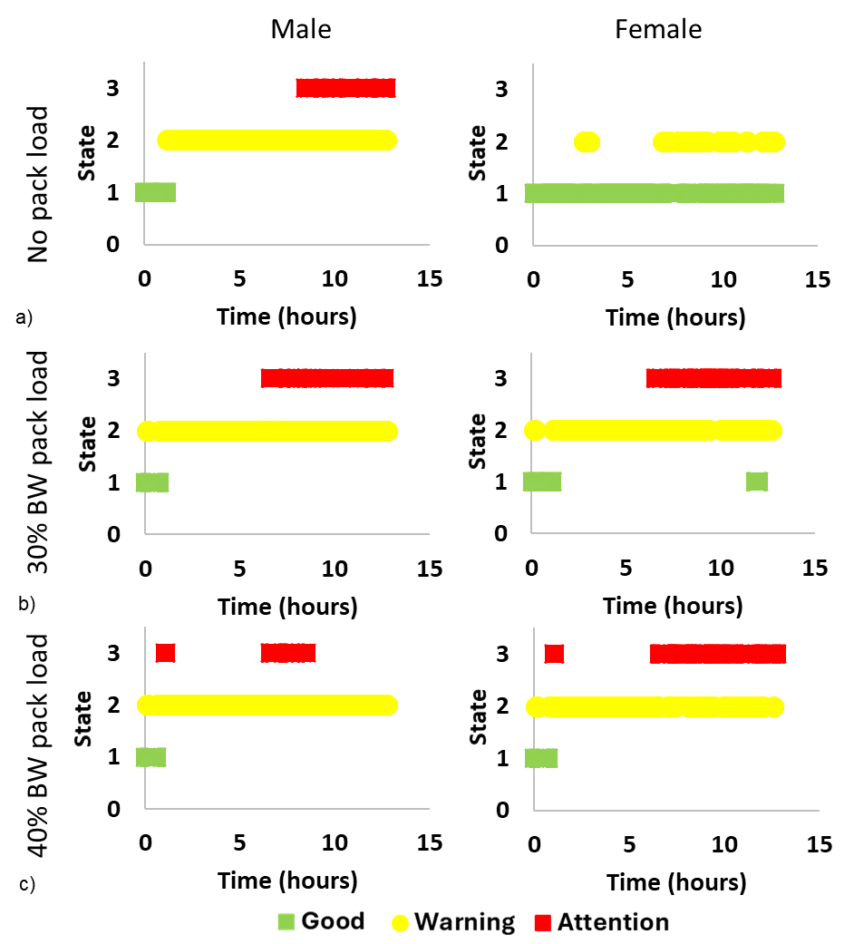
Results
Notes:
Successfully completed simulation of 12-hour ruck march
Reasonable physiological responses to exertion, temperature, oxygen
Demonstrates proof-of-concept for simulating long-duration missions
More validation is needed

Slide 17
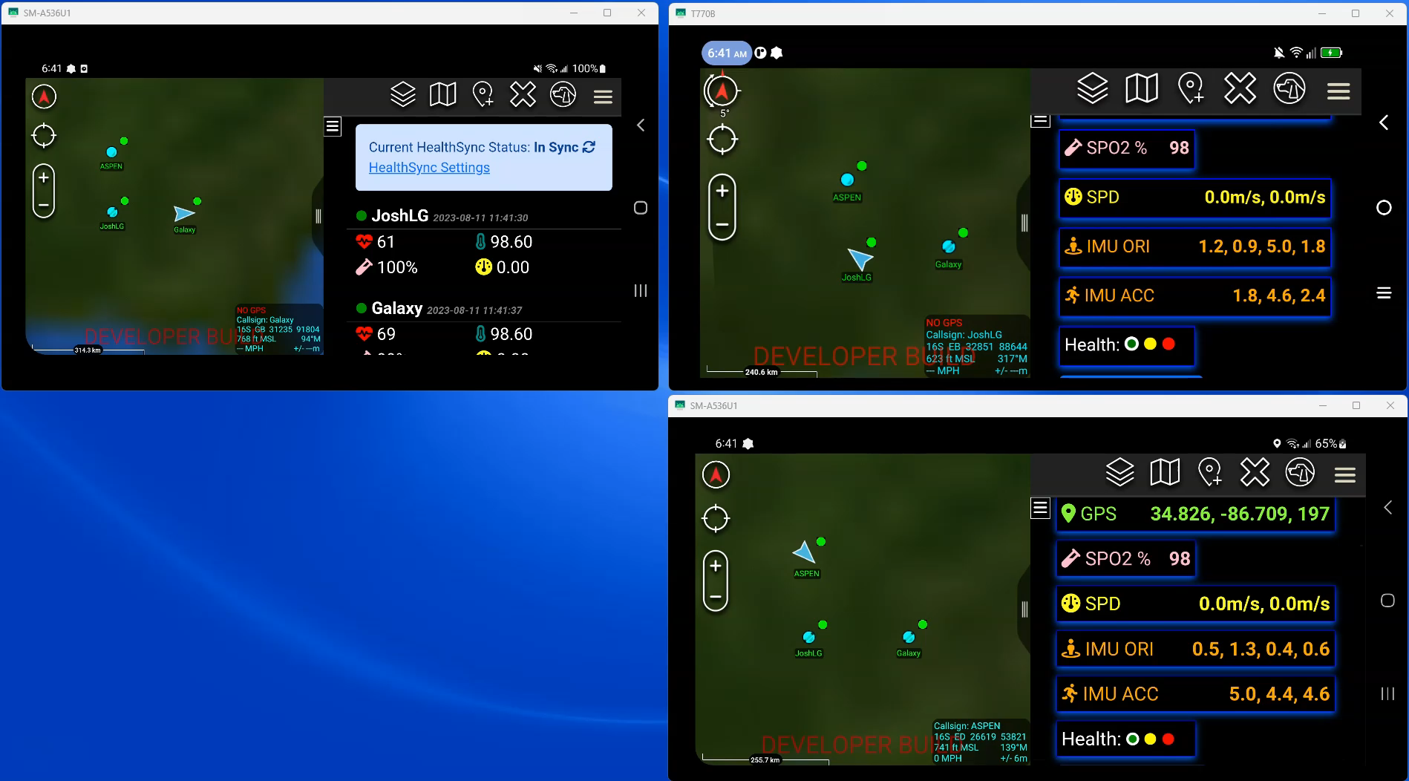
Demonstration
Squad Leader
Individual Users

Slide 18
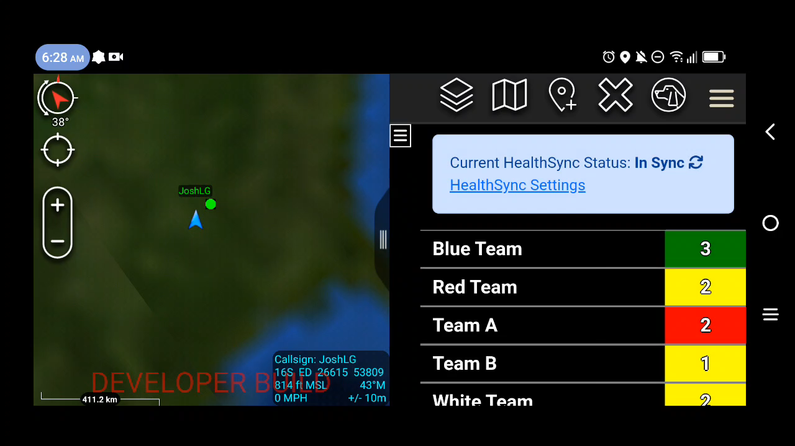
Platoon Sergeant

Slide 19
Conclusions
Achievements
Aggregated sensor and device data into actionable insights
Extensible & agnostic – sensors, algorithms, devices, simulations, etc.
Insights into musculoskeletal injury, TBI, fatigue, and medical emergencies
Prognostic insights
Demonstrated in laboratory environment
What’s next?
Validation and refinement with field data
Collect large dataset for injury prediction
Integrate with existing frameworks and military health records
Expand algorithms
Closed loop simulations / digital twin
Point of contact:
Paulien Roos, PhD
Manager, Biomechanics
paulien.roos@cfd-research.com

