Slide 1
An Enhanced Approach to Dynamic Unsupervised Clustering
Christopher Heinlen, Lone Star Analysis
Dr. Randal Allen, Lone Star Analysis
Mark Volpi, Lone Star Analysis

Slide 2
Agenda
Background
System Overview
Unsupervised Clustering Algorithm
Minimum Spanning Tree
Dendrogram & Cluster Culling
Efficacy
Future Work
The ability to identify rare events, and ignore false alarms, increases the effectiveness of training and increases readiness

Slide 3
Background
Unsupervised Clustering Goals
Identify emergent behavior
Real time identification of unknown types
New behaviors from software defined radios or changing traffic patterns
Anomalous behaviors, due to emerging failure or undesired activity
System Needs
The ability to discover new class types and record them for future data
The ability to find clusters and maintain tight cluster definitions in the presence of large amounts of noise
The ability to automatically determine the number of (if any) clusters are present in a dataset
Readiness demands that we cannot wait for observations taken from historic data

Slide 4
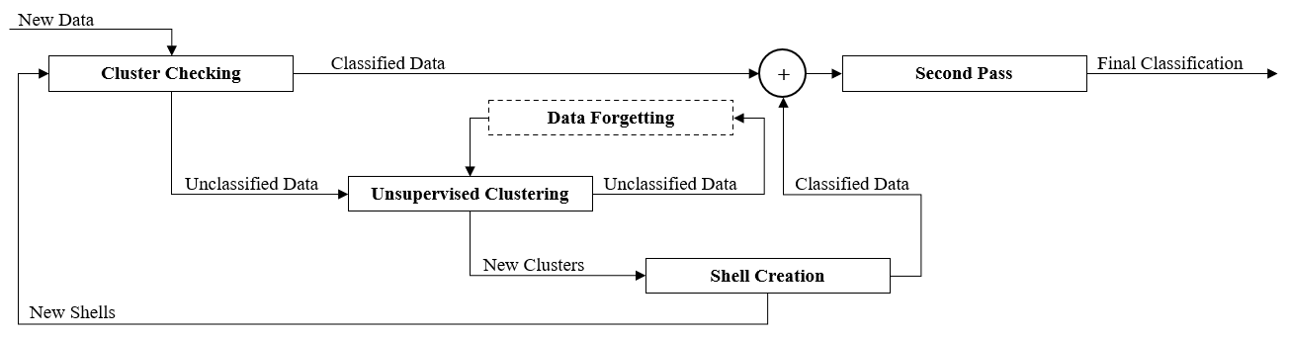
System Overview
Incoming data is first checked against known clusters
Second pass to further refine cluster definition and classifications
Unsupervised clustering is performed on unclassified data to find emergent data classes
New clusters definitions are created that can be used to check future data

Slide 5
System Overview
Incoming data is first checked against known clusters
Second pass to further refine cluster definition and classifications
Unsupervised clustering is performed on unclassified data to find emergent data classes
New clusters definitions are created that can be used to check future data

Slide 6
Unsupervised Clustering Algorithm
Unsupervised Clustering
k-Nearest Neighbor (kNN) Graph
Generate Dendrogram
Build kD-Tree
Define Core Distances
Cull Dendrogram
Build Minimum Spanning Tree (MST)

Slide 7
Unsupervised Clustering Algorithm
k-Nearest Neighbor (kNN) Graph
Generate Dendrogram
Build kD-Tree
Define Core Distances
Cull Dendrogram
Build Minimum Spanning Tree (MST)

Slide 8
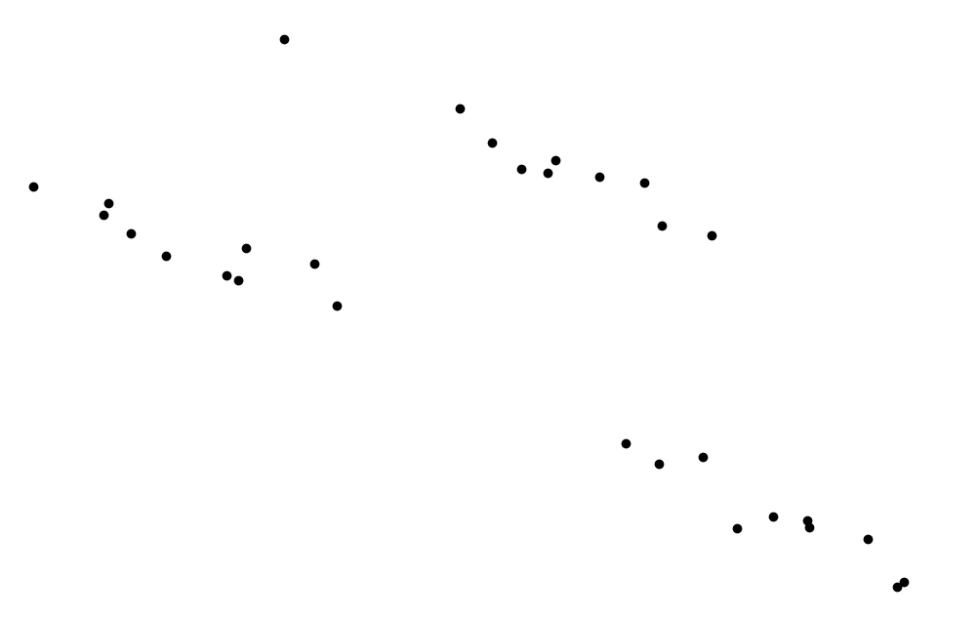
Minimum Spanning Tree
A Minimum Spanning Tree is a graph in which there exists a path between any two vertices and the combined edge weight of the graph is as small as possible
Well-Separated Pair Decomposition breaks a dataset into a series of well-separated pairs of point sets. This structure allows for shortcuts in the tree building process that significantly reduce build time

Slide 9
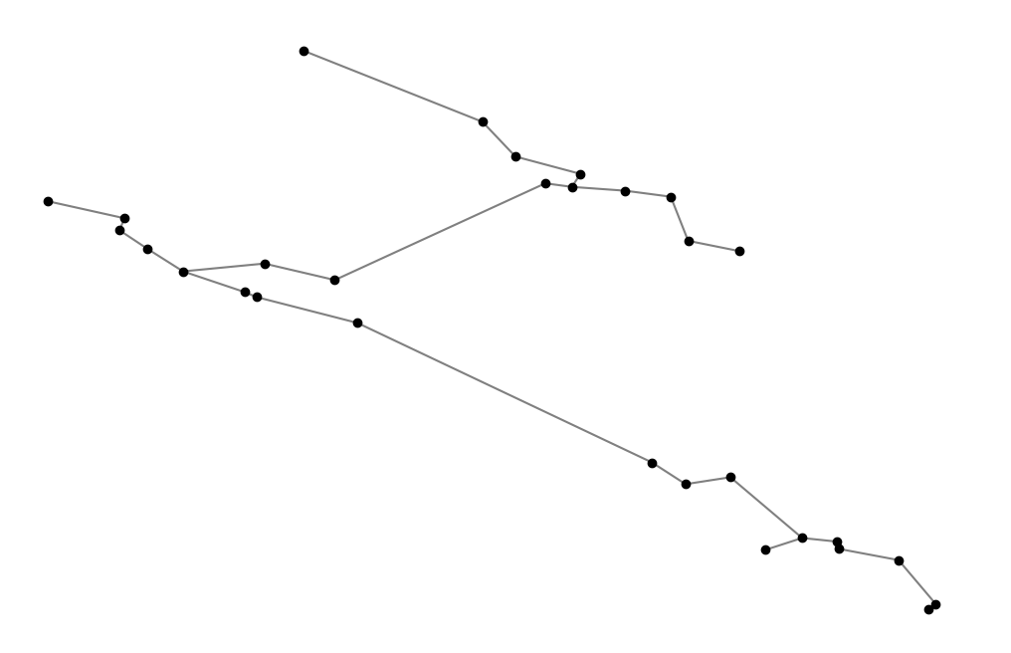
Minimum Spanning Tree
A Minimum Spanning Tree is a graph in which there exists a path between any two vertices and the combined edge weight of the graph is as small as possible
Well-Separated Pair Decomposition breaks a dataset into a series of well-separated pairs of point sets. This structure allows for shortcuts in the tree building process that significantly reduce build time

Slide 10
Minimum Spanning Tree
A Minimum Spanning Tree is a graph in which there exists a path between any two vertices and the combined edge weight of the graph is as small as possible
Well-Separated Pair Decomposition breaks a dataset into a series of well-separated pairs of point sets. This structure allows for shortcuts in the tree building process that significantly reduce build time
Edge B
Cluster 3
Cluster 2
Edge A
Cluster 1

Slide 11
Unsupervised Clustering Algorithm
k-Nearest Neighbor (kNN) Graph
Generate Dendrogram
Build kD-Tree
Define Core Distances
Cull Dendrogram
Build Minimum Spanning Tree (MST)

Slide 12
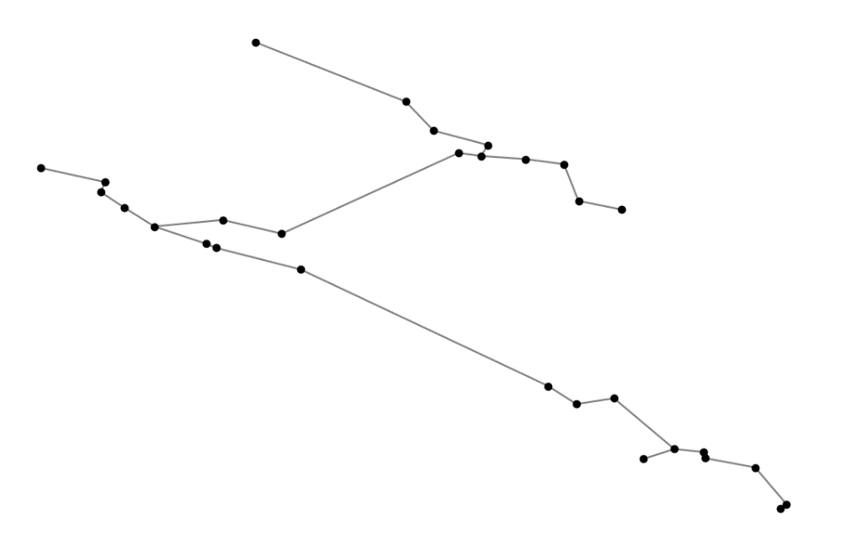
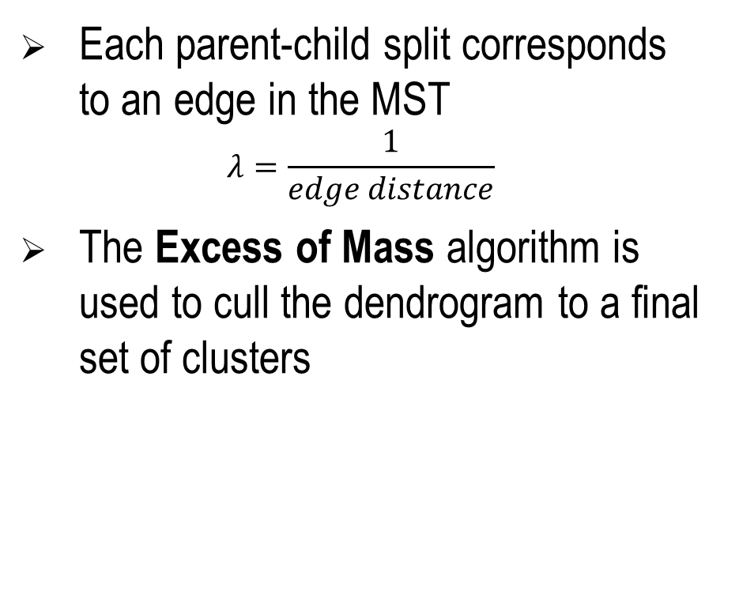
Dendrogram & Cluster Culling
A Dendrogram is a hierarchical binary tree of potential clusters
Each parent-child split corresponds to an edge in the MST
$$λ=\frac{1}{edge distance}$$
The Excess of Mass algorithm is used to cull the dendrogram to a final set of clusters
A
A

Slide 13
Dendrogram & Cluster Culling
A Dendrogram is a hierarchical binary tree of potential clusters
Each parent-child split corresponds to an edge in the MST
$$λ=\frac{1}{edge distance}$$
The Excess of Mass algorithm is used to cull the dendrogram to a final set of clusters
B
A
A
C
B
C

Slide 14
Dendrogram & Cluster Culling
A Dendrogram is a hierarchical binary tree of potential clusters
Each parent-child split corresponds to an edge in the MST
$$λ=\frac{1}{edge distance}$$
The Excess of Mass algorithm is used to cull the dendrogram to a final set of clusters
B
D
E
A
A
C
B
C
D
E

Slide 15
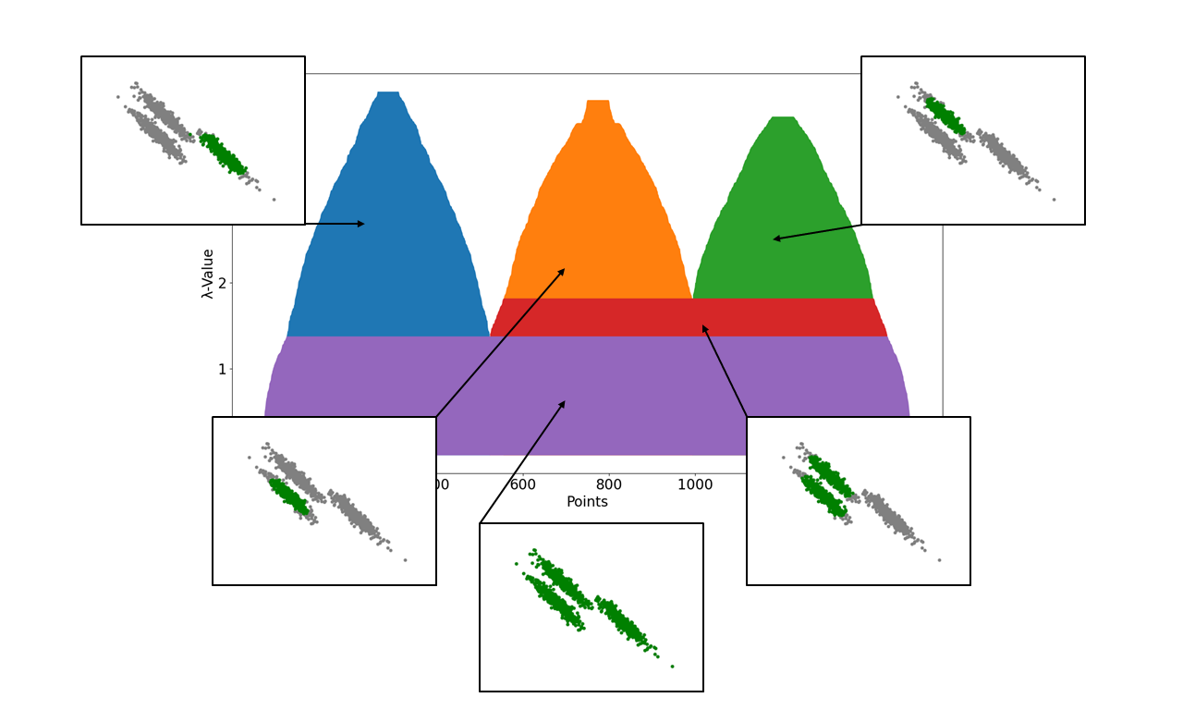
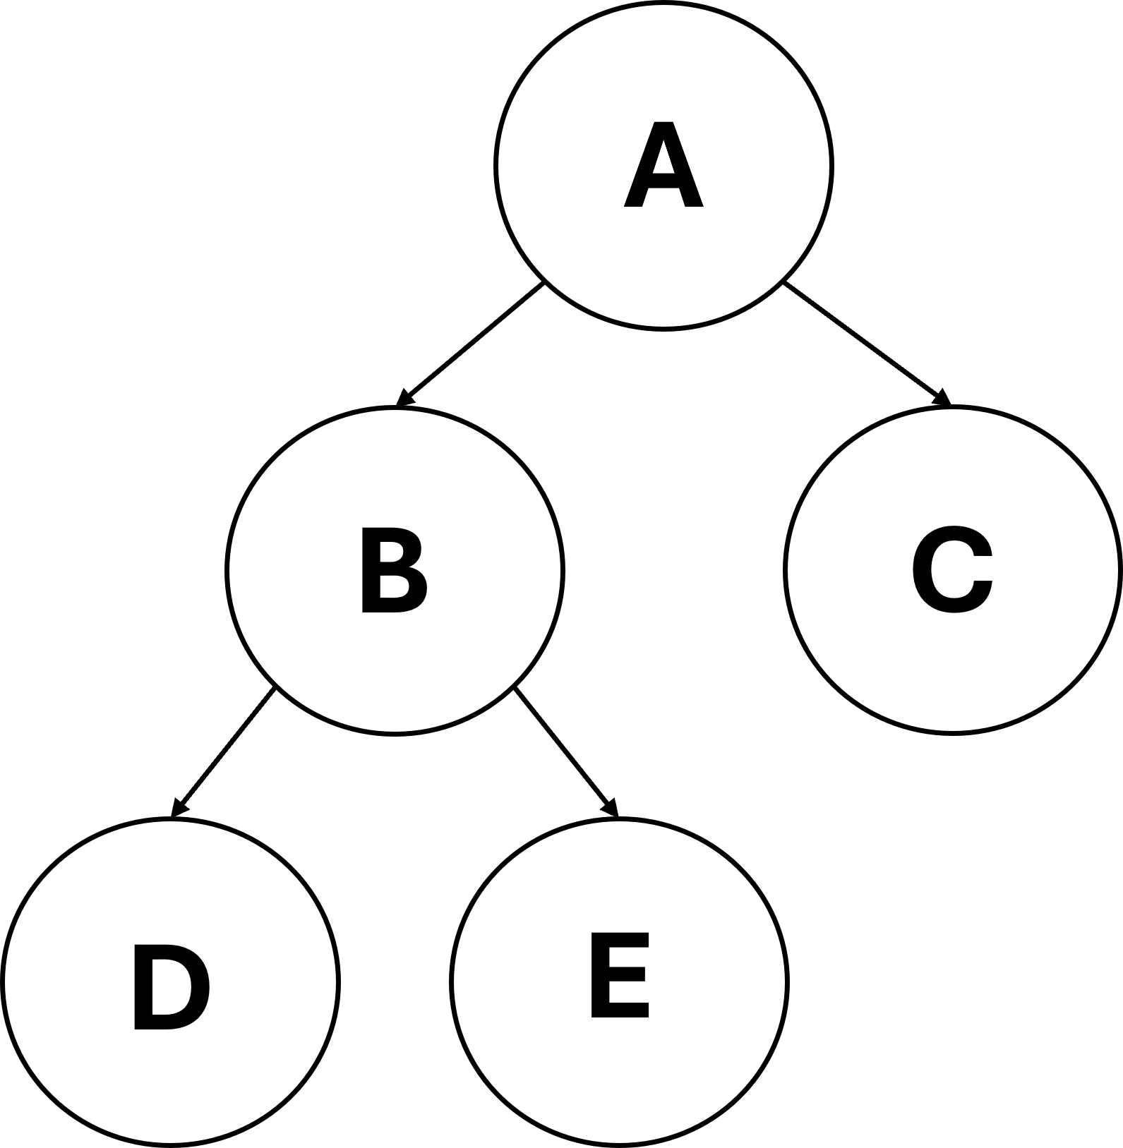
Dendrogram & Cluster Culling
E
C
D
B
A

Slide 16
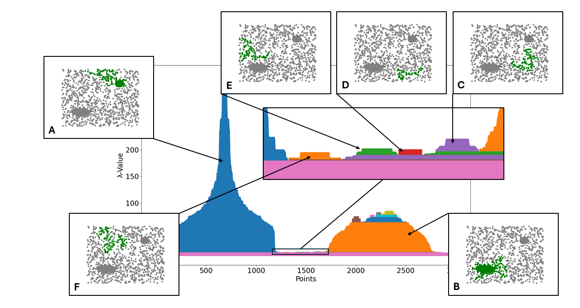
Cluster Culling

Slide 17
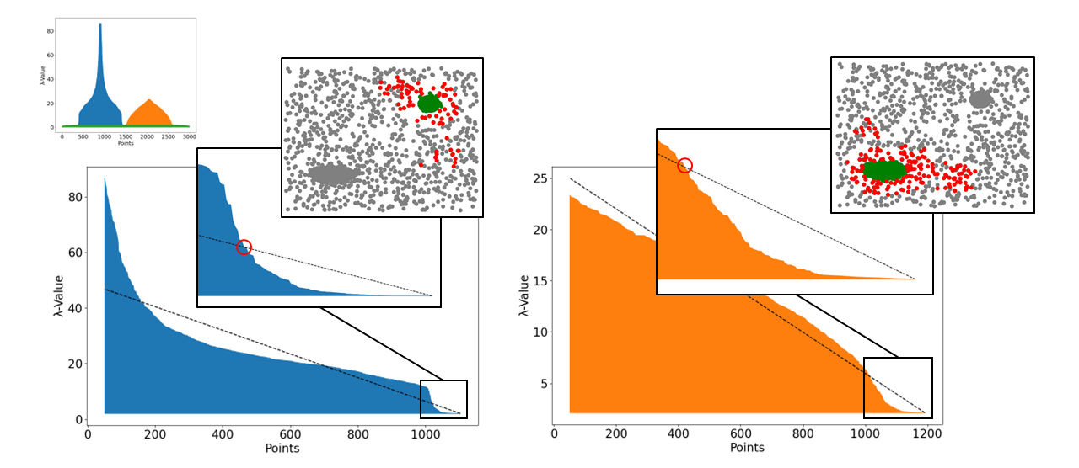
Cluster Culling

Slide 18
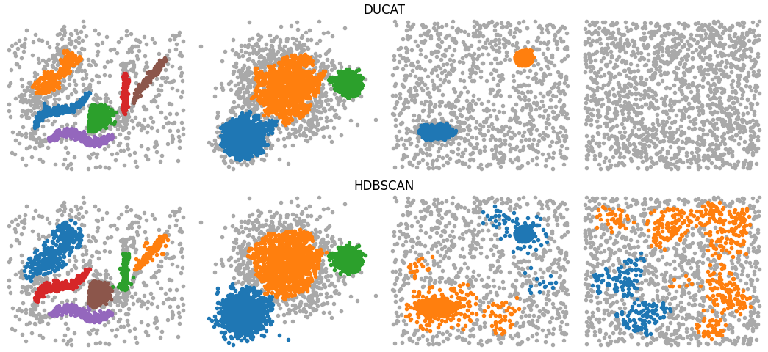
Efficacy
DUCAT identifies clusters as well or better while effectively rejecting noise, meaning less time and effort is spent on false alarms

Slide 19
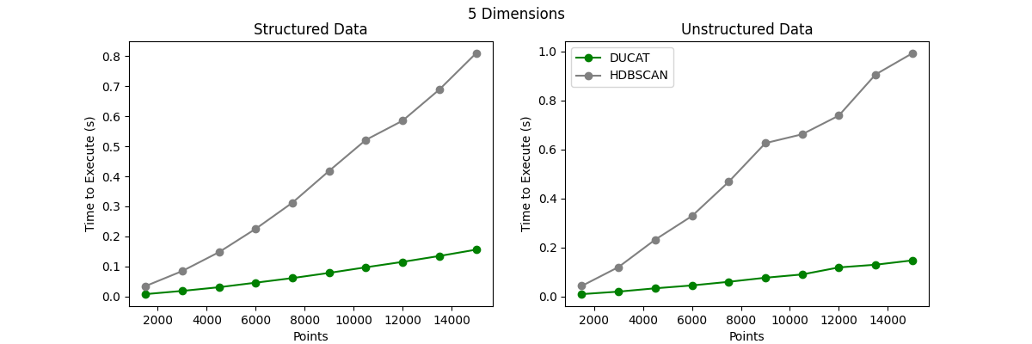
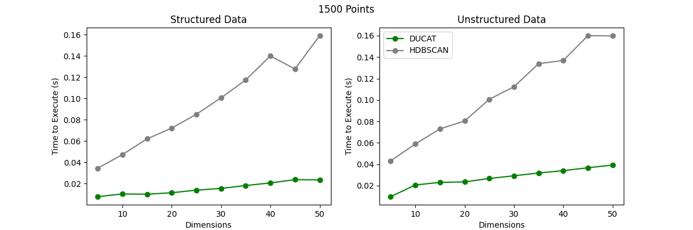
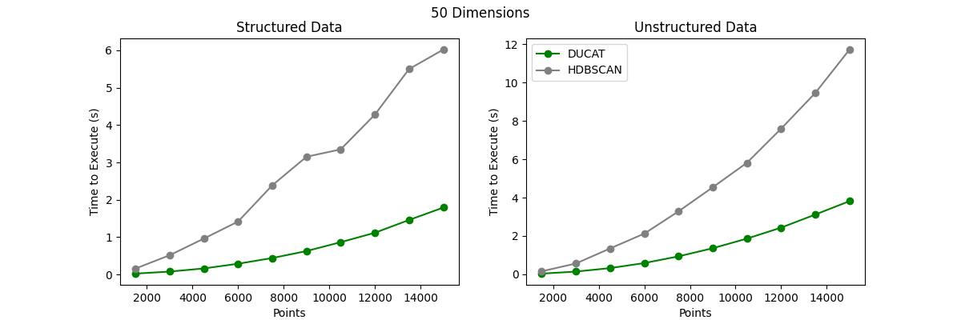
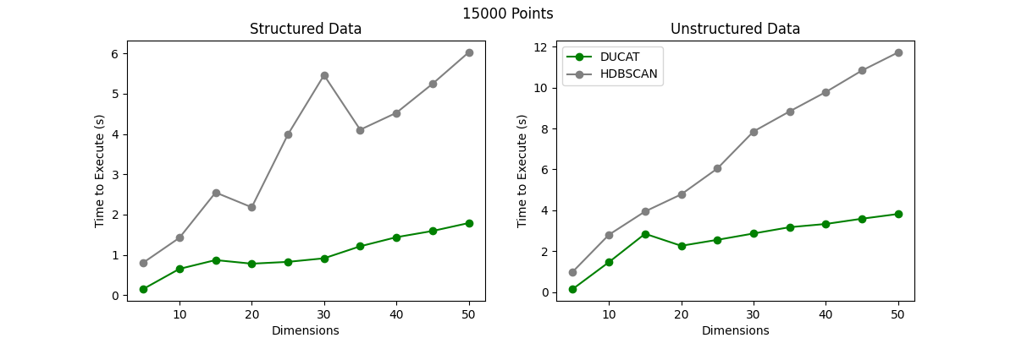
Timing Benchmarks

Slide 20
Future Work
MST Approximations for high dimension and large datasets
Approximate MST builds can be significantly cheaper than exact builds
Initial testing shows that clustering accuracy does not degrade with reasonably accurate approximations
Continued development of the surrounding DUCAT architecture
The past year has been focused on the unsupervised clustering algorithm
Sophistication can be added to the way that clusters are defined once found
Refinement of general, and domain specific, approaches to the Second Pass module

