Slide 1
Uncertainty Aware Distributional Ensemble Reinforcement Learning for Flight Control
Micah Bryant, GA-ASI
Joseph D. Gleason, GA-ASI
Anastacia Macallister, GA-ASI

Slide 2



We Want to Automate the Warfighter
Find
Fix
Track
Target
Engage
Assess
Find
Hold CAP
Track
Follow Track
Target
Weapons Targeting
There are various segments of an aircraft’s mission that need to be automated

Slide 3
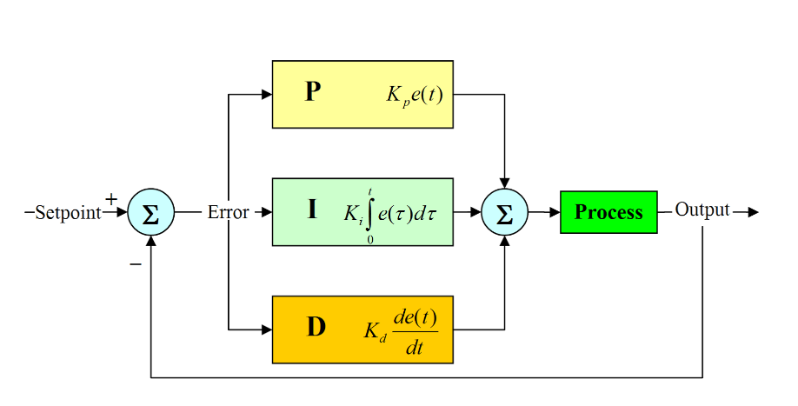


Use Controls or Reinforcement Learning
Control Theory
Reinforcement Learning
Actions
States, Rewards, Terminations
Controls uses model of system to create predictable and stable solutions
RL learns model of system and trains Neural Network to solve problem
Traditional controls offer stability and reinforcement learning offers complexity

Slide 4




Overview of Reinforcement Learning
Actions
Policy
Algorithm
Rewards
Environment
Observations

Slide 5
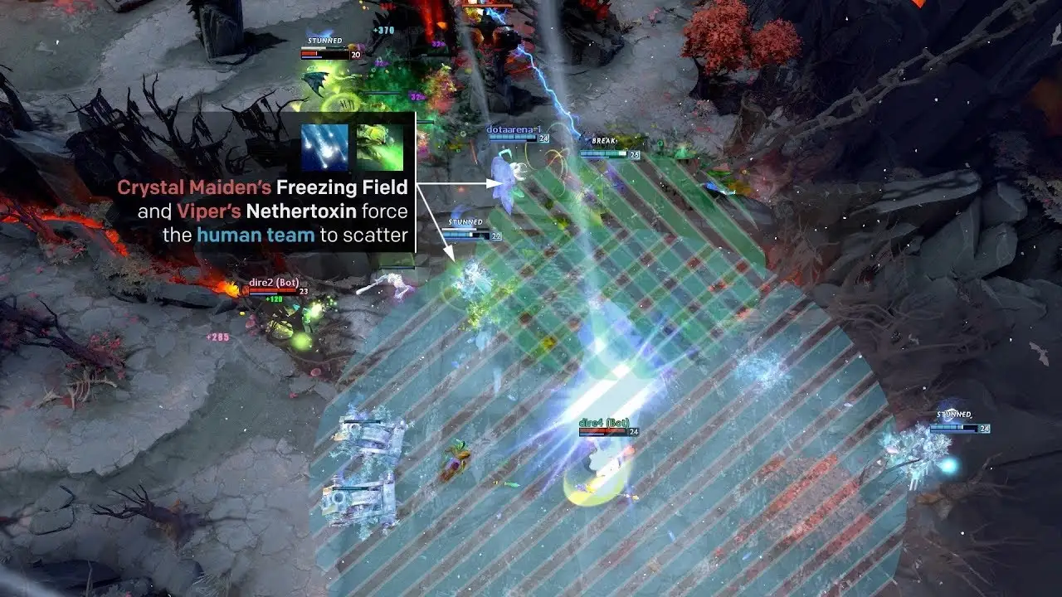
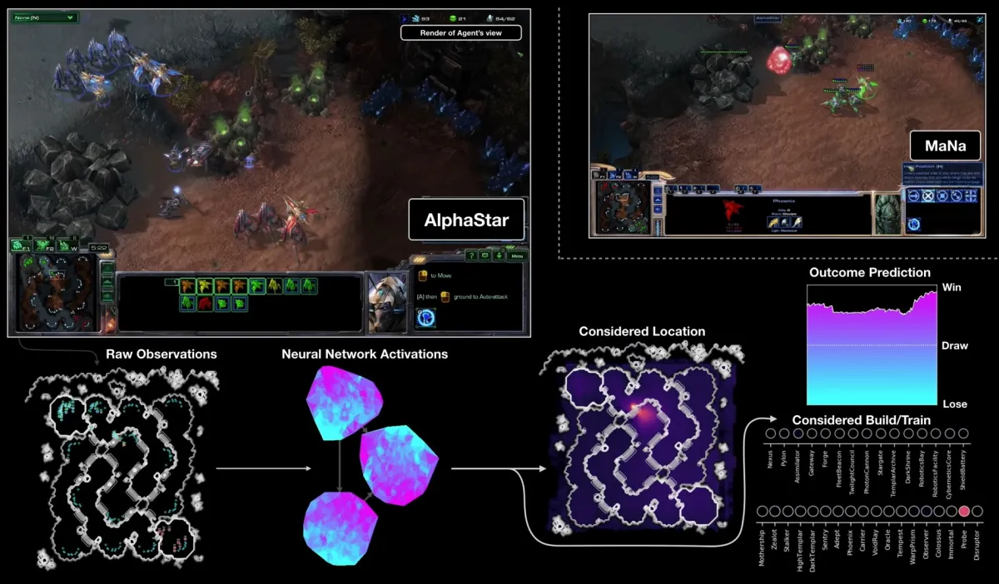
Benefits of Reinforcement Learning
OpenAI et al. “Dota 2 with Large Scale Deep Reinforcement Learning.” ArXiv abs/1912.06680 (2019): n. pag.
Vinyals, O., Babuschkin, I., Czarnecki, W.M. et al. Grandmaster level in StarCraft II using multi-agent reinforcement learning. Nature 575, 350–354 (2019).
RL shines in high dimensional, dynamic environments, that are not easily modellable

Slide 6
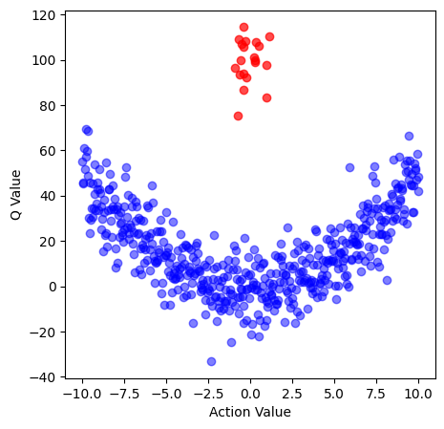

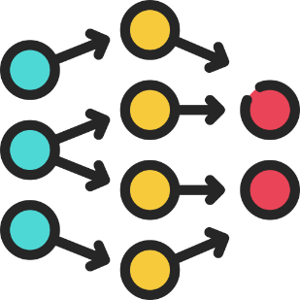
Drawbacks of Reinforcement Learning
State
Action
Next State
Base optimization can lean toward high-risk high-reward inherently
Uses NN instead of kinematic model

Slide 7
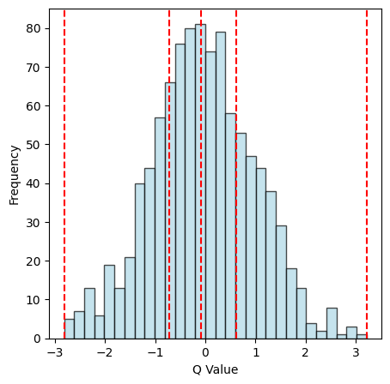
Methods to Solve Issues
20
10
11.67
±6.24
5
Critics output distributions of Q values
Use ensemble of models to estimate uncertainty

Slide 8
PROPOSED METHOD

Slide 9
Critic Modifications
Observation
Actor
Critic
Critic
Risk Distorted Q Value
Critic
Replay Buffer
Training Tuples
Environment
Uncertainty
Action
Action Log Probability
Temperature

Slide 10
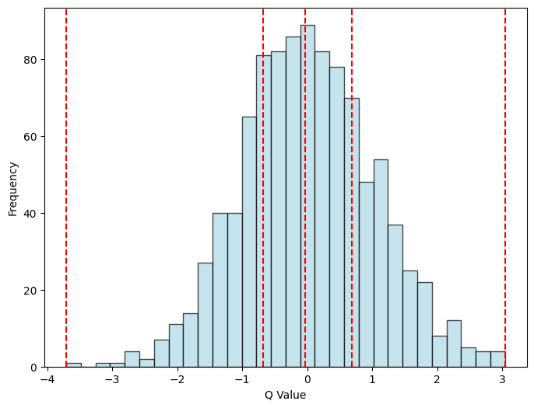
Critic Output
Critic
Critic
Critic
Critic is modified to output randomly sampled quantiles

Slide 11
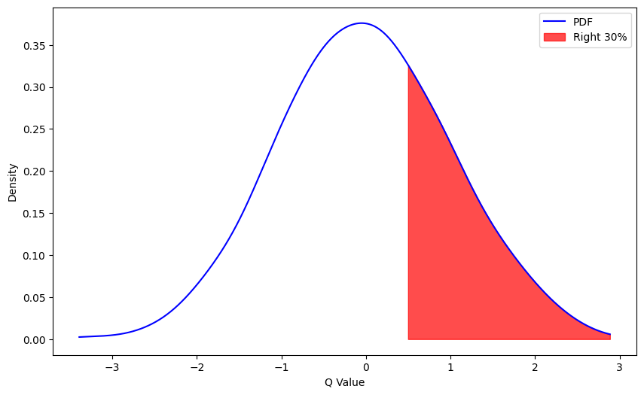
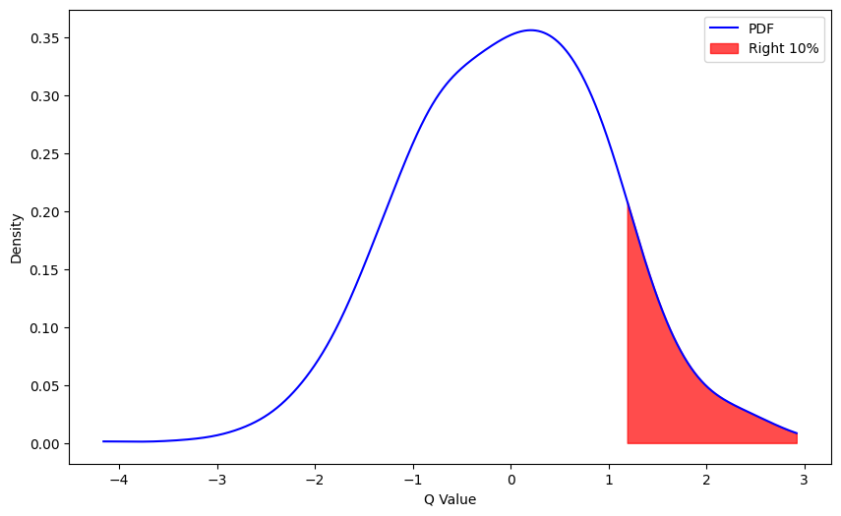
Risk Distortion
Apply a distortion to minimize for the lowest 70% of Q values to lower high-risk high reward strategies

Slide 12


What is Uncertainty?
Epistemic Uncertainty
Aleatoric Uncertainty
Epistemic uncertainty is due to a lack of information about the environment, aleatoric uncertainty is the irreducible randomness in the environment

Slide 13
Estimating Epistemic Uncertainty
2000
2
40
Std
±958.7
1.8
Std
±0.163
-100
2.2
High Epistemic Uncertainty
Low Epistemic Uncertainty
Increasing variance in the predictions corresponds to increasing epistemic uncertainty

Slide 14
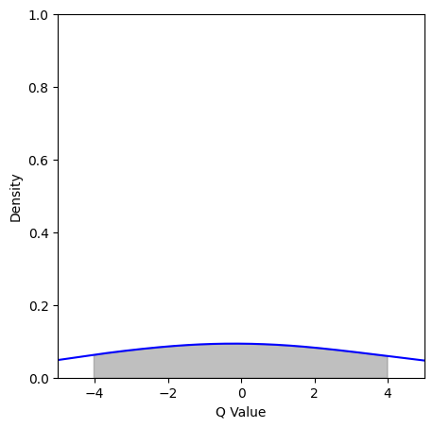
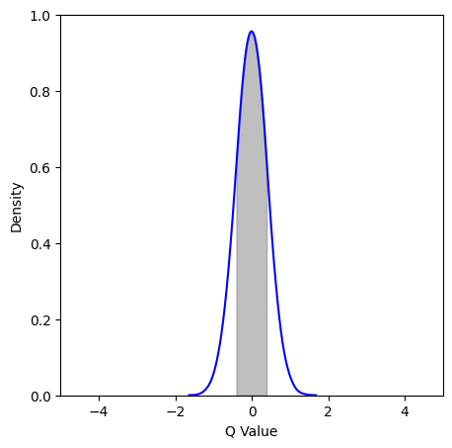
Estimating Aleatoric Uncertainty
High Aleatoric Uncertainty
Low Aleatoric Uncertainty
Increasing standard deviation correlates to increasing aleatoric uncertainty

Slide 15
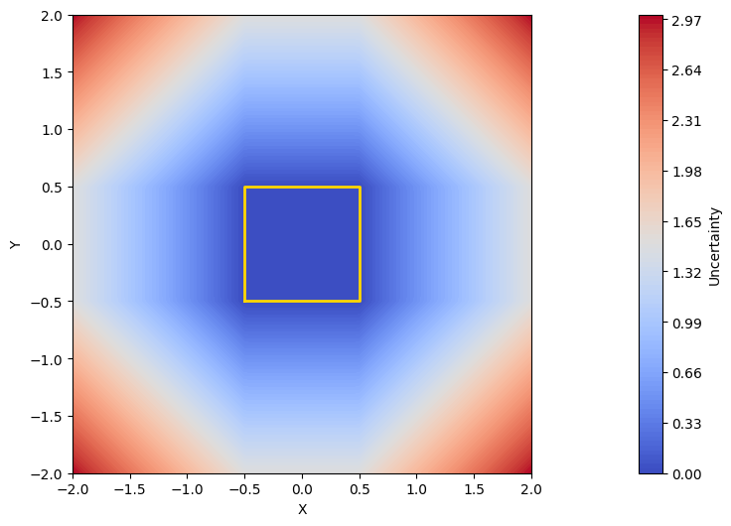
Usage of Uncertainty in Deployment
When deploying can turn off agent when it goes into regions of high uncertainty

Slide 16
TESTING & RESULTS

Slide 17

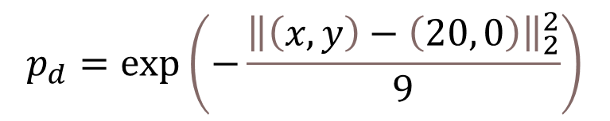
Scenario for Testing
$$p_{d}=\exp\left(−\frac{{\left\|\left(x,y\right)−\left(20, 0\right)\right\|}_{2}^{2}}{9}\right)$$
6 nmi
20 nmi
25 nmi
Tested both SAC and DESAC against sensor with exponential detection probability

Slide 18
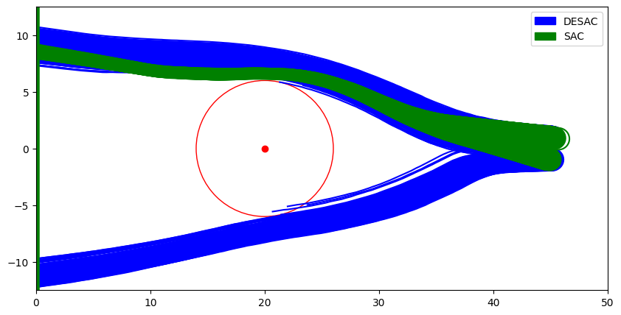
Results in Path
Algorithm | Detection %
SAC | 24.7%
DESAC | 13.0%
DESAC takes much wider approach from the radar resulting in lower detection rate

Slide 19
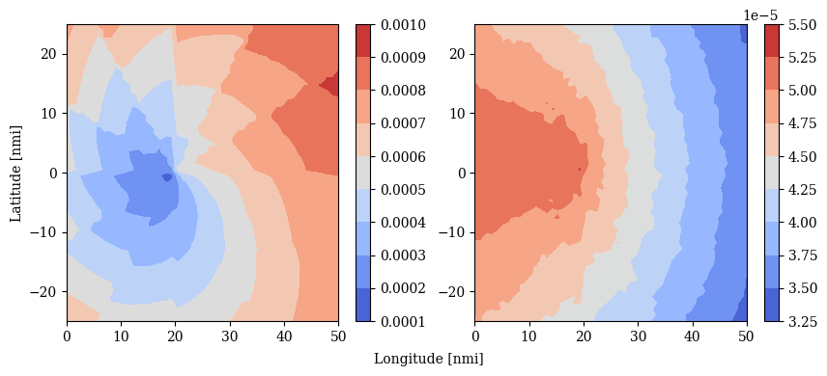
Visualization of Uncertainty
Epistemic (left) and Aleatoric (right) uncertainties visualized of the scenario

Slide 20
Differences in Performance
 | SAC | DESAC
Min Reward | 2.665e-5 | 1.455e-5
Mean Reward | 76.286 | 88.082
Max Reward | 101.312 | 101.311
Reward Variance | 1907.600 | 1163.115
Detection Probability | 0.247 | 0.130
DESAC had significantly lower reward variance and detection probability than SAC

Slide 21
CONCLUSION

Slide 22
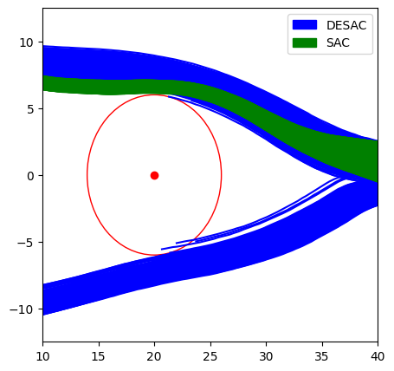
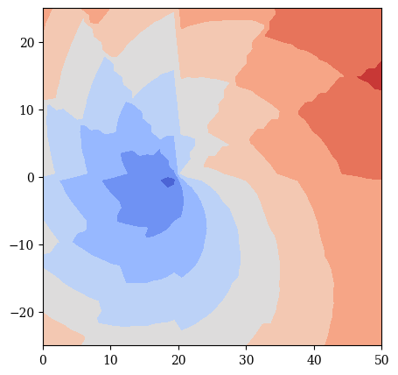
Conclusion
Increase in safety over base SAC
Visualizations and metrics given to operators
Have demonstrated increase in safety as well as applicable visualizations for deployable autonomy
Notes:
Tie this back to the intro better

