Slide 1



From Innovation to Integration:
Data-Driven Evaluation of Modernized Training
Alexxa Bessey, Summer Rebensky, Mark Shroeder-Strong, Aptima Inc.
Brian Schreiber
Steve Macut, BGI LLC
Winston “Wink” Bennett, Bennett Research Consulting, LLC

Slide 2

Agenda
Introduction
Background
Approach
Methods
Results
Themes and Limitations
Best Practices

Slide 3
Introduction
Military Training is Evolving
There is a Need for Evaluation Methodologies
Test and Evaluation (T&E) Data are Critical
Purpose of presentation:
Highlight the gap in evaluating training technologies
Advocate for a data-driven approach in the integration of emerging technologies
Offer insights, recommendations, and best practices from three case studies
Goal: Establish a more systematic evaluation approach to optimize training outcomes.
Notes:
The Military Training Training Landscape is Evolving
Blend of traditional and cutting-edge technologies
Shift from live exercises and classroom instruction to simulator-based and innovative training technologies
Immersive experiences simulating operational environments with adaptive learning
Geopolitical shifts demand agility and adaptability in training
Need for Evaluation Methodologies:
Lack of comprehensive methods to assess impact of new training technologies
New technologies need evaluation to ensure readiness, proficiency, and performance outcomes
Advanced technologies may not always be superior or effective for meeting training goals
Role of Test and Evaluation (T&E) Data:
Essential for informed decision-making in technology acquisition and curriculum development
Standardized data required to assess technology effectiveness pre- and post-deployment
Provides actionable feedback for vendors and updates to curriculum

Slide 4
Background
Innovation also needs evaluation
Innovation
Advanced simulators, AR/VR, and AI revolutionize training paradigms
Realistic, immersive environments replicate combat scenarios safely
Reduces costs and risks associated with live exercises
Importance of Systematic Evaluation:
Provides a comprehensive framework for assessing training technology effectiveness
Data-driven decision-making enables objective, evidence-based assessments
Identifies strengths, weaknesses, and areas for improvement in training technologies
Fosters accountability and transparency through empirical evidence

Slide 5
Background
Risks of Insufficient Evaluation:
Lack of standardized evaluation can result in inconsistent and unreliable assessments
Small or informal sample sizes limit decision-making confidence
Missed opportunities to optimize training or identify impactful technologies
Data helps drive strategic investments for higher ROI in training technologies.

Slide 6
Case Study Overview
Systematic Evaluation Approach
Identify the user (e.g., the trainee, the tester, the evaluator)
Embed the existing training requirements/other identified content
Develop deficiency trees
Execute the evaluation
Generate a report
Notes:
Systematic Evaluation Process:
Adaptable framework used across diverse domains and training devices
Evaluation content derived from established training documentation (e.g., TTLs, RTMs)
Customization with key stakeholders and SMEs ensures relevance to training needs
Deficiency Categorization:
Primary and secondary deficiencies (e.g., Visuals → Resolution, Field of View) identify key areas for improvement
Operators rate evaluation items on a Likert scale, selecting deficiencies where applicable
Data Collection & Reporting:
Multimodal dataset includes Likert scale data, deficiency data, and open-ended comments
Data exported as JSON and compiled into Excel reports summarizing strengths, deficiencies, and training gaps

Slide 7
Case Study #1
Evaluation Goal:
Understand the extent to which local simulated training and distributed training (DMO) provide necessary training requirements for Command and Control (C2) operators.
Sample Information:
CONUS and OCONUS
Active duty and National Guard units
Two position groups (Surveillance/Links operators and Weapons Section/Position operators)
Evaluation of three training centers

Slide 8
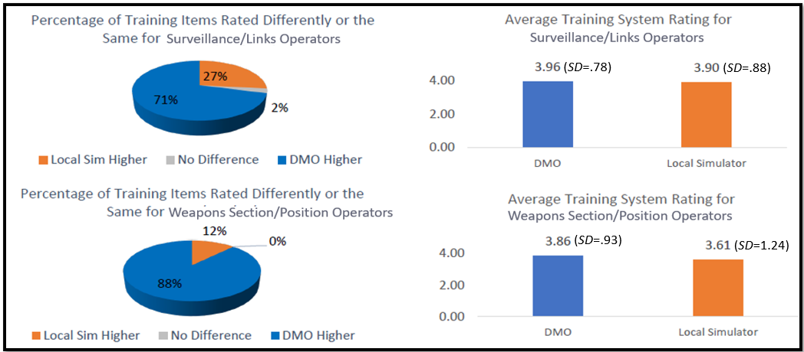
Case Study #1

Slide 9
Case Study #1
Insights:
15% of of training requirements were demonstrated to be effective in the distributed training environment but were found to be deficient in the local environment.
7% of the training requirements were found to be deficient in both training environments.
Deficiencies were most often related to the scenarios utilized during training (e.g., scenario realism, scenario variety), IOS (e.g., IOS implementation), connectivity, and mission preparation.
Cross-site differences resource differences
Consistency of deficiencies
Notes:
Comment data were analyzed for trends. For the distributed training environment, operators noted a lack of clarity on training center capabilities, limitations with training center scenario development, and logistic issues related to scheduling and connectivity. For local training, operators noted the lack of locally based resources to execute training which taxed other aspects of training. For example, the necessitation of instructors to drive training, gaps in understanding how to use local simulation training tools, and the lack of debrief capabilities.

Slide 10
Case Study #2
Evaluation Goal:
Evaluate a new extended reality solution for flight simulation
Help inform evolutionary acquisition
Technology that is funded in phases
Sample Information:
Pilots

Slide 11
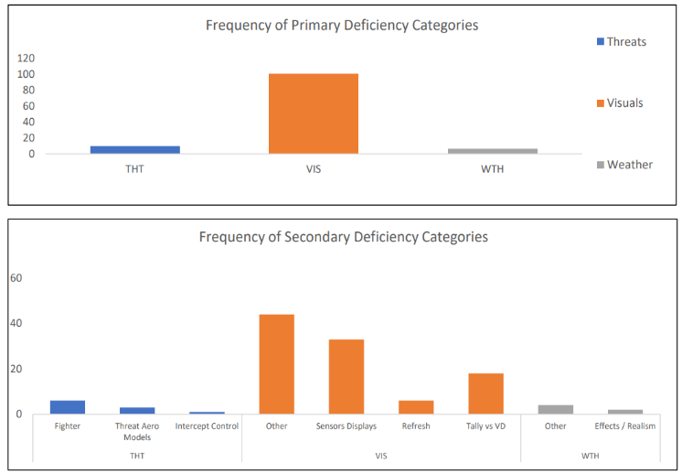
Case Study #2

Slide 12
Case Study #2
Insights:
Visuals were the largest category with noted issues.
Comments uncovered issues with focus issues, field of view limitations, refresh rate, and visual identification. Multiple comment responses mention difficulty identifying threats over 1 mile out.
Results that demonstrate a good or excellent rating for instrument related procedures but ineffective for combat related procedures would align the solution for basic flight training.
Data provides limitations for vendor to address or insights for standing up new competitive solicitations for solutions with clear and actionable requirements.

Slide 13
Case Study #3
Evaluation Goal:
Analyze Tactics Techniques & Procedures (TTPs)
Inform large scale acquisition decisions
Measure impacts of inserting DOTMLPF-P (Doctrine, Organization, Training, Materiel, Leadership, and Education, Personnel, Facilities, and Policy) solutions
Sample Information:
Similar to both use case 1 & 2, particularly with respect to large force exercises

Slide 14
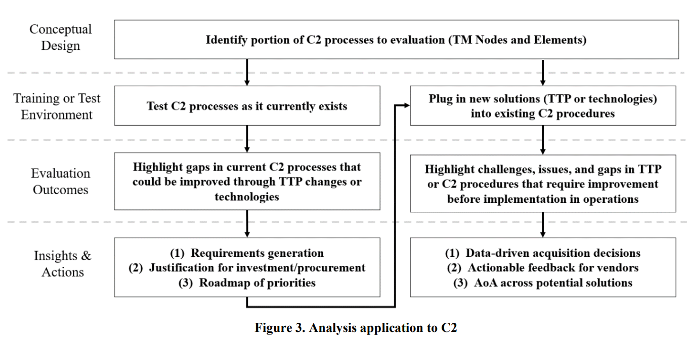
Case Study #3

Slide 15
Case Study #3
Insights:
Highlight current gaps in operational capabilities
Then, evaluate if improvements are seen with the insertion of new technologies
“Where can I best spend my dollar?”
Employ evaluations at multiple sites to understand differences across sites
Rolled together to then provide insights into large force exercise design

Slide 16
Conclusion
Emerging technologies are reshaping military training approaches
Data-driven, systematic methodologies are essential for informed decision-making in technology acquisition
Systematic evaluation processes highlight strengths, areas for improvement while helping to inform the entire training pipeline (acquisition, curriculum development)
Such insights are essential for optimizing training technology and ensuring readiness in complex environments like JSE
Data-driven approaches maximize the impact of emerging training technologies, ensuring agility and effectiveness in modern warfare.

Slide 17
Questions?

Slide 18
Dr. Alexxa Bessey
Aptima, Inc.
abessey@aptima.com
630-624-5394
Booth #1018

