Slide 1

Dual-Stream Semantic Segmentation Architecture for ​
Point Cloud Analysis
Brendon Hales, Dignitas Technologies, Orlando, Florida ​
Troy Crawford, Dignitas Technologies, Orlando, Florida ​​
Philly Tang, Dignitas Technologies, Orlando, Florida​
Marjaneh Safaei, Dignitas Technologies, Orlando, Florida

Slide 2
Outline
Introduction
Problem
Technical Approach
  Data Preprocessing
  2D Sematic Segmentation
  3D semantic segmentation
  Ensemble Learning
Experimental Results
Conclusion
Questions

Slide 3
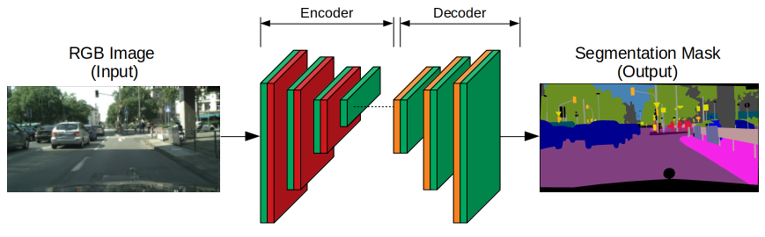
Introduction
Semantic Segmentation is a key task in Computer Vision and Image Processing
Pixel-wise Classification
Assigns a class label to pixels using a deep learning (DL) algorithm
  Deconstruction: Feature Extraction (Backbone, Encoder)
  Reconstruction: Upsampler (Decoder)
Notes:
Talk about semantic segmentation -> why it is important for ML, how it differs from object detection vs semantic segmentation via pixel-wise classification
How it appends a label per-pixel, rather than bulk classification of a BBox
Mention deep learning,when discussing how it is important (neural net)

Slide 4
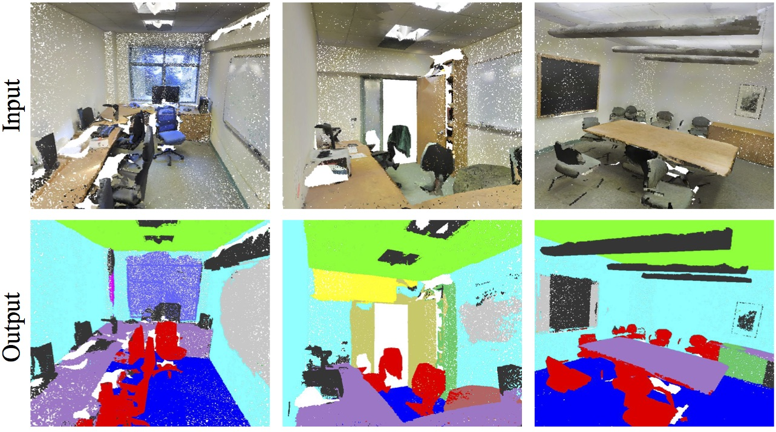
Problem
3D Semantic Segmentation (Point Cloud)
Point Cloud is an important type of geometric data structure
Associating each point in a point cloud with a semantic label
Input
Output
Notes:
Problem needed to be solved: 3D semantic segmentation
Akin it to 2D semantic segmentation
Describe PC vs pixel, and the similarities
When 3D semantic segmentation can be used, how it can be captured possibly
Mention how it is a semantic label per point

Slide 5
Problem
Challenges
  Scalability Issues with Massive Datasets
  Dealing with Noise and Outliers
  Robustness to Variations
  Handling Partial and Occluded Objects
  Lack of Annotated 3D Training Data
Notes:
Lots of challenges for 3D compared to 2D
Read up on these bullets: BE ON POINT, KNOW WHAT I AM TALKING ABOUT
Scalability ->
Noise/Outliers -> Scan to scan variation based on actual scanner used, lighting
Variations -> point scale resolution, how dense a PC is, new data could be more/less detailed
Occlusion -> how some objects are hidden. When a scan is taken, it does not always get objects under others
Lack of data -> 2D images are readily available, anyone with a camera can make this data. 3D is more specialized, niche. Requires special equiptment, and time consuming for annotation

Slide 6
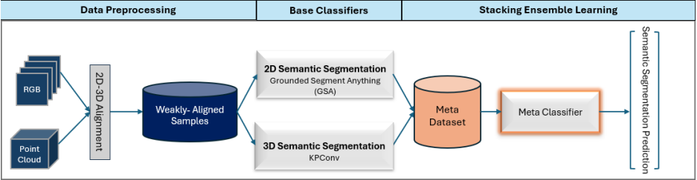
Technical Approach
Two-stream Ensemble Semantic Segmentation Framework
Notes:
Very important -> more time on this slide longer than other initial slides
OVerall approach overview
Why two stream -> two methodologies -> 2D and 3D images
Trying to fuse multiple data structs together 2D/3D RGB/3D
Mention 2D/3D alignment, a quick preface not in depth | weeakly aligned samples
Talk lightly about 2D/3D networks -> we will talk more regarding in later slides (CALL THEM BASE CLASSIFIERS)
Output will become the meta dataset which will become the input of the stacking ensemble learning section.
Meta classifier method is the logistic regression method
In later slides we will further discuss more in depth

Slide 7
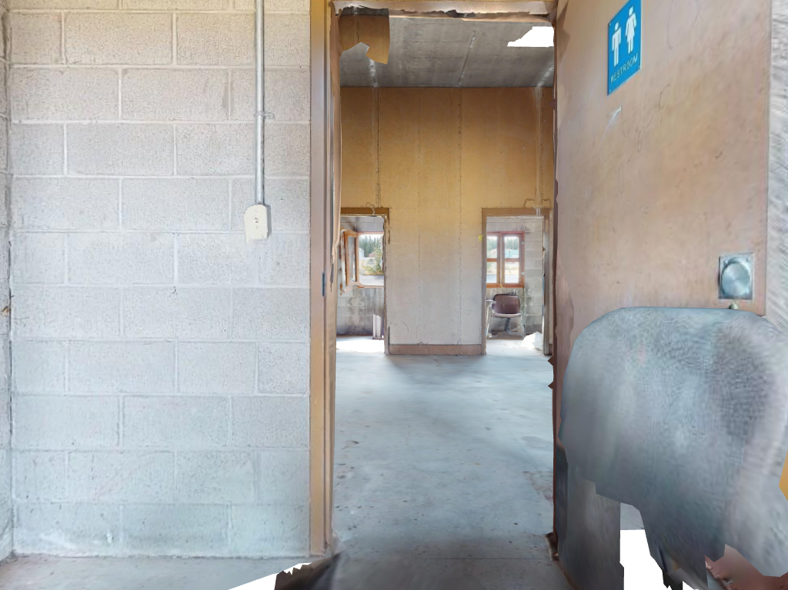
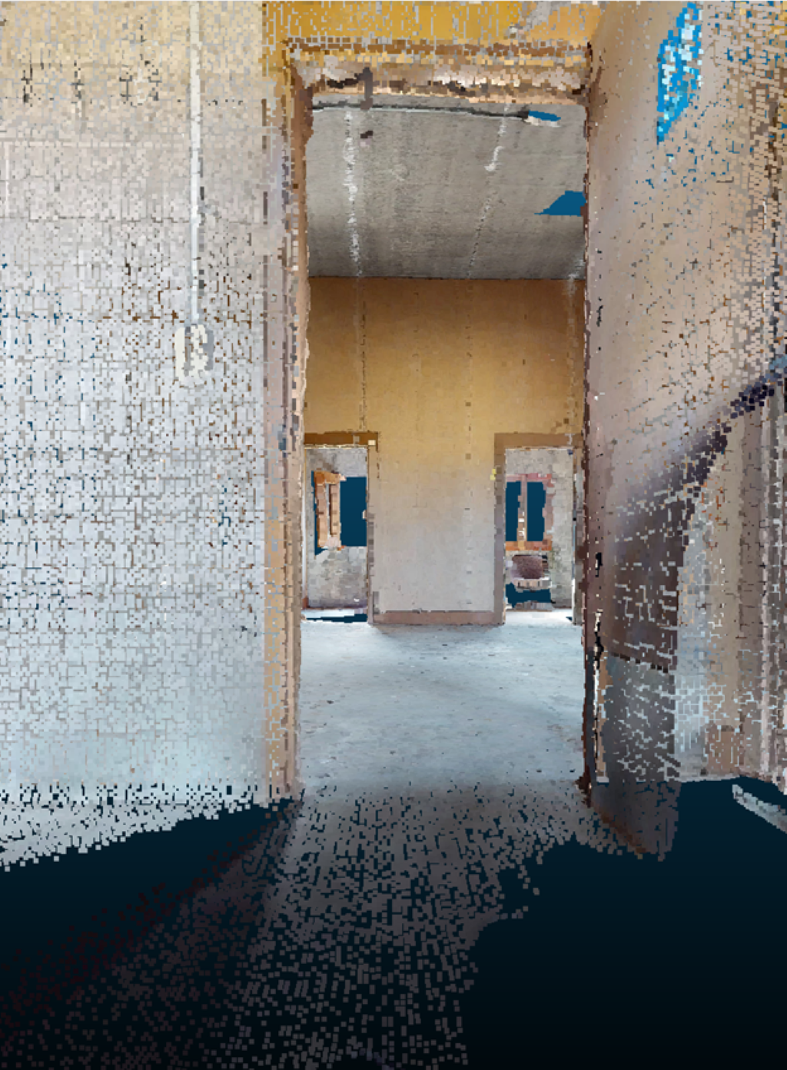
Technical Approach
Data Preprocessing
2D-3D Alignment Process
  2D images are taken of a mesh that is overlayed on top of a point cloud
  Each pixel is projected out into 3D space and if a collision with a point in the point cloud is made, it is kept
Weakly Aligned Samples
  These collisions are considered "weakly aligned" as there is a match between the 2D image and a 3D point
  These samples allow for the pipeline to work from beginning to the end over a set of samples that are related in multiple dimensions
Serve as the input to the 2D and 3D segmentation networks
2D Image
3D Weakly Aligned
Notes:
In order to get a set of samples in both 2D and 3D space, a process was developed that utilizes a 3D mesh that can be rendered virtually.
This mesh can then be iterated through systematically and have images taken, resulting in a 2D image that was captured using a 3D mesh
Underlying this mesh is an accompanying 3D point cloud. The points in this point cloud are different from the points within the mesh due to the desire for higher resolution point clouds. For example, in the image here, the entire mesh contains 125k verticies, whereas the point cloud used contains over 12M points. Higher the total number of points available results in an increased number of weakly aligned points resulting in a stronger pipeline overall
The image is then systematically processed pixel by pixel (for our case it is 1024x768) and a ray is then projected out from this point out into the 3D space
If a point is encountered along this ray, then a weakly aligned point is then identified and saved
These points will then be combined into a resulting point cloud that is weakly aligned only
Both of these weakly aligned points, both in 2D and 3D, are then passed off to the respective 2D and 3D networks to continue through the pipeline
In earlier diagram, we discussed the 2D/3D RGB/3D input. With the first section, this requires aligning the 2D and 3D data
Why is it called weakly versus strongly (not an entire point to point)

Slide 8
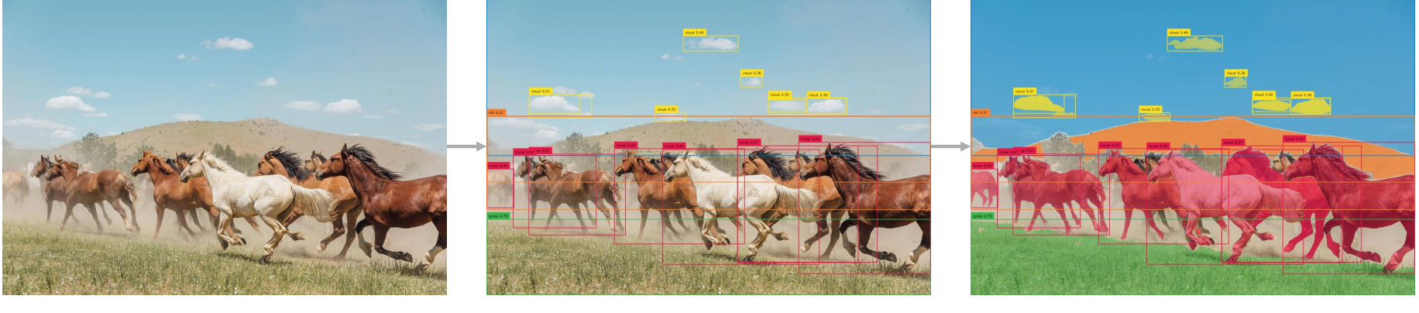
Technical Approach
2D Semantic Segmentation
Grounded Segment Anything (GSA)
  Grounding Dino (G): Detect objects in images using bounding boxes
  Segment Anything Model (SAM): Semantically segment the detected objects
Text Prompt :
"Horse. Cloud. Grasses. Sky. Hill."
Grounding DINO :
Detect Everything
SAM :
Detect and Segment Everything
Notes:
Running Inference on 2D Base Model
Using Ground Segment Anything (GSA), inference is made on the raw images that were also duplicated and sent to be manually annotated
GSA uses Grounding Dino (G) to predict objects in images to bounding boxes
GSA then uses Segment Anything (SA) to semantic segmentations on the images
For the next few slides, we will discuss the first base classifier -> GSA
GSA has two components -> GDINO and SA
Brief discussion regarding the images (Ask Philly for any technical questions)

Slide 9
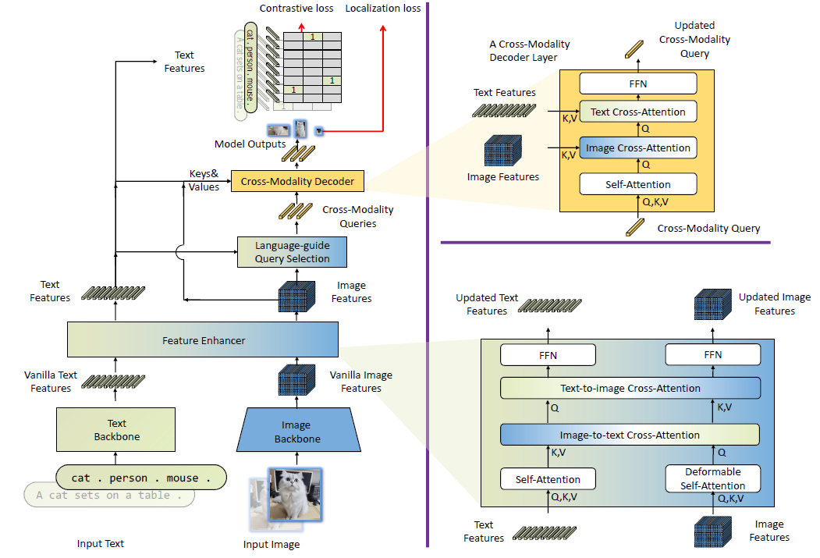
Technical Approach
2D Semantic Segmentation
Main Components of GDINO
  A Feature Enhancer Layer
    Image and text feature fusion
  A Decoder Layer
    Inject text information into queries for better modality alignment
    DINO decoder layer has been fine-tuned and improved by supplementing each decoder layer with an extra text cross-attention
Notes:
3 Components (Blocks)
Model Overall (GDINO Architecture)
A Feature Enhancer Layer
For each (Image, Text) pair, we first extract vanilla image features and vanilla text features using an image backbone and a text backbone, respectively.
Vanilla Features: Extracting vanilla features refers to the process of obtaining fundamental and basic characteristics or representations from an image.
These features are typically low-level and do not capture high-level semantic information about the contents of the image.
Instead, they focus on capturing simple visual elements.
For example in images vanilla features would be: edges, textures, colors, and shapes, that can be used for various computer vision tasks.And in text vanilla features would be bag of words, TF-IDF, word embeddings, N-grams ( a collection of n successive items in a text document that may include words, numbers, symbols, and punctuation.) etc.
Deformable self-attention (DSA) for enhancement of the traditional self-attention mechanism. It is designed to improve the ability of models to capture fine-grained details and local patterns in images.
In a standard self-attention mechanism, an input image is divided into patches or regions, and each patch is represented as a query, key, and value. These queries, keys, and values are used to calculate attention scores, determining how much each patch should “pay attention” to other patches in the image. Traditional self-attention relies on a fixed regular grid structure for the patches, meaning that each patch looks at other patches in a fixed, grid-like pattern. Instead of a fixed grid, DSA allows each patch to dynamically adjust its attention to other patches in the image. This enables the model to focus more on informative regions and adjust its attention based on the content of the image.
In DSA, the key innovation is the introduction of learnable offsets. For each query in a patch, the model learns how to deform (shift) the position of the key patches that it attends to. These learnable offsets allow the model to adaptively change its attention pattern for different patches.
Vanilla self attention for text feature enhancers
A Decoder Layer
Here the DINO decoder layer has been fine tuned and improved by supplementing each decoder layer with an extra text cross-attention. This will enable to inject text information into queries for better modality alignment.
Very high level (quick slide)

Slide 10
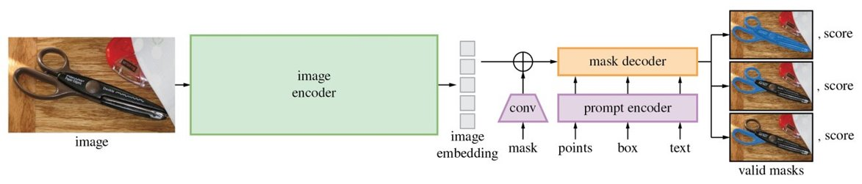
Technical Approach
2D Semantic Segmentation
Main Components of SAM
  Image Encoder
    Uses Masked AutoEncoder (MAE) pretrained Vision Transformer (ViT) minimally adapted to process high resolution inputs
  Prompt Encoder
    Two sets of prompts: Sparse (points, boxes, text) and Dense (masks)
  Mask Encoder
    Decoder efficiently maps the image embedding, prompt embeddings, and an output token to a mask

Slide 11

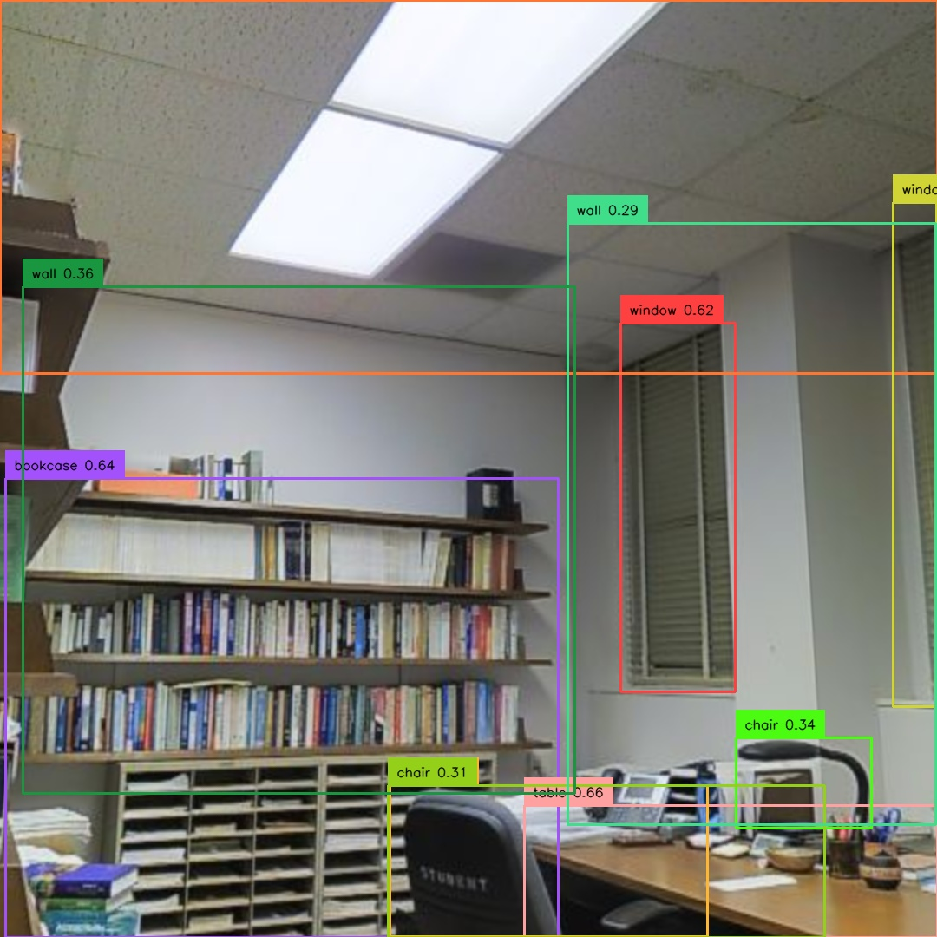
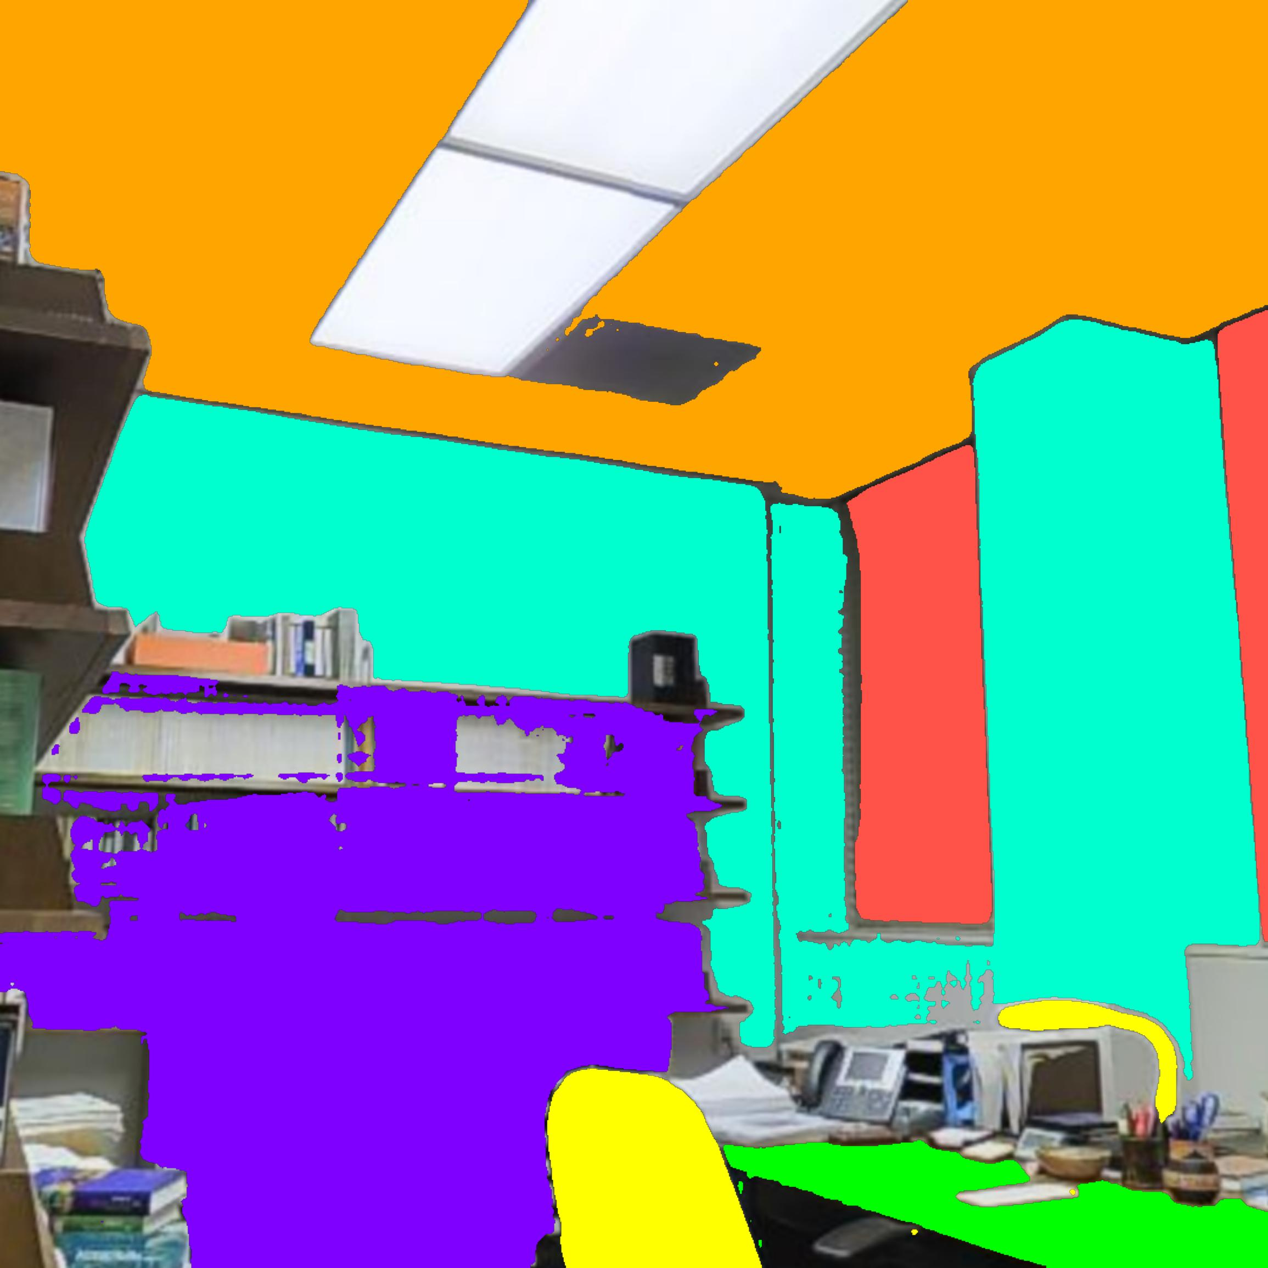
Technical Approach
2D Semantic Segmentation
S3DIS Example of both GDINO and SAM
GDINO
SAM
RGB Image
Detected Bounding Box
Segmented Output
Text Prompt: "Wall. Floor. Ceiling. Table. Chair. Bookcase. Window"

Slide 12
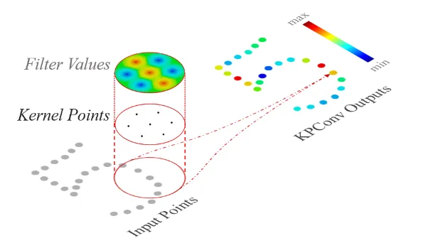
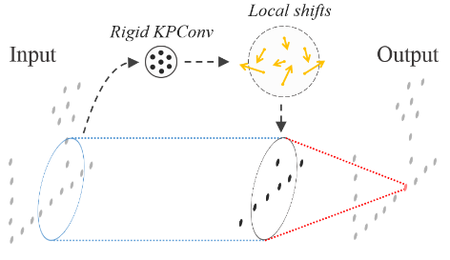
Technical Approach
3D Semantic Segmentation
KPConv – Kernel Point Convolution
3D point cloud machine learning algorithm that utilizes Kernel Point Convolutions to make predictions
  Subsample a set radius around each point
  Average the subsamples points to make final prediction
  Occasionally performs localized shifting to strengthen the final prediction
These predictions are then assigned to specific classes appended to each 3D point
The resulting point cloud will contain {X,Y,Z,R,G,B,Class} for each point
Notes:
KPConv is a 3D point cloud algorithm that helps make predictions on points within 3D space by utilizing kernel point convolutions
The process for these convolutions is: KPConv goes through each point of the input PC, and sets a specific radius around the point
This radius will contain smaller points within, and "subsample" the radius to determine what the radiused point actually is
This subsample will then be averaged out to be determined to be a certain point, resulting in a prediction.
This prediction is then remembered and the algorithm moves to the next point
Once a certain number of points are processed, this becomes a batch. Once a batch is made, that is considered one epoch step. This process continues until the entire point cloud is cycled through at which point, an epoch has been completed.
To validate these predictions, occassionally throughout the process, the points' order will be shuffled around and will be retested. This shuffling step helps ensure that the predictions are as strong as they can be.
After this process completes and the total number of epochs is reached, a final predicted point cloud is output. Each point is assigned a predicted class that is appended to the rest of the information of that point.
Second base classifier

Slide 13
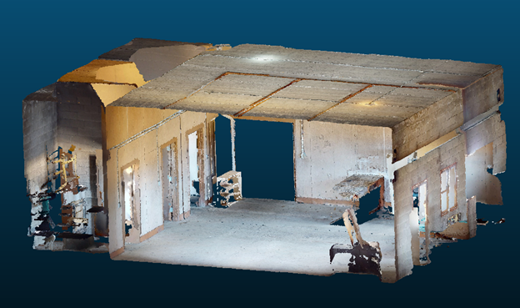
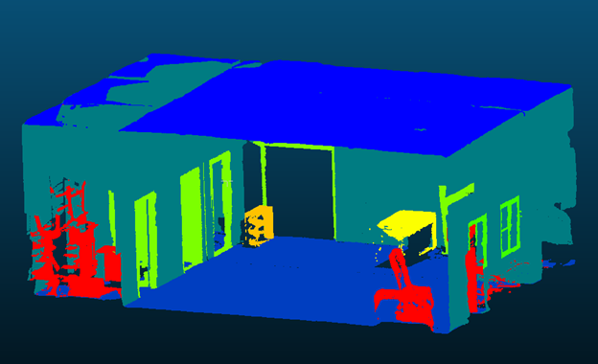
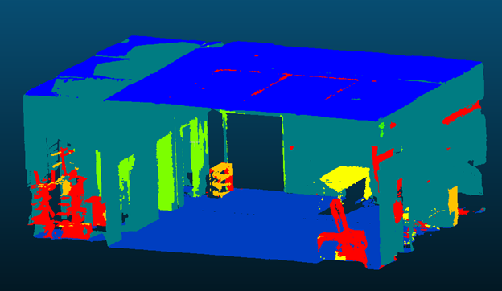
Technical Approach
3D Semantic Segmentation
Hospital RGB
Ground Truth
KPConv Prediction
S3DIS Pre-trained model
  Trained over areas 1-6, minus area 2 used for testing
Configuration used:
  500 epochs
  500 steps per epoch
  Batch size of 6
3D Results
  Hospital
    76.89% IoU
    95.49% Accuracy
  Municipal
    70.04% IoU
    90.50% Accuracy
  S3DIS
    66.14% IoU
    93.97% Accuracy
Notes:
Full cycle of testing, from input to output
Talk about the number of classes, obvious semantic coloring
Don't go in depth regarding the config
Datasets used for benchmarking are covered more in depth

Slide 14
Technical Approach
Ensemble Learning
Ensemble Learning
  Combines multiple Machine Learning models to produce a more accurate prediction on given input data
Types of Ensemble Methods
  Boosting – Multiple weak learners that are trained sequentially
    Uses similar models to correct the mistakes of the previous one
  Bagging – Multiple weak learners that are trained in parallel
  Stacking – Uses independent strong learners to later combine into a Meta Learner
    Ability to use heterogenous models
Notes:
Ensemble learning will be the next topic

Slide 15
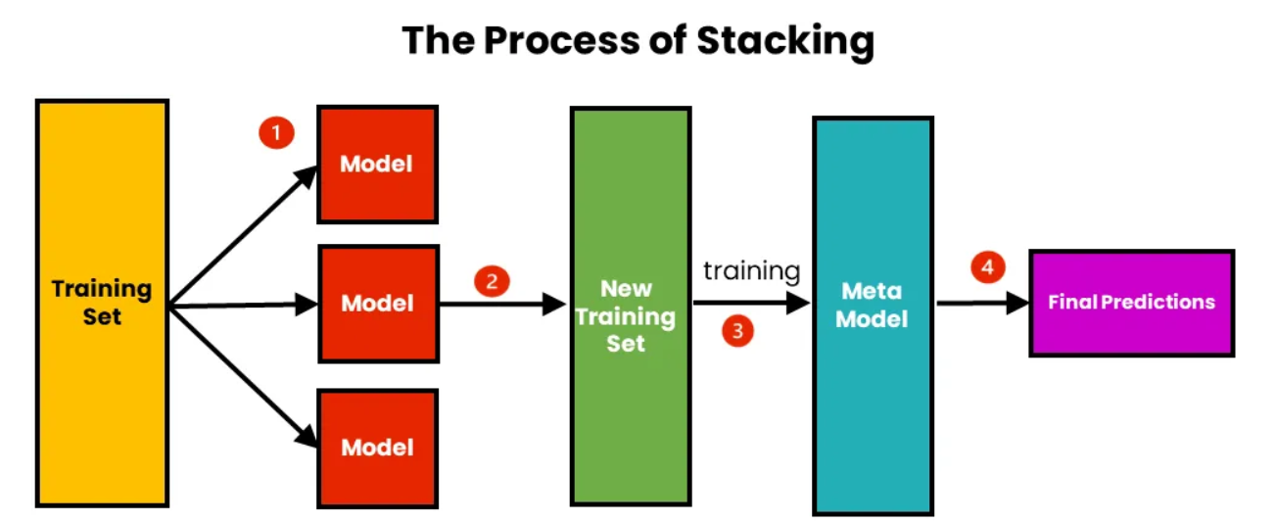
Technical Approach
Ensemble Learning
Utilized stacking to make use of heterogenous models of 2D and 3D
  Get predictions from 2D and 3D models
  Create Meta Dataset by aligning predictions on ground truths
  Use Meta Classifier to train over the Meta Dataset
  Output 3D point cloud with Meta Classifier predictions

Slide 16
Technical Approach
Ensemble Learning
2D Preprocessing
  2D segmented images are converted from RGB values to a single integer representing the predicted class for each pixel
  Convert the 2D image format to a 1D array
  Align 1D prediction array to ground truths
Class Mask
Convert to Numeric 1D Array
Align to Ground Truths
SAM Output
[[40 200 40 ]
[40 200 40 ]
[40 200 40 ]
...
[137 225 121]
[55 125 37 ]
[123 255 255]]
[[True]
[True]
[True]
...
[False]
[False]
[False]]
2D_prediction
9
9
9
6
6
Label
2.0
2.0
2.0
6.0
6.0
[9 9 9 6 6 2]

Slide 17
Technical Approach
Ensemble Learning
3D Preprocessing
  Extract 3D predictions and match them to their respective ground truths
KPConv Output
Extract Predictions
Align to Ground Truths
X
22.207001
19.118000
22.600000
22.610001
22.603001
Y
-11.684
-11.684
-5.789
-5.822
-5.894
Z
2.539
2.608
2.631
2.628
2.630
Scalar_field
2
6
0
0
0
Scalar_field
2
6
0
0
0
3D_prediction
2
6
0
0
0
Label
2.0
2.0
2.0
6.0
6.0

Slide 18
Technical Approach
Ensemble Learning
Meta Dataset
  Combine ground truths between 2D & 3D ground truths
2D
2D_prediction
9
9
9
6
6
Label
2.0
2.0
2.0
6.0
6.0
Meta Dataset
2D_prediction
9
9
9
6
6
3D_prediction
2
6
0
0
0
Label
2.0
2.0
2.0
6.0
6.0
3D
3D_prediction
2
6
0
0
0
Label
2.0
2.0
2.0
6.0
6.0

Slide 19
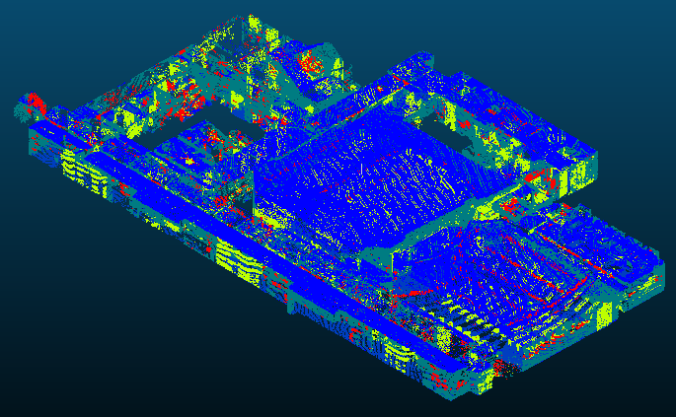

Technical Approach
Ensemble Learning
Meta Classifier
  Input – Meta Dataset
  Model – Logistic Regression
  Output – 3D point cloud with semantic segmentations
Meta Dataset
Meta Classifier
Meta Classifier Output (S3DIS)
2D_prediction
9
9
9
6
6
3D_prediction
2
6
0
0
0
Label
2.0
2.0
2.0
6.0
6.0

Slide 20
Experimental Results
Benchmarking Datasets
  S3DIS
    Stanford University Campus in California
    3 buildings across Stanford University
    13 classes
    5,978 samples
  JBLM Hospital
    Joint Base Lewis-McChord (JBLM) in Washington state
    Training facility consisting of a single-floored field hospital
    10 classes
    143 samples
  JBLM Municipal
    Joint Base Lewis-McChord (JBLM) in Washington state
    Training facility consisting of a three-floored apartment building
    8 classes
    475 samples

Slide 21
Experimental Results
Number of Samples per Object Class
Class | S3DIS | JBLM Hospital | JBLM Municipal
Ceiling | 385 | 7 | 46
Floor | 284 | 7 | 42
Wall | 1548 | 62 | 181
Beam | 159 | - | -
Column | 254 | - | -
Door | 543 | 14 | 35
Window | 168 | 10 | 57
Table | 455 | 6 | -
Chair | 1363 | 6 | -
Sofa | 55 | - | -
Bookcase | 385 | 7 | 46
Board | 284 | 7 | 42
Clutter | 1548 | 62 | 181
Doorframe | 159 | - | -

Slide 22
Experimental Results
Base-Classifier 1: GSA (2D) Accuracy Scores
Class | S3DIS | JBLM Hospital | JBLM Municipal
Ceiling | 96.04% | 92.07% | 98.65%
Floor | 99.52% | 99.08% | 94.75%
Wall | 96.81% | 95.12% | 96.65%
Window | 94.56% | 91.96% | N/A
Door | 98.47% | 82.53% | 93.34%
Chair | 96.56% | N/A | N/A
Bookcase | 94.60% | N/A | N/A

Slide 23
Experimental Results
Base-Classifier 2: KPConv (3D) Accuracy Scores
Classes | S3DIS | JBLM Hospital | JBLM Municipal
Ceiling | 90.30% | 95.18% | 50.84%
Floor | 95.25% | 94.86% | 21.57%
Wall | 72.55% | 88.27% | 83.38%
Beam | 20.32% | N/A | 3.09%
Column | 0.16% | N/A | 42.06%
Window | 22.01% | 0.0% | 0.0%
Door | 47.67% | 46.66% | 22.26%
Chair | 95.22% | 74.46% | 9.85%
Table | 53.24% | 48.29% | N/A
Bookcase | 25.96% | 18.43% | 0.0%
Sofa | 9.55% | N/A | N/A
Board | 2.54% | N/A | N/A
Clutter | 39.20% | 27.88% | 15.12%

Slide 24
Experimental Results
The accuracies for the Ensemble method triumph all baselines when comparing to the 3D base model
  The Ensemble method considers the output of both 2D and 3D predictions, optimally learning what predictions were better from either model for a particular class
Results on Base Models vs. Meta Classifier (Ensemble)
Dataset | 2D (%) | 3D (%) | Ensemble (%)
S3DIS | 94.97 | 93.97 | 94.63
Hospital | 95.79 | 95.49 | 98.05
Municipal | 94.93 | 90.50 | 93.59

Slide 25
Conclusion
Ensemble method to learn a Meta Classifier
Comprising of 2D and 3D semantic segmentation networks
Two heterogeneous base classifiers
Combines the strengths of 2D image analysis and 3D data processing
Extensive experiments over three datasets
The two base classifiers are complementary in terms of their per-class accuracy
Ensembles of classifiers outperform the individual 2D and 3D base classifiers

Slide 26

Questions

