Slide 1
Development and Evaluation of Biosensing Apparel for Monitoring Fighter Pilot Physiological Episodes
Dr. Nichola Lubold, Honeywell Aerospace Technology
Dr. Tor Finseth, Honeywell Aerospace Technology
Bridget Rinkel, Naval Air Warfare Center Aircraft Division
Raisa Marshall, Naval Air Warfare Center Aircraft Division
NAVAIR Public Release 2024-0447. Distribution Statement A: Approved for Public Release

Slide 2

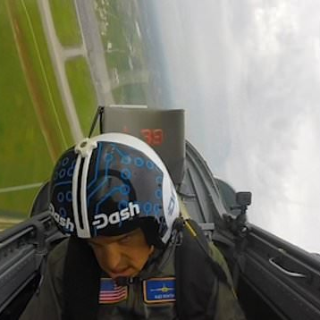


Physiological Episodes can be Problematic
The health & well-being of fighter pilots is paramount to mission success and overall operational readiness.
Pilots in the armed forces can experience compromised physical and cognitive functioning in the form of physiological episodes harming mission success and operational readiness.

Slide 3
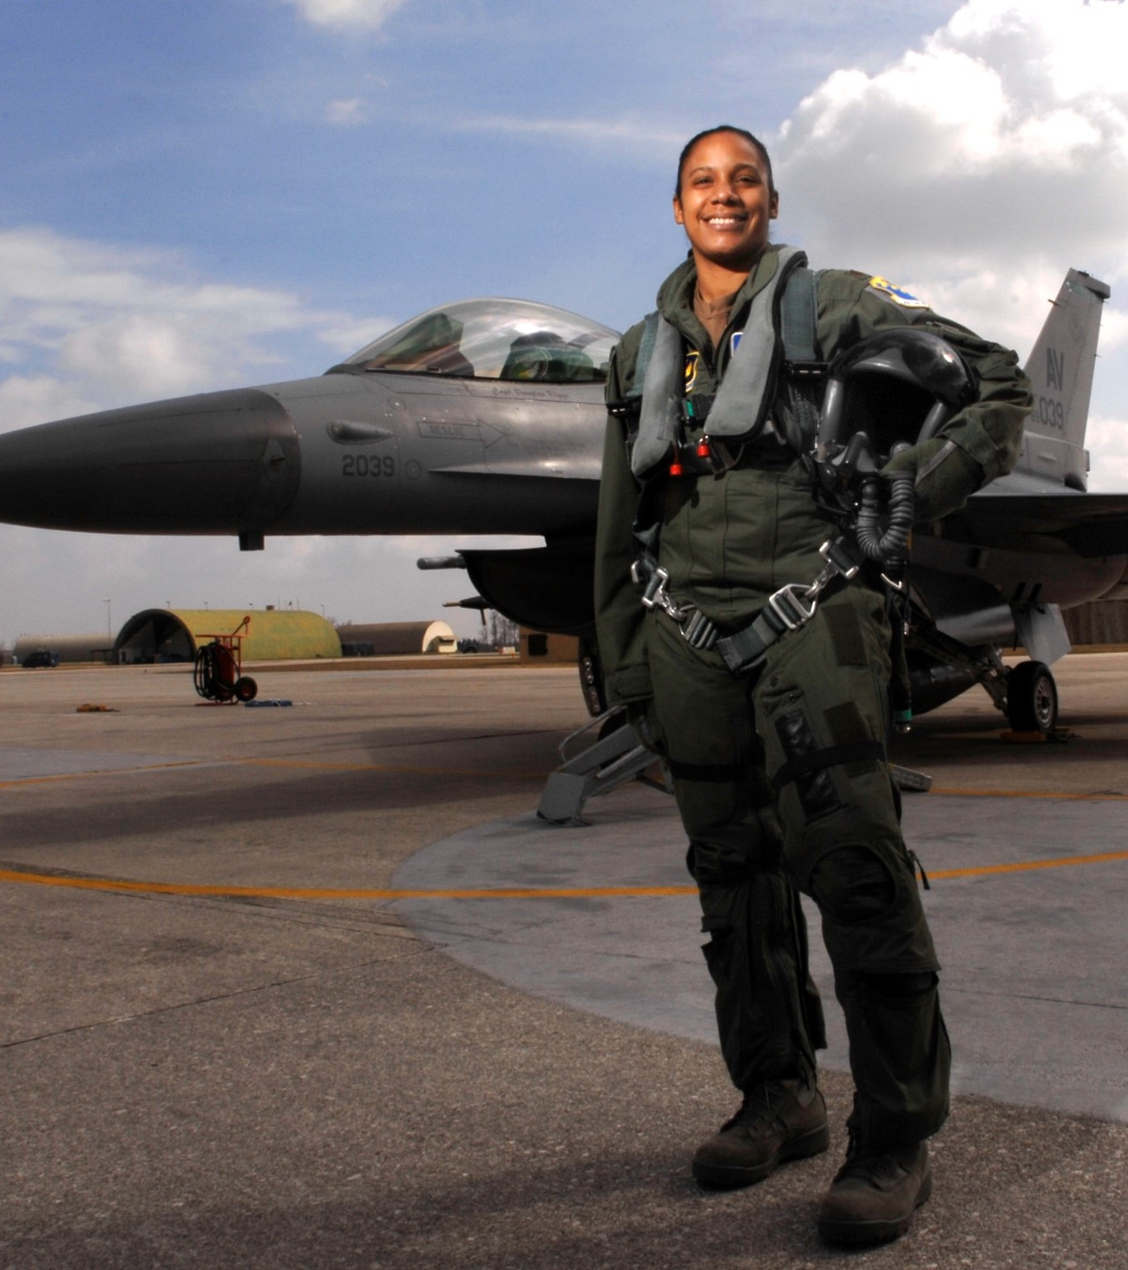
Detecting Pilot State is Challenging
The underlying causes of these physiological episodes can be complex and challenging to identify.
We are seeing a need for real-time, advanced pilot health monitoring systems.

Slide 4
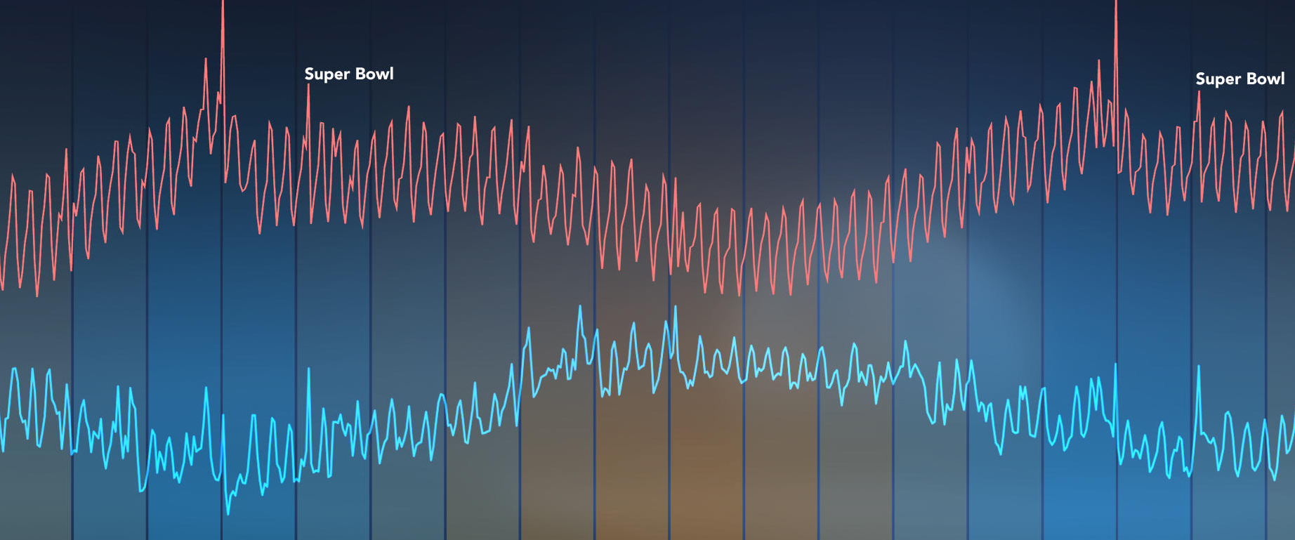
Biosensing Apparel as a Health Monitoring System
Physiological sensors integrated into fabric.
Garment can be in-place of other everyday clothing
Sensors can make direct contact with skin to move with and record biosignals directly at the source.
Advancements in biosensing apparel in the sports and medical community indicates potential for pilot state¹
(1) Li et al., 2023; Schauss, Arquilla, & Anderson, 2022; Azeem et al, 2024

Slide 5
Using Biosensing Apparel for Pilot Health Monitoring
There are potential challenges with using biosensing apparel as a solution for pilot health monitoring, including…
Compression versus comfort
Physical hardware could be problematic
Reliability and consistency of measures over time
Environment of fighter jets is unique
Accommodate both male and female anatomy comfortably
(1) Li et al., 2023; Schauss, Arquilla, & Anderson, 2022; Azeem et al, 2024

Slide 6



This Work
How effective are biosensing garments in capturing physiological signals for both males and females in the environments that fighter pilots operate?
How acceptable are biosensing garments to fighter pilots for capturing physiological signals?
Can biosensing garments be used to detect states that may indicate fighter pilot physiological episodes?

Slide 7
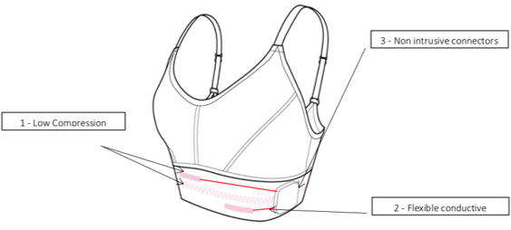
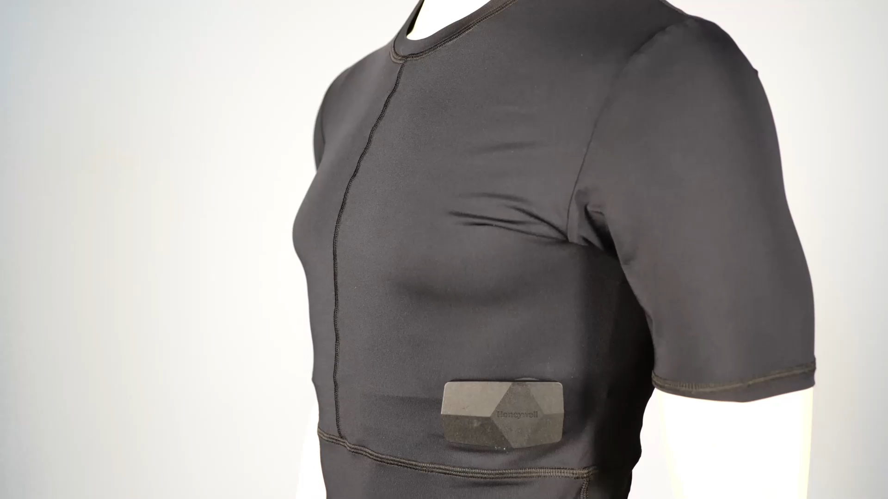
Description of Biosensing Garments
Biosensing garments used in this work:
T-shirt for men, sports bra for women
Embedded ECG sensor
Embedded respiration sensor
Detachable recording module with IMU sensor
24 hours of data storage
Software analytics to extract heart rate, heart rate variability, breathing rate, breathing depth, and movement
Real-time data streaming

Slide 8
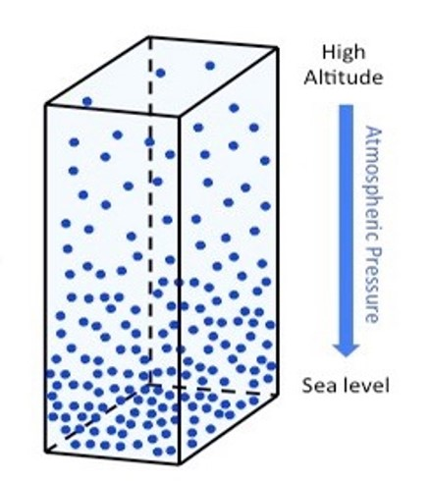
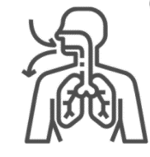
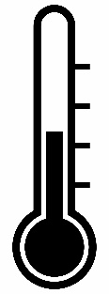
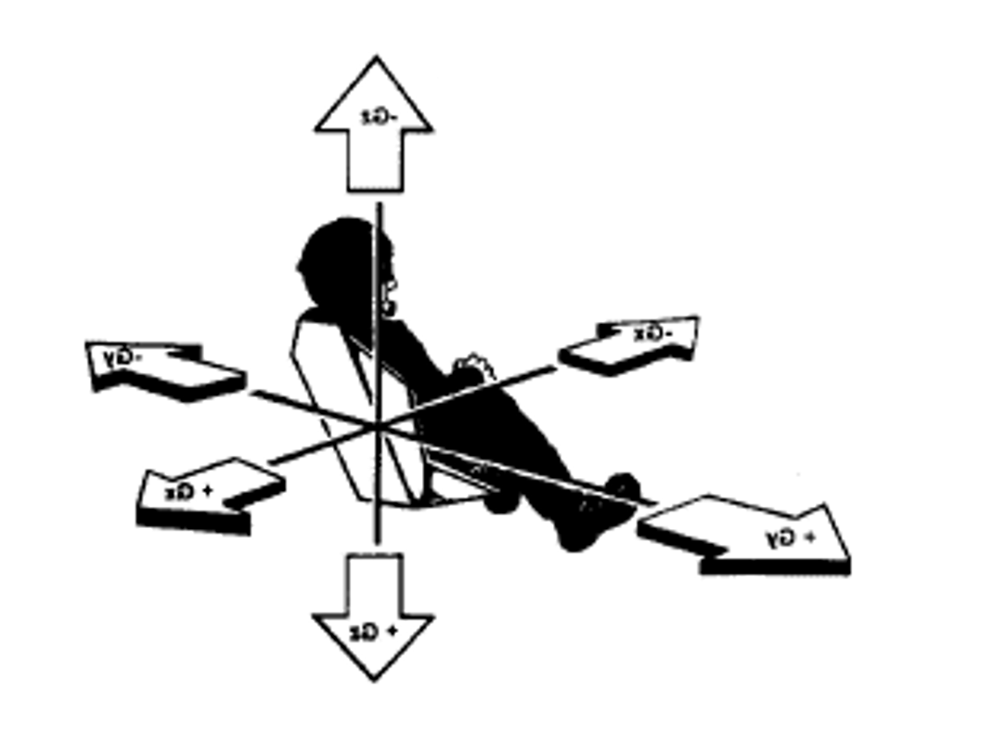
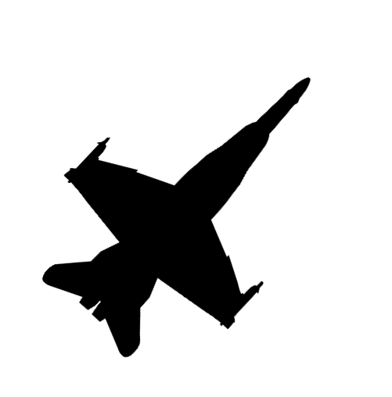
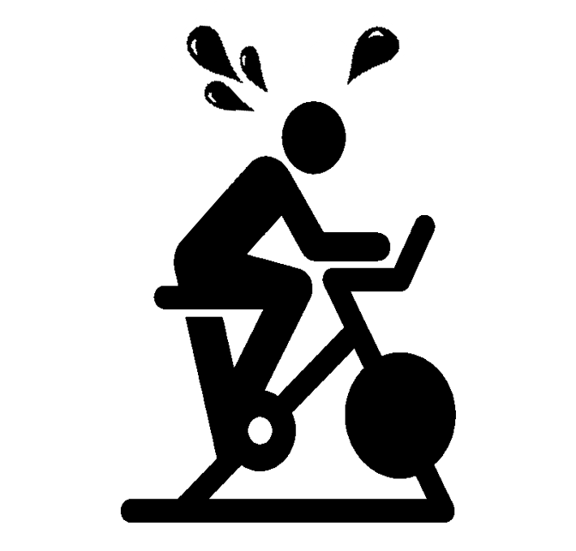
Seven Evaluations of the Biosensing Garments
Reduced Oxygen Breathing Device
Thermal Chamber
Altitude Chamber
Cycle Ergometer
Centrifuge Testing
Flight Testing
Flight Squadron Evaluation

Slide 9
Seven Evaluations of the Biosensing Garments
Participants:
Navy Fighter Pilots
Age Range: 27 – 46 yrs
Sample sizes: Male Female
ROBD 3 1
Altitude Chamber 3 0
Thermal Chamber 5 4
Cycle Ergometer 25 11
Centrifuge 6 2
Flight Testing 9 1
Flight Squadron 15 2
Metrics:
Reference sensor systems were used to evaluate the apparel. These included:
Mindray ECG,
Masimo Forehead Sensor
Nonin WristOx
Generic pulse oximetry pod
The biosensing garments were evaluated in the flight squadron test with subjective questionnaires.

Slide 10
Effectiveness in Capturing Bio-signals
Three signals from the biosensing garments were compared to reference systems by computing Pearson’s correlation coefficient in a two-tailed t-test:
 | Biosensing Garment | Heart Rate |  | Breathing Depth |  | Breathing Rate
Evaluation | Reference Sensor(s) | HR | SpO₂ | HR | SpO₂ | HR | SpO₂
ROBD | HR: Mindray ECG SpO_{2:} Pulse oximetry pod | .95** | -.61** | .23 | -.25* | -.19 | .26**
Altitude Chamber | HR: Nonin WristOx (pulse rate) SpO_{2:} Nonin WristOx | .48* | -.79** | .19 | -.35** | -.23 | .39**
Thermal Chamber | HR: Mindray ECG | .99** | N/A | .22 | N/A | .67* | N/A
Cycle Ergometer | SpO_{2:} Pulse oximetry pod | N/A | .41 | N/A | .09 | N/A | .40
Centrifuge | HR: (unspecified) ECG SpO_{2:} Nonin WristOx | .87** | -.36* | .31** | -.67** | .16** | .19
Flight Testing | HR: Nonin WristOx (pulse rate) SpO_{2:} Nonin WristOx | .30** | .26** | .12** | -.11** | .14** | .10**
Flight Squadron | None | N/A | N/A | N/A | N/A | N/A | N/A
Notes:
Heart rate as captured by the garments was significantly positively correlated with reference sensor systems across all evaluations at either p < .01 or p < .001.
Breathing depth was significantly negatively correlated with SpO2 for all evaluations except the cycle ergometer at either p < .01 or p < .001.
Breathing rate was significantly positively correlated with SpO2 in the ROBD, Altitude Chamber, and Flight-Testing evaluations.
Alignment between the apparel and the reference system measures of SpO₂ was complex and less clear.

Slide 11
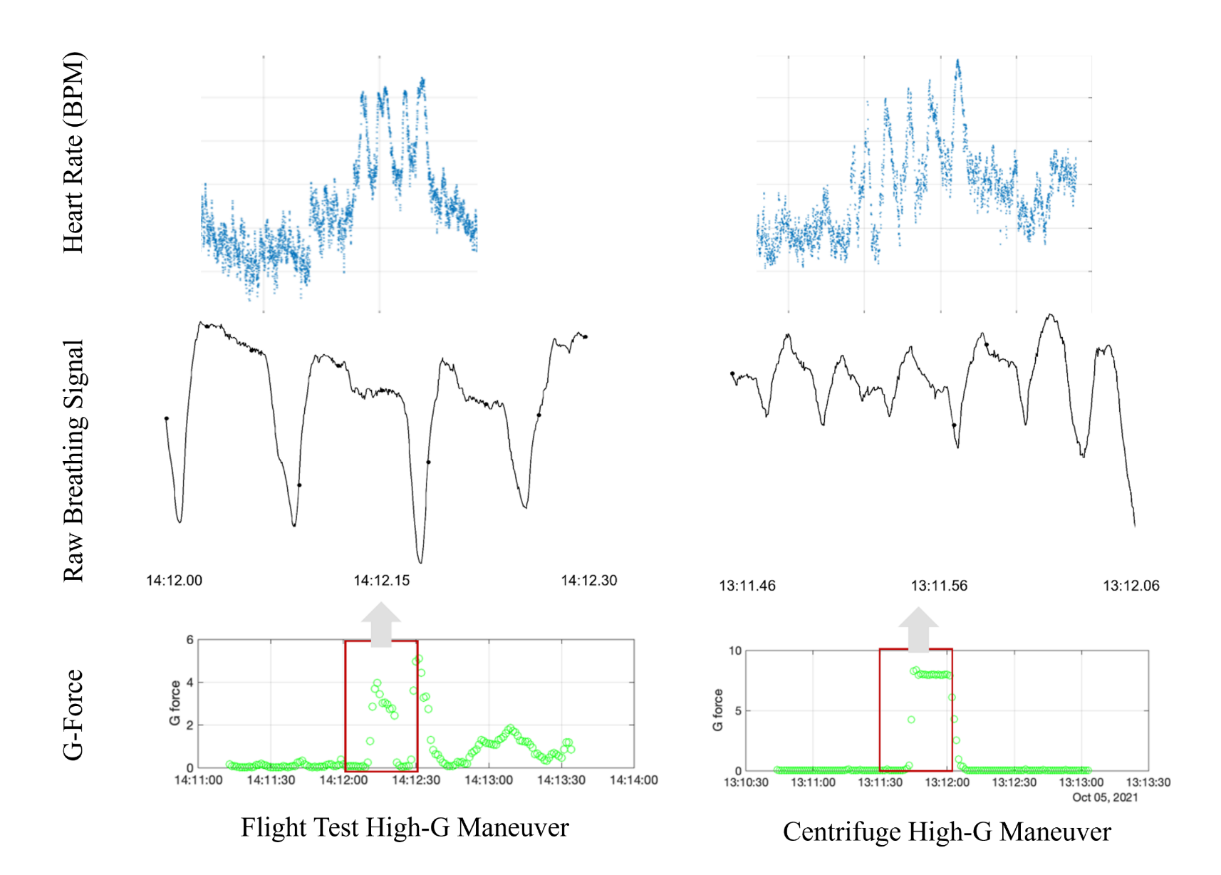
Effectiveness for Capturing Physiological Signals
Capturing Signals in a Unique Environment
Heart rate and breathing rate signals were compared from the centrifuge to in-flight data.
Similar changes in heart rate and breathing rate were seen in the aircraft environment when pilots experienced high-G forces reflecting patterns observed in the centrifuge evaluation
However, variability observed within individuals up to 15bpm.

Slide 12
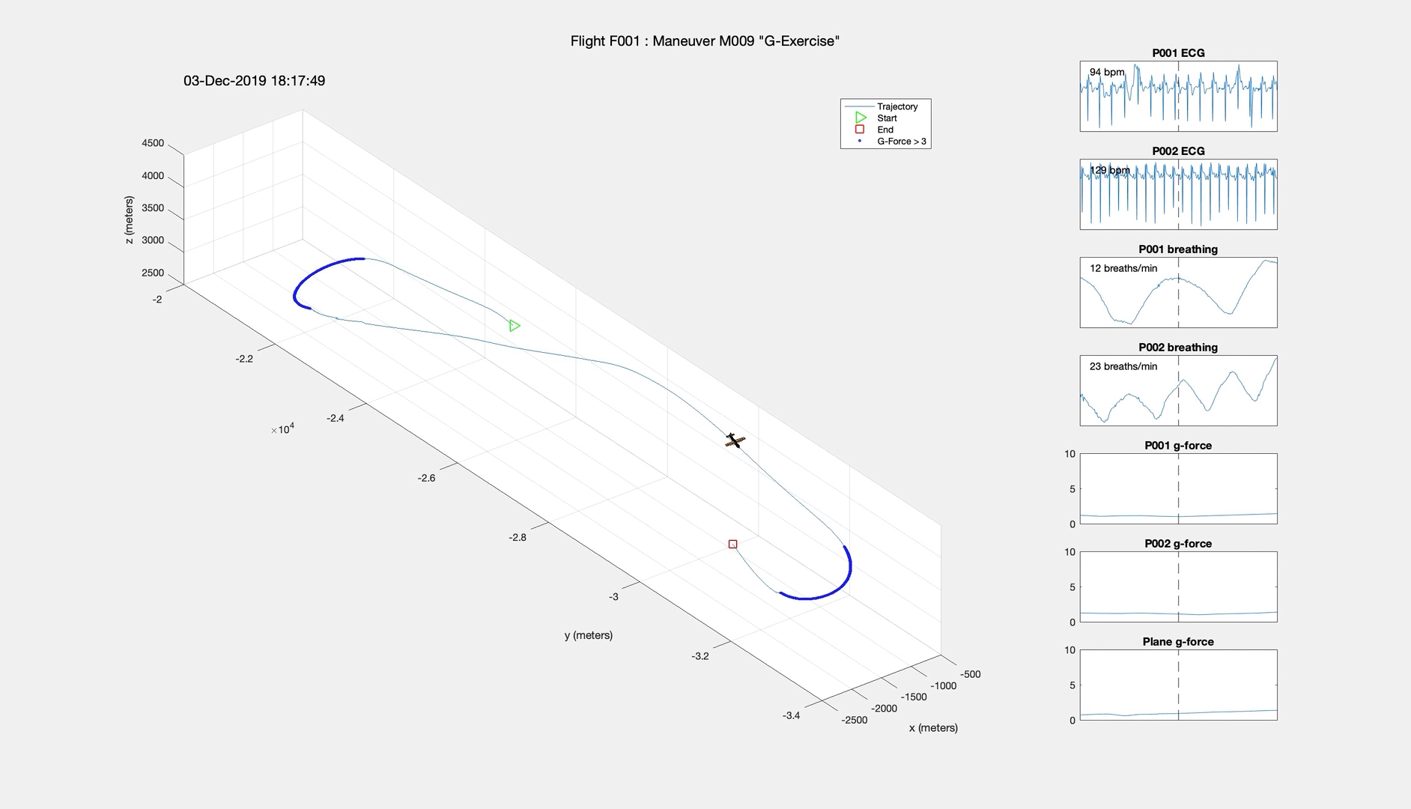
Effectiveness for Capturing Physiological Signals

Slide 13

Acceptability of Biosensing Garments
Participants filled out subjective assessments in all evaluations:
20% felt the garment was “tight” initially but over time, the garment became more comfortable, while 80% responded that it was acceptable.
All flight squadron evaluators felt the garments would be most useful in a test environment. 73% felt it would be useful in training.
The shirt and box are not even really noticeable.
The garments felt good. They were comfortable.
When thinking about it, I know it’s there but otherwise it’s not noticeable

Slide 14
Detecting Pilot State with Biosensing Garments
Using data collected during the cycle ergometer evaluation, convolutional neural network models were built to assess how well the garments can detect breathing states potentially related to physiological episodes.
Breathing States
Coughing
Shallow breathing
Hyper-ventilation
Holding Breath
Talking

Slide 15
Detecting Pilot State with Biosensing Garments
Different models for detecting breath types were assessed.
Highest performing model combined shallow breathing and hyperventilation (results shown).
Shallow breaths and breaths indicative of hyperventilation were hard to differentiate.
Accuracy
Precision
F1
Accuracy | Precision | F1 Score
97.2 | 94.3 | 88.0

Slide 16
Summary
Effectiveness: Heart rate aligned in expected directions with reference systems. SpO2 is more complex. Potential variability within individuals.
Acceptability: Most acceptable for flight testing, with most interviewees also agreeing the garments would be acceptable for training. Female representation ranged from 5% to 44% across evaluations; no noticeable differences in subjective feedback.
Pilot State: Results form models (e.g., F1 score of 94.2) indicates potential future applicability of apparel for detecting states, but there are challenges with differentiating breaths of different types.

Slide 17
Limitations & Future Work
Structure and Composition of Garments Limitations:
50% cotton fabric means to change over time with extended use.
Results did not indicate signal degradation or subjective perceptions of increased discomfort, but changes in the fabric were observed in the extended flight squadron evaluation
Hardware puck connection issue: poor quality data or no data was recorded in six flight squadron events
Future Work
Iterations on the fabric and hardware design to reduce the potential for such issues.
Explore potential individual differences in physiological responses to high-G.
Focused longitudinal study on physiological changes over time, both on the ground and in the air.

Slide 18
Thank you!
Author Contact Information:
Nichola Lubold, PhD
nichola.lubold@honeywell.com
Tor Finseth, PhD
tor.finseth@honeywell.com
Bridget Rinkel
bridget.k.rinkel.civ@us.navy.mil
Raisa Marshall
raisa.e.marshall.civ@us.navy.mil
NAVAIR Public Release 2024-0447. Distribution Statement A: Approved for Public Release

Slide 19
Appendix

Slide 20
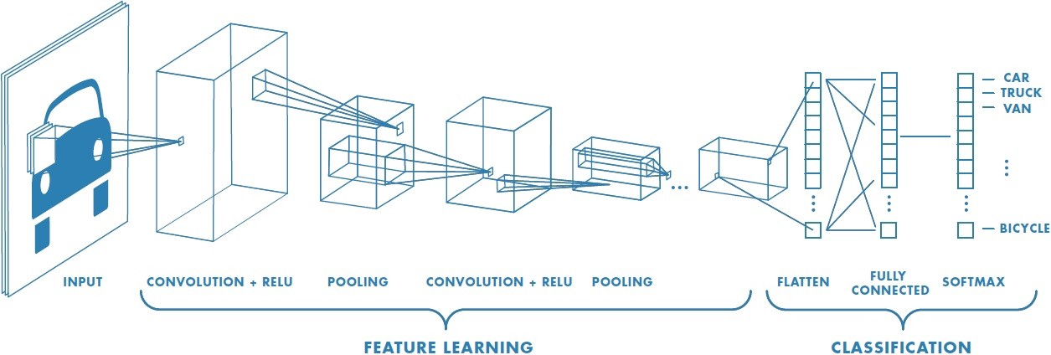
CNN Parameters
Image of breath
Coughing
Shallow
Hyperventilation
Max ventilation
Holding breath
Talking
Big breath
Normal
Noise
784
inputs
2 3x3 conv2s layers, 1 2x2 max2d layer, .20 dropout, 128 dense
9 Outputs

