Slide 1
Beyond the Cockpit: VR Training Solutions for Air Refueling Proficiency
Dr. Lindsay Gouedy, Louisiana Tech University
Dr. Mary Fendley, Louisiana Tech University
Brandon “Steppen” Wolf, Lt Col, USAF
Effort sponsored by the Air Force under MOU FA6800-23-H-0001. The U.S. Government is authorized to reproduce and distribute copies for Governmental purposes notwithstanding any copyright or other restrictive legends. The views and conclusions contained herein are those of the authors and should not be interpreted as necessarily representing the official policies or endorsements, either expressed or implied, of the Air Force of the U.S. Government.
Notes:
Current as of 11/26/24

Slide 2
Objectives
Evaluate whether USAF pilots trained using VR technology experience a reduction in training duration and/or the number of sorties needed to achieve proficiency compared to historical data from non-VR-trained pilots undertaking the same air refueling task.
Differences in participants' cognitive load at different points during the training program and in different environments were observed enabling a deeper assessment of the environmental training impacts.
Notes:
Lindsay
Assess the efficacy of new training technology looking at whether their was a reduction in training time.
Assess whether virtual reality impact cognitive load

Slide 3
Beyond the Cockpit
Air Refueling a “BUFF”
Virtual Reality
Training Transfer
Methods
Results
Notes:
Lindsay

Slide 4
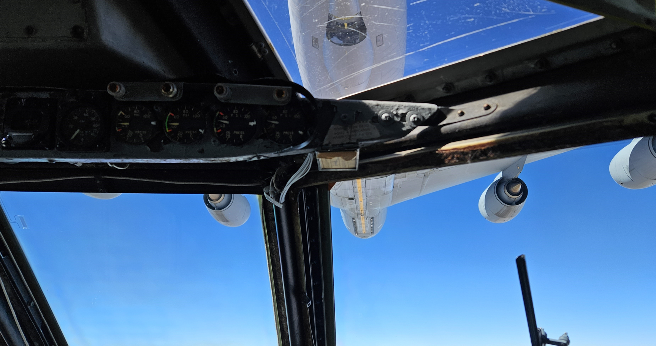
Air Refueling Contact
Successful Contact Viewpoint from within the B-52
Notes:
Steppen
Here is what it is, the task, high level
Legacy and conventional training methodologies, to lead into VR as a training tool
Conventional training is pictures and in the jet

Slide 5
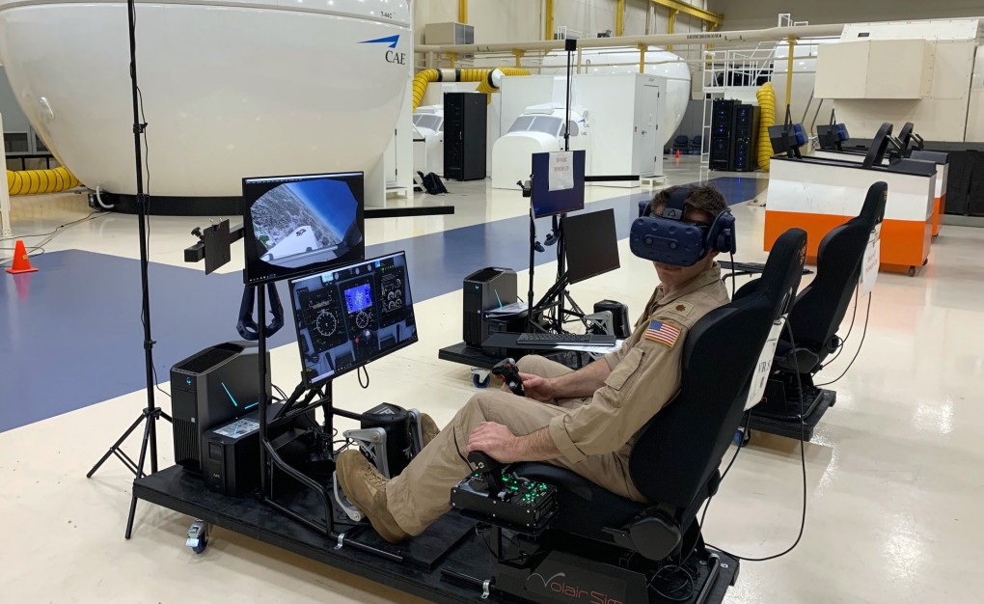
Virtual Reality
The ability to manipulate the training environment to any scenario in a controlled setting is a clear advantage of incorporating VR in defense training (Garcia & Winer, 2022). Van Weelden (2021) also references the benefits of safe and controlled environments resulting from VR training.
Notes:
Steppen
The craze of VR lead us to want to utilize VR for training AR to provide a safer more efficient space to practice the visual cues and feel of the jet and unique control inputs required to AR a B-52 specifically.
One

Slide 6
Cognitive Load
The American Psychological Association defines cognitive load as the mental demands imposed on a person while performing a task.
These demands increase significantly when the task is challenging, dangerous, or unfamiliar, leading to situations where performance speed and success can be greatly impacted (American Psychological Association, 2018).
The complexity of air refueling tasks stresses the importance of understanding cognitive load to improve training methods and enhance pilot performance.
By examining the cognitive demands of these tasks, we can develop more efficient and effective training programs that not only model the physical aspects of refueling but also address the mental challenges pilots face.
Ultimately, by recognizing and addressing the cognitive load involved in air refueling, we aim to improve pilot proficiency, reduce errors, and increase overall mission success.
Notes:
Lindsay
Emphasis on cognitive load
Could VR impact positively VR

Slide 7
Training Transfer
Testing Learning Models to produce a successful transfer of training model to link conventional learning and advanced training environments, such as virtual reality (VR).
SEEV model (Wickens, 2003)
Four Component Instructional Desnight (4C/ID) Model (Van Merriënboer, 2019)
The four key components of the 4C/ID Model are as follows; 1) design the learning tasks, 2) design the supportive information, 3) design procedure information, and 4) design part-task practice (Van Merriënboer, 2019). These integrated four parts would enhance the transfer of training.
By gradually increasing complexity and decreasing the support and guidance provided, this helps the student learn to coordinate different aspects of performance and combine acquired skills, knowledge, and attitudes.
Notes:
Lindsay

Slide 8
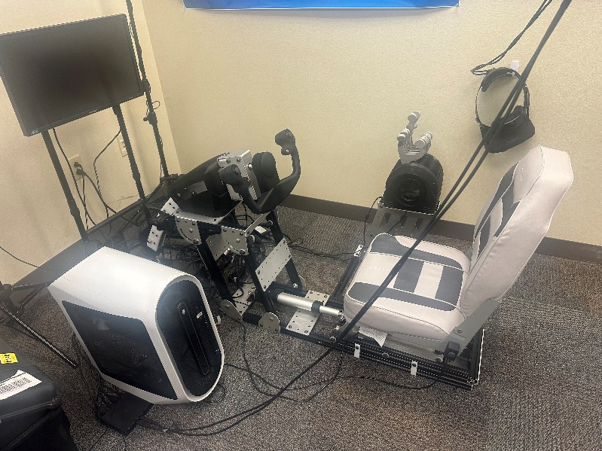
Research Methods
Variables | Definition
Sorties to Proficiency | The number of sorties (flights) it takes a pilot to reach the level of ‘proficient’ competence level.
Minutes to Proficiency | The number of minutes a pilot spends on air refueling attempts (practice) to reach the level of ‘proficient’ competence level.
Hypothesis: Based on a comprehensive literature review, we hypothesize that pilot trainees undergoing training with VR simulation experiences will achieve 'proficiency' standards with a reduced number of in-air task minutes and/or fewer sorties compared to historical student trainees who did not have access to this training technology
Notes:
Steppen
EARL plug

Slide 9
Procedures
Historical data on current and previously graduated pilots was provided to build out historical metrics on proficiency timeline based on the number of minutes pilots practice air refueling as well as the number of sorties flown.
The class averages of the test pilot groups were used as a comparison to the historical averages of the control pilots.
The differences relevant to our research defined the expectation of minutes where air refueling (AR) was attained during each of the four blocks of the training program.
The data was first assessed by looking at the entire data set of pilots (152 non-VR-trained pilots vs. 46 VR-trained pilots), across all three iterations of the syllabi.
Analysis was then conducted to assess the cognitive load on the pilots using visual heat maps and the NASA-TLX.
Notes:
Steppen

Slide 10
Results:
Data Collection Totals
Total Students | 198
Total Minutes of AR Training | 64408
Average minutes per student | 325.29
Highest # of minutes to training completion | 579
Lowest # of minutes to training completion | 152
Notes:
Lindsay

Slide 11
Results
Research Question | N | Mean | p value | Effect Size | Results
Does VR use in training reduce the number of minutes to reach proficiency? | Non-VR=152 | 250.25 min | .032 | 0.313 | Statistically significant, Small Effect Size
 | VR=46 | 227.67 min
Does VR use in training reduce the number of sorties to reach proficiency? | Non-VR=152 | 9.16 sorties | <.001 | 0.608 | Statistically significant, Medium Effect Size; VR use for training air refueling skills has a measurable positive impact on the trainees.
 | VR=46 | 7.80 sorties
Notes:
Lindsay

Slide 12
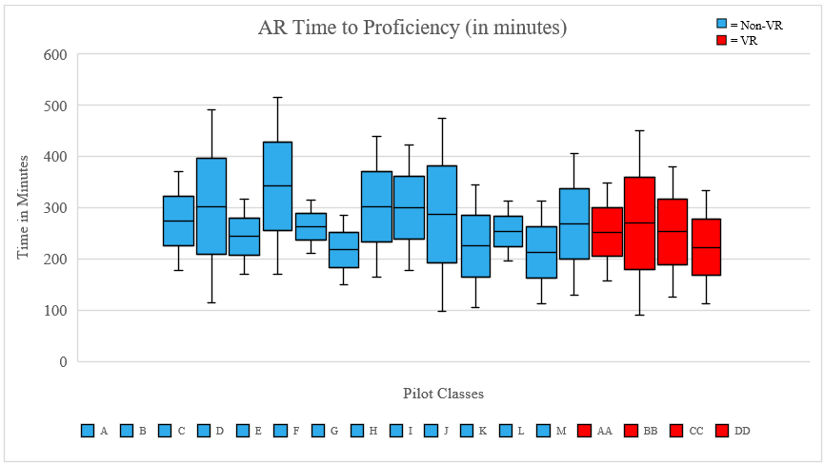
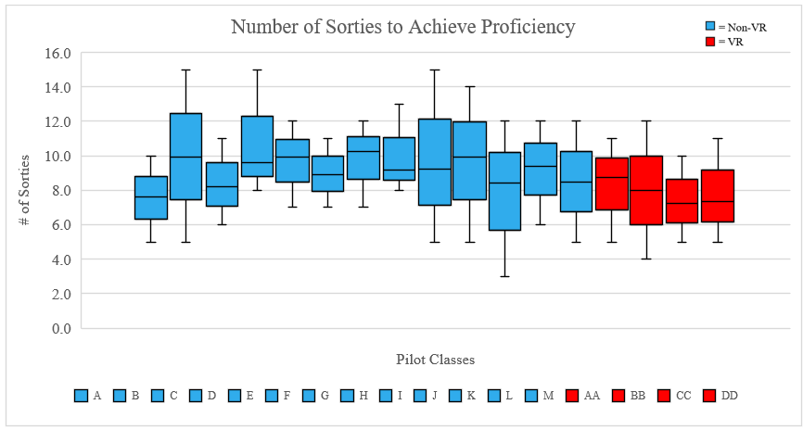
Results
Notes:
Lindsay

Slide 13
Results
Training Groups | Average # of Sorties to Proficiency | Reduction in Sorties from the Historical Average
Historical Average (A-M): | 9.28
Class AA average | 8.73 | -0.60
Class BB average | 8.00 | -1.28
Class CC average | 7.25 | -2.03
Class DD average | 7.33 | -1.94
Notes:
Lindsay

Slide 14
Cognitive Load
The NASA Task Load Index (NASA-TLX) survey allowed our team to put a quantitative measure to the movement of cognitive load by score.
By looking at the scores of the pilots at several points throughout the training program we are able to observe trends from differing times during the training program.
We compared three different points: the first sortie to proficient sorties, the first VR session to VR post-proficient sorties, and the first VR session to proficient sortie. In each comparative analysis, we observed a decline in the average score from the first point of measure to the second.
Notes:
Lindsay

Slide 15
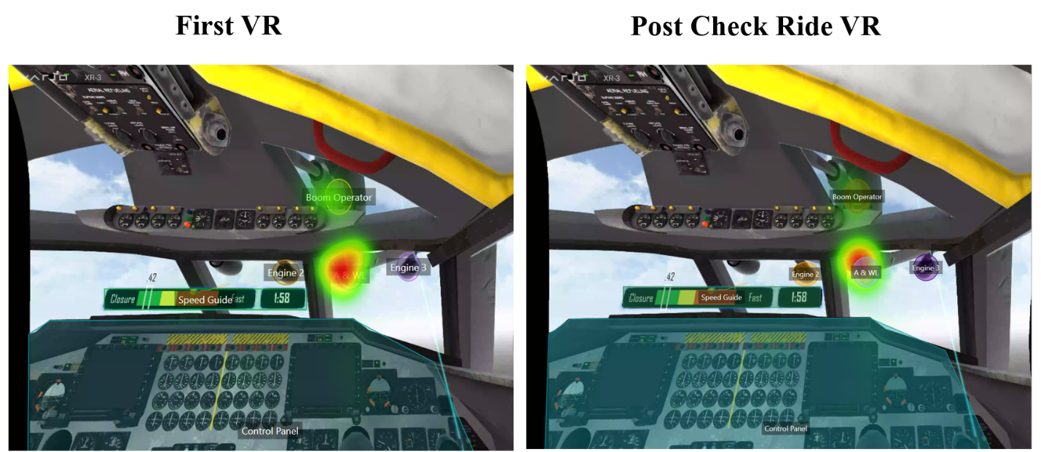
Notes:
Lindsay
Less drifting of visual attention…
Improved situational awareness and task performance
We can however observe in the post-check ride VR a tightening of the visual focus which indicates less drifting of visual attention. By tracking these visual attention patterns, we can identify improvements in the pilots' situational awareness and task proficiency, which are crucial for successful air refueling operations.

Slide 16
Discussion
Based on the results we can infer that the opportunity the VR simulation program offers for pilots to practice air refueling outside of the jet helped reduce the number of sorties and overall time needed to become proficient.
The use of VR for training provides a level of accessibility and affordability that conventional supplemental training platforms do not.
In our research, we found multiple instances where, even with the VR training tool in place, there was immense value in having a live human instructor on hand with the student during task simulations.
Notes:
Steppen

Slide 17
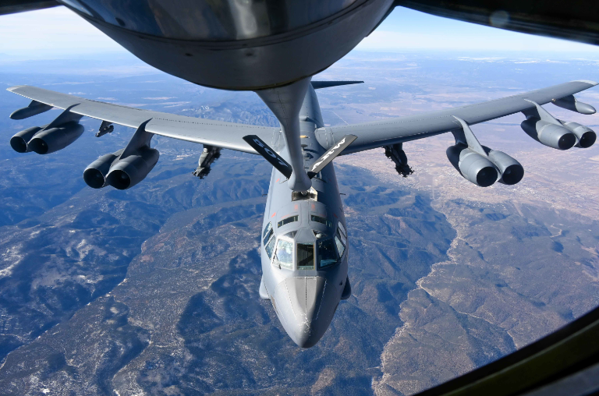
Questions?
Notes:
Steppen

