Slide 1

Mesh-as-a-Service:
Automated 3D Modeling Fast as L-AI-ghtning
Mathijs Henquet / Thomas Bellucci,
Royal NLR – Netherlands Aerospace Centre
Co-authors: Chihab Amghane, Jasper Steringa, Lodewijck Foorthuis

Slide 2
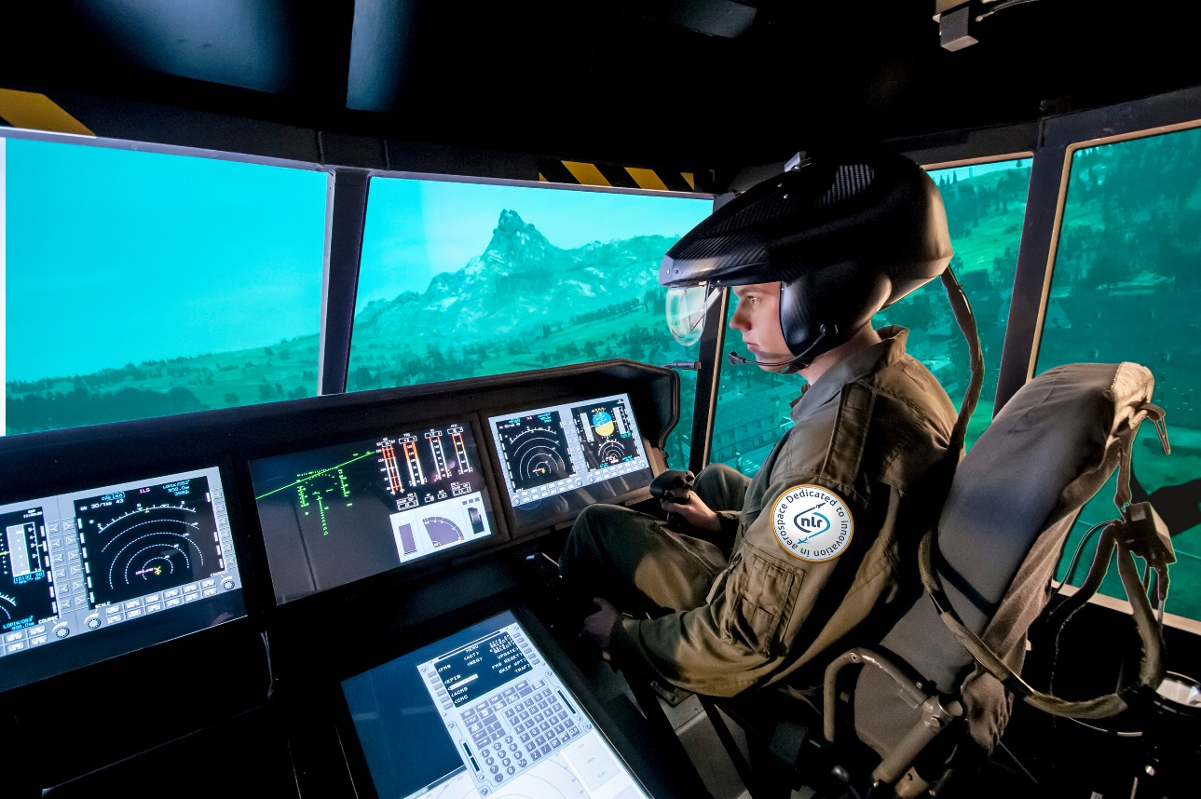
Background: Training at RNLAF
Training complex helicopter operations by the Royal Netherlands Air Force (RNLAF)
RNLAF is developing a Multi-Ship-Multi Type (MSMT) Simulator center
Requires development of many virtual components with different fidelity levels / interactions.

Slide 3
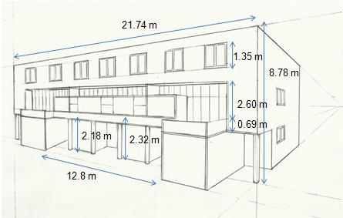
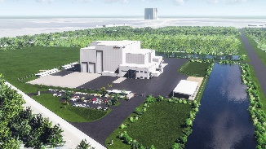
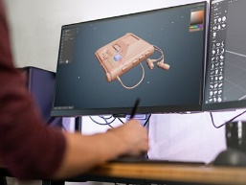

Background: Traditional 3D modelling
Requires detailed schematics
Requires 3D modeler or artist
Expensive!

Slide 4
Request & Contents
NLR was asked to make a 3D model of the gas turbine auxiliary power unit (APU) for the CH-47F Chinook Rear Crew Trainer
How we made the APU model
Pose detection with background segmentation
3D reconstruction (Gaussian Splatting with Surface Alignment)
Mesh extraction and texturing
Mesh-as-a-Service: Our pipeline as an asset generation service

Slide 5
Challenge
The APU was recorded with a consumer grade photo camera
Inconsistent background and lighting, no prior instruction
Many conventional methods require some form of depth sensing
Laser (LIDAR), Stereovision or structured light scanning
Off-the-shelf RGB only (no depth data) methods did not work
Struggle with required quality: glossy surfaces and small details
Failed to reconstruct due to the inconsistent background

Slide 6
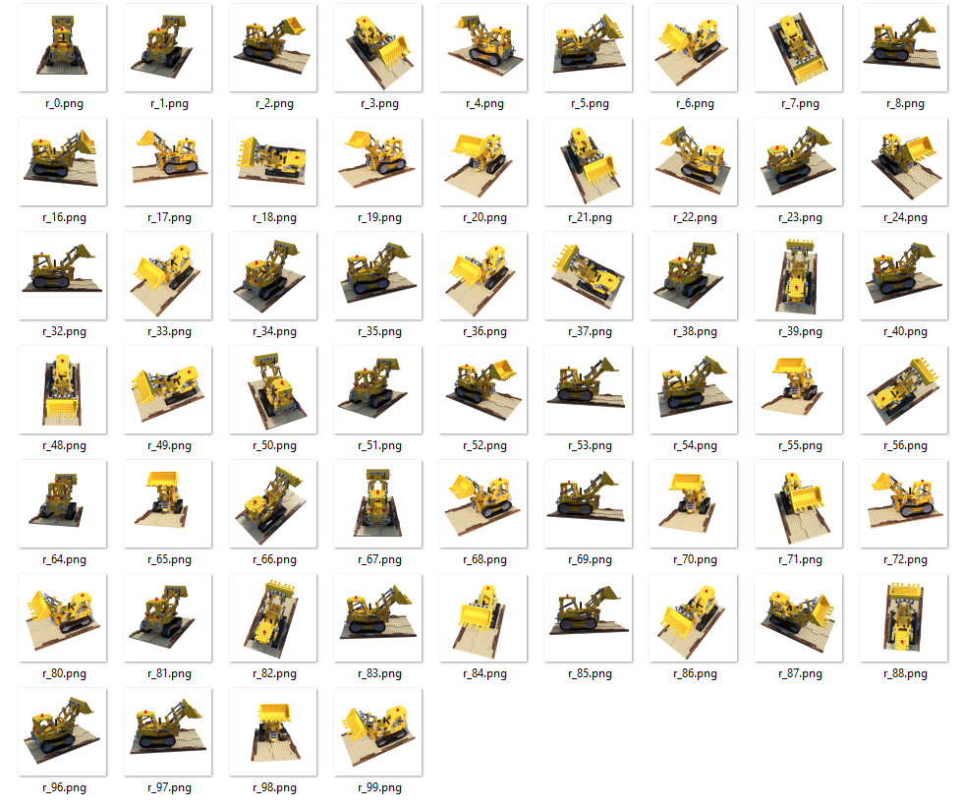
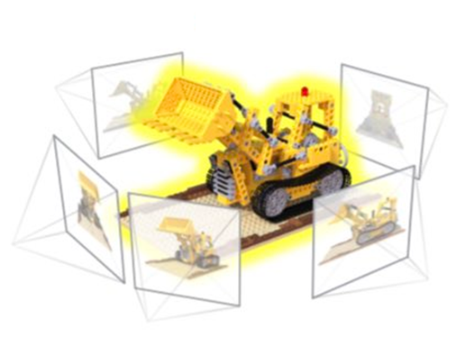
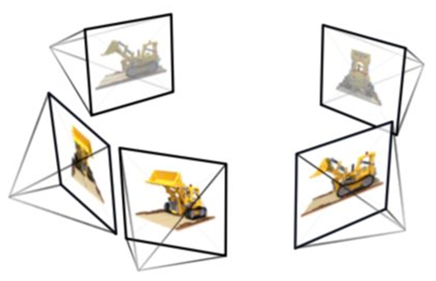
Conventional Multi-view Reconstruction
Step 1: Pose detection
Step 2: 3D reconstruction
Step 1
Step 2
Image set
Images with accurate poses
3D representation

Slide 7
Challenge: Background Segmentation
Challenge: The changing backgrounds in the APU dataset made pose detection impossible.
Solution: Semi-automatic background segmentation

Slide 8
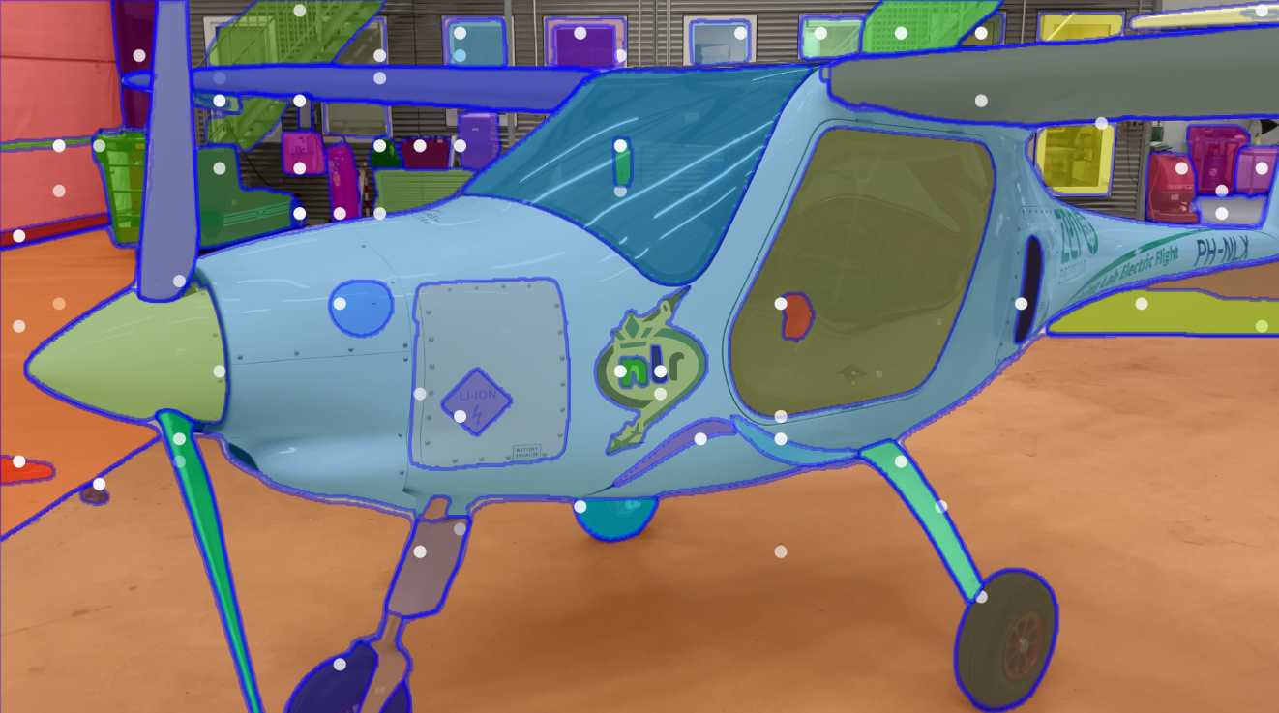
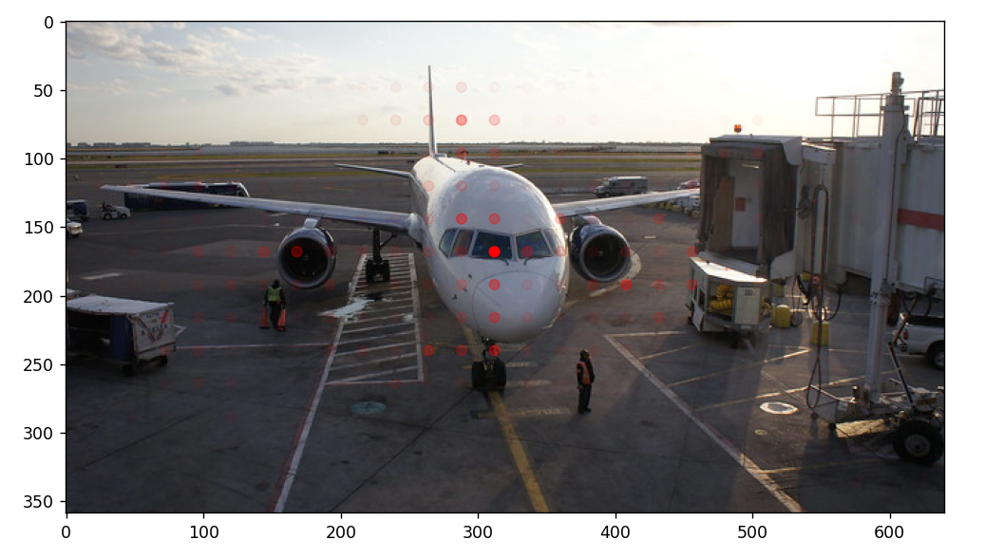

Background segmentation
Using Segment Anything Model (Meta 2023) we can automatically segment based on point prompts
Using CLIP model (OpenAI 2021) we can generate the point prompts automatically.
“Airplane”

Slide 9
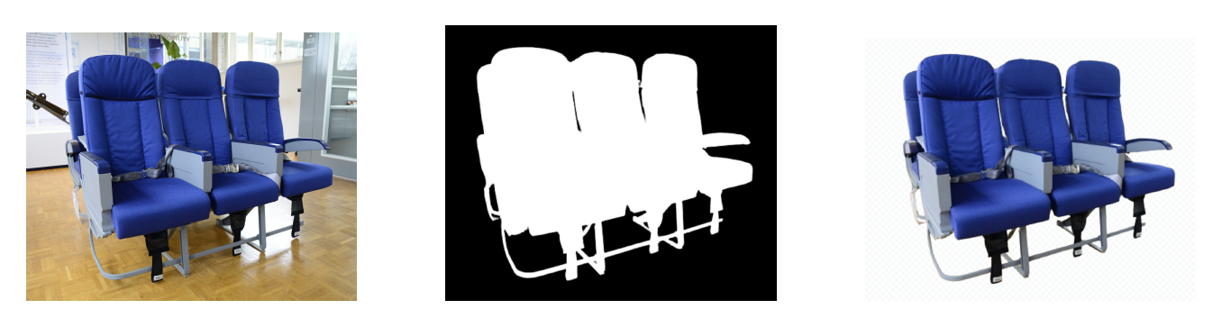
Background Segmentation
Semi-automatic background segmentation of the dataset
Use only foreground to do pose detection, ignore features from the background

Slide 10
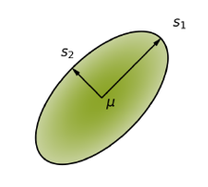

3D reconstruction
3D Gaussian Splatting (2023)
Represents the scene as a set of Gaussians
Oriented blobs in space
Angle dependent appearance
Can represent glossy surfaces / specular highlights
Position, size and color of Gaussians are optimized using gradient descent

Slide 11
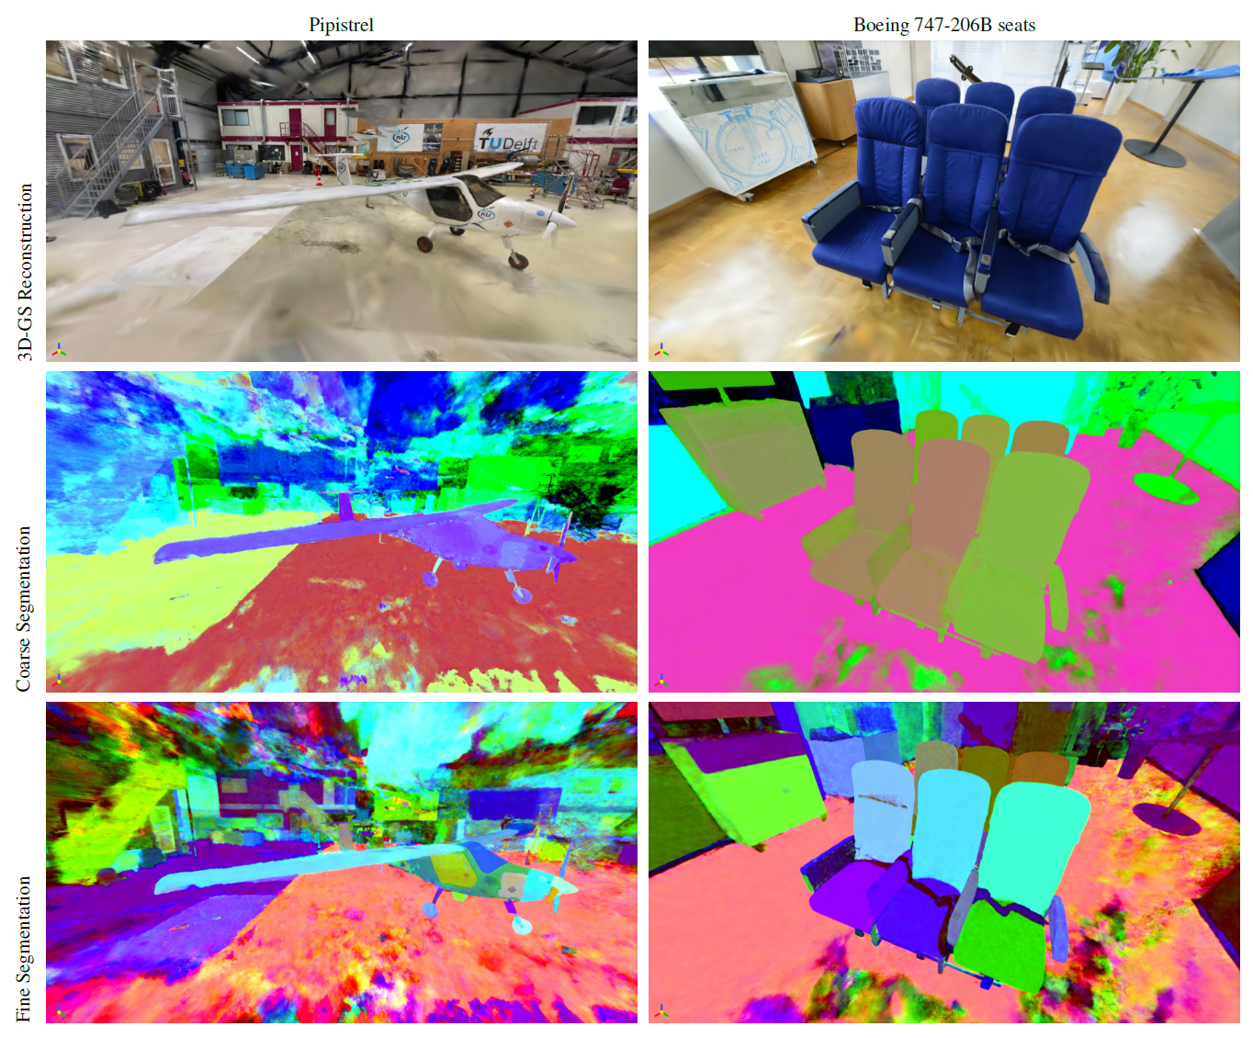
3D reconstruction
This works extremely well!

Slide 12
Challange: Towards a Mesh
In order to extract a usable Mesh there are 2 challenges to overcome:
Despite great visual reconstruction, surfaces are generally rough
Especially at homogeneous appearing surfaces
Objects of interest have to be separated from the background

Slide 13
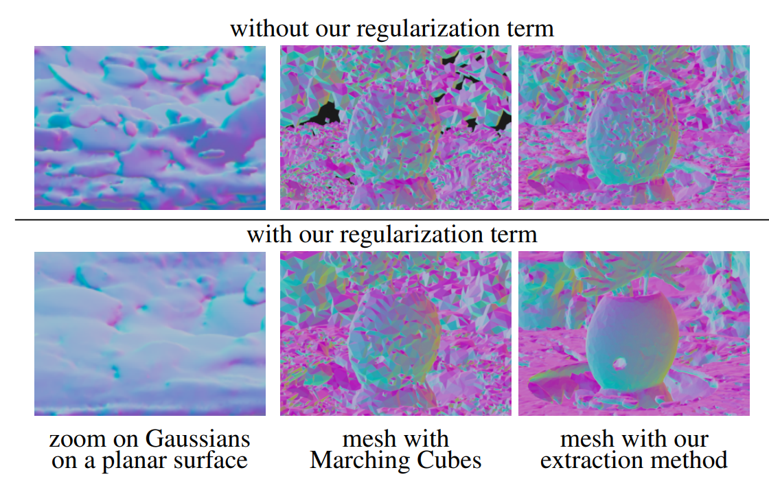


Surface Alignment
Surface Aligned Gaussians (SuGaR 2023)
Ensures Gaussians are locally aligned
Vanilla 3D Gaussian Splatting
RGB Reference
With Surface Alignment
Notes:
The colors in these images display the normals, left is a close up

Slide 14
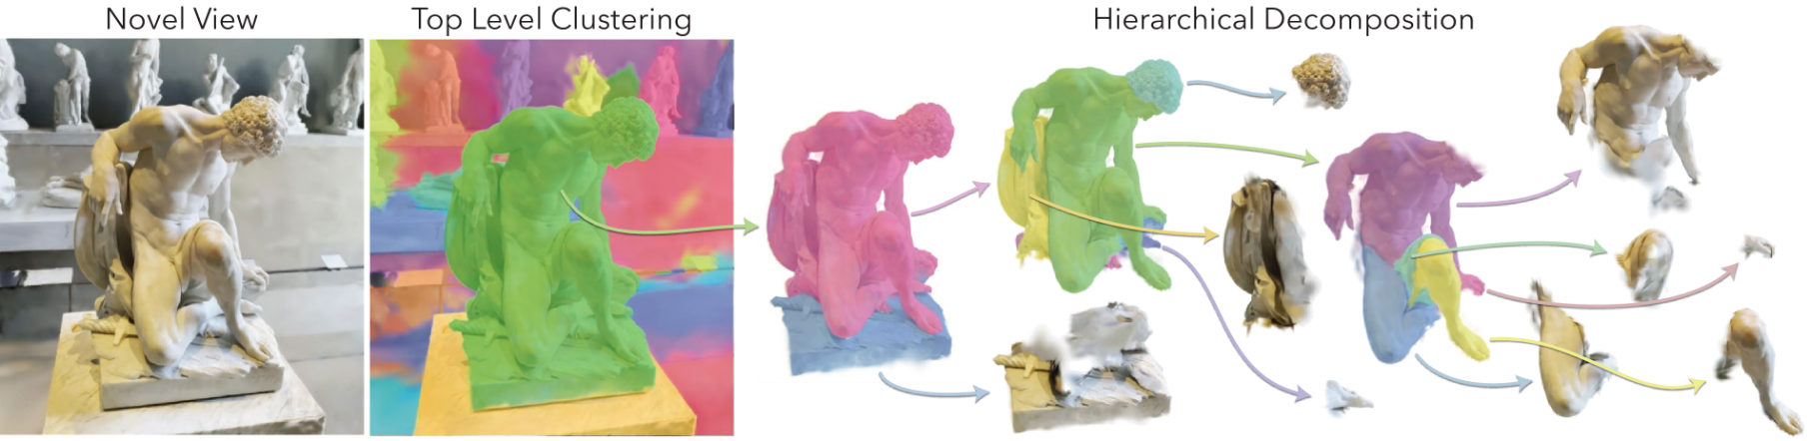
3D Segmentation
Hierarchical 3D Segmentation using GARField (2024)
Lifts 2D segmentation using SAM to 3 dimensions
Works by scale dependent clustering of scene primitives to imitate SAM masks

Slide 15
3D Segmentation
Coarse segmentation
Fine segmentation
Notes:
Left pipistrel, right boeing planes
Top coarse scale, bottom fine scale

Slide 16
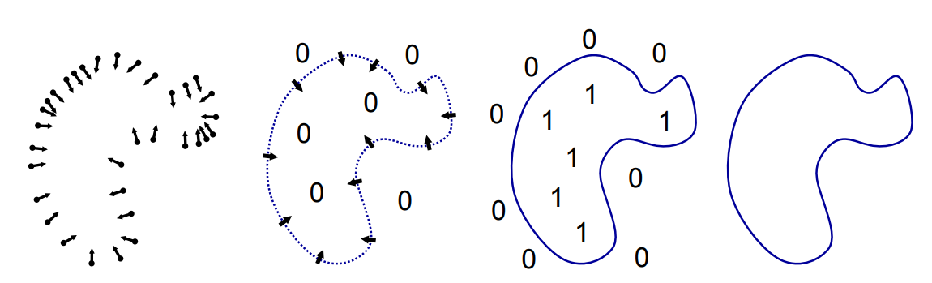
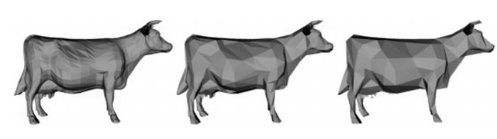
Mesh Extraction & Texturing
Mesh extraction
using Poisson reconstruction
simplified using quadratic error metric to obtain a mesh with desired fidelity
Texturing
optimized a texture using differentiable rendering pipeline

Slide 17
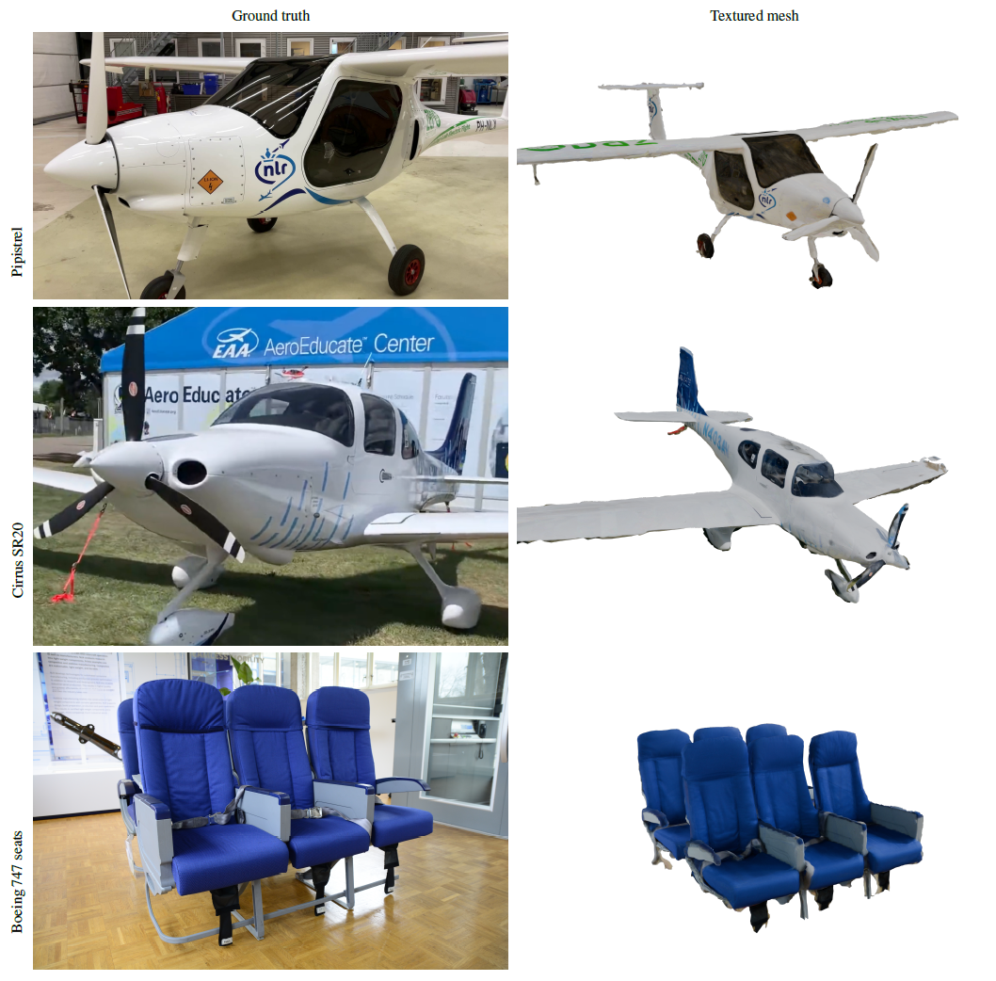
Results
The APU for the RNLAF was successfully reconstructed
Left: results of the pipeline with NLR made datasets.
Ground truth
Textured mesh
Notes:
Top: pipistrel, bottom: boeing airplane seats

Slide 18
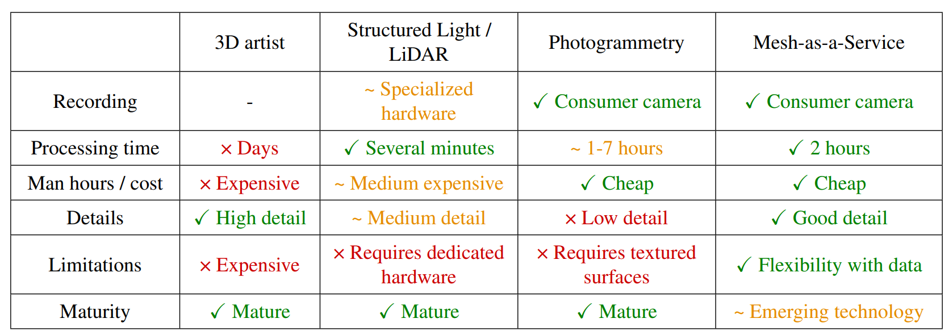
Discussion
Comparison to conventional 3D modelling methods
Notes:
Comparison to alternatives

Slide 19
Limitations
Image Dataset Quality can hinder reconstruction accuracy
Can we use drones to automate capture of complex objects?
Reflective Surfaces cause problems for 3D reconstruction
Semi-transparent surfaces can indicate reflective surfaces
Mesh Reconstruction loses detail from the Gaussian Splatting scene

Slide 20
Question
How can we make 3D mesh reconstruction accessible?
Pose detection
Model training
3D Segmentation
Mesh extraction
Texturing
Mesh in simulator
Input images / Video
Background removal
Input images / Video
Mesh-as-a-Service
Mesh in simulator

Slide 21
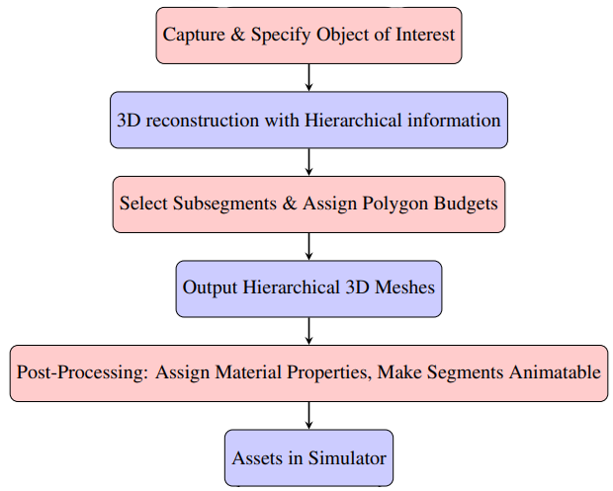
Concept of Operations
Should enable the use of this pipeline with an intuitive interface
Semi-automated with the ability of a human to intervene and correct
Further explored with 2 use cases

Slide 22
Use case: Own-Ship
Objective: Create detailed 3D models of platforms (e.g., military vehicles, aircraft, naval vessels).
Process:
Users capture images of platform parts without specialized training.
Images processed by Mesh-as-a-Service to generate meshes with polygon budgets.
Key Feature: Hierarchical 3D segmentation for detailed subcomponent modeling.

Slide 23
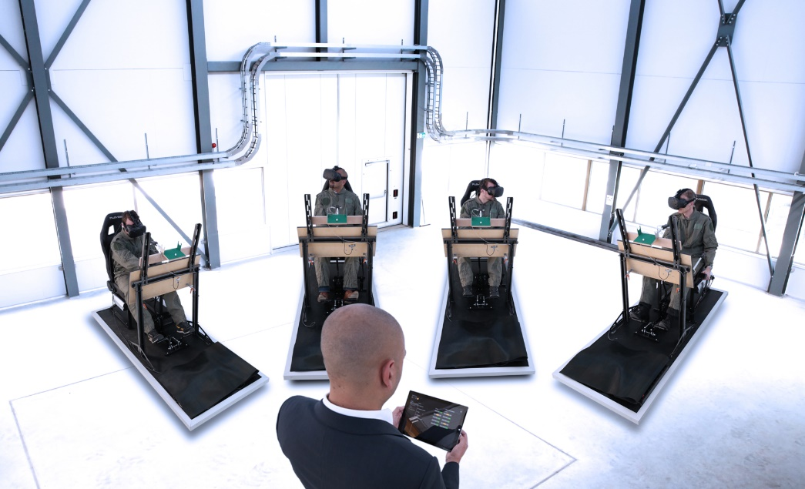
Use case: Own-Ship
Hierarchical Segmentation
Break down platforms into subcomponents (e.g., cockpit parts).
Produces assets with articulatable parts
Assign material properties to parts
Tools & Interface
Develop tools for picking the hierarchical subdivisions.
User-friendly interface for review and adjustment.
Advantage: Flexibility and ease of adjustment for immersive training scenarios.

Slide 24
Thank you
Questions?

