Slide 1


Taking a Data-Informed Approach to Squad Training Evaluations
Michael King, Ph.D., Quantum Improvements Consulting
Julian Abich IV, Ph.D., Quantum Improvements Consulting
Clifford Hancock, M.S., U.S. Army Combat Capabilities Development Command (DEVCOM)
Meghan O’Donovan, M.S., U.S. Army Combat Capabilities Development Command (DEVCOM)
Gregory Goodwin, Ph.D., U.S. Army Combat Capabilities Development Command (DEVCOM)

Slide 2
Acknowledgments
This research was sponsored by the U.S. Army Combat Capabilities Development Command - Soldier Center (DEVCOM SC). The views and conclusions contained in this document are those of the authors and should not be interpreted as representing the official policies, either expressed or implied, of DEVCOM-SC or the U.S. Government. The U.S. Government is authorized to reproduce and distribute reprints for Government purposes notwithstanding any copyright notation hereon.

Slide 3
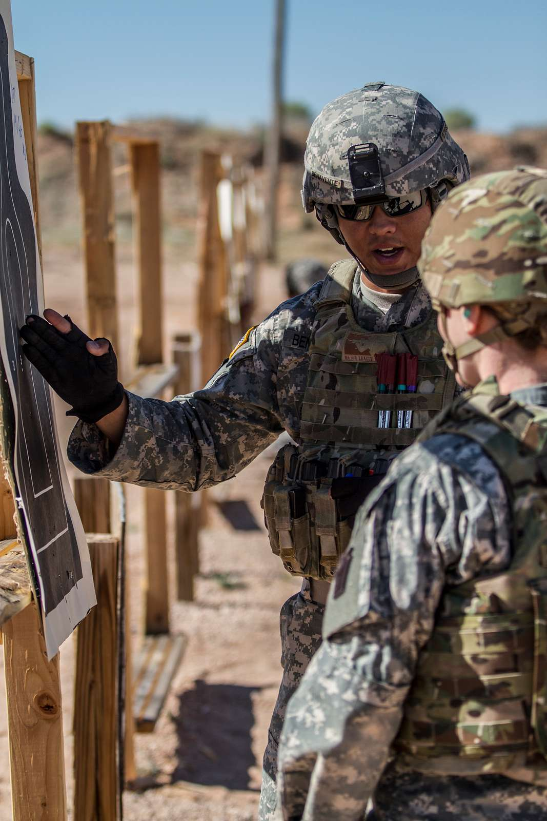
Overview
The U.S. Army is interested in using wearable sensors to collect Soldier training data.
This data creates a digital performance record to assist OC/Ts in squad evaluations.
The aim of this research is to explore how sensor data can combine with Observer Controller/Trainer (OC/T) observations and experience to make evaluations more efficient and actionable.

Slide 4
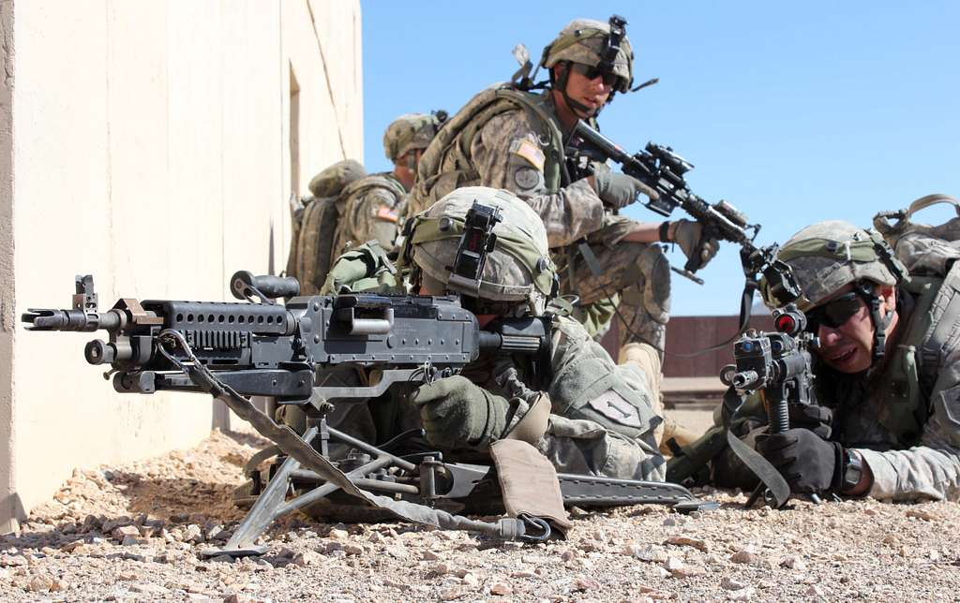
Small Unit Performance Analytics (SUPRA)
Data was collected from 18 dismounted infantry squads during the BD2A drill.
Sensors Used
  GPS Tracking: Monitors squad movement and positioning.
  IMU Sensors: Tracks weapon and helmet orientations.
  Audio Recordings: Captures squad communication.
  Physiological Data: Heart rate, stress levels, etc.

Slide 5
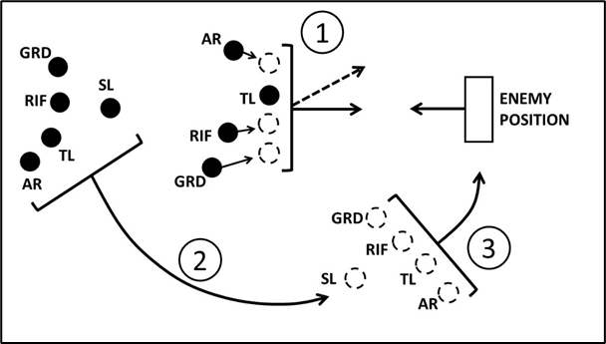
Battle Drill 2A: React to Contact
Alpha Team
-Immediately returns fire and assumes nearest covered position
-Calls out 3 Ds (Distance, Direction, Description)
Bravo Team
-Flanks the enemy
-Assaults through the objective
Alpha Team
-Calls “shift fire” and shifts fire away from the assault movement
-Calls “lift fire” once Bravo Team assaults through
Bravo Team
-Takes cover and concealment
-Prepares to flank depending on the objective

Slide 6
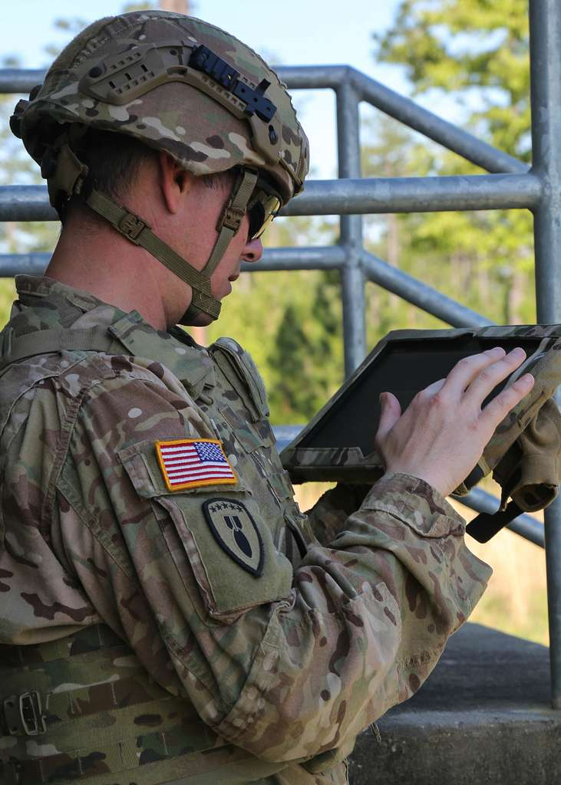
Challenges in Current Squad Evaluations
Traditional squad evaluations rely heavily on real-time OC/T observations, which can be subjective and prone to error. Sensor data can help with this.
Simply giving OC/Ts raw data isn't enough; it must be easy to understand and combine well with expert judgment to provide a full picture of Soldier performance.
Challenge: Integrate objective data into squad evaluations to help trainers give better feedback and make more accurate evaluations of performance

Slide 7

User-Centered Design (UCD)
Often, technological solutions are created without considering what the actual end user wants, how it fits in their day-to-day work, and if it is solving a problem they have.
UCD focuses on designing tools around the needs, preferences, and goals of the end user.
  Ensures tools are practical and aligned with end-user preferences.
  Creates intuitive, easy-to-use visualizations that fit into workflows.
  Provides relevant information to enhance assessments and reviews.

Slide 8


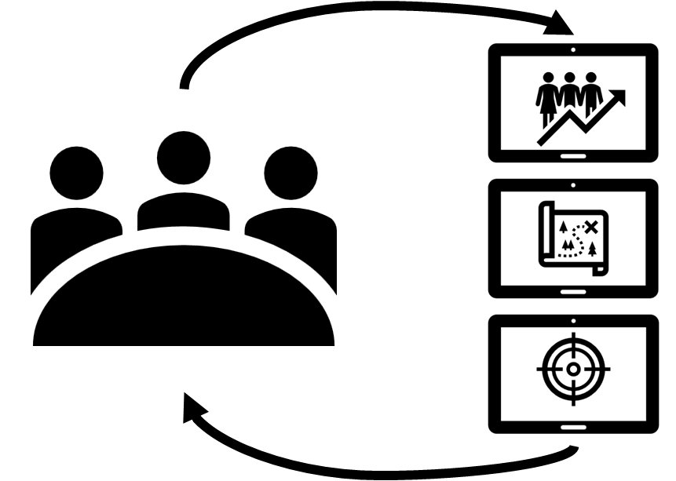
Methodology
Phase 1: OC/T Interviews
Phase 2: Feedback and Refinement
Data Visualization Mockups
Notes:
Research Objectives
Develop a data-informed approach to squad assessments using wearable sensor data
Talk with OC/Ts to better understand their needs
Create visualizations that aid OC/Ts in interpreting sensor data and accurately assessing squads, through a UCD approach

Slide 9
Phase 1: OC/T Interviews
We conducted interviews with 10 OC/Ts to gather insights on their evaluation needs
Participants were current and former OC/Ts stationed at JRTC at Fort Johnson, LA.
Questions focused on current evaluation methods, gaps in access to information, and potential data sources for improvement for each assessment detailed in training and evaluation outlines (T&EO) for BD2A.
Participants | MOS, Sample Size | Time as OC/T (Months) | Number of Battle Drills Evaluated
Sergeant 1st Class (SFC) | 11 Bravo, n = 5 19 Kilo, n = 1 12 Bravo, n=1 11 Charlie, n=1 | M = 22.3 (SD = 16.5) | M = 135.5 (SD = 166.4)
Staff Sergeant (SSG) | 11 Bravo, n = 2 | M = 21 (SD = 12.7) | M = 25 (SD = 21.2)

Slide 10
Phase 1: OC/T Interviews
What data or information would you like to have to aid evaluations and present to Soldiers during an AAR to discuss performance?
GPS Locations and Movement
N=10
Visualization Overlays
N=7
Shot Accuracy
N=9
Communications
N=7
Firing Rate
N=4
Target hit-and-miss data
Visualizations showing details of kills and deaths (who killed whom and when)
Sensors on the body to indicate where hits were taking place. It helps to know what portions were exposed and what was covered or concealed
Communications overlayed with rates of fire
Communications overlayed with GPS position and movement
Video of movements overlayed with firing rate
GPS locations and movements of Soldiers from MILES (i.e., dots moving on a map)
Timestamp trackers for GPS movement of individual Soldiers
Visualizations of their movement throughout the drill
Aerial shots would be helpful. Soldiers often don’t get to see the “big picture” and where the rest of the platoon and company is during a drill
Communication transcriptions of the entire squad
Squad Leader communications would be especially helpful
Timestamps for communication logs
Visualizations of firing rates
Shot counts
Ammo depletion counter
Rate of fire and ammo expenditure can help to evaluate the extent to which a squad was a “well-tuned orchestra”

Slide 11
Data Visualization Mockups
Based on the Phase 1 Thematic Analysis results, we created data visualization mockups.
Applied design principles familiar to Soldiers, drawn from industry standards and video games.
Created mockups in Microsoft PowerPoint.
Designed to drive feedback and discussion with OC/Ts in Phase 2 interviews.
Focused on:
  GPS Positioning
  Communication
  Firing Rate
  Shot Accuracy

Slide 12
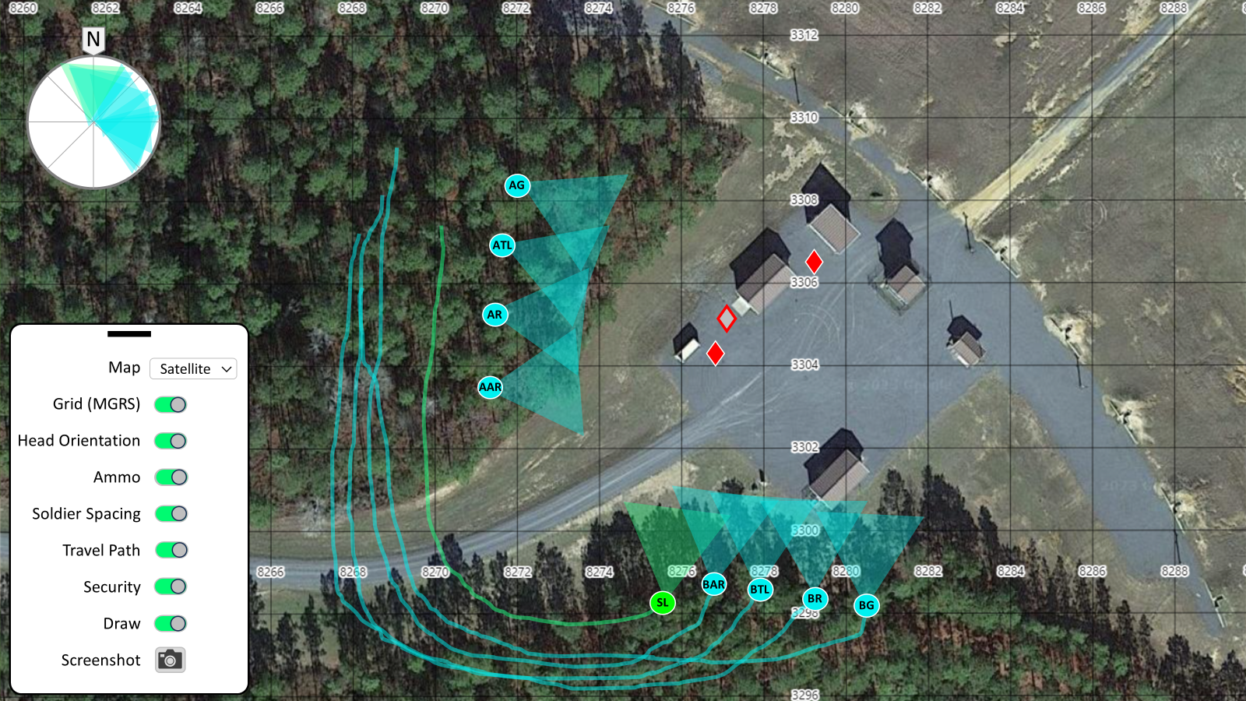
Data Visualization Mockups: GPS Positioning
5. Combined squad head orientation shows squad security level
5
3
3. Head orientation updates to show gaze directions
6. A menu allows the user to turn features on and off
6
4. Snail trail shows the history of squad members’ movements
2
1. Friendly Soldiers locations
2. OPFOR locations
1
4

Slide 13
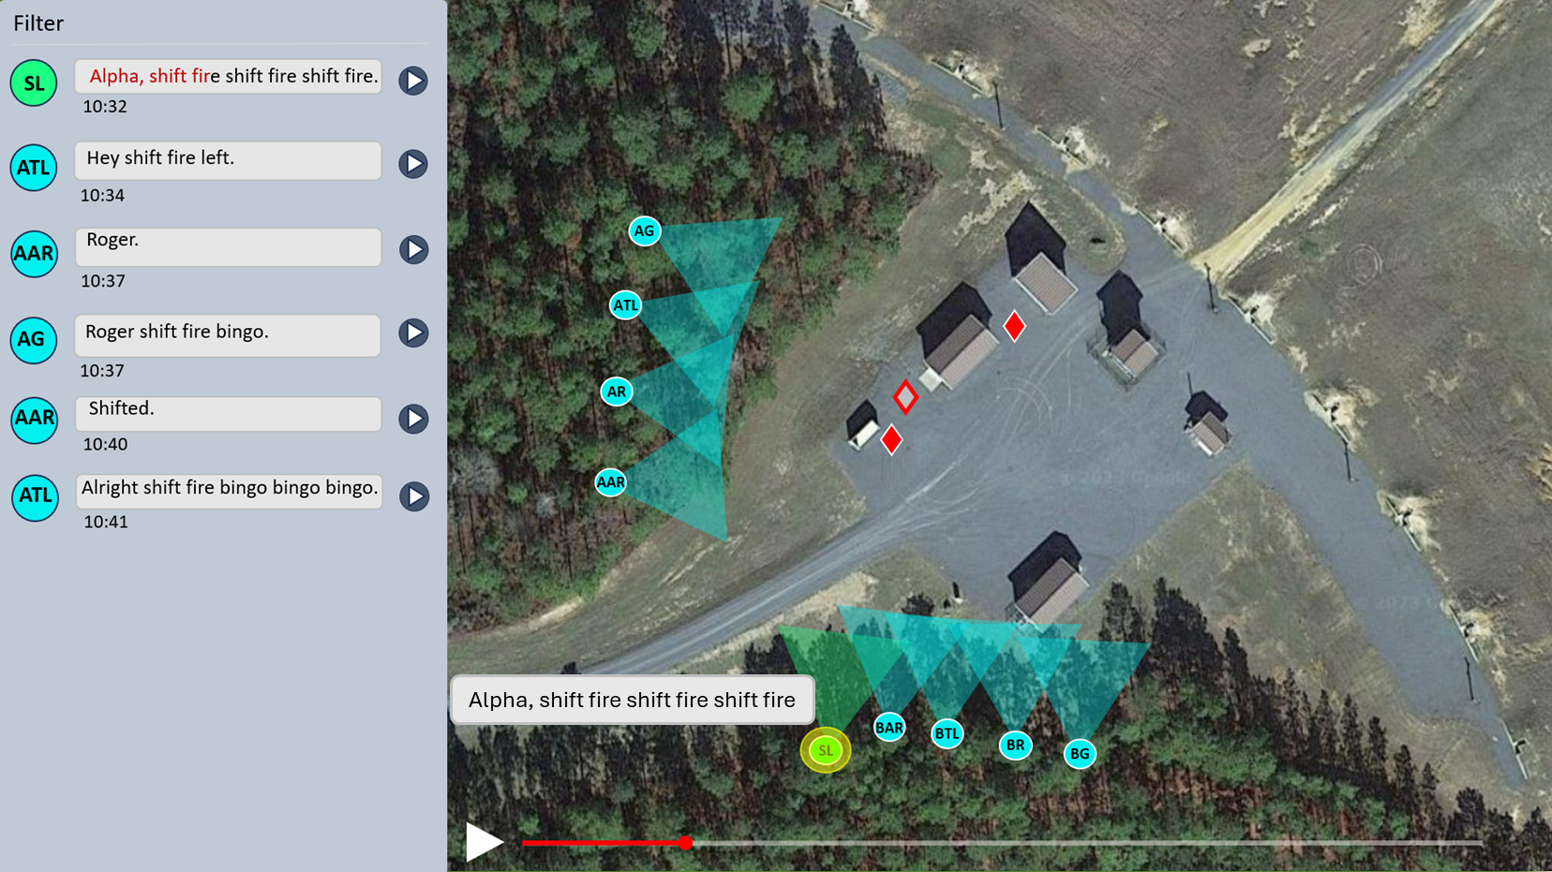



Data Visualization Mockups: Communication
1. Scrolling transcript on the left while the squad movement animation plays in the panel to the right
2. Audio recordings can be played back for the user to hear
3. Comms are highlighted on the left panel and appears briefly as a text bubble

Slide 14
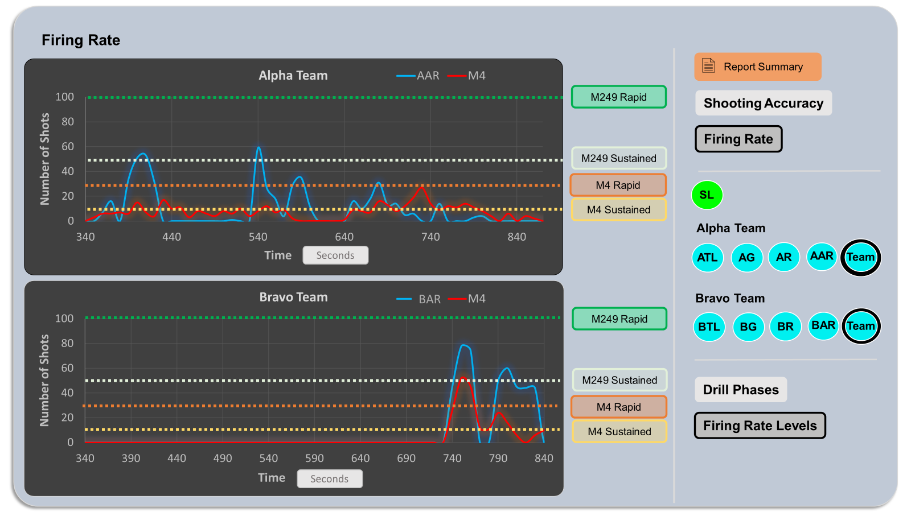
Data Visualization Mockups: Firing Rate
1. Firing rate graphs showing squad fire over time
2. Options to toggle different squad members and teams
3. Graph overlays showing firing rate thresholds

Slide 15
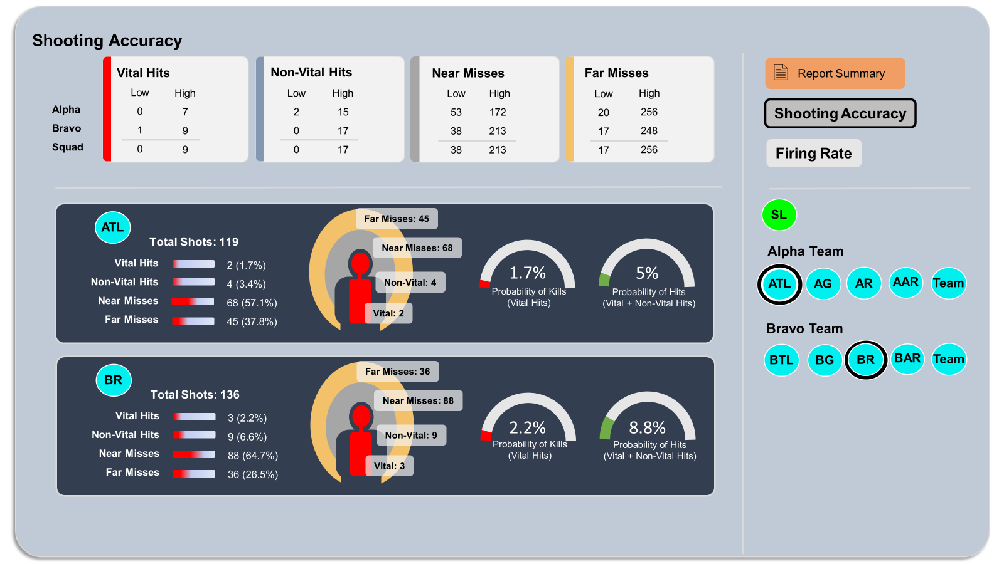
Data Visualization Mockups: Shot Accuracy
1. Various metrics of shot accuracy
3. Options to toggle different squad members and teams
2. Hits and kills probability metrics

Slide 16
Phase 2: Feedback and Refinement
We conducted interviews with 10 OC/Ts to gather insights on their evaluation needs
Similar to Phase 1, participants were current and former OC/Ts stationed at JRTC at Fort Johnson, LA with BD2A evaluation experience.
OC/Ts were asked to evaluate the mockups’ usefulness for squad performance evaluation and AAR feedback with squads and provide feedback on improvements.
Utility ratings were given on a four-point scale from Very Useful to Not Useful.
Participants | MOS, Sample Size | Time as OC/T (Months) | Number of Battle Drills Evaluated
Sergeant 1st Class (SFC) | 11 Bravo, n = 4 12 Bravo, n = 1 | M = 21.8 (SD = 19.2) | M = 340 (SD = 156)
Staff Sergeant (SSG) | 11 Bravo, n = 4 Delta Scout, n = 1 | M = 10 (SD = 6.7) | M = 28 (SD = 24)
Notes:
OC/Ts were asked not to consider the feasibility of implementing and fielding these capabilities.

Slide 17
Phase 2: Feedback and Refinement
GPS Positioning
Recommendations
Add a north arrow to provide a cardinal reference point
Show firing position (e.g., Prone, kneeling, sitting)
Head orientation showing elevation angle with short or long triangles that indicate where Soldiers are looking
Show paths in a different color than one already used on the maps (Blue may not be the best because it could be confused with rivers)
 | Very Useful | Moderately Useful | Somewhat Useful | Not Useful
Evaluation | 70% | 30% | 0% | 0%
AAR | 90% | 10% | 0% | 0%

Slide 18
Phase 2: Feedback and Refinement
Communication
Recommendations
Ability to track or mark arm and hand signals and other non-verbal communications (e.g., smoke)
Ability to turn on/off the comms audio but still have the full transcript available during playback and still highlight who is speaking on the BLUFOR icons
Expand to include communications from the PL up to higher echelons
 | Very Useful | Moderately Useful | Somewhat Useful | Not Useful
Evaluation | 80% | 10% | 10% | 0%
AAR | 90% | 10% | 0% | 0%

Slide 19
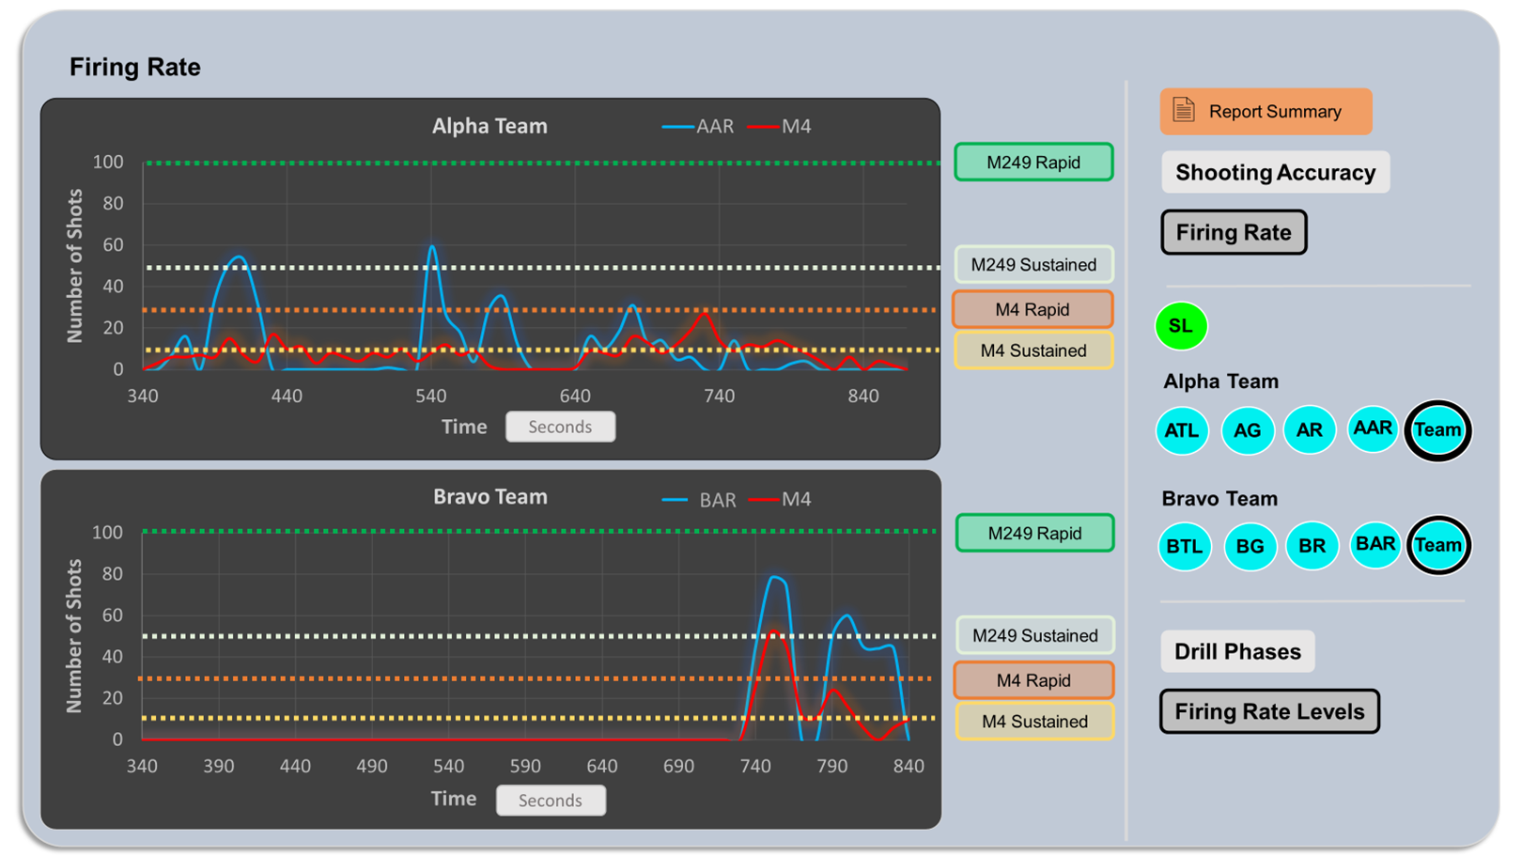
Phase 2: Feedback and Refinement
Firing Rate
Recommendations
Ability to have firing rate as an overlay window with the comms and maps visuals to see it all together
Ability to see firing commands from the team leaders on the firing graphs
Ability to see shooting accuracy at the same time, possibly add this as a drop-down under the shooting accuracy graphs
Add time scale marks for minutes even if seconds is chosen as the scale
Firing rates should look more like an EKG, not smoothed out
 | Very Useful | Moderately Useful | Somewhat Useful | Not Useful
Evaluation | 70% | 20% | 0% | 10%
AAR | 70% | 10% | 20% | 0%

Slide 20

Phase 2: Feedback and Refinement
Shot Accuracy
Recommendations
Ability to see shooting performance over time to show if Soldiers are benefiting from their training
Indicate the type of data captured (e.g., MILES, sim or live rounds); Possibly a way to filter and compare these different data types
Make sure metrics account for team members that are supposed to be providing suppressive fire since they will likely have no hits but lots of near misses
 | Very Useful | Moderately Useful | Somewhat Useful | Not Useful
Evaluation | 80% | 10% | 10% | 10%
AAR | 80% | 10% | 10% | 0%

Slide 21
Conclusions
This study demonstrates a process for developing a data-informed approach to enhance OC/T assessments.
By understanding the end-user’s perspective, we were able to design visualizations that address OC/Ts’ limitations in performance evaluations.
A user-centered design approach was key, as OC/T feedback was gathered to refine and improve the visualizations.
Takeaway
Prioritizing end-user needs allowed us to develop a framework for data-informed squad assessment, combining sensor data that fills the gaps of observation with expert judgment and experience to improve squad assessments.

Slide 22




Questions
Contact Information
Michael King, PhD
mking@quantumimprovements.net
407-770-5135
@TrainWithQIC

