Slide 1
B-52 Pilots in Focus: Human Factors in Virtual Reality Research
Dr. Lindsay Gouedy, Louisiana Tech University
Dr. Mary Fendley, Louisiana Tech University
Brandon “Steppen” Wolf, Lt Col, USAF
Effort sponsored by the Air Force under MOU FA6800-23-H-0001. The U.S. Government is authorized to reproduce and distribute copies for Governmental purposes notwithstanding any copyright or other restrictive legends. The views and conclusions contained herein are those of the authors and should not be interpreted as necessarily representing the official policies or endorsements, either expressed or implied, of the Air Force of the U.S. Government.
Notes:
Who introduces?

Slide 2
Objectives
Identify training inefficiencies in in-air refueling training using Applied Cognitive Task Analysis (ACTA) methodology and eye tracking technology.
Define potential improvements to maximize the desired outcome of available advanced learning tools.
Notes:
Looking at conventional training what is being successfully applied VR/eye tracking allowed us to analyze visual cues to the visual references.
Steppen

Slide 3
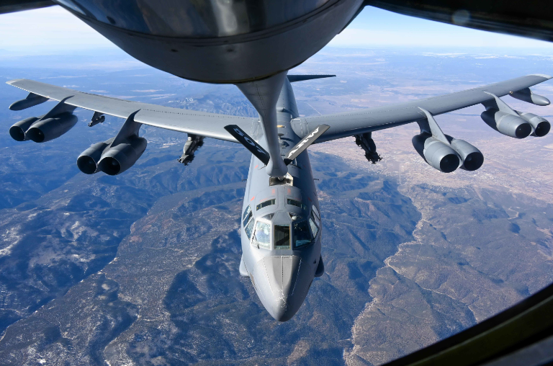
B-52 Pilots in Focus
Air Refueling (AR) a “BUFF”
ACTA
Background
Research Questions
Recommendations
Notes:
Lindsay - Overview

Slide 4
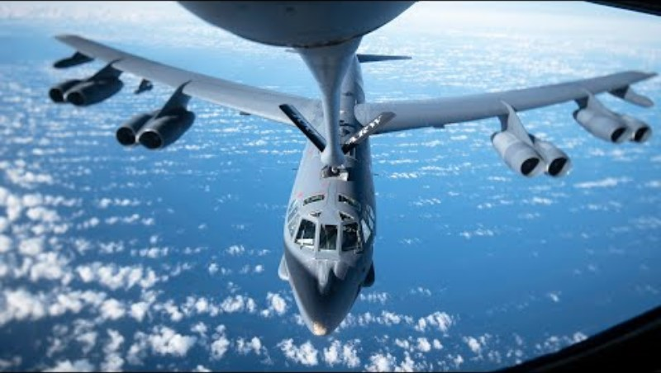
Air Refueling a BUFF
(Military Archive, 2019)
Notes:
Steppen

Slide 5
Applied Cognitive Task Analysis
ACTA Method
Task Diagram
Knowledge Audit
Simulation Interview
Cognitive Demands Table
(Militello et al., 1997)
Notes:
Lindsay
Toolkit of interview methods to analyze the cognitive demands of the task.
Way to elicit and represent cognitive task performance
Informs recommendations for system and, in this case, training design

Slide 6
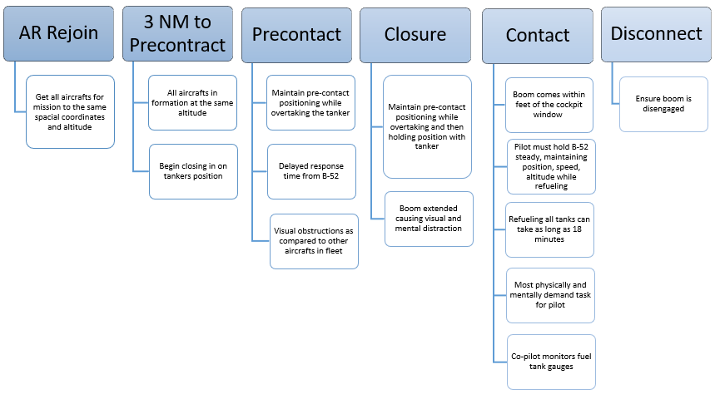
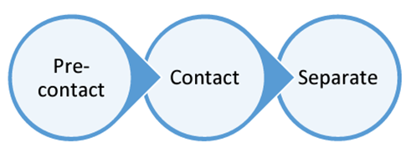
ACTA: Task Diagram
Notes:
Lindsay
What defines the successful completion of the task?
As a non-pilot breakdown the muscle memory from the experts and understand each move

Slide 7
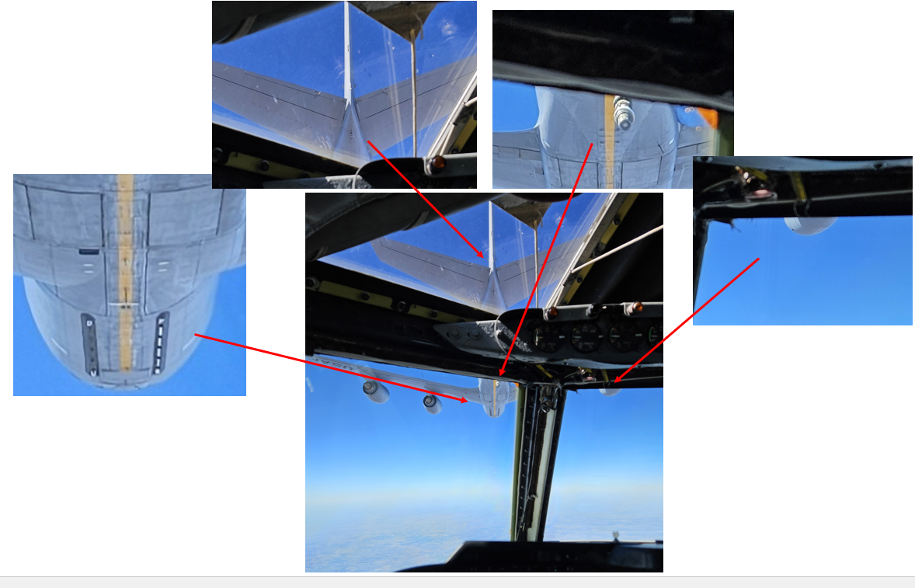
Air Refueling Precontact
Notes:
Steppen
POINT OUT Antinna and White Line (AOI 1)… key visual reference
What makes AR challenging. Look to the middle image and the visual references are the only cues that a pilot has to make contact.
The B-52 should be positioned strategically beneath and underneath the tanker to in order to make contact.
How we do that is placing visual cues in specific locations with our window view.

Slide 8
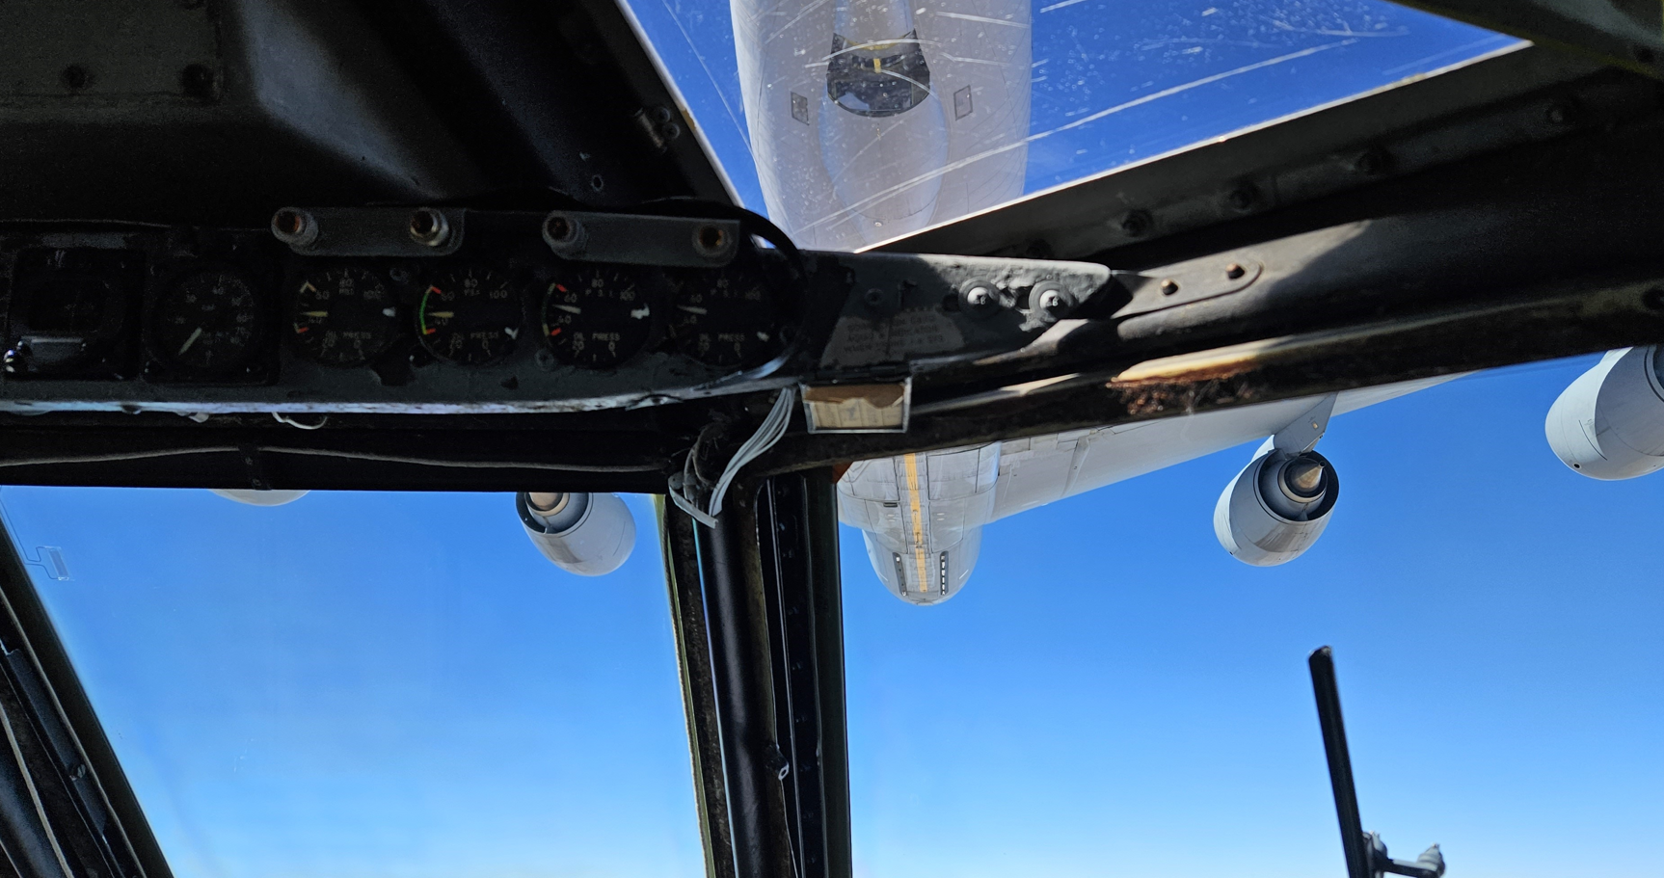
Air Refueling Contact
Successful Contact Viewpoint from within the B-52
Notes:
Steppen
BOOM OPERATOR In the top WINDOW (AOI 2)… Key reference
Challenging to see references
The visual

Slide 9
B-52 Applied Cognitive Task Analysis (ACTA)
B-52 Pilot In-Air Refueling – Cognitive Demands Table
Difficult Cognitive Element | Why Difficult? | Common Errors | Cues and Strategies Used
Getting distracted by the boom's proximity | The pilot's focus should be on the 3D visual reference points, however, the boom's proximity to the window of the cockpit comes unnervingly close. For the novice can become distracting and cause mental distraction | Losing focus of the 3D visual reference points | Maintain visuals of 3D reference points
Mirrored cockpit controls | The gauges/controls in the B52 are mirrored from pilot to copilot which is a departure from any other aircraft in the U.S. Air Force fleet. | Forgetting the placement of gauges/controls in B52 | Awareness and memory
Length of time for refueling | The B52 can take up to 18 minutes to refuel. Maintaining a stable contact position while the boom is engaged is both physically and mentally challenging for a pilot. | Not self-monitoring physical/mental status | Personal awareness (self-monitoring) of cognitive load, disengage the boom physical/mental focus lags
Maintain steadiness of aged and cumbersome aircraft | The aircraft's size, unique aerodynamics and flight controls result in a delayed reaction to the pilot(s) commands. | Overcorrecting movements when the aircraft is simply slower to respond to the original desired in air placement | Maintain 3D visual references
Maintaining Situational Awareness | Continuous monitoring is required, very few outside references and many cues are difficult to see (not salient) | Experiencing tunnel vision, missing a cue due to unreliability or difficulty distinguishing it. | Keep gaze moving to monitor all relationships between cues
Notes:
Steppen
The final portion of the ACTA was the cognitive demands table, which provided a method that would consolidate the data gathered to provide meaningful input into our training recommendations.

Slide 10
Research Questions
Do pilots follow the prescribed cognitive strategies?
How long does it take for the pilot to fixate on each of the defined Areas of Interest (AOIs)?
Is there a difference in gaze behavior during contact and disconnect?
Notes:
Lindsay
Key aspect of the task revolved around the visual references, informed by the ACTA. This developed our questions to better understand what visual behavior is happening beyond

Slide 11
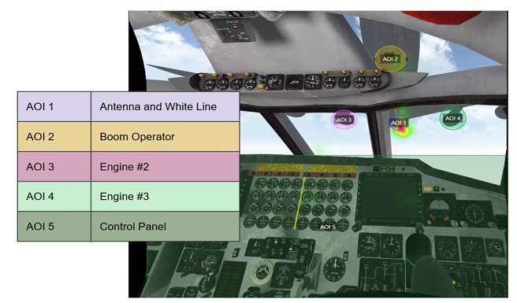
Do pilot follow the prescribed cognitive strategies?
Using embedded eye tracking technology in the headset we identified five Areas of Interest (AOIs)
For each pilot, we generated a heat map of their gaze during the entire flight. We used those individual gaze maps to generate aggregate heat maps of the instructors as well as the students.
Notes:
Lindsay
5 Areas of Interest were identified using the ACTA and conventional training platforms. AOI 1 and 2 are

Slide 12
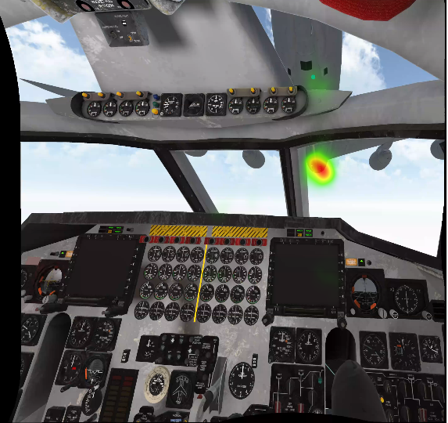
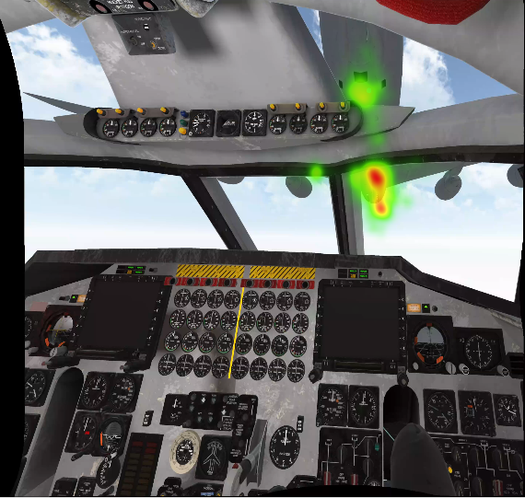
Do pilot follow the prescribed cognitive strategies?
The images show a clear visual distinction from where the instructor pilot’s focal emphasis is throughout the flight versus that of the students.
The heat map is arguably one of the best indications, in the imagery collected, as it shows the highest area of focal concentration as the color progresses from green to red, red being the most concentrated.
Aggregate Heat Map of Instructors
Aggregate Heat Map of Students
Notes:
Lindsay
Using the VR with embedded eye tracking, we compared visual focus of instructors vs that of students

Slide 13
How long does it take for the pilot to fixate on each of the defined AOIs?
To answer this we looked at the ‘time to first fixation’.
The instructors looked at the antenna and white line one second into the flight, while it took the students roughly twenty seconds to look at the same AOI.
These data points can be used to inform where the pilots are focusing, and when. This also allows us to see what level of importance the pilots of different experience levels attribute to the AOIs.
AOI | Instructor | Student | Difference
Antenna/ White Line | 1.04 | 20.7 | -19.66
Boom Operator | 21.2 | 13.2 | 8
Engine #2 | 65.7 | 58.8 | 6.9
Engine #3 | 367.9 | 84 | 283.9
Control Panel | 262 | 306.9 | -44.9
Notes:
Lindsay
Students emphasis was on other references where the Instructors went their first and spent more time there.
Quickness of instructor attention to antenna/white line as compared to the student

Slide 14
Is there a difference in gaze behavior during contact and disconnect?
This analysis further informed that the antenna and white line was the most valued AOI by both instructors and students at connect and disconnect.
It is also relevant to note the continued evidence that the students value the boom operator reference point more than the instructors do, based on the statistical gaze data.
Pilot # | Participant Level | Total Connection Time
2 | Instructor | 11:09.0
3 | Instructor | 11:27.0
4 | Instructor | 01:22.3
10 | Instructor | 13:09.1
11 | Instructor | 05:31.1
5 | Student | 10:32.4
6 | Student | 03:36.0
7 | Student | 11:46.8
8 | Student | 00:56.7
9 | Student | 09:05.4
 |  | Antenna & White Line | Boom Operator | Control Panel | Engines #2 and #3
Instructor | Connects | 80% | 16% | 3% | 1%
 | Disconnects | 92% | 8% | 0% | 0%
Student | Connects | 79% | 21% | 0% | 0%
 | Disconnects | 83% | 15% | 0% | 2%
Notes:
Lindsay

Slide 15
Recommendations: Training Needs
ACTA: Difficult Cognitive Elements | Challenge | Training Need
Getting distracted by the boom’s proximity | Maintaining focus on visual reference points | Train sequence of monitoring visual references, understanding visual illusions, Overcoming tunnel vision
Mirrored cockpit controls | Control placement confusion | Train in both left and right seat
Length of time for refueling | Physical/mental challenge over the duration of refueling | Incorporate physical aspects, if possible, lengthy training sessions, proper positioning, and movement
Maintain steadiness of aged and cumbersome aircraft | Determine corrections and movement needed | Practice for instinctive response
Maintaining situational awareness | Periods of high cognitive demand | Vary starting points of training scenarios, error recovery training
Notes:
Steppen

Slide 16
Recommendations
Feedback is an important element identified as critical throughout the entire training process. The key is determining when and how the feedback is most beneficial (Wisniewski et al., 2020).
The implementation of a strong learning model that bridges the gap between conventional training syllabi requirements and modern technology is critical to realizing the highest benefits of enhanced training technology (VanMerriënboer, 2019) .
Feedback is an important element identified as critical throughout the entire training process. The key is determining when and how the feedback is most beneficial (Wisniewski et al., 2020).
Using gaze overlays as a form of feedback allows the students to critically compare their own mental models and cognitive strategies with those of the instructors.
Training the instructor on how to use and implement the scenarios in the VR simulator to support scaffolding will aid in training transfer
Notes:
Steppen
This slide was our bridge recommendation from Part 1 of our research into Part 2 which is testing the success of the use of VR.
Learning Strategies
Inform and Improve the training process based on what information was gathered using the ACTA and eye tracking to test the gaze behavior.

Slide 17
Questions?

