Slide 1

INSPECT:
Understanding Trainee Cognitive Processes in ATC Training
Thomas Bellucci, MSc.
Royal Netherlands Aerospace Centre (NLR)
Co-authors: Emmy Gabriel, Petra ten Hove, Maykel van Miltenburg, Steven Niedenzu, Daniela Pistone, Thimo Willems

Slide 2
Agenda
Background: Air Traffic Control (ATC)
Role of Cognitive Processes in ATC Training
INSPECT: Instructor Support for Performance-based Training
Observations and Challenges
Recap

Slide 3
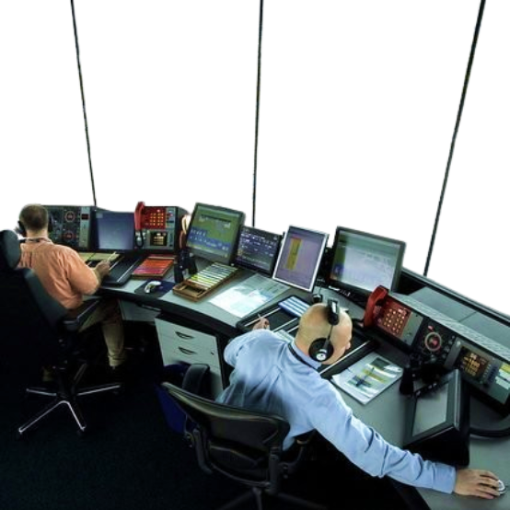
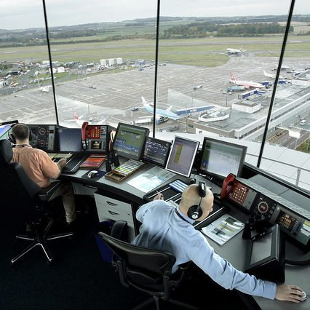
Motivation
Air Traffic Control (ATC) is an essential component of the global air transportation system.
Responsible for maintaining safety and efficiency of air travel throughout one’s national airspace.
Ensure safe separation of aircraft
Issue clearances for departure and landing
Around the clock, ATC centres monitor the airspace to guide air traffic and prevent accidents.
Notes:
Inkorten
Upwards of 3 years

Slide 4
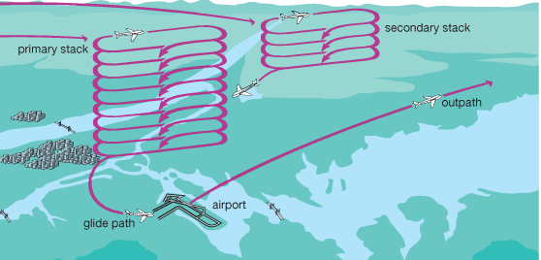
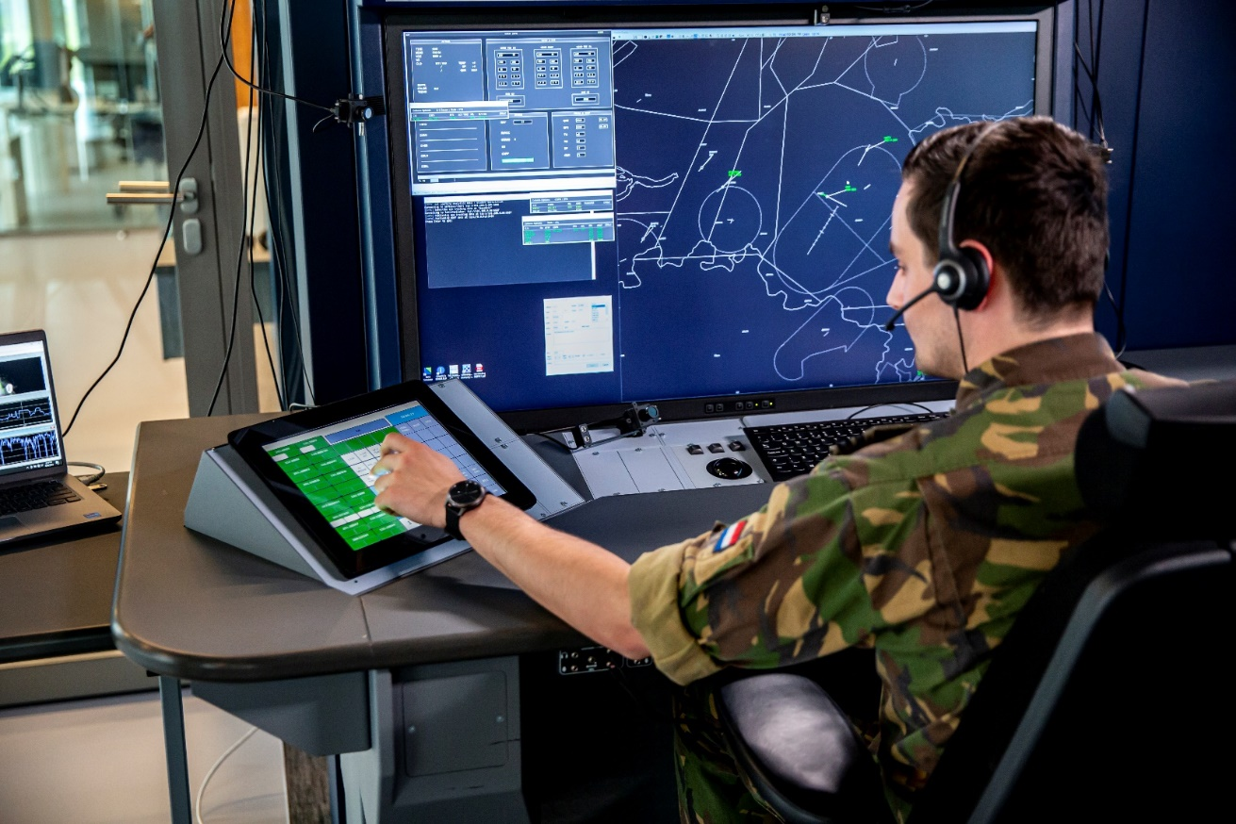
Background – Air Traffic Approach Control
Approach Control (APP) is responsible for guiding arriving (en-route) aircraft to their final approach at a specific airport.
Responsibilities:
Vectoring aircraft by issuing instructions to pilots
Sequencing of approaching aircraft within the Terminal Manouvering Area (TMA)
Systems:
Radar display
Radio communication
TMA
CTR
Source: Encyclopedia Britannica, 2009 (adapted)
Source: Royal NLR, 2024
Notes:
Although it is ommonly believes that ATC is a single profession, multiple roles exist. One such role is Approach Control.
These controllers have many of the same responsibilities as other controllers, namely to separate aircraft and maintain a steady flow of traffic. However, they have additional tasks that make their job more difficult:
Sequencing: Managing the safe and efficient arrival of aircraft, avoiding collisions and minimizing delays.
Vectoring: Assigning specific headings to adjust aircraft paths, increasing controller workload and frequency occupancy.
Holding Stacks: Managing multiple aircraft at different levels, using stacks to accommodate excess demand.

Slide 5
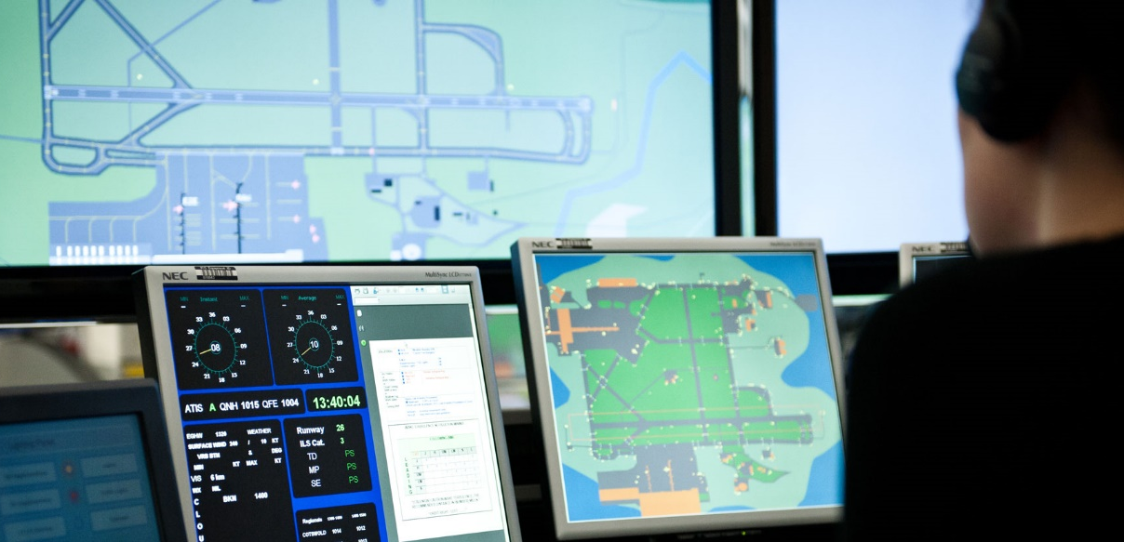
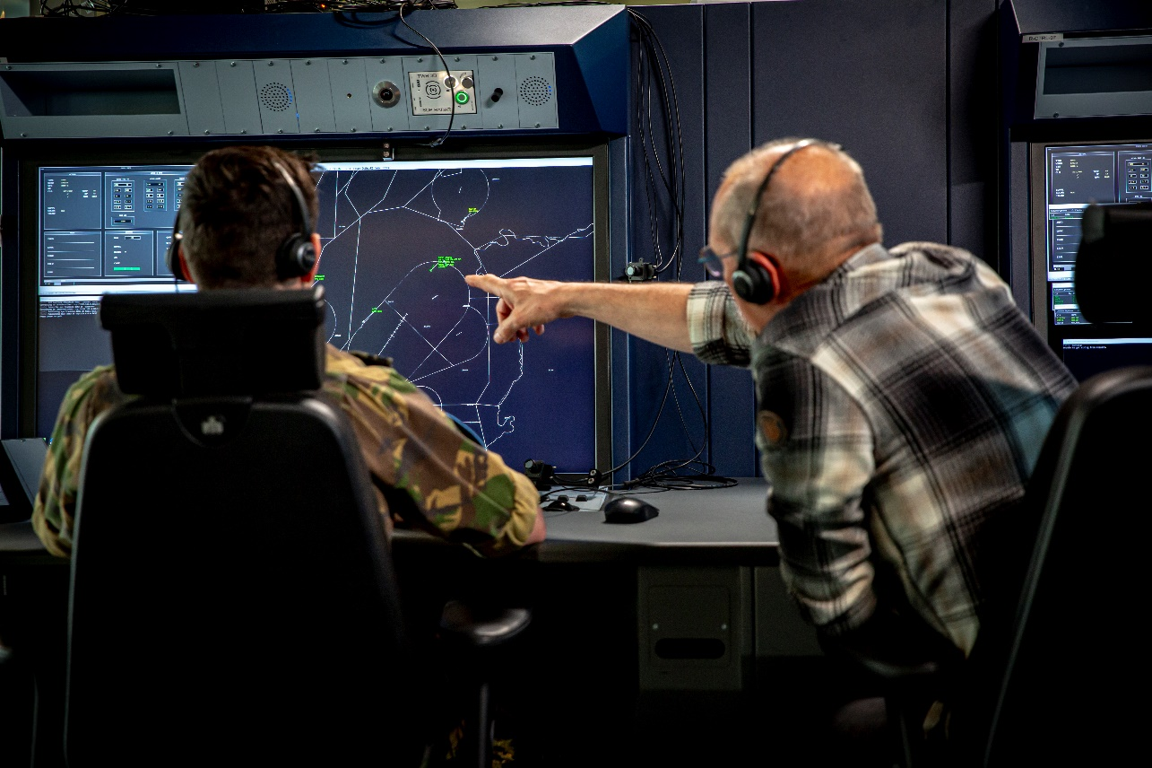
Background – APP Training
Basic training
Classroom instruction on foundational ATC concepts, regulations and procedures
Introduction to systems and equipment
Rating training
Specialized training in a specific ATC rating (i.e. approach control)
Simulation training in a mock ATC environment
Emphasis on the development of skills in handling complex and dynamic situations

Slide 6
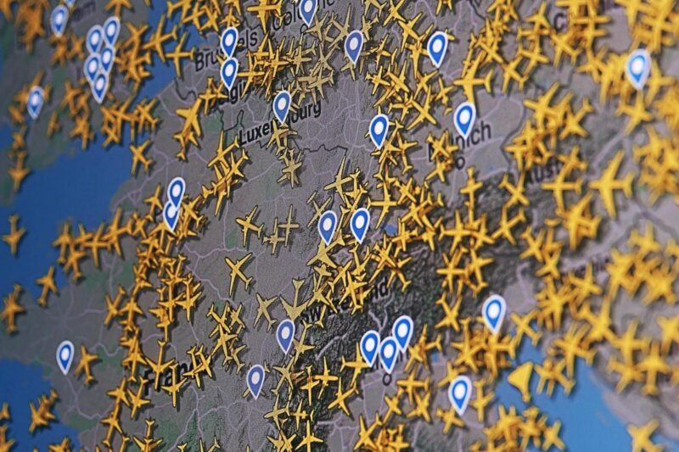
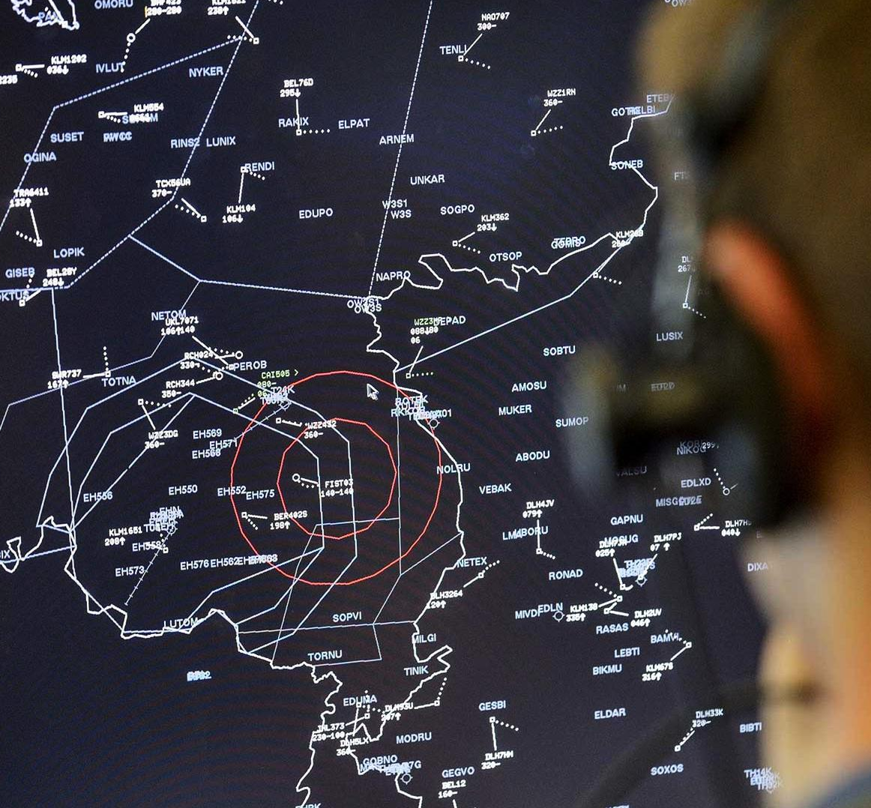





Cognitive Processes in ATC Training
TMA
Attention & Workload Management
Ability to effectively allocate time and attention to optimize efficiency and minimize stress.
Situational Assessment
Perception of information and anticipation of arriving aircraft.
Problem Solving & Decision-Making
Plan development and conflict resolution
Notes:
This point is what makes ATC challenging. There may be many situations that strain the controller.

Slide 7
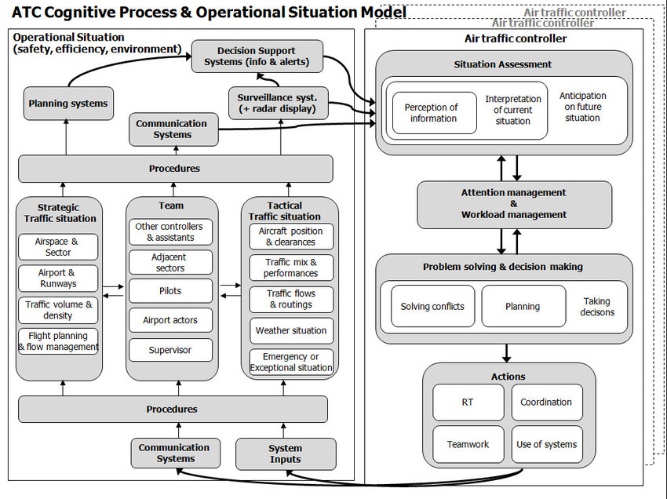
ATC Cognitive Process & Operational Situation Model
Identifying and
assessing changes in
information and
situation
Ability of the ATCO to
effectively direct his/her
attention and manage high
workloads effectively
Ability to make
effective decisions
in a timely manner to
prevent conflicts
Source: Schuver-van Blanken et al. (2010) [2]

Slide 8
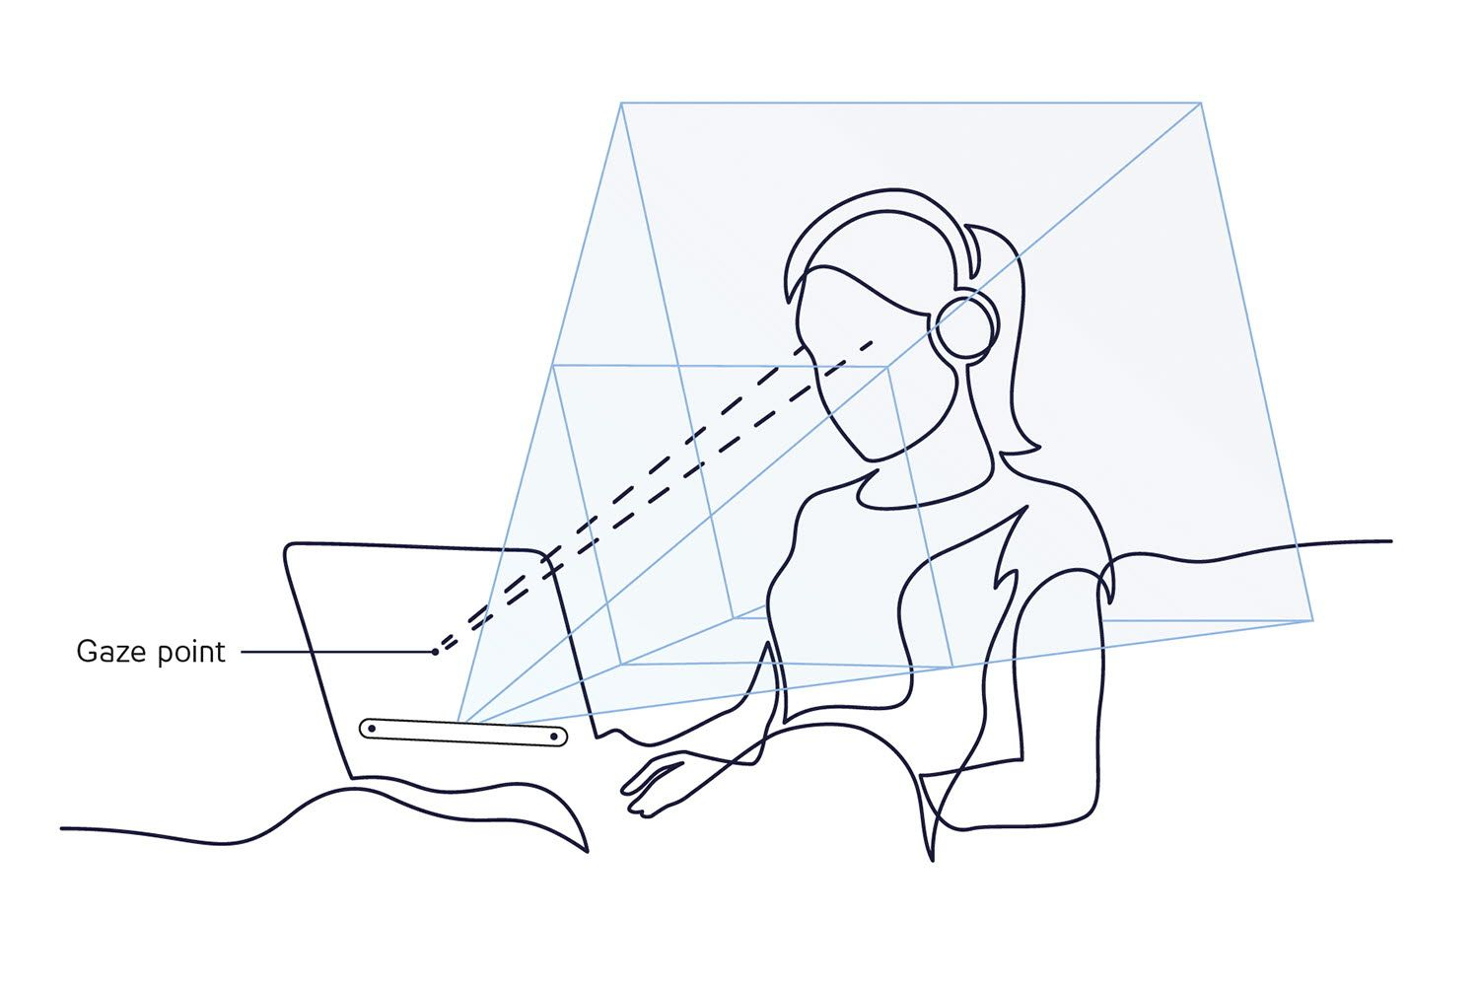
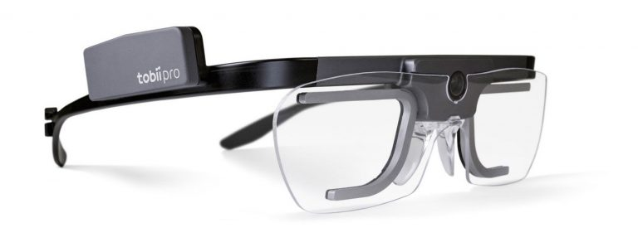
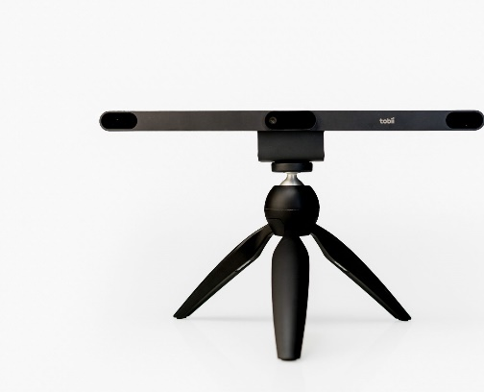
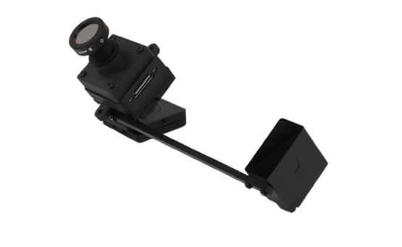
Eye Tracking
Eye-tracker are specialized hardware to track a subject’s eye movements / gaze as they perform a task.
Versatile: provide a range of measurements:
Eye gaze
Pupil dilation (size)
Fixation durations
“Potential to provide real-time insights into aspects of attention and information processing that are difficult to quantify, observe, and assess, otherwise.”
Notes:
One of the ways, one could go about exposing of the aforementioned processes is through eye tracking.

Slide 9
Research Question(s)
RQ: Can data analytics on physiological measurements derived from eye tracking be used to support ATC instructors in gaining insight into the cognitive process of their trainees?
Subquestions
Measurements: What information can be gathered during a training session?
Algorithms: How can the ACoPOS model be formalized into objective metrics, in order to transform raw data into actionable insights?
Visualization: How to provide the right analytics during- and post-training (debrief)?

Slide 10




INSPECT
Instructor Support for Performance-based Training
A technology demonstrator designed to help ATC instructors gain insight into trainees' cognitive processes during- and post-training
Objective performance metrics based on ACoPOS model
Generated unobtrusively with eye-tracking
ATC Training Simulator
Analytics Dashboard
Instructor Live Tool
Eye-tracker
Instructor
TID Panel
Eye Gaze
Training session
Debrief (post-training)
Notes:
In order to research these questions, we developed INSPECT

Slide 11
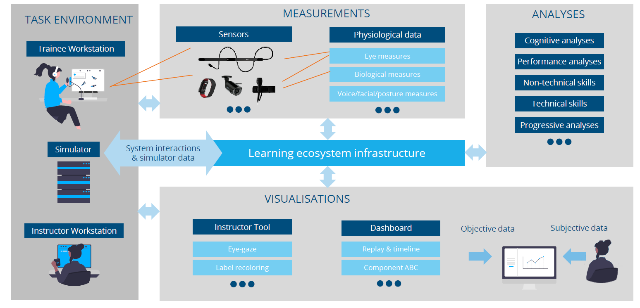

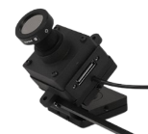
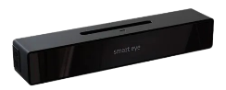
Overview
TASK ENVIRONMENT
MEASUREMENTS
ANALYSES
Trainee Workstation
Devices
Data Streams
Perception
Anticipation
Eye Measurements
Workload
Radio Communication (PTT)
RT Transcription
Scanning Patterns
ATC Simulator
System Interactions
& Logs
LEARNING ECOSYSTEM INFRASTRUCTURE
Conflict Resolution
VISUALIZATIONS
Instructor Workstation
Live Instructor Tool
Dashboard
Eye Gaze
Replay & Timeline
Label Recoloring
Analyses

Slide 12
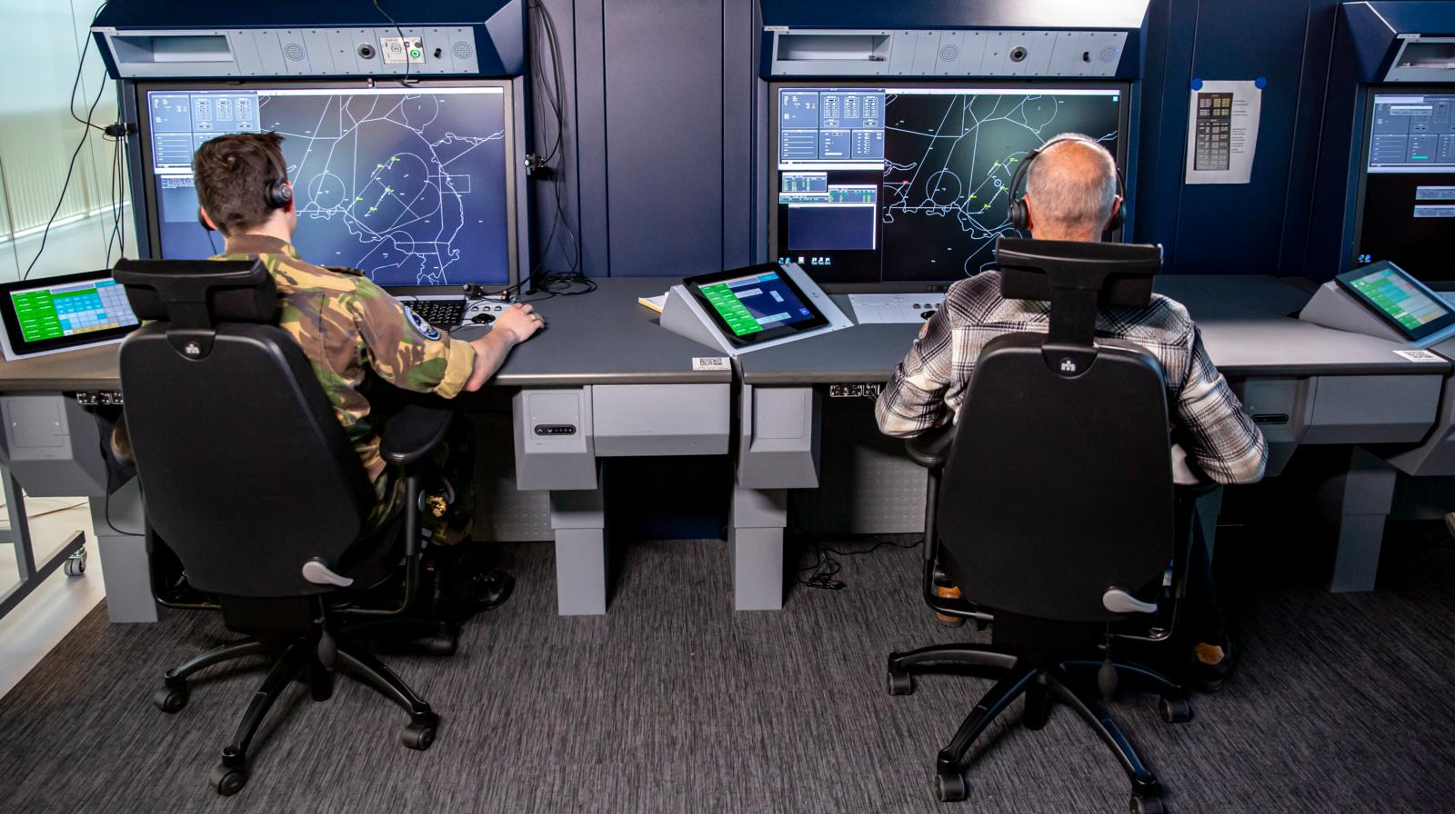
Task Environment
TASK ENVIRONMENT
Student position with
eye tracker (display-mounted)
Instructor station with INSPECT software
Trainee Workstation
ATC Simulator
Instructor Workstation
Where: Military Air Traffic (Approach) Control Room

Slide 13
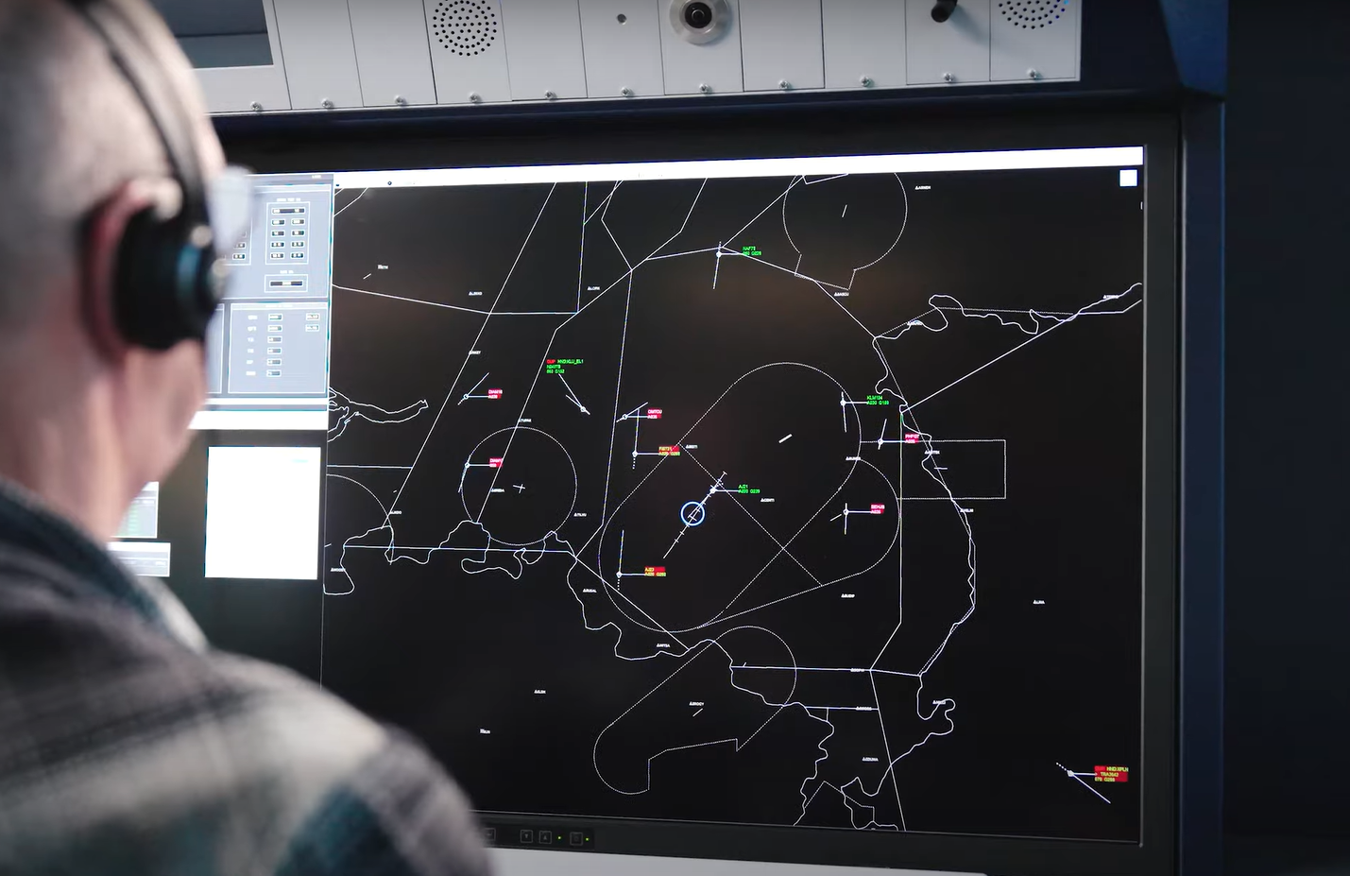
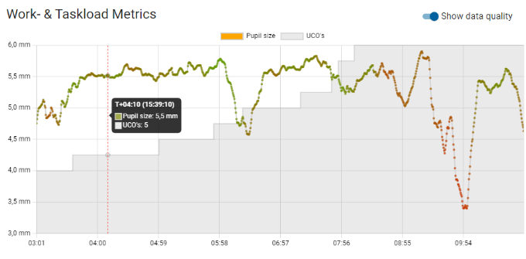
Visualization Concepts
VISUALIZATIONS
Live
Debrief
Eye Gaze
Timeline
Label Recoloring
Analysis Results

Slide 14
Live Instructor View
Eye gaze
Label recoloring

Slide 15
Debrief Application
Opportunity to provide deeper analyses of session during debrief
Data analysis pipeline
Relates eye tracking data to information presented on screen
Derives a range of metrics covering three ACoPOS competencies
User Interface
Presents results of analyses to instructor and trainee

Slide 16


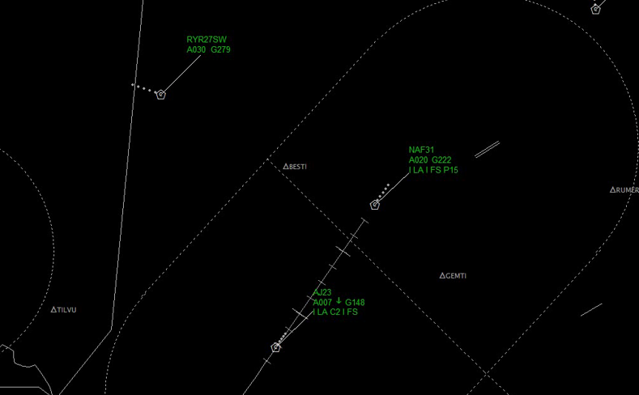
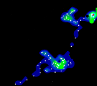
Debrief: Situational Assessment
Perception of Information:
Quantifying the degree of perception as the
percentage of flights observed in the last X sec.
Anticipation:
Reaction time of trainee measuring the time
between an aircraft entering the radar screen
and it being observed for the first time.
Anticipation

Slide 17

Debrief: Workload Management
But how to measure workload objectively with eye tracking...?
Conventional methods:
Questionnaires: Highly subjective
fNIRs / EEG: Obtrusive [3]
Alternative:
Pupillary dilation
Pupil size known to increase as a function of workload [4, 5]
(when other environmental conditions, such as illumination, remain constant)
Low workload
High workload

Slide 18
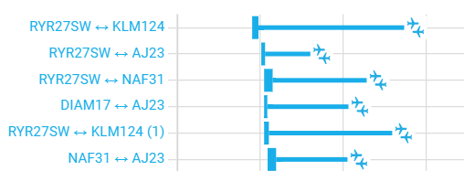
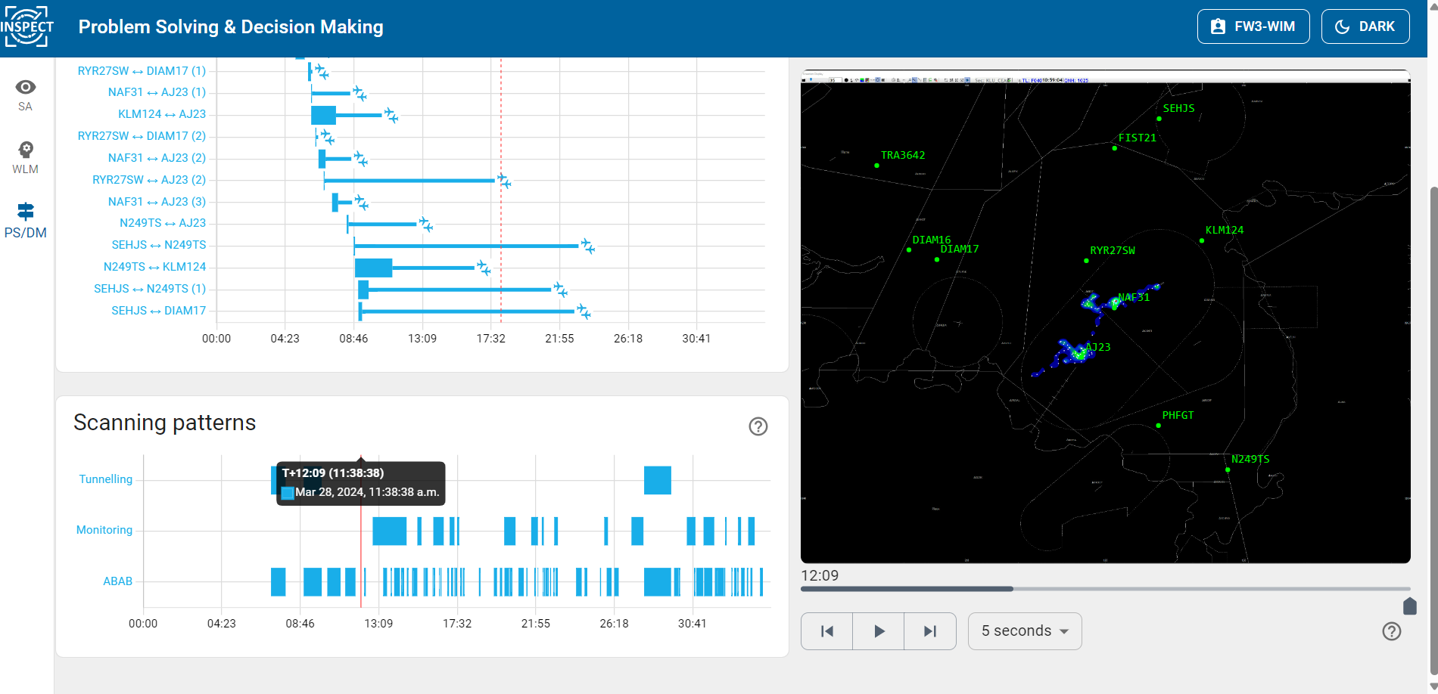
Debrief: Problem Solving and Decision-Making
Scanning behavior indicative of problem solving phase [7]
Conflict Resolution: A conflict detection system is
used to forecast when a conflict is expected to occur
between two aircraft and when the controller took
corrective action to resolve it.
Categorization of Scanning Patterns:
Categorizes intervals of consecutive dwells on
flights as belonging to one of four categories:

Slide 19
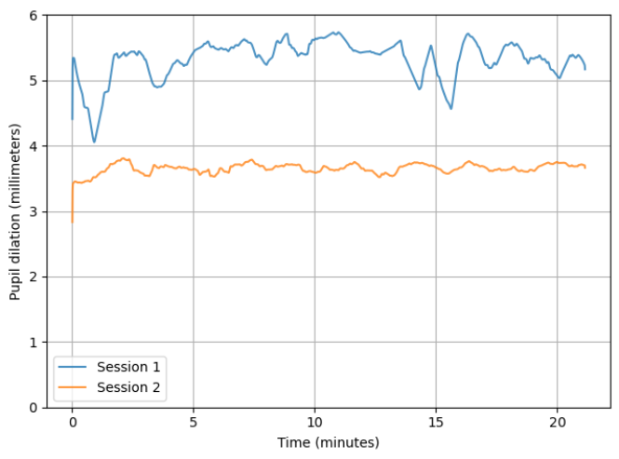
Early Observations
Session 1 Beginning trainee <3 months experience
Session 2 Senior instructor >10 years experience
Fig. 1: Situational Assessment: Aircraft perception over time (proportion of aircraft observed in last 30 sec.)
Fig. 2: Workload Management: Pupil dilation over time

Slide 20
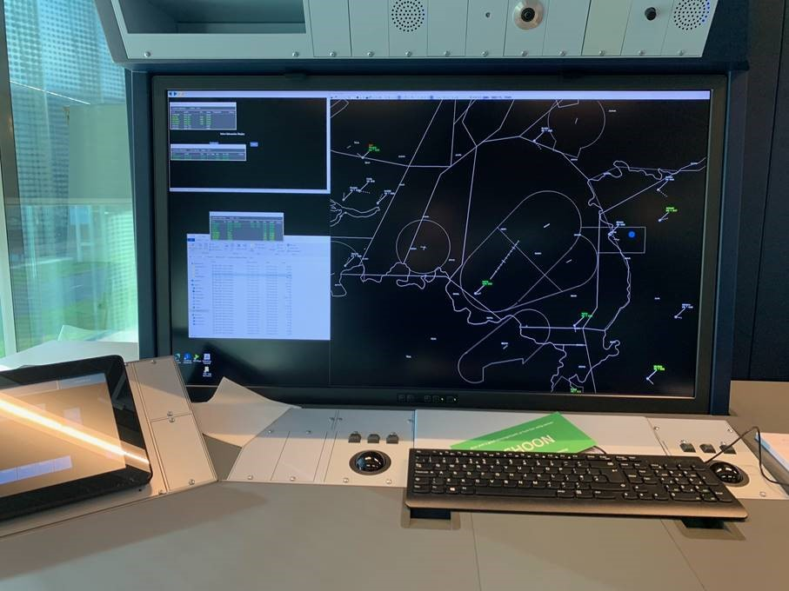
Challenges and Limitations
Reliability and precision of display-mounted eye trackers:
Limiting resolution (impossible to discern aircraft label content).
Fragile calibration process
Limited screen coverage
40”
Notes:
Wouldn’t be a demonstrator if there weren’t also limitations

Slide 21
Challenges and Limitations
Reliability and precision of display-mounted eye trackers:
Limiting resolution (impossible to discern aircraft label content).
Fragile calibration process
Limited screen coverage
Workload measurement through pupil dilation sensitive to changes in illumination and not stable between sessions
Longitudinal user study to assess the efficacy of the software within a live training setting
Notes:
Wouldn’t be a demonstrator if there weren’t also limitations

Slide 22
What Next?
Validation study to validate derived metrics across training sessions of multiple trainees.
Increasing sensitivity of workload and stress assessment through Index of Pupillary Activity (IPA) [6].
Integration of INSPECT inside tower operations simulator.

Slide 23
Recap
ATC is a demanding profession where cognitive processes, such as workload management and situational awareness, are essential.
INSPECT is a technology demonstrator designed to support instructors in coaching these non-technical, cognitive skills.
Our software uses objective metrics derived from eye tracking to assess three major non-technical competencies: situational assessment (SA), workload management (WLM) and decision-making (PS&DM).
Analytics obtained by relating the trainee’s eye gaze to the information on screen shows to provide a glimpse into the cognitive processes of the trainee.

Slide 24
Thank You

Slide 25
References
[1] “The Most Stressful Job In The World? What it’s Really Like To Be An Air Traffic Controller”, Michele Robson, Forbes (2021).
[2] “The ATC Cognitive Process and Operational Situation Model - A model for analysing cognitive complexity in ATC”, Schuver-van Blanken (2010).
[3] “Measuring Mental Workload Variations in Office Work Tasks using fNIRS”, Midha et al. (2021).
[4] “Task difficulty and physiological measures of mental workload in air traffic control: a scoping review”, Pagnotta et al (2021).
[5] “Review of eye-related measures of drivers’ mental workload”, Marquart et al. (2015).
[6] “The Index of Pupillary Activity.”, Duchowski et al. (2018).
[7] “Extraction of CD&R Work Phases from Eye-Tracking and Simulator Logs: A Topic Modelling Approach”, Nordman et al (2023).

Slide 26
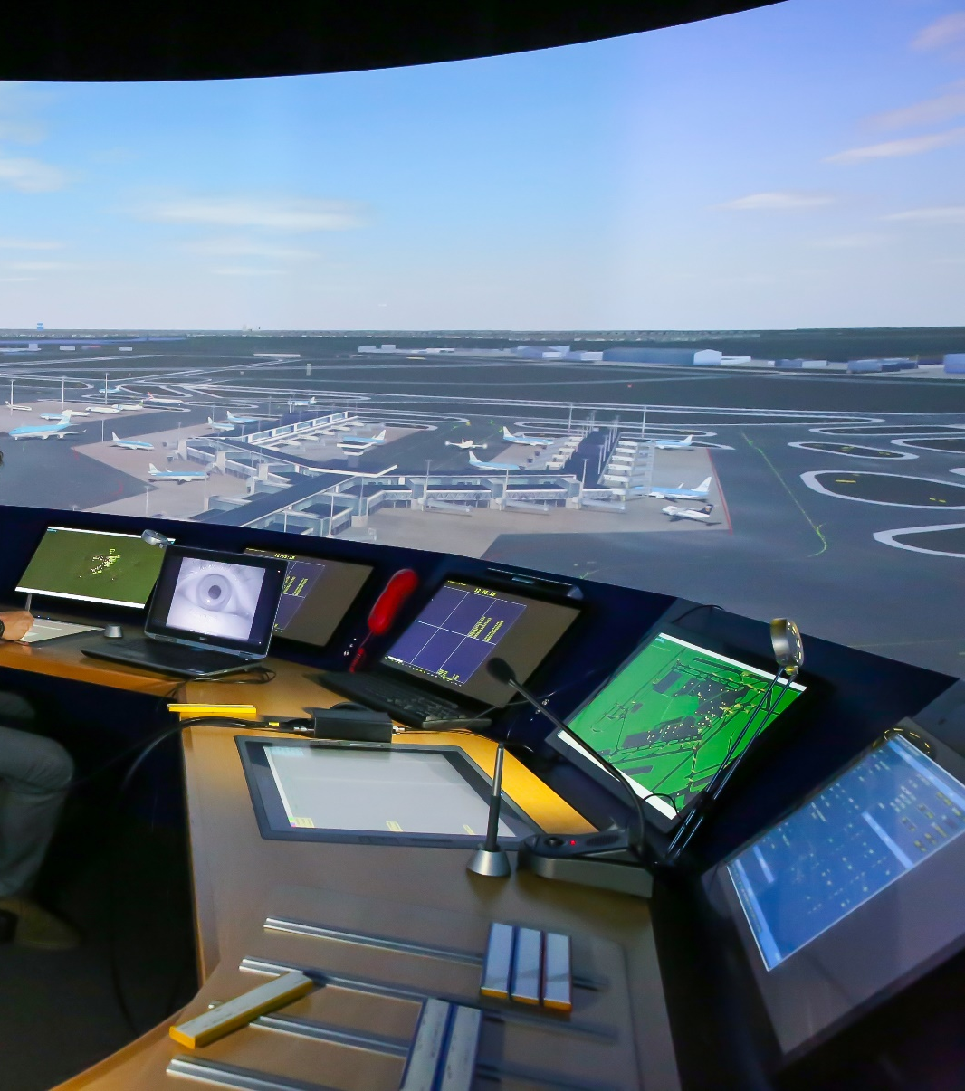
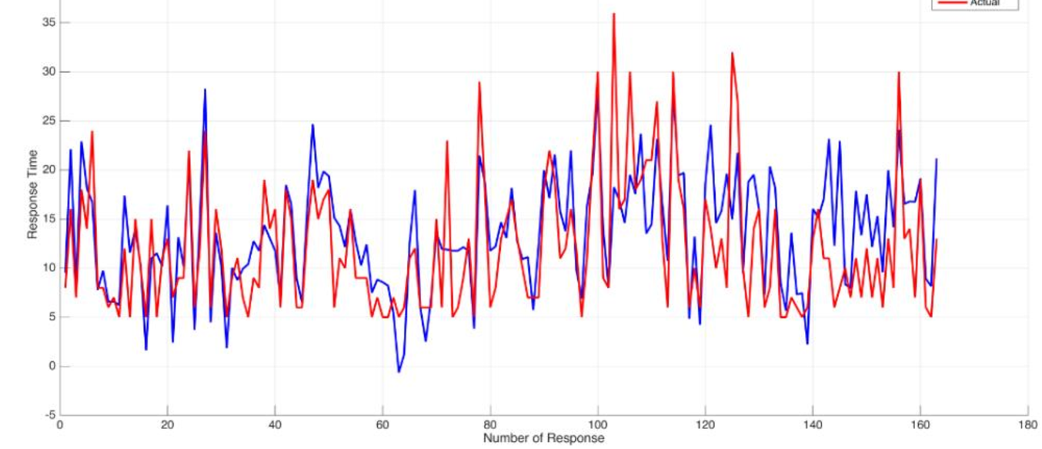
Advancements in ATC Training
Training Simulators
Training Methodology
Data & Learning Analytics
Notes:
Lots of interest in modernizing ATC training and operations in recent years:

Slide 27









Debrief: Situational Assessment
Perception of Information:
Quantifying the degree of perception as the
percentage of flights observed in the last X sec.
Anticipation:
Reaction time of trainee measuring the time
between an aircraft entering the radar screen
and it being observed for the first time.
Unseen
Seen

