Slide 1

Social Simulator Madness: Simulating Social Behavior in Dynamic Environments
Chihab Amghane, MSc.
Pieter de Marez Oyens, MSc.
Royal Netherlands Aerospace Centre (NLR)

Slide 2
Agenda
Why? Background and Motivation
What? Methods and Approach
How? Demonstration and Results
What Next? Future Work

Slide 3
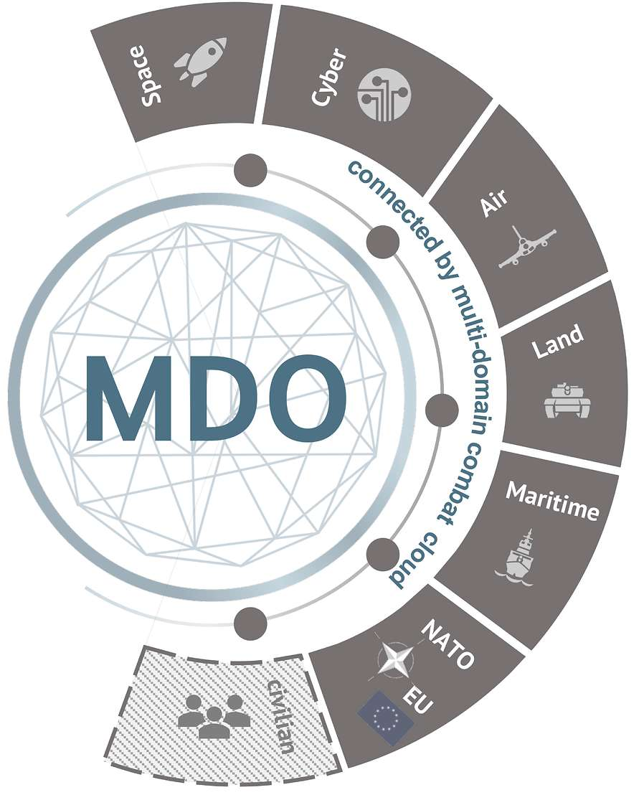
Why? Motivation
There’s a Growing Need To
Train military personnel to analyze, respond and formulate social media-driven narratives.
Integrate social media effects in simulators, enabling simulated multi-domain operations
The information domain within Multi-Domain Operations is Important but Difficult
Public Perception and Conflict
Dynamic Nature of Social Media
Challenges of Information Verification
Legal and Analytical Constraints
©PlgABw
Notes:
First mention the growing needs
Second, explain why these needs are there

Slide 4
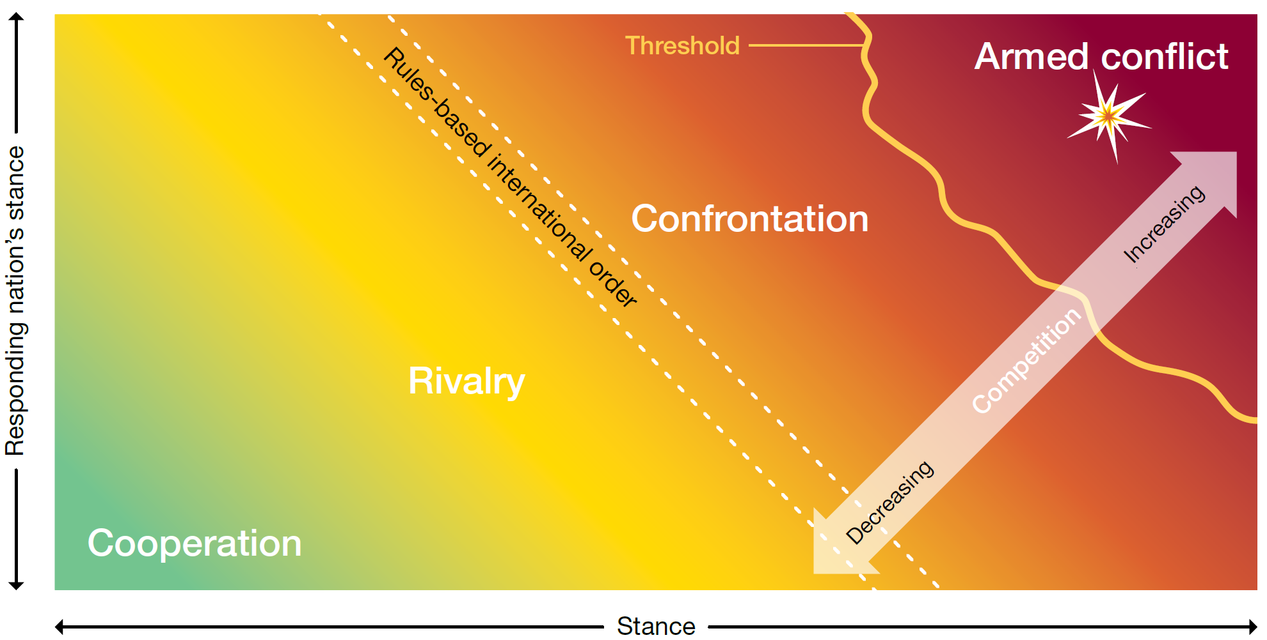
Why? Motivation
Source: Allied Joint Publication-10, NATO
Notes:
Misschien iets over MDO en over information warfare en dat personeel daarop getraind moet worden.

Slide 5
What? – Problem and Exploration
The Issue
Limited methods and tools for simulating information warfare
Limited integration with other simulators, such as Virtual Battlespace (Bohemia)
This Research Explores
How to practically leverage Large Language Models (LLMs)
On our own hardware, using smaller AI models
Simulate online behaviors in response to tactical and strategic events
How to integrate multiple domains using the Virtual Battlespace Simulator
Notes:
In our search, we encountered little simulations that focused on information warfare
And little integration
- On our own hardware: to avoid being reliant on third-parties
- Simulating Online Behaviors: To help train personnel to anticipate and react to public sentiment.

Slide 6
What? – Technical Foundation: LLMS
LLMs Overview: LLMs generate text based on massive datasets and are trained to predict the best response by following instructions.
Factors Affecting Output: model's size, training data, and the structure of prompts.
Our Approach: Use a 7B parameter Mistral model, running locally on limited computing resources. High-quality prompts are essential for producing good results.
Notes:
Why Locally: to handle sensitive information, avoid third-parties
Why Smaller: possible to go near real-time interactivatiy and generation
Aditional benefits: focus on prompt quality instead of relying solely on a big LLM model

Slide 7
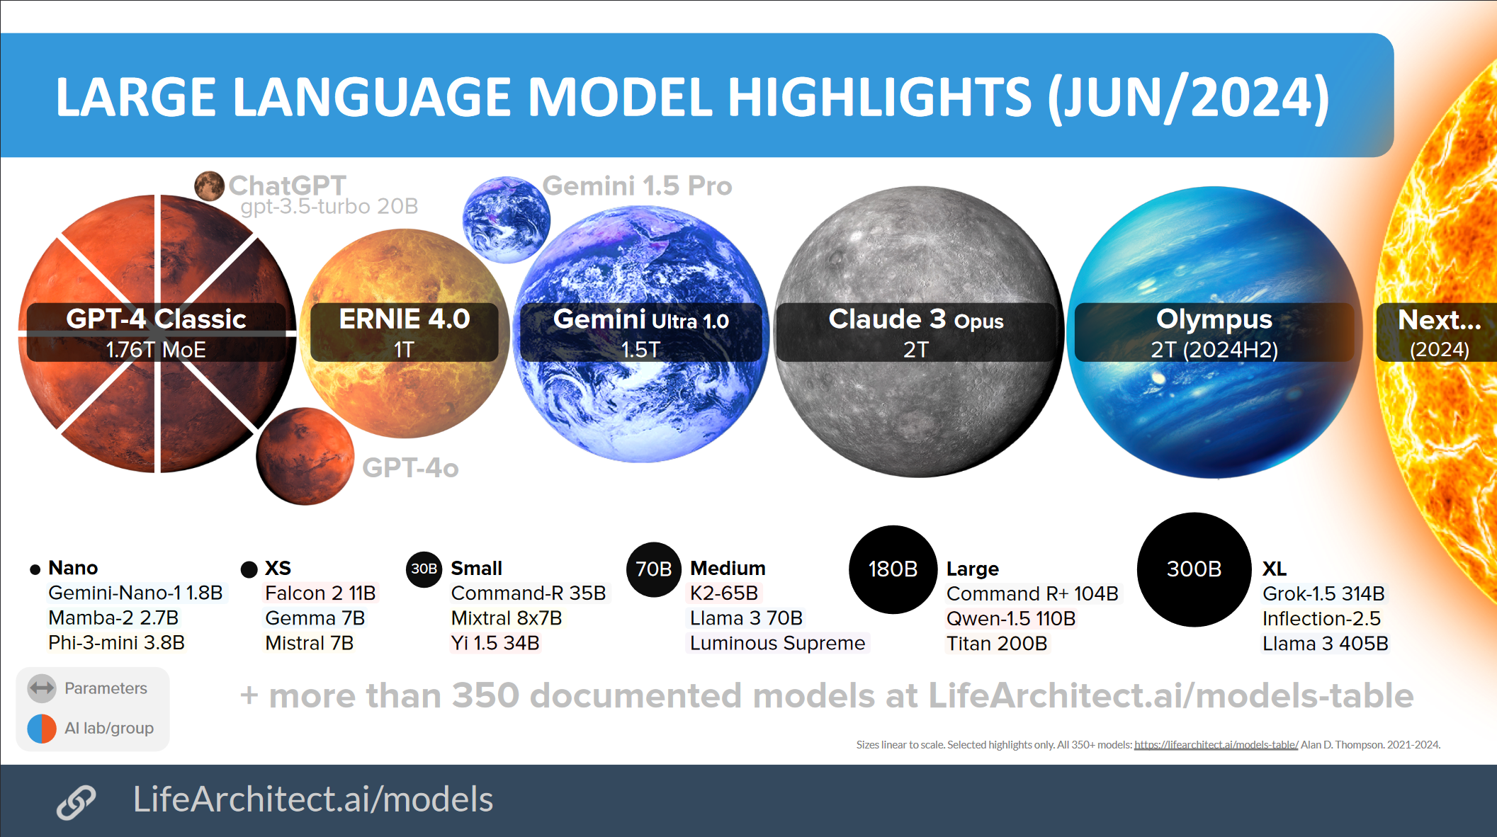
What? – Technical Foundation: LLMS
Notes:
Why Locally: to handle sensitive information, avoid third-parties
Why Smaller: possible to go near real-time interactivatiy and generation
Aditional benefits: focus on prompt quality instead of relying solely on a big LLM model

Slide 8
What? – Technical Foundation: LLMS
Notes:
Why Locally: to handle sensitive information, avoid third-parties
Why Smaller: possible to go near real-time interactivatiy and generation
Aditional benefits: focus on prompt quality instead of relying solely on a big LLM model

Slide 9
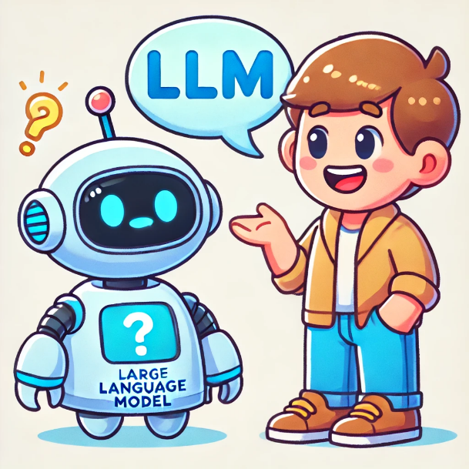
What? – Technical Foundation: Prompting
Prompting Engineering
Zero-shot: "Generate a personas"
Few-shot : Provide multiple examples to improve response variety aided by the Maximal Marginal Relevance (MMR) algorithm for optimal selection of diverse examples.
Chain-of-Thought: step-by-step reasoning, useful for multi-step tasks.
Notes:
MMR selection algorithm
selects samples from a set based on a distance metric between elements that scores them on variation and relevancy.
ensuring that these examples are diverse

Slide 10
What? – Incorporating VBS
Multi Domain Integration through Virtual Battlespace V4
Written by our colleagues:
“Simulating the Weaponization of Public Opinion in Multi-Domain Scenarios”
Monitor Distributed Interactive Simulation (DIS) traffic for specific events involving civilian entities within a simulation.
A DIS event monitor listens for events occurring near civilians
(Schuver-van Blanken et al., 2010)
Notes:
Paper JJ: more indepth about Information Warfare, ethical considerations and Tactics.
Events are: a tank driving by, distant gunfire, or a helicopter hovering

Slide 11
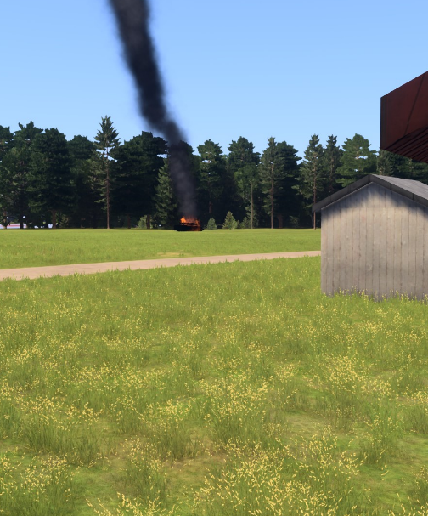
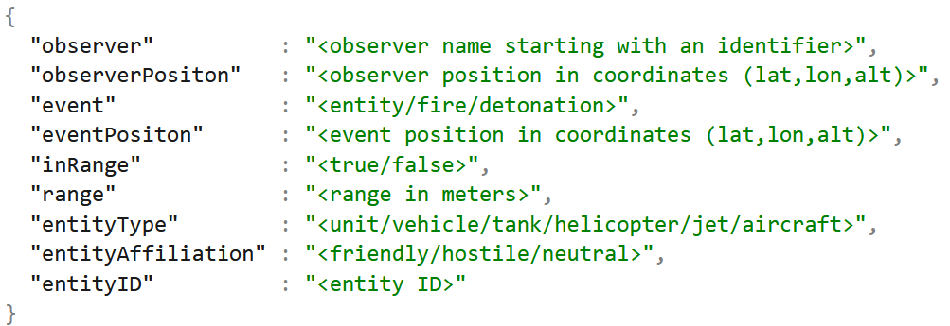
What? – Incorporating VBS
Event Information gathered by DIS event listener
Image generated by VBS4 from the perspective of a civilian
Notes:
Paper JJ: more indepth about Information Warfare, ethical considerations and Tactics.
Events are: a tank driving by, distant gunfire, or a helicopter hovering

Slide 12

How? – Experiment Approach
Persona Creation
Identity
Depth
Persona Interaction
Scenario 1: Online-only social network
Scenario 2: Social network plus Virtual Battlespace Integration
Notes:
Personas Creation to create better posts
- Identity = Description
- Depth = Emotion and Stance
Scenario 1: only describe a situation/conflict
Scenario 2: give a description that is similar to the VBS event/scenario, represents the multiple domains

Slide 13
How? – Creating Personas
Creation
Name generator for creating the names (Mimesis)
LLM creates descriptions given a name and examples (using Few-Shot Prompting)
Each persona is added to a list, 20 diverse personas are picked as examples.
This was repeated until we had 300 personas.
Concerns and Focus Points
Behavior like trolling and fake news (manipulating public opinion and information warfare)
Emotions (Prompt Chaining)
Notes:
We also describe, by hand, 10 or so personas as our initial examples for the few shot.
Emotions are vague so: asking the LLM to describe emotions, and use these descriptions to later add a sentiment when writing a prompt
Examples: Love, fear, happines and Disgust.

Slide 14
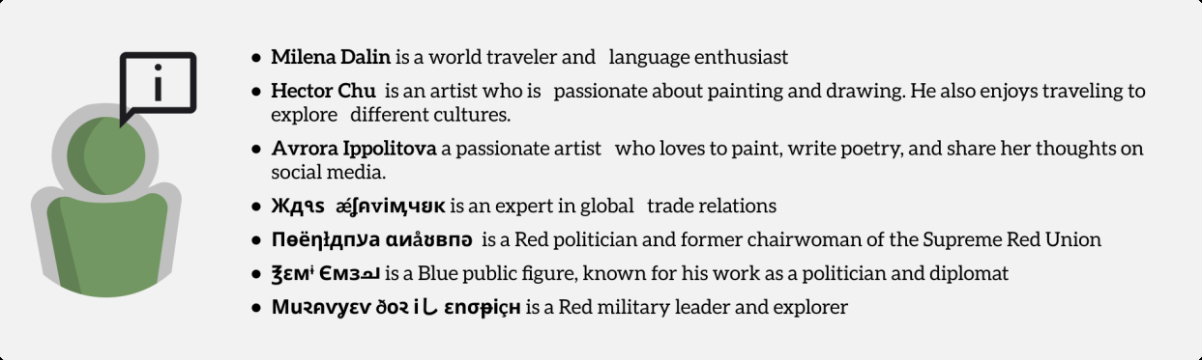
How? – Creating Personas Results
Notes:
The post looks at a scenario from both perspectives

Slide 15
How? – Online Discussion, Setup
Initializing Discussion
Topic is described by us: a war between Red and Blue
10 top-level posts are generated by 10 random users (done by the LLM based on the topic)
Selected Personas to Reply to Top-Level Post(s)
Emotions indicate how a personas should respond
Trolling behavior is random probability
Sentiment (pos., neutral, neg.)
Stance (pro-blue, neutral, pro-red)
Notes:
Pos is pro blue
Neg is pro red

Slide 16
How? – Online Discussion, Results
Name | Michael Ross
Description | Works as a foreign diplomat
Emotions | Peaceful, Happy, Love
Sentiment | Positive
Stance | Neutral
Post | I do not condone Red's violent actions in Kalkovia, but I also think Blue should not send drones to oil depots in Red. #peace #stopaggression
Notes:
The post looks at a scenario from both perspectives

Slide 17
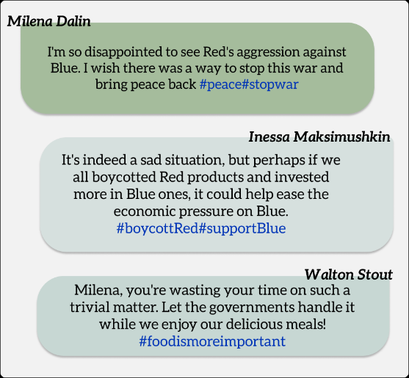
How? – Online Discussion, Results
Notes:
The top-level posts based on persona information, emotions, stance and sentiment. The flags indicate the stance. The emojis indicate the sentiment, devil is trolling, long face is neutral, smiling is positive, and angry is negative.
The post by Gorshkov Anturovich (Figure 4) has a trolling sentiment. The combination of a pro-Red stance, trolling sentiment, and the fact that Gorshkov is a citizen of Blue all contribute to the trolling nature of the post, where Gorshkov strongly expresses a pro-Red stance.

Slide 18
How? – Multi-Domain, Setup
VBS Scenario Created: involved three civilians near a bridge in Kalkovia.
One civilian observes an Apache helicopter flying
Other civilians see the helicopter firing a missile and destroy a bridge.
Observations are Synthesized and Top-level Posts are Created
An Image of the helicopter event
Text generated by the LLM (based on the textual description of the event)
A Group of Virtual Personas Discuss
Notes:
Observations are sent throught DIS
Synthesized by the LLM

Slide 19
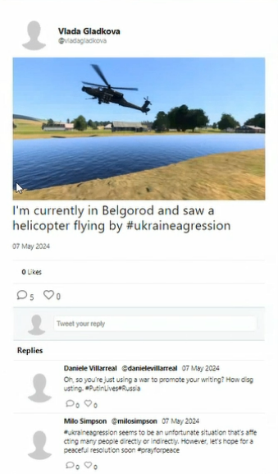
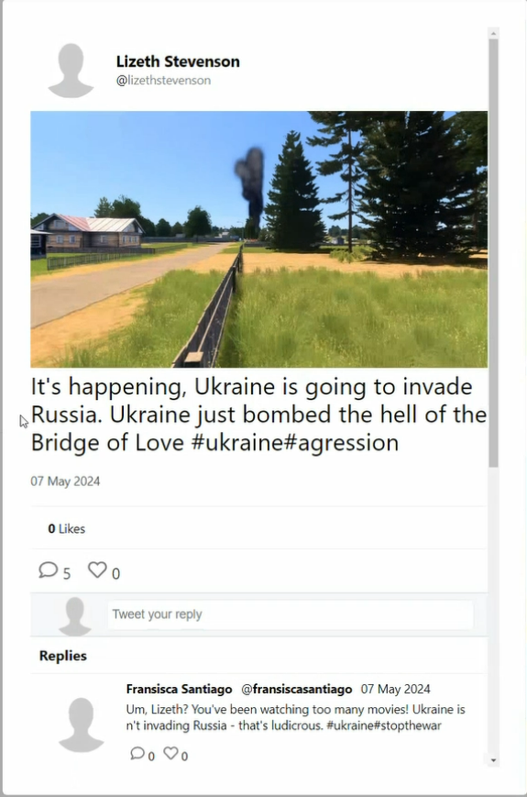
How? – Multi-Domain, Results
Notes:
An overview of the posts generated by the personas that were coupled to the civilians in VBS. The first civilian is coupled to persona Walton Stout and a subset of the post thread is visualized in the left most column. The second civilian is coupled to Evgeniye Tikhonova and the post thread is visualized in the middle column. The third civilian is coupled to Avrora Ippolitova and the resulting thread of posts is visualized in the right most column.

Slide 20
How? – Multi-Domain, Results
Notes:
An overview of the posts generated by the personas that were coupled to the civilians in VBS. The first civilian is coupled to persona Walton Stout and a subset of the post thread is visualized in the left most column. The second civilian is coupled to Evgeniye Tikhonova and the post thread is visualized in the middle column. The third civilian is coupled to Avrora Ippolitova and the resulting thread of posts is visualized in the right most column.

Slide 21
Short Recap
Goal: exploratory study integrating LLMs and VBS
Create realistic behavior between individuals and populations
Multi-Domain training, operations, etc.
Created
Social Network Simulation
Behavioral Flexibility
VBS Simulator Integration
Technical Framework
Notes:
Social Network Simulation:
LLMs generate personas with different social media interactions.
Behavioral Flexibility:
Behaviors modified through sentiment, stance, and emotion in prompts.
VBS Simulator Integration:
Social media discussions dynamically reflect events in the VBS simulator.
Technical Framework
Reproducible framework for simulating multi-domain operations.
Accessible for both large organizations and small teams.

Slide 22
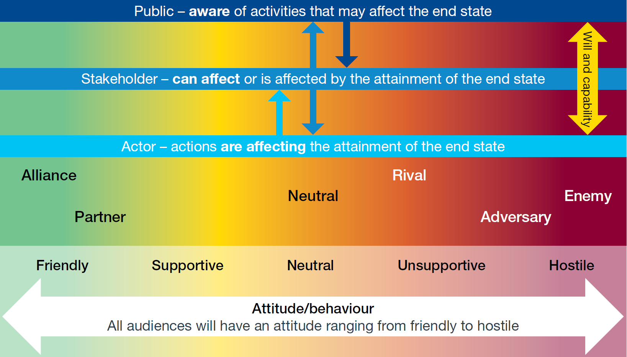
What’s Next? – Future Work
Model opinion change in response to events like trolling, astroturfing, and echo chambers.
Source: Allied Joint Publication-10, NATO

Slide 23
What’s Next? – Future Work
Dynamic Simulation:
Integrating real-time (fake) information from news outlets.
Multimodal Expansion:
Incorporate images, video, and audio to create a more immersive simulation for military training.
Notes:
Dynamic Simulation:
Enhance the simulator by integrating real-time information from news outlets for more realistic, evolving scenarios.
Multimodal Expansion:
Incorporate images, video, and audio to create a more immersive simulation for military training.

Slide 24

Thank You
Questions?

