Slide 1

A Review on Education and Training Needs for Military Space Operations
Simone Caso, The Netherlands Aerospace Centre

Slide 2



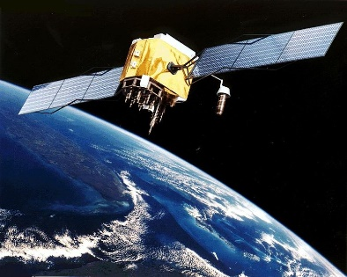

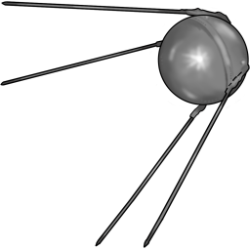
INTRODUCTION
The MILITARY and SPACE
Galileo Galilei
Italy, 1609
Hans Lippershey
Netherlands, 1608
GPS, 1960s
Sputnik, 1957

Slide 3
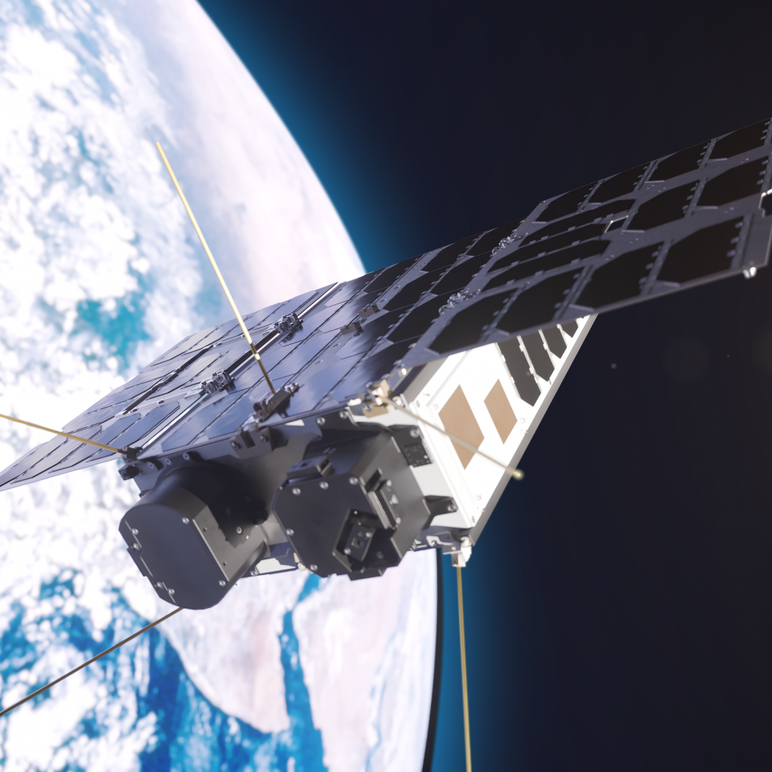
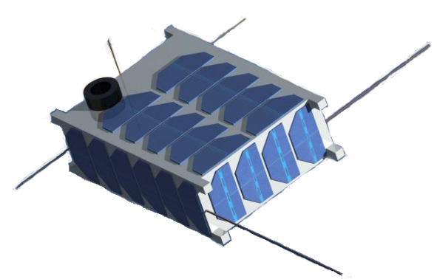

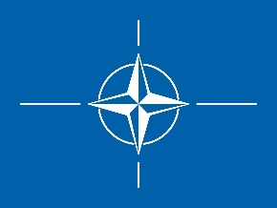

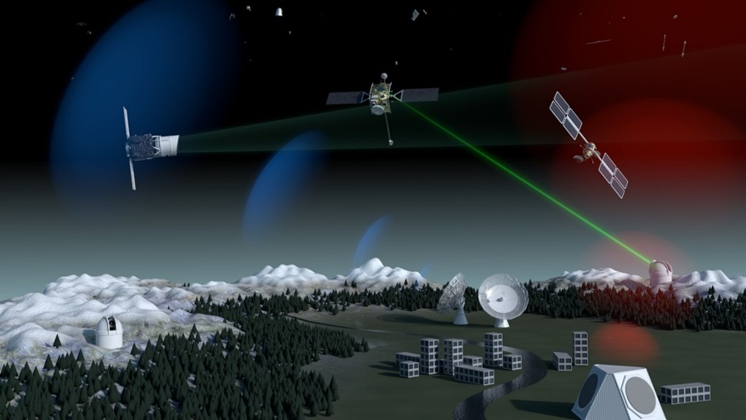
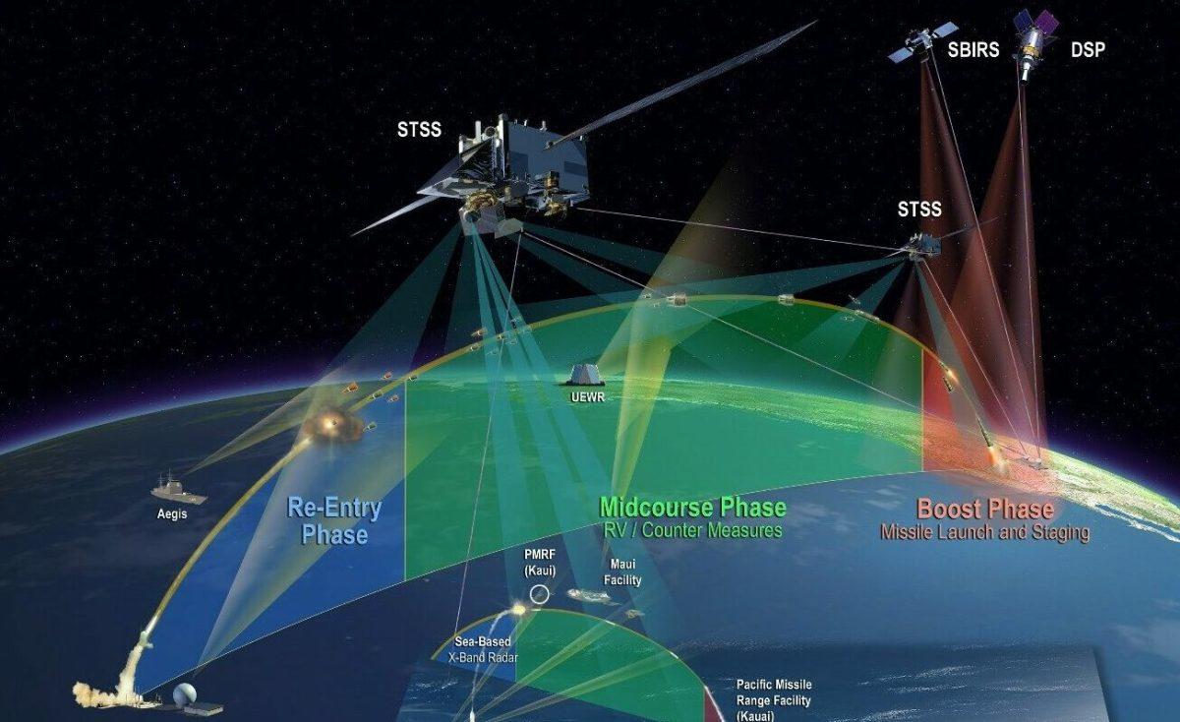
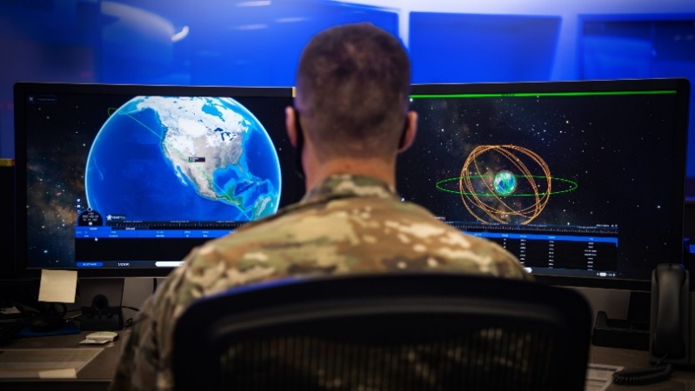
INTRODUCTION
Recent Years
2019
© ESA
© SpaceNews
© Breaking Defense

Slide 4
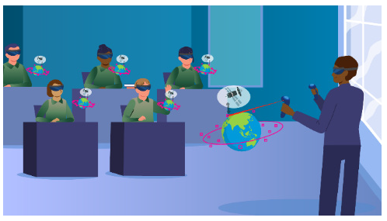
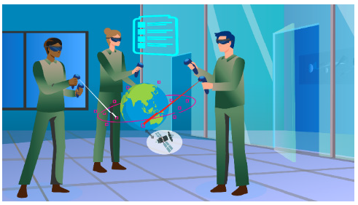
METHOD
EDUCATION
TRAINING
EDUCATION
Educational sessions are considered activities that aimed at developing knowledge (e.g., classes) (Manpower Services Commission, 1981; Masadeh, 2012)
Training programs are considered as a planned process intended to modify attitudes or skills through experiential learning, with the objective of achieving effective performance in any activity or range of activities (e.g., exercises) (Manpower Services Commission, 1981; Masadeh, 2012)
© Stouch et al. (2023)
© Stouch et al. (2023)

Slide 5
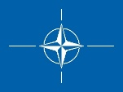





METHOD
Participants: 42
Age (year) average: 42.3
Years (experience) in the space domain.
Less than 5 years: 17
Between 5 and 20 years: 18
Over 20 years: 7
Online survey
Topics
1. Space Domain Awareness
SSA - Space Situational Awareness
STM - Space Traffic Management
Space weather
2. Space-based services
GNSS use for PNT (Positioning, Navigation and Timing)
Early Warning (threats)
ISR – Intelligence, Surveillance and Reconnaissance
SATCOM – Satellite Communication
3. Security
Secure Communication
Cyber security
Counter (counter) space
4. In-space operations
Satellite operations
Payload operations
Rendezvous operations
5. Access to Space
Launch operations
Education
Training
Future Military Space Operations

Slide 6
RESULTS
Education
What are the current educational programs and sessions regarding space military operations that you follow(ed)?
Percentages

Slide 7
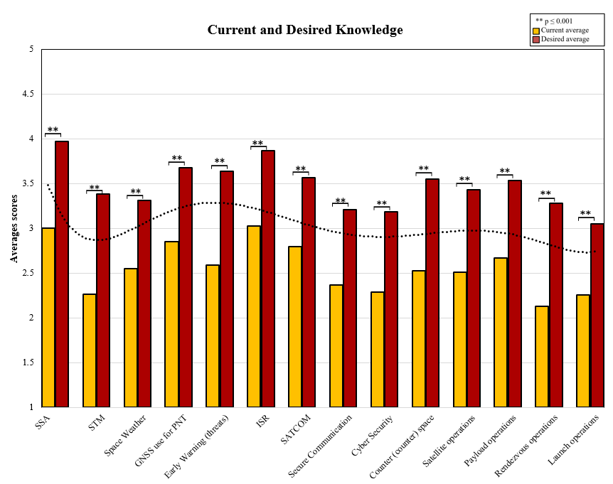
RESULTS
Education Topics
Rate your general level of knowledge on the following topics, and the desired level you wish to achieve on a scale from 1 to 5 (1 being low - 5 being high), needed for your daily tasks
The highest discrepancy was by STM and secondly by Rendezvous Operations
The highest average score was by SSA

Slide 8
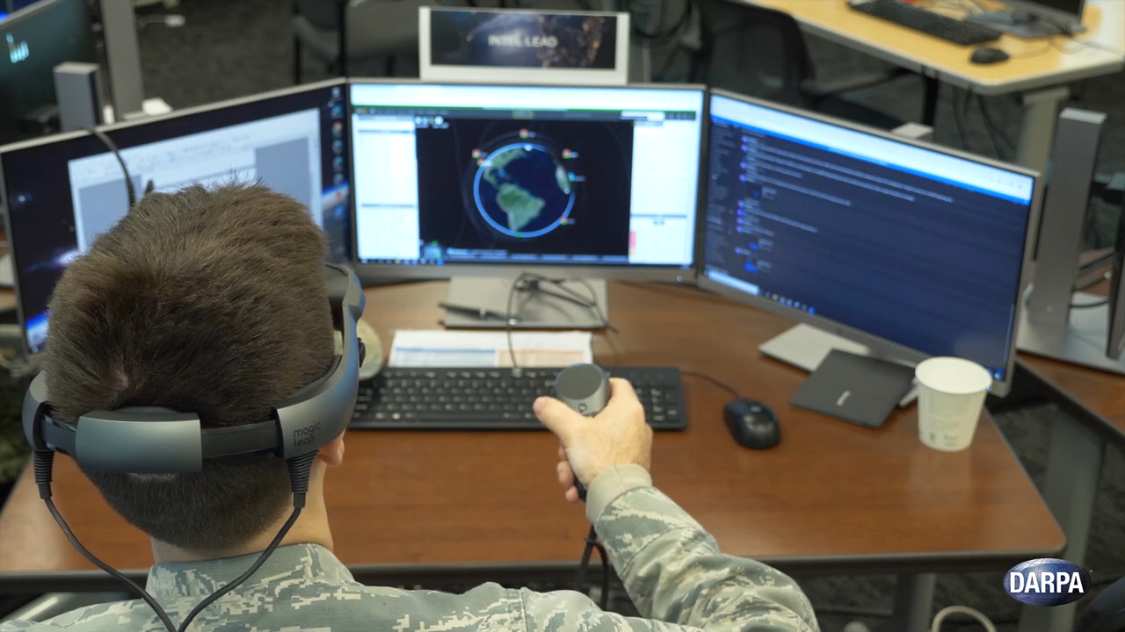
RESULTS
Education Type of courses
By which means?
VR and AR
Educational videos
Reading materials
Conferences
Expert guest lectures
Other topics suggested
Cislunar and lunar operations
Dual use (military and civil)
Meteorology and oceanography (METOC)
Navigation warfare
Policy
Sensors (EO, IR, SAR)
Supply chain
Space power theory
Asteroid mining
Electromagnetic warfare
Joint military operations and wargames
©

Slide 9




RESULTS
Ranking Educational Methods
What specific technologies could be helpful and thus should be improved for educational sessions?
Best method: having all combined
Other wishes:
- To engage users, have interactions
- To have better visuals like 2D/3D animations
- To enhance AR/VR visuals for concepts like orbital mechanics and SSA
- To avoid motion sickness, have high-fidelity devices
- To include/have AI-based scenarios
Ranking
Practice hands-on training
Classroom-based lectures
Games (tabletop, wargames)
Simulation exercises in AR/VR

Slide 10
RESULTS
Education Frequency of courses
What is the current frequency of the educational sessions within your organization? And which frequency would you desire? Please fill the table with the following options: none, daily, weekly, monthly, quarterly, semi-annually and annually
CURRENT
DESIRED
- % ‘none’ sessions decreased for each topic from the current to the desired frequencies
- Satellite, payload and launch operations had the highest preference for daily frequencies in the desired category
- For weekly frequencies, the highest levels of interest were found in space weather, secure communication, cyber security and counter (counter) space

Slide 11
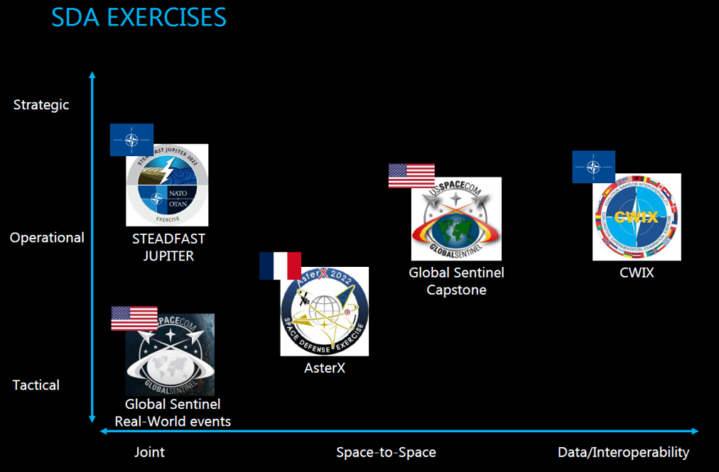
RESULTS
Training
What are the current training programs regarding space military operations that you do/did?
Military exercises
Percentages

Slide 12
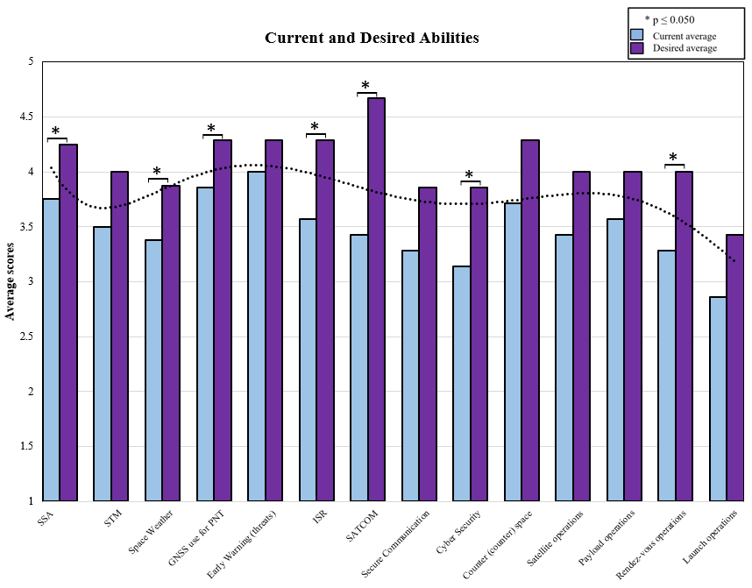
RESULTS
Training Topics
Rate your level of expertise (i.e., your working skills level) and the desired level you wish to achieve on a scale from 1 to 5 (1 being low - 5 being high) for your daily tasks
The highest discrepancy was in SATCOM
Other topics suggested
Joint Military Operations

Slide 13



RESULTS
Ranking Training Methods
What specific technologies could be helpful and thus should be improved for training sessions?
Best method: having all combined
Other wishes
- To engage users, have interactions
- To have games that help to train the intel operators and developers for intel-algorithm
- To have better visuals like 2D/3D animations
- To enhance AR/VR visuals
- To avoid motion sickness, have high-fidelity devices
- To include AI-based scenarios
- To have simulated control room environments for practice
Ranking
Classroom-based lectures
Practice hands-on training
Simulation exercises in AR/VR
Games (tabletop, wargames)

Slide 14
RESULTS
What is the current frequency of the training programs within your organization? And which frequency would you prefer? Please fill the table with the following options: none, daily, weekly, monthly, quarterly, semi-annually and annually
Training Frequency
CURRENT
DESIRED
% ‘none’ sessions was the highest
No changes in SSA, SATCOM, Space Weather
The monthly frequency option was no longer preferred for ISR, counter (counter) space, satellite operations and payload operations in the desired frequency. Respondents opt for the weekly frequency

Slide 15
RESULTS
Future Military Space Operations
For future operations, in which specific operational topic do you believe military space personnel must be specialized in?
SDA
- Keep an eye on space threats and environment, essential for both strategic and tactical decision-making
Space-based services
- Fundamental for military operations
Security
- Fundamental; important for resilience of mission; security of military data
In-Space operations
- Space is becoming a domain of warfighting
Access to Space
- Rapid response / deliver is crucial
Added topics
- Cyber security; Space Weather; Space Power theory; Electromagnetic Spectrum Operations; ASAT (Anti-satellite weapons)

Slide 16




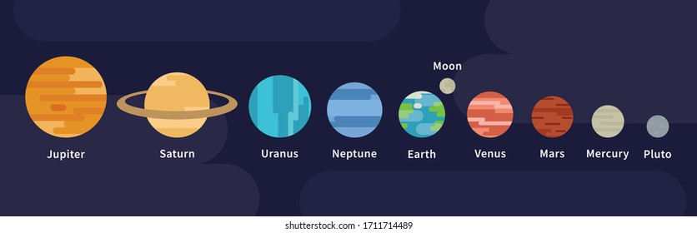



CONCLUSIONS
Key Points
There are important / relevant education and training needs
Some less, some more. For education: STM, Rendezvous Operations & SSA for education. For training: SATCOM.
Combining methods are the most favourited way
2D/3D visualizations; the use of AR/VR; integrate AI-based scenarios; avoid motion sickness, high fidelity tools; have simulated control rooms.
In educational and training sessions, training exercises are generally required to be more frequent
-Some less, some more. For education: Satellite, payload and launch operations have the highest daily %. For training: ‘none’ sessions were the highest; ISR, counter (counter) space, satellite operations and payload operations → weekly frequency are the desired ones.
Future operations
- Personnel should be the most specialized in SDA, space-based services, security and in-space operations. SDA
Strengths & Limitations
40-50 K
42
Percentages
Percentages

Slide 17
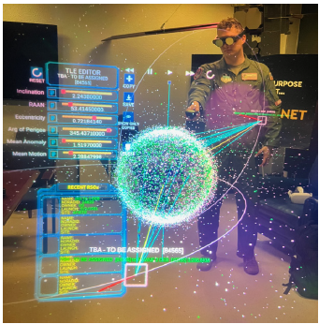

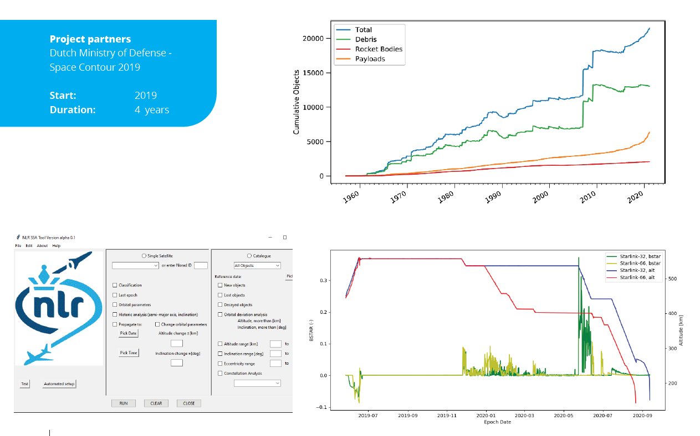

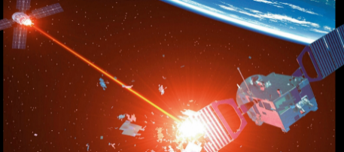
CONCLUSIONS
Education and Training Solutions
ISR
SDA
Space data + AI = intel (ISR)
Hostile RPO/CPO readiness
© Stouch et al. (2023)
Data → Information → Intel
Use of algorithms to improve sensor data
Educate and train military/intel personnel in using the data
Result: Improved battlespace / situational awareness
Use case: detection of manoeuvre of hostile/classified satellite
CONOPS from suspicious manoeuvre of hostile Sat
Predict all possible events
Prepare for upcoming events
Result: Blueprint Training + Tooling
© Stouch et al. (2023)

Slide 18
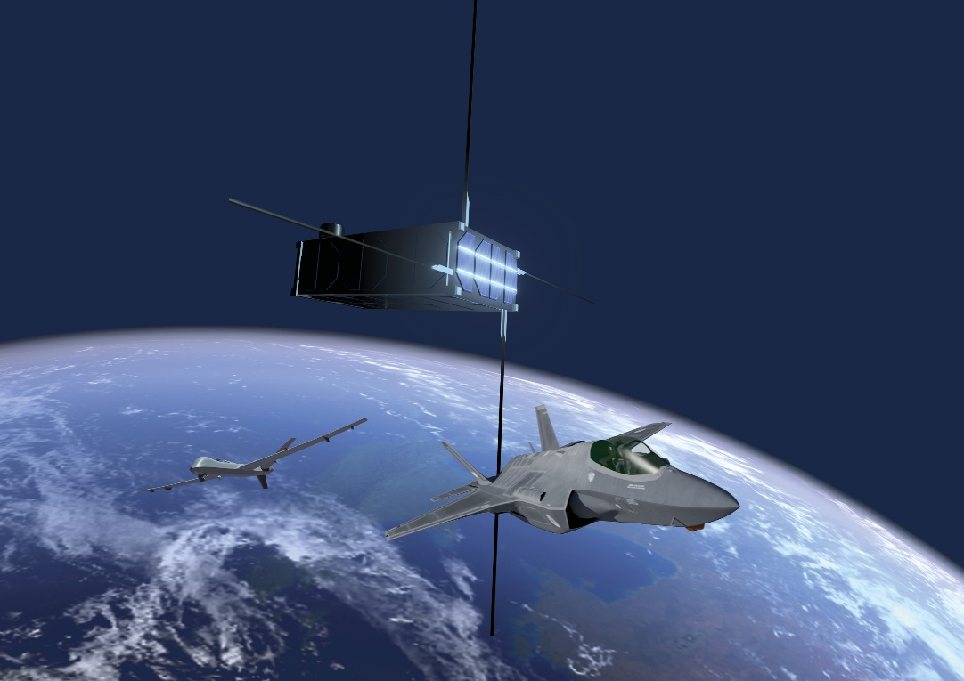

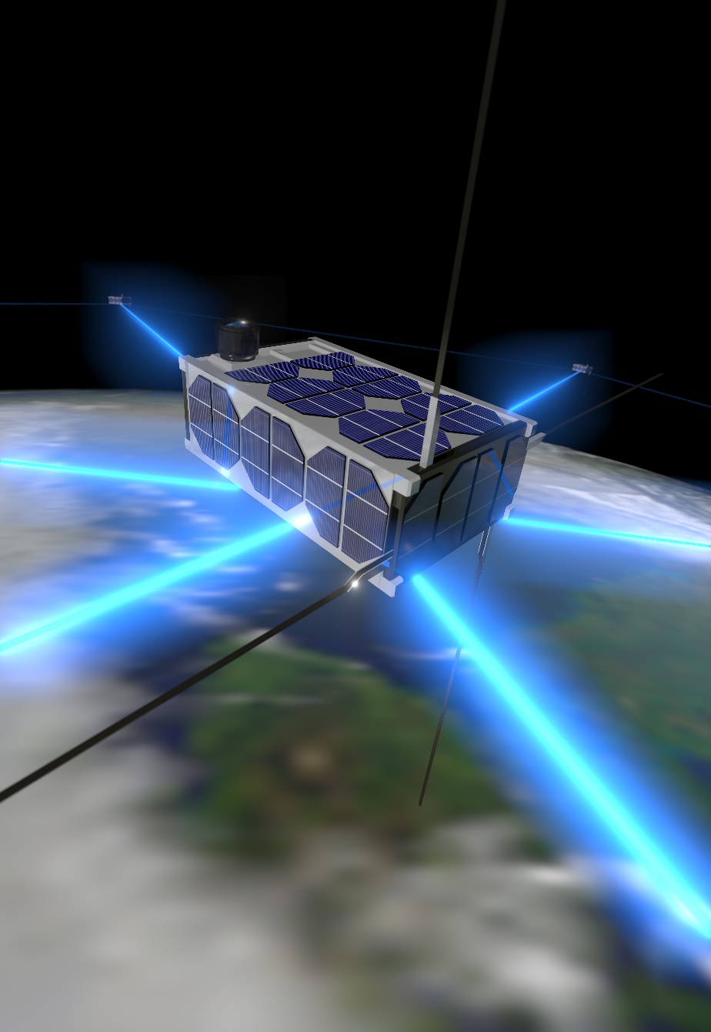

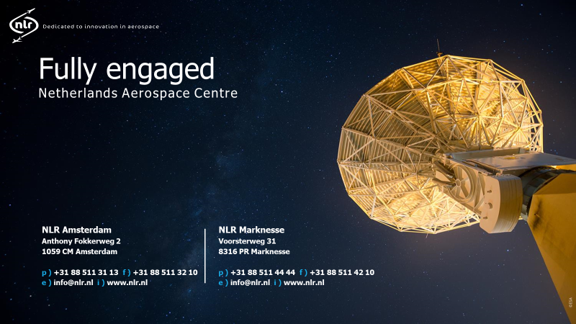
simone.caso@nlr.nl
18

Slide 19


Slide 20
DEFINITIONS
Space traffic management (STM): The set of rules, procedures and systems for managing the safe and efficient operation of spacecraft, satellites and other space objects in Earth's orbit and beyond, to prevent collisions, ensure safe distances and promote sustainable use of space.
Space situational awareness (SSA): The knowledge and characterization of space objects, including their location, status and intentions, to support safe and efficient space operations and to enable the detection and response to potential threats or hazards in the space environment.
Space weather: The dynamic and variable conditions in the space environment that can affect space and ground-based systems, including solar and geomagnetic storms, cosmic rays, radiation and plasma variations, which can impact spacecraft operations, communication systems and technological infrastructure.
Positioning, Navigation & Timing (PNT): The use of GNSS signals to determine the location, velocity and time of a vehicle or object, enabling precise navigation and synchronization.
Early Warning (Threats): The use of space-based sensors and systems to detect and warn of potential threats, such as missile launches or other hostile activities.
Intelligence, Surveillance & Reconnaissance (ISR): The use of space-based sensors and systems to gather information on activities, objects or events, supporting military or national security operations.
Satellite Communication (SATCOM): the use of satellites to transmit data, voice, or video communications, often for military, government or commercial purposes.
Secure Communication: The use of encryption, authentication and other security measures to protect communications from unauthorized access or interception.
Cyber Security: The protection of computer systems, networks and data from unauthorized access, damage, or disruption, particularly in the context of space-based systems.
Counter (Counter) Space: The development and deployment of systems and technologies to detect, track, disrupt, or destroy hostile space-based assets, such as anti-satellite missiles or cyber attacks.
Satellite Operations: The management and control of satellites in orbit, including tasks such as station-keeping, orbit adjustment, and payload management.
Payload Operations: The management and control of the payload (e.g. instruments, sensors or communications equipment) onboard a satellite, to achieve specific mission objectives.
Rendezvous Operations: The process of maneuvering a spacecraft to meet or dock with another spacecraft, satellite, or orbital platform.
Launch Operations: The preparation, execution and monitoring of a launch vehicle to place a spacecraft or satellite into orbit or on a trajectory to another celestial body.
Space Domain Awareness (SDA): The knowledge and characterization of the space environment, including the location, status and intentions of space objects, as well as the conditions and events that affect space operations, to support safe and efficient use of space, prevent collisions and interference and enable effective decision-making for space-based activities.

