Slide 1

Evaluating the Trustworthiness of
Large Language Models for Code Generation
E. Michael Bearss Ph.D.

Slide 2
Rapid Evolution of Artificial Intelligence
1960
1980
1990
2010
2015
2020
Birth
of AI
Multilayer
Perceptron
Deep
Learning
LLMs
Support
Vector
Machines
Expert
Systems
Generational
Models
Over the years, several major advancements have spurred the adoption of AI technologies
Progression has been driven by increased computational power and the growth of available data
AI technologies are becoming more widespread and accessible
Widespread use introduces ethical and safety concerns
Notes:
1986 - backpropagation

Slide 3
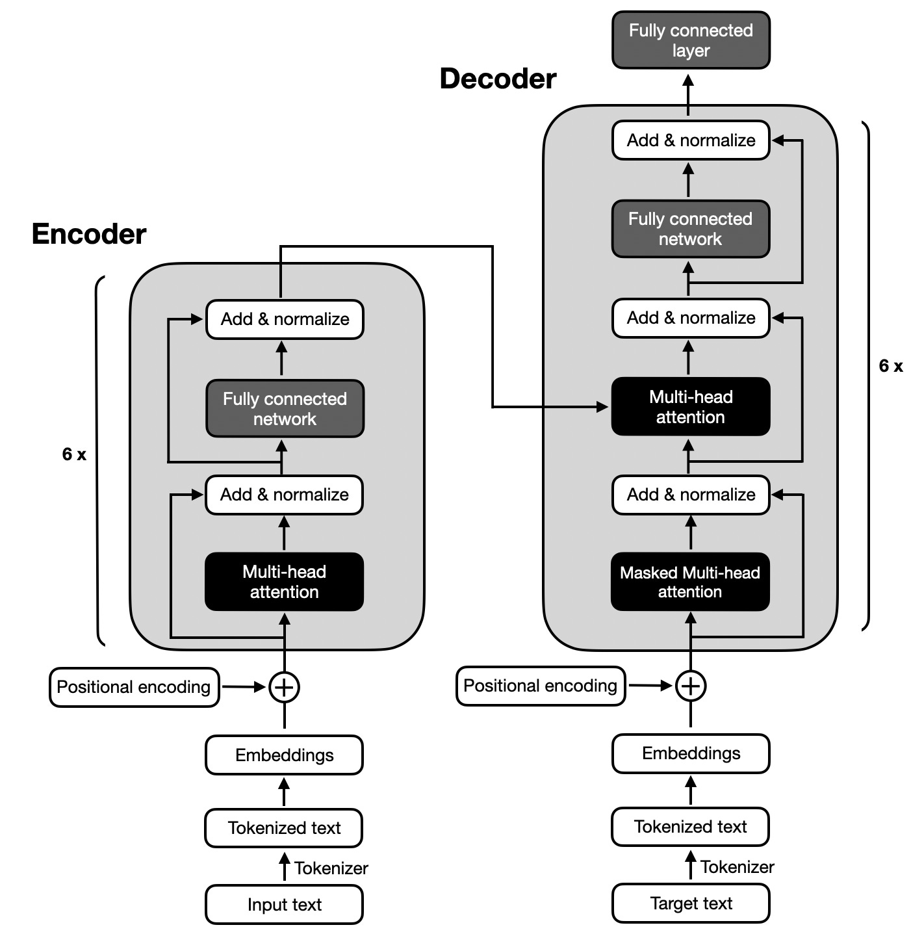
What is an LLM?
Based on the transformer architecture
Revolutionized natural language processing (NLP) tasks
Self-attention mechanism captures relationships between words regardless of position
Model variants can perform different tasks:
Decoder-only: text generation
Encoder-only: summarization / question answering
Encoder-Decoder: translation
Transformer Architecture
(Vaswani et al., 2023)

Slide 4
LLMs in Code Generation
LLMs can generate computer code from natural language prompts
Productivity enhancements:
Automate/accelerate routine and boilerplate code
Allows developers to focus on more creative and complex tasks
Lowers barrier to entry in software development
Rapid prototyping concepts
Automation of code documentation and refactoring
Challenges and considerations:
Probabilistic nature of LLMs can lead to unpredictable variations
Unchecked code can lead to inefficiencies and vulnerabilities

Slide 5
Need for Verification and Validation (V&V)
There is an urgent need to perform V&V of LLMs that perform essential tasks
Performing V&V helps establish trust (or identify concerns) with models
Verification:
Generated code is free from errors
Generated code is free from vulnerabilities
Generated code is well-documented and maintainable
Validation:
Generated code successfully meets the prompt criteria
Generated code complies with legal regulations and ethical standards

Slide 6
Challenges in V&V of LLM-Generated Code
LLMs may produce different code outputs for the same prompt
LLMs may misinterpret the intent behind the prompt without proper context
Black-box nature of LLMs makes it difficult to understand how code is generated
Hallucinations can generate factually incorrect or nonsensical information and/or bias (discriminatory or harmful outputs)
Inconsistent adherence to coding standards
Risk of unintentionally violating licenses, patents, or data protection laws
Frequent updates to models can change code generation behaviors

Slide 7
V&V Techniques for LLMs
Formal verification
Applying mathematical methods to guarantee model behavior
Faces scalability challenges with large models
Human-in-the-loop evaluation
Incorporating expert judgement in evaluating and refining outputs
Addresses nuanced issues like context and ethics
Faces scalability issues with problem space
Adversarial testing
Designing inputs that challenge the model
Uncovers weaknesses and robustness issues
Combined approach
This research uses a combination of method 2 and 3

Slide 8
Evaluation Steps
Develop coding problems difficult for an LLM to solve
Survey human experts to obtain control sample of human solutions
Perform unit testing to assess the accuracy and efficiency of the solutions
Conduct a survey to compare human vs LLM generated solutions based on:
Correctness
Readability
Perceived origin
Evaluate solutions using an ML-based classifier to detect origin

Slide 9
Developing Test Cases
Problem selection was critical for successful V&V
Criteria for effective problems:
Solvable in about 30 minutes
Self-contained requiring no external resources or domain knowledge
Complete solutions not readily available
Additional goals:
Facilitate straightforward evaluation through unit tests
Encourage range of solution quality
Allow for partial credit (e.g., solving sub-problems or inefficient solutions)
Notes:
LeetCode

Slide 10
nth Fibonacci Prime
The Fibonacci sequence is the series of numbers where each number is the sum of the two preceding numbers. For example:
0, 1, 1, 2, 3, 5, 8, 13, 21, 34, 55, 89, 144, 233, 377, 610, ...
Prime numbers are natural numbers that are divisible by only 1 and the number itself. In other words, prime numbers are positive integers greater than 1 with exactly two factors.
For example:
2, 3, 5, 7, 11, 13, ...
A Fibonacci prime is a number that is both a Fibonacci number and a prime. For example:
2, 3, 5, 13, 89, ...
Create a function that takes a single argument n and returns the nth number in the sequence of Fibonacci primes.
Notes:
Task: Create a function that returns the nth number that is both a Fibonacci number and prime.
Challenges:
Integration of prime checking and Fibonacci sequence generation.
Efficient computation for larger values of n.
How large?

Slide 11
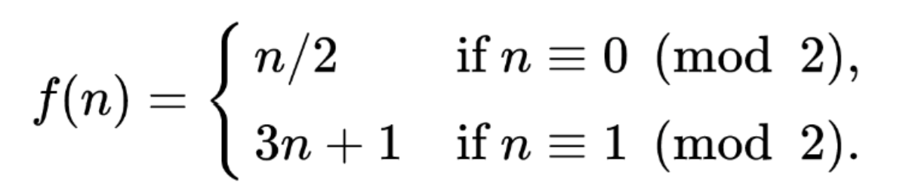
Collatz Numbers
The Collatz conjecture is one of the most famous unsolved problems in mathematics.
The conjecture asks whether repeating two simple arithmetic operations (shown below) will
eventually transform every positive integer into 1.
Let an integer's Collatz number (C) be the number of operations required to transform it into 1.
Create a function that takes a single argument n (1 <= n <= 60) as a parameter
and returns the size of the set of integers with that Collatz number.
Notes:
Task: Create a function that returns the size of the set of numbers with a specific Collatz number.
Challenges:
Inverting the Collatz function.
Avoiding inefficient brute-force methods.

Slide 12
Gathering Sample Solutions
Two LLMs were used to generate sample solutions:
Generated in February 2024
ChatGPT 3.5 - current generation capability
ChatGPT 4.0 – latest generation model
Prompt was provided with no additional context or explanation
Multiple interactions were used with additional feedback to the model to help troubleshoot
The goal was to mimic an experienced developer using an LLM to solve a problem

Slide 13
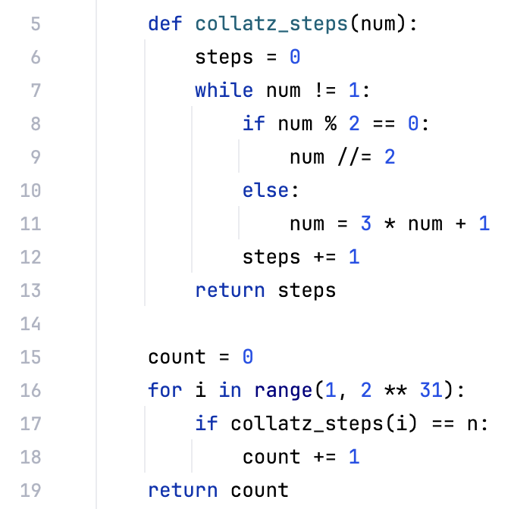
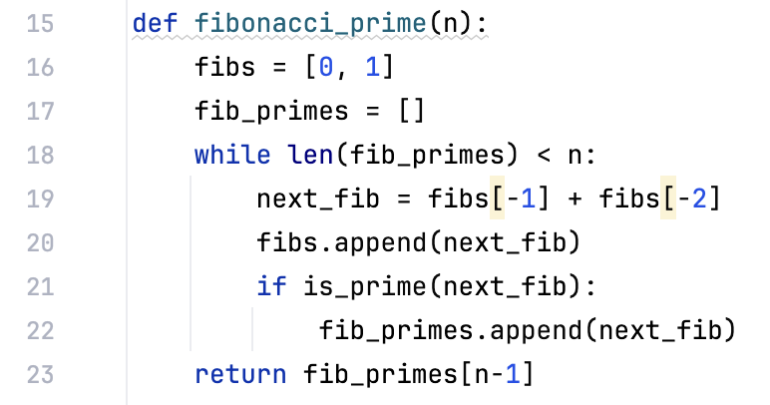
Code Samples
Fibonacci Prime Code Excerpt from ChatGPT 4
Collatz Number Code Excerpt from ChatGPT 3.5

Slide 14
Results – Technical Correctness
Each solution was graded:
Correctness
1 - all unit tests pass
0 - otherwise
Efficiency (asymptotic)
2 - best known
1 – inefficient
0 – infeasible
LLMs were effective at the simple problem
LLMs struggled to solve the more complex problem
 | nth Fibonacci Prime |  | Collatz Numbers
 | Correctness | Efficiency | Correctness | Efficiency
ChatGPT 3.5 | 1 | 0 | 1 | 0
ChatGPT 4 | 1 | 2 | 0 | 0
Human (3-5 years) | 1 | 1 | 1 | 2
Human (3-5 years) | 1 | 1 | 0 | 0
Human (10+ years) | 1 | 1 | 1 | 0
Human (10+ years) | 1 | 1 | 1 | 0
Human (3-5 years) | 1 | 2 | 1 | 0
Notes:
What language? - Python

Slide 15
Survey Design
Survey was created on Google Forms and was widely distributed on social media and SurveyCircle
A small prize raffle was used to encourage participation
Email addresses were recorded to ensure response quality
85 total responses were collected
Results reliability assessed with Krippendorff’s ⍺(⍺ = 0.68)
All responses measured on a Likert scale from 1 to 5
Respondents asked:
How confident are you that the sample was generated using generative AI?
Which sample is more correct?
Which sample is easier to understand?

Slide 16
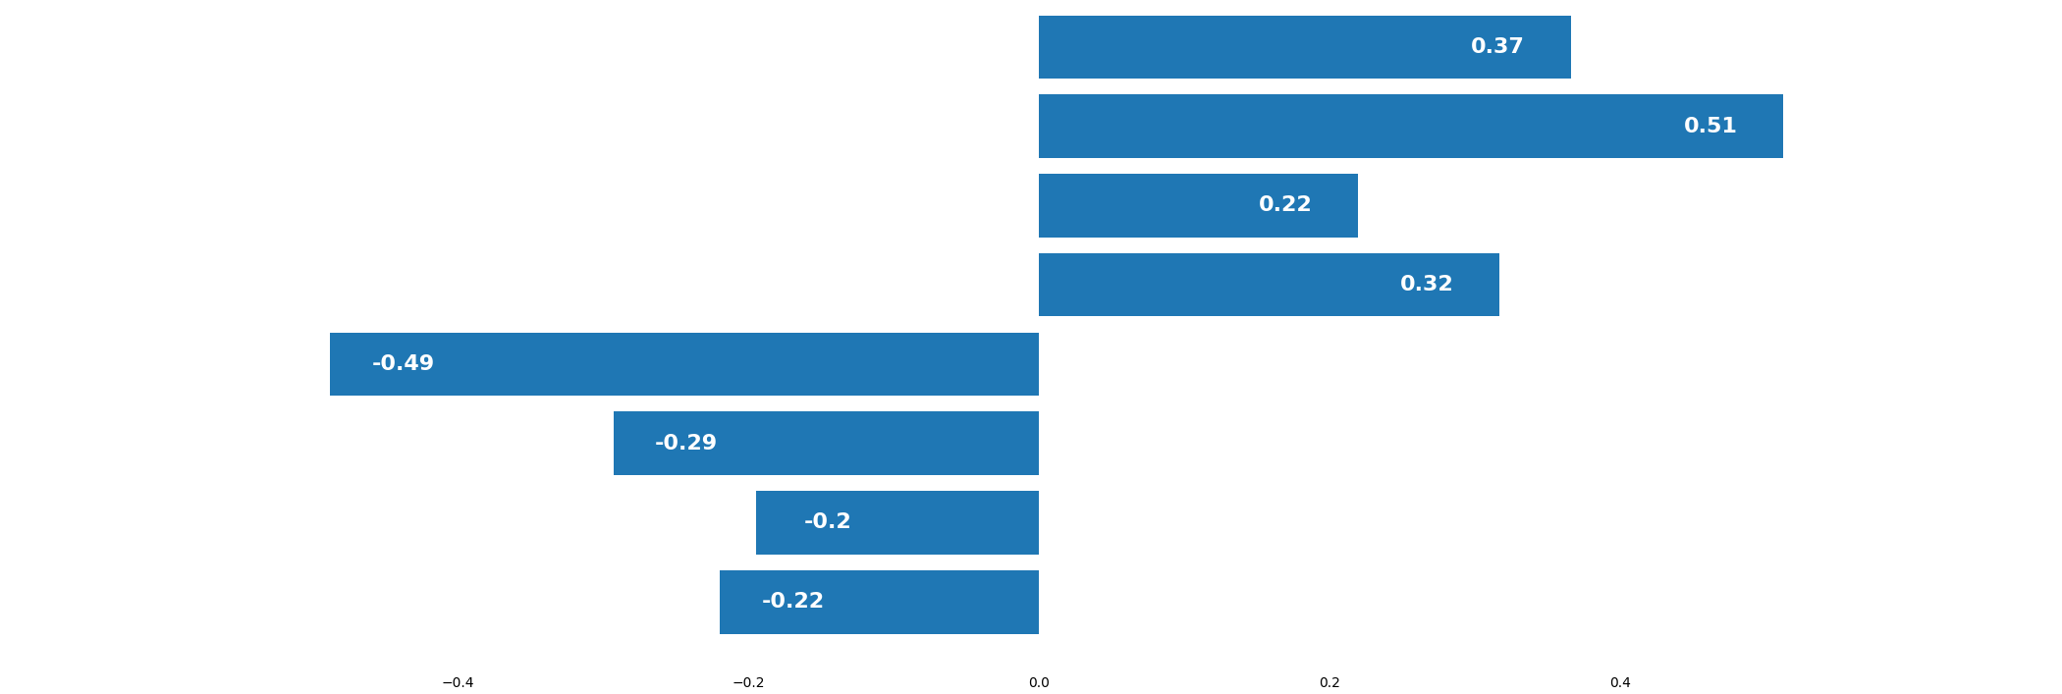
Results – Face Validation Survey
Confidence Sample was AI-Generated
LLM-Generated
Human-Generated
Respondent Confidence Code Sample was AI-Generated (Avg)
Experts could successfully distinguish between human and LLM-generated samples

Slide 17
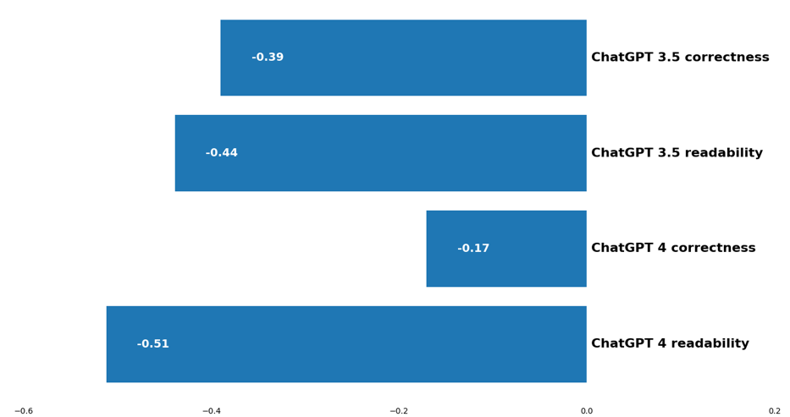
Results – Face Validation Survey
Correctness and Readability of AI-Generated Samples
Respondents preferred human-generated code over LLM-generated code
Newer LLM produced more correct code
Respondents found code generated by the older LLM more readable overall
Restricting responses to developers with 5+ years experience, both models produced code with equivalent readability
Respondent Preference of Code Samples (Avg)

Slide 18
Results – ML Detection Model
Trained on two sources of code samples:
Public GitHub repositories
LLM interaction samples
Significant pre-preprocessing required to get comparable data from data sources
Model accuracy for held-out data: 96.2%
Setting classification threshold to 0.7:
3 of 4 LLM samples classified correctly
7 of 8 human samples classified correctly
Not possible to determine if human participants used LLM assistance
Researcher’s solutions (no LLM assistance) highlighted in blue
LLM | Probability |  | Human | Probability
1 | 0.9983 |  | 1 | 0.0484
2 | 0.9968 |  | 2 | 0.5674
3 | 0.9862 |  | 3 | 0.9982
4 | 0.4327 |  | 4 | 0.5730
 |  |  | 5 | 0.1674
 |  |  | 6 | 0.0432
 |  |  | 7 | 0.6079
 |  |  | 8 | 0.6275

Slide 19
Discussion
LLMs are effective at generating code for straightforward tasks
Limitations arise with nuanced or complex tasks (especially when integrating multiple sub-problems)
Latest generation LLMs are good an explaining their solutions, but often make mistakes
LLMs often require a human expert to provide feedback to fine-tune solutions for correctness or efficiency
LLMs can not be relied on to generate code without expert review
Notes:
Only no feedback was GPT 4 on fib primes

Slide 20
Conclusion
LLMs offer significant potential in code generation
Increase productivity
Lower barrier to entry
V&V of LLMs is difficult
LLMs are black-box in nature and incredibly complex
Unpredictable and probabilistic outputs
A study was conducted to evaluate the latest LLMs (as of February 2024) for code generation:
LLMs performed worse than human experts at two coding prompts
Human experts could distinguish the origin of code samples and preferred code written by human for both correctness and readability
An ML-based classifier could distinguish between LLM and human generated code samples
LLMs are a useful tool in code generation, but human expertise remains critical

