Slide 1


Breaking Silos to Build the Next Generation of Navy Leaders: Navy Leadership Behavioral Model
John S. W. Spinda, Ph.D., Cognitive Performance Group
Bradley D. Celestin, Ph.D., Cognitive Performance Group
Holly C. Baxter, Ph.D., Cognitive Performance Group

Slide 2
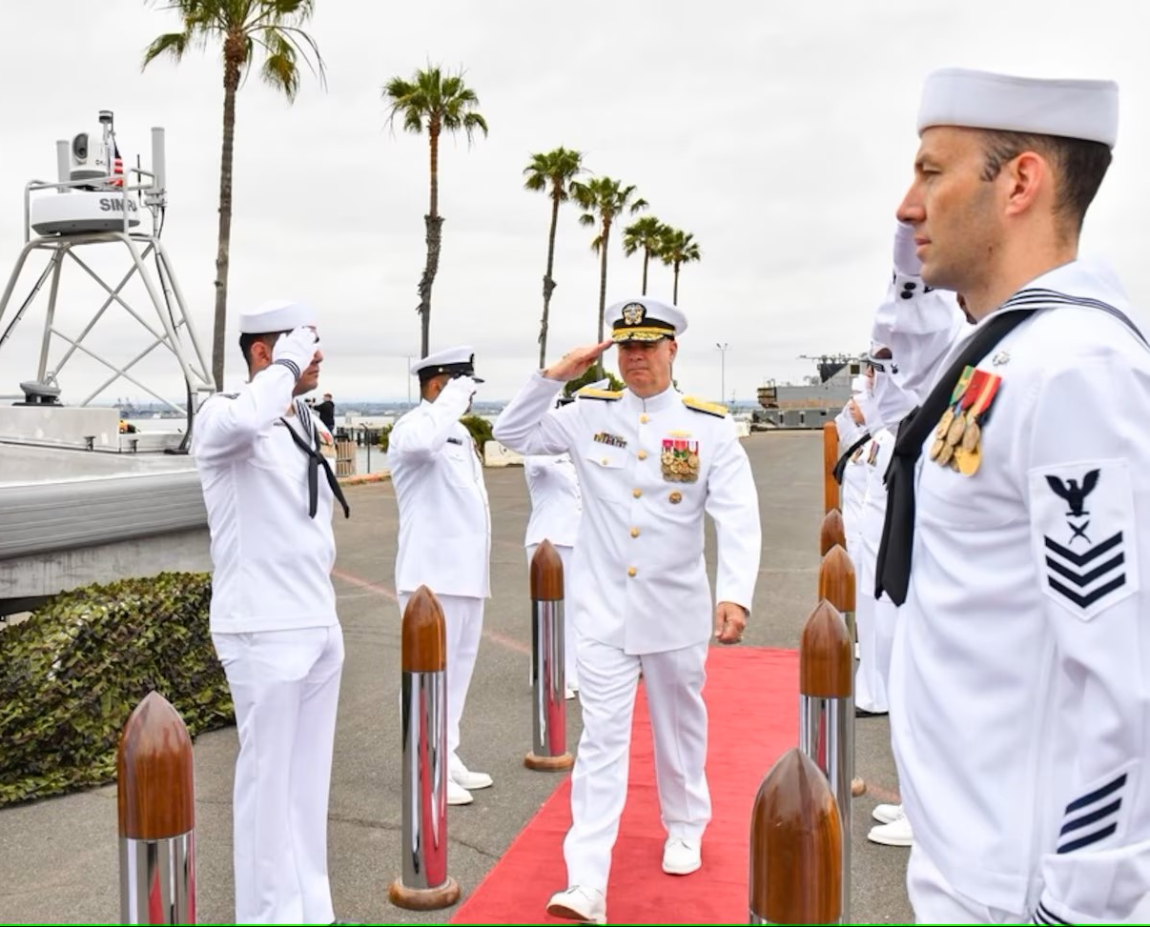
Presentation Overview
Background & Motivation
Development Process
NLBM Model
Challenges & Discussion
Next Steps
Source: Commander, Naval Surface Force, U.S. Pacific Fleet​

Slide 3


Background
Navy Leadership Behavioral Model
(NLBM)
An effort to develop and validate an evidence-based, transparent, and data-driven model that describes effective leadership behaviors across all Navy communities.
Source: Official Facebook Page of the U.S. Navy​

Slide 4

Motivation
The need for the NLBM is driven by multiple factors
Need for standardization of guidance improving outstanding leadership across the Navy
Further development of effective Navy leaders
Emphasis on improving leadership development from the Navy
Get Real Get Better
Culture of Excellence 2.0
Navy Leader Development Framework
Designed to support and inform ongoing Navy leader retention, selection, and slating efforts through the Talent Management Center of Excellence (TMCOE)
MyNavy Coaching
Performance and Evaluation Transformation (PET)
Navy Leadership Assessment Program (NLAP)

Slide 5

NLBM Development
NLBM Development Process
Front-end analysis of Navy leadership documents (e.g., Navy community job analyses/competency models, NLDF, GRGB)
Raw interview statements from six different Navy communities (n= 3,820) from semi-structured interview transcriptions and focus groups
Review of leadership research literature
Input from Navy SMEs at each stage of development
Source: Commander, U.S. 2nd Fleet Public Affairs​

Slide 6
Methods for NLBM Development: NLBM 1.0
Front-end Analysis of Navy Leadership Documents
Qualitative Card Sort
Thematic Coding
Navy community job analyses/competency models
Materials outlining Navy leadership (e.g., PCC, NLDF, GRGB)
Raw interview and focus group data from 5 Navy communities (n= 1,689)
Sorted data into categories that reflected similar themes or characteristics
Resulted in 64 categories of leadership characteristics.
Refined into NLBM 1.0 model (18 Factors, 5 Meta-Factors)
Raw interview data coded using NLBM 1.0 (n= 3,820)
Two coders coded each statement, if the coders could not reach an agreement, the statement was coded by a 3rd coder
Method 1
Method 2
Method 3

Slide 7
NLBM 1.0 to 2.0 transition
Problems |  | Solutions
Interrater reliability at acceptable, but not optimal levels 53%, 2 of 2 agreement; 79%, 2 of 3 agreement. IRR = .51 |  | Reframing of factors
Possibility that we missed research-supported leadership factors |  | Turn to leadership research and comprehensive leadership models
Data was challenging, often indicating multiple factors |  | Primary/secondary coding

Slide 8
Methods for NLBM Development: NLBM 2.0
1
Revised model
Combined NLBM 1.0 factors with factors from Campbell (2012) framework
NLBM 2.0 had 21 factors across 3 determinants (i.e., meta-factors)
2
Thematic Coding (Research Team)
Coded raw interview data (n= 793) where no agreement was found in first round of coding (NLBM 1.0)
Used primary/secondary coding
3
Thematic Coding (Navy SMEs)
Coded items (n= 3,481) using factors from Campbell (2012)
Used primary/secondary coding

Slide 9
Methods for NLBM Development: NLBM 2.0
4
Topic Modeling
Applied natural language processing (NLP) methods to raw interview and focus group data, using structural topic models.
A parallel search was used to identify an optimal number of topics (k) based on exclusivity (i.e., uniqueness) and semantic coherence (i.e., how well the words from a topic relate to each other).
After evaluating the results from a series of models (e.g., k=5, k=30), a 15-topic model was selected as an optimal choice.
Researchers generated topic labels for the k=15 model by reviewing distinguishing terms and raw statements associated with each topic.
The 15-topic model strongly supported the researcher-derived NLBM factors and converged on very similar results.

Slide 10
NLBM 2.0 to 3.0 transition
Problems |  | Solutions
Interrater reliability still below optimal levels Research Team: 40% primary agreement; 64% all agreement types (IRR = .57) Navy SMEs: 48% primary agreement; 63% all agreement types (IRR = .63) |  | Re-organizing of factors
Are model titles and operational definitions relevant to the Navy? |  | Input from Navy SMEs at workshop to refine and clarify model
How can we account for stable, individual influences? |  | Addition of an Ethos determinant and factors

Slide 11
Methods for NLBM Development: NLBM 3.0
Revised model
Thematic Coding
Revised NLBM 2.0 factor titles and operational definitions.
Added fourth determinant: Ethos
NLBM 3.0 has 22 factors across 4 determinants (i.e., meta-factors)
Full set of raw interview/focus group data was coded using NLBM 3.0 (n = 3,820)
3rd coder used on factors where no agreement occurred
Improved primary agreement among two coders (59%) and three coders (63%)
96% agreement across all agreement types (primary/secondary factors); IRR =.96
Coders also had high levels of agreement at determinant level (77% for all primary factors)
Method 1
Method 2

Slide 12
NLBM 3.0: Model Overview
Mission | Develop/Inspire | Management
Technical Proficiency | Sailor Support | Decision Making & Problem Solving
Communication | Relationship Building | Strategic Goal Setting
Initiative, Persistence, & Effort | Goal Emphasis | Provides Guidance, Direction, & Structure
Facilitating Team & Peer Performance | Empowerment | Monitoring Unit Effectiveness
Serves as a Role Model | Training, Coaching, & Mentoring | Administration

Slide 13
NLBM 3.0: Model Overview
Ethos
Emotional Intelligence | Interests
Personality | Metacognition
Cognitive Ability | Motivation
Values

Slide 14
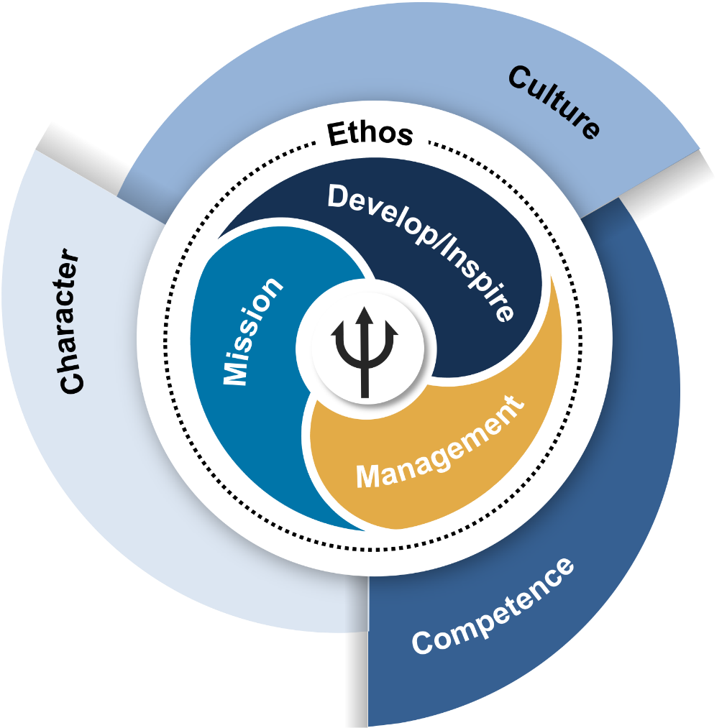
Challenges
Challenges
Interrater reliability was initially not as strong as desired due to NLBM factor overlap.
Data was a mix of interviewer notes/summaries and actual interviewee statements, and questions changed across communities.
Distribution of agreed upon raw interview statements among NLBM factors.

Slide 15
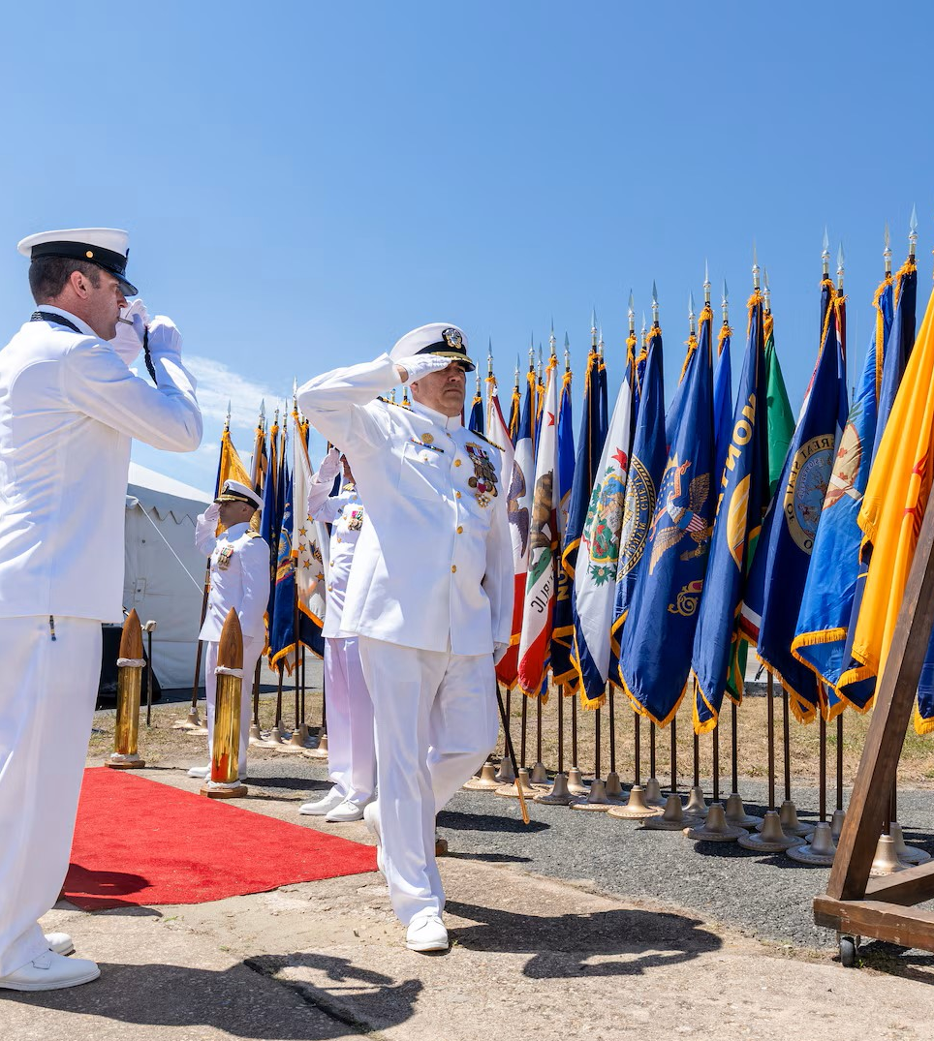

Discussion
This study demonstrates a method for developing and validating behavioral models of leadership.
Utilizing qualitative data from Navy personnel about leadership experience within different naval communities.
Ensures that leadership factors are measurable and trainable to align with Navy talent management goals.
Incorporating NLP algorithms and human analysis on the same data set.
NLP results helped refine the findings of the human analysis at the factor level.
Utilizing NLP and human analysis together may help build on the strengths and minimize the weaknesses of both approaches.
Source: Naval Sea Systems Command, Corporate Communications​

Slide 16
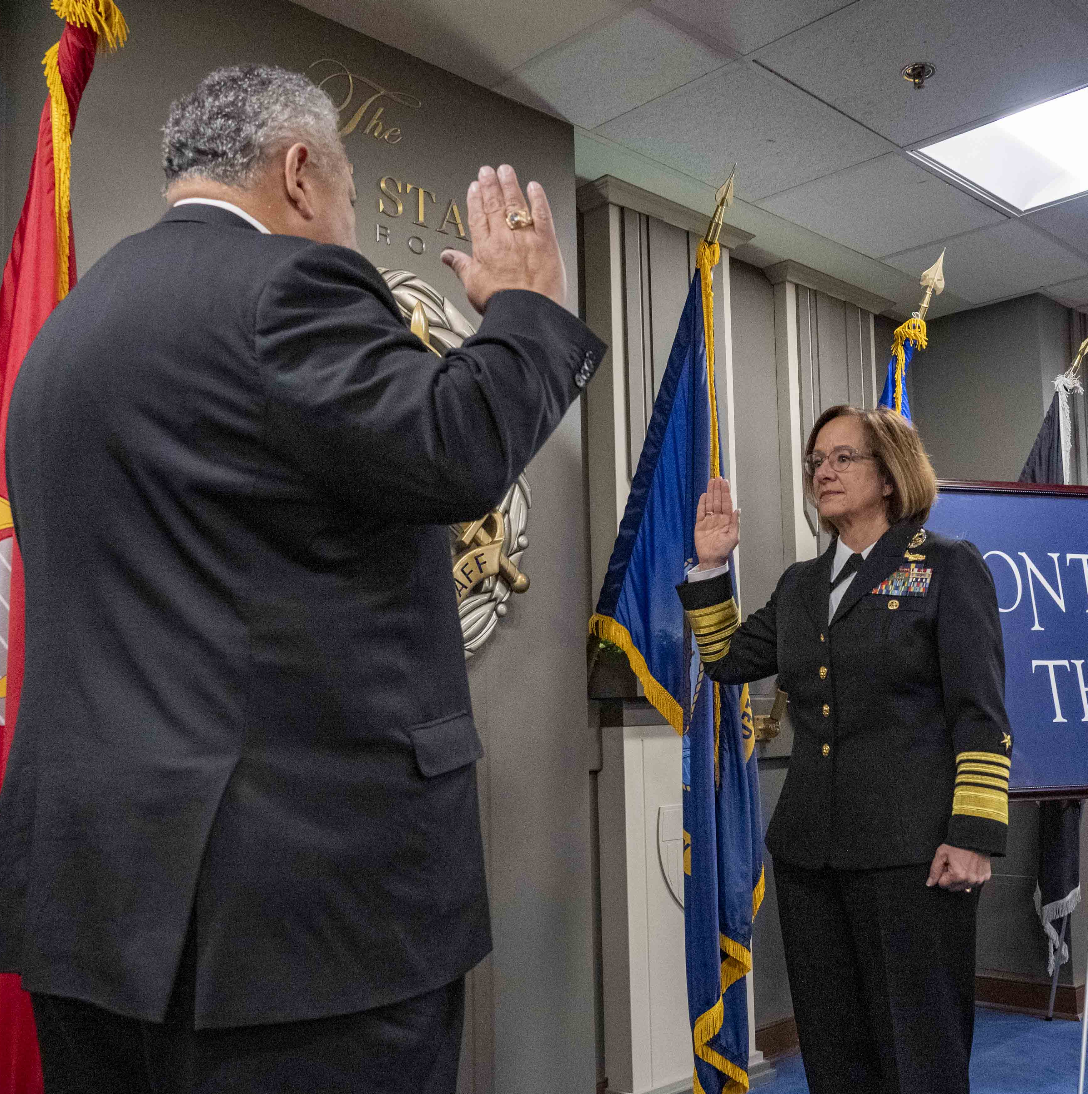
Next Steps
Next steps for NLBM:
Incorporation of additional community data.
Determine model adjustments to create final behavioral model
This will be NLBM 4.0
NLP Analysis to test NLBM 4.0
Development of behaviorally anchored rating scales (BARS) and 360-degree assessments in support of NLBM
1
2
3
4
Source: The United States Navy, Press Office​

Slide 17
Questions
For Questions:
Holly C. Baxter, Ph.D.
holly@cognitiveperformancegroup.com

