Slide 1
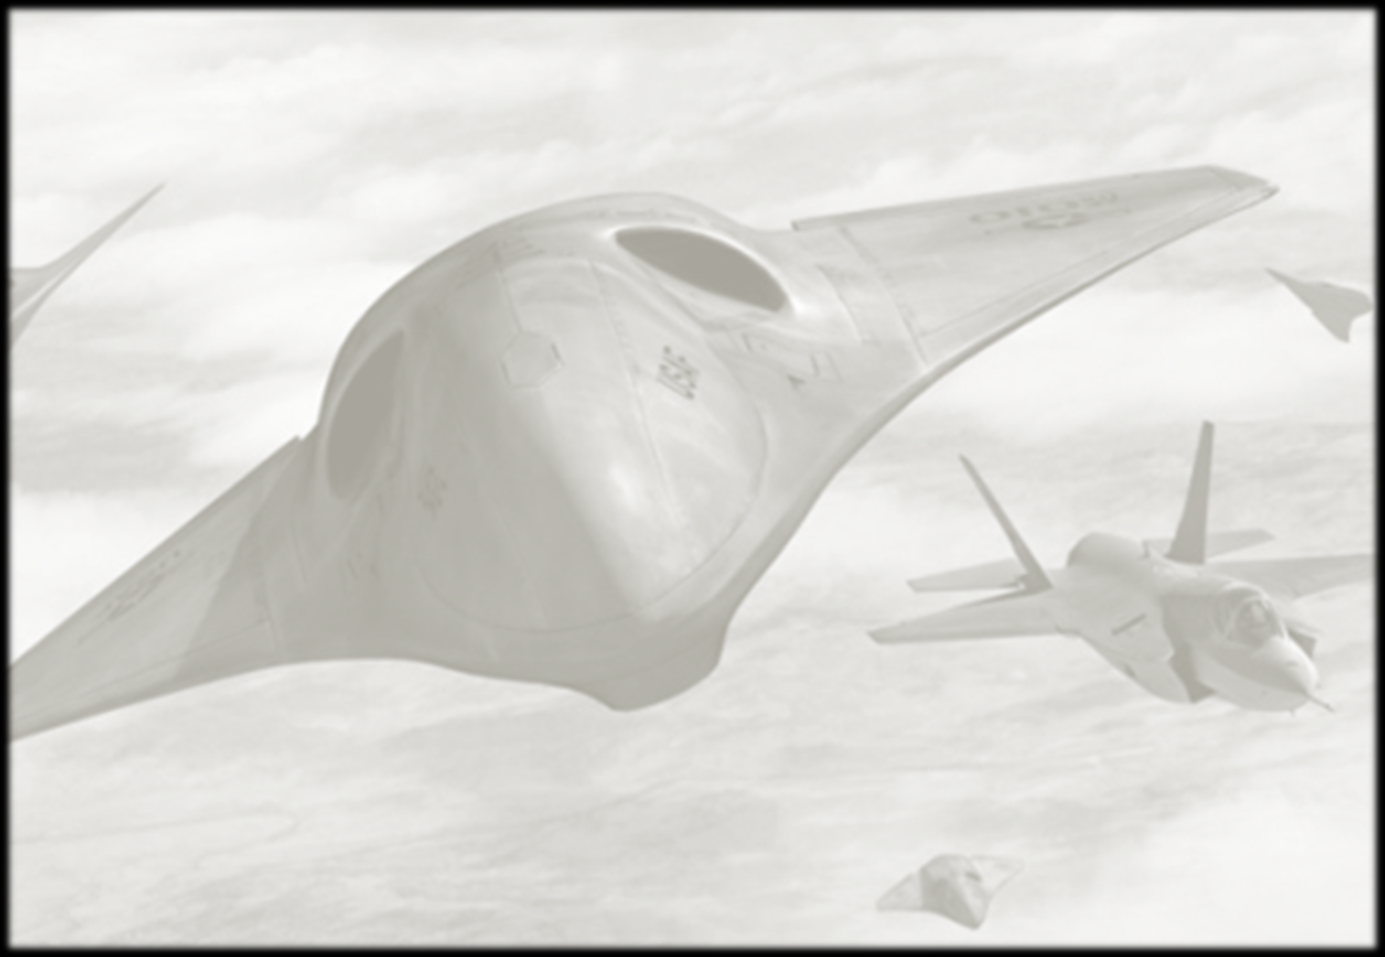

Mastering Air Combat: Using Neural Fields for Self-Improving AI Agents
Orlando Avila-García, Arquimea Research Center
George Hellstern, Lockheed Martin Aeronautics
Notes:
Paper PIRA: AER2024060631

Slide 2
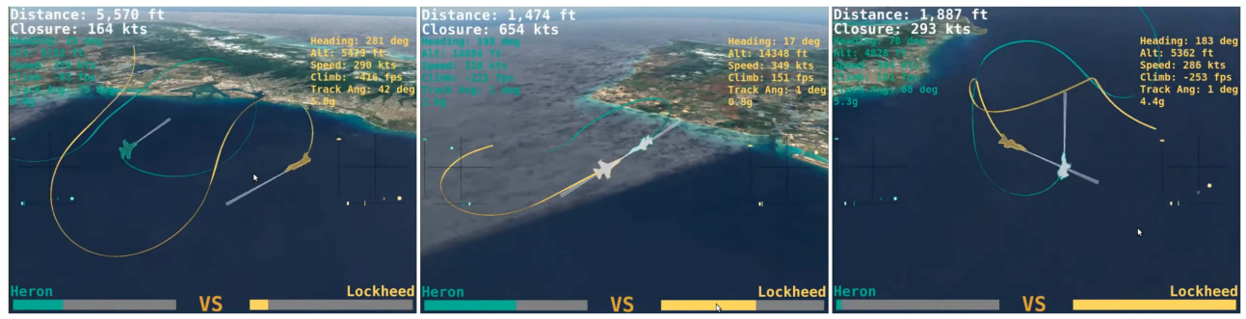
The Cost of Autonomy Development and Continuous Improvement
Despite Deep Reinforcement Learning (DRL) agents’ previous success in combat autonomy, the engineering effort required remains enormous.
Human experts (experienced pilots, engineers and scientists) must collaborate carefully to improve those DRL agents, a process that is both costly and time-consuming.

Slide 3
Outline
First steps
Concept of Self-Improving Agents
Power of Episodic Memory
Neural Radiance Fields
Putting it all Together: NF-HEM Architecture
Application to AlphaDogfight
Simple Ideas with Profound Impact

Slide 4
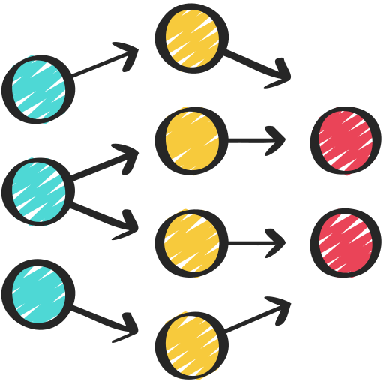

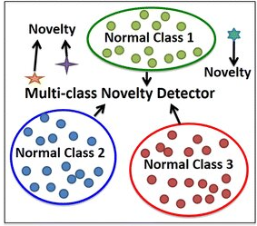
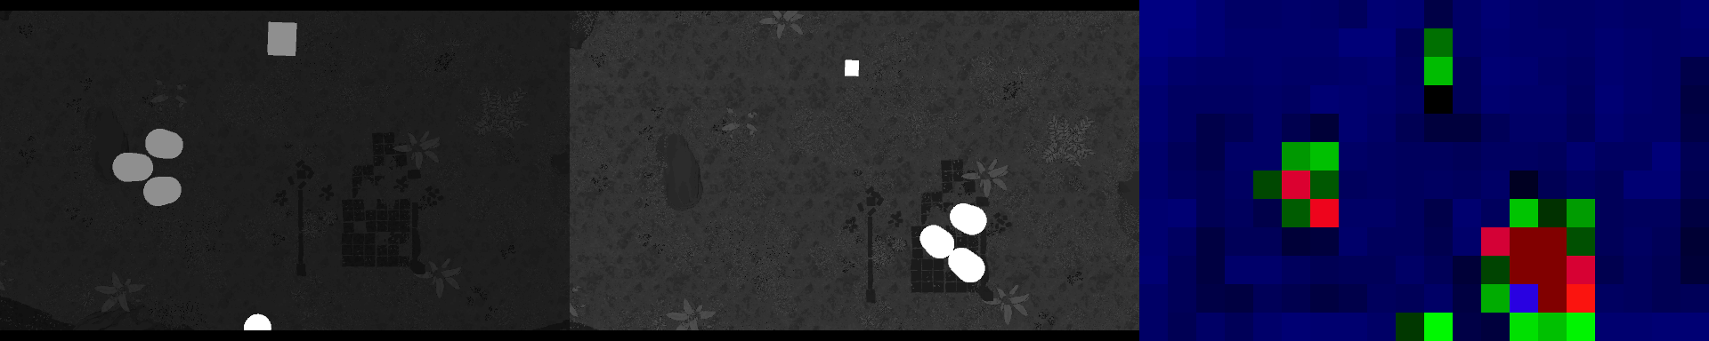
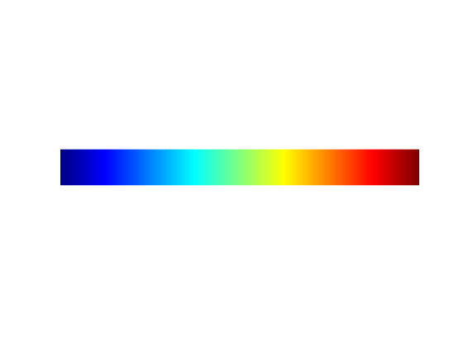
Situational Analysis for Neural Network Detectors (SANND) Storing memories in latent space to “imagine” what should be in a scene
Value Statement: Can we know when the DRL agent is in a novel situation?
Neural Memory
Real-time drone
Novelty Detection
100% prob. of novelty
50% prob. of novelty
0% prob. of novelty
SANND Concept
Formation
DARPA DSO
Pitch
LMCO
Proposal
Kickoff Tenerife, SP
Neural
Field Compression
Neural Distance Metric
ARQUIMEA Discussions
Lit Review
Prototype
I/ITSEC
Presentation
1QTR
2QTR
3QTR
4QTR
1QTR
2QTR
3QTR
4QTR
2023
2024
Notes:
Images used by permission from Arquimea

Slide 5
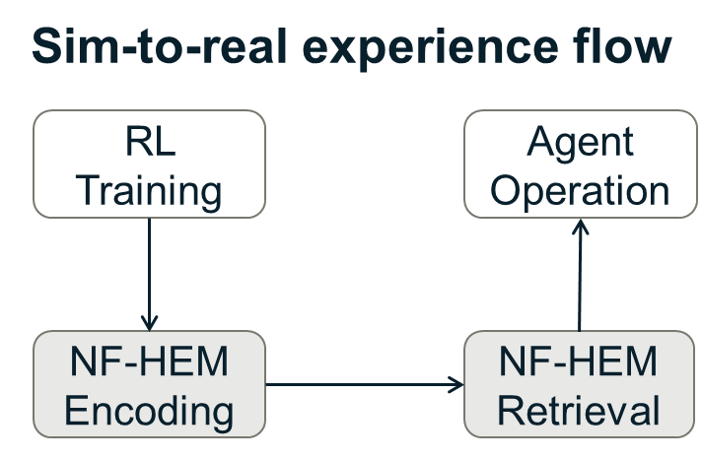
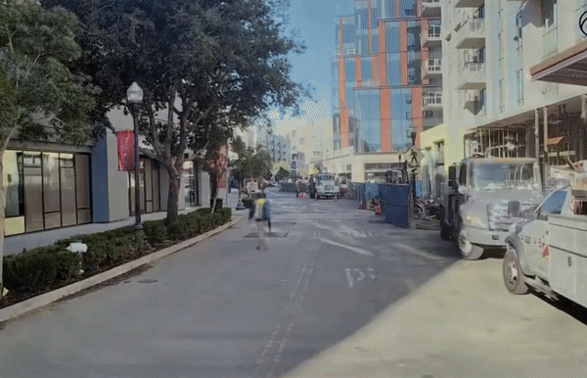
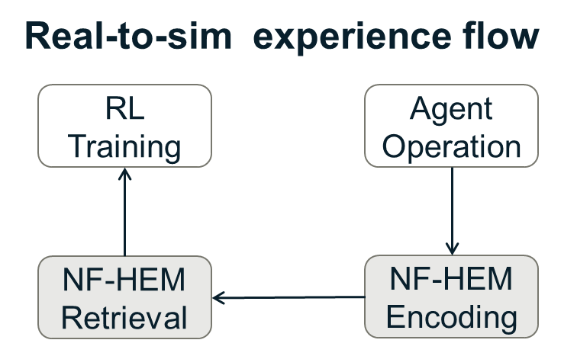
Two-Way Self-Improvement Process Using NF-HEM
PRISM-1: Photorealistic reconstruction in static and dynamic scenes - WAYVE

Slide 6
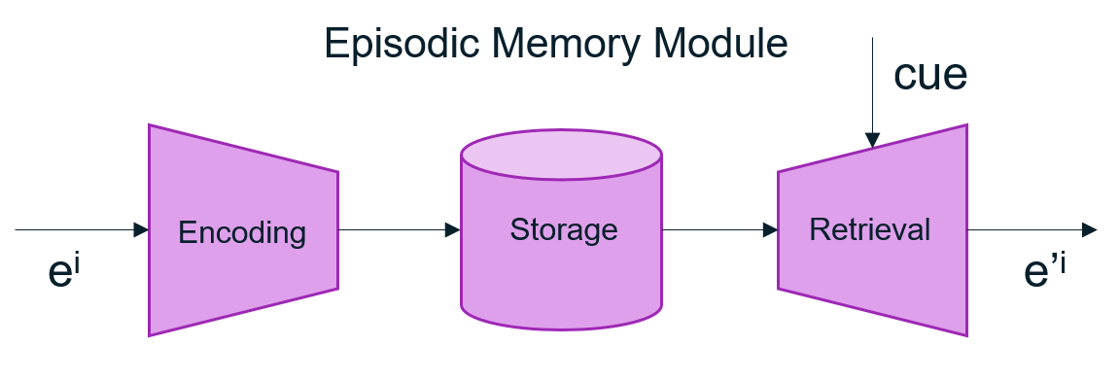
Power of Episodic Memory
A Deep Episodic Memory (DEM) uses Deep Neural Networks to encode, store, index, and/or retrieve specific events (episodes) without making assumptions about the structure or content of those episodes.
Open scientific questions:
When to encode
What to encode
How to index
How to retrieve

Slide 7
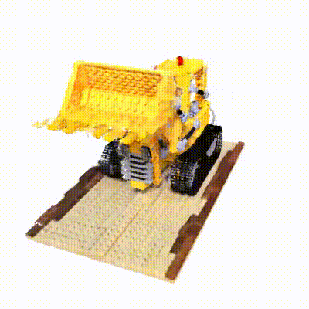
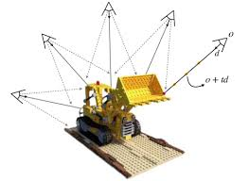
Neural Radiance Fields (NeRF)
Episodic Memory can be encoded in a compact high-fidelity representation with Implicit Neural Representations (INR), such us Neural Radiance Fields (NeRF)
Images from multiple viewpoints
Novel view synthesis from arbitrary viewpoints

Slide 8
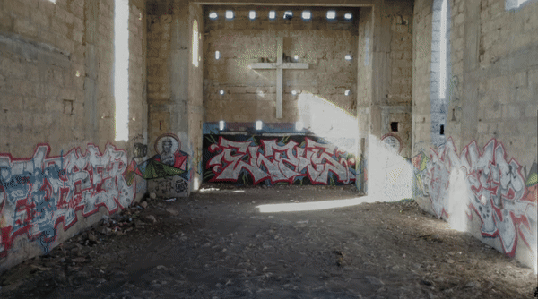
NeRF Examples

Slide 9
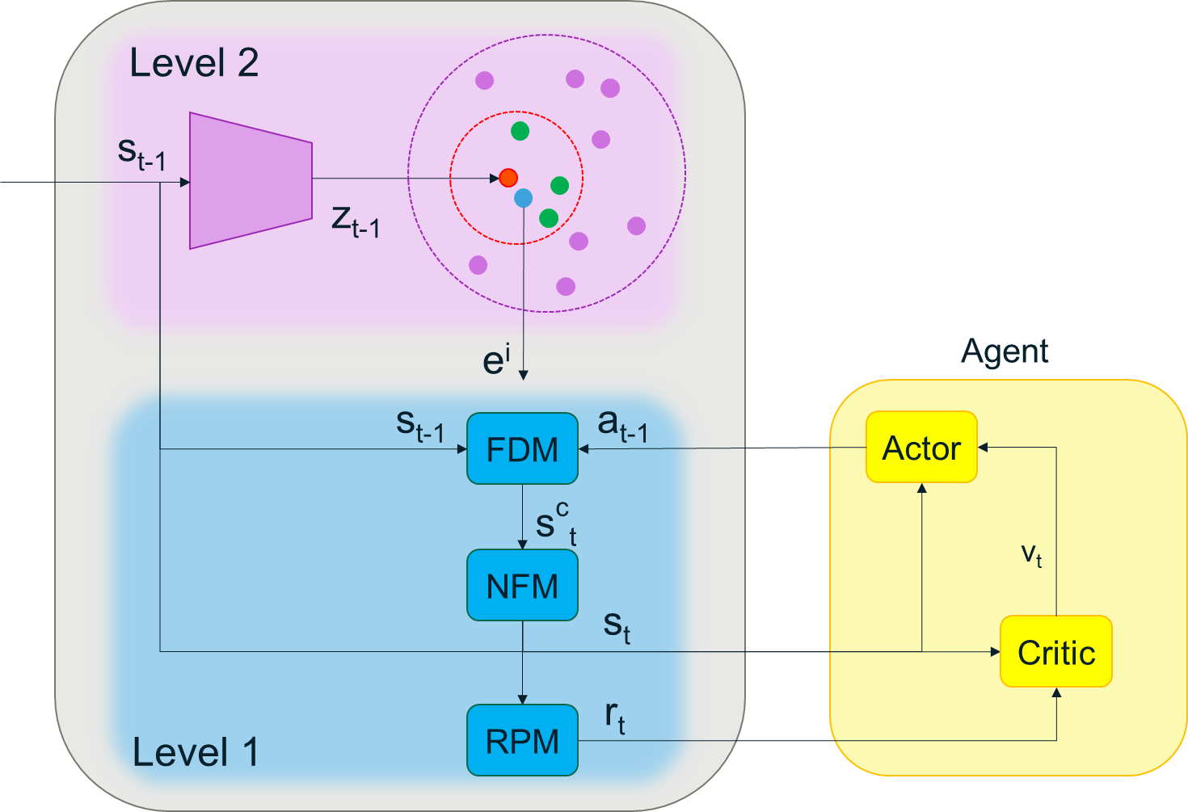
Putting it all Together: NF-HEM Architecture
Capturing Environment
C
A
D
E
Novel view synthesis
B
F
The system provides efficient storage and retrieval of episodic memory, helping the agent learn from past experiences and improve autonomously.
Notes:
L2: Encodes and indexes observations in a latent space, storing them efficiently in a vector database.
L1: Reconstructs the detailed observation data from an episode in a spatially aware and continuous form, allowing the agent to access specific points in space and time.

Slide 10

Application to AlphaDogfight
Sim-to-real experience flow (a)
Capturing experiences during training
NF-HEM Encoding
NF-HEM Retrieval
Detecting novel behaviours during evaluation

Slide 11
Application to AlphaDogfight
Real-to-sim experience flow (b)
Training on novel behaviours
NF-HEM Retrieval
NF-HEM Encoding
Capturing experiences during evaluation

Slide 12


Questions?
Orlando Avila-García, oavila@arquimea.com Joaquín Fernández León, jfleon@arquimea.com Germán Pescador Barreto, gapescador@arquimea.com Javier Rodríguez Vázquez, fjrodriguez@arquimea.com | George Hellstern, george.Hellstern@lmco.com Rachael Shudde, rachael.shudde@lmco.com
Arquimea Research Center | Lockheed Martin Aeronautics Company
Santa Cruz de Tenerife, Spain | Fort Worth, Texas, USA

