Slide 1
Optical See-Through as a Cybersickness Mitigation Strategy in Extended Reality Helicopter Flight Simulation
Boris Englebert (presenter)
Roemer Bakker
Tanja Bos
Tobias Tanis

Slide 2
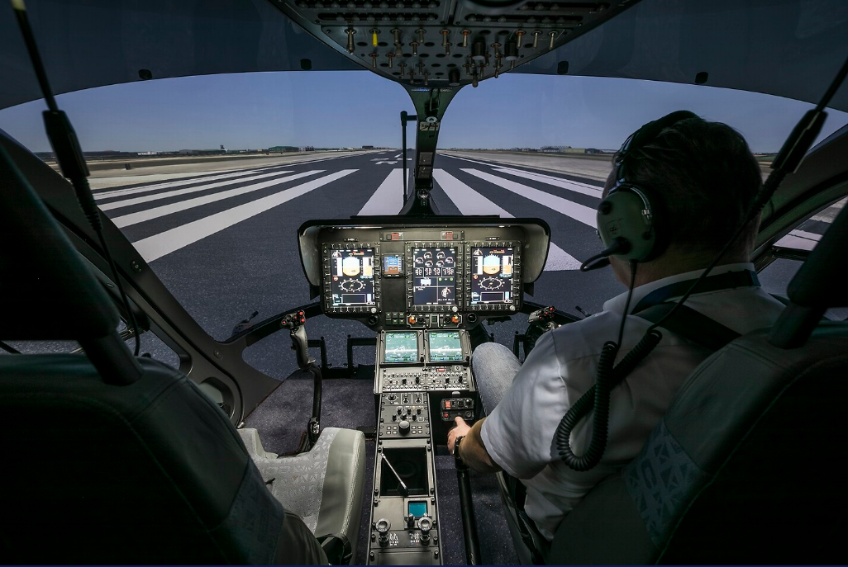
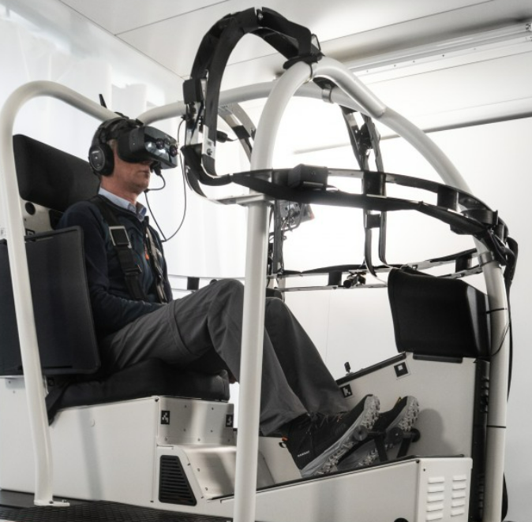



Why Extended Reality in Flight Simulation?
‘Conventional’ helicopter flight simulation
Extended Reality (XR) helicopter flight simulation
[2]
+
+
-
Cost-effective
Flexible Usage
Cybersickness

Slide 3
Extended Reality Flight Simulation and Cybersickness
Higher incidence of motion sickness in XR flight simulation compared to conventional flight simulation
-
XR – umbrella term spanning concepts like Virtual Reality (VR) and Mixed Reality (MR)
Cybersickness
Motion sickness triggered by virtual environments - cybersickness
Negatively impacts training effectiveness
Visual sensory inputs from virtual environment do not correspond with the motion that is felt
Occurrence of visual-vestibular conflict
Causes and exacerbates cybersickness
Prevents adoption of VR training environments
Mitigating visual-vestibular conflict to alleviate feelings of cybersickness
In the virtual environment, provide a visual reference to the actual environment that corresponds with the motion that is felt

Slide 4
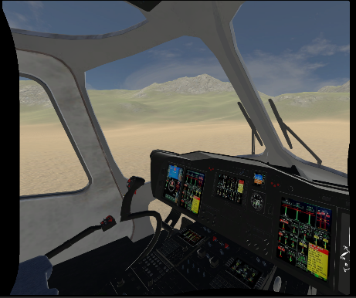
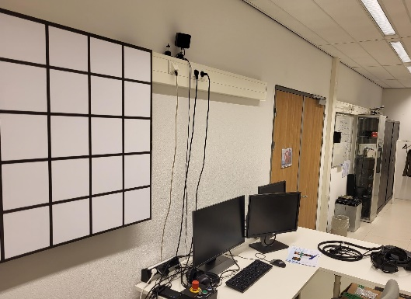
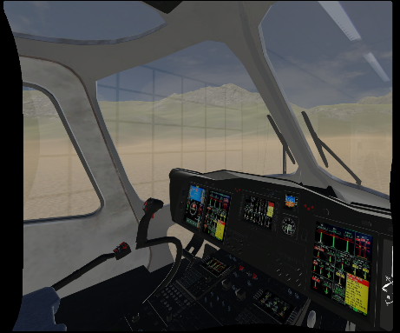


Previous Cybersickness Mitigation in Flight Simulation Research
In the virtual environment, provide a visual reference to the actual environment that corresponds with the motion that is felt
Blend the virtual environment with the actual environment – Mixed Reality (MR)
Virtual Environment
Actual Environment
Mixed Reality
+
-
Without physical motion – MR reduces cybersickness
MR breaks immersion, and negatively affects pilot performance and training effectiveness

Slide 5
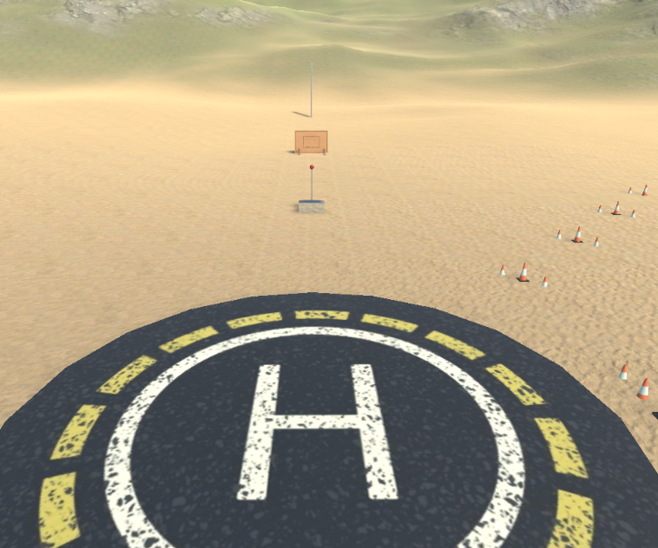
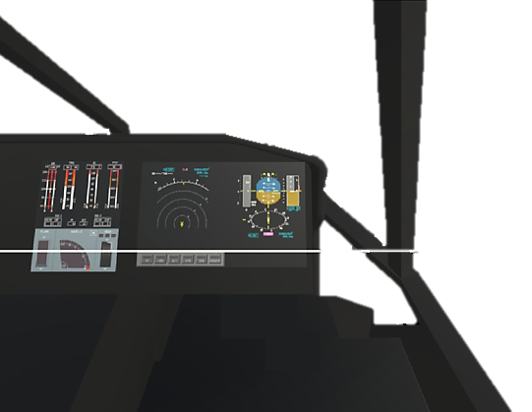
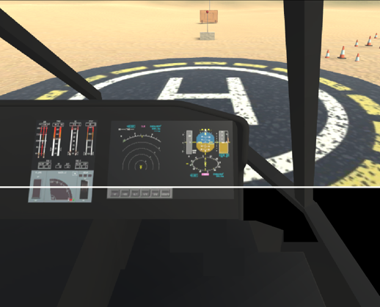
Optical See-Through Mixed Reality for Cybersickness Mitigation
In the virtual environment, provide a visual reference to the actual environment that corresponds with the motion that is felt
Combine a purely virtual outside environment with an optical see-through view of the real cockpit environment – Optical See-Through Mixed Reality (MR OST)
Virtual (Outside) Environment
Real Cockpit Environment
OST MR
How does Optical See-Through Mixed Reality (OST MR) affect the development of cybersickness compared to Virtual Reality (VR), in helicopter flight simulation?

Slide 6
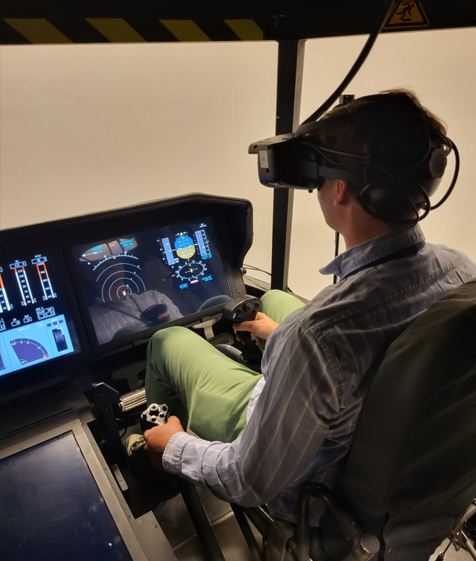
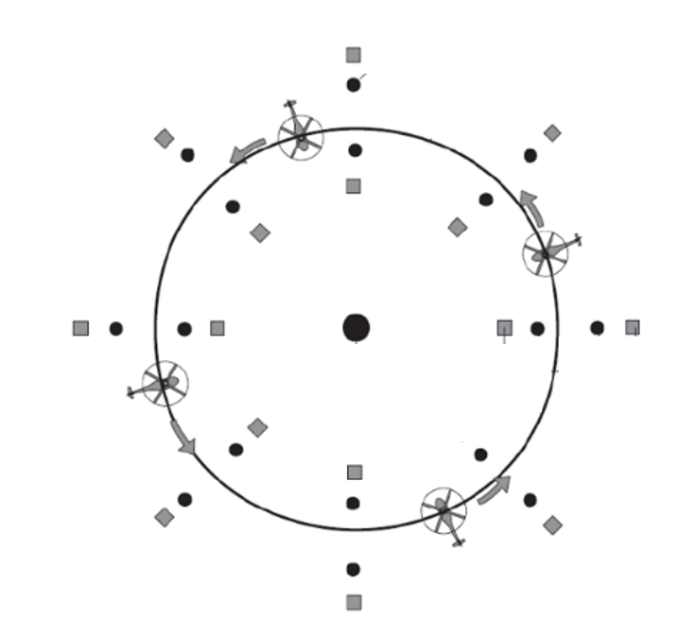
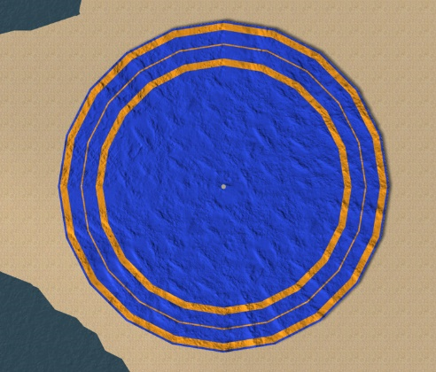
Experiment Setup – Flight Simulation Environment
Human-in-the-loop experiment - participants performing predetermined helicopter flying tasks
Simulation Setup - Hardware
Virtual Environment and Flying Task
Physical cockpit mock-up
Fixed track consisting of ADS-33E-PRF Mission Task Elements (MTEs)
Control loaded flight controls
Hover
Depart-Abort
Slalom
Sloped landing
Lateral sidestep
Vertical remask
Hovering turn
Pirouette
AS532 ‘Cougar’ helicopter flight model
Half-mirror and combiner-based OST HMD
‘Open’ downview
Visualization of flight simulation environment
Example of Pirouette MTE in virtual environment

Slide 7
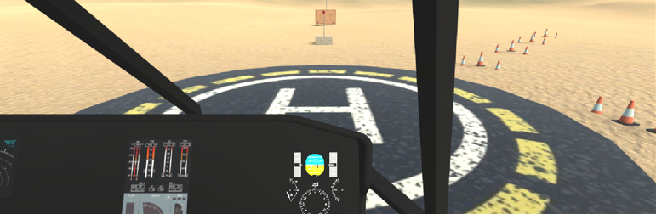
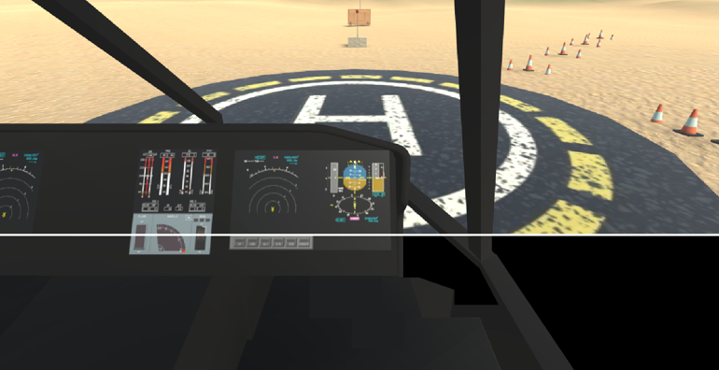
Experiment Setup – Experiment Conditions
In the virtual environment, provide a visual reference to the actual environment that corresponds with the motion that is felt
Regular VR (baseline)
Virtual Cockpit + Virtual Environment
OST MR
Physical Cockpit + Virtual Environment

Slide 8
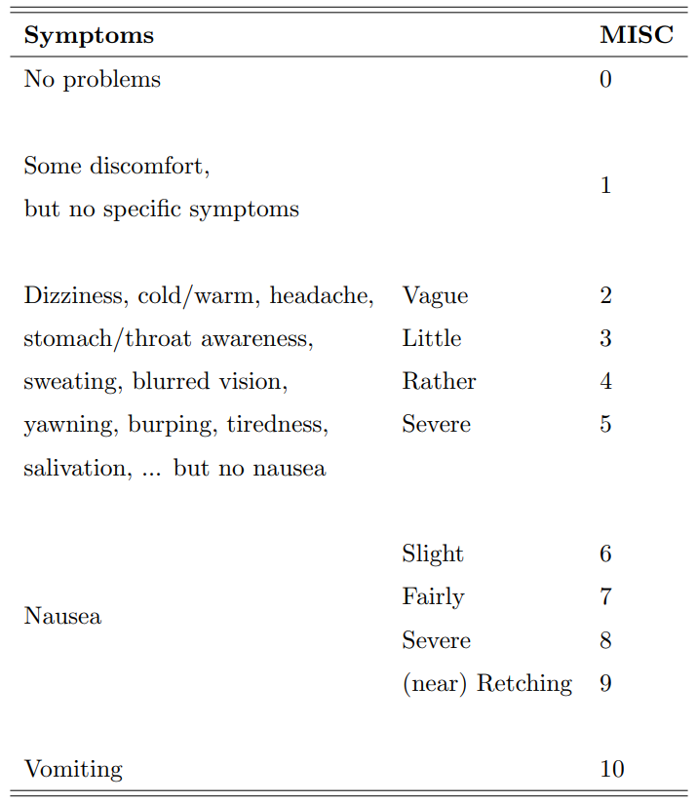
Experiment Setup – Participants and Dependent Measures
Five pilots completed the experiment, all of whom held an active MPL(H) or CPL(H)
Between subjects experiment design
Subjective cybersickness dependent measures
MIsery SCale (MISC) scores, evaluated after completion of each ADS-33 MTE
Simulator Sickness Questionnaire (SSQ) scores
4-point Likert scale for severity of most common sickness symptoms
Objective cybersickness dependent measures
Amount of head movement in VR versus OST MR for the pirouette MTE
Standard deviation of lateral and vertical head position

Slide 9
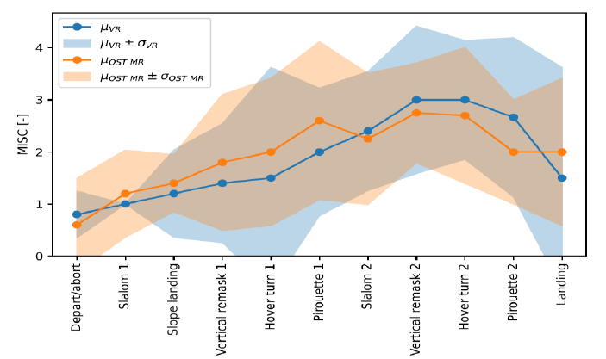
Experiment Results – MIsery SCale (MISC) Scores
Progression of mean MISC scores
Maximum MISC scores statistics
Condition | Median Max. MISC
VR | 4 (μ = 3.20, σ = 1.17)
OST MR | 3 (μ = 3.20, σ = 1.17)
Minimal difference in progression of MISC scores between VR and OST MR conditions
Slightly higher median max. MISC score for VR than for OST MR – identical mean max. MISC score

Slide 10
Experiment Results – Simulator Sickness Questionnaire Scores
 | SSQ Scores
Condition | P1 | P2 | P3 | P4 | P5 | μ | σ
VR | 29.9 | 44.9 | 67.3 | 7.5 | 44.9 | 38.9 | 19.7
OST MR | 15.0 | 44.9 | 67.0 | 18.7 | 74.8 | 44.1 | 24.4
Individual differences for sickness severity
Higher sickness scores in VR than OST MR: P1
Higher sickness scores in OST MR than VR: P4, P5
Slightly higher mean SSQ score in OST MR than VR

Slide 11
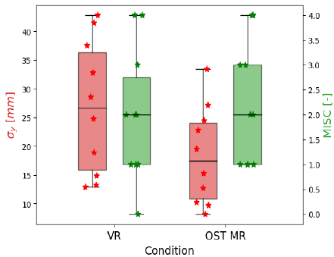
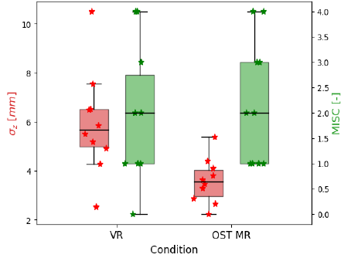
Experiment Results – Head Movement
Lateral head movement
Vertical head movement
Statistically significantly more lateral and vertical head motion in VR than in OST MR
High within-pair correlation (r > 0.8), implying statistical power despite small sample size
No observable differences for the MISC scores between conditions after pirouette MTE completion
No correlation between the MISC scores and lateral/vertical head motion

Slide 12
Conclusions and Future Research
How does Optical See-Through Mixed Reality (OST MR) affect the development of cybersickness compared to Virtual Reality (VR), in helicopter flight simulation?
No clear benefit of OST MR compared to VR for the mitigation of cybersickness
Minimal difference between OST MR and VR in MISC score progression, maximum MISC scores, and mean SSQ scores
Individual differences in reported SSQ scores imply that individual preferences may exist in terms of comfort in extended reality helicopter flight simulation
Despite observable differences in the amount of lateral and vertical head motion, no correlation with cybersickness severity
Pilots reported that the real world cockpit in OST MR did provide additional useful visual cues for the execution of the MTEs
Visual cues from OST MR real-world cockpit did not meaningfully contribute to visual motion perception

Slide 13
Conclusions and Future Research
How does Optical See-Through Mixed Reality (OST MR) affect the development of cybersickness compared to Virtual Reality (VR), in helicopter flight simulation?
Pilots reported that the real world cockpit in OST MR did provide additional useful visual cues for the execution of the MTEs
Visual cues from OST MR real-world cockpit did not meaningfully contribute to visual motion perception
OST MR HMD vertical field-of-view: 72 degrees, vertical field-of-views larger than 50 degrees do not contribute significantly to motion perception
Future research efforts on cybersickness mitigation in extended reality helicopter flight simulation:
Focus on the area of the field-of-view that elicits the strongest motion perception
Minimize immersion deterioration as a result of visual cybersickness mitigation measures

