Slide 1

Metalog Synthetic Data Generation for Healthcare
Raul Rios, Lone Star Analysis
Randal Allen, Lone Star Analysis
Eric Haney, Lone Star Analysis

Slide 2
BLUF
To generate readiness, we must be able to fully exploit the data we have
  Can’t wait for more data
  Enabling cross-collaboration is key; break down data silos
Multivariate metalog distributions is statistic tool that can help bridge data silos
  Continuous parametric metalog models can fit to any dataset
  Improving correlation shaping and better handling for discrete variables extends use
Through example in Health data, Multivariate metalog models shown to:
  Anonymize data – to securely share sensitive data
  Bootstrap data – to feed larger models
  Compress data – to efficiently share data
Notes:
Model overfitting is another concern

Slide 3
Outline
Data Silos
Healthcare Data Protections
Modeling with Metalogs
Healthcare Data Application
Summary

Slide 4
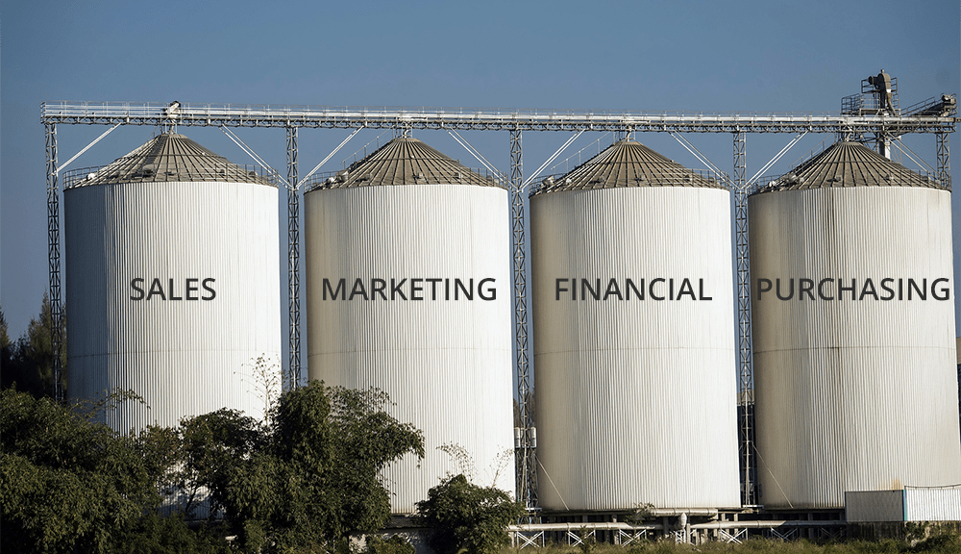
Data Silo Problem
clicdata.com
Data silos create losses in efficiency and value
Notes:
Title says “healthcare,” but in reality, applicable for wider problems
Data silos - What are they?
Why are they a problem?
arise when organizational structures, policies, workflows, and technology artificially separate data access from potential users
create losses in efficiency and value in many domains by limiting cross-collaboration, creating data inconsistencies, and wasting resources (Talend, 2020)
Often discussed within organizations but also a problem between organizations looking to partner
For an example, let’s look at the healthcare sector… NEXT!

Slide 5


Data Silo Problem
clicdata.com
Structures
Policies
Workflows
Users
Technology
Data
InfoSec
Limit cross-collaboration
Create data inconsistencies
Waste resources
Data silos create losses in efficiency and value
Notes:
Title says “healthcare,” but in reality, applicable for wider problems
Data silos - What are they?
Why are they a problem?
arise when organizational structures, policies, workflows, and technology artificially separate data access from potential users
create losses in efficiency and value in many domains by limiting cross-collaboration, creating data inconsistencies, and wasting resources (Talend, 2020)
Often discussed within organizations but also a problem between organizations looking to partner
For an example, let’s look at the healthcare sector… NEXT!

Slide 6
Data Silo Problem
clicdata.com
Structures
Policies
Workflows
Users
Technology
Data
InfoSec
Limit cross-collaboration
Create data inconsistencies
Waste resources
Data silos create losses in efficiency and value
DoD wants to break down data silos and improve data quality
If we want a ready force, we cannot afford data silos
Notes:
Title says “healthcare,” but in reality, applicable for wider problems
Data silos - What are they?
Why are they a problem?
arise when organizational structures, policies, workflows, and technology artificially separate data access from potential users
create losses in efficiency and value in many domains by limiting cross-collaboration, creating data inconsistencies, and wasting resources (Talend, 2020)
Often discussed within organizations but also a problem between organizations looking to partner
For an example, let’s look at the healthcare sector… NEXT!

Slide 7
Healthcare Data Silos and Privacy
Privacy Act
PII
HIPAA
Unique
identifying
characteristic
Individual
health information
PHI
Notes:
PII := Personally Identifiable Information
PHI := Protected Health Information
PHI is a subset of PII. It is PII that is specifically “associated with or derived from a healthcare service event”
PII and PHI both have protection requirements (Privacy Act and HIPAA) -> leads to data silos
These necessary protections, make it difficult to collaborate on research
Empowering researchers with data via anonymization; leads to innovation and better solutions for end-users
One thing about the Privacy Act: PII an be legally accessed for research purposes if sufficiently anonymized… NEXT

Slide 8
Healthcare Data Silos and Privacy
Privacy Act
PII
HIPAA
Necessary protections create data silos
Unique
identifying
characteristic
Individual
health information
PHI
Medical research community struggles to access
data needed for studies (Chevrier et al., 2019)
Notes:
PII := Personally Identifiable Information
PHI := Protected Health Information
PHI is a subset of PII. It is PII that is specifically “associated with or derived from a healthcare service event”
PII and PHI both have protection requirements (Privacy Act and HIPAA) -> leads to data silos
These necessary protections, make it difficult to collaborate on research
Empowering researchers with data via anonymization; leads to innovation and better solutions for end-users
One thing about the Privacy Act: PII an be legally accessed for research purposes if sufficiently anonymized… NEXT

Slide 9
Healthcare Data Silos and Privacy
Privacy Act
PII
HIPAA
Necessary protections create data silos
Unique
identifying
characteristic
Individual
health information
PHI
Medical research community struggles to access
data needed for studies (Chevrier et al., 2019)
Security / Privacy can be a barrier to data collection and sharing – and thus collaboration & innovation
Solutions that address data silos are needed to aid research across gov’t entities, DoD included
Notes:
PII := Personally Identifiable Information
PHI := Protected Health Information
PHI is a subset of PII. It is PII that is specifically “associated with or derived from a healthcare service event”
PII and PHI both have protection requirements (Privacy Act and HIPAA) -> leads to data silos
These necessary protections, make it difficult to collaborate on research
Empowering researchers with data via anonymization; leads to innovation and better solutions for end-users
One thing about the Privacy Act: PII an be legally accessed for research purposes if sufficiently anonymized… NEXT

Slide 10
Healthcare Data Silos and Privacy
Privacy Act
PII
HIPAA
Necessary protections create data silos
Unique
identifying
characteristic
Individual
health information
PHI
Medical research community struggles to access
data needed for studies (Chevrier et al., 2019)
PII an be legally accessed for research purposes if sufficiently anonymized…
But!
Security / Privacy can be a barrier to data collection and sharing – and thus collaboration & innovation
Solutions that address data silos are needed to aid research across gov’t entities, DoD included
Notes:
PII := Personally Identifiable Information
PHI := Protected Health Information
PHI is a subset of PII. It is PII that is specifically “associated with or derived from a healthcare service event”
PII and PHI both have protection requirements (Privacy Act and HIPAA) -> leads to data silos
These necessary protections, make it difficult to collaborate on research
Empowering researchers with data via anonymization; leads to innovation and better solutions for end-users
One thing about the Privacy Act: PII an be legally accessed for research purposes if sufficiently anonymized… NEXT

Slide 11
Data Anonymization Techniques (& Drawbacks)
Anonymity
Utility
Data
Anonymization
Notes:
TWO main types of anonymization: SDG and “Data Manipulation”
Use manipulation if you care about each specific datapoint
Use SDG if more concerned with aggregate behavior
Data manipulation techniques are ones in which the raw patient data is modified directly before being shared, and so contains some portion of the original data.
a) simple operations, such as perturbation and data masking
b) privacy models (e.g., differential privacy)
c) collaborative privacy models such as those that use homomorphic encryption (Zuo et al., 2021)
These techniques have an inherent tradeoff between data utility and anonymity
87% of Americans can be uniquely identified by just their birthdate, gender, and 5-digit zip code (Sweeney, 2000)
Large models can leak data to the end-user and thus compromise the privacy of that data (Carlini et al., 2023).
Anonymization := any process that transforms PHI data such that it would be virtually impossible to link the data back to a specific individual i.e., for a patient to be reidentified
De-identification:= an anonymization technique that explicitly removes, in whole or in part, the explicit patient identifiers, e.g., names and social security numbers; often the first step in any anonymization process

Slide 12
Data Anonymization Techniques (& Drawbacks)
Anonymity
Utility
Data
Manipulation
Data
Anonymization
Synthetic Data
Generation
Notes:
TWO main types of anonymization: SDG and “Data Manipulation”
Use manipulation if you care about each specific datapoint
Use SDG if more concerned with aggregate behavior
Data manipulation techniques are ones in which the raw patient data is modified directly before being shared, and so contains some portion of the original data.
a) simple operations, such as perturbation and data masking
b) privacy models (e.g., differential privacy)
c) collaborative privacy models such as those that use homomorphic encryption (Zuo et al., 2021)
These techniques have an inherent tradeoff between data utility and anonymity
87% of Americans can be uniquely identified by just their birthdate, gender, and 5-digit zip code (Sweeney, 2000)
Large models can leak data to the end-user and thus compromise the privacy of that data (Carlini et al., 2023).
Anonymization := any process that transforms PHI data such that it would be virtually impossible to link the data back to a specific individual i.e., for a patient to be reidentified
De-identification:= an anonymization technique that explicitly removes, in whole or in part, the explicit patient identifiers, e.g., names and social security numbers; often the first step in any anonymization process

Slide 13
Data Anonymization Techniques (& Drawbacks)
Anonymity
Utility
Data
Manipulation
Simple Operations
Privacy Models
Encryption
Data
Anonymization
Synthetic Data
Generation
Notes:
TWO main types of anonymization: SDG and “Data Manipulation”
Use manipulation if you care about each specific datapoint
Use SDG if more concerned with aggregate behavior
Data manipulation techniques are ones in which the raw patient data is modified directly before being shared, and so contains some portion of the original data.
a) simple operations, such as perturbation and data masking
b) privacy models (e.g., differential privacy)
c) collaborative privacy models such as those that use homomorphic encryption (Zuo et al., 2021)
These techniques have an inherent tradeoff between data utility and anonymity
87% of Americans can be uniquely identified by just their birthdate, gender, and 5-digit zip code (Sweeney, 2000)
Large models can leak data to the end-user and thus compromise the privacy of that data (Carlini et al., 2023).
Anonymization := any process that transforms PHI data such that it would be virtually impossible to link the data back to a specific individual i.e., for a patient to be reidentified
De-identification:= an anonymization technique that explicitly removes, in whole or in part, the explicit patient identifiers, e.g., names and social security numbers; often the first step in any anonymization process

Slide 14
Data Anonymization Techniques (& Drawbacks)
Anonymity
Utility
Data
Manipulation
Simple Operations
Privacy Models
Encryption
Data
Anonymization
Synthetic Data
Generation
Notes:
TWO main types of anonymization: SDG and “Data Manipulation”
Use manipulation if you care about each specific datapoint
Use SDG if more concerned with aggregate behavior
Data manipulation techniques are ones in which the raw patient data is modified directly before being shared, and so contains some portion of the original data.
a) simple operations, such as perturbation and data masking
b) privacy models (e.g., differential privacy)
c) collaborative privacy models such as those that use homomorphic encryption (Zuo et al., 2021)
These techniques have an inherent tradeoff between data utility and anonymity
87% of Americans can be uniquely identified by just their birthdate, gender, and 5-digit zip code (Sweeney, 2000)
Large models can leak data to the end-user and thus compromise the privacy of that data (Carlini et al., 2023).
Anonymization := any process that transforms PHI data such that it would be virtually impossible to link the data back to a specific individual i.e., for a patient to be reidentified
De-identification:= an anonymization technique that explicitly removes, in whole or in part, the explicit patient identifiers, e.g., names and social security numbers; often the first step in any anonymization process

Slide 15
Data Anonymization Techniques (& Drawbacks)
87% of Americans can be identified with just their
birthdate, gender, and 5-digit zip code
Anonymity
Utility
Data
Manipulation
Simple Operations
Privacy Models
Encryption
Data
Anonymization
Synthetic Data
Generation
Notes:
TWO main types of anonymization: SDG and “Data Manipulation”
Use manipulation if you care about each specific datapoint
Use SDG if more concerned with aggregate behavior
Data manipulation techniques are ones in which the raw patient data is modified directly before being shared, and so contains some portion of the original data.
a) simple operations, such as perturbation and data masking
b) privacy models (e.g., differential privacy)
c) collaborative privacy models such as those that use homomorphic encryption (Zuo et al., 2021)
These techniques have an inherent tradeoff between data utility and anonymity
87% of Americans can be uniquely identified by just their birthdate, gender, and 5-digit zip code (Sweeney, 2000)
Large models can leak data to the end-user and thus compromise the privacy of that data (Carlini et al., 2023).
Anonymization := any process that transforms PHI data such that it would be virtually impossible to link the data back to a specific individual i.e., for a patient to be reidentified
De-identification:= an anonymization technique that explicitly removes, in whole or in part, the explicit patient identifiers, e.g., names and social security numbers; often the first step in any anonymization process

Slide 16
Data Anonymization Techniques (& Drawbacks)
87% of Americans can be identified with just their
birthdate, gender, and 5-digit zip code
Anonymity
Utility
Data
Manipulation
Simple Operations
Privacy Models
Encryption
Data
Anonymization
Generative AI
Synthetic Data
Generation
Statistics
Notes:
TWO main types of anonymization: SDG and “Data Manipulation”
Use manipulation if you care about each specific datapoint
Use SDG if more concerned with aggregate behavior
Data manipulation techniques are ones in which the raw patient data is modified directly before being shared, and so contains some portion of the original data.
a) simple operations, such as perturbation and data masking
b) privacy models (e.g., differential privacy)
c) collaborative privacy models such as those that use homomorphic encryption (Zuo et al., 2021)
These techniques have an inherent tradeoff between data utility and anonymity
87% of Americans can be uniquely identified by just their birthdate, gender, and 5-digit zip code (Sweeney, 2000)
Large models can leak data to the end-user and thus compromise the privacy of that data (Carlini et al., 2023).
Anonymization := any process that transforms PHI data such that it would be virtually impossible to link the data back to a specific individual i.e., for a patient to be reidentified
De-identification:= an anonymization technique that explicitly removes, in whole or in part, the explicit patient identifiers, e.g., names and social security numbers; often the first step in any anonymization process

Slide 17
Data Anonymization Techniques (& Drawbacks)
87% of Americans can be identified with just their
birthdate, gender, and 5-digit zip code
Anonymity
Utility
Data
Manipulation
Simple Operations
Privacy Models
Encryption
Data
Anonymization
Requires a lot of data, compute, and time
Can leak data to end-user
Generative AI
Synthetic Data
Generation
Statistics
Notes:
TWO main types of anonymization: SDG and “Data Manipulation”
Use manipulation if you care about each specific datapoint
Use SDG if more concerned with aggregate behavior
Data manipulation techniques are ones in which the raw patient data is modified directly before being shared, and so contains some portion of the original data.
a) simple operations, such as perturbation and data masking
b) privacy models (e.g., differential privacy)
c) collaborative privacy models such as those that use homomorphic encryption (Zuo et al., 2021)
These techniques have an inherent tradeoff between data utility and anonymity
87% of Americans can be uniquely identified by just their birthdate, gender, and 5-digit zip code (Sweeney, 2000)
Large models can leak data to the end-user and thus compromise the privacy of that data (Carlini et al., 2023).
Anonymization := any process that transforms PHI data such that it would be virtually impossible to link the data back to a specific individual i.e., for a patient to be reidentified
De-identification:= an anonymization technique that explicitly removes, in whole or in part, the explicit patient identifiers, e.g., names and social security numbers; often the first step in any anonymization process

Slide 18
Data Anonymization Techniques (& Drawbacks)
87% of Americans can be identified with just their
birthdate, gender, and 5-digit zip code
Anonymity
Utility
Data
Manipulation
Simple Operations
Privacy Models
Encryption
Data
Anonymization
Requires a lot of data, compute, and time
Can leak data to end-user
Generative AI
Synthetic Data
Generation
Statistics
Typically requires more careful consideration of underlying data models
Notes:
TWO main types of anonymization: SDG and “Data Manipulation”
Use manipulation if you care about each specific datapoint
Use SDG if more concerned with aggregate behavior
Data manipulation techniques are ones in which the raw patient data is modified directly before being shared, and so contains some portion of the original data.
a) simple operations, such as perturbation and data masking
b) privacy models (e.g., differential privacy)
c) collaborative privacy models such as those that use homomorphic encryption (Zuo et al., 2021)
These techniques have an inherent tradeoff between data utility and anonymity
87% of Americans can be uniquely identified by just their birthdate, gender, and 5-digit zip code (Sweeney, 2000)
Large models can leak data to the end-user and thus compromise the privacy of that data (Carlini et al., 2023).
Anonymization := any process that transforms PHI data such that it would be virtually impossible to link the data back to a specific individual i.e., for a patient to be reidentified
De-identification:= an anonymization technique that explicitly removes, in whole or in part, the explicit patient identifiers, e.g., names and social security numbers; often the first step in any anonymization process

Slide 19
Data Anonymization Techniques (& Drawbacks)
87% of Americans can be identified with just their
birthdate, gender, and 5-digit zip code
Anonymity
Utility
Data
Manipulation
Simple Operations
Privacy Models
Encryption
Data
Anonymization
Requires a lot of data, compute, and time
Can leak data to end-user
Generative AI
Synthetic Data
Generation
Statistics
Typically requires more careful consideration of underlying data models
Metalogs can solve this
Notes:
TWO main types of anonymization: SDG and “Data Manipulation”
Use manipulation if you care about each specific datapoint
Use SDG if more concerned with aggregate behavior
Data manipulation techniques are ones in which the raw patient data is modified directly before being shared, and so contains some portion of the original data.
a) simple operations, such as perturbation and data masking
b) privacy models (e.g., differential privacy)
c) collaborative privacy models such as those that use homomorphic encryption (Zuo et al., 2021)
These techniques have an inherent tradeoff between data utility and anonymity
87% of Americans can be uniquely identified by just their birthdate, gender, and 5-digit zip code (Sweeney, 2000)
Large models can leak data to the end-user and thus compromise the privacy of that data (Carlini et al., 2023).
Anonymization := any process that transforms PHI data such that it would be virtually impossible to link the data back to a specific individual i.e., for a patient to be reidentified
De-identification:= an anonymization technique that explicitly removes, in whole or in part, the explicit patient identifiers, e.g., names and social security numbers; often the first step in any anonymization process

Slide 20
Data Anonymization Techniques (& Drawbacks)
87% of Americans can be identified with just their
birthdate, gender, and 5-digit zip code
Anonymity
Utility
Data
Manipulation
Simple Operations
Privacy Models
Encryption
Data
Anonymization
Requires a lot of data, compute, and time
Can leak data to end-user
Generative AI
Synthetic Data
Generation
Statistics
Typically requires more careful consideration of underlying data models
Metalogs can solve this
Notes:
TWO main types of anonymization: SDG and “Data Manipulation”
Use manipulation if you care about each specific datapoint
Use SDG if more concerned with aggregate behavior
Data manipulation techniques are ones in which the raw patient data is modified directly before being shared, and so contains some portion of the original data.
a) simple operations, such as perturbation and data masking
b) privacy models (e.g., differential privacy)
c) collaborative privacy models such as those that use homomorphic encryption (Zuo et al., 2021)
These techniques have an inherent tradeoff between data utility and anonymity
87% of Americans can be uniquely identified by just their birthdate, gender, and 5-digit zip code (Sweeney, 2000)
Large models can leak data to the end-user and thus compromise the privacy of that data (Carlini et al., 2023).
Anonymization := any process that transforms PHI data such that it would be virtually impossible to link the data back to a specific individual i.e., for a patient to be reidentified
De-identification:= an anonymization technique that explicitly removes, in whole or in part, the explicit patient identifiers, e.g., names and social security numbers; often the first step in any anonymization process

Slide 21
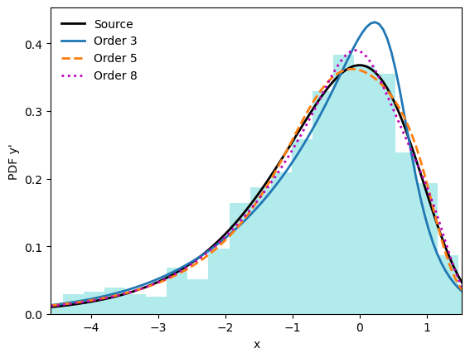
Metalog Distributions (Keelin, 2016)
Flexible distribution
  Parametrically fits to any continuous distribution
  Eliminates need to consider multiple distribution families
  Multivariate extension
Notes:
Metalog is one-dimensional distribution
Multivariate extension encodes correlation via copula

Slide 22
Metalog Distributions (Keelin, 2016)
Flexible distribution
  Parametrically fits to any continuous distribution
  Eliminates need to consider multiple distribution families
  Multivariate extension
Relies only on CDF values
  Simple to calculate!
Notes:
Metalog is one-dimensional distribution
Multivariate extension encodes correlation via copula

Slide 23
Metalog Distributions (Keelin, 2016)
Flexible distribution
  Parametrically fits to any continuous distribution
  Eliminates need to consider multiple distribution families
  Multivariate extension
Relies only on CDF values
  Simple to calculate!
Anonymize data – Securely share sensitive data
Notes:
Metalog is one-dimensional distribution
Multivariate extension encodes correlation via copula

Slide 24
Metalog Distributions (Keelin, 2016)
Flexible distribution
  Parametrically fits to any continuous distribution
  Eliminates need to consider multiple distribution families
  Multivariate extension
Relies only on CDF values
  Simple to calculate!
Anonymize data – Securely share sensitive data
Bootstrap data – Feed larger models
Notes:
Metalog is one-dimensional distribution
Multivariate extension encodes correlation via copula

Slide 25
Metalog Distributions (Keelin, 2016)
Flexible distribution
  Parametrically fits to any continuous distribution
  Eliminates need to consider multiple distribution families
  Multivariate extension
Relies only on CDF values
  Simple to calculate!
Anonymize data – Securely share sensitive data
Bootstrap data – Feed larger models
Compress data – Efficiently share data
Notes:
Metalog is one-dimensional distribution
Multivariate extension encodes correlation via copula

Slide 26
Modeling Approach
Anonymized Patient Data
Raw Patient Data
Synthetic Data Generation (SDG)
GOAL
Notes:
Goal: anonymize healthcare data
How: synthetic data generation (SDG)
Multivariate metalog models
Automated workflow
Data: COVID-19 dataset (10k patients)
Open-source patient population simulation (Walonoski et al., 2017)
Easier to access and share than real patient data (data privacy)

Slide 27
Modeling Approach
Anonymized Patient Data
Raw Patient Data
Synthetic Data Generation (SDG)
GOAL
SDG
Metalogs
Automation
Notes:
Goal: anonymize healthcare data
How: synthetic data generation (SDG)
Multivariate metalog models
Automated workflow
Data: COVID-19 dataset (10k patients)
Open-source patient population simulation (Walonoski et al., 2017)
Easier to access and share than real patient data (data privacy)
6 interralted tables on Patients, Encounters with medical system, insurance Coverage, Costs, Test Results, and their Outcomes

Slide 28
Modeling Approach
Anonymized Patient Data
Raw Patient Data
Synthetic Data Generation (SDG)
GOAL
SDG
Metalogs
Automation
Data: COVID-19 dataset (10k patients)
  Open-source patient population simulation (Walonoski et al., 2017)
  Easier to access and share than real patient data (data privacy)
Notes:
Goal: anonymize healthcare data
How: synthetic data generation (SDG)
Multivariate metalog models
Automated workflow
Data: COVID-19 dataset (10k patients)
Open-source patient population simulation (Walonoski et al., 2017)
Easier to access and share than real patient data (data privacy)

Slide 29
Metalog SDG Workflow
Source Data
SDG
Mlogs
Auto
Synthetic data
Notes:
Note on “Cluster”: in reality I had labeled COVID data that was preprocessed to produce survival labels; other datasets may not have ready labels
Goodness of Fit metric used was the Kolmogorov-Smirnov (KS) distance, which measures CDF error
Metalog model parameter number scales with order, dimension, and clusters; correlation matrix grows as square of dimension

Slide 30
Metalog SDG Workflow
Source Data
Cluster
In this case, data partitioned on patient survival status
SDG
Mlogs
Auto
Synthetic data
Notes:
Note on “Cluster”: in reality I had labeled COVID data that was preprocessed to produce survival labels; other datasets may not have ready labels
Goodness of Fit metric used was the Kolmogorov-Smirnov (KS) distance, which measures CDF error
Metalog model parameter number scales with order, dimension, and clusters; correlation matrix grows as square of dimension

Slide 31
Metalog SDG Workflow
Source Data
Cluster
In this case, data partitioned on patient survival status
Create data model for each cluster class: correlation + n-dim metalogs
Correlation
Fit metalog
Use goodness of fit metric to find best metalog order
SDG
Mlogs
Auto
Synthetic data
Notes:
Note on “Cluster”: in reality I had labeled COVID data that was preprocessed to produce survival labels; other datasets may not have ready labels
Goodness of Fit metric used was the Kolmogorov-Smirnov (KS) distance, which measures CDF error
Metalog model parameter number scales with order, dimension, and clusters; correlation matrix grows as square of dimension

Slide 32
Metalog SDG Workflow
Source Data
Cluster
In this case, data partitioned on patient survival status
Create data model for each cluster class: correlation + n-dim metalogs
Correlation
Fit metalog
Use goodness of fit metric to find best metalog order
SDG
Mlogs
Auto
Data Model
Create persistent data model for SDG
Synthetic data
Notes:
Note on “Cluster”: in reality I had labeled COVID data that was preprocessed to produce survival labels; other datasets may not have ready labels
Goodness of Fit metric used was the Kolmogorov-Smirnov (KS) distance, which measures CDF error
Metalog model parameter number scales with order, dimension, and clusters; correlation matrix grows as square of dimension

Slide 33
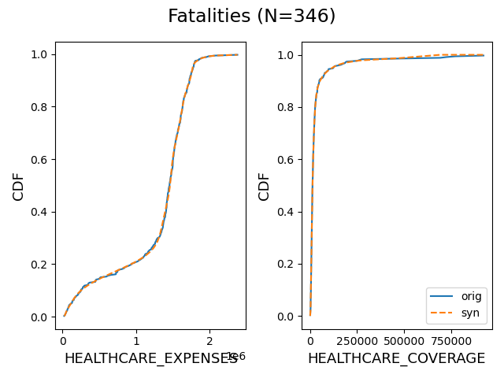
How Do We Do? Blue = Original, Orange = Synthetic
Expenses Data – 2 features
Largest CDF diff is 3%
N=346
Notes:
Dropped patients who had $0 healthcare coverage (worse artifacts)
Survivors CDF matched just as well or better
Used MMD for hypo testing in paper; fGPK is a better test
Could use different copula (Gaussian here) for better shape matching

Slide 34
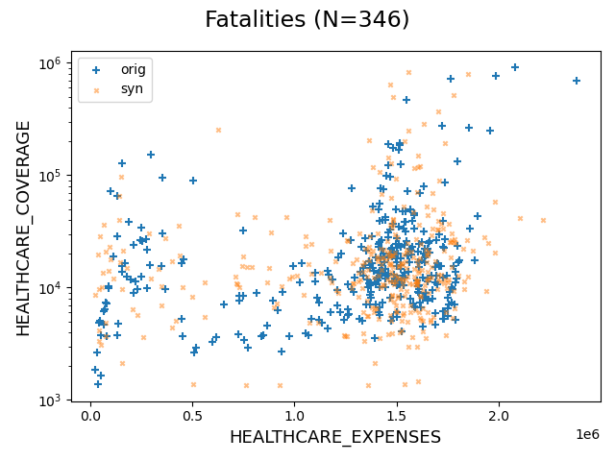
How Do We Do? Blue = Original, Orange = Synthetic
Expenses Data – 2 features
Good 2D agreement;
verified by hypo. testing
Largest CDF diff is 3%
Notes:
Dropped patients who had $0 healthcare coverage (worse artifacts)
Survivors CDF matched just as well or better
Used MMD for hypo testing in paper; fGPK is a better test
Could use different copula (Gaussian here) for better shape matching

Slide 35
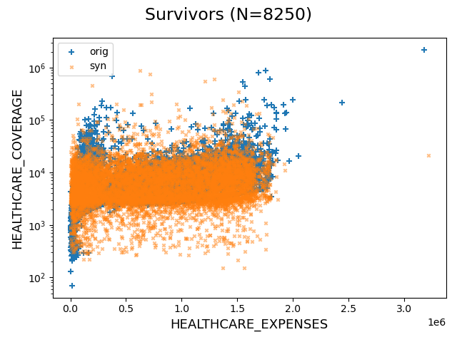
How Do We Do? Blue = Original, Orange = Synthetic
Expenses Data – 2 features
Good 2D agreement;
verified by hypo. testing
Largest CDF diff is 3%
Notes:
For figures, dropped patients who had $0 healthcare coverage (worse artifacts)
6% stat included ALL patients
Survivors CDF matched just as well or better
Used MMD for hypo testing in paper; fGPK is a better test
Could use different copula (Gaussian here) for better shape matching

Slide 36
How Do We Do? Blue = Original, Orange = Synthetic
Expenses Data – 2 features
Good 2D agreement;
verified by hypo. testing
Largest CDF diff is 3%
Matches aggregate statistics, but
shape matching could be improved
Notes:
For figures, dropped patients who had $0 healthcare coverage (worse artifacts)
6% stat included ALL patients
Survivors CDF matched just as well or better
Used MMD for hypo testing in paper; fGPK is a better test
Could use different copula (Gaussian here) for better shape matching

Slide 37
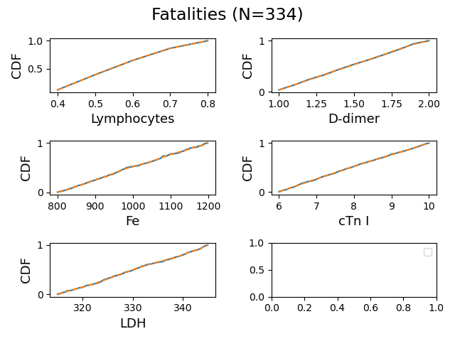
How Do We Do? Blue = Original, Orange = Synthetic
Lab Data – 5 features
Great CDF agreement (<1%)
Notes:
Features: D-dimer; serum ferritin (Fe); high sensitivity cardiac troponin (cTn) I, lymphocytes, and lactate dehydrogenase (LDH)
Survivors CDF matched just as well or better as fatalities
Survivor pairwise plots showed similar results; not shown: cTn I and LDH look like Fe
Neither MMD or fGPK testing showed differences in these distributions

Slide 38
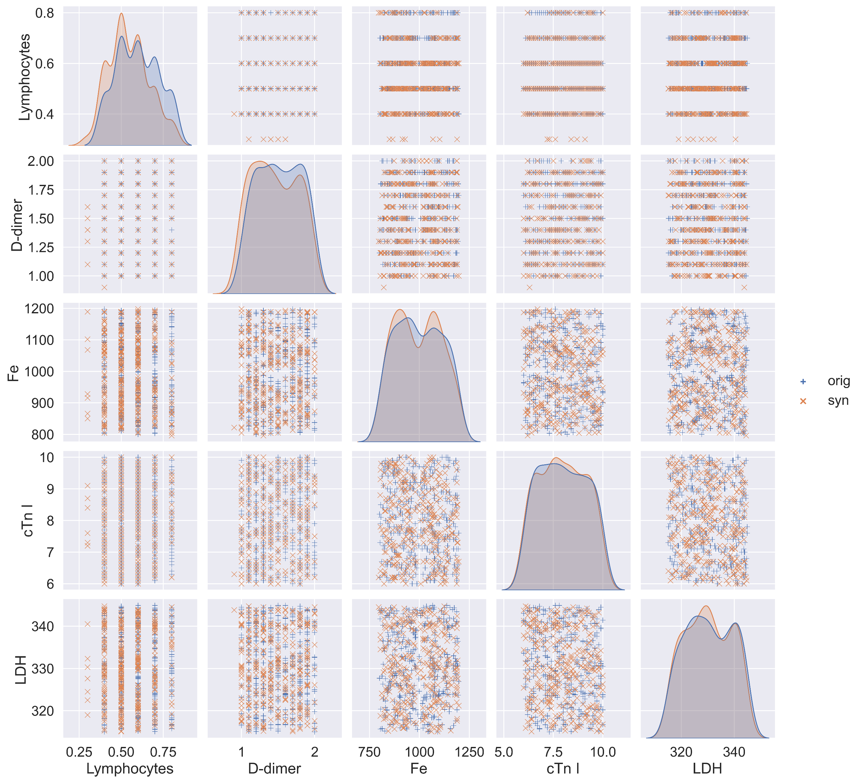

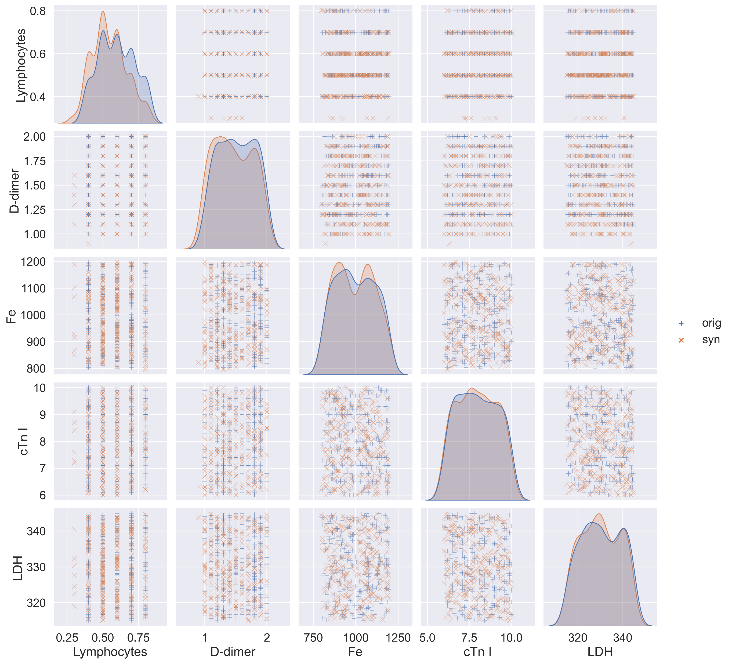
How Do We Do? Blue = Original, Orange = Synthetic
Lab Data – 5 features
Good agreement in shape;
verified by hypo. testing
Great CDF agreement (<1%)
Notes:
Features: D-dimer; serum ferritin (Fe); high sensitivity cardiac troponin (cTn) I, lymphocytes, and lactate dehydrogenase (LDH)
Survivors CDF matched just as well or better as fatalities
Survivor pairwise plots showed similar results; not shown: cTn I and LDH look like Fe
Neither MMD or fGPK testing showed differences in these distributions

Slide 39
How Do We Do? Blue = Original, Orange = Synthetic
Lab Data – 5 features
Good agreement in shape;
verified by hypo. testing
Great CDF agreement (<1%)
Perhaps some drift in discrete data
Notes:
Features: D-dimer; serum ferritin (Fe); high sensitivity cardiac troponin (cTn) I, lymphocytes, and lactate dehydrogenase (LDH)
Survivors CDF matched just as well or better as fatalities
Survivor pairwise plots showed similar results; not shown: cTn I and LDH look like Fe
Neither MMD or fGPK testing showed differences in these distributions

Slide 40
Summary
Multivariate metalog distributions proven to generate synthetic data that:
  Creates a scalable source of synthetic outcomes
  Anonymizes sensitive patient data
  Maintains representative population distributions in both univariate and multi-variate dimensions
Multivariate metalog models should further be utilized for:
  Anonymizing data – to securely share sensitive data
  Bootstrapping data – to feed larger models
  Compressing data – to efficiently share data
Approach is one way to generate additional Readiness from current Data:
  Sometimes we can’t wait for more data
  Enabling cross-collaboration is key; break down data silos
Notes:
Model overfitting is another concern

