Slide 1



An Evaluation of Visual and Performance Metrics in Virtual Reality-Based Parachute Descent Training
Jenna Korentsides, Embry-Riddle Aeronautical University

Slide 2
Author’s Notes
Authors: Jenna Korentsides, M.S., Victoria Trabysh, Ph.D., Emily Rickel, Ph.D., Matthew B. Pierce, M.S., Barbara Chaparro, Ph.D., Joseph R. Keebler, Ph.D., Beth F Wheeler Atkinson, M.A.
The views of the authors expressed herein do not necessarily represent those of the U.S. Navy or Department of Defense (DoD). Presentation of this material does not constitute or imply its endorsement, recommendation, or favoring by the DoD.
Distribution Statement A – Approved for public release; distribution is unlimited, as submitted under NAWCTSD Release Authorization 24-ORL065.

Slide 3
Parachute Descent Training
Overview
Essential for naval personnel in airborne operations
Ensures proficiency in safe and effective parachute procedures during emergencies
Training Components
Classroom instructions: Equipment, procedures, aerodynamics, and landing techniques
Practical exercises: Use of Parachute Descent Trainer (PDT) for real-world simulation

Slide 4
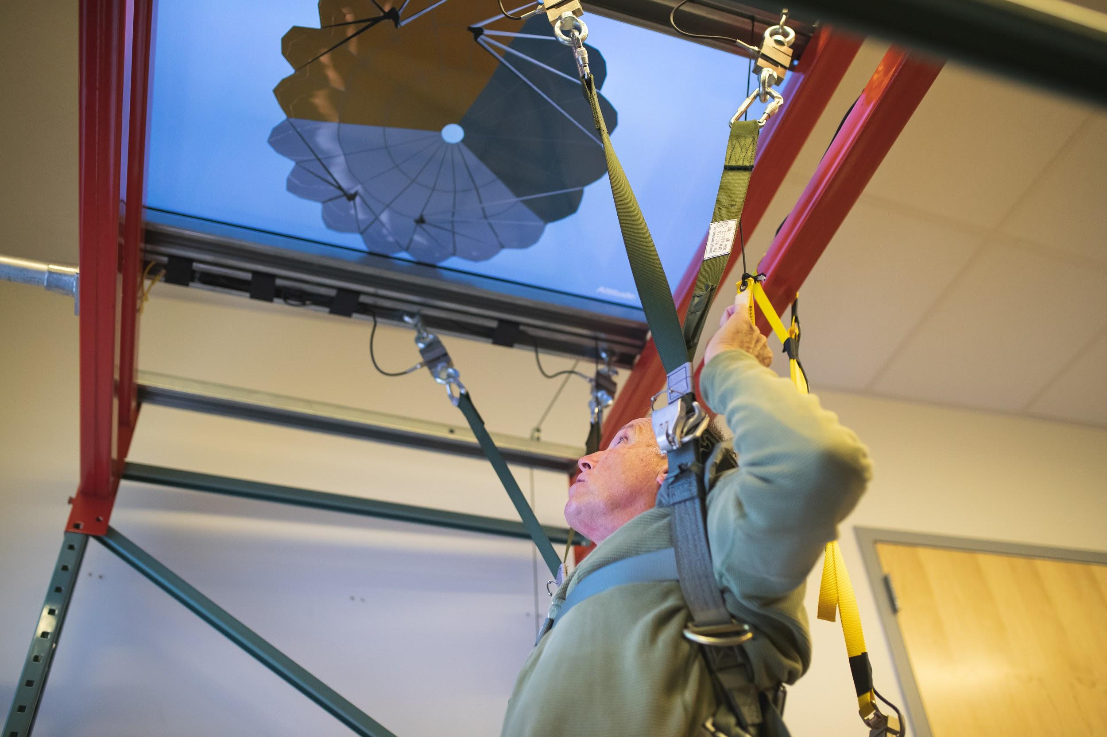
Training Aims
Key Training Focus Areas
Malfunction identification and mitigation
Decision-making for landing locations
Canopy control and body positions
Training Objectives
Familiarize trainees with equipment
Develop understanding of procedures that enhance survivability
Practice survival procedures
SkyFall Parachute Descent Training System – Trainees’ Upward View

Slide 5
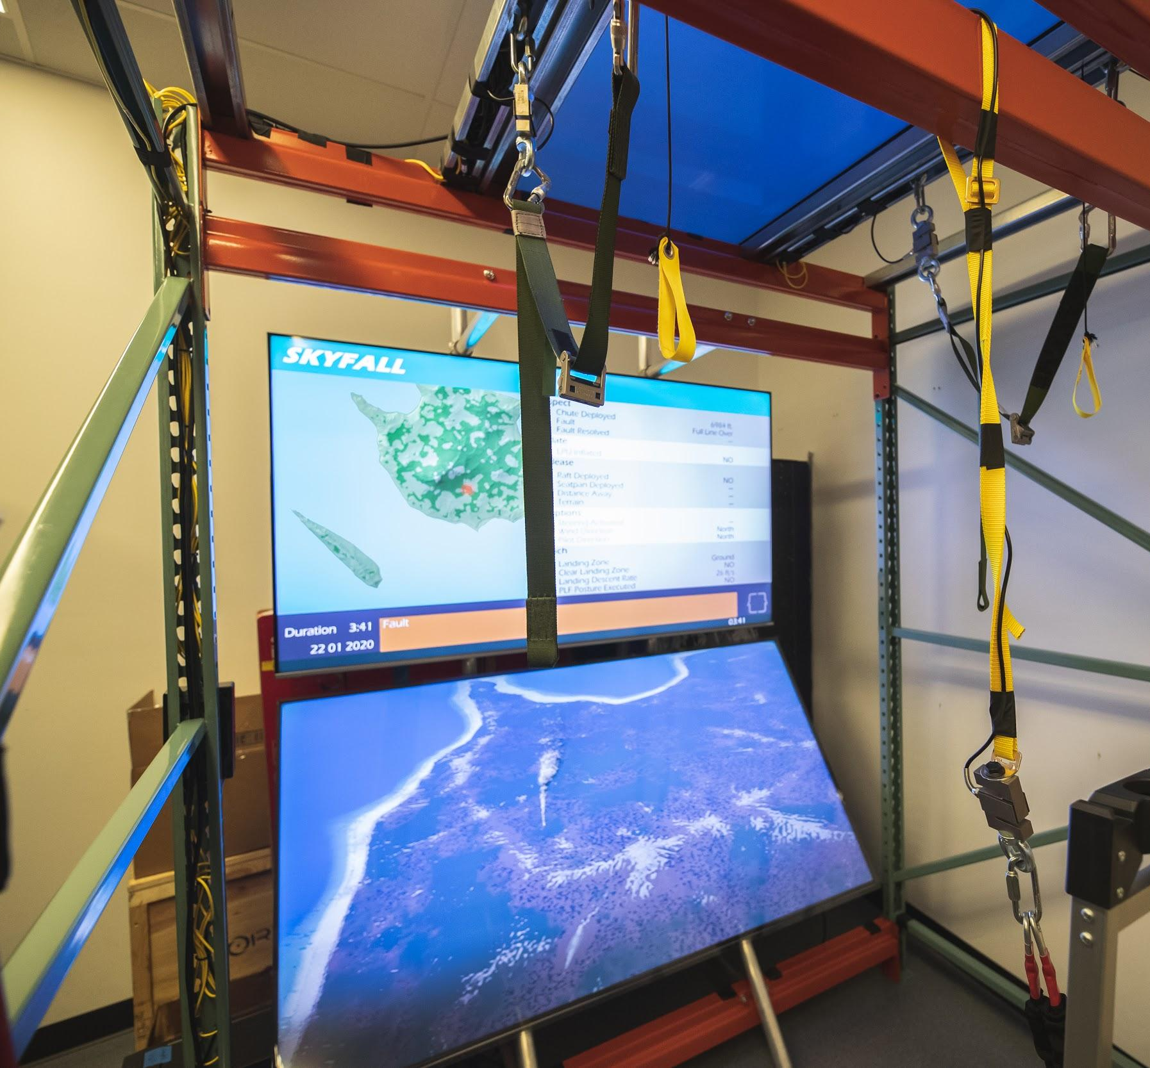
Enhancing PDTs with SkyFall Technology
Technological Advancements
SkyFall System: Virtual environment with realistic visuals
Capabilities: Flexible options for large flat screen display or VR HMD
Monitoring and Feedback
System-based event markers
Instructor observation tools for performance feedback
SkyFall Parachute Descent Training System – Screen View
Skyfall
Modernized version of legacy VR HMD parachute descent trainer

Slide 6
HMD Advantages and Concerns
Advantages of HMD-based Training
Cost-effective, immersive, flexible, and safer than field training
Potential Concerns
Technical limitations (e.g., latency, maintainability, calibration time)
Adverse effects (e.g., cybersickness, negative training)
Individual differences (e.g., learning styles, VR acceptance)

Slide 7
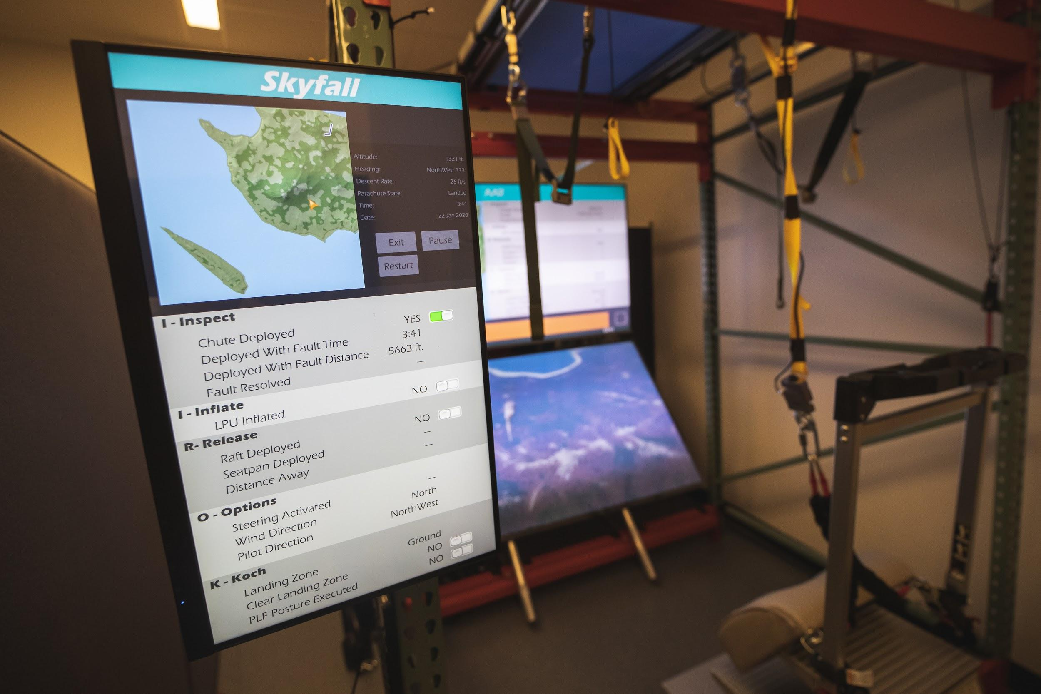
IROK Procedures in Training
IROK Acronym
Inflate: Life preserver unit (LPU) for water landing or neck protection
Release: Seat kit to prevent injury and ensure access to survival contents
Option: Adapting to environmental conditions (not examined in the study)
Koch Fittings: Unclasp harness connections (not examined in the study)
Training Objective
Memorize and execute emergency procedures
SkyFall Parachute Descent Training System – IROK Controls

Slide 8
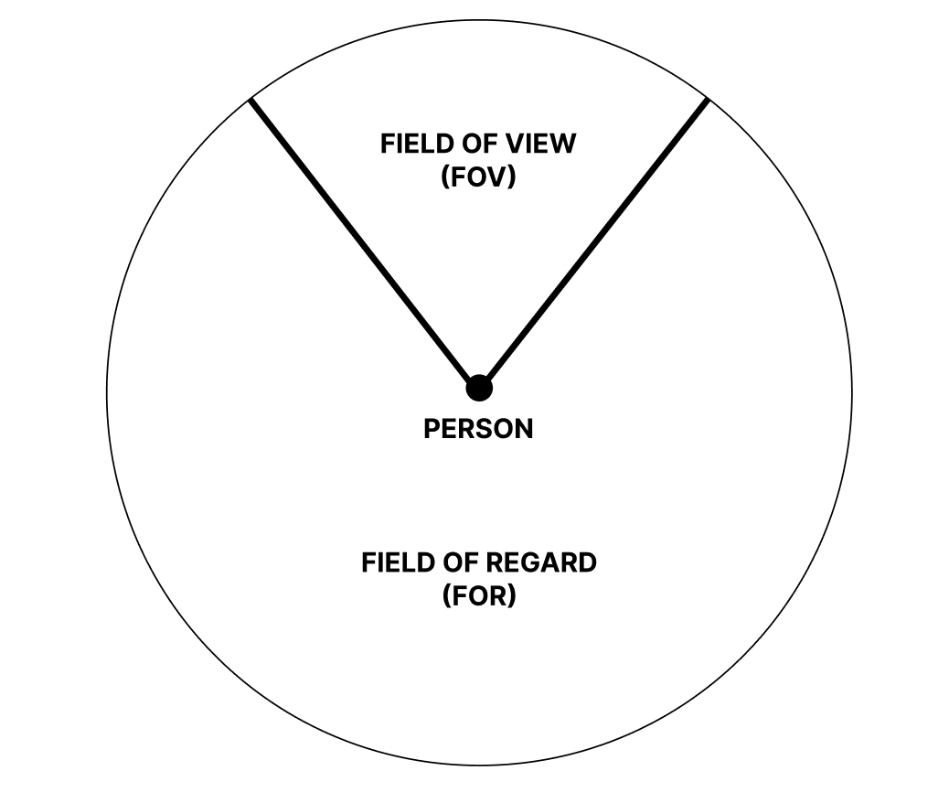
Field of View (FOV) and Field of Regard (FOR)
Definitions
FOV: Extent of the visual field visible at one time
FOR: Total visual environment available to be viewed by the user
Importance
May affect user experience and performance in VR environments
Prior Research Findings
Larger FOR linked to better situational awareness and usability

Slide 9
Study Participants
Demographics
35 participants (23 males, 12 females)
62.9% had very limited VR experience
20% had civilian parachute experience
Exclusion
Data integrity issues led to exclusion of 2 participants
History of seizures or back injuries

Slide 10
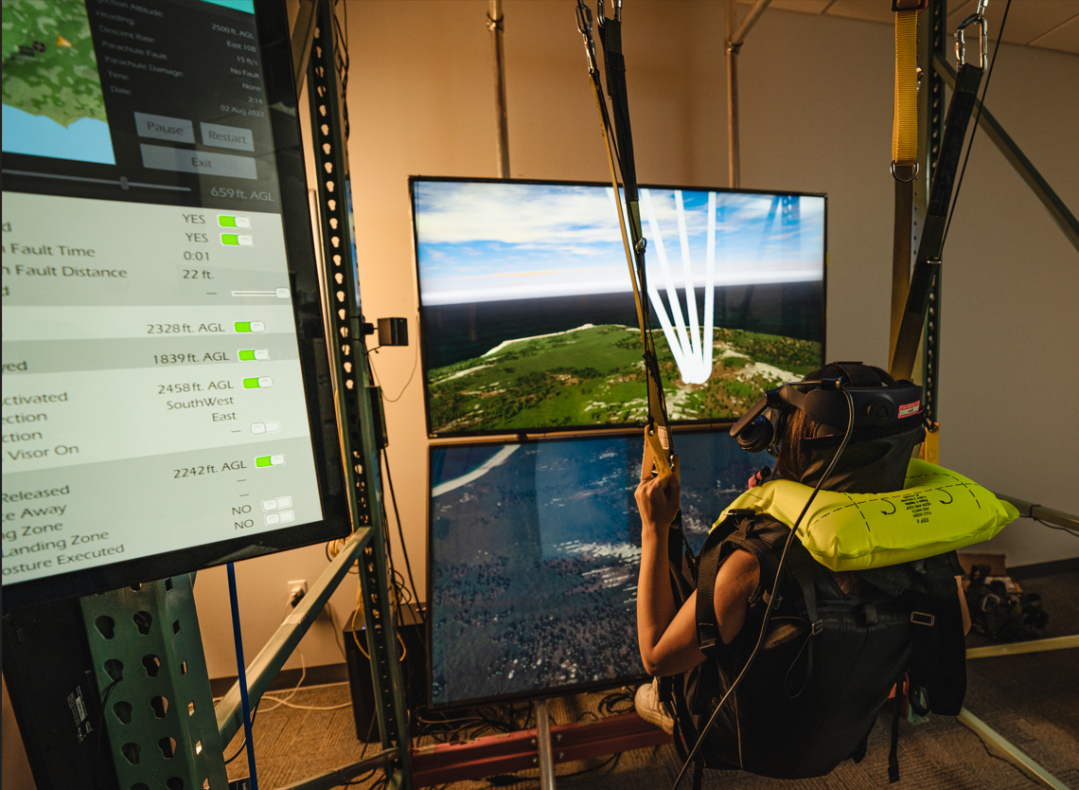
Study Materials
Simulator Features
Realistic 3D virtual environments and interactive controls
Tethered bucket seat and yellow steering toggles
LPU-like vest to simulate neck restrictions
Measures
Spatial orientation
Task performance
Eye-tracking
Self-efficacy (confidence in training)
Simulator sickness
SkyFall Parachute Descent Training System Set-Up

Slide 11
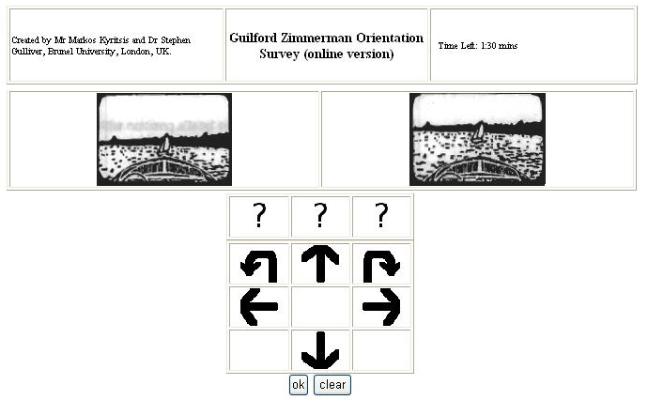
Measurement Details
Spatial Orientation
Online Guilford-Zimmerman Spatial Orientation Survey
Task Performance
Scoring rubric based on training observations
Online Guilford-Zimmerman Spatial Orientation Survey
Exploratory Eye-Tracking Metrics
Time to first fixation, dwell time, number of fixations, search time
Self Efficacy (Confidence)
7 point Likert scale
Simulator Sickness (Kennedy et al.)

Slide 12
Procedure Summary
Initial Steps
Completion of demographics and spatial orientation survey, 10-minute instructional presentations on emergency procedures
Simulation Training
Familiarization with the system
Practice and test scenarios with varying conditions
Researcher rubric
Self efficacy measured after each scenario
Assessed simulator sickness throughout the training

Slide 13
Hypotheses Overview
H1: Smaller FORs will yield better task performance (rubric scores)
H2: Larger FORs will improve seat kit release accuracy
H3: Larger FORs will increase course correction times
H4: Larger FORs will enhance confidence (self-efficacy) in training
H5: Smaller FORs will result in longer time to first fixation
H6: Larger FORs will lead to longer dwell times
H7: Larger FORs will result in fewer fixations
H8: Larger FORs will increase search times

Slide 14
Bayesian Analysis & Analysis of Variance (ANOVA)
ANOVA:
Traditional method.
Tests for significant variable differences between FOR sizes.
Uses a fixed significance threshold (p-value).
Establishing whether observed differences are statistically significant.
Bayesian Analysis:
Estimates the probability of a hypothesis given the data.
Provides nuanced interpretation of evidence, especially for inconclusive or non-significant results.

Slide 15
Bayesian Analysis & Analysis of Variance (ANOVA) Results
H1-H8: No significant differences or effects were found based on FOR size across task performance, accuracy, fixations, or confidence measures.
Bayesian and ANOVA analyses both converged on non-significant results.

Slide 16
Results
Key Takeaways
Insufficient evidence to support the impact of FOR variations on performance measures
Bayesian and ANOVA results align, showing similar results

Slide 17
Conclusions
Summary
Display technologies (HMD vs. large flat screen) and FOR variations were evaluated for potential impact on parachute descent training.
Results show that FOR variations studied did not significantly influence training outcomes.
Results show that differences in display technologies did not significantly influence training outcomes
Final Thoughts
Impact: VR did not increase return on investment for the parachute simulator (i.e., not more effective than conventional display methods).
Iterative Testing: The training design/development process involved frequent testing to help optimize system design and implementation.
Future Focus: Continue to explore ways to enhance training effectiveness/affordability by employing emerging technologies.

Slide 18
Future Research Directions
Explore how individual differences interact with adaptability and Mixed Reality (XR) technologies
Investigate combining adaptive capabilities with XR system capabilities to increase training effectiveness
Conduct longitudinal studies to explore performance trends
Explore application of XR capabilities to tasks requiring significant real-time spatial context for successful performance
Potential Improvements
Accelerate learning by providing richer environmental and task cues via XR

Slide 19
Questions?

