Slide 1
More than a Kid’s Toy: Using NeRFs for 3D Mesh Creation
Graham Webster: Integration Innovation

Slide 2
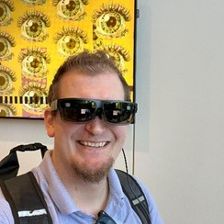

Author Backgrounds
Graham Webster
Hunter Stinson
Senior 3D Artist & XR Designer at i3
Experience with hard surface modeling on vehicles & 3D environments
Iron Dev at I/ ITSEC (2021)
B.S. in Game Art from Full Sail University
Senior Technologist at i3
Experience in software engineering, modeling & simulation, & XR devices
B.S. in Computer Engineering and an M.S. in Software Engineering from the University of Alabama in Huntsville

Slide 3
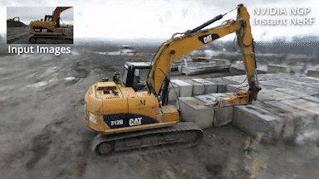
Introduction
NeRFs: Neural Radiance Fields
NERF
NeRFs utilize deep learning for 3D scene and object capture by representing a scene as a Radiance Field that represents scene geometry, lighting conditions, and reflectance of objects.
Each image in a data set provides camera position/orientation data that feeds into camera ray marching to generate a set of 3D points, each with a given radiance direction.
NeRFs allow reflection and shadow to be dynamic as they would be in real life.
NeRFs can provide a 3D point of reference for modelers to work over that allows them to accurately represent the proportions of the model as they create clean topology over it.
NeRFs

Slide 4
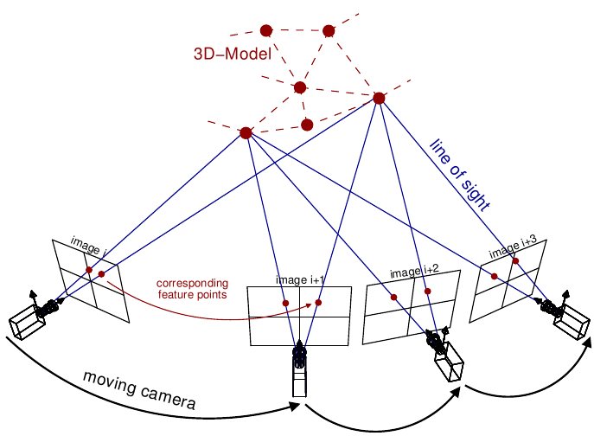
Introduction
Photogrammetry Fundamentals
A tried-and-true method of digital object and environment capture that has been around for decades.
Photogrammetry uses triangulation to and feature matching to locate shared points across multiple images to generate a 3D mesh model.
Uses camera information such as orientation and position to overlap a set of photos to determine the dimensions of objects and environments.
Bakes RGB information of the subject as diffuse texture files with static reflections and shadows.
Photogrammetry diagram

Slide 5
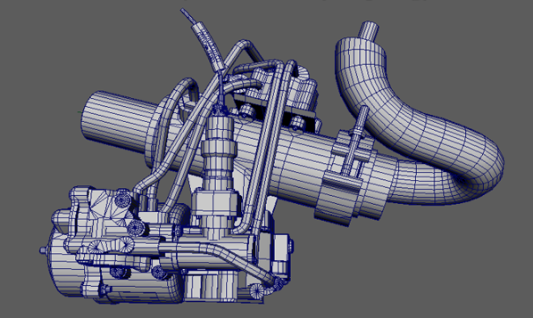
Introduction
What Makes a Quality Mesh Model?
Mesh models differ from CAD because they represent the surface of objects using vertices, edges and faces. CAD uses ARCs and Booleans mostly to represent the form of objects.
Mesh models are the primary form of model type for real time visualization using game engines, film, and games.
Topology can be important with 3D models especially if there are parts that deform needing animations.
Topological density of the model may negatively affect performance. (Tri-count)
Mesh Quality is essential for reusability. Form, Precision, Scale and Topology all play a factor depending on the model use-case.

Slide 6
NeRF Tooling
NeRF Best Practices
Data set photo count limited between 50-150 photos. 200 may work depending on the hardware used.
Capture photos from bottom to top (or vice versa)
Move around the subject, taking photos every 10 degrees around the subject.
Keep the subject static & avoid multiple poses in one data set.
Avoid taking photos while moving, the blur will cause distortions in the NeRF.
Avoid extremely dark lighting scenarios.
Avoid casting a moving shadow into the shot.
Keep the subject level

Slide 7
NeRF Tooling
Experiment Set Up
Capture Devices: Nikon D5600, & Nikon D3400 were used, both DSLR. Camera should ideally have a fixed Aperture to avoid lens warping.
Instant NGP, Luma.ai, for processing the images, & Reality Capture 1.4.
Python 3.7 required to execute instantNGP scripts.
Colmap used to transform images and videos into a NeRF compatible format.
Hardware Specs
Operating System | Windows 10 64-bit 10.0.19045
Graphics Card | Nvidia RTX 4090
CPU | Intel Core i9-13900KS
RAM | 64GB
Hard Drive | 2TB NVMe Solid State Drive

Slide 8
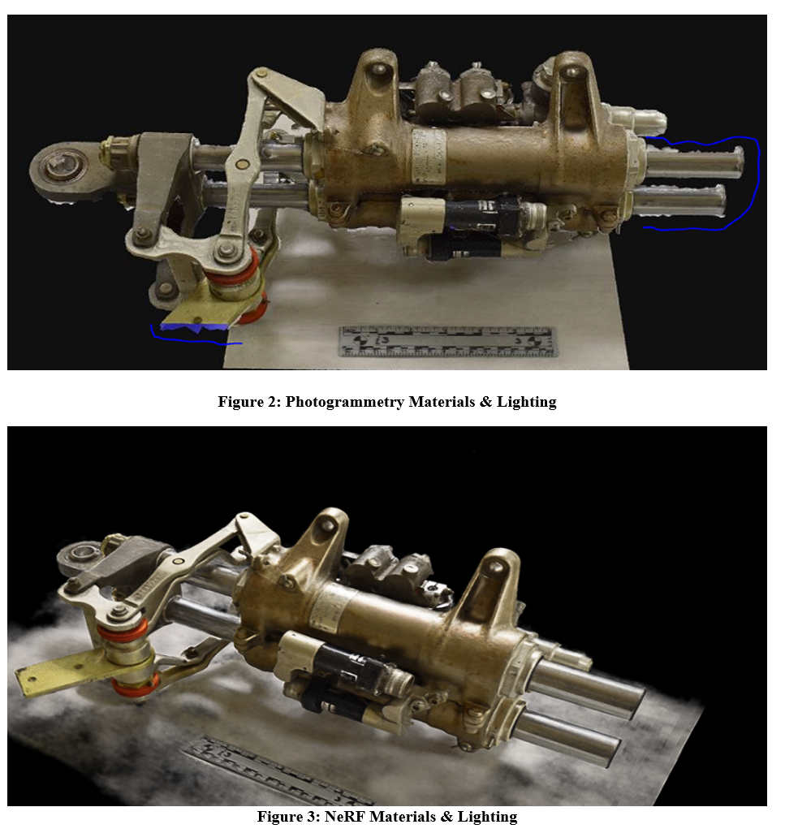
NeRF & Photogrammetry Comparison
Materials & Lighting
Photogrammetry does not have to calculate for reflections and shadows due to baking them down to a static diffuse texture.
NeRFs capture the full form of highly reflective metallic parts.
Photogrammetry struggles to capture reflective parts, and black reflective parts.
Accurate reflections and shadow from NeRF encode multiple values for a single point.

Slide 9
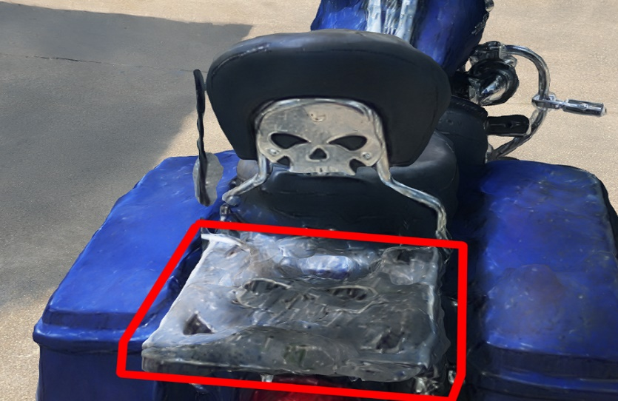
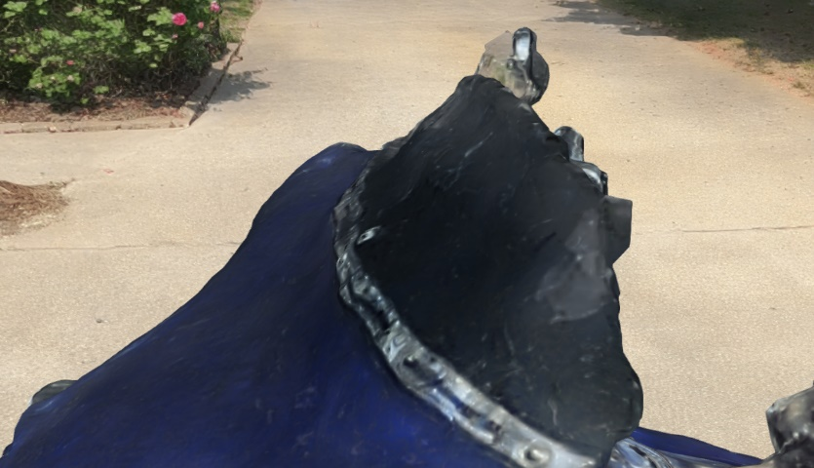
NeRF & Photogrammetry Comparison
Materials & Lighting
Mirror like planar surfaces will create artifacts in final result of the NeRF.
Small text can sometimes come off as blurry in NeRFs, where-as small text can sometimes be more resolute in good photogrammetry due to higher mesh precision.
Clear reflective glass may produce artifacts similar to photogrammetry in some cases entirely omitting large areas of the glass. (Tinted more opaque glass may have better results)

Slide 10
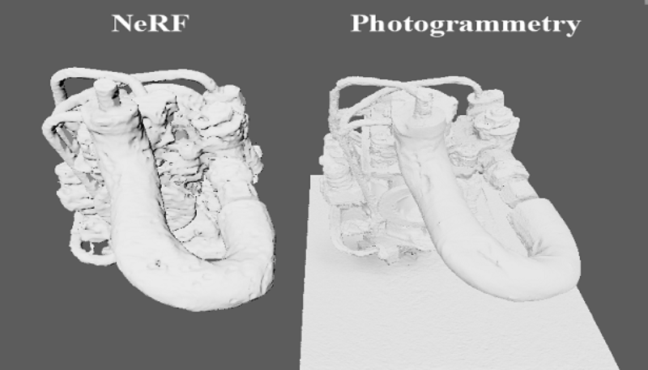
NeRF & Photogrammetry Comparison
Overall Mesh Form
Overall form of NeRFs can sometimes be more comprehensive due to less reflective areas being completely omitted.
Curved reflective surfaces come out with less silhouette degradation in NeRF captures.
Form degrades on mirror-like surfaces and glass materials for both methods.
Heavy shadows may cause form degradation for both methods.

Slide 11
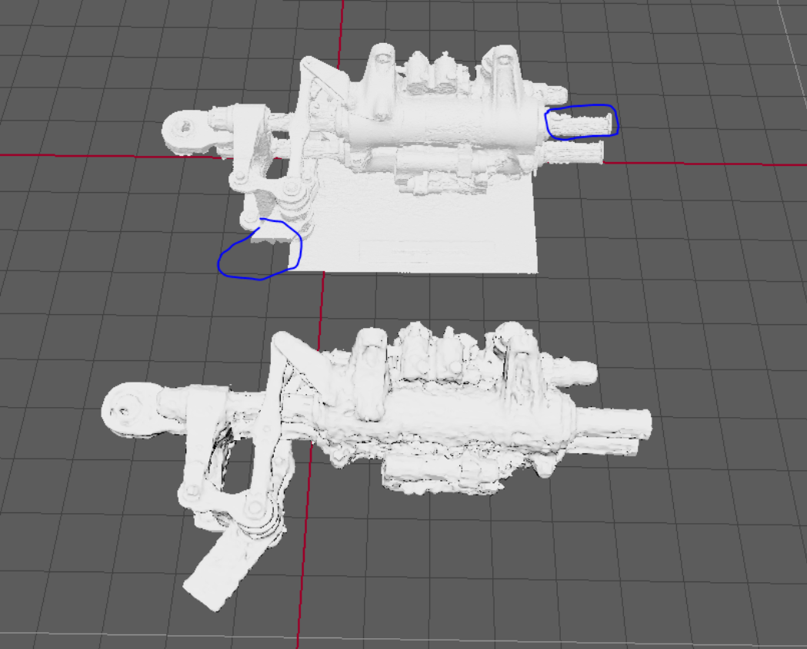
NeRF & Photogrammetry Comparison
Mesh Precision & Topology
Topology for both NeRFs and Photogrammetry are excessive in polycount, lack proper riggable topology, and are not be ideal for UV mapping and texturing.
Better overall mesh precision in areas that photogrammetry works well on. Producing millimeter level accuracy in certain cases.
Mesh Precision suffers for photogrammetry on shiny surfaces, glass and surfaces in extreme shadow. Sometimes entirely omitting areas of the model.

Slide 12
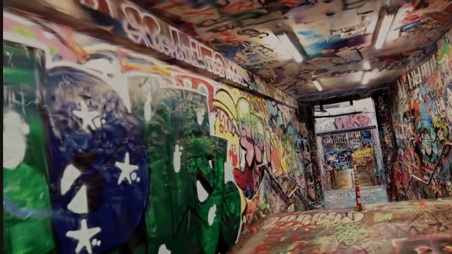
Potential Use Cases
NeRFs in Virtual Reality
NeRFs & an upcoming similar method called Gaussian Splats can be integrated into Virtual Reality applications.
Benefits include shockingly realistic looking environments to experience in world space with an HMD.
Useful for architects, historians and civil engineers working with real-world environments.

Slide 13
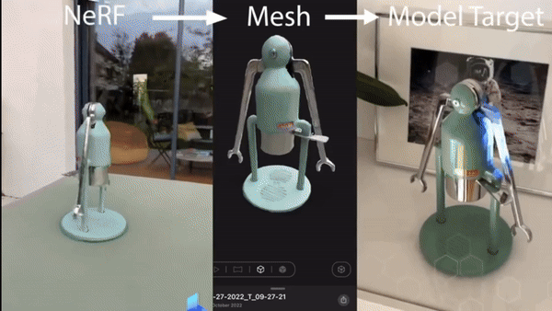
Potential Use Cases
NeRF & 6 DoF Silhouette Recognition
Devices can recognize real-world objects and overlay augmented reality projections on top of them with stable 6 DoF tracking by using a silhouette recognition profile or “Model Target”.
The more accurate the form of the model target, the more stable the tracking.
A mildly cleaned up NeRF mesh of a reflective object can lead to a valid model target.
Useful for countless industrial and training related scenarios where recognizing parts and their relevant data is critical to a job in the field
Real Life
NeRF
Model Target

Slide 14
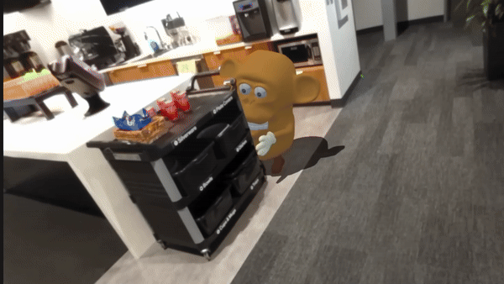
Potential Use Cases
Virtual Object Removal & Replacement
Creating a 3D twin of an object, allows users the capability to replace or remove the object in a Mixed Reality application.
Useful for potential warehouse or load master field work.
Useful for interior design planning and construction.

Slide 15
Lessons Learned & Future Research
NeRF LESSONS LEARNED
FUTURE RESEARCH
Work closely with the IT team to approve any and all NeRF software through the appropriate channels before jumping in.
Be aware that InstantNGP should primarily be used for research.
We chose InstantNGP because NeRF studio was primarily a web-based application & would’ve required internal hosting of it for the web-based viewer to be truly secure.
NeRFs are a useful alternative for artists to utilize as a reference tool, but photogrammetry still has the advantage of better mesh precision over traditional NeRFs.
Gaussian Splat workflows
NeRFs & Gaussian Splats with Extended Reality
6 DoF Pose Estimation for Extended Reality
Extended Reality Object Replacement and Removal

