Slide 1


Fortifying the Virtual Battlefield: Integrating Cyber Effects using Simulation
Matt Smith, Defence, Science & Technology Laboratory, UK MOD
Notes:
Good Morning, my name is Matt Smith from the Defence Science & Technology Laboratory, DSTL is the Science and Technology branch of the UK Ministry of Defence. Today, I am going to share work we have done to explore a technical approach for the representation of cyber effects in modelling and simulation systems using open standards.

Slide 2
Background
Initial Pitch Panel
Phase 1 Studies Conclude
Phase 2 Demonstrator
2022
2023
2024
Phase 1 Studies Start
Phase 2 Studies Start
I/ITSEC 2024
Cyber Security Pitch Panel enabled industry to pitch work for funding against specified focus areas
Phase 1: Three individual studies commissioned
Phase 2: Outputs combined into a collaborative technology demonstrator to test Cyber Data Exchange Model’s (DEM) capability
Notes:
In 2022, the Defence Science & Technology Laboratory’s (DSTL) Developing Education, Training and Learning Advances (DELTA) project commissioned three individual studies through an industry cyber security pitch panel.
The studies demonstrated that it was possible in theory to represent and distribute cyber effects in a synthetic environment. These studies included:
Study 1: An investigation into the Simulation Interoperability Standards Organisation (SISO) Cyber Data Exchange Model (DEM);
Study 2: Adding simulated agents to an existing Network Vulnerability Assessment tool;
Study 3: Integrating an adversarial emulation framework with virtual simulation.
As part of the pitch panel, successful participants may be offered a second phase to further develop work.
Study 1’s investigation into the standard highlighted the potential for interoperability between cyber ranges, cyber simulations, kinetic simulation tools.
A second phase was initiated but instead of individual studies, the decision was made to commission a collaborative technology demonstrator which combined the previous three studies to test Cyber DEM’s capability.

Slide 3
Cyber Technology Demonstrator Objectives
Objectives included:
Demonstrate the ability to represent a cyber-effect across multiple distributed simulation federates
Identify any limitations in CyberDEM and gain a greater understanding of how cyber effects propagate through the simulation
The aim was not to create a demonstrator that meets a particular training need
It was to investigate how cyber effects can be represented in distributed synthetic environments
Notes:
Phase 2 had a couple of objectives:
This primarily included:
Demonstrate the ability to represent a cyber-effect across multiple distributed simulation federates
Identify any limitations in CyberDEM and gain a greater understanding of how cyber effects propagate through the simulation.
Crucially, the aim was not to create a demonstrator that might be directly adopted to meet a particular training need but was to investigate how cyber effects can be represented in distributed synthetic environments

Slide 4
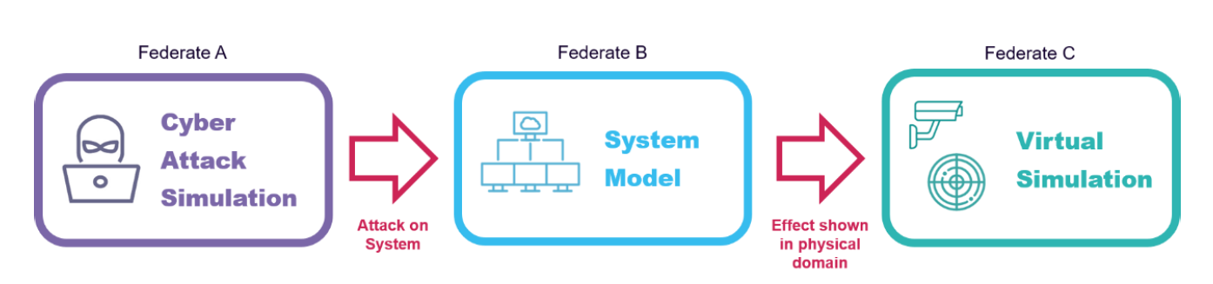
Conceptual Model
The concept of the demonstrator was to show how a red cyber-attack federate could attack a separate blue computer network federate
In turn this would demonstrate an effect on an associated blue system in a physical domain simulator
Notes:
In order to design the synthetic environment for the demonstrator – the recommended practice outlined in the Distributed Simulation Engineering and Execution Process (DSEEP) was broadly followed.
I will brief some of the elements in this presentation.
Conceptual Analysis comprised of two main elements: Conceptual Modelling and Scenario Design.
The concept The concept of the demonstrator was to show how a red cyber-attack federate could attack a separate blue computer network federate. In turn this would demonstrate an effect on an associated blue system in a physical domain simulator.
This can be seen in the diagram where Federate A, the Cyber attack simulator conducts and attack on Federate B which represents a system or infrastructure model. The outcome of this attack is then represented in Federate C which shows the effect on the physical domain, for example, the degradation of a sensor or denial of a system.

Slide 5
Scenario Design
The fictional RAF Rice is being disrupted by various forms of Cyber Attack
Narrative designed to include a wide range of effects
GPS Jamming
Radio Frequency (RF) Jamming
Data-links degradation
Information Exfiltration
Phishing Attack
Due to project constraints only two vignettes focusing on RADAR and CCTV were taken forward
Notes:
The scenario was carefully designed to ensure it would effectively challenge both the representation of cyber within the individual federates and the CyberDEM as a medium for communicating them.
The fictional RAF Rice is being disrupted by various forms of Cyber Attack
Narrative designed to include a wide range of effects, including:
GPS Jamming
Radio Frequency (RF) Jamming
Data-links degradation
Information Exfiltration
Phishing Attack
Due to project constraints only two vignettes focusing on RADAR and CCTV were taken forward

Slide 6
High Level Federation Design
Physical Domain Simulations
VR-Forces
VBS4
Pitch RTI
Cyber DEM Plugin
Cyber DEM Plugin
Cyber DEM Federation
Cyber Gateway Service
Generic Cyber Attacker
Wi-Fi Federate
HLA Adapter
MITRE Caldera
MITRE ATT&CK Framework
CyberAware Resilience
Cyber Effects Simulation Service
Cyber Attack Simulation
Cyber System Simulation
Notes:
The ‘Cyber DEM’ federation used Pitch RTI running RPR FOM & the Cyber FOM module derived from CyberDEM. [CLICK]
The ‘Cyber Attack Simulation’ was responsible for modelling cyber-attacks. [CLICK]
It uses TTP’s from the MITRE ATT&CK framework as the basis for attacks on networked systems. [CLICK]
It also uses MITRE Caldera to simulate the outputs of a cyber-attack. [CLICK]
The development team created a HLA adaptor for Caldera to map the simulation outputs to Cyber DEM interactions – this was primarily just CyberAttack due to Caldera having a far higher fidelity that CyberDEM (more on this later) [CLICK]
The ‘Cyber System Simulation’ federate is responsible for modelling cyber systems and cyber effects and is composed of several components: [CLICK]
CyberAware Resilience is an ‘off the shelf’ product developed by RiskAware. Originally developed as part of Dstl’s JUMP programme. It was created to provide cyber risk modelling that can be incorporated within military mission planning. [CLICK]
Cyber Effects Simulation Service, developed in Phase 1, is an API to allow a developer to utilise the underlying capabilities within CyberAware Resilience [CLICK]
Cyber Gateway Service has created mappings of the CyberAware Resilience data models to the CyberDEM standard to translate CyberDEM interactions and objects into parameters required by CyberAware Resilience . This enables inputs to be translated and to provide outputs into a wider HLA federation. [CLICK]
Physical Domain Simulators [CLICK]
VR-Forces is a COTS CGF)product employed within the UK air synthetic training environment called GLADIATOR. Within this federation, it is responsible for the representation of physical systems, primarily air platforms and associated sensors (radar). [CLICK]
Virtual Battlespace 4 is a COTS virtual desktop training simulation that is widely used for land forces training under the Defence Virtual Simulation 2 enterprise contract which provides a virtual simulation tool to UK Armed Forces, free at the point of need. Within this federation, it is responsible for the representation of physical systems, primarily land platforms and associated sensors (e.g. camera systems). [CLICK]
Plugins needed to be developed to support the Cyber DEM integration into both physical domain simulators. Before anyone gets too excited these were both limited to the scope of the respective vignettes – the necessity to do this highlights the need for the respective developers to consider how to enable better representation of the degradation of denial of a physical asset due to a cyber attack (again… more on that later) [CLICK]
Wi-Fi Federate – This is a new federate developed to represent a Wi-Fi hotspot. This federate demonstrated cyber events that involve both attacking and defensive measures.
Generic Cyber Attacker – GUI based federate is capable of invoking CyberDEM events and receiving CyberDEM objects and interactions. It was originally developed in Phase 1 to inject CyberDEM events into traditional simulation tools. Despite the name - In this federation it is used to provide defensive cyber effects.
API: Application Programming Interface
COTS: Commercial Off The Shelf
DEM: Data Exchange Model
FOM: Federation Object Model
GUI: Graphical User Interface
HLA: High Level Architecture
JUMP: Joint User Mission Planning for Cyber and Electro-Magnetic Activity
RTI: Run Time Interface
TTP: Tactics Techniques and Procedures

Slide 7
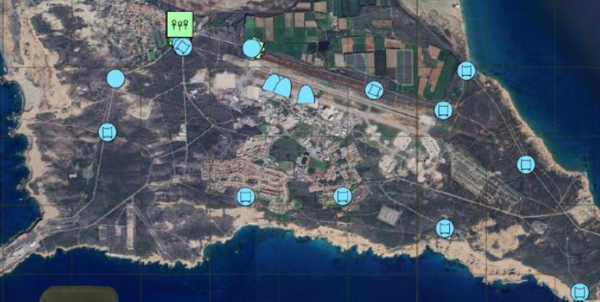
RADAR Vignette
A simple approach which included:
Internal states and CyberAcknowledge Interaction (including TargetID) used to keep track of which devices are available to be attacked
Allows federates to encapsulate their modelling responsibilities without having to rely on external systems
Attack steps described solely by series of interactions
Success or failure depends solely on the set parameters
Fictional RAF Rice showing RADAR detected assets in Constructive Simulation
Notes:
The RADAR vignette
demonstrates representation of cyber effects across multiple federates, with cyber attacker, cyber defender, system model and physical domain federates.
simple approach where, the Cyber Attack and Cyber System Simulation rely on their internal states and CyberAcknowledge interaction responses (including the TargetID parameter) to keep track of which devices on the network are available to be attacked.
This allows federates to encapsulate their modelling responsibilities without having to rely on external systems. Attack steps are described solely by the series of interactions (CyberAttack, CyberRecon, CyberEvent, etc.) and their success or failure depends solely on the set parameters.

Slide 8
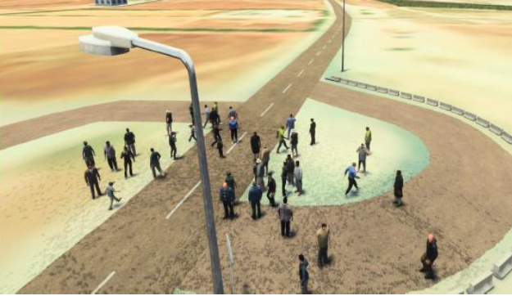
CCTV Vignette
A complex approach which included:
The WiFi Federate publishes objects, whose attributes are updated to reflect the current state of the attack
Objects define which devices on the network are exposed to the attacker
Success and failure depends, not only on individual interactions, but also persistent cyber objects
Exposure of the attack steps allows for greater visibility, and can be helpful in recordings of the data for After Action Review
View from CCTV Camera in Virtual Simulation
Notes:
The CCTV vignette
cyber effects across a network consisting of multiple federates,
CCTV system is modelled by the Cyber System Simulation
a separate WiFi federate modelling part of the network used by the CCTV system
a virtual simulation, Virtual Battlespace 4 modelling the CCTV cameras, physical environment & POL
This is a more complex approach where:
the WiFi Federate publishes PhysicalNetworkLink objects, whose NetworkInterfaces attributes are updated to reflect the current state of the attack.
These objects define which devices on the network are exposed to the attacker.
Success and failure now depends, not only the parameters of individual interactions, but on persistent cyber objects which are exposed to the federation execution.
This exposure of the current state of the attack steps allows for greater visibility, and can become even more helpful in recordings of the data and After Action Review (AAR).

Slide 9
Demonstration Outcomes
The Technology Demonstrator Stakeholder Event took place on the 18th June 2024 which showed:
Real-Time Platform Reference Federation Object Model (FOM) and Cyber DEM FOM module loaded in same federation, connecting cyber-domain and kinetic-domain simulations
A cyber system successfully represented using Cyber DEM objects, and could be successfully attacked and defended using Cyber DEM events
Cyber Effects could be triggered using Cyber DEM events and represented within kinetic-domain simulations
Commercial simulations could be extended to introduce cyber effects showing that different simulations can adopt the same standard for communicating cyber data
Both the CCTV and Radar vignettes executed successfully, and all intended visual effects could be seen within their respective kinetic simulation environments

Slide 10
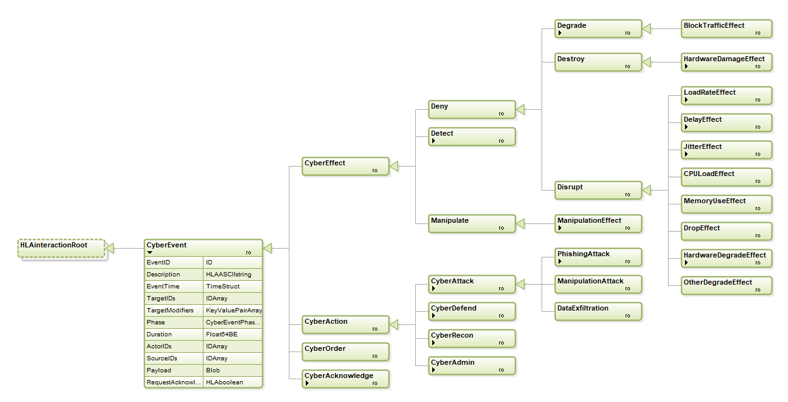
Findings
Pre-definition limited how dynamic the scenario could be
There was no direct linkage between RPR-FOM physical-domain objects and Cyber DEM
Publishing Ground truth vs Perceived truth
Need standardise the outcomes of cyber effects within a simulation
Difference in Fidelity
Difference between attack steps
Wider range of CyberEffect events (blue) compared to the CyberAttack event (orange) side of the DEM
Notes:
Pre-definition was required in the scenario/federation design limiting how dynamic the scenario could be
Hard Coded ObjectIDs were used to ensure that the correct Cyber Object was targeted. Identifying target objects a flexible way would allow for more dynamic scenarios
There was no direct linkage between RPR-FOM physical-domain objects and Cyber DEM.
For supporting dynamic, unscripted scenarios, and for supporting data analysis, it would be better if the object relationships were exposed within the FOM data.
Publishing Ground truth vs Perceived truth
In our implementation the attacker gradually gained knowledge about the simulation, leading to new objects being registered in the federation.
Partial data publication was an interesting approach as, by exposing the current state of an attack chain, all federates can be aware of which nodes on the network are compromised at any time simply by subscribing to an object type, rather than having to rely on internal modelling and calculation.
This could be helpful as different models, of different levels of fidelity, will have the exact same data at all times. It could also be useful during after action review, where more complex information is exposed to the federation. However, in future, a more traditional “truth” approach is preferable. Publishing the ground-truth data aligns with traditional approaches, supports expansion to encompass federations with multiple attackers, and is invaluable for exercise controllers.
A suggested approach is to maintain separation between FOM integration and end-point cyber effects. This could be achieved via a central "cyber controller", with listeners for all interactions presented in the Cyber DEM. Individual entities which need to respond in some way to cyber effects would include a "cyber component" (via the simulation model set) which can register which functions to call at each relevant event. This enables multiple Cyber-enabled objects to be added to a scenario whilst retaining a single federate connection to the federation. Further, using a centralised controller could give a White team fine control over how and when cyber effects actually affect a scenario. A "cyber dashboard" could be implemented which allows a White team to decide whether any incoming cyber effect would be beneficial to the training audience during scenario execution,
Difference in fidelity between the Cyber Attack Simulation and the Cyber System Simulation.
The Cyber Attack Simulation model, Caldera, has a much higher fidelity in how it models the attacks compared to the Cyber System Simulation model, CyberAware Resilience, which is intended to provide a higher level mission model overview of an attack. Caldera runs individual attack steps on each node whereas CyberAware Resilience is concerned with the overall progression of the attack through the network.
Despite these differences, CyberDEM effectively enabled that gap to be bridged.
Difference between attack steps run by Cyber Attack Simulation and the CyberAttack events available in CyberDEM.
In order to achieve the vignettes demonstrated, it was necessary to use TargetModifiers or in some cases extend the CyberDEM in order to be able to send the relevant information.
There is currently a wide range of CyberEffect events in the DEM and it would be useful to replicate this on the CyberAttack event side of the DEM.
The requirement for higher levels of detail in the attack steps would depend on the audience for any particular simulation. The structure of the DEM is such that it would always be possible to abstract it back up to a higher level if that better suited the objectives of the simulation.
There is a way around this! CyberDEM offers several customisable data fields, such as TargetModifiers that allow users to define and exchange data that goes beyond the scope of what Cyber DEM provides. However, when using these customisable fields, the data defined is not standardised. This lack of standardisation will make any federate using these fields harder to reuse effectively.

Slide 11
CyberDEM Specific Recommendations
Extension of CyberDEM to include more CyberAttack events
Identify commonly used TargetModifiers to be introduced into CyberDEM as separately defined attributes
Standardise identifier representations
Define further encoding of Payload and TargetModifiers parameters
Notes:
Extension of CyberDEM to include more CyberAttack events
This study found that the CyberDEM already meets the requirements in cases where a simulation is only interested in the effects of an attack. However, it would be beneficial to supporting a broader range of cyber use cases if the CyberDEM was extended to include a wider range of CyberAttack events without requiring that level of fidelity to be used in every case.
Identify commonly used TargetModifiers to be introduced into CyberDEM as separately defined attributes
As the TargetModifiers are not standardised, it will make re-use of components between different simulations difficult as interoperability challenges are likely to exist.
For example, one simulation may have used a username field as key ‘user’ while another may have used ‘credentials’.
Whilst these semantically mean the same thing, they would not be understood programmatically causing interoperability issues.
Standardise Identifier Representations
The latest draft of the Cyber DEM FOM made improvements to all object and interaction ID representation, previously integers now strings. This is a good step as it allows IDs to be treated similarly to conventions in other object models (e.g. the UUIDs of NATO FOM).
However, there is still no guidance on how these should be used within the FOM itself. Meaning less formal agreements must be made within a supplementary federation agreement document.
A standardised way of representing and assigning IDs should be considered, in order to guarantee understanding between all federates, and uniqueness of values. Alternatively, adopting an existing standard’s method (e.g. the UUIDs of NATO FOM) could work to solve the same issues while presenting a familiar methodology to users.
Define Further Encoding of Payload and TargetModifiers parameters
The flexibility of the byte array types of the Payload and TargetModifiers parameters means that they can be used to transmit any information within an interaction. As noted in Phase 1, this presents an interoperability challenge as possible encoding/decoding mismatches may arise between federates when attempting to use these ambiguous types.
Encoding should be defined for these parameters, as even within this technical demonstrator we found that it was simpler and cleaner to extend the FOM than make real use of them. At present this is the preferred approach, due to its ease within HLA.
Extend or adapt the DataStatus enumeration to represent the Confidentiality, Integrity, and Availability (CIA) impact on a device post-cyber-attack.
A major area of CyberAware Resilience output missing from Cyber DEM is mission outputs. These use Confidentiality, Integrity, and Availability (CIA) metrics to assess the impact of cyber-attacks on the devices. These metrics are used in the analysis of the performance degradation of the mission components related to the devices, and the effect on the higher level mission processes and goals, such as security of a specific area or success of an objective.

Slide 12
Cyber Effects Representation Recommendations
Develop a ‘playbook’ of cyber effects that training simulations need to incorporate to support requirement writing for future simulation procurements
Develop CyberDEM interfaces for a broader spectrum of adversary emulations to support different use cases
Notes:
Develop a ‘playbook’ of cyber effects that training simulations need to incorporate to support requirement writing for future simulation procurements:
It has been highlighted in previous work (Wells & Bryan, 2015) that when integrating Cyber DEM with existing traditional M&S tools, modifications need to be made in order to make the tools “cyber aware”.
This means that tools will need to be able to apply the correct effect to the Cyber DEM inputs being provided.
The lack of “cyber awareness” is still a prevalent problem and software modifications need to be made to integrate existing traditional M&S tools with a Cyber DEM federation.
Developing a catalogue of relevant cyber effects which need to be incorporated into virtual and constructive simulations would support the development of system requirements for future systems.
Develop CyberDEM interfaces for a broader spectrum of adversary emulations to support different use cases
This work focussed on the development of a federate as a means to provide an HLA adapter for the Caldera adversary emulation tool. There are, however, several other adversary emulation tools that could be used instead.
In Phase 1 of this work, two other adversary emulation tools, namely Atomic Red Team and Sliver, were investigated and used to run the cyberattack simulations.
These alternative tools could provide a means to run alternative attacks or include a human-in-the-loop for training purposes.

Slide 13
Questions?
Matt Smith
Defence Science and Technology Laboratory
mcsmith2@dstl.gov.uk
Notes:
Ref: DSTL/CP162804
© Crown copyright (2024), Dstl. This material is licensed under the terms of the Open Government Licence except where otherwise stated. To view this licence, visit http://www.nationalarchives.gov.uk/doc/open-government-licence/version/3 or write to the Information Policy Team, The National Archives, Kew, London TW9 4DU, or email: psi@nationalarchives.gov.uk

