Slide 1

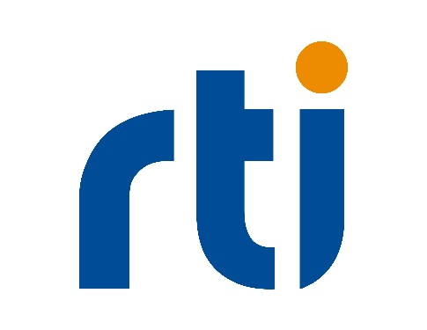
An Open Standards Data Model and Taxonomy to
Enable Digital Twins for Defense
proposing a common taxonomy to define the terms, roles, and responsibilities for an open standard based approach to data production, management, consumption, and analysis of Digital Twins
Patrick Buckley, PhD, Integration Innovation, Inc. (i3)
Robert Proctor, Real-Time Innovations

Slide 2
Outline
Introduction and Problem Statement
Digital Twin means different things to different audiences
Digital Twin Taxonomy
Maturity and Fidelity
Scope and Security & Access
Integration & Interoperability and Decision Aid Integration
Proposed Data Architecture
Future Work and Acknowledgements

Slide 3
Introduction & Problem Statement
Digital Twin means different things to different audiences
A 3D Model of a Physical Object?
Virtual Representation of a Physical Component or an Entire System?
Multifaceted definition is necessary due to the complexity of the systems composing the DT
Similarly, an open-system, standardized data model provides the greatest flexibility when building a DT while ensuring interoperability and data security
A comprehensive definition of a digital twin and the ontology for it would allow for all definitions of Digital Twins to co-exist

Slide 4
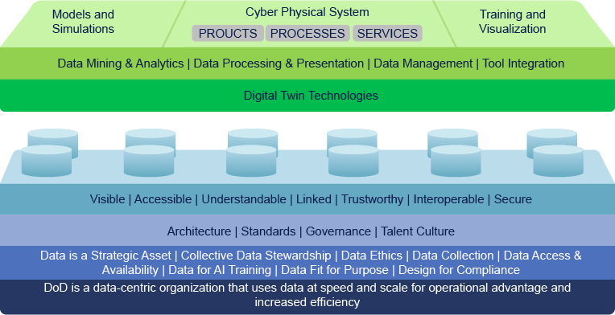
Digital Twin as defined by AD1112684, US DoD, 2020; UDRA, 2024

Slide 5
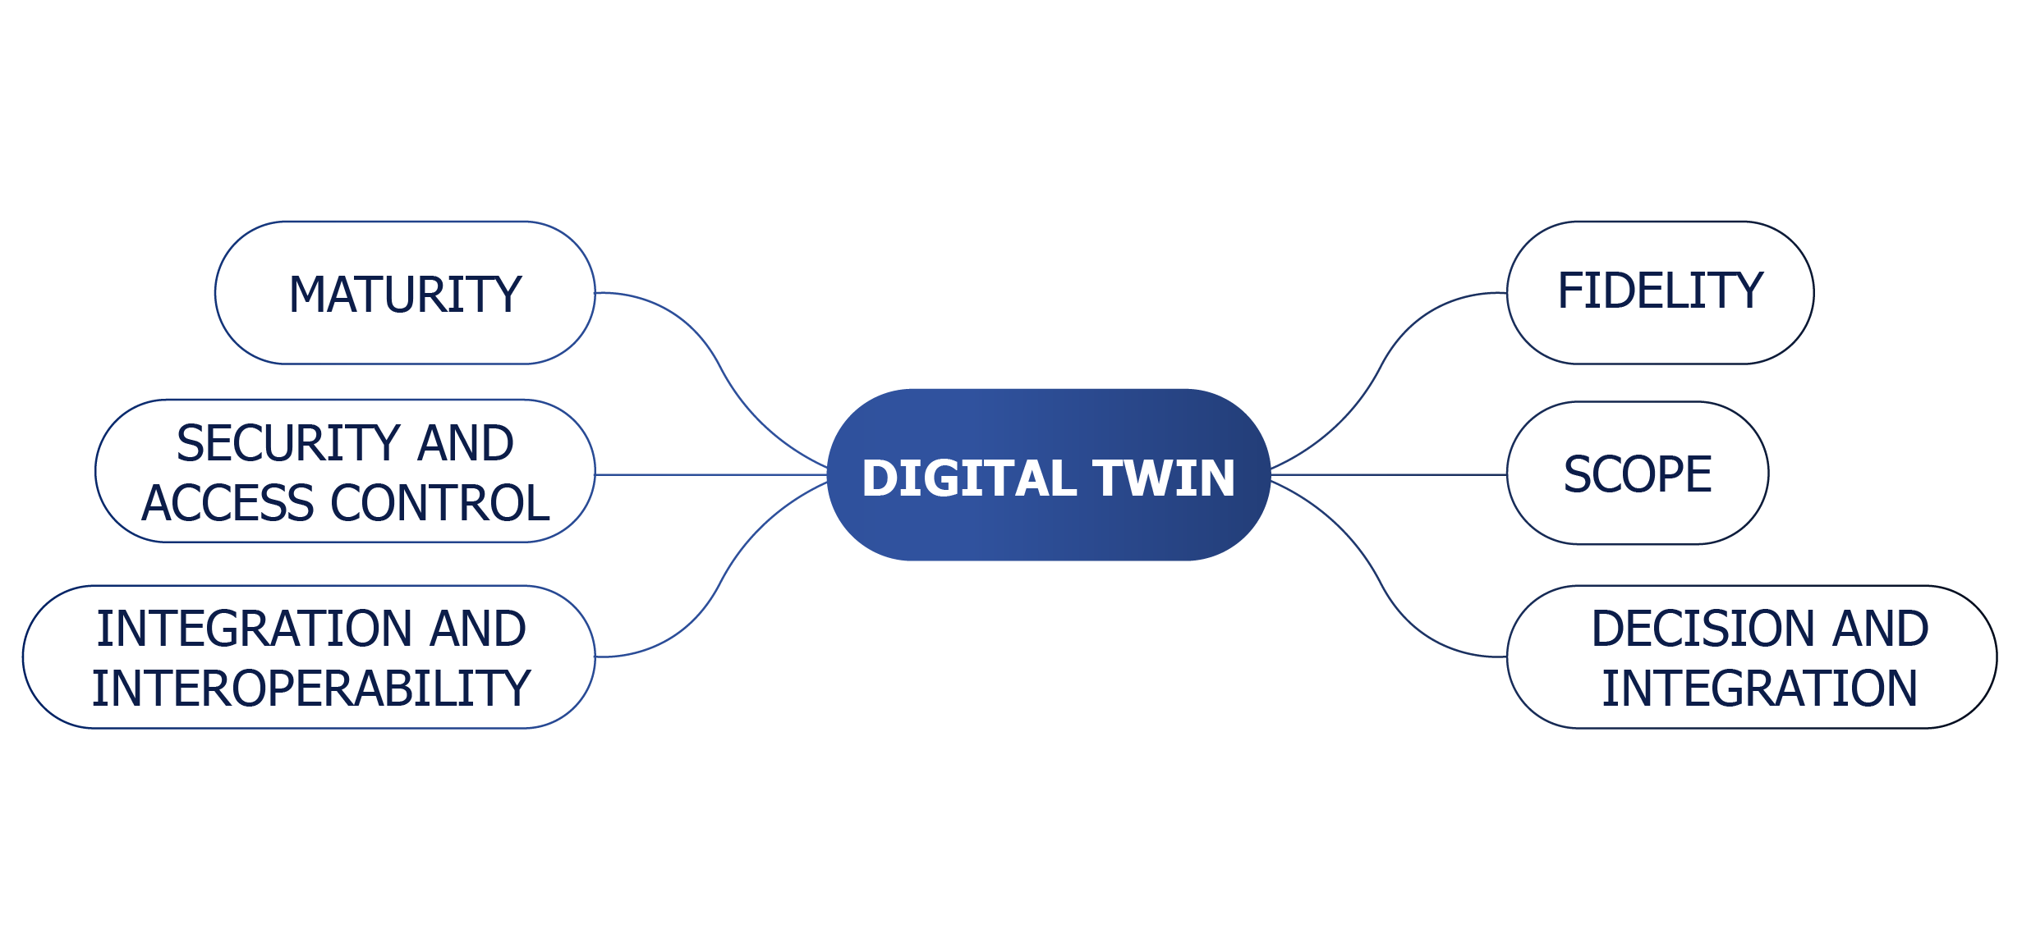
Digital Twin Taxonomy
A systematic hierarchical definition framework for the purpose of classification of digital twin technologies
Allows for grouping of complex ideas through a series of subclassifications to improve definition and understanding

Slide 6
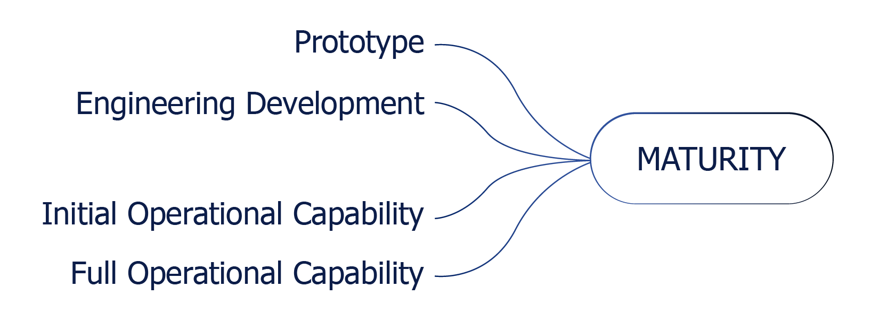
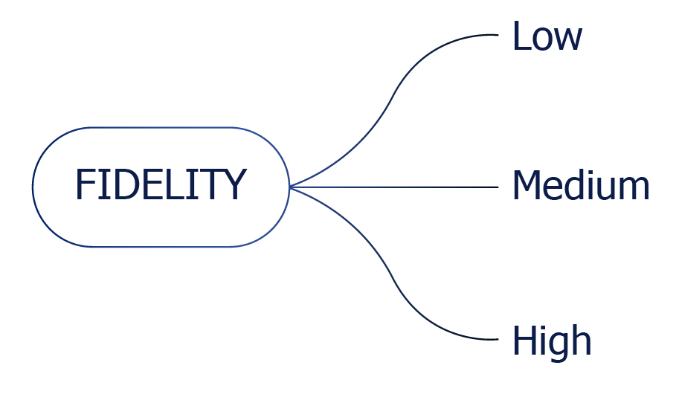
Subcategories: Maturity and Fidelity
Maturity
Prototype – drives technology roadmaps and future improvements
ED – prototype advances to assess performance and develop acquisition strategies
IOC – production ready for training validation in the operational environment
FOC – precisely and accurately represents the fielded system
Fidelity
Low – not anchored in data collected in operationally-relevant environment
Medium – early stages of validation as test data becomes available
High – physical, virtual, and simulated components are reliably communicating at the speed of relevance

Slide 7
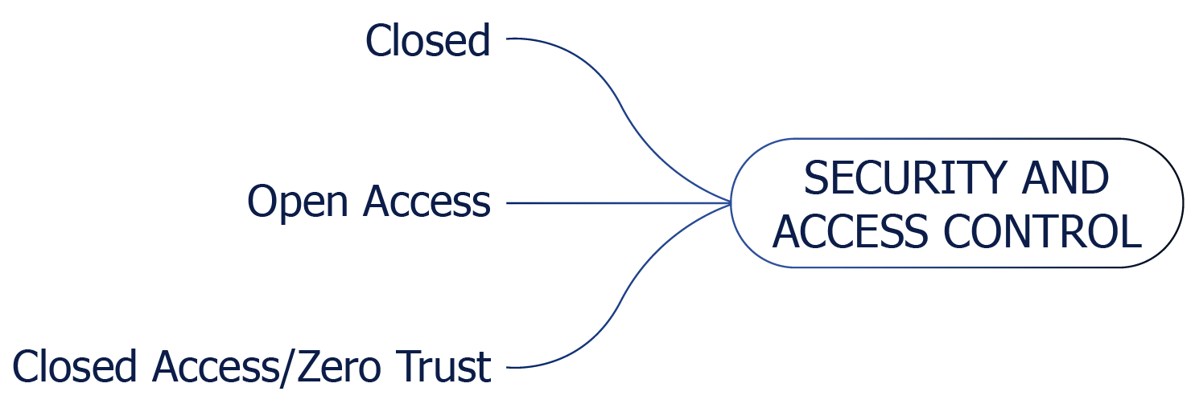
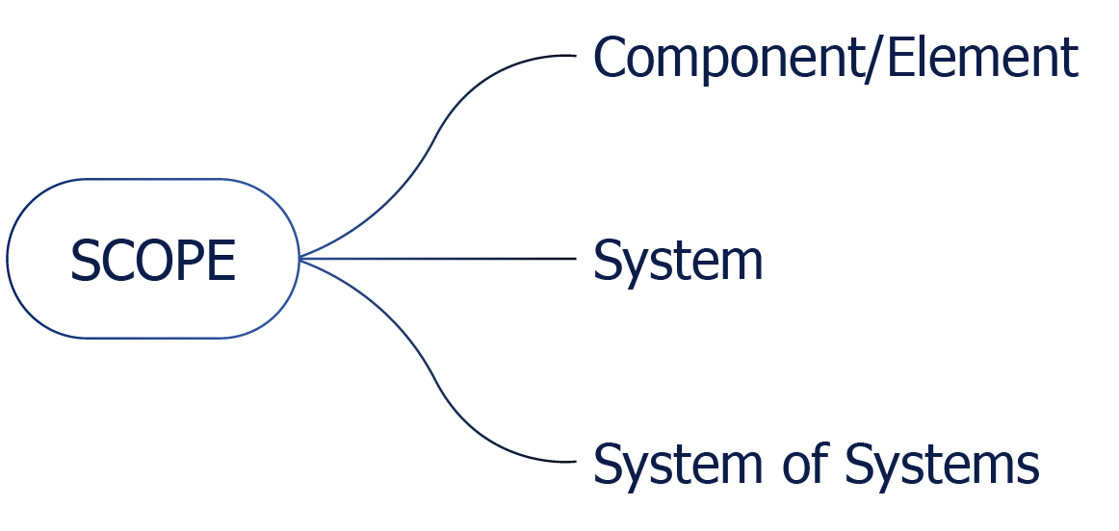
Subcategories: Security & Access and Scope
Security and Access
Closed – no external network access offers maximum security but reduced interoperability
Open – maximize data availability with greatest vulnerability
Zero Trust – assumes all users are untrustworthy until authorized by a trusted agent or authorization authority
Scope
Component – singular element of the system or system of systems
System – an arrangement of components that together exhibit behavior or meaning the constituent components do not
System of Systems – scalable, integrated set of systems providing greater capability or functionality the individual system does not provide by itself

Slide 8
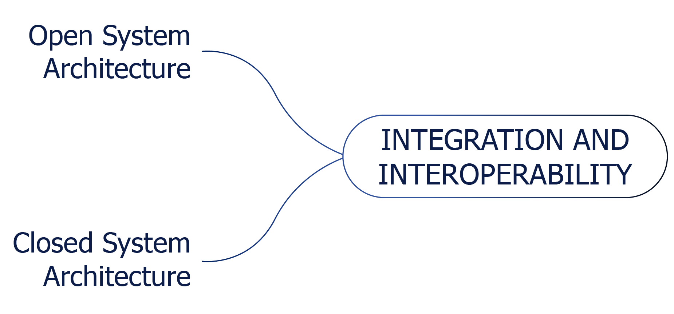
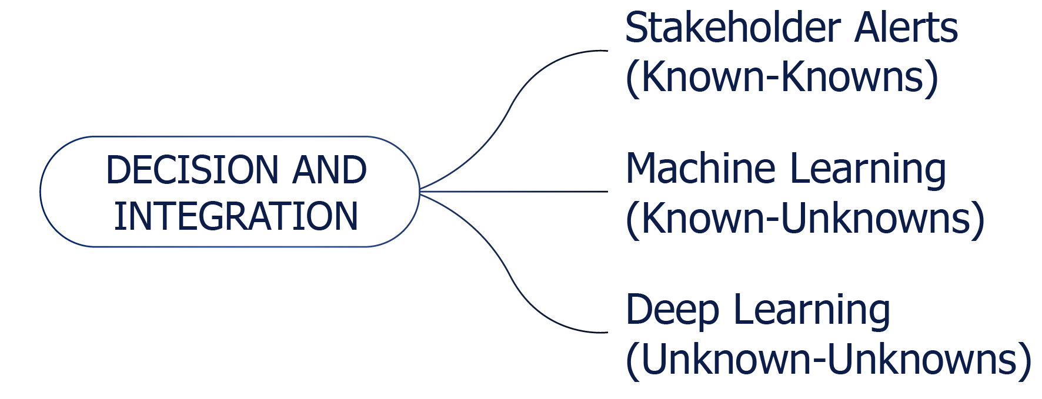
Subcategories: Integration & Interoperability and Decision Aid Integration
Integration & Interoperability
Open System Architecture – MOSA conformance requires considerations for modularity and openness in all DoD programs; ensures integration with other open systems through standards-based interfaces (e.g., UDRA)
Closed System Architecture – considerations for proprietary or sensitive data in a competitive environment; could result in greater lifecycle cost
Decision Aid Integration
Stakeholder Alerts – notification of known-knowns (e.g., failure modes, maintenance metrics); penultimate human factors engineering
Machine Learning – training the DT to capture performance and address known-unknowns
Deep Learning – assess the DT operationally to determine the unknown-unknowns and potentially address in future improvements

Slide 9
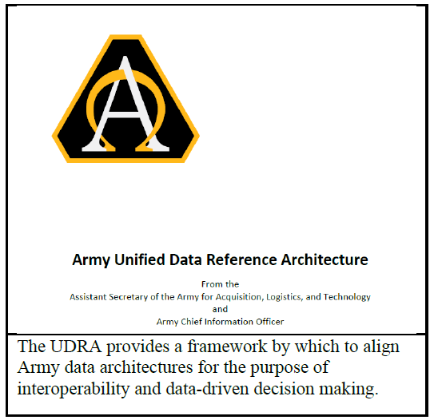
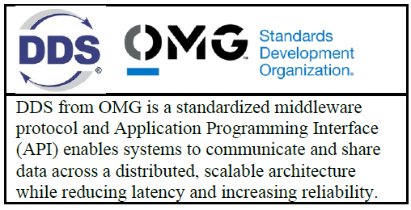
Data-Centric Digital Twin Architecture
Data Model Development
Aligned with the Department of Defense's mandate for data-centricity outlined in the DoD Data Strategy, the data model must adhere to standardized frameworks and protocols to ensure consistency, interoperability and reusability.
By adopting open standards such as OMG DDS and combining them with mandates such as the UDRA via the principles of DoDI 5000.97, defense organizations can assert greater control over the ownership and management of DT data models.

Slide 10


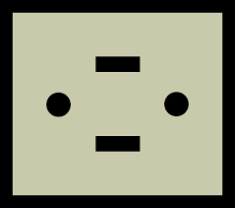

Data-Centric Digital Twin Architecture
Structure
Behavior
DDS is the Real-Time Connectivity Framework Open Standard used in Many Industries
Participant X
Participant Y
Participant X
Distributed Data
Interoperability and Management
Information (Data in Context)
Distributed Data
Interoperability and Management
Semantic
Interoperability
(data context)
Framework
Data (State, Events, Streams)
Framework
Syntactic
Interoperability
(data structures)
DDS
Transport
Messages
Transport
Technical
Interoperability
(opaque blobs)
Network
Packets
Network
Link
Frames
Link
Physical
Bits
Physical
Notes:
AUTOSAR has offered DDS communication binding since 2018.03

Slide 11
Proposed Digital Twin Data Architecture
Software
Component
UDRA based DT Models
Open
Standard
API
DDS Databus (middleware)
Data-Centric Publish-Subscribe Interface
Topic Based
Quality of Service
Configuration
Topic Based
Data-Object
Local Cache
DDS Library
OS Independent
Transport Independent
Platform Specific Portability Layer
Abstract Network Architecture
Platform Specific
Discovery Plugin
Transport Plugin
OS API
Open
Standard
Wire Protocol
Network
Notes:
Platform = CPU, OS, Compiler

Slide 12
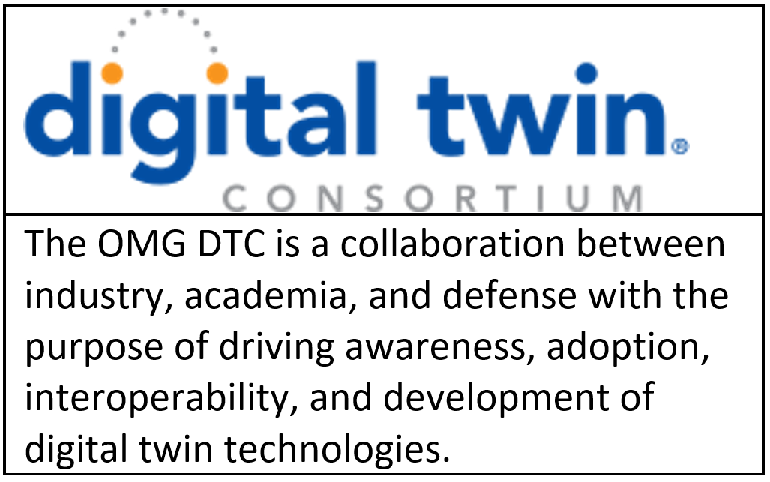
Data-Centric Digital Twin Architecture
Data Model Ownership
One of the key challenges in DT implementation within the defense sector is ensuring clear ownership and governance of the data models. The Digital Twin Consortium or the Simulation Interoperability Standards Organization could be a logical locations for such data-models.
In contrast to proprietary approaches that often lead to data silos and fragmentation, open models that have a data-centric view promote centralization and standardization. This enables greater transparency, accountability, and collaboration.

Slide 13
Future Work and Acknowledgements
This paper proposes a detailed DT taxonomy for defense applications along with a proposed black-box data model as a cornerstone for enabling a standards-based approach to DT implementation. The DTT provides the foundation setting terms and expectations to ensure stakeholders looking to develop the technology for their application are clearly defining what they require, ultimately reducing cost and expediting fielding.
FUTURE WORK: Find willing stake holders to help standardize this taxonomy
The potential adoption of a black-box model, centered around OMG DDS and UDRA, enables a governed approach to DT implementation owned by the defense stakeholder and not the equipment manufacturer. This allows for reuse and ensures the DTs support the data-centric vision outlined by the DoD. By leveraging these frameworks and incorporating UDRA Use Cases, defense organizations can achieve greater interoperability, scalability, and security, ultimately enhancing mission success and operational effectiveness.
FUTURE WORK: Create an example Digital Twin to give to the community for inspection

