Slide 1

Assessing Cognitive Workload Prediction Models Using a Continuous Subjective Approach
LTC Charles Rowan, Ph.D., USA, Naval Postgraduate School

Slide 2
Agenda
Background
Modeling Effort
Experimental Approach
Results
Discussion

Slide 3
Background
Future systems will grow in complexity, with some potential for adaptive automation to help assist human operators (Endsley, 2017).
Therefore, assessing cognitive workload will be critical to help ensure high levels of performance while mitigating negative operator outcomes (Smith & Baumann, 2020).
Adaptive Automation
One of the most important topics in Human Factors history (Hancock et al., 2013).
Seeks to keep operators within a band of optimal workload (de Greef & Arciszewski, 2009).
Triggered with one of three strategies (Inagaki, 2003):
critical-event, performance/model-based, and neurophysiological measurement.

Slide 4
Background
Cognitive workload prediction models can assist in understanding the impacts of various task conditions (Samms, 2010).
These models need to be validated to assess representational capacity and to provide design recommendations.
Because cognitive workload is experienced subjectively by individuals, it can be described and assessed through introspection subjectively with reliability (Cain, 2007).
This work leveraged human performance modeling and a human-in-the-loop study to investigate the impacts of adaptive automation systems, serving to assess a subjective surrogate tool for measuring cognitive workload.

Slide 5
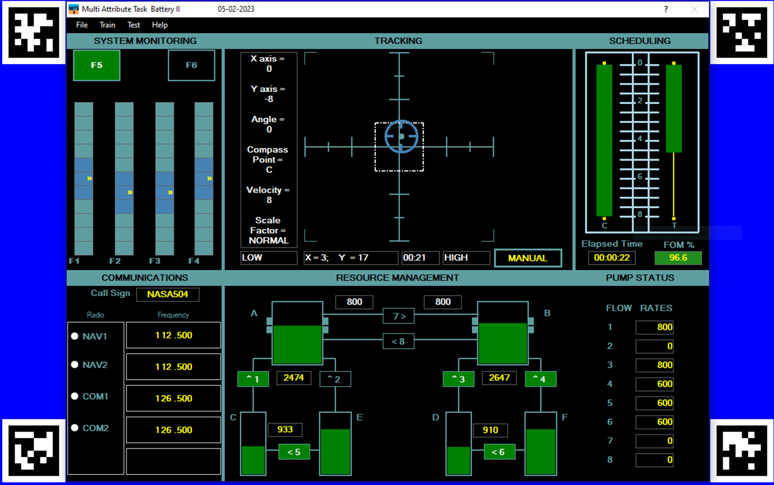
Modeling Effort
NASA’s Multi-attribute Task Battery-II v. 3.5 (Santiago-Espada et al., 2011)

Slide 6
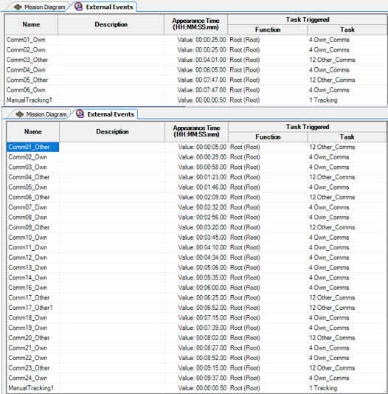
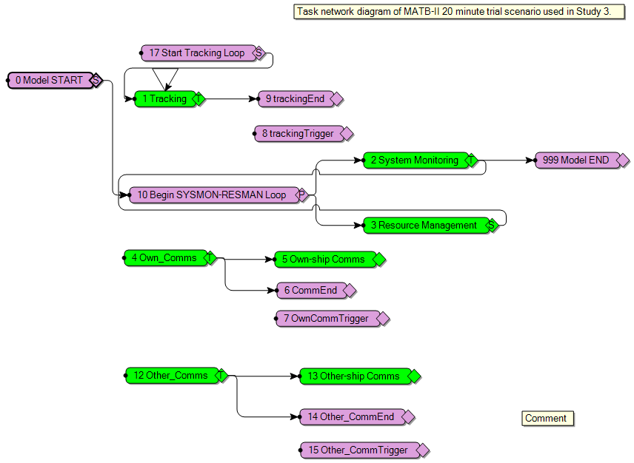
Modeling Effort
Improved Performance Research Integration Tool (IMPRINT)
A US Army dynamic, stochastic, discrete event modeling and simulation tool that assists in assessing human interaction with a system and the resulting workload experienced in completing a mission.
MATB-II Task Network Diagram
Communications Event Triggers

Slide 7
Modeling Effort
Improved Performance Research Integration Tool (IMPRINT)
Resource-Interface Workload Demand Values
Group 1 Operator Workload Graph

Slide 8
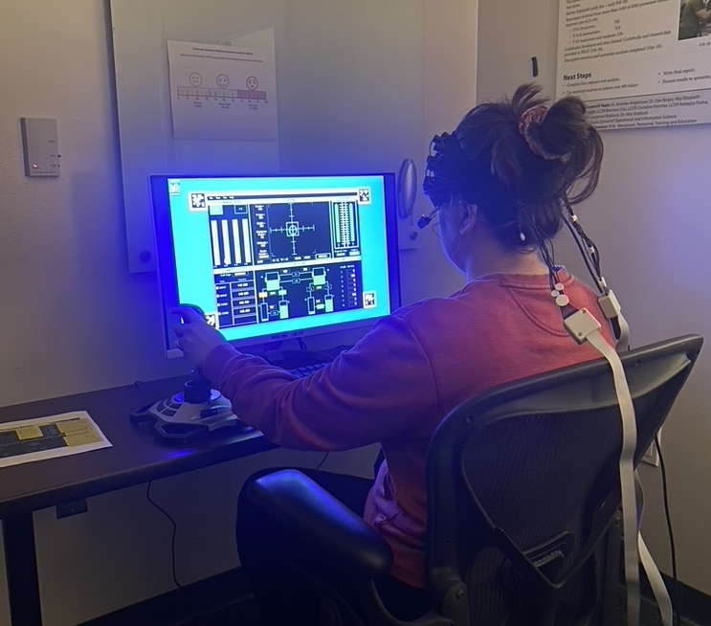
Experimental Approach
Human-in-the-Loop Study Design
Day 1, participants trained on MATB-II through video tutorial, part-task training sessions, four full-task training sessions (5 minutes each).
Day 2 (within 72 hours of day 1), sequence below.

Slide 9
Experimental Approach
Continuous Subjective Workload Assessment Graph
Miller & Shattuck (2004) originally developed the tool.
Participants provided a self-assessment of their currently experienced workload as a percentage of their maximum capacity through marking on a graph at set intervals of time.
Similar to other subjective workload assessment tools.
Modified Cooper-Harper, Bedford Workload Rating Scale, Workload Profile, etc.
Participants verbally prompted every 60 seconds starting at the :30 mark for workload.
They then provided a verbal response.

Slide 10
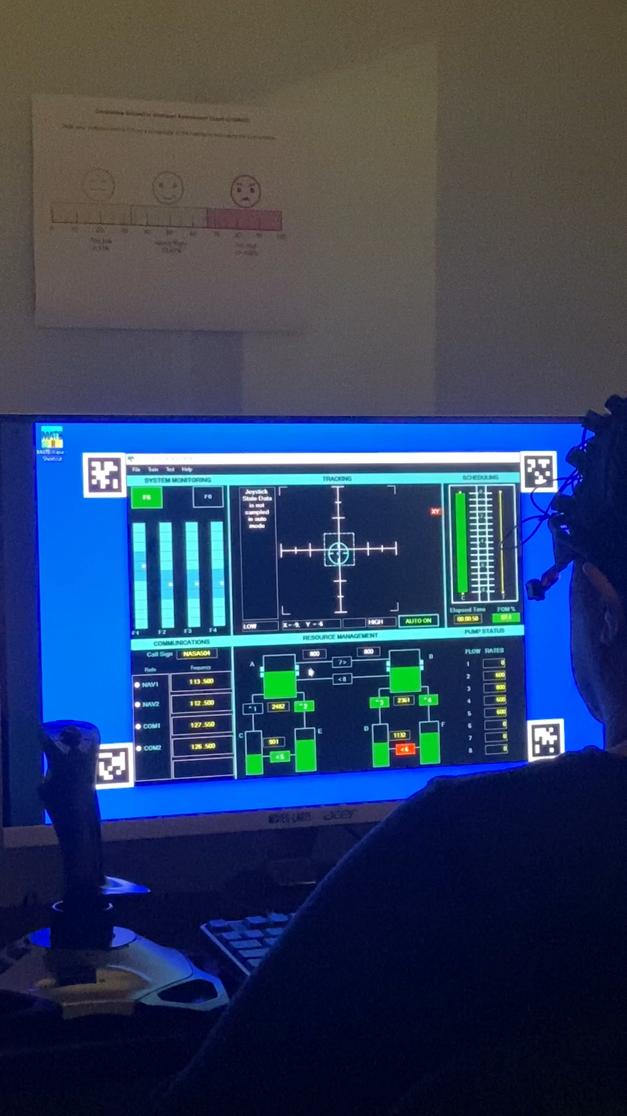
Experimental Approach

Slide 11
Results
Mixed-effects model using JMP 16.0.0 used to analyze the data.
Fixed effects included workload level and automation conditions
Participants were included as a random effect in the model and nested within groups.
No statistically significant differences between groups for CSWAG responses.

Slide 12
Results
CSWAG differences between workload (left) and tracking (right) conditions.
Error bars denote the standard error.

Slide 13
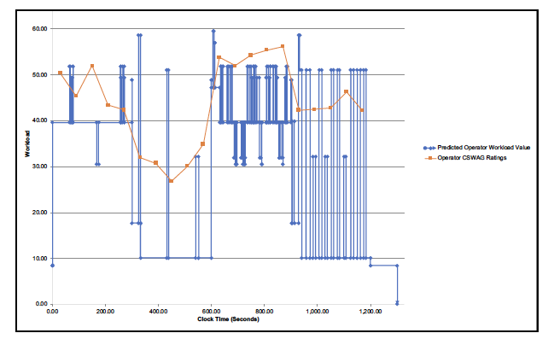
Discussion
CSWAG percentages found to be sensitive to different workload and adaptive automation conditions.
Results show alignment of CSWAG results with IMPRINT prediction values.

Slide 14
Discussion
Results serve as validation of the IMPRINT prediction models using the CSWAG approach.
Higher workload conditions yielded higher reported workload and lower workload conditions yielded lower report workload as predicted in the IMPRINT models.
This research highlights capability of the CSWAG approach in subjective workload assessment, with caveats.
However, study was done in controlled setting in laboratory environment.
Introduction of CSWAG prompting should be modeled as a task in IMPRINT to properly account for workload solicitation in context.
Sustained attention and transitions state transitions need to be modeled.
Multi-modal (objective, subjective, and performance-based) approach to workload measurement is critical to future design of scalable autonomous systems.

Slide 15
Thank You!
Questions, comments, and discussion.

