Slide 1

Simulating the Weaponization of Public Opinion in
Multi-Domain Scenarios
Linking the Information Domain with the Traditional Domains of Warfare
Jan Jaap Knobbout, Royal Netherlands Aerospace Center
Lodewijck Foorthuis, Royal Netherlands Aerospace Center

Slide 2
Defence Against the Digital Arts - 101
Cognitive Warfare in the Digital Age
Information is a powerful weapon in shaping thoughts and behavior.
Digital platforms, especially social media, play a critical role in modern warfare.
Ethical training environments focus on synthetic information simulations to avoid real-world impacts.

Slide 3
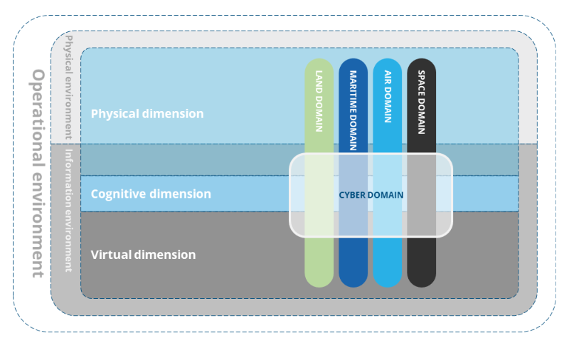
Anatomy of Information Warfare
The Information Environment (IE)
The IE is a key part of military strategy, influencing decision-making across multiple domains.
It includes physical, cognitive, and virtual dimensions, each impacting perceptions and actions.

Slide 4
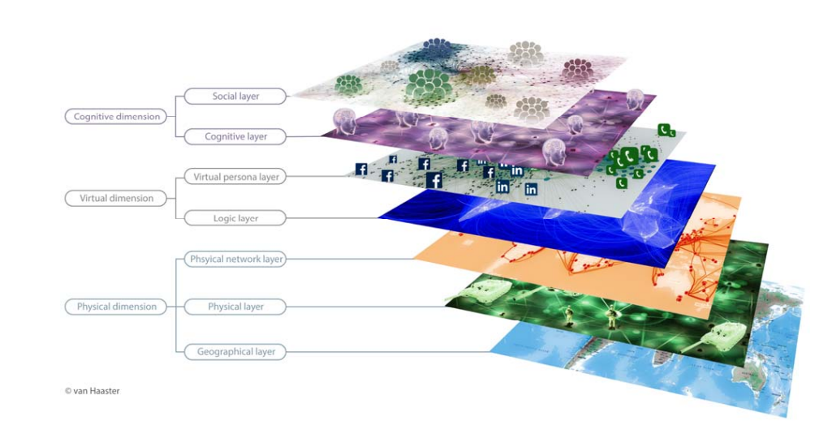
Anatomy of Information Warfare
Information in Military Domains
Five military domains (land, air, maritime, space, cyber) all rely on effective information flow.
Information is used to gain situational awareness and create operational advantages.

Slide 5

Virtual Warfare Tactics
Social Media as a Tool for Conflict
Social media platforms are vital tools for influencing behavior and spreading narratives.
Unintended consequences can arise from misinformation and propaganda spread on these platforms.

Slide 6
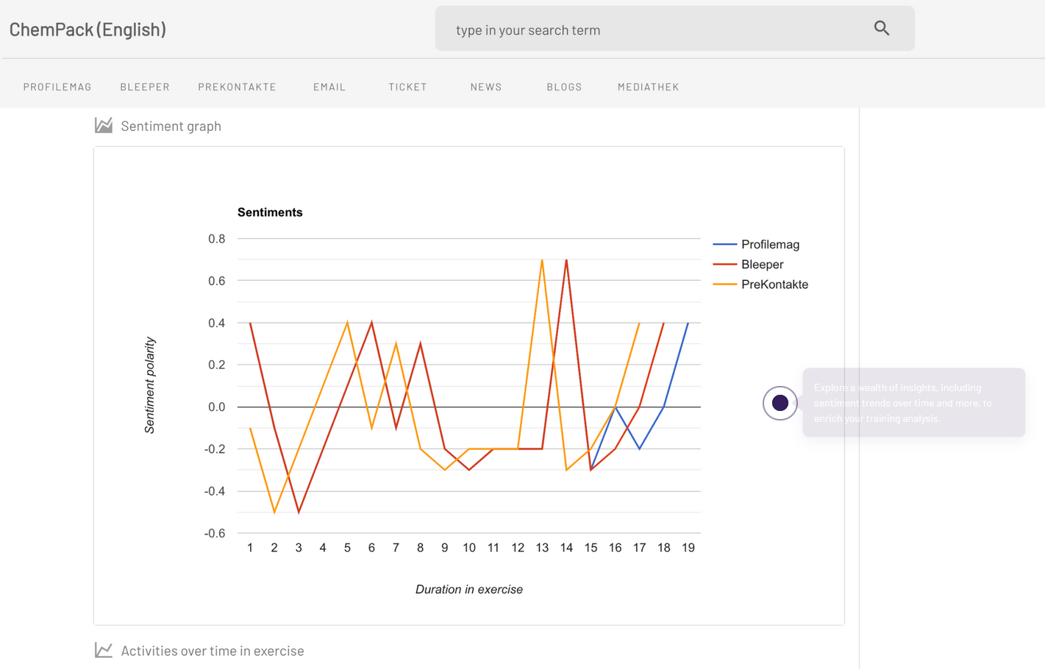
Virtual Warfare Tactics
Social Media as a Tool for Conflict
Simulated social media environments allow safe and effective training for cognitive warfare.
These environments allow trainees to monitor and counteract hostile information without legal risks.
Source: Prevency.com

Slide 7
Virtual Warfare Tactics
Virtual Tactics Impacting Real Operations
Disinformation and virtual influence can trigger real-world military responses.
Cyber operations and influence campaigns can support or hinder physical military actions.

Slide 8
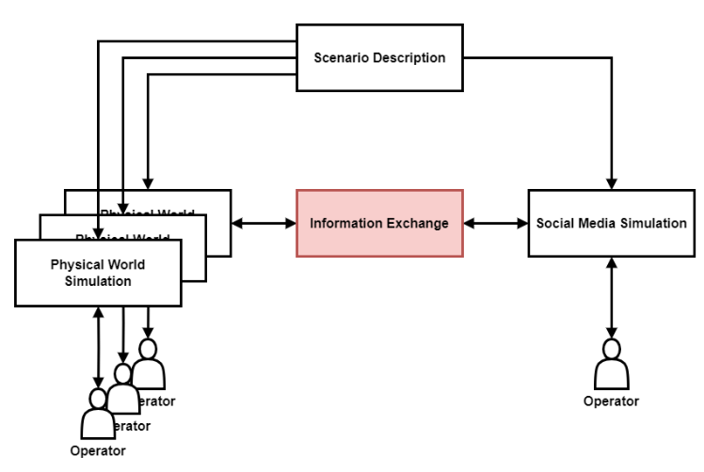
Bridging the Gap
Integrating Information Environments with MDO
Bridging the gap between traditional military simulations and information environment simulations is essential for realistic training.
Automated systems help link physical and virtual simulations.

Slide 9
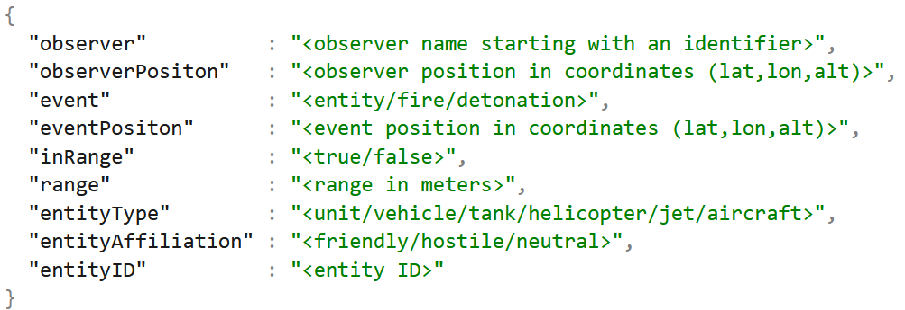
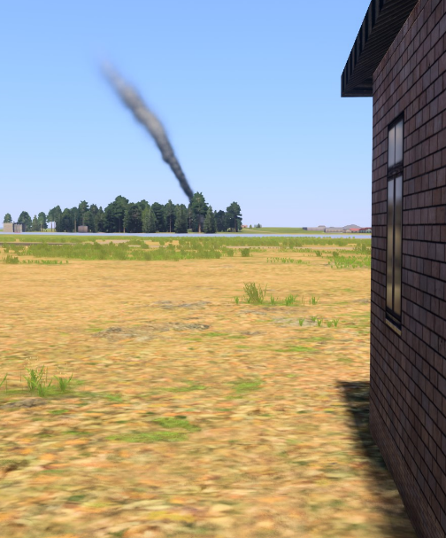
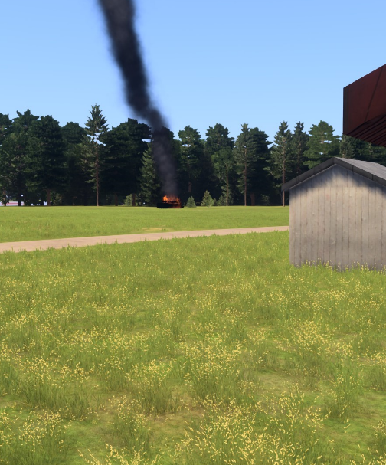
Bridging the Gap
Automating Simulated Events
Software tools can monitor physical events and generate real-time social media posts.
Civilians and digital personas can react to military activities in simulated environments.

Slide 10
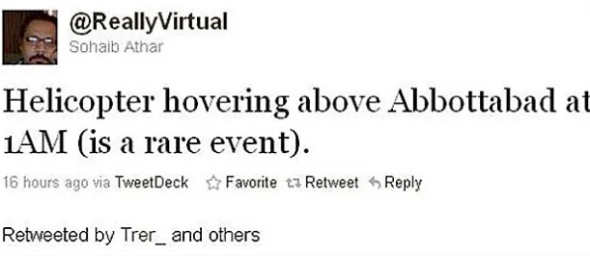
Bridging the Gap
The Impact of Virtual Actions on Military Strategy
Virtual posts and social media reactions can alter real-time military decisions.
IE operations require commanders to make decisions influenced by public perception.

Slide 11
Bridging the Gap
Building Comprehensive Training Environments
The future of warfare training lies in fully integrated, multi-domain simulations.
Combining traditional domains with the information environment prepares operators for complex decision-making.

