Slide 1
Interpretable Learning with Distance Aware Radial Basis Function Networks
Ethan Cramer, Lone Star Analysis
Co-Author: Dr. Randal Allen, Lone Star Analysis

Slide 2
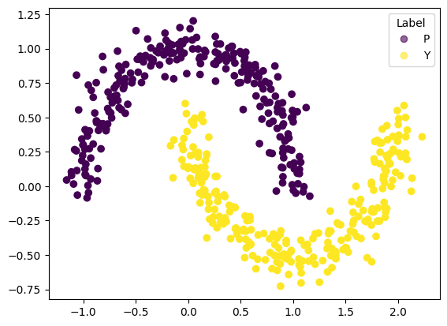
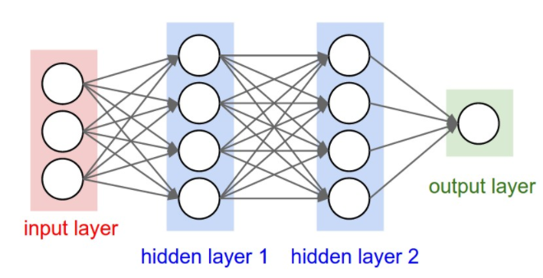
Two Moons – A Motivating Example
Two Moons Training Dataset
A traditional neural network classifier
What are the properties of this type of network?

Slide 3
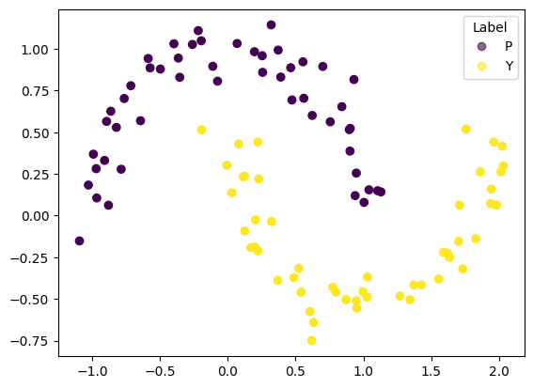
A test set from within the training distribution
Can it correctly classify points withheld from the training data?
Two Moons Testing Dataset
Test Samples
X | Y | Label
0.93 | 0.82 | P
0.20 | -0.03 | Y
-0.99 | 0.37 | P
1.73 | -0.32 | Y
0.95 | -0.55 | Y
…

Slide 4
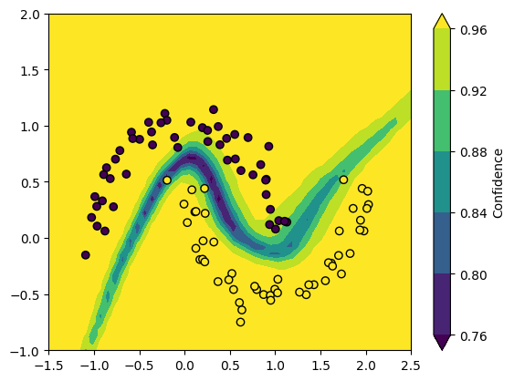
In-Distribution Test Data
Test Data |  | Neural Network Classifier
X | Y | Label | Pred. | Conf.
0.93 | 0.82 | P | P | 1.0
0.20 | -0.03 | Y | Y | 1.0
-0.99 | 0.37 | P | P | 1.0
1.73 | -0.32 | Y | Y | 1.0
0.95 | -0.55 | Y | Y | 1.0
… |  | …
Accuracy: |  | 100%
Avg Confidence: |  | 0.99
Yes, but…
Confidence
…is there a problem here?

Slide 5
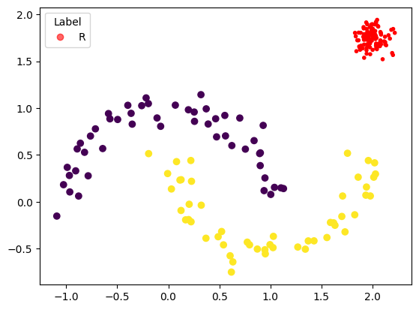
A test set from outside the training distribution
New Testing Dataset
New Test Samples
X | Y | Label
2.04 | 1.92 | R
2.12 | 1.71 | R
1.92 | 1.73 | R
1.95 | 1.68 | R
2.07 | 1.68 | R
…

Slide 6
Out-of-Distribution Test Data
Test Data |  | Neural Network Classifier
X | Y | Label | Pred. | Conf.
2.04 | 1.92 | R | P | 1.0
2.12 | 1.71 | R | Y | 0.99
1.92 | 1.73 | R | P | 0.99
1.95 | 1.68 | R | Y | 0.99
2.07 | 1.68 | R | Y | 0.99
… |  | …
Accuracy: |  | 0%
Avg Confidence: |  | 0.99
The model was only trained on two classes

Slide 7
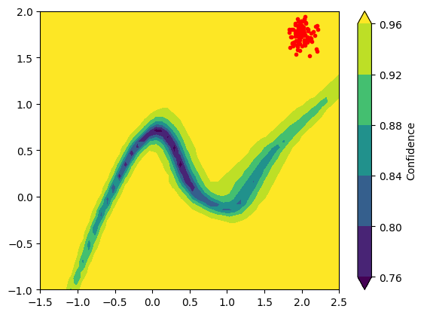
Out-of-Distribution Test Data
Test Data |  | Neural Network Classifier
X | Y | Label | Pred. | Conf.
2.04 | 1.92 | R | P | 1.0
2.12 | 1.71 | R | Y | 0.99
1.92 | 1.73 | R | P | 0.99
1.95 | 1.68 | R | Y | 0.99
2.07 | 1.68 | R | Y | 0.99
… |  | …
Accuracy: |  | 0%
Avg Confidence: |  | 0.99
The model was only trained on two classes
Confidence
There is a problem.

Slide 8
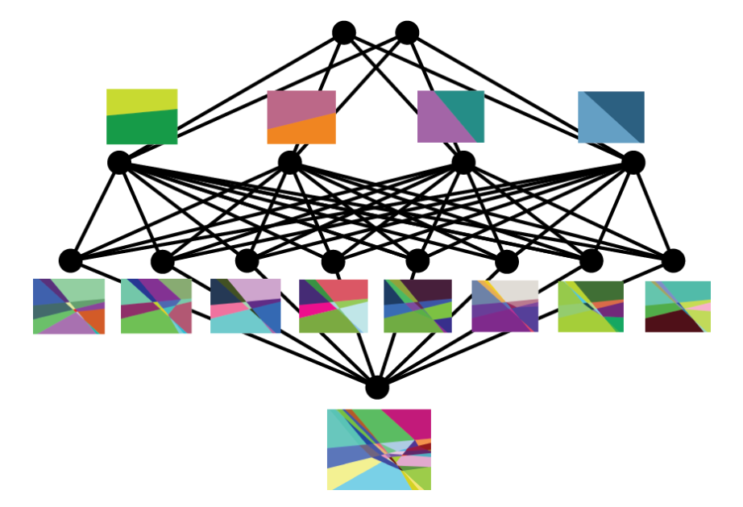
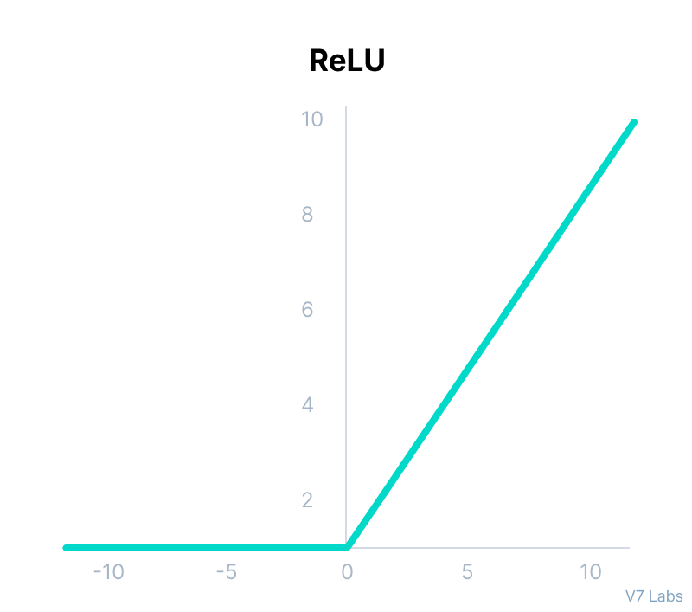
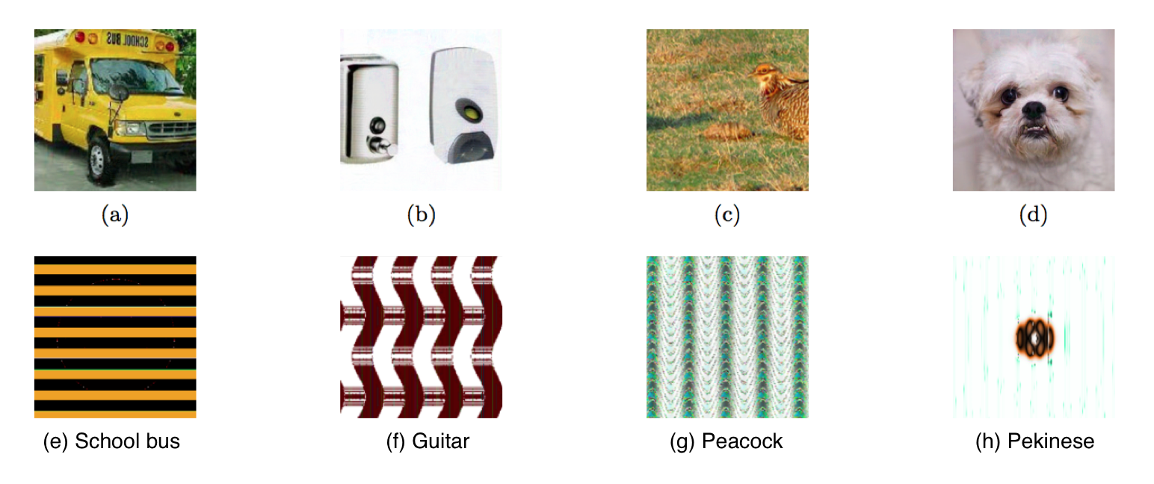
What’s going on here?
During training, the input space is partitioned into a finite number of regions, each of which corresponds to a different linear function (i.e., a piecewise function).
Each neuron defines a linear boundary.
ReLU
ReLU
ReLU
ReLU
Softmax
ReLU
ReLU
ReLU
ReLU
(Hanin & Rolnick, 2019)
ReLU
The outer regions extend to infinity, which is where neural networks make arbitrarily high confidence predictions.
(Wang, Raj & Xing, 2017)

Slide 9
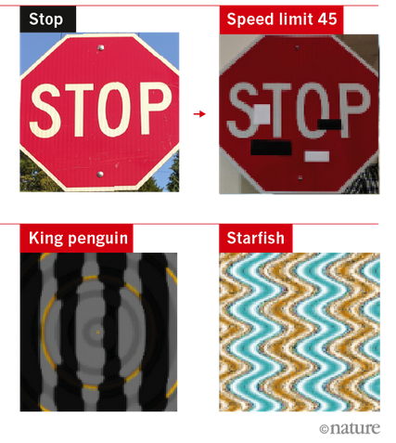
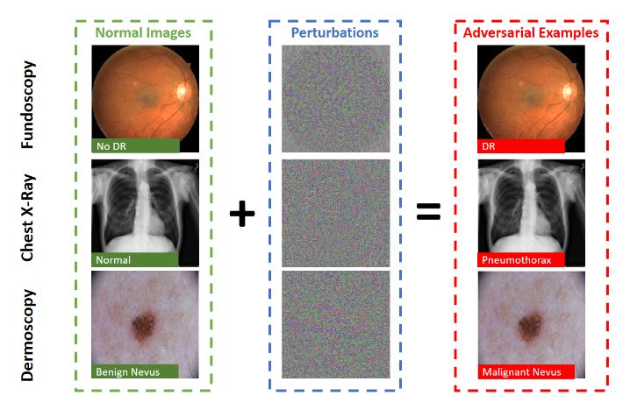
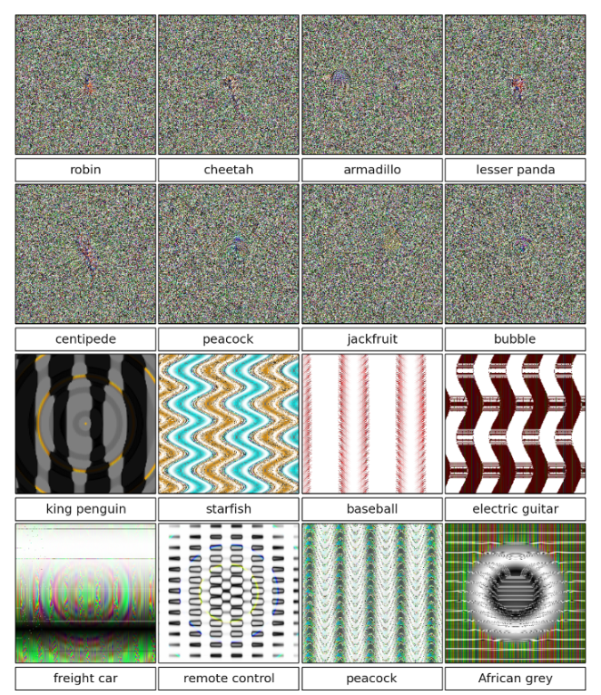
Neural networks are easy to fool
(Heaven, 2019)
(Heaven, 2019)
High-dimensional perturbations can fool networks into making wrong predictions with high confidence.
Accurately modeling uncertainty so that our model can answer “I don’t know” is critical to readiness.
(Nguyen et al., 2015)

Slide 10
Let’s return to the motivating example.
Test Data |  | Neural Network |  |  | Our Approach
X | Y | Label | Pred. | Conf. | Label | Pred. | Conf.
0.93 | 0.82 | P | P | 1.0 | P | P | 0.73
0.20 | -0.03 | Y | Y | 1.0 | Y | Y | 0.94
-0.99 | 0.37 | P | P | 1.0 | P | P | 0.87
1.73 | -0.32 | Y | Y | 1.0 | Y | Y | 0.93
0.95 | -0.55 | Y | Y | 1.0 | Y | Y | 0.93
… |  | … |  |  | …
Accuracy: |  | 100% |  |  | 100%
Avg Confidence: |  | 0.99 |  |  | 0.91

Slide 11
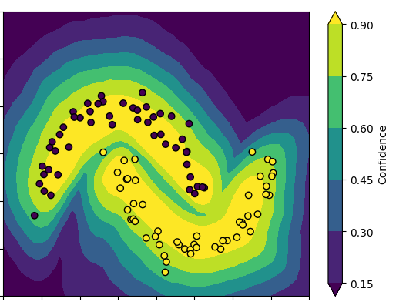
An important difference
Neural Network Classifier
Our Approach
 | Neural Network Classifier | Our Approach
Accuracy: | 100% | 100%
Avg Confidence: | 0.99 | 0.91

Slide 12
Out of distribution data
Test Data |  | Neural Network |  |  | Our Approach
X | Y | Label | Pred. | Conf. | Label | Pred. | Conf.
2.04 | 1.92 | R | P | 1.0 | R | P | 0.003
2.12 | 1.71 | R | Y | 0.99 | R | Y | 0.001
1.92 | 1.73 | R | P | 0.99 | R | P | 0.002
1.95 | 1.68 | R | Y | 0.99 | R | Y | 0.002
2.07 | 1.68 | R | Y | 0.99 | R | Y | 0.001
… |  | … |  |  | …
Accuracy: |  | 0% |  |  | 0%
Avg Confidence: |  | 0.99 |  |  | 0.001

Slide 13
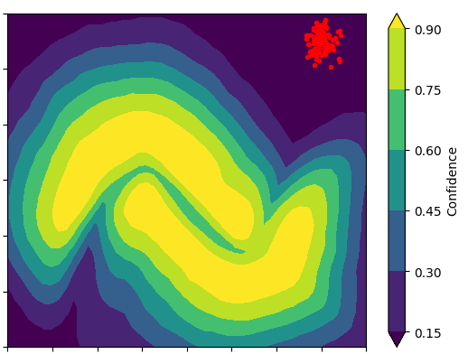
Out of distribution data
Neural Network Classifier
Our Approach
 | Neural Network Classifier | Our Approach
Accuracy: | 0% | 0%
Avg Confidence: | 0.99 | 0.001

Slide 14
AI Malfunction
The Center for Security and Emerging Technology defines categories of AI malfunction as follows:
Failures of robustness. The system is subjected to unusual or unforeseen inputs, causing failures.
Failures of specification. The system is attempting to do something that is subtly different from what the developer anticipated, which might result in surprising behaviors or consequences.
Failures of assurance. In operational mode, the system cannot be fully supervised or regulated.
And we would like to add one more:
Failures of data. There are many problems where there is simply not enough data to train.
Our Approach:
Is robust against adversarial attacks and unforeseen inputs.
Accurately assesses its own uncertainty.
Maintains the human-interpretable semantics in the data.
Allows the model to be taught human concepts, requiring less data.

Slide 15
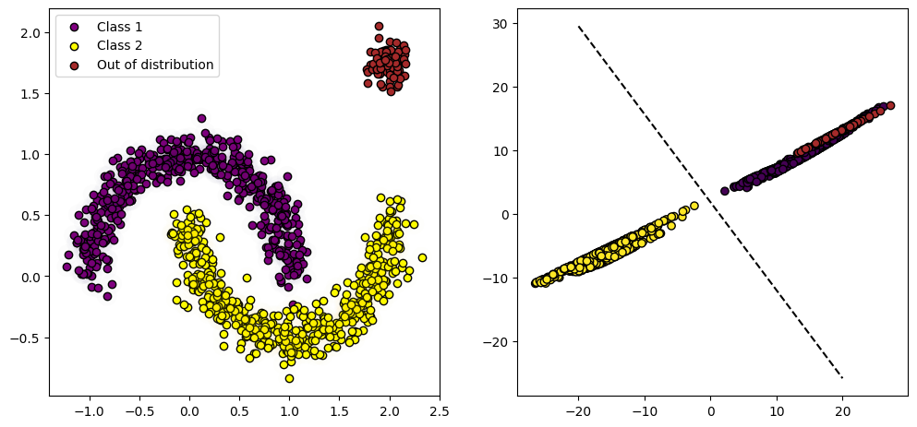
Theory
The hidden layers perform a non-linear (piecewise, for ReLU) transformation of the input data.
hidden representation
Class 1
Class 2
hidden representation

Slide 16
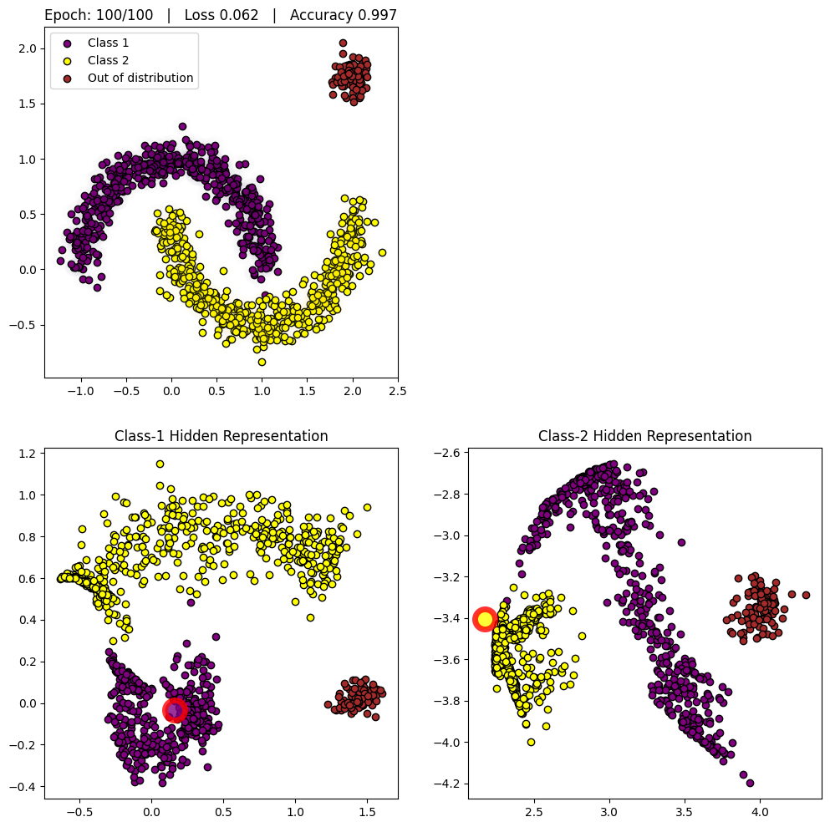
Theory
hidden representation
???
We would like the hidden representation to preserve the distance between points in the input space.
Class 1

Slide 17
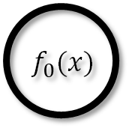



Theory
Class-1 hidden representation
Each class gets its own hidden representation
Class 1
centroid
$${ e}_{1}$$
Class-2 hidden representation
$${ f}_{0}(x)$$
Model
output
$$Uncertainty$$
$${ e}_{2}$$
Class 2
centroid

Slide 18
Theory
Class-1 hidden representation
Each class gets its own hidden representation
Class 1
centroid
$${ e}_{1}$$
Distance to centroid 1
Class-2 hidden representation
$${ f}_{0}(x)$$
Model
output
Distance to centroid 2
$$Uncertainty$$
$${ e}_{2}$$
Class 2
centroid
The RBF Kernel allows us to learn the weights which minimize an input’s distance to the correct centroid while maximizing its distance from all other centroids.

Slide 19
Theory
Class-1 hidden representation
Each class gets its own hidden representation
Class 1
centroid
$${ e}_{1}$$
MAXIMIZE
Distance to centroid 1
MAXIMIZE
Class-2 hidden representation
$${ f}_{0}(x)$$
Model
output
MINIMIZE
MINIMIZE
Distance to centroid 2
$$Uncertainty$$
$${ e}_{2}$$
Class 2
centroid
The RBF Kernel allows us to learn the weights which minimize an input’s distance to the correct centroid while maximizing its distance from all other centroids.

Slide 20
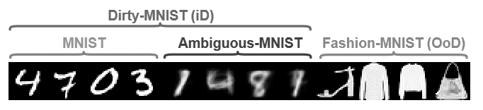
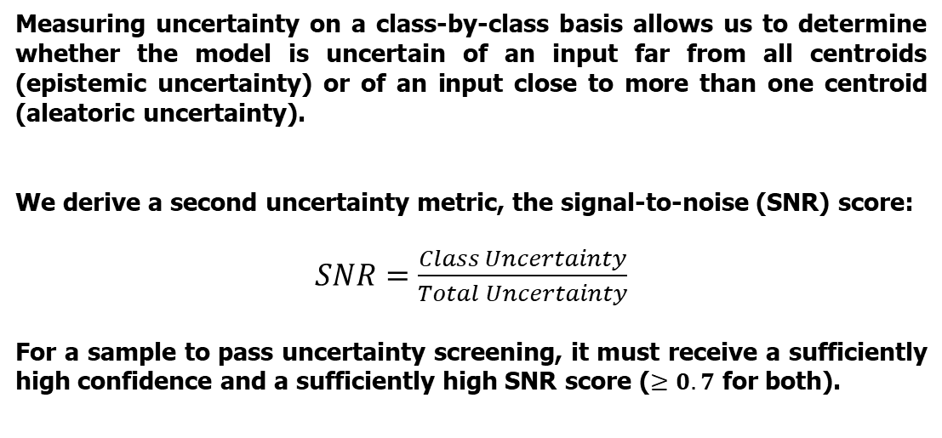
Untangling OOD from ID Data
Clean-MNIST
Dirty-MNIST
Fashion-MNIST
In-Distribution (ID)
Out of Distribution (OOD)
Measuring uncertainty on a class-by-class basis allows us to determine whether the model is uncertain of an input far from all centroids (epistemic uncertainty) or of an input close to more than one centroid (aleatoric uncertainty).
We derive a second uncertainty metric, the signal-to-noise (SNR) score:
$SNR=\frac{Class Uncertainty}{Total Uncertainty}$
For a sample to pass uncertainty screening, it must receive a sufficiently high confidence and a sufficiently high SNR score ($≥0.7$ for both).

Slide 21









Untangling OOD from ID Data
Clean-MNIST
Dirty-MNIST
Fashion-MNIST
$$0$$
$$Uncertainty$$
$$1$$
In-Distribution (ID)
Out of Distribution (OOD)
$$2$$
$${ f}_{0}(x)$$
Measuring uncertainty on a class-by-class basis allows us to determine whether the model is uncertain of an input far from all centroids (epistemic uncertainty) or of an input close to more than one centroid (aleatoric uncertainty).
We derive a second uncertainty metric, the signal-to-noise (SNR) score:
$SNR=\frac{Class Uncertainty}{Total Uncertainty}$
For a sample to pass uncertainty screening, it must receive a sufficiently high confidence and a sufficiently high SNR score ($≥0.7$ for both).
$$3$$
$$4$$
$$5$$
$$9$$
. . .
Clean inputs result in low uncertainty, because there is one correct centroid.

Slide 22



Untangling OOD from ID Data
Clean-MNIST
Dirty-MNIST
Fashion-MNIST
$$0$$
$$Uncertainty$$
$$1$$
In-Distribution (ID)
Out of Distribution (OOD)
$$2$$
$${ f}_{0}(x)$$
Measuring uncertainty on a class-by-class basis allows us to determine whether the model is uncertain of an input far from all centroids (epistemic uncertainty) or of an input close to more than one centroid (aleatoric uncertainty).
We derive a second uncertainty metric, the signal-to-noise (SNR) score:
$SNR=\frac{Class Uncertainty}{Total Uncertainty}$
For a sample to pass uncertainty screening, it must receive a sufficiently high confidence and a sufficiently high SNR score ($≥0.7$ for both).
$$3$$
$$4$$
$$9$$
$$5$$
. . .
Ambiguous inputs result in high aleatoric uncertainty, because there are multiple correct centroids.

Slide 23

Untangling OOD from ID Data
Clean-MNIST
Dirty-MNIST
Fashion-MNIST
$$0$$
$$Uncertainty$$
$$1$$
In-Distribution (ID)
Out of Distribution (OOD)
$$2$$
$${ f}_{0}(x)$$
Measuring uncertainty on a class-by-class basis allows us to determine whether the model is uncertain of an input far from all centroids (epistemic uncertainty) or of an input close to more than one centroid (aleatoric uncertainty).
We derive a second uncertainty metric, the signal-to-noise (SNR) score:
$SNR=\frac{Class Uncertainty}{Total Uncertainty}$
For a sample to pass uncertainty screening, it must receive a sufficiently high confidence and a sufficiently high SNR score ($≥0.7$ for both).
$$3$$
$$4$$
$$5$$
$$9$$
. . .
Out of distribution inputs result in high epistemic uncertainty, because there are no correct centroids.

Slide 24
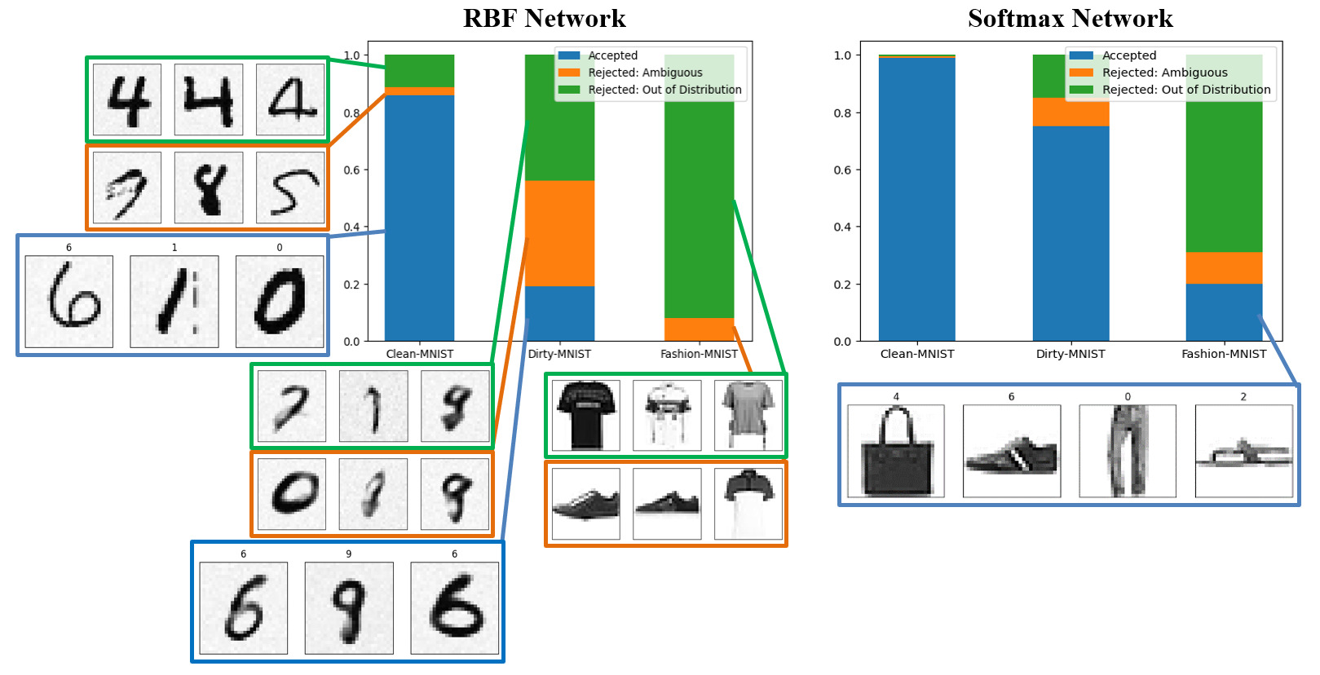
Results
Neural Network Classifier
The neural network attempted to classify 20% of the Fashion-MNIST samples with nearly 100% confidence.

Slide 25
Results
Our Approach
Ultimately, the thresholds indicate risk tolerance. Some tasks have severe consequences for false-positives (weapons targeting, medical diagnosis), one may want to turn up the thresholds and pass anything with middling certainty over to a human reviewer.
Dataset | Model | Raw Accuracy (%) | Accuracy After Rejection (%) | Reject Rate (%)
Clean-MNIST | Neural Network | 98.9 | 99.3 | 1.1
 | Our Approach | 98.6 | 99.8 | 14.1
Dirty-MNIST | Neural Network | 72.8 | 80.3 | 24.9
 | Our Approach | 64.6 | 87.4 | 80.8
Fashion-MNIST | Neural Network | - | - | 80.0
 | Our Approach | - | - | 99.9
After rejecting ambiguous and OOD samples from the test set, the accuracy of our approach exceeds the neural network.

Slide 26
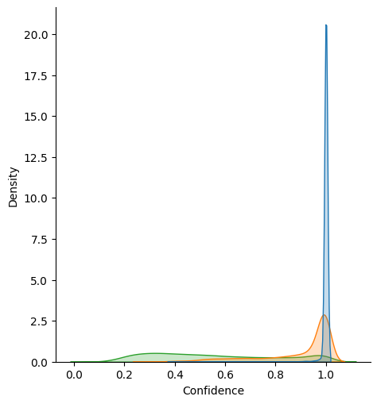
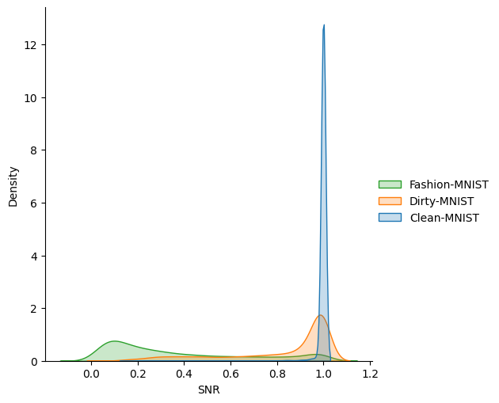
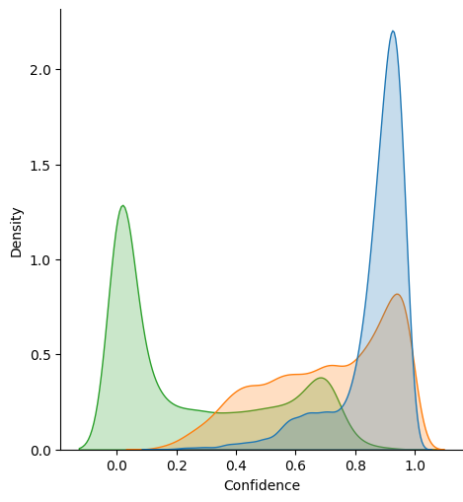
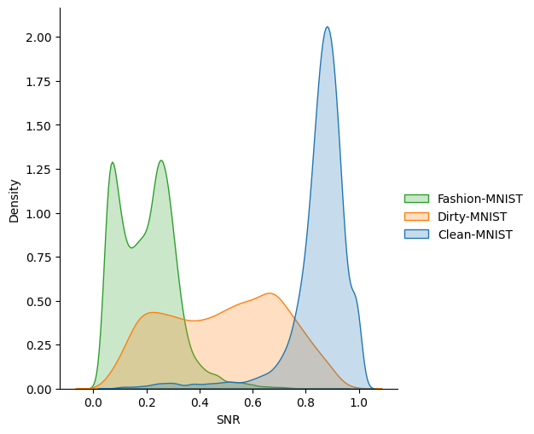
Results
Neural Network Classifier
Our Approach
The neural network struggles to separate any uncertainty.
Nearly all Clean-MNIST samples and most Dirty-MNIST samples are predicted with 100% confidence.
Even for some Fashion-MNIST samples, the model is 100% confident in its predictions.
Our approach can separate OOD (Fashion-MNIST) from ID (Dirty-MNIST and Clean-MNIST) using confidence as an uncertainty metric.
Using the SNR score the model can separate ambiguous samples from clean samples.
With these two scores, we reject samples due to high aleatoric uncertainty (high confidence + low SNR) or high epistemic uncertainty (low confidence).

Slide 27
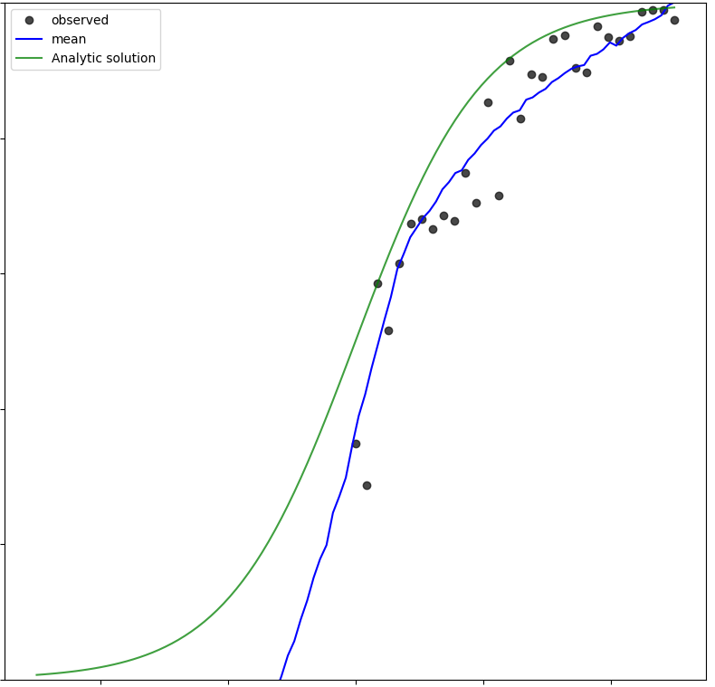
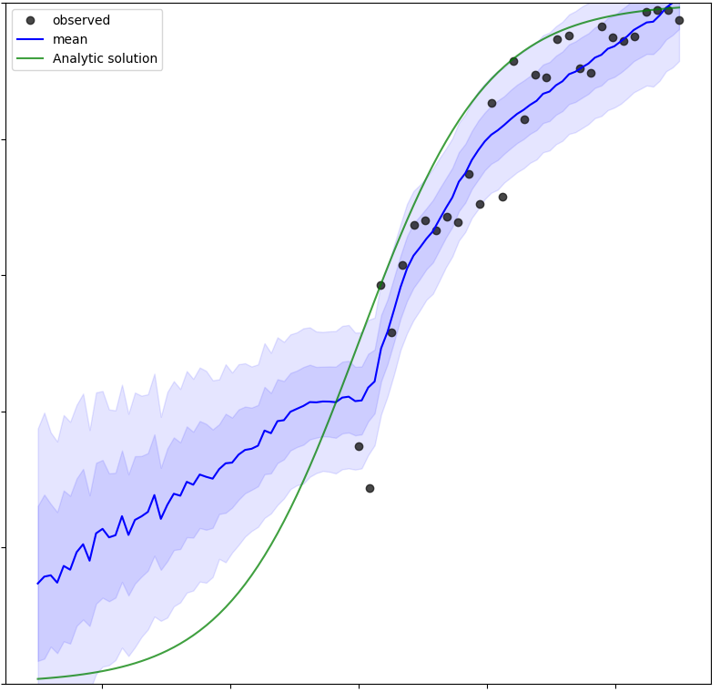
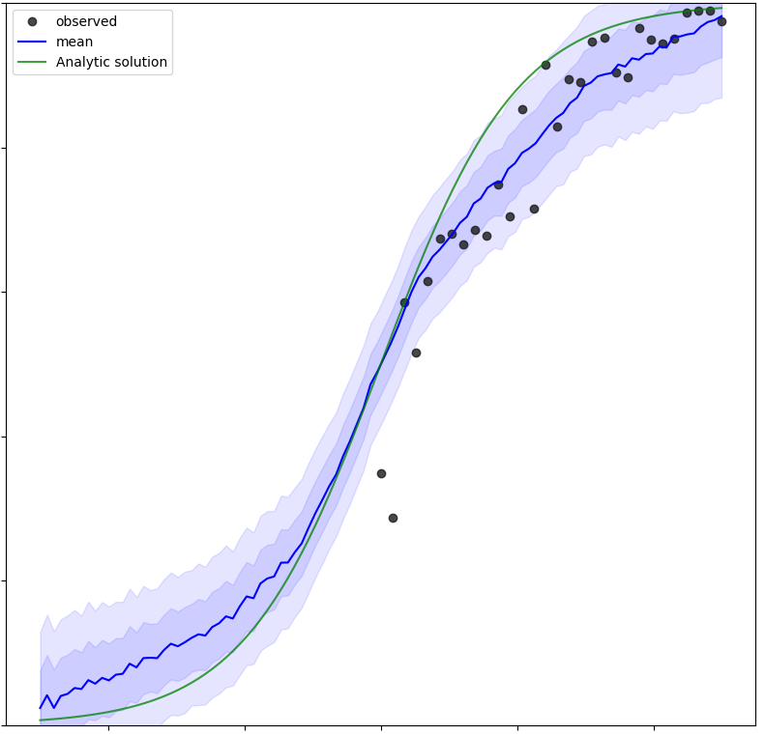
Building Common Sense into the Model
Traditional Neural Network
Our Approach
Our Approach with Logistic Policy
If we have some ideas about the function we’re modeling (logistic, thermodynamics, sinusoidal, etc.), then we can build a policy into the model to achieve better predictions from less data.

Slide 28
Summary
Our approach can use any set of rules to “teach” and constrain the model. ‘Physics based’ is one example.
Books like “AI Superpowers” by Kai Fu Lee talk about how the US is not going to win the AI arms race, but that is predicated on the assumption that Big Data AI is the answer to all AI problems. We win by being different.
While we have seen many great advances in the last 75 years in AI and machine learning, there are still known challenges such as AI being very certain of wrong answers.
Accurately modeling uncertainty, and having an AI that can answer “I don’t know” is critical to readiness.

