Slide 1
Expanding Access To Learning Decision-Making And Teamwork Skills Using Low Fidelity, Tabletop Games: A Measurement Approach
Combat Capabilities Development Command - Soldier Center
Tamara Griffith, PhD
Lisa Townsend
Jerry R. Mize
Affiliated Researchers
Joan Johnston, PhD
Grant Johnston
Jake Engel
Approved for Public Release PR2024-1573

Slide 2
Overview
Research Questions
Game Design
Method
Results
Discussion
To understand how to expand trainee access to learning leadership and team skills
Approved for Public Release PR2024-1573

Slide 3


Shamble On
What do you call the part of an I/ITSEC zombie paper that thanks someone?
Groans and Moans Welcome
Approved for Public Release PR2024-1573
Notes:
Groans and Moans Please...
Shows the light hearted approach to serious questions. Intimates how novel techniques and popular genre’s can affect training/evaluation without subject knowing they are training/being evaluated.

Slide 4

Research Questions – WHY???
How can we observe and understand basic questions on how people (nod toward military) react to crisis management:
Decision Making
Teamwork / Teamwork Behaviors
Leadership / Emergent Leadership
Communication Conduct and Content
Team Cohesion and Efficacy Levels
Game Confidence
Cooperation Under Stress
Used popular genre (zombies) and established gaming methods through Table Top Role Playing and Live Action Role Playing
Approved for Public Release PR2024-1573
Notes:
Outside the coffin thinking on personnel attributes leads to crazy ideas and a crazy framework to do hard research.
Leadership (inherent, emerging, non-forming) Charismatic, Traditional, Rational-legal (Weber) also, Formal, Moral, Charismatic, Coercive, Democratic...
Some psychology: Can we use cognitivism and to a greater extent constructionism to elicit recordable responses and interactions?
How can we use the principle of motivation without a full blown DnD type session or the too familiar military setting to elicit recordable desired level of responses and interactions? - Zombies
Therefore, build a rules light, zombie game that induces stressors to elicit recordable responses and interactions.
Other tangible leader questions:
Recognize undeveloped/underused talent?
Recognize natural leadership?
Recognize teaming flaws?
Blue Falconry (unwanted personal characteristics that affect/displaced onto other team members)
Slides following explain

Slide 5
The Game BLUF
Novel, low fidelity crisis management evaluative tool
Use a kluge of existing gaming systems to induce reactions
Unknown or unusual scenarios facilitate observation in a military-like setting without being “Army” - Dynamic
Threat + role playing + live action = increased stimulation and enhanced reaction – outside the coffin thinking
Can look at individuals (leadership) and teams or team dynamic
Draws out emergent leaders
More than identify – practices, promotes improvements
Approved for Public Release PR2024-1573
Notes:
To answer our research questions we wanted to build a way to measure and observe. The military has training and evaluation sessions but they are lengthy or possibly burdensome. So how can we get to something simplified that will still let us get at the questions? Answer: GAMES. TTRPG and LARP.
Leadership (inherent, emerging, non-forming) Charismatic, Traditional, Rational-legal (Weber) also, Formal, Moral, Charismatic, Coercive, Democratic...
Some psychology: Can we use cognitivism and to a greater extent constructionism to elicit recordable responses and interactions?
How can we use the principle of motivation without a full blown DnD type session or the too familiar military setting to elicit recordable desired level of responses and interactions? - Zombies
Therefore, build a rules light, zombie game that induces stressors to elicit recordable responses and interactions.
Other tangible leader questions:
Recognize undeveloped/underused talent?
Recognize natural leadership?
Recognize teaming flaws?
Blue Falconry (unwanted personal characteristics that affect/displaced onto other team members)
Slides following explain

Slide 6
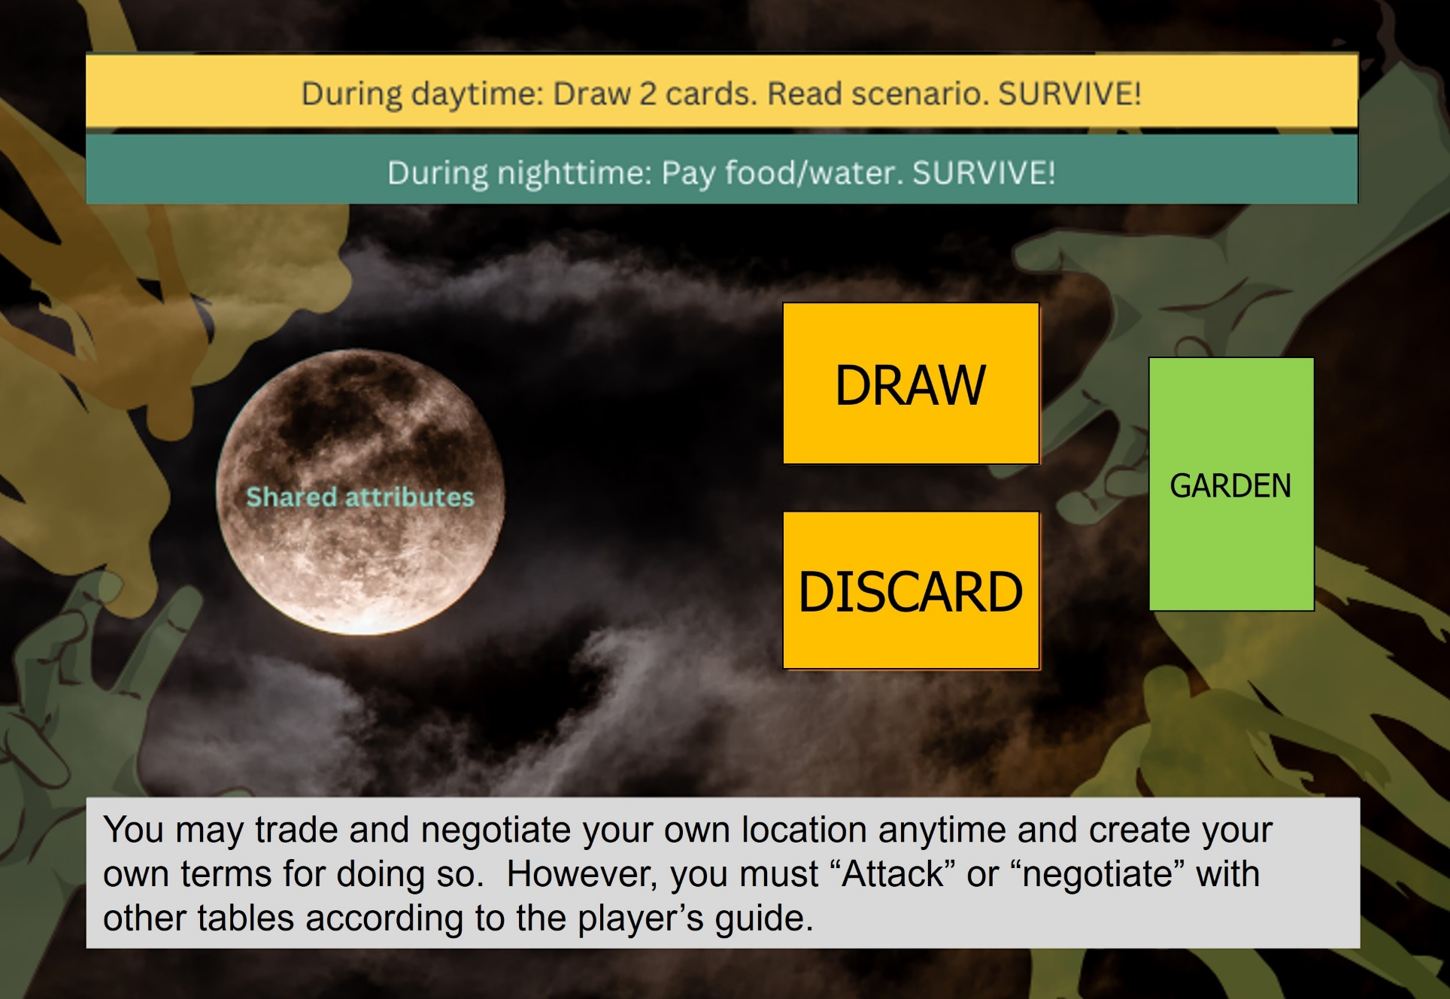
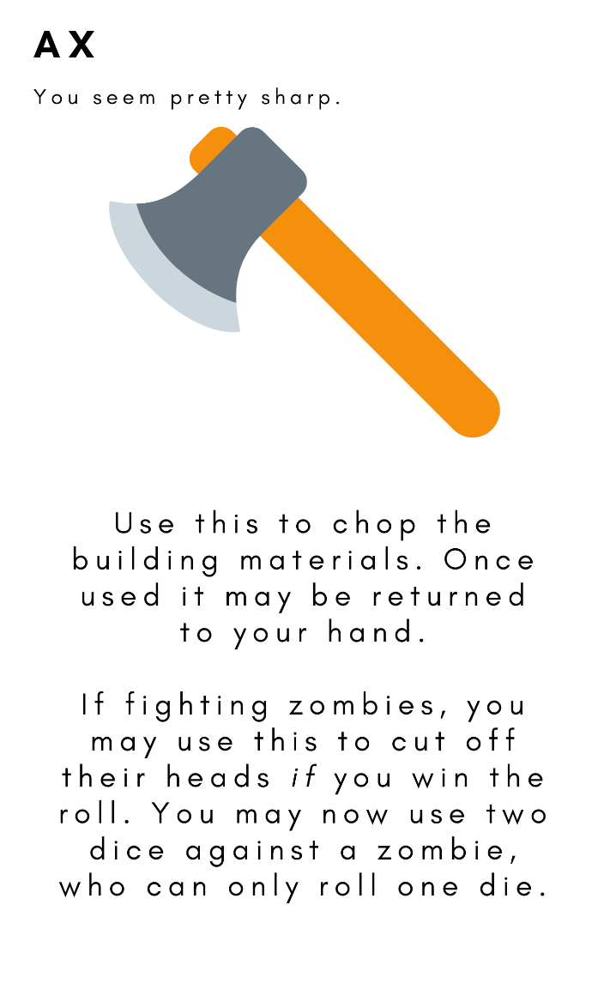
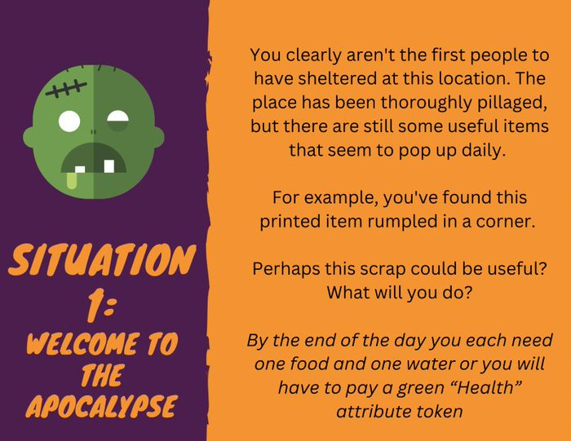

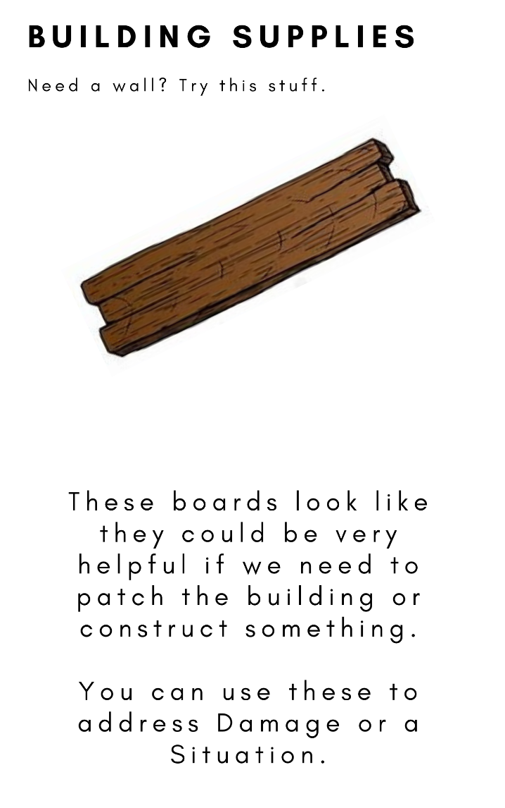
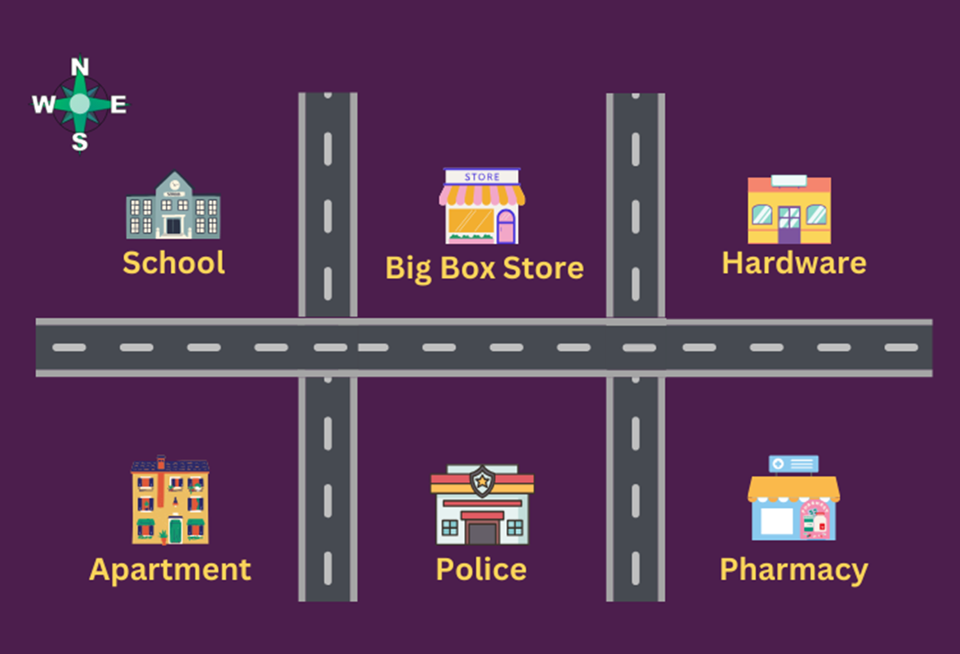
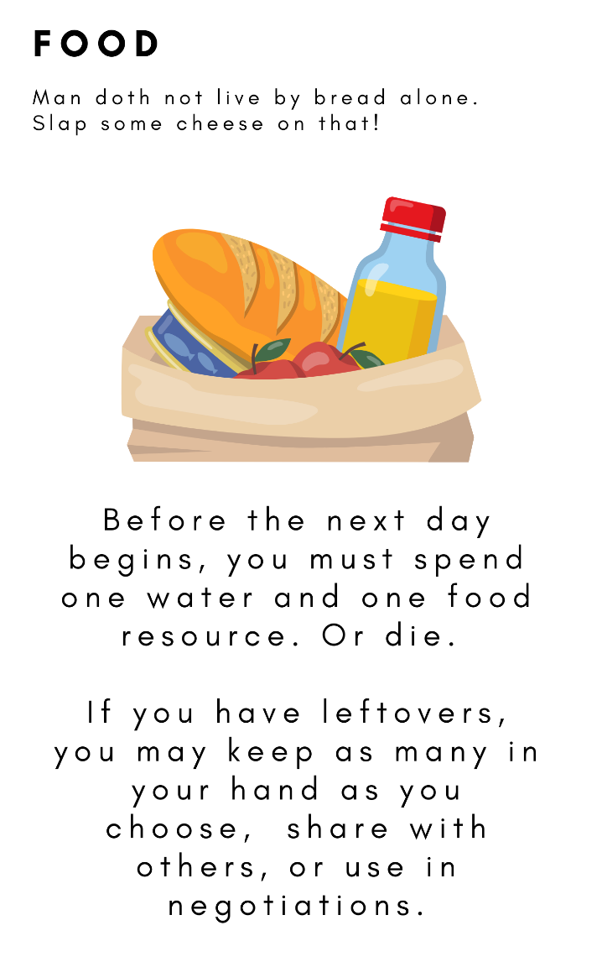
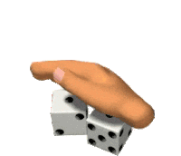



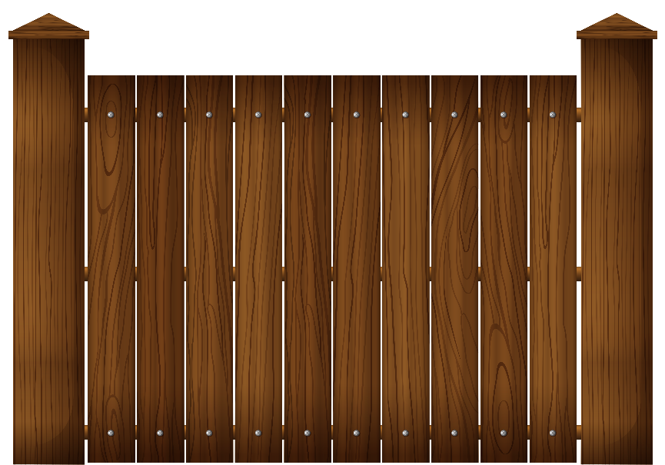
The Game
Rules light
No assigned play area or roles
Group Mat
Map
Resource Cards
Daily Event cards
Combat – Player v Player (PvP), PvEnvironment, PvZombie
Boundary Lines / Walls
Bridging
Six sided dice (D6)
Approved for Public Release PR2024-1573
Notes:
No assigned tables or roles – Allows behavior to emerge organically. Table represents a building on map. All questions
Rules light – but rules, however “light” gives more freedom and creativity for players to explore their limits to our questions
Resource Cards (scarcity by building) – Decision Making, Leadership, Teamwork, Communication, Cooperation
D6s for variability and for action adjudication. Zombies would “shake and roll” their dice in metal bowls for added mood/urgency
Daily Event cards – all questions touched - Forces action – Hones in on Research Questions
Map – Decision Making and Communication. Simple but seeing what buildings are available/defenses cues thoughts
Boundary Lines – Decision making, Communication, Cooperation. Each building represented as a table had a tape line for the building, then one for a fence, another for a double fence, could also block roads between buildings
Bridging - Decision making, Teamwork, Communication, Cooperation– Method to create a walkway to adjacent buildings.
Combat –All questions – Either zombies break in, encounter on street, or Player v. Player

Slide 7
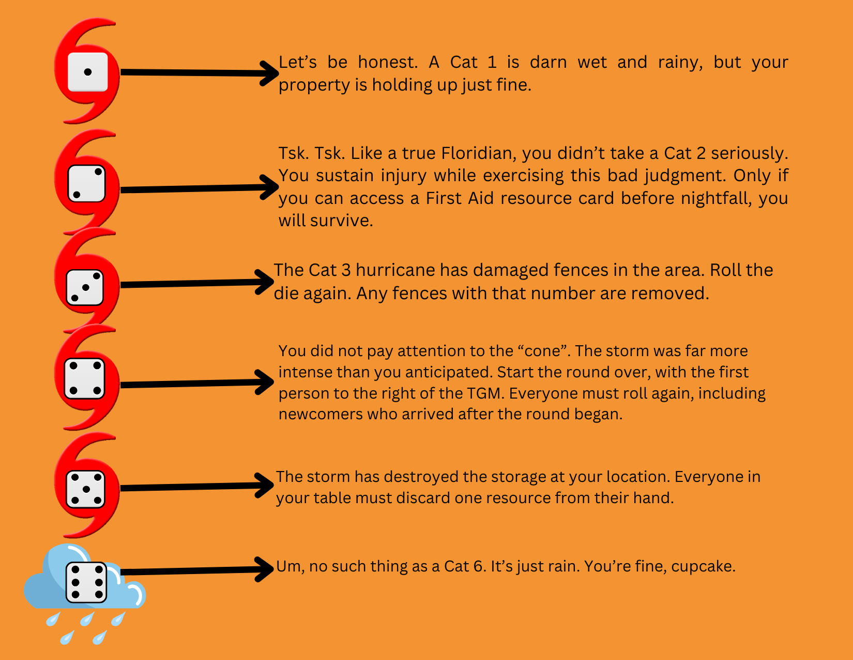
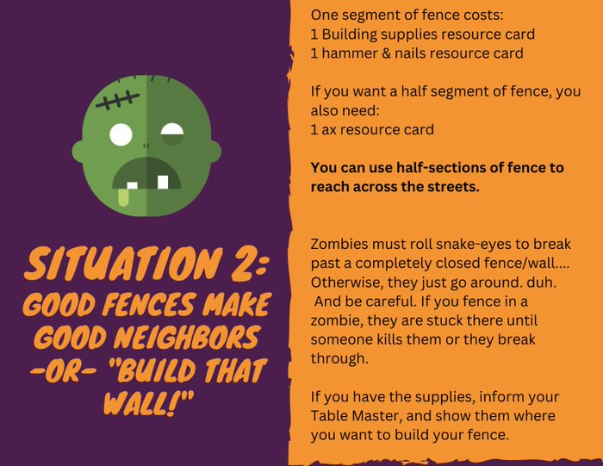
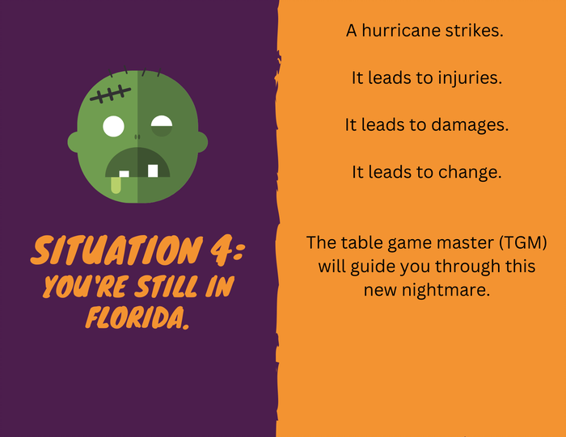
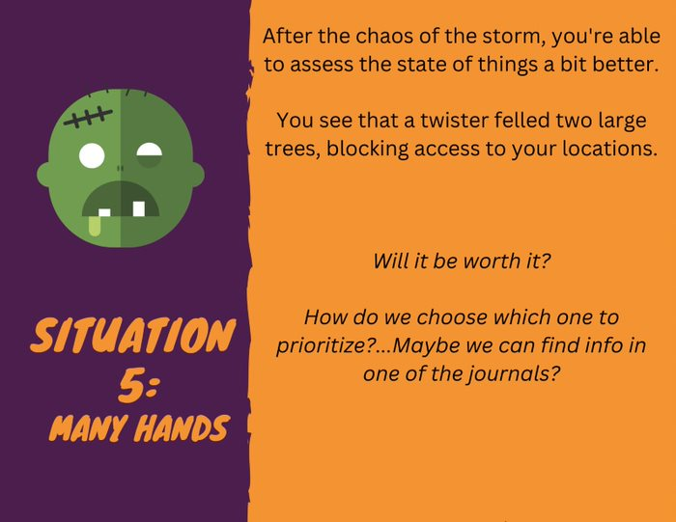
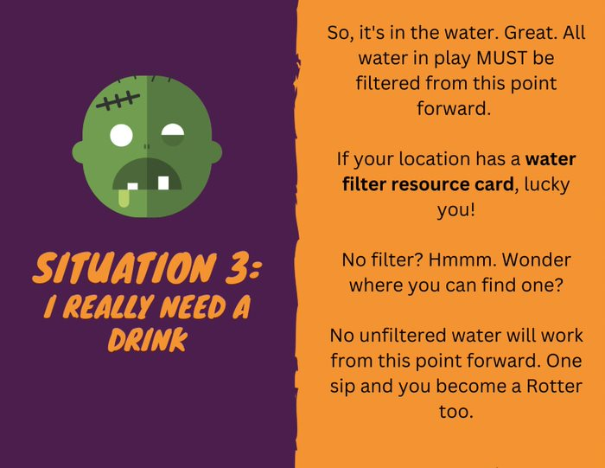
Events / Triggers
Day Title Event/Trigger
Welcome to the Apocalypse You’ve found a printed item rumpled in the corner. Perhaps this could
be useful? What will you do?
Good Fences Make Good Acquire supplies to build fences and then build them.
Neighbors – or – build
That Wall
3 I Really Need a Drink So, it’s in the water – all water must be filtered from this point forward.
No Filter? Where/how can you obtain one?
4 You’re Still in Florida A hurricane strikes, it leads to injuries, damage, and change. Roll one dice and
number is the Cat # storm you encountered.
5 Many Hands After the chaos of the storm, you’re able to assess the state of things better.
You see a twister caused two large tree to fall, blocking access to your
locations from two directions. One direction leads to a military base and the
other leads to a farm. Should you move the trees and how will you prioritize
which path to choose?
Approved for Public Release PR2024-1573
Notes:
Observers used checklists during game play and users conducted an instride and end review. We also conducted an overall AAR to gather more insight.
This all led a review by our numbers crunching team.

Slide 8
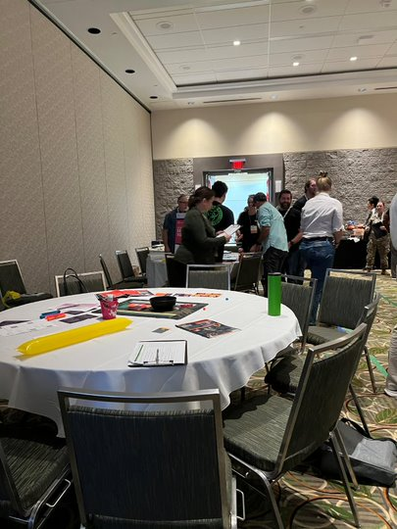
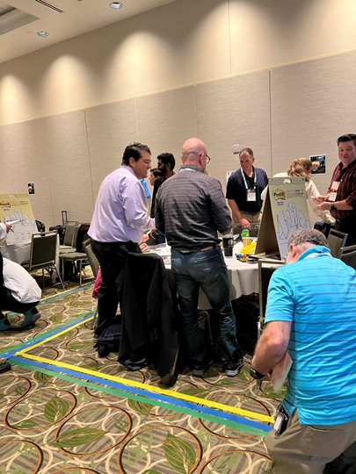
Players In Action
Basic Table Set Up
In Play
Fences/Boundaries
Approved for Public Release PR2024-1573
Notes:
Pictures of participants having fun, learning, and having emergent behaviors without realizing it... My cohort Grant will go over the data.

Slide 9
Study Method
Crisis Management Elements | Self-Report Surveys | Checklists | AARs
Multiple, inter-related, and time dependent problems |  | x | x
Team communications, emergent leader, role adoption, trust | x | x | x
Outcome predictability and availability of information |  | x | x
Planning | x | x | x
Providing real-time coaching |  | x | x
Conduct AARs | x | x | x
Approved for Public Release PR2024-1573

Slide 10
Surveys & Procedure
Pre-Game | Demographics Confidence
End Day 1 End Day 2 | Team Cohesion Team Efficacy Mini-AAR
Post-Game | AAR Team Cohesion, Team Efficacy, Post-game Confidence AAR Climate survey
Open-ended questions | Overall Workshop Reactions included trust, teamwork, team roles, leadership
Observer Checklists | Table Game Manager Dearly Departed (dead Zombies)
Approved for Public Release PR2024-1573
Notes:
Paperbased and GIFT

Slide 11
Method: Table Manager Checklist
Approved for Public Release PR2024-1573

Slide 12
Results
Demographics
35 participants ranging in age from 17 to 67, many with gaming experience
Nearly all had experience working in a team-based setting
Game Feature Reactions
AAR climate was positive
Would play the game again in 2024
High level of trust
Wanted more time to learn the game
Approved for Public Release PR2024-1573

Slide 13
Results (Cont.)
Table Game Manager Observations
Most players contributed to team decisions
Five leaders emerged
Players appeared to be working well together
Game Confidence – Started evenly divided between lower and higher levels of confidence, that increased slightly at game end (not significant)
Team Cohesion - Moderate to high levels before and after game (no change)
Team Efficacy – Moderate to high levels that dropped to moderate levels after the game (Wilcoxon signed ranks t test =2.71, p=.007)
Approved for Public Release PR2024-1573
Notes:
Team Efficacy - effectively setting contingency plans and determining progress towards goals had diminished by the end of the game which is likely due to all but four players becoming Zombies.

Slide 14
Results Team Cohesion & Team Efficacy Scales
 | Pre-Game Confidence | Day 1 Team Cohesion | Day 1 Team Efficacy | Post Game Confidence | Post Game Team Cohesion | Post-Game Team Efficacy
Day 1 Team Cohesion | .26 | .93
Day 1 Team Efficacy | .21 | .69** | .84
Post-Game Confidence | .29ª | .55** | .63** | -
Post-Game Team Cohesion | .06 | .58** | .58** | .50* | .93
Post-Game Team Efficacy | .10 | .63** | .66** | .63** | .93** | .89
Good internal consistency of scale items (Cronbach’s Alpha)
* p=.003; ** P <=.001; ª p=.072; n ranged from 26 to 31.
Notes:
Correlation Matrix (Spearman’s Rho (r_{s}) of Pre-game and Post-game Measures of Confidence, Team Cohesion, and Team Efficacy
Bolded numbers are internal consistency-reliability
Game demanded good teamwork among participants, especially toward the end of the game

Slide 15
Results (Cont.) Team Cohesion & Team Efficacy Correlations
 | Pre-Game Confidence | Day 1 Team Cohesion | Day 1 Team Efficacy | Post Game Confidence | Post Game Team Cohesion | Post-Game Team Efficacy
Day 1 Team Cohesion | .26 | .93
Day 1 Team Efficacy | .21 | .69** | .84
Post-Game Confidence | .29ª | .55** | .63** | -
Post-Game Team Cohesion | .06 | .58** | .58** | .50* | .93
Post-Game Team Efficacy | .10 | .63** | .66** | .63** | .93** | .89
Day 1 Cohesion and Efficacy
Post Game Cohesion and Efficacy
Spearman’s Rho (r_{s}); * p=.003; ** P <=.001; ª p=.072; n ranged from 26 to 31.
Notes:
Correlation Matrix (Spearman’s Rho (r_{s}) of Pre-game and Post-game Measures of Confidence, Team Cohesion, and Team Efficacy
Bolded numbers are internal consistency-reliability
Game demanded good teamwork among participants, especially toward the end of the game

Slide 16
Results (Cont.) Team Cohesion & Team Efficacy Correlations
 | Pre-Game Confidence | Day 1 Team Cohesion | Day 1 Team Efficacy | Post Game Confidence | Post Game Team Cohesion | Post-Game Team Efficacy
Day 1 Team Cohesion | .26 | .93
Day 1 Team Efficacy | .21 | .69** | .84
Post-Game Confidence | .29ª | .55** | .63** | -
Post-Game Team Cohesion | .06 | .58** | .58** | .50* | .93
Post-Game Team Efficacy | .10 | .63** | .66** | .63** | .93** | .89
Day 1 Cohesion and Efficacy related to post game Cohesion and Efficacy
Spearman’s Rho (r_{s}); * p=.003; ** P <=.001; ª p=.072; n ranged from 26 to 31.
Notes:
Correlation Matrix (Spearman’s Rho (r_{s}) of Pre-game and Post-game Measures of Confidence, Team Cohesion, and Team Efficacy
Bolded numbers are internal consistency-reliability
Game demanded good teamwork among participants, especially toward the end of the game

Slide 17
Results (Cont.) Pre-Game Confidence
 | Pre-Game Confidence | Day 1 Team Cohesion | Day 1 Team Efficacy | Post Game Confidence | Post Game Team Cohesion | Post-Game Team Efficacy
Day 1 Team Cohesion | .26 | .93
Day 1 Team Efficacy | .21 | .69** | .84
Post-Game Confidence | .29ª | .55** | .63** | -
Post-Game Team Cohesion | .06 | .58** | .58** | .50* | .93
Post-Game Team Efficacy | .10 | .63** | .66** | .63** | .93** | .89
Pre-game confidence not related to other measures before or after game
Spearman’s Rho (r_{s}); * p=.003; ** P <=.001; ª p=.072; n ranged from 26 to 31.
Notes:
Correlation Matrix (Spearman’s Rho (r_{s}) of Pre-game and Post-game Measures of Confidence, Team Cohesion, and Team Efficacy
Bolded numbers are internal consistency-reliability
Game demanded good teamwork among participants, especially toward the end of the game

Slide 18
Results (Cont.) Team Cohesion, Team Efficacy, and Post-Game Confidence
 | Pre-Game Confidence | Day 1 Team Cohesion | Day 1 Team Efficacy | Post Game Confidence | Post Game Team Cohesion | Post-Game Team Efficacy
Day 1 Team Cohesion | .26 | .93
Day 1 Team Efficacy | .21 | .69** | .84
Post-Game Confidence | .29ª | .55** | .63** | -
Post-Game Team Cohesion | .06 | .58** | .58** | .50* | .93
Post-Game Team Efficacy | .10 | .63** | .66** | .63** | .93** | .89
Day 1 Cohesion and Efficacy related to post game confidence
Post game Cohesion and Efficacy related to post game confidence
Spearman’s Rho (r_{s}); * p=.003; ** P <=.001; ª p=.072; n ranged from 26 to 31.
Notes:
Correlation Matrix (Spearman’s Rho (r_{s}) of Pre-game and Post-game Measures of Confidence, Team Cohesion, and Team Efficacy
Bolded numbers are internal consistency-reliability
Game demanded good teamwork among participants, especially toward the end of the game

Slide 19
Conclusion Team Cohesion, Team Efficacy, & Post-Game Confidence
 | Pre-Game Confidence | Day 1 Team Cohesion | Day 1 Team Efficacy | Post Game Confidence | Post Game Team Cohesion | Post-Game Team Efficacy
Day 1 Team Cohesion | .26 | .93
Day 1 Team Efficacy | .21 | .69** | .84
Post-Game Confidence | .29ª | .55** | .63** | -
Post-Game Team Cohesion | .06 | .58** | .58** | .50* | .93
Post-Game Team Efficacy | .10 | .63** | .66** | .63** | .93** | .89
Game demanded good teamwork among participants, especially toward the end of the game
Spearman’s Rho (r_{s}); * p=.003; ** P <=.001; ª p=.072; n ranged from 26 to 31.
Notes:
Correlation Matrix (Spearman’s Rho (r_{s}) of Pre-game and Post-game Measures of Confidence, Team Cohesion, and Team Efficacy
Bolded numbers are internal consistency-reliability
Game demanded good teamwork among participants, especially toward the end of the game

Slide 20
Discussion, Challenges & Lessons Learned
Feedback from participants was very positive
Most common criticism was difficulty understanding rules
Challenges with WiFi network connection to GIFT
Underestimated game dynamics for observing team behaviors
Feedback has been integrated into 2024 workshop
Approved for Public Release PR2024-1573

