Slide 1

Zero Trust Security in Cloud-Based Simulation
Patric Stout, Tom van den Berg, Luca Morgese
TNO Defence Research, The Netherlands
{patric.stout, tom.vandenberg}@tno.nl

Slide 2
Topics
Context
Zero Trust
HLA and Zero Trust
Field Testing
Conclusions and Future Work

Slide 3
Context

Slide 4
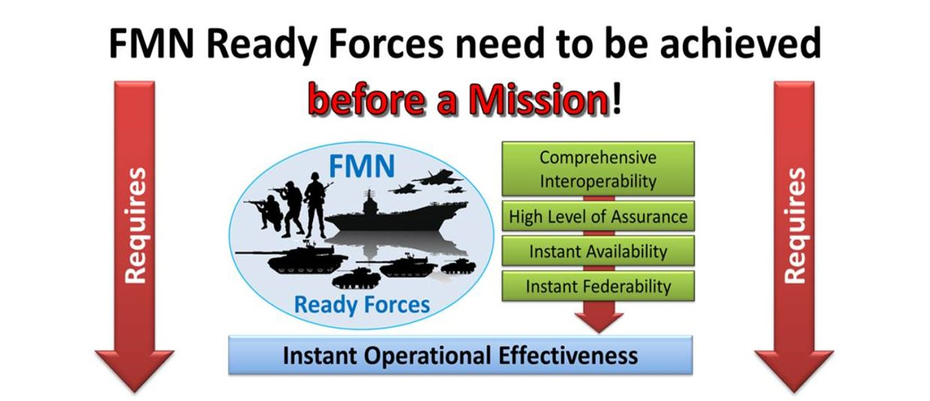
Context
NATO Federated Mission Network (FMN)
  “Day zero” interoperability
  Standards and practices for nations to implement
  Path to interoperability; not a network infrastructure

Slide 5
Context
NATO Research Taskgroup MSG-201 (2022-2025)
  Chartered to support the development of M&S specifications for FMN
  Part of the NATO Modelling & Simulation Group (NMSG)
    Which falls under the NATO Science & Technology Organization (STO)
  Simulation standards include High Level Architecture (HLA)
Coalition Warrior Interoperability Exercise (CWIX)
  Environment to explore requirements for inclusion in FMN M&S specifications
  Test the interoperability between simulation systems
CWIX-2024: Explore security interoperability requirements

Slide 6
Zero Trust

Slide 7

Zero Trust
Zero Trust
  Assume breach; no more "castle walls"
  Never trust, always validate
Can Zero Trust deliver controls to have a trusted simulation?
  Even on untrusted networks?
  For example:
    Running parts of the simulation in a public Cloud
    And the rest in a (mostly) closed-off network on-site

Slide 8
Zero Trust
Earlier research at TNO created a framework for Zero Trust in simulation networks
Combines three well-known frameworks for Zero Trust
  CISA: Zero Trust Maturity Model
  NIST: Special Publication 800-207 (Reference framework)
  USA DoD: Zero Trust Reference Architecture
Applies those on the simulation world
  Zero Trust for Simulation Architectures (ZeTSA) framework

Slide 9
Zero Trust
Zero Trust has three "basic" controls
  Encryption
  Authentication (who you are)
  Authorization (what you have access to)
Part of: never trust, always validate
  Without these controls, all other controls are less meaningful

Slide 10
Zero Trust
Encryption
  Without it, anyone can see what happens "on the wire"
    As we assume the network is breached
    Easy to see passwords, etc
  Use existing standards: Transport Layer Security (TLS)
    Already used by HTTPS world-wide
  Lot of documentation and experience
  Part of (nearly) all programming languages
    Easy to implement and use
  Lot of hardware to "offload" the biggest performance impact

Slide 11
Zero Trust
Authentication (who you are)
  Two "main" standards: SAML and OpenID Connect (OIDC)
OIDC most popular on the web
  Used by vendors like Google, Microsoft, …
    Also a trend within FMN to use OIDC
  Easy to setup your own
  Easy to implement; many existing languages

Slide 12
Zero Trust
Authorization (what you have access to)
  Built-in into OIDC, called "claims"
    Can define, as fine-grained as needed, what access a user has
  For example:
    “operations": "rti:connect" - allows for a federate to connect to an RTI
    "federations": "TheWorld" - allows for a federate to join "TheWorld" federation
    “interest”: reference to one or more HLA SOMs; the HLA Simulation Object Model (SOM) denotes the HLA object and interaction classes that the federate is permitted to publish or subscribe to

Slide 13
HLA and Zero Trust

Slide 14
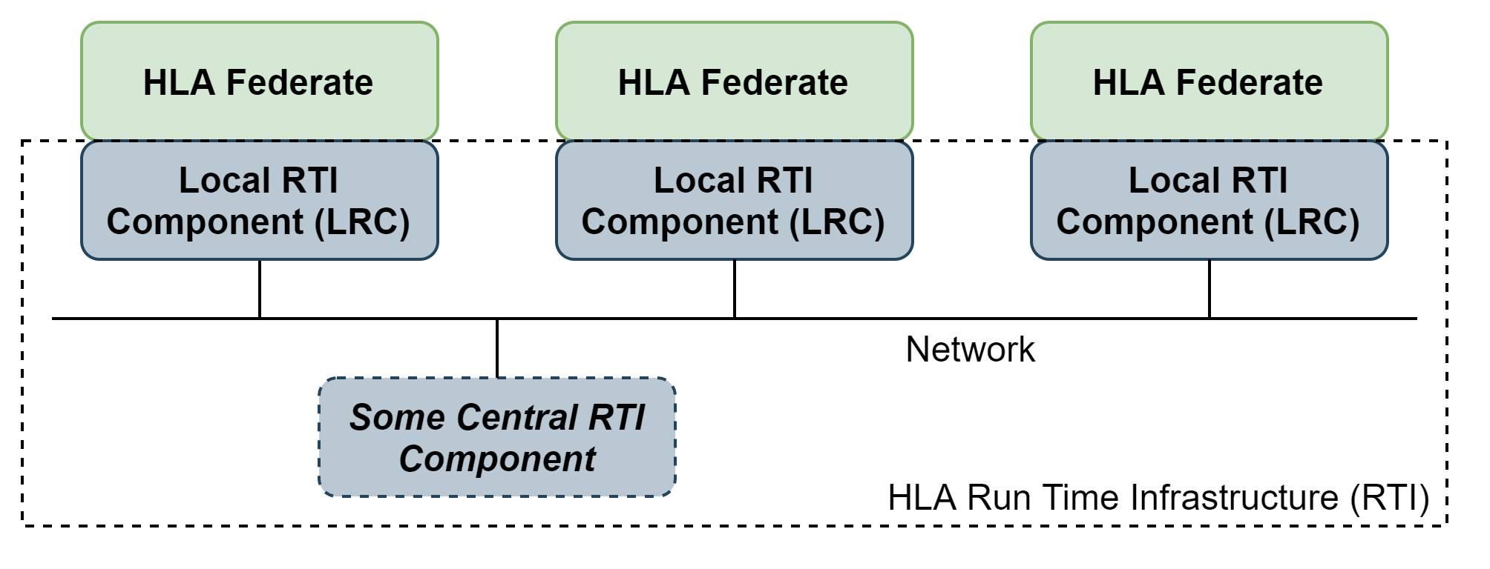
HLA and Zero Trust
HLA Evolved is the current version of HLA
HLA4 is the new version of HLA (being finalized soon)
  Extends further on HLA Evolved
  Makes adding Zero Trust concepts easier

Slide 15
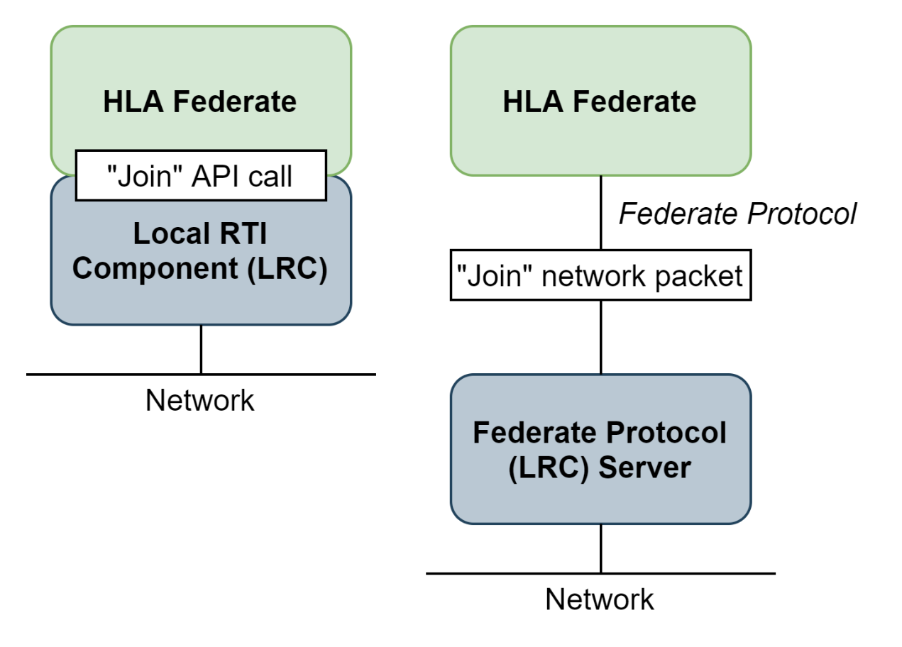
HLA and Zero Trust
HLA4: Federate Protocol
  TCP-based connection (point-to-point)
  Easy to connect to (even without LRC)
Why useful for Zero-Trust?
  Because point-to-point, easy to add encryption
  Traffic always goes via RTI
But: support for encryption is not mandatory in HLA4

Slide 16
HLA and Zero Trust
HLA4: Authorizer API
  New API that lives inside the RTI
  Provides methods to handle authorization when federates connect / join
    E.g., can reject the federate from joining
  "Connect" call has new field: Credentials
But: Authorizer API only validates the connect / join calls
  We want more fine-grained authorization
    E.g., are you allowed to publish or subscribe to certain classes or attributes therein?

Slide 17
HLA and Zero Trust
Couldn't add Zero Trust capabilities within HLA4 itself
  So HLA4 had to be extended
Extended around the "Federate Protocol Server"
  Added TLS support
  Extended Authorizer API with publish/subscribe validation
  Added OIDC claim-based authorizer
  Created example code for federates

Slide 18
Field testing

Slide 19
Field Testing
Questions when going in CWIX-2024
  Which of these security controls can be applied?
  What is the effort required by other parties to participate?
  Do the Zero Trust controls work and deliver a more resilient simulation environment against cyberattacks?

Slide 20
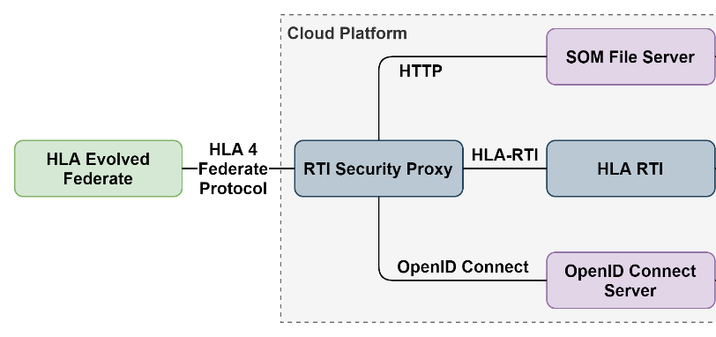
Field Testing
Participants
  HLA Evolved Federates: MASA SWORD, IABG KORA, and PEO STRI OneSAF

Slide 21
Field Testing
Findings
  Quick adoption of Zero Trust security controls by the CWIX participants
  HLA federates seamlessly transitioned over
  All validations worked well
    Authorization for connect / join / create
    Class and attribute-based authorization
  Security controls were in place throughout CWIX-2024
    Everything was stable and no issues were reported

Slide 22
Conclusion and future work

Slide 23

Conclusion and Future Work
Successful first step
  ZeTSA is a good framework to build up Zero Trust in simulation networks
  HLA can be extended with basic Zero Trust security controls
  Security controls can be added with very little friction
    Quick adoption is important for its success

Slide 24
Conclusion and Future Work
Lot of possible future work
  Benchmarking
    Impact of using the Federate Protocol and impact of encryption on top of that
  Standardize Zero Trust for simulation networks via SISO
    Extension of the HLA4 Authorizer API
    Make TLS support for HLA4 Federate Protocol mandatory
    Standardize OIDC as default choice for Identity Providers
  Continue with implementing ZeTSA framework
    For example, by adding monitoring and logging
  Extend Zero Trust to connections with other systems
    Such as C2-Simulation mediation services and C2 systems

Slide 25
Questions?

