Slide 1
WTD 91
VR Team Training for Military Special Forces I/ITSEC 2024

Slide 2
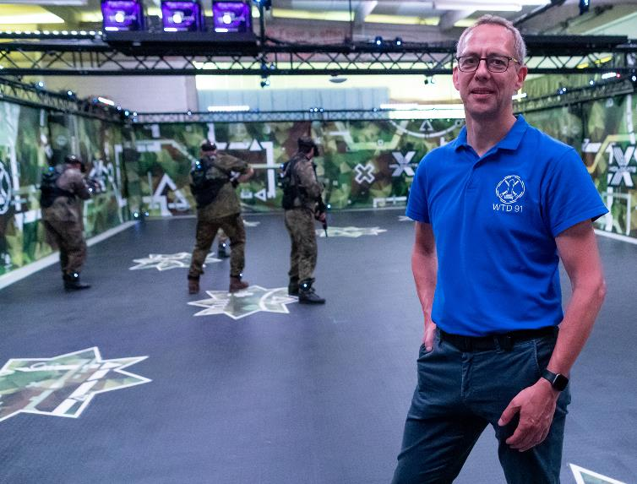
Information
Frank Jaspers, WTD 91 – 450, Head of Department AR, VR and MR at the Technical Test Center for weapons and ammunition (WTD 91), Germany
Since 1989 at WTD 91
Communication Electronics Technician
Telecommunications Technician
Ergonomics, especially Software Ergonomics
Since 2005: Use of VR for ergonomic issues
Since 2015: R&D activities in the field of AR, VR, and MR
Since 2020: Project manager for the first digital shooting range of the German Armed Forces
Organizer of the AR, VR and MR symposium in German Armed Forces
Chairman / Member of NATO working groups

Slide 3
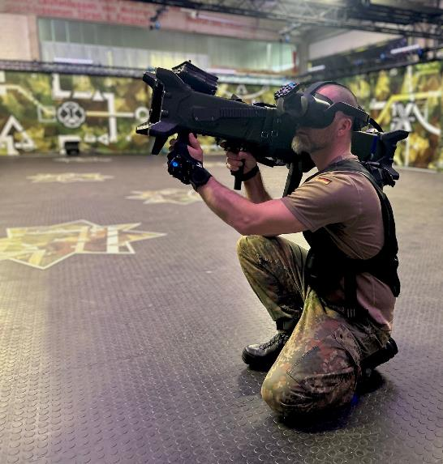
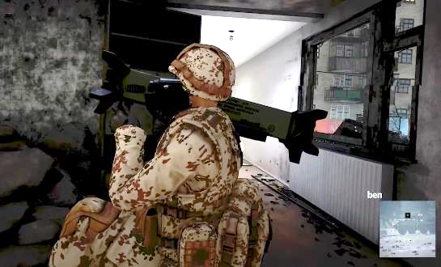
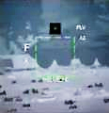
Virtual Team Training
Research Study VirTuOS - Virtual Training of Urban Operations as a Multi-User Scenario
Examination of the suitability of Virtual Reality for action training for a team of four people
Determining the added value of Virtual Reality for action training compared to traditional training methods
Acceptance by the troops
Exemplary implementation of a demonstrator to investigate
virtual training using urban combat as an example
Results as a decision-making basis for the use of Virtual Reality training in the existing action training of the German special forces

Slide 4
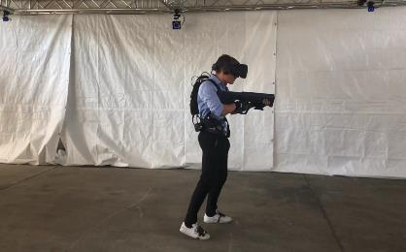
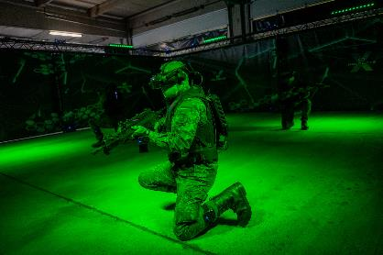
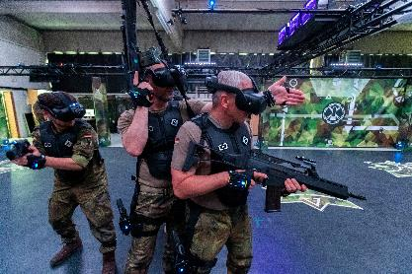
Implementation VIRTUOS
2019 Development of a test and inspection environment for testing VR hardware and software (possession of VR hardware and software)
2020 Development of the technical demonstrator virtual action trainer VirtAT
2021 Expansion of VirtAT to the training system
2022 Targeted adjustments based on the investigations, AAR
2023 NPC interaction concept and functional enhancements
Iterative development approach
Workshops with SME (Subject Matter Experts)
Carrying out annual subject examinations with specialized forces and special forces, as well as the federal police / GSG 9
Evaluation of the results and targeted system adjustments

Slide 5
VirtAT – Virtual Action Trainer

Slide 6
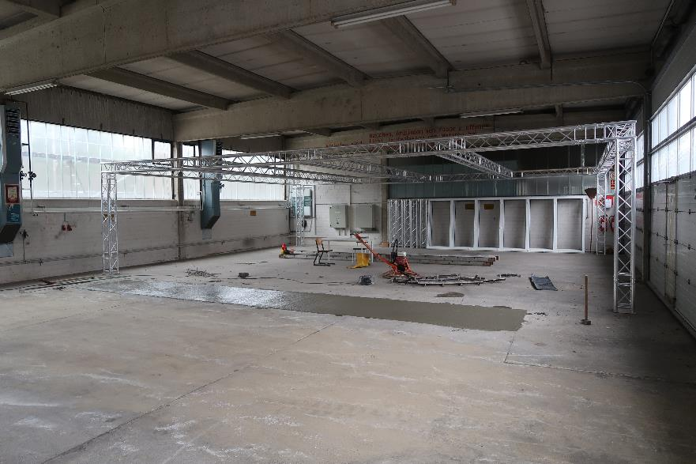
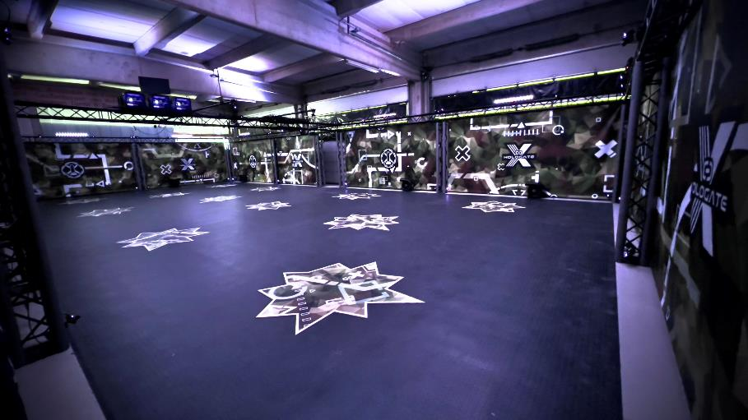
Virtual Action Trainer
A vehicle hall on the grounds of WTD 91...
...is converted into a virtual reality test environment
6

Slide 7
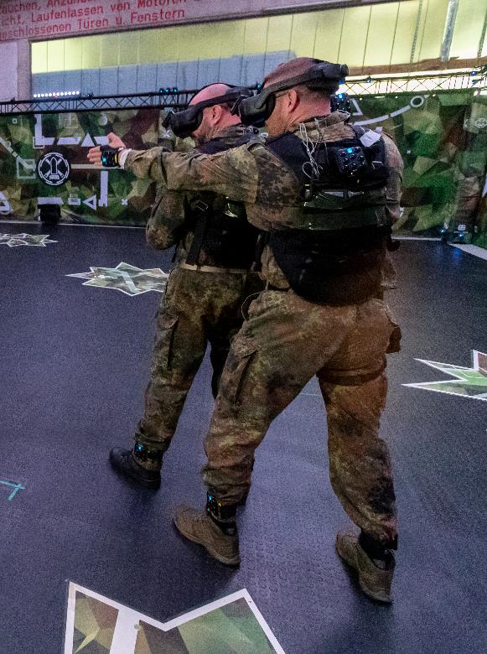
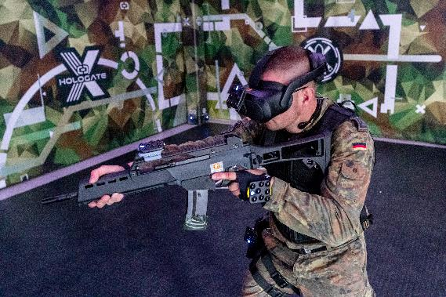
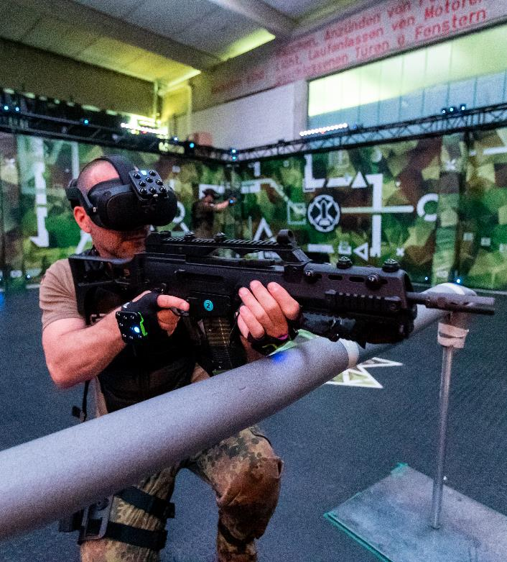
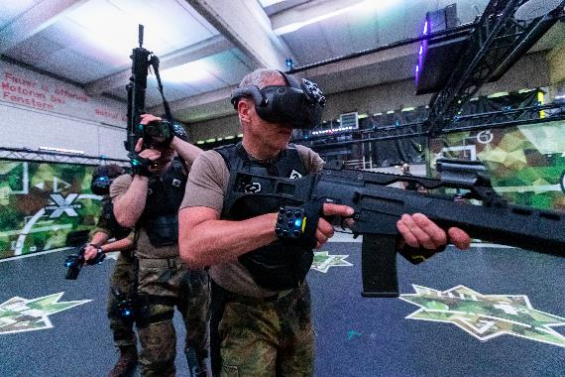
Virtual Action Trainer
Test subjects during the examination

Slide 8
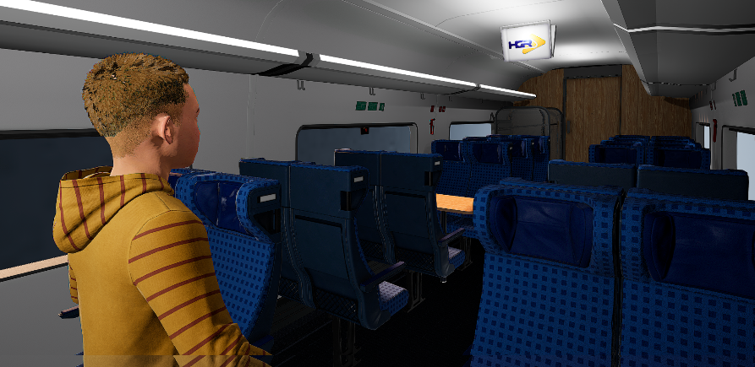
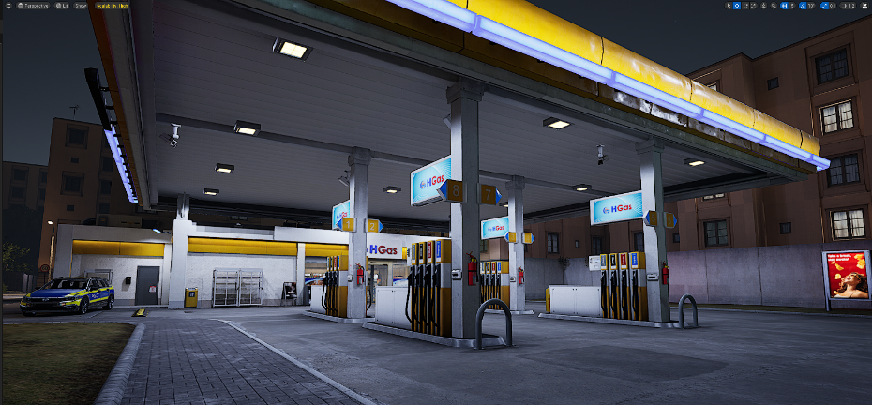
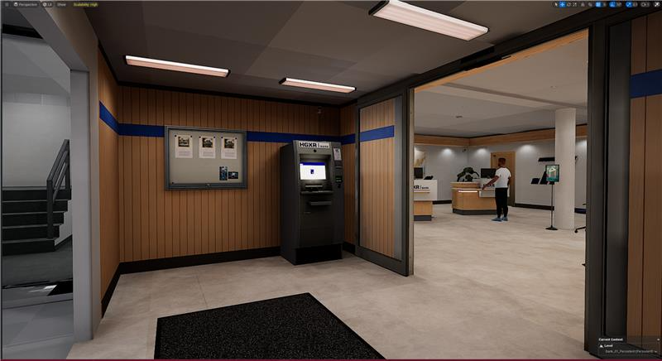
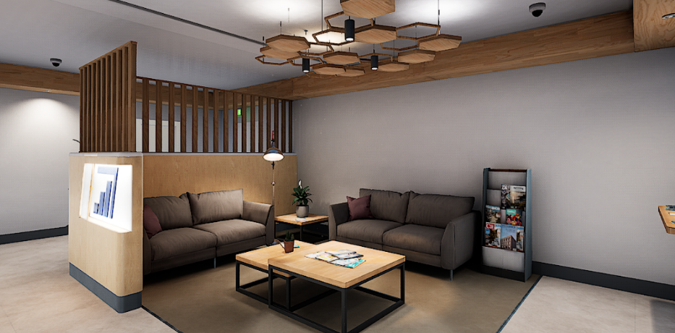
Virtual Action Trainer

Slide 9


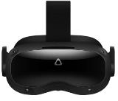




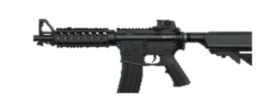








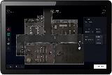
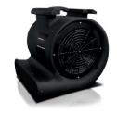

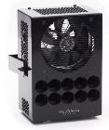
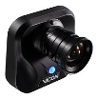








Virtual Action Trainer
Vest
6 x Body Tracker
Weapons with tracker – P8, M4, G36, Enforcer
HMD (VR Headset)
Optical
Marker
Feedback-
device
Headset
Unreal Game Network 5.3
Trainer Tablet
Heat
Wind
Cam 1
Cam 96
WIFI 6E Access Point
Tracking Server
Evoke Tracking Network
Game PC 1
Game PC 4
Scenario Server
Smell
DMX

Slide 10
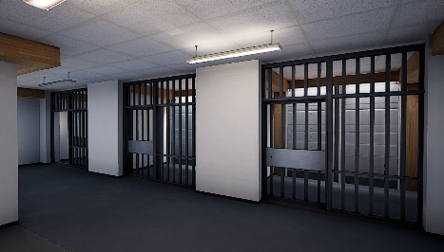
Virtual Action Trainer
Urban Eastern Europe Scenario
Subway - bright lighting conditions
Subway - dark lighting conditions
Parking garage - bright lighting
Parking garage - dark lighting
Country road - vehicle check
Warehouse
Ship bridge
School
Train station with ICE and subway
Airplane
Gas station
Bank building with forecourt
on four floors with
floor changes
23 available training maps
Training Rooms 1-3
Training Room 4
Training Rooms 5-7
Shooting Range
Desert Rooftop
Apartment 1
Apartment 2
Apartment 3
Apartment 4
Hotel Lobby
10

Slide 11
Virtual Action Trainer
Study results

Slide 12
Study results
Brief Summary of the Results of the Test Subject Study
Training in VR does not replace real training but can extend existing training. Existing training gaps can be closed.
The VirtAT is an enrichment for training.
Training in VR offers significant added value for education.
Feedback from soldiers is very positive; all test subjects wish for such a training system.
There are numerous use cases/training opportunities for team training in VR.
Training with role players is a valuable training extension as realism increases, but a clear situation/mission is essential.
The system provides a high level of immersion/presence with high realism.
System stability needs to be improved.
Robustness needs to be increased, especially the weapons are too prone to malfunction.
12

Slide 13
Study results
Brief Summary of the Results of the Test Subject Study
Motion sickness is almost no issue
Tracking of the hand/fingers is still needed for non-verbal communication
Relatively high cognitive load on the test subjects due to constantly changing environments and adapting to the situation
Negative training effects must be avoided, which requires an appropriate training concept for VR training - Which training content can be trained in VR? - Which training content is not suitable for VR? - What is appropriate training content? - What are the limitations/technological boundaries VR?

Slide 14
Advantages of action training in VR

Slide 15
VirtAT - Advantages of VR Team Training
Short set-up times, no construction of scenery etc.
Low personnel deployment NPC's (None Playable Characters) take over the role player
Easy handling of the weapons (simulation input device)
No safety distances required when firing shots
No ammunition consumption
Danger-free training of dangerous situations, as well as situations that are difficult to train for in real life, e.g. interaction with dogs, person with IED
Unlimited training content - Wide range of different training scenarios - Training in places that are otherwise inaccessible, e.g. airplane, subway station - Quick adaptation of training content to new requirements (e.g. NATO eastern flank)
15

Slide 16
“You can repeat the same training scenario over and over again until the team succeeds in maintaining control.”
Alex, police instructor NRW

Slide 17
VirtAT - Advantages of VR Team Training
Varied training thanks to rapidly changing training scenarios
No training system has more evaluation options, both during and after the exercise by means of an after-action review - Overlay of weapon lines with detection (color change opponent, friend) - Free camera perspectives, top view, user / opponent perspective, etc. - Statistics of the mission, e.g. number of shots, hit detection - Slow motion playback

Slide 18
Evaluation during the exercise with after-action review
“Do you see what you did wrong? I don't need to explain it to you - you can see for yourself what was wrong.”
Mario, Instructor ObjSRgt Schortens

Slide 19
VirtAT - Advantages of VR Team Training
Varied training thanks to rapidly changing training scenarios
No training system has more evaluation options, both during the exercise and after the exercise by means of an after-action review - Overlay of weapon lines with detection (color change opponent, friend) - Free camera perspectives, top view, user / opponent perspective etc. - Statistics of the mission, e.g. number of shots, hit detection - Slow motion playback
Continued high technical growth potential - Resolution, display, tracking systems, behavior
VR is very highly regarded, especially among young people - Increased attractiveness The YouTube video of the Bundeswehr channel had 290,000 views and universally positive comments
19

Slide 20
“I've been a police trainer for over 10 years and we trained with a lot of different systems, but the VR training system is the first system, where trainees voluntarily want to continue training after the regular training"
Maarten V., police instructor Antwerp

Slide 21
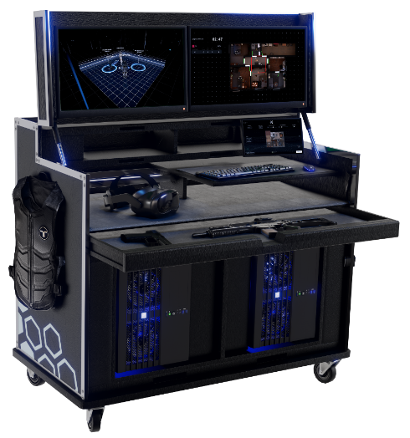
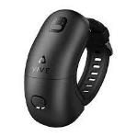
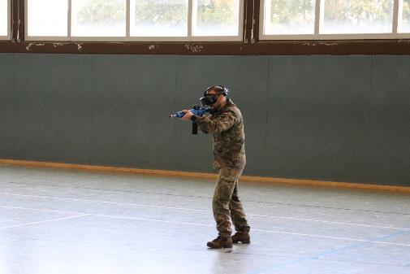
Further study implementations
Mobile virtual action trainer Initial requirement : - One user system - Networking capability - Mobile use - No full-body tracking
Current state of development - Four user system – up to eight user possible (two cases) - Expansion with full-body tracking has now been completed
Test conducted on 722 m²
Mobile systems with inside-out tracking is an game changer
21

Slide 22
Facts about the VIRTUOS R&T study
The results of the study are convincing
Direct transfer of the demonstrator to procurement
The demonstrator is now a product
The product is now also used by the police
With this study, the Bundeswehr and its contractual partner Hologate have made a massive impact on VR open-space training

Slide 23

Virtual Action Trainer
Any questions or suggestions?
Thank you for your attention
Frank Jaspers SG AR, VR and MR
Weapons and Ammunition Technical Center (WTD 91) Am Schießplatz 25
49716 Meppen
FrankJaspers@bundeswehr.org
Telefon: 05931 – 432987
The virtual action trainer on

