Slide 1

Virtual Reality Cue Exposure Therapy System
Derek Chong, Home Team Science & Technology Agency (HTX)
Notes:
All Presentations will be displayed using Sony VPLFH30 LCD Projector – or similar with 1920 x 1080 resolution and 16:9 aspect ratio

Slide 2

VR Cue Exposure Therapy System
I/ITSEC 2024
Unclassified

Slide 3
Agenda
Background and Introduction
System Overview
Phase 1 Trial Discussion
Phase 2 Trial Discussion
Psychological Perspectives
Conclusion and Future work
Q&A

Slide 4
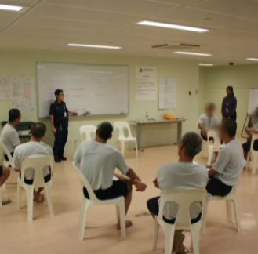
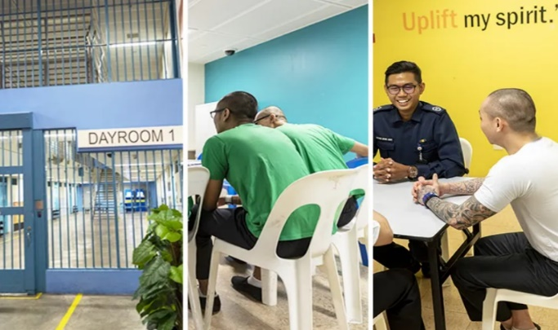
Background and Introduction
Singapore Prison Service (SPS) drug abuser rehabilitation:
  Purpose: To counsel abusers using role-playing and talk therapy by addressing mental models that perpetuate drug abuse
  Problem: Due to the sanitised environment of the drug rehabilitation centres, drug abusers have insufficient opportunities to be exposed to drug cues for skills practice in naturalistic environments
VR-based Substance Abuse Therapy Prototype
  Collaborative research program
  Objective: Desensitize drug abusers to drug use cues, applying cognitive behavior therapy (CBT) principles.

Slide 5
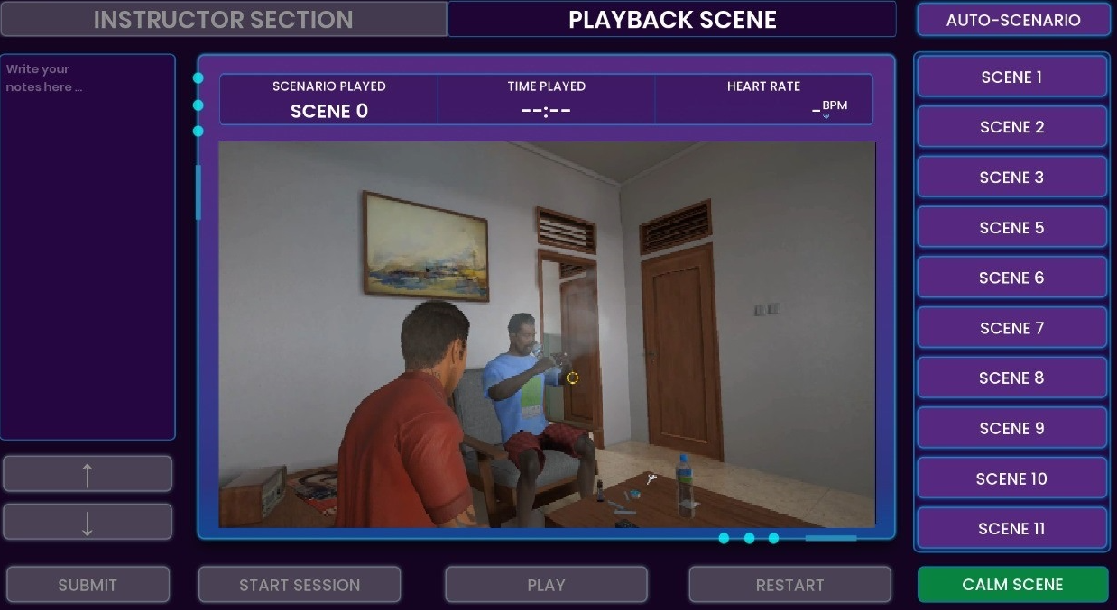
System Overview
Notes:
VR CET Hw and Sw specs
Laptop: i7-12700H, 16 GB RAM. NVIDA RTX 3070 8Gb, 1 TB SSD. 15.6” display
Unreal Engine version 4.26

Slide 6
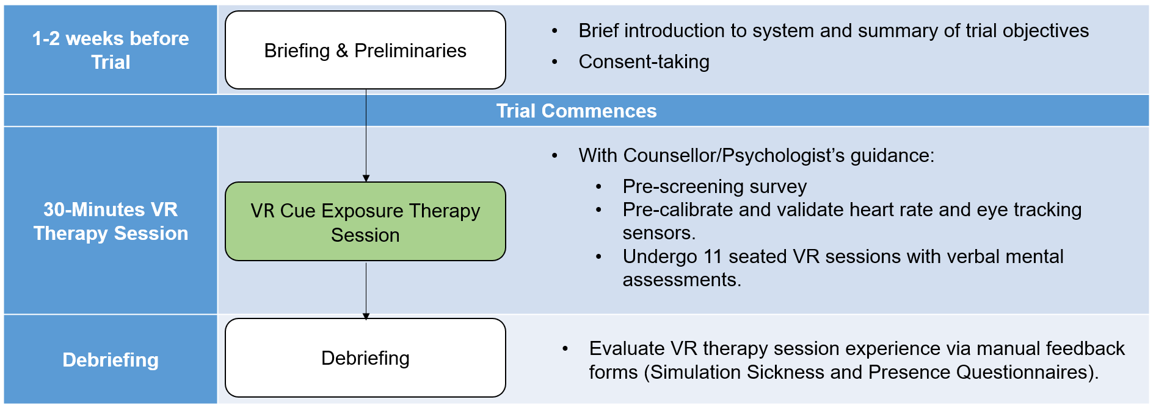
Trial Methodology
Notes:
Phase 1 and 2 objectives. Pre-calibrate and validate heart rate and eye tracking sensors with a counselor's guidance. Subjects undergo 11 seated VR sessions, with verbal assessments on mental state and well-being.

Slide 7
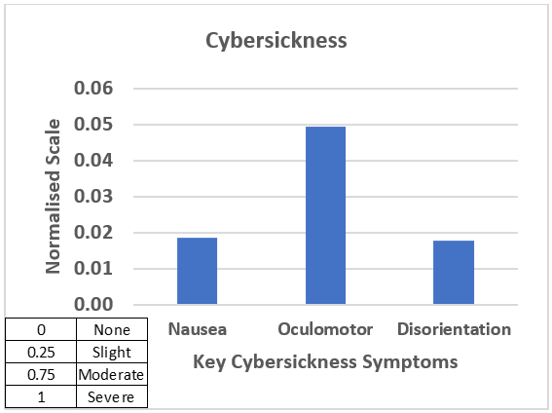
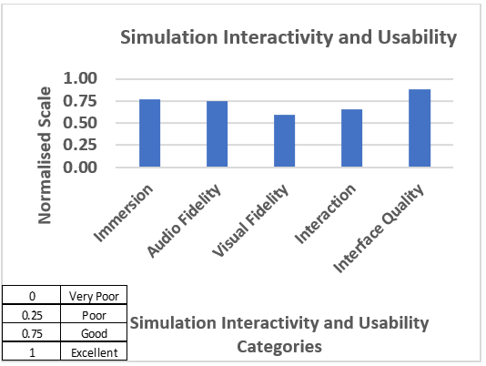
Phase 1 Results: Simulation Safety and Usability
  Cybersickness: participants exhibited little/no symptoms of cybersickness
    Overall mean normalized "symptoms severity" score of only 0.03
  Simulation Interactivity/Usability: very positive feedback
    System achieved a normalized highest score of 0.88
    Visual fidelity scored the lowest at 0.59 because participants were seated behind a desk, limiting their movements
Notes:
In this survey, a normalised score of “0” constitutes a “no/nil symptoms severity” while “1” constitutes a severe or high symptoms severity rating. Participants gave an overall average “symptoms severity” response normalised score value of “0.03” across all questions. The most severe area of discomfort was found to be that of oculomotor (highest average “symptoms severity” score of “0.05”) where in particular 6 (out of 27) participants indicated that they experienced slight eye strain during the VR sessions. The other two sickness categories “nausea” and “disorientation” also had a relatively low severity score of “0.02” each.
Regarding the aforementioned 6 participants who had indicated experiencing slight eye strain during the VR sessions, on further analysis, it was found that a majority of them had pre-existing ailments of migraine headaches and stomach discomfort.
The SSQ results indicate that the VR simulation caused minimal or no cybersickness for most participants. This outcome is attributed to participants being seated during the sessions, individual VR headset calibration, and proper briefing and familiarization with the VR technology before use.
The term "Oculomotor area of discomfort" refers to regions or aspects of visual or eye movement functions where discomfort or strain is experienced. This might relate to difficulties in controlling eye movements, focusing, or maintaining visual fixation, potentially leading to symptoms such as eye strain, headaches, or dizziness, especially in scenarios like extended VR usage or other visually demanding tasks.
The lowest scored category is visual fidelity which had a score of “0.59” (Figure 6). This represents the accuracy with which the VR computer generated (CG) graphics reproduces the real-life environment from the participants’ perspective. The survey questions include “How closely were you able to examine objects?” and “How well could you examine objects from multiple viewpoints?”.

Slide 8
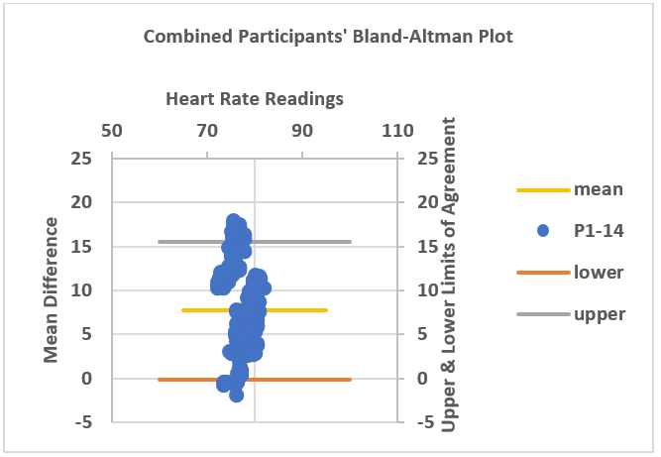
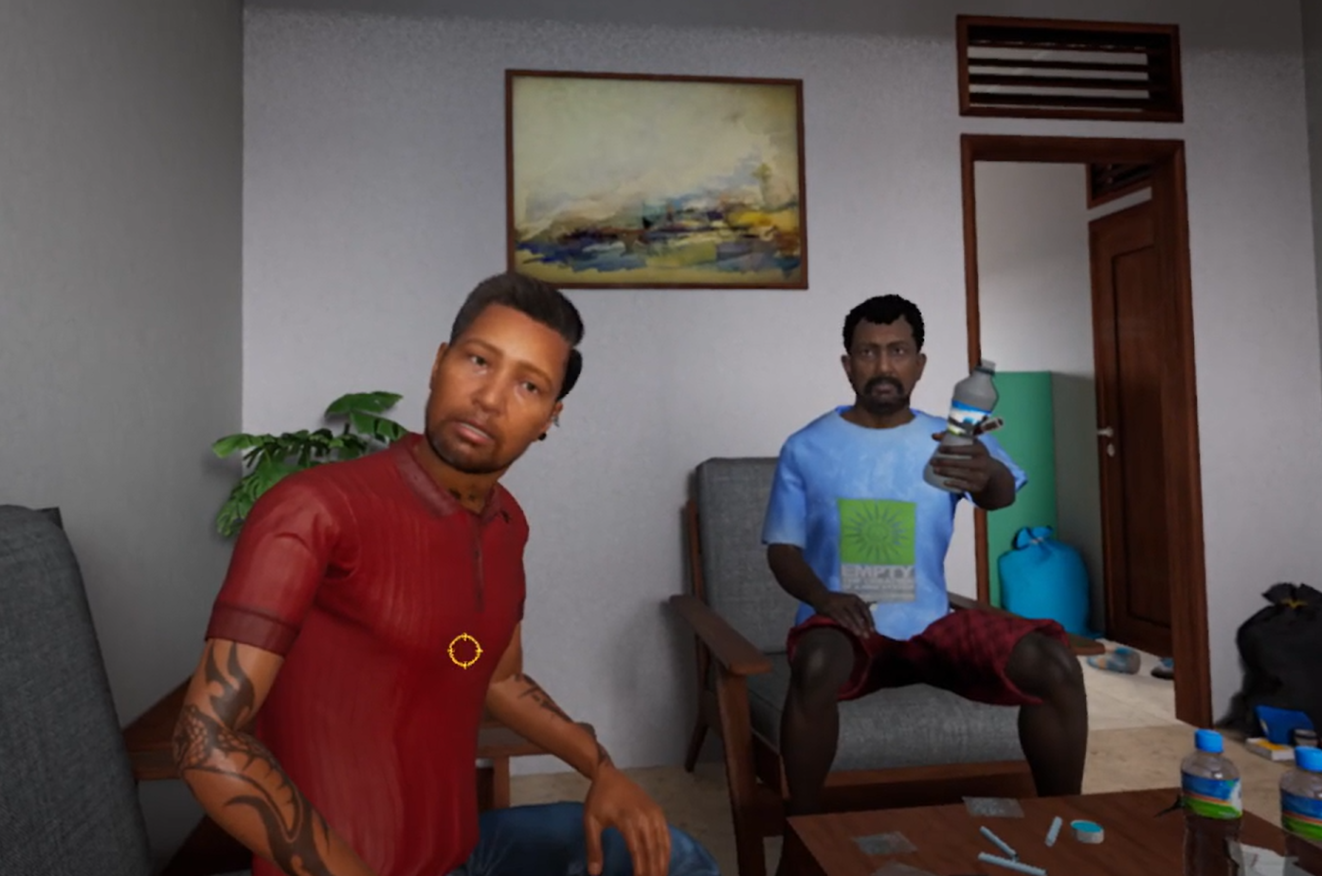
Phase 1 Results: Efficacy of VR Headset Heart Rate and Eye Gaze Sensors
  Physiological sensors (heart rate & eye gaze) demonstrated high efficacy:
    VR headset heart rate sensor and oximeter readings agree, with 95% of differences within limits (Bland-Altman plot)
      Rear padding was inserted in the VR Headset to improve heart rate sensor contact with the forehead
    95% accuracy for eye gaze
Notes:
Bland-Altman plots were used to compare VR headset heart rate and oximeter readings across all 11 scenes, including the calm scene, for participants P1 to P14..
The Bland–Altman plot technique was used to assess agreement between two instruments or measurement techniques. If the methods agree, values will cluster around the mean of the differences (bias) and fall within 2 standard deviations, creating a 95% prediction interval, known as the limits of agreement. (Zaiontz, Charles, 2017).

Slide 9
Phase 2 Trial Methodology
VR scenes increased in intensity of triggering cues from sessions 1 to 6 to stagger drug cue exposure (treatment group)
Separate control group of 20 subjects (non-VR conventional CBT)
Mean heart rate and eye gaze data were calculated across all VR sessions
Trends showed varied responses based on subjects' drug abuse history
Session # | VR Scenes | Social Cues | Drug Cues | Drug avoidance and craving surveys
1 | 1 to 2 | Yes | No | Yes (Pre)
2 | 1 to 4 | Yes | No | No
3 | 1 to 6 | Yes | Yes | Yes (Post)
4 | 1 to 8 | Yes | Yes | No
5 | 1 to 10 | Yes | Yes | Yes (Post)
6 | 1 to 10 | Yes | Yes | Yes (Post)
Notes:
Visual Analogue Drug Scale for Craving (VASc): A 100-mm line scale where participants rate their current craving for drugs from 0 ("not at all") to 100 ("extremely"). It includes nine questions about drug urges, mood, and physical state, adapted from Culbertson et al. (2010).
Drug Avoidance Self-Efficacy Scale (DASES): A 16-item scale where participants rate their confidence in avoiding drug use in various situations on a 7-point scale, adapted from Martin et al. (1995).
scale ranging from 1 (Definitely cannot) to 7 (Definitely can).

Slide 10
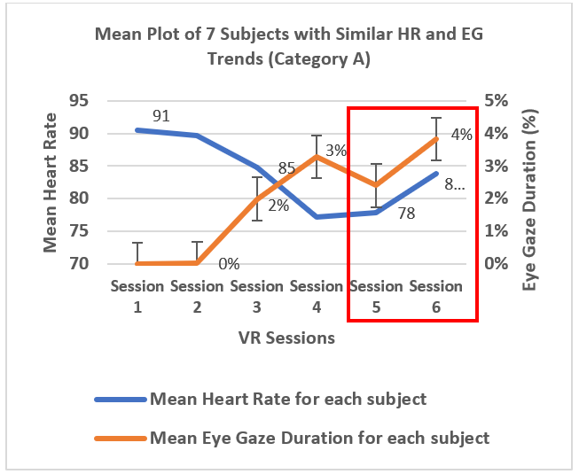
Phase 2 Results and Analyses (VR Sessions #5 and 6): Category A Inferences
35% of subjects showed increased heart rate and eye gaze duration over VR sessions:
  Anxiety symptoms triggered by the drug cues in VR Sessions #5 and #6
    Corroborated by their verbal feedback to the counselor, where they reported feeling triggered by the virtual 3-D drug and social cues
Notes:
The key focus of the analysis is on VR Sessions #5 and 6 where the drug and social cues were at their maximum exposure (subjects were exposed to all 11 VR scenes in both sessions), as indicated in the red boxes in the below plots. The similar trending patterns (upward or downward) in heart rate and eye gaze durations in sessions #5 and 6 are categorized as Categories A to C respectively."
In the final 2 VR sessions #5 and 6, the subjects were exposed to VR Scene #11 in which one of the drug friends intentionally reached out to the subjects with the prepared drug in his hand and both drug friends verbally coerced him to consume the drug.

Slide 11
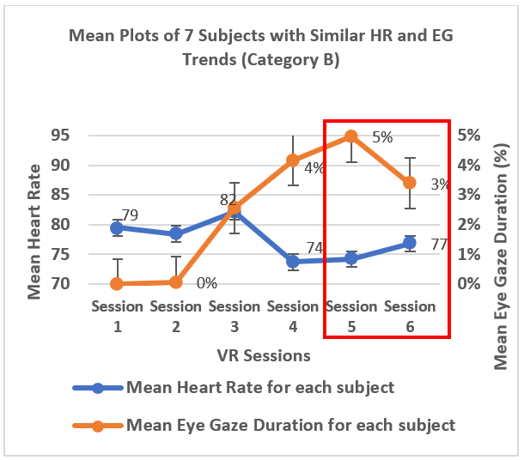
Phase 2 Results and Analyses (VR Sessions #5 and 6): Category B Inferences
45% of subjects maintained stable heart rates and reduced eye gaze duration:
  Habituation of the subjects to the VR drug and social cues over repeated exposures
  Subjects shifted focus from cues to coping strategies, reducing cue gaze
    Corroborated by subjects suggesting adding olfactory cues, syringe drug scenes, and interactive avatars
Notes:
Cat B Subjects’ eye gaze duration decreased, likely due to habituation to the cues and a shift in cognitive effort towards managing responses and using coping mechanisms.
Habituation of the subjects to the VR drug and social cues: over repeated exposures, the subjects became accustomed to the drug-related cues, reducing their initial heightened interest or craving response. This decrease in novelty can lead to reduced attention, reflected in shorter or less frequent eye gazes at the cues;
Cognitive effort: Initially, the subjects might focus more on the drug-related cues as they are highly relevant to their addiction. As they progress through therapy, their cognitive effort may shift towards managing their responses and utilizing coping mechanisms, reducing their gaze on the cues

Slide 12
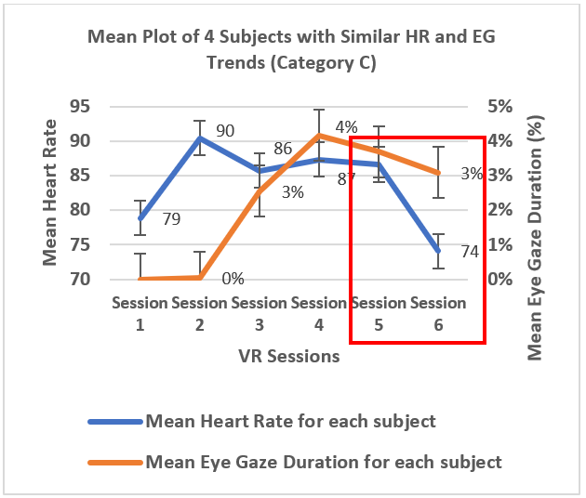
Phase 2 Results and Analyses (VR Sessions #5 and 6): Category C Inferences
20% of drug abusers demonstrated decreasing heart rates and eye gaze duration:
  Hypothesis: Subjects may not have been triggered by the meth drug cues
    Subjects were on syringe administered substances (e.g. heroin) prior to their incarceration
  Subjects possibly developed coping mechanisms to effectively reduce their desire in drug use
    Subjects reported thinking of their family and loved ones when deciding whether to accept a friend's drug offer in the last VR scene
Notes:
Subjects classified under Category C likely developed coping mechanisms to mitigate their desire for drug use. This inference is supported by verbal exchanges with prison counselors, where these subjects revealed that they considered their family and loved ones when deciding to reject drug offers in the final VR scene.

Slide 13
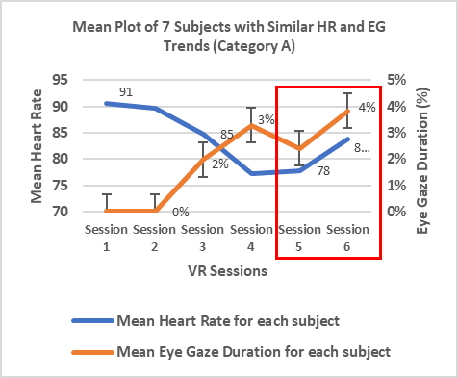
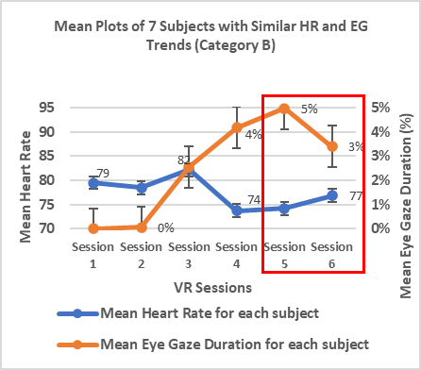
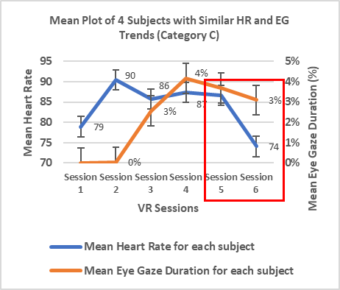
Phase 2 Results and Analyses (VR Sessions #1 to 4)
Heart Rate: Observed to be well-controlled to help subjects adapt to the VR environment in preparation for VR Sessions #5 and 6
Eye Gaze: Duration increased with the introduction of 3-D drug and social cues
Notes:
Heart rate not conclusive for 1-4 due to physical
Heart rate ..ease them into the vr experience. Prepare them for
Well controlled

Slide 14
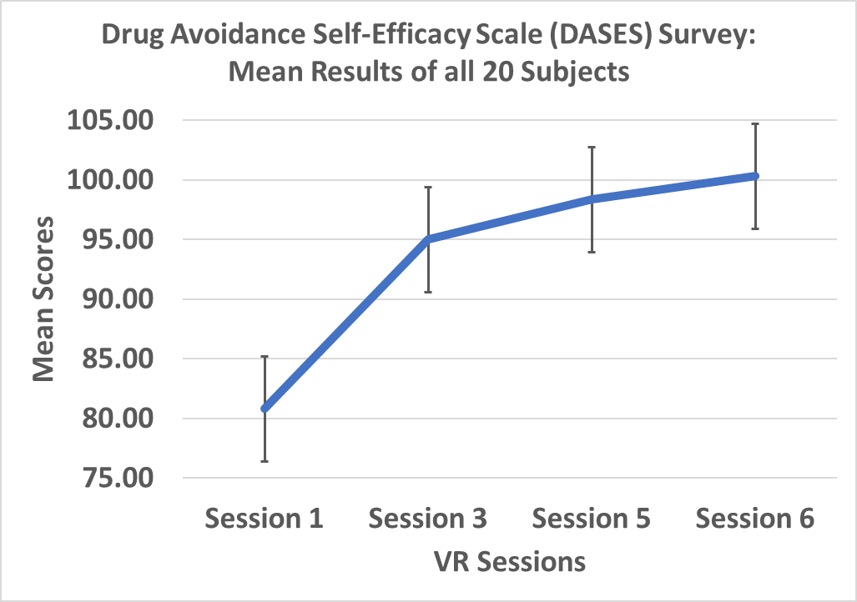
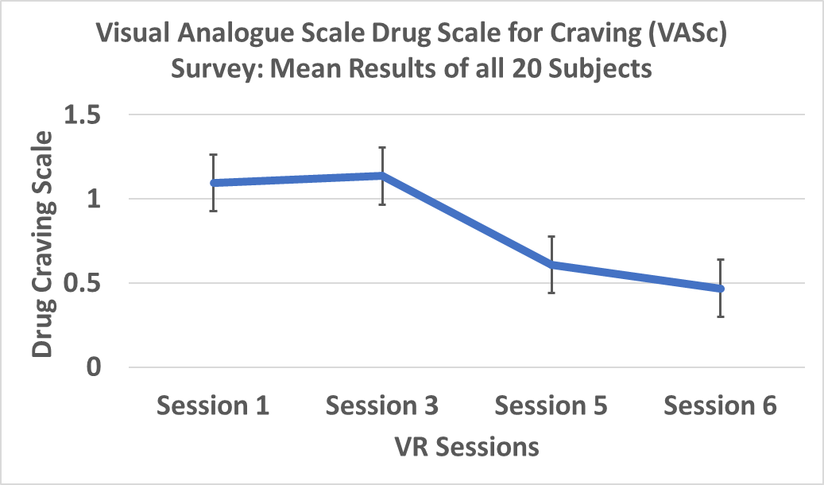
Phase 2 Results and Analyses (VR Sessions #5 and 6): VASc and DASES drug craving and avoidance survey data
Psychological survey data: subjects exhibited favourable responses to drug craving and avoidance
Notes:
Visual Analogue Drug Scale for Craving (VASc): The Visual Analogue Drug Scale for Craving (VASc) is a 100-mm line on which participants have to rate their subjective experience of current craving for drugs, ranging from ‘not at all’ (0) to ‘extremely’ (100). Adapted from the VAS used by Culbertson et al (2010), the VAS form incorporated the following nine questions: four regarding urges to use drugs (“How much do you crave/want/desire drugs right now?”, and “If you had access to drugs right now, how likely would you be to use it right away?”), two questions regarding mood (“How depressed/ anxious do you feel right now?”) and three questions regarding physical state (“Do you feel any drug effect right now?”, “How high are you right now?”, and “How stimulated do you feel right now?”). Desire was specifically defined in subtext next to the question as “to want (a feeling)” and crave as “strong or intense need (an internal force)”.
Drug Avoidance Self-Efficacy Scale (DASES): The Drug Avoidance Self-Efficacy Scale (DASES) is a 16-item scale adapted from the DASES used by Martin et al. (1995). It assesses drug-refusal self-efficacy, where participants are presented with different situations involving drugs, and are to rate their perceived ability to avoid drug use in those situations on a 7-point scale ranging from 1 (Definitely cannot) to 7 (Definitely can).

Slide 15
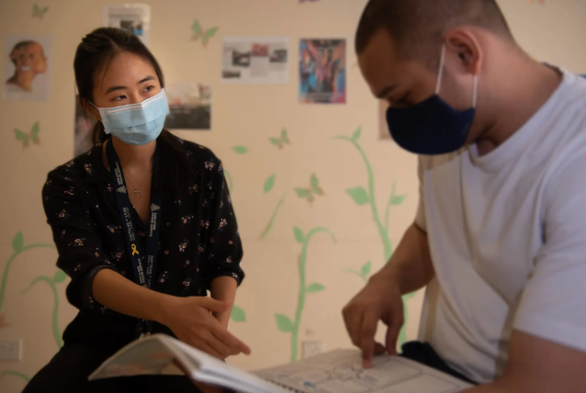
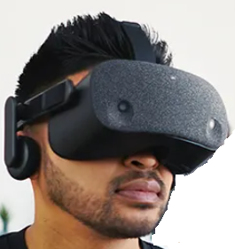
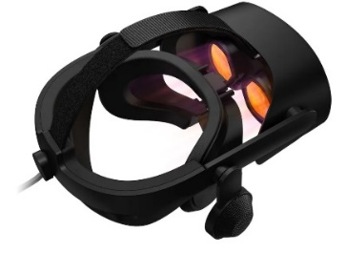
Psychological Perspectives
Criminology Constructs: Focus on risk, needs, and responsivity in drug rehabilitation
Varied Needs: Different abusers require tailored approaches
Enhancements: Enhance VR interactivity and intelligence for better outcomes
Notes:
Based on the Preliminary findings from the subjective drug craving and avoidance survey data, it can be inferred that substance abuse rehabilitation should account for risk, needs, and responsivity, as a one-size-fits-all approach may not be so effective. Participants showed varied needs based on drug type, which may not be fully addressed by current VR scenarios. Data suggest that personalization is needed, and its effectiveness could improve by enhancing the interactivity and adaptability of the VR system.

Slide 16
Conclusion and Future Work
Conclusion: The study successfully demonstrates the potential efficacy of VR-based Cue Exposure Therapy (CET) as a novel intervention for drug abusers. Subjects likely developed coping mechanisms that reduced their desire for drugs as evidenced by experimental physiological data, such as heart rate and eye gaze metrics, collected during VR sessions.
Future work:
  Integration of Generative AI:
    Development of interactive, AI-responsive VR scenarios
    Creation of immersive, dynamic training environments
  Expansion of VR Therapy Use Cases like modesty outrage and family violence
    Incorporation of EEG and GSR sensors for deeper analysis and rehabilitation
  Special Ops Forces Training:
    PTSD mitigation and management of stress reactions
    Overcoming phobias (e.g. fear of heights)
  Homeland Security Training & Education:
    Police/firefighter training for high-stress scenarios
    Sharpening of officers’ situational awareness in terrorist response
Notes:
In conclusion, this pilot study demonstrates the potential efficacy of virtual reality cue exposure therapy as a novel intervention for ex-drug abusers as evidenced by experimental physiological data gathered from the Phase 2 trials
In conclusion, this pilot study demonstrates the potential efficacy of virtual reality cue exposure therapy as a novel intervention for ex-drug abusers as evidenced by experimental physiological data gathered from the Phase 2 trials. Broader and longitudinal studies are nonetheless needed to confirm these results and to optimize the therapeutic protocols for broader clinical application given the variations in the subjects’ responses and nuances in their background and regimes
Integration of Generative AI:
Next research phase focuses on creating hyper-realistic and dynamic VR interactions using Generative AI.
Development of AI engines capable of generating interactive virtual scenarios based on facial and behavioral inputs.
Aims to create hyper-realistic 3D elements and meta-human characters for immersive and responsive VR experiences.
Expansion of VR Therapy Use Cases:
Potential applications include therapy for offenses like outrage of modesty and family violence.
Incorporation of additional physiological sensors (EEG, GSR) could enhance research and psychological rehabilitation.
Use Cases in Special Operations:
VR scenarios could be designed as tools for mitigating PTSD risk and training special operations forces.
Scenarios would help personnel manage physical reactions to stress for optimal performance.
Potential application in treating phobias, such as fear of heights.
Homeland Security Training:
Immersive VR technology paired with physiological sensors could improve training for police and firefighters.
Enhances situational awareness and effectiveness in high-stress operations, including terrorist incident response.

Slide 17
Q&A
Thank you for your attention. I'm happy to answer any questions
HTX contacts:
Derek Chong
email: derek_chong@htx.gov.sg
Dr Saravana Kumar
email: saravana_kumarasamy@htx.gov.sg
Notes:
Future:
Develop, sculpt, and enhance the hyper realistic avatar creation process
Integration of more realistic mannerisms to create a more compelling interaction experience
Vocal localisation – develop speech patterns and colloquialisms to make the avatars more identifiably Singaporean

Slide 18
Back-up Slides
required to confirm long-term impact on recidivism.
required to confirm long-term impact on recidivism.

Slide 19
Simulation Safety
1 | General discomfort | None | Slight | Moderate | Severe
2 | Fatigue | None | Slight | Moderate | Severe
3 | Headache | None | Slight | Moderate | Severe
4 | Eye Strain | None | Slight | Moderate | Severe
5 | Difficulty Focusing | None | Slight | Moderate | Severe
6 | Salivation Increasing | None | Slight | Moderate | Severe
7 | Sweating | None | Slight | Moderate | Severe
8 | Nausea | None | Slight | Moderate | Severe
9 | Difficulty Concentrating | None | Slight | Moderate | Severe
10 | Fullness of the Head | None | Slight | Moderate | Severe
11 | Blurred Vision | None | Slight | Moderate | Severe
12 | Dizziness with Eyes Open | None | Slight | Moderate | Severe
13 | Dizziness with Eyes Closed | None | Slight | Moderate | Severe
14 | Vertigo | None | Slight | Moderate | Severe
15 | Stomach Awareness | None | Slight | Moderate | Severe
16 | Burping | None | Slight | Moderate | Severe
Nausea
Oculomotor
Disorientation
1 | Fatigue in the head, neck or spine area?
2 | Imbalance or Inadvertent tripping or falling?
3 | Body or muscle aches?
4 | Haptic and/or auditory discomfort?
Human Factors Issues in
Virtual Environments. Presence, 7(4), 327-351,1998
An enhanced method for quantifying simulator sickness. International Journal of Aviation Psychology, 3(3), 203-220, 1993

Slide 20
Simulation Interactivity/Usability
1 | How much were you able to control the events?
2 | How responsive was the environment to actions that you initiated/performed?
3 | How natural did your interactions with the environment seem?
4 | How much did the visual aspects of the environment involve you?
5 | How much did the auditory aspects of the environment involve you?
6 | How natural was the mechanism which controlled movement in the environment?
7 | How compelling was your sense of objects moving through space?
8 | How much did your virtual experience seem consistent with your real world experience?
9 | Were you able to anticipate what happens next in response to the actions performed?
10 | How completely were you able to actively survey/search the environment using vision?
11 | How well could you identify sounds?
12 | How well could you localize sounds?
13 | How well could you actively survey/search the virtual environment using touch?
14 | How compelling was your sense of moving around inside the virtual environment?
15 | How closely were you able to examine objects?
16 | How well could you examine objects from multiple viewpoints?
17 | How well could you move or manipulate objects in the virtual environment?
18 | How involved were you in the virtual environment experience?
19 | How much delay did you experience between your actions and expected outcomes?
20 | How quickly did you adjust to the virtual environment experience?
21 | How proficient in moving & interacting with the virtual environ. did you feel at the end?
22 | How much did the visual display quality interfere/distract from performing tasks/activity?
23 | How much did the control devices interfere with performing tasks/activities?
24 | How well could you concentrate on tasks/activities vs mechanism used to perform them?
25 | How completely were your senses engaged in this experience?
26 | To what extent did outside events distract from your experience in the virtual environ.?
27 | Overall, how much did you focus on using disp & ctrl devices vs virtual experience & task?
28 | Were you involved in the assigned task to the extent that you lost track of time?
29 | How easy was it to identify obj via physical interaction eg touching obj. bump into wall?
30 | Were there moments in the virtual exp. when you completely focused on the task/env.?
31 | How easily did you adjust to the ctrl devices used to interact with the virtual environ.?
32 | Was the info provided through diff senses in the virtual env. consistent eg. touch, vision?
The Factor Structure of the Presence Questionnaire. Presence 14(3), 298-312, 2005

Slide 21
Simulation Interactivity/Usability
Interaction | Audio Fidelity | Haptic Fidelity | Visual Fidelity | Interface Quality | Adaptation | Immersion
Control of events (1) | Involvement of auditory aspects (5) | Survey/search of virtual environment using touch (13) | Close examination of objects (15) | Delay between actions and expected outcomes (19) | Adjustment to the virtual environment (20) | Concentration on tasks/activities vs mechanism used to perform them (24)
Responsiveness of actions (2) | Sounds identification (11) | Objects' movement/manipulation in virtual environment (17) | Examination of objects from multiple viewpoints (16) | Interference of control devices with tasks/activities (23) | Movement & interaction with the virtual environment (21) | Senses' engagement in this experience (25)
Involvement of visual aspects (4) | Sounds localisation (12) | Identification of objects via physical interaction (29) |  | Interference of visual display quality with tasks/activity (0 - Very distracting, 1 - Not distracting) (22) | Adjustment to the control devices with virtual environment (31) | Distraction in the virtual environment (26)
Natural interactions with the environment (3) |  |  |  |  | Were you able to anticipate what happens next in response to the actions performed? (9) | Were you involved in the assigned task to the extent that you lost track of time? (28)
Natural movement control of mechanism in the environment (6) |  |  |  |  |  | Were there moments in the virtual experience when you completely focused on the task/environment? (30)
Sense of objects moving through space (7) |  |  |  |  |  | Was the info provided through different senses in the virtual environment consistent? (e.g. Touch, vision, etc.) (32)
Consistency of virtual experience with the real world (8)
Completeness of visual survey/search (10)
Movement inside virtual environment (14)
Objects' movement/manipulation in virtual environment (17)
Virtual environment experience (18)
Focus on using display & control devices vs virtual experience & task (27)
Identification of objects via physical interaction (29)

