Slide 1
Automated Human Performance Measurement: Standardizing Lifelong Learning Training Data
Presenter: LT Sarah Beadle, Ph.D., Naval Air Warfare Center Aircraft Division
Mitchell Tindall, Ph.D., Naval Air Warfare Center Training Systems Division
Beth Atkinson, M.A., Naval Air Warfare Center Training Systems Division

Slide 2
Author’s Notes
Authors: Mitchell Tindall, Ph.D, Beth Atkinson, M.A, LT Sarah Beadle, Ph.D.
The views of the authors expressed herein do not necessarily represent those of the U.S. Navy or Department of Defense (DoD). Presentation of this material does not constitute or imply its endorsement, recommendation, or favoring by the DoD.
NAWCTSD Public Release 24-ORL064 Distribution Statement A – Approved for public release; distribution is unlimited.

Slide 3
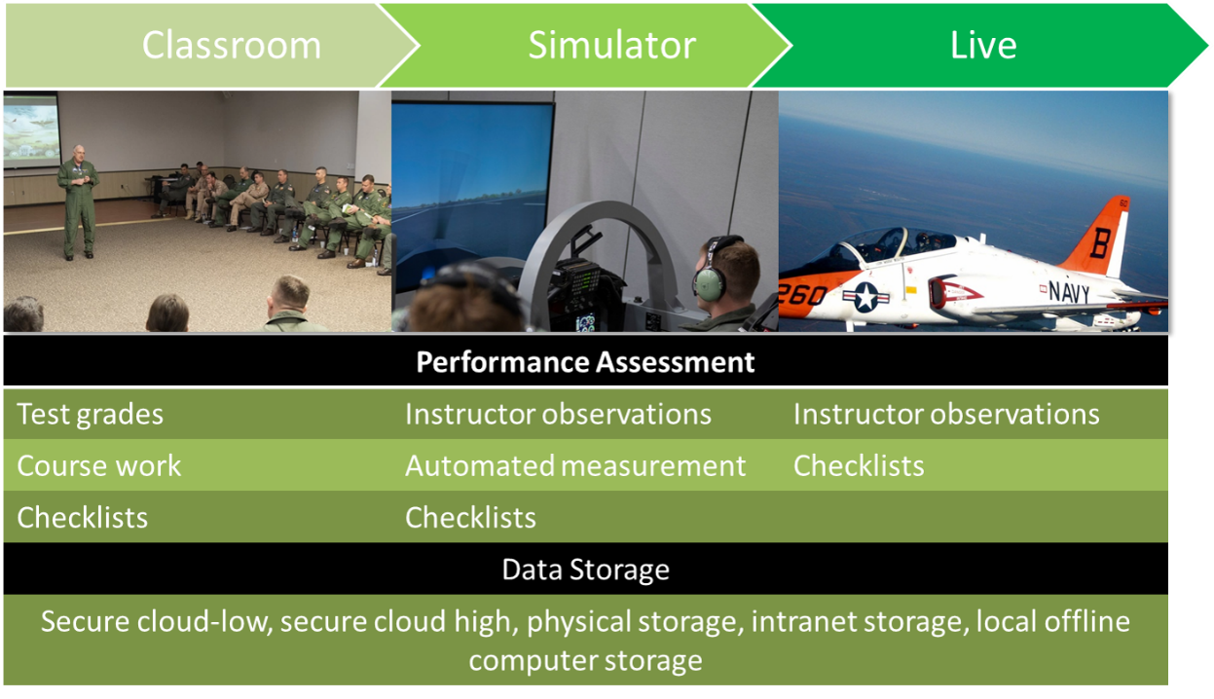
Learning and Human Performance Standards
Standards are absolutely necessary for achieving the aim of the 2020 DoD Data Strategy
Two standards related to Human Performance Modeling (HPM):
Experience Application Programming Interface (xAPI)
Human Performance Modeling Language (HPML)
Facilitates tracking of learning and performance over time and across modes of education
Notes:
NOTE: We are reviewing two standards relevant to HPM that we feel are most relevant to our paper but this is not an exhaustive list as there are other standards that have relevancy
2020 DoD Data Strategy Aim: become a data centric organization that leverages enterprise-level management to ensure valid and critical data is widely available to all relevant stakeholders

Slide 4
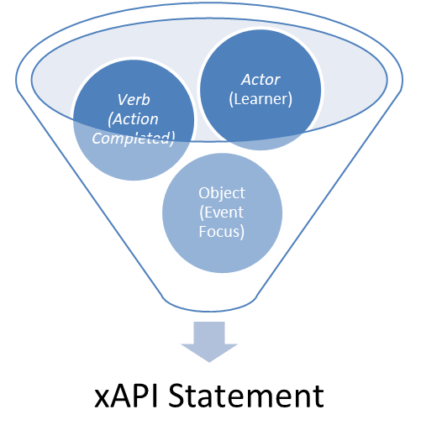
Learning Standard: xAPI
IEEE approved standard that expanded on SCORM’s eLearning focus, broadest and most widely adopted learning standard
Learning Record Stores (LRSs) facilitate tracking experiences associated with learning
Learning experiences can range from completing an action to how the learner performed on multiple-choice test
Primarily supported for learning technologies such as videos, eLearning, Learning Experience Platforms, and LRSs
Potential Limitations:
Granularity of data required for assessing proficiency with procedural knowledge during live or simulated operations
Performance modeling using emerging data (e.g., physiological & eye tracking) may not be supported

Slide 5
Human Performance Modeling Language: HPML
Defines what data is required for automated HPM in DoD services and domains
Primarily focused on the “walk” and “run” phases of training when procedural knowledge is acquired (i.e., medium fidelity simulation through live training)
Considers data relevant to performance — environmental, systems, or adversarial data that would impact mission difficulty
Contextual information important to consider when providing feedback and assessments
Limited availability of the right data, despite large available data sets, may result in measurement challenges
Training simulators and aircraft not currently designed with HPM data availability and formatting as requirement

Slide 6
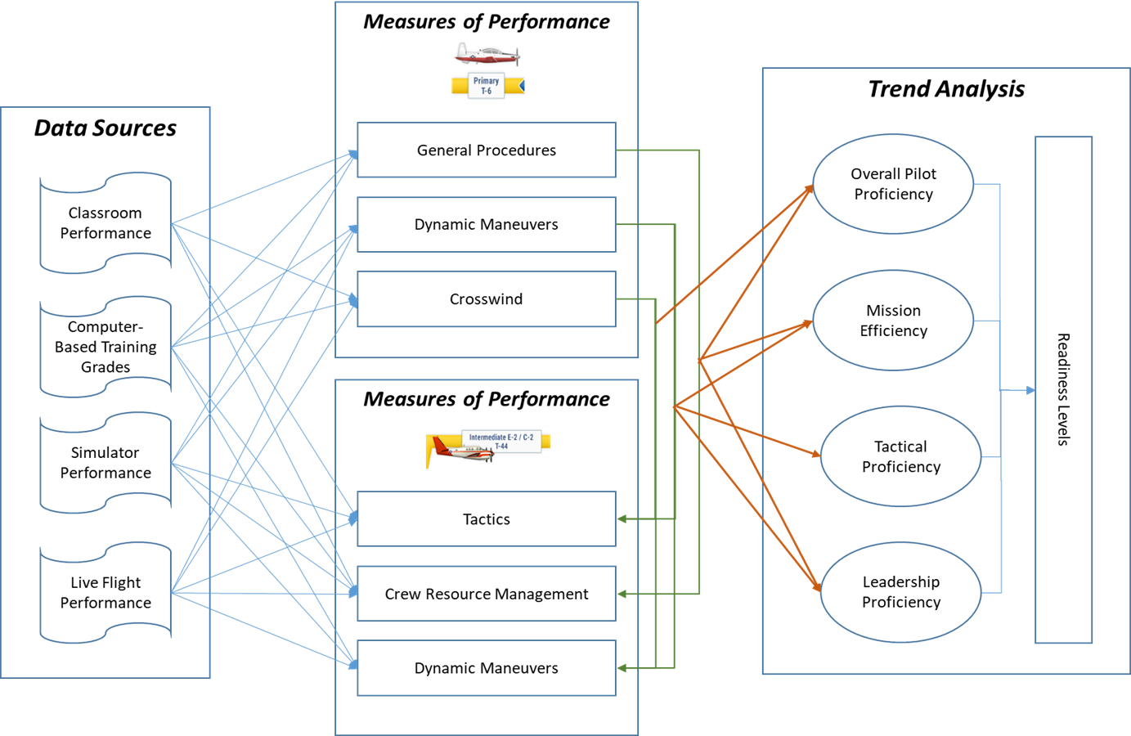
Model Based Systems Engineering (MBSE)
Methodology used by systems engineers to support the lifecycle of complex systems
Useful when establishing the requirements of future systems, tracking system deficiencies, and gaps that can be addressed with R&D in emerging technologies
Potential benefits to extending MBSE models with performance measurement system considerations to support multi-level trend analyses
Example of Human Performance MBSE Applied to a Navy Aviation Training Use case
Notes:
DoD leadership has long talked about the ability to conduct data analyses across the training pipeline through operations for a variety of purposes such as uncovering trends that have implications for how we train, when we train, what we train, when to deploy, who to deploy, etc..
The development of robust HPM systems across communities are required to support this vision
The complexity of individual communities platforms, training systems, cultures, prime contractors, support staff, etc.. Make meeting this aim very challenging
MBSE offers a means by which this complexity can be organized into actionable models that outline what the HPM requirements of a community or platform are, where that data exists and how that data needs to be connected to produce the intended analyses – furthermore, these models can highlight areas where investments need to be made in order to expand our coverage of the HPM construct
MOSA and containerization are examples of MBSE software approaches that allow for resilience of the system to changing of the subsystem components (Morgan, Holzer, & Everleigh, 2021).

Slide 7
Example of Human Performance MBSE Applied to a Navy Aviation Training Use-case
Benefits of Standards Update:
Common language across training phases
Storing data with same labeling convention regardless of modality of delivery
Standardizing what data is collection at each learning opportunity
Providing top-down data requirements to vendors to increase interoperability
Notes:
DoD leadership has long talked about the ability to conduct data analyses across the training pipeline through operations for a variety of purposes such as uncovering trends that have implications for how we train, when we train, what we train, when to deploy, who to deploy, etc..
The development of robust HPM systems across communities are required to support this vision
The complexity of individual communities platforms, training systems, cultures, prime contractors, support staff, etc.. Make meeting this aim very challenging
MBSE offers a means by which this complexity can be organized into actionable models that outline what the HPM requirements of a community or platform are, where that data exists and how that data needs to be connected to produce the intended analyses – furthermore, these models can highlight areas where investments need to be made in order to expand our coverage of the HPM construct

Slide 8
Considerations for Standards and Architecture
xAPI and HPML provide the data points needed to deliver usable, real-time, and interoperable data
MBSE architecture provides a strategy for connecting this data in a meaningful way to facilitate valid and data centric decisions related to proficiency
Emerging technologies will also play a role in advancing our ability to accurately and comprehensively assess human performance
Notional MBSE Model Primary Aviation Training
Measures of Performance
Data Source
Class Grades
v
General Procedures
Standards = requirements for our data sources
v
Sim Perf
Dynamic Maneuvers
v
Live Perf
Crosswind

Slide 9
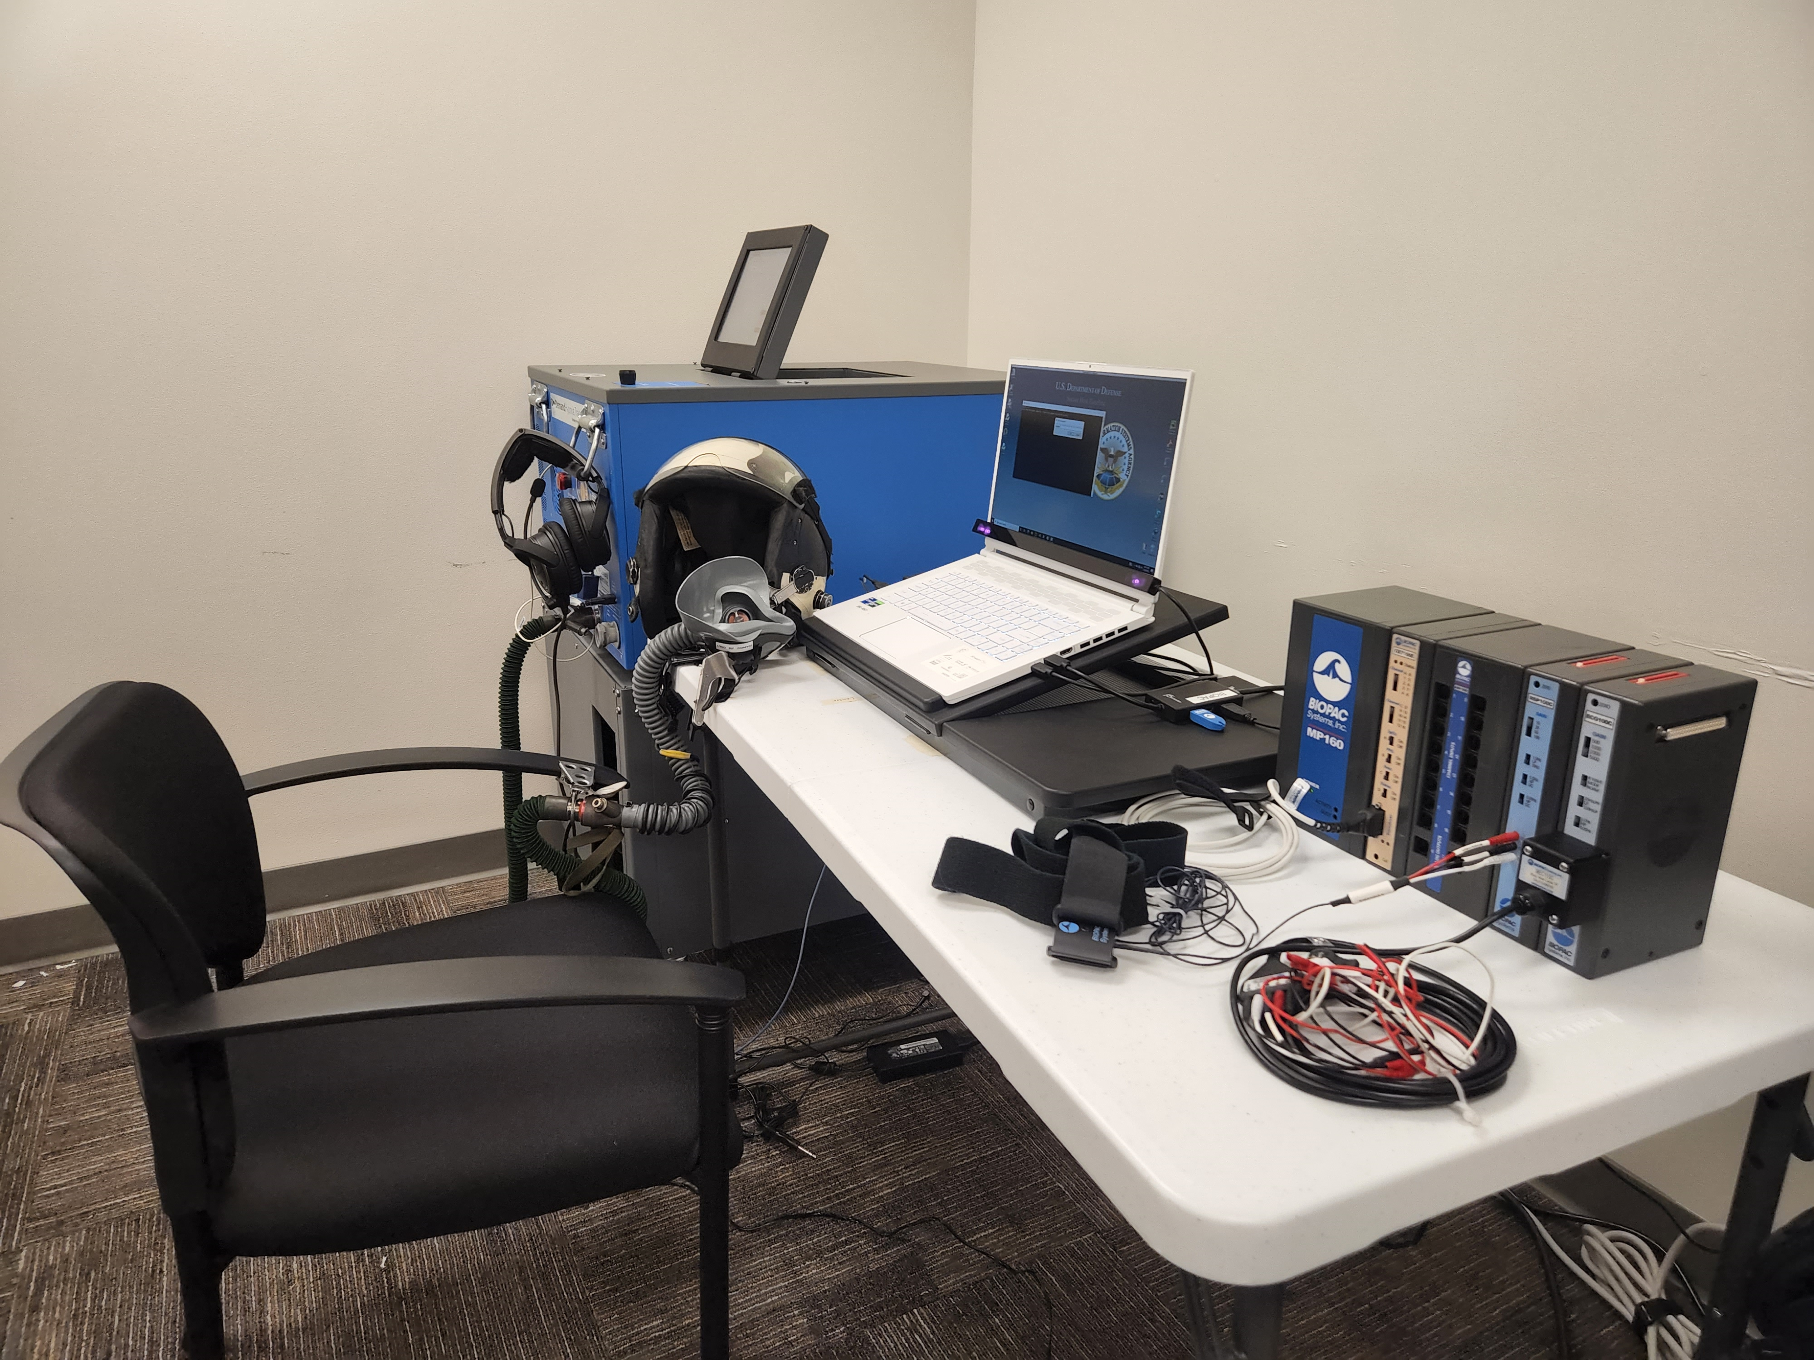
Physiological Monitoring
Sensors that monitor individual physiology such as heart rate, breath rate, and blood pressure have provided extensive data for supporting monitoring of individuals in medical or training situations
Advances in technology have created an increased consideration for these technologies in training and/or operational environments where tracking and understanding human performance are important
Validation within HPM models is required in order to use these metrics in training
Notes:
Physiological data offer unique manifest variables that can help us better understand the human performance construct – specifically, they can help us better understand the complex (parabolic) relationship between things like fatigue, stress, arousal and performance – for training this information can be useful for adapting training scenarios to individual abilities and helping identify each individual’s ceiling of performance.

Slide 10
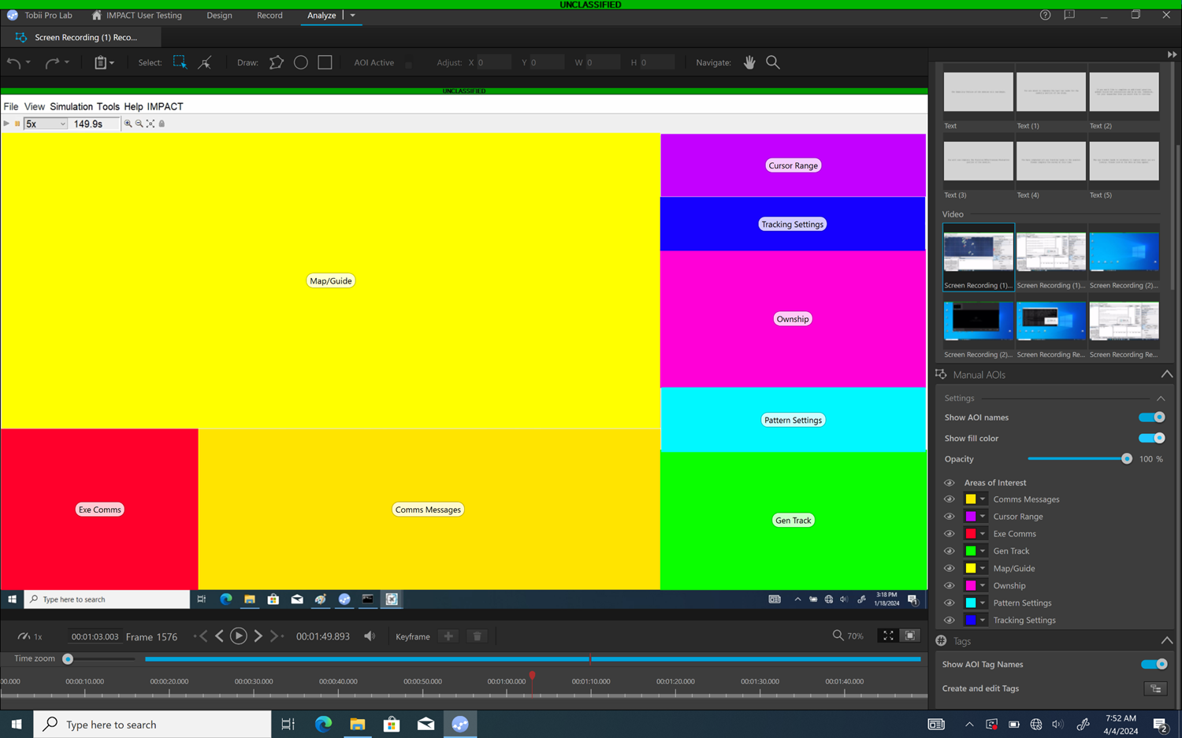
Eye Tracking
Provides a method to collect and understand ocular metrics such as blink rate, gaze patterns, fixation time, fixations, saccades, and pupillometry
Technology advances in recent years have decreased the size and increased the data fidelity of these sensors
Available products include:
Screen-mounted eye tracking sensors
Wearable glasses
Embedded eye tracking in XR devices
“For 100 years, eyes have been studied as indicators of cognitive functions” (Spering, 2022, p. 9.1)
Notes:
Assessing HPM as an observer is a notoriously difficult task, made more difficult in military aviation contexts where much of performance is cognitive (i.e., not available for observation via outward behavior).
Eye tracking offers a means by which we can automate the assessment of some of the processes that lead to performance outcomes – these processes are crucial for training environments where detailed and accurate feedback help facilitate learning.

Slide 11
Speech Processing
Automatic speech recognition solutions to support dictation or other monotonous tasking have been evolving for decades
Early solutions required a significant amount of initial engineering investment
Recent advances in deep learning and other techniques have exponentially matured automated speech recognition solutions
Unique Military Domain Problems
Jargon or brevity terms
Lack of available data for training
Noisy and/or encrypted audio files
Mix of protocol-based and natural language interactions
Notes:
Automation of speech processing offers a means by which DoD communities can assess communications performance with more reliability and accuracy. As the Navy emphasizes more coordinated training opportunities through LVC, this technology is uniquely suited for assessing one of the most important aspects of perf in these situations.

Slide 12
Recommended Standard Changes
A section of the HPML manual should be added to describe the considerations outlined above
Data storage, physiological and behavioral data conventions (eye tracking, speech, etc.)
The HPML manual is the appropriate venue for adding definitions of these terms and their considerations for use
Describing the sampling rate and introducing recommendations for documenting data synchronization would also make this data more usable for MBSE applications
Example: standard time of recording, the type of measurement recorded (i.e., heart rate), the recording tool (i.e., wearable device name), and the unit of measurement (i.e., beats per minute)

Slide 13
Future Research and Development Efforts
Potential Improvements
Improving our ability to use simulator data to measure performance
Outcome data will only ever be able to account for a portion of HPM
Emerging technologies offer component capabilities that may assess unique variance in performance
AI/ML Integration
AI/ML approaches require well labeled data- which is enabled by using xAPI and HPML concepts
Novel video and audio capture technologies combined with emerging AI/ML analytic capabilities may offer advanced means to automatically capture both cognitive and behavioral processes that lead to performance outcomes

Slide 14
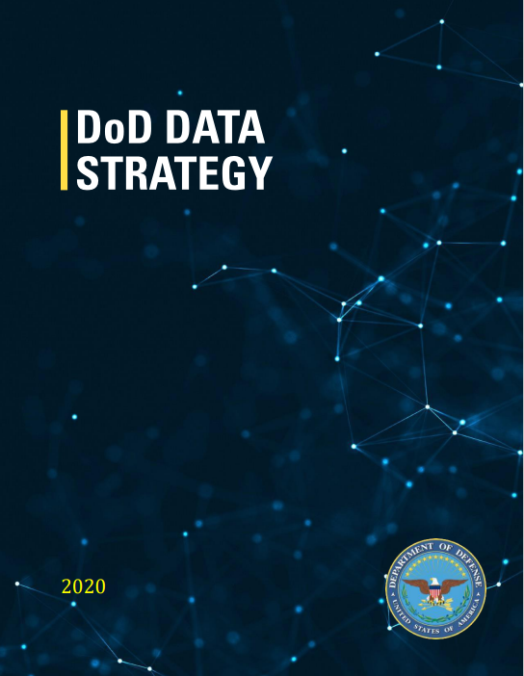
Conclusion
As the DoD moves towards becoming a data-centric organization, there is a need to expand the standards for HPM data derived from advancing technologies
Avoid approaches that don’t scale by including the structure in SBIR/STTR and other acquisition efforts
The proposed expansion of standards and architecture will support achieving the goals of the DoD data strategy and improve proficiency
An architecture such as MBSE can support defining the application of these solutions within modular systems enabled by the emerging capabilities of artificial intelligence and machine learning

Slide 15
Questions

Slide 16
References
Department of Defense (2020, September 30). Department of Defense Data Strategy. https://media.defense.gov/2020/Oct/08/2002514180/-1/-1/0/DOD-DATA-STRATEGY.PDF
Department of Defense Acquisition Agility (2020). Code 10. Sec 805. Ch. 144B. § 2446a. Requirement for Modular Open System Approach. https://www.cto.mil/sea/mosa/
Geier, N. (May, 2022). TECHNICAL REPORT: OUSD(R&E) MOSA Assessment Criteria. https://www.cto.mil/wp-content/uploads/2023/06/MOSA-Assess-2022.pdf
IEEE Standards Association. (2021). What are standards? Why are they important? https://standards.ieee.org/beyond-standards/what-are-standards-why-are-they-important.
IEEE 9274.1.1. (2023). IEEE Standard for Learning Technology—JavaScript Object Notation (JSON) Data Model Format and Representational State Transfer (RESTful) Web Service for Learner Experience Data Tracking and Access. IEEE SA.
Morgan, M., Holzer, T., & Eveleigh, T. (2021). Synergizing model‐based systems engineering, modularity, and software container concepts to manage obsolescence. Systems Engineering, 24(5), 369-380.
Nouira, A., Cheniti-Belcadhi, L., & Braham, R. (2018). An enhanced xAPI data model supporting assessment analytics. Procedia Computer Science, 126, 566-575.
Spering, M. (2022). Eye movements as a window into decision-making. Annual review of vision science, 8, 427-448.
Wiese, E., Atkinson, B., Roberts, M., Ayers, J., & Ramoutar, D. (2012). Automated human performance measurement: Data availability and standards. In Proceedings of the 2012 Interservice/Industry Training, Education, and Simulation Conference, Orlando, FL.

