Slide 1



I/ITSEC 2024
Mark Zais, Ph.D.; Trish Sowles; Matt Zepp; Frank Turinsky
Integration Innovation Inc. (i3)
Optimizing Simulation Fidelity for Cost-Effective Aviation Training
@IITSEC
NTSAToday

Slide 2
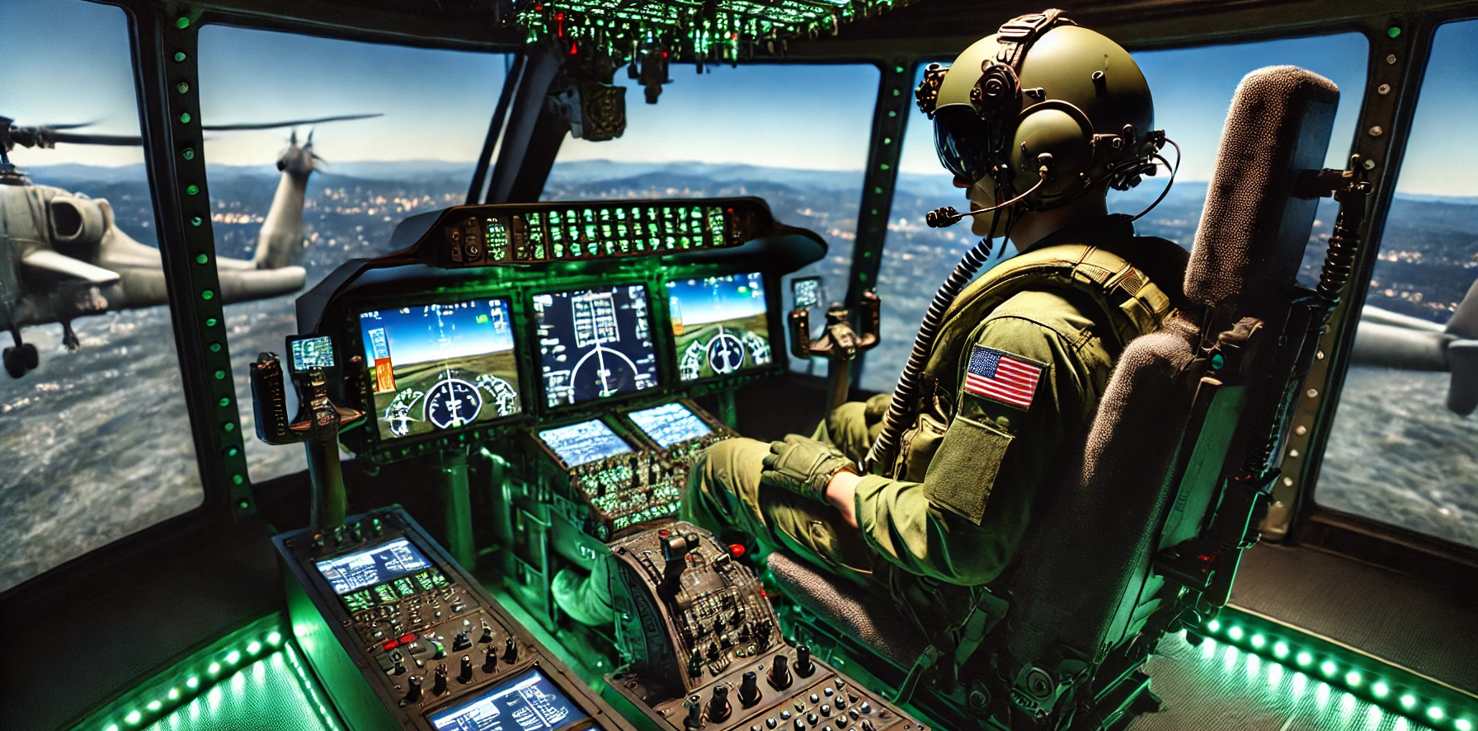
Introduction
This study evaluated the effectiveness of various simulation fidelity levels in aviation training. Our findings challenge conventional beliefs about motion cueing in simulators and suggest significant cost-saving opportunities by using more scalable solutions for specific training tasks.
Notes:
Key Points
Assessing effectiveness of simulation fidelity
Cost-effective training solutions

Slide 3
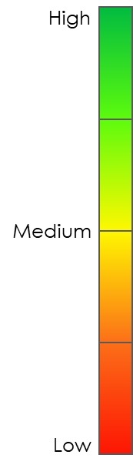
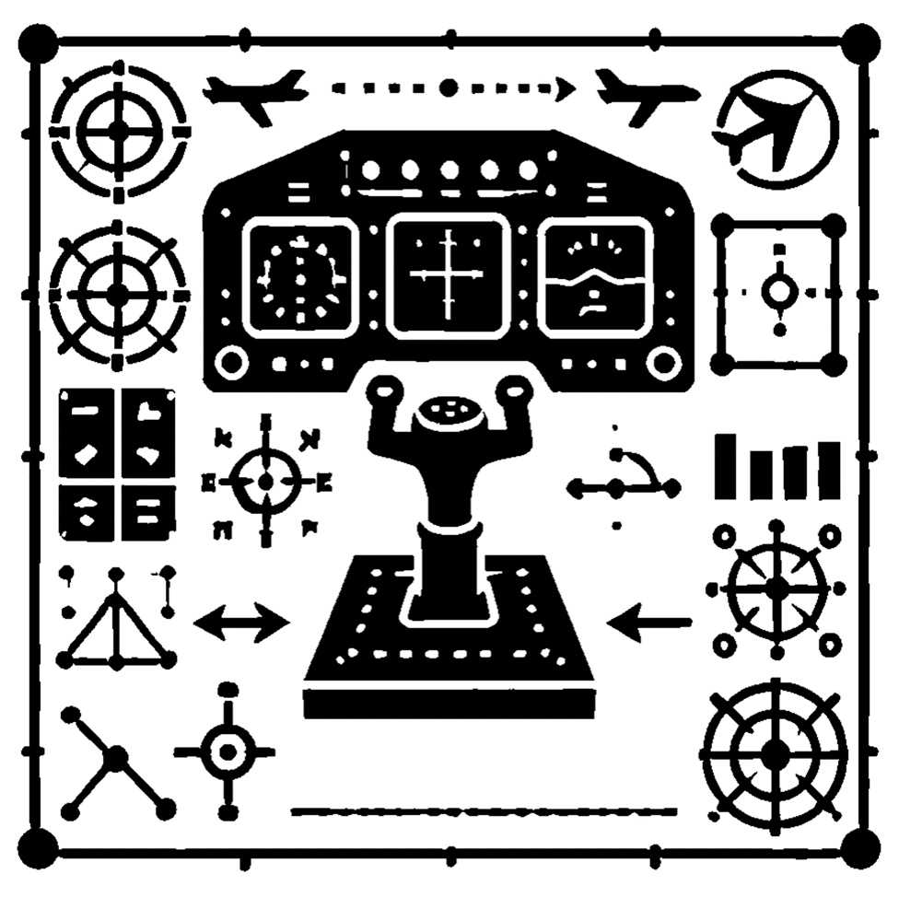



Background
High-fidelity simulation plays a crucial role in modern military aviation training, ensuring operational readiness.
This research explores the fidelity requirements for institutional vs. operational training, the efficacy of different training devices, and the potential of emerging technologies like VR and AR.
Physical Fidelity
Functional Fidelity
Cognitive Fidelity
Notes:
Key Points
Importance of simulation fidelity
Objectives: Assessing fidelity requirements, exploring new technologies
SMEs rated tasks based on their required levels of fidelity.

Slide 4
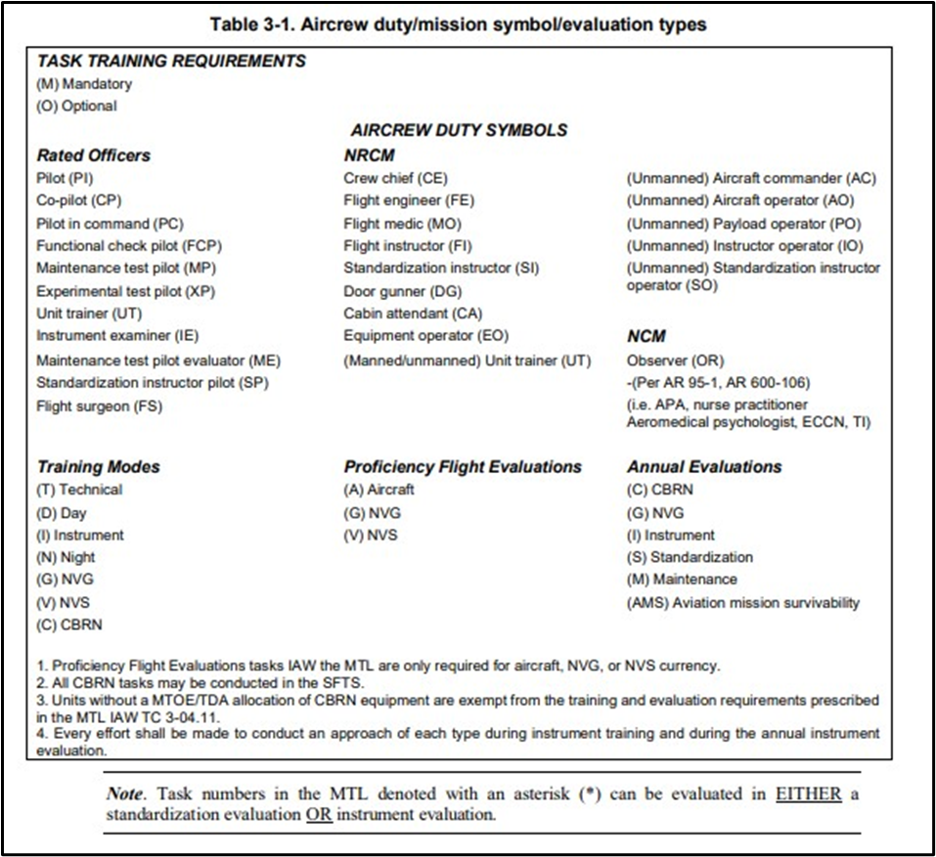
Task Fidelity Requirements
Example: 81 AH-64D Training Tasks
Base, Tactical, and Mission

Slide 5

Findings (1 of 2)
Seat-based motion cueing (vibration) may be just as effective as full-motion simulators for many training tasks.
The relationship between fidelity and motion in a training device is not intrinsically interconnected.
These elements can be independently assessed to understand their individual and possibly uncorrelated impacts on training effectiveness.
There are currently no written requirements for a deployed mode for simulation devices.
The ability to meet accreditation standards is a critical criterion for training device selections.
Implementation of a training strategy that emphasizes academic instruction, instructor interaction, and operational repetition enhances the overall result compared to an overreliance on simulator devices.
Integration of a versatile Operator Training Device Suite (OTDS) requires co-designing its hardware and software while carefully trading off competing design objectives such as onboard computing capacity and platform agility.
Updates to aircraft software versions will require rapid updates to training devices to maintain training value.
1
Effectiveness of Seat Vibration vs Full-Motion Simulators
2
Fidelity and Motion Independence
3
Lack of Deployed Mode Requirements
4
Importance of Accreditation Standards
5
Pivotal Role of a Robust Training Strategy
6
Designing Versatile Operator Training Device Suite
7
Rapid Updates to Training Devices

Slide 6
Findings (2 of 2)
Training transfer has significant impact on the learning process, safety, and overall effectiveness of the training, but incur some limitations that require a combination of Training Aids, Devices, Simulators and Simulations (TADSS), and in-flight training.
Requirements for training in deployed environments may create a need for a tradeoff between training tasks and the fidelity available in the deployed environment.
Some examples of deployable training are using a Desktop Trainer (DTT) for mission planning, aircraft embedded training, and FTDs in mobile environmental containers.
Simulators in mobile environmental containers may have limited field of view with reduced peripheral stimuli, which can lead to limited situational awareness.
Relatively few studies explore the tradeoffs between fidelity, transportability, and cost in flight training devices.
Integration and interoperability of simulation capabilities for collective training are a significant priority and force multiplier. This may include combined and joint forces.
Pilot training simulations using AI-powered customization reveal promising results in tailoring critical task training to individual needs and learning styles.
Emerging technologies have facilitated the creation of AR systems that are displayed on an aircrew helmet-mounted screen where the helmet’s visor usually mounts. The display can generate visual friendly aircraft, threat systems, etc. as well.
The impact of simulation fidelity on training efficacy appears to diverge based on whether the pilot is a novice or experienced. This is influenced by factors such as task specificity, mission complexity, and individual learning traits.
8
Transfer of Training
9
Training in Deployed Environments
10
Limitations of Portable Simulators
11
Collective Training
12
Adaptive Training
13
Advanced Augmented Reality (AR) System
14
Fidelity and Experience Levels

Slide 7
Key Insights
Material Solutions
Effectiveness of Simulators
Fidelity and Motion Independence
Training
Accreditation and Training Strategy
Deployment Requirements
Trade-offs in Deployed Training
Training in Deployed Environments
Technology Integration
Rapid Adaptability
Motion Platforms
VR/AR Technologies
Data and Analytics
Fidelity and Experience Levels
Train the Trainer

Slide 8

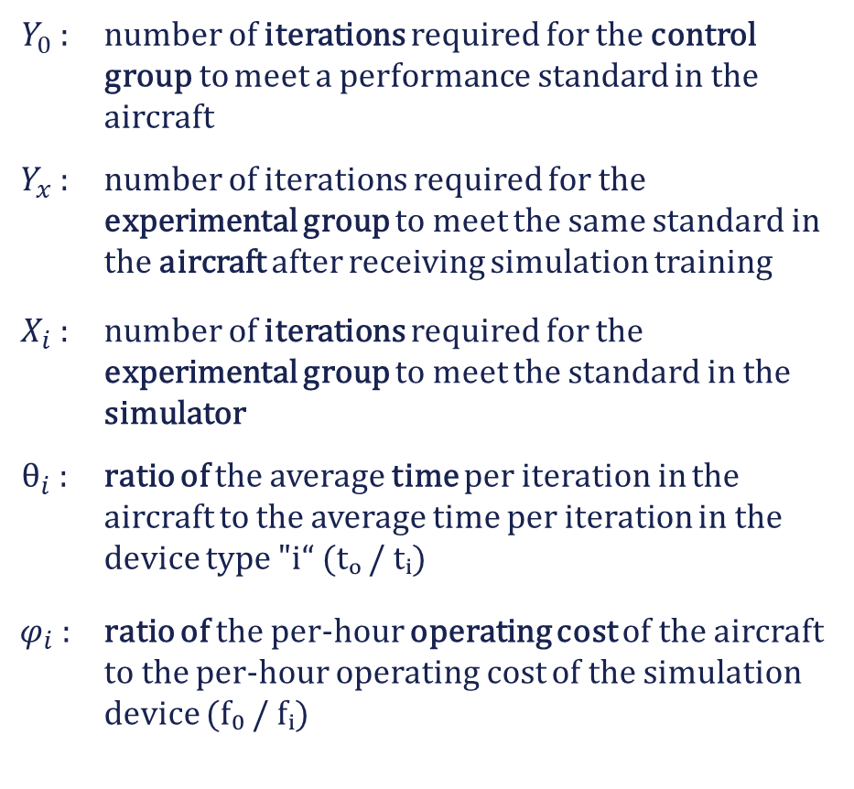

Cost-Benefit Analysis: TER & CER
$Y_{0}$ : | number of iterations required for the control group to meet a performance standard in the aircraft
$Y_{x}$ : | number of iterations required for the experimental group to meet the same standard in the aircraft after receiving simulation training
$X_{i}$ : | number of iterations required for the experimental group to meet the standard in the simulator
$θ_{i}$ : | ratio of the average time per iteration in the aircraft to the average time per iteration in the device type "i“ (tₒ / tᵢ)
$φ_{i}$ : | ratio of the per-hour operating cost of the aircraft to the per-hour operating cost of the simulation device (f₀ / fᵢ)
Transfer Effectiveness Ratio (TER)
$$TER={\left(Y_{0}−Y_{x}\right)}/{X_{i}}$$
Cost Effectiveness Ratio (CER)
$${CER}_{i}=TER∙θ_{i}∙φ_{i}$$
By applying these metrics, we can evaluate cost-effectiveness and optimize training resource allocation.
Notes:
TER and CER are key metrics introduced to evaluate the cost-effectiveness of simulation-based training. TER measures the benefit of training in a simulated environment, while CER considers the relative costs of aircraft and simulation devices. By applying these metrics, we can optimize training resource allocation.

Slide 9

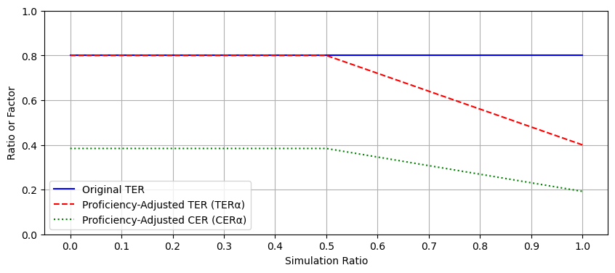


Proficiency Factor Enhancement
Adjust the TER based on the ratio of simulation to live flight hours, reflecting the potential decline in training effectiveness as the proportion of simulation hours increases beyond a threshold.
$${TER}_{α}=α{\left(Y_{0}−Y_{x}\right)}/{X_{i}}$$
$${CER}_{α}={θ_{i}φ_{i}TER}_{α}$$
Notes:
To visually represent the impact of the proficiency factor on the TER and CER, we can plot these values against the simulation ratio, as shown in Figure 2. This illustrative example, where a notional TER equals 0.8, demonstrates several key insights:
The proficiency factor adjusts the TER and CER when the simulation ratio exceeds a threshold of 0.5. This adjustment reflects the potential decline in training effectiveness as the proportion of simulation hours increases.
While the original TER remains constant, the proficiency-adjusted TER (TERα) and proficiency-adjusted CER (CERα) decline as the simulation ratio exceeds 0.5. This decline indicates a potential reduction in training effectiveness and cost efficiency as the use of simulation increases.
The rate of decline in TERα and CERα is influenced by the constant 𝑘. A higher 𝑘 value results in a steeper decline, indicating greater sensitivity to increased simulation hours. Conversely, a lower 𝑘 value results in a more gradual decline, indicating less sensitivity.
The CER is further influenced by the time ratio (𝜃𝑖) and cost ratio (𝜙𝑖). The time ratio (𝜃𝑖) is the ratio of the average time per iteration in the aircraft to the average time per iteration in the simulator. A higher 𝜃𝑖 value indicates that the simulator is more time-efficient compared to the aircraft, leading to a higher CER and indicating better cost-effectiveness. The cost ratio (𝜙𝑖) is the ratio of the per-hour operating cost of the aircraft to the per-hour operating cost of the simulator. A higher 𝜙𝑖 value indicates that the simulator is more cost-efficient compared to the aircraft, also resulting in a higher CER.
The trade-off between cost savings and training effectiveness becomes apparent as the simulation ratio increases. Decision-makers can use this visual representation to identify the optimal simulation ratio that balances cost savings and training effectiveness based on their specific requirements and constraints.

Slide 10


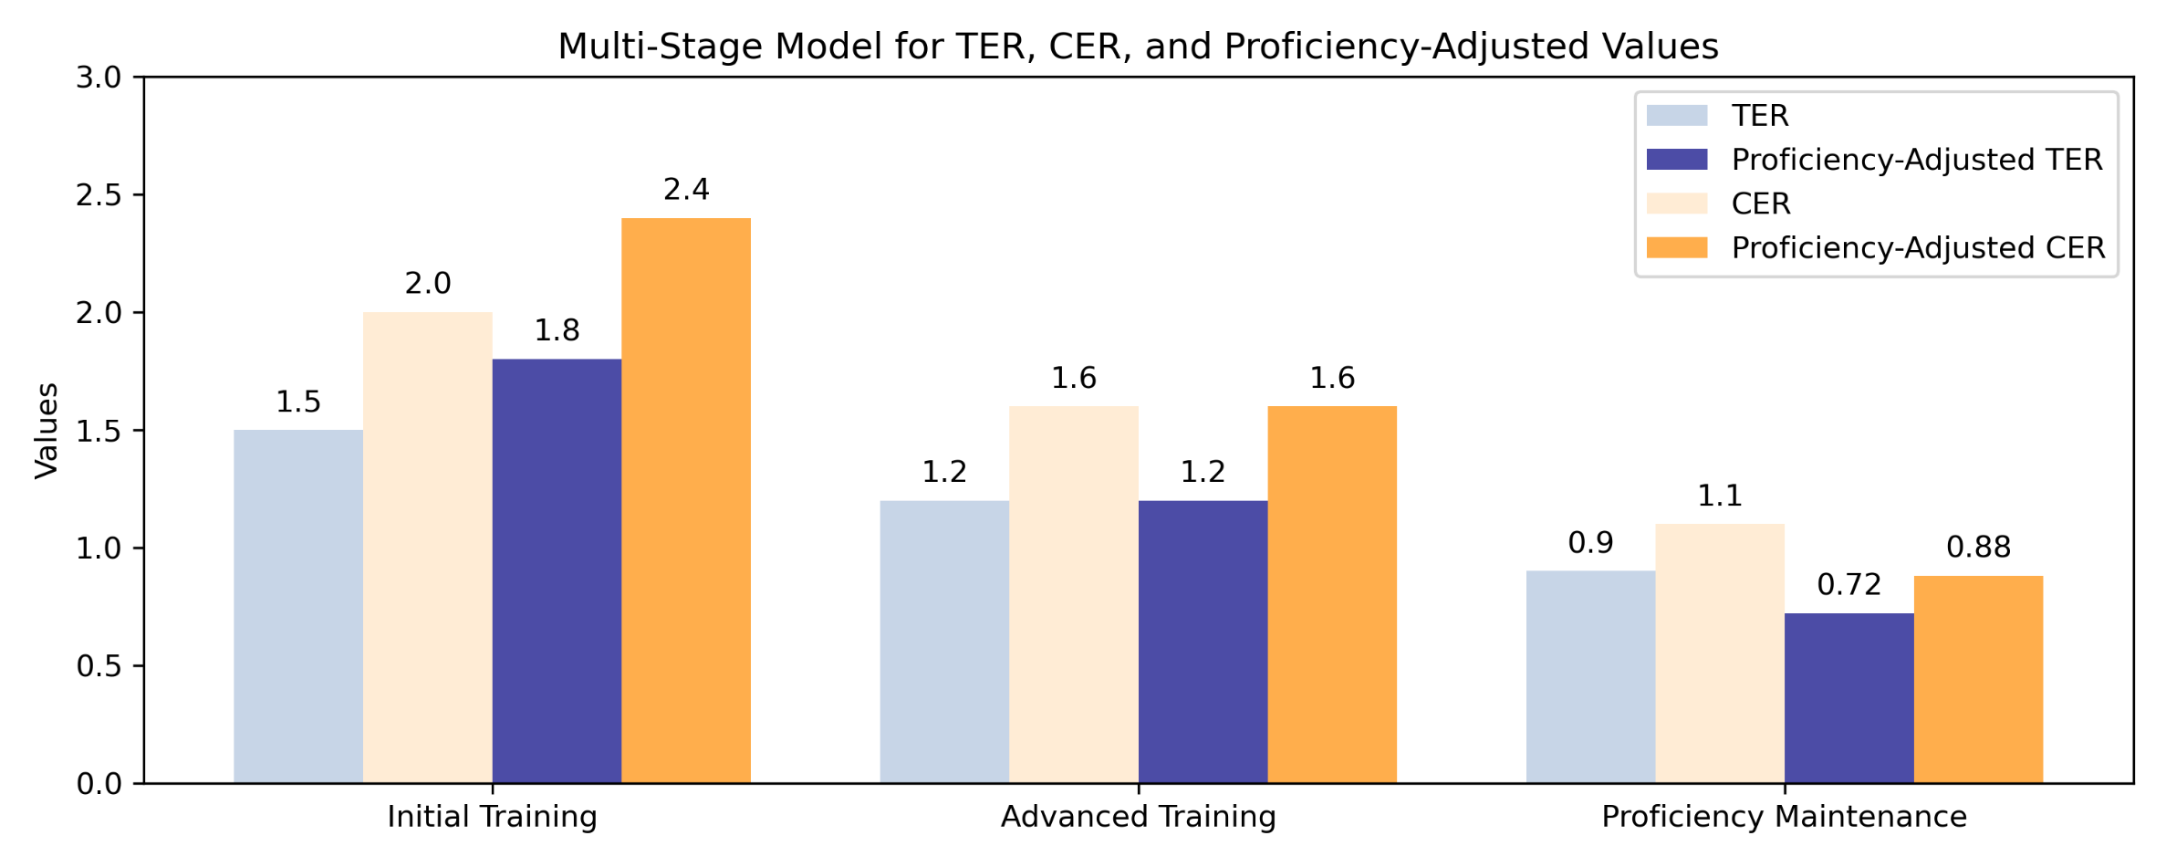
Introducing a Multi-Stage Model
The multi-stage model further refines TER by accounting for different training stages.
This approach allows for a nuanced analysis of simulation effectiveness across a pilot’s career.
α: represents a proficiency factor
β: represents a stage factor
Notes:
To enhance TER, we introduce a proficiency factor that adjusts for the ratio of simulation to live flight hours. The multi-stage model further refines TER by accounting for different training stages, such as initial and advanced training. This approach allows for a nuanced analysis of simulation effectiveness across a pilot’s career.

Slide 11
Data Collection & Analysis Strategy
Capture Key Performance Metrics: Collect data on task performance, costs, pilot proficiency, and training throughput to measure simulation effectiveness.
Leverage Advanced Databases: Use database systems to handle large volumes of data, support parallel simulations, and enable data sharing across devices and scenarios.
Integrate AI & Machine Learning: Use AI/ML to identify patterns, optimize training scenarios, and personalize feedback for enhanced pilot learning paths.
Ensure Interoperability: Standardize data formats and ensure system flexibility for real-time data exchange and updates.
Data-Driven Continuous Improvement: Align simulated and live training data to enable ongoing assessment and refinement of training programs.
Notes:
Effective data collection and analysis is critical to optimizing simulation-based training. First, we must capture key performance metrics—such as task performance, operating costs, and pilot proficiency—to accurately measure training effectiveness.
Advanced database systems play a vital role here, handling large volumes of data and ensuring seamless sharing across devices and scenarios.
Incorporating AI and machine learning can further enhance insights, allowing us to identify patterns, optimize scenarios, and provide personalized feedback.
Interoperability is also essential, ensuring systems can exchange data in real-time while remaining flexible for updates.
Finally, aligning simulated and live training data enables continuous improvement, ensuring our training programs remain both effective and adaptable to evolving needs

Slide 12
Additional Considerations
Fidelity & Experience Levels: Novice pilots benefit from lower fidelity, while experienced pilots gain more from high-fidelity simulations.
Mission Planning: High-fidelity synthetic environments enhance mission planning accuracy and real-time responsiveness.
Emerging Technologies: VR, AR, and MR offer immersive training, enhancing visual and cognitive fidelity.
Embedded Training: Integrating training tools directly into aircraft enables versatile, on-the-spot training.
Deployed Modes: Need for deployable simulation modes to support training in operational environments.
Accreditation Standards: Continuous updates must align standards with evolving technologies.
Notes:
Simulation fidelity plays a key role in tailoring training to pilot experience levels. Novice pilots may benefit from lower fidelity simulations, while experienced pilots thrive with high-fidelity environments that mirror real-world scenarios. In mission planning, high-fidelity synthetic environments improve accuracy and responsiveness, making them essential for comprehensive mission rehearsal.
Emerging technologies like VR, AR, and MR are transforming training by offering immersive, realistic experiences that enhance both visual and cognitive fidelity. Embedded training tools integrated directly into aircraft platforms offer a versatile training solution, but also raise concerns about cybersecurity and power consumption.
We’ve identified the need for deployable simulation modes to support operational environments, particularly in high-intensity conflicts where training time is limited. Finally, we must continuously update accreditation standards to keep pace with advancing simulation technologies, ensuring training programs remain rigorous and relevant.
--------------------------------------------------------------------------------------------------------------
AR - Challenging tasks such as aerial refueling, formation flying, or xxxxxx can be practiced without the huge risk, but because the training is done in the aircraft with the feel and sound of being in the air, it is as real as it gets.
The pilots are essentially able to take the simulator in the air with them, seeing real elements, such as the mountains and clouds.

Slide 13
Recommendations
Optimize the use of flight simulation devices in aviation training by conducting a comprehensive cost-benefit analysis using the Transfer Effectiveness Ratio (TER) and Cost Effectiveness Ratio (CER) methods, or other similar methods.
Prioritize the development and acquisition of modular, adaptable, and rapidly updatable simulation devices to keep pace with the evolving technology and training requirements of aviation training.
Establish a comprehensive data collection and analysis program to continuously evaluate the effectiveness of simulation training and optimize the use of simulation devices.
Consider a comprehensive set of factors to ensure the optimal balance of fidelity, interoperability, and cost-effectiveness when evaluating and selecting VR/AR devices for training.
Leverage AI technologies and ML methods to objectively assess and identify potential training tasks, competencies, and procedures to enhance student readiness and efficiency.

Slide 14
Conclusion
Challenges Conventional Wisdom: This research challenges assumptions that high-fidelity, full-motion simulators are always necessary, highlighting that seat-based motion cueing can provide comparable outcomes for many tasks.
Cost-Effective Alternatives: Leveraging the enhanced TER and CER models, we find that lower-fidelity solutions can offer significant cost savings without sacrificing training quality, supporting a strategic shift in simulation investments.
Tailored Training Solutions: The proposed framework enables precise tailoring of visual and motion fidelity, optimizing simulation capabilities to meet specific training phase needs and enhancing overall program efficiency.
Roadmap for Adaptable Training: By addressing deployed mode requirements and implementing a robust data collection strategy, this research provides a roadmap for more flexible, effective, and scalable aviation training programs.

Slide 15

Questions

